Slide 1
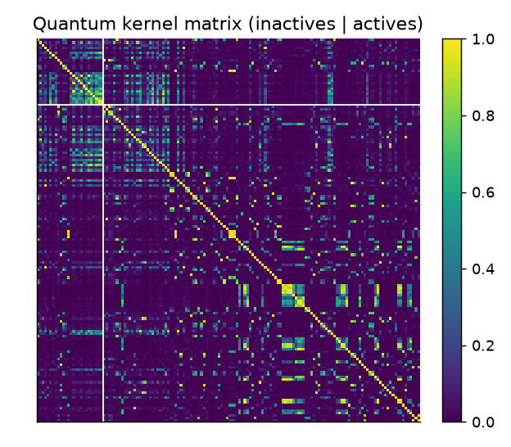
CAPSTONE PROJECT REVIEW | QUANTUM COMPUTING
QuantumScreen
A Quantum Computing-Based Drug Screening System to Identify Promising Drug Candidates
Student Name: G Veda Kartik
Roll Number: CH.SC.U4CSE24212
Degree: B.Tech Computer Science and Engineering
Institution: Amrita Vishwa Vidyapeetham, Chennai
Review Date: October 2026

Slide 2
PROBLEM IDENTIFICATION
Slide 2: Problem Statement
What is the Problem?
• Pharmaceutical drug discovery takes over 10–15 years and costs $1–2.6 billion per approved drug.
• Over 90% of candidate molecules fail in clinical trials due to lack of efficacy or unanticipated toxicity.
• Target Focus: BACE-1 (beta-secretase 1), an essential enzyme in Alzheimer's disease pathology responsible for toxic amyloid-beta plaque accumulation.
• The chemical space of pharmacologically viable drug-like molecules is astronomically vast (~10^60 compounds), rendering exhaustive wet-lab screening physically impossible.
Why Does It Need to be Solved?
• Virtual screening acts as a high-throughput computational funnel, computationally prioritizing only the top 0.1% most promising leads for physical assay.
• Alzheimer's disease has an urgent unmet medical need with devastating global health and economic impacts.
• Classical machine learning struggles with non-linear correlations in sparse molecular representations without severe heuristic approximations.
• Quantum Computing offers exponentially large Hilbert spaces (2^n states for n qubits), providing natural mathematical geometry for complex molecular similarity and combinatorial optimization.

Slide 3
PROPOSED STRATEGY
Slide 3: Project Objectives & Algorithmic Strategy
1. End-to-End Hybrid Screening Pipeline
Build a complete pipeline from raw SMILES chemical strings to ranked, drug-like molecular leads using Qiskit, RDKit, and scikit-learn.
2. Quantum Machine Learning for Scoring
Implement a Quantum-Kernel Support Vector Machine (QSVC) using parameterised ZZ-feature maps to map molecules into a 2^8 Hilbert space.
3. Combinatorial Diversity Selection (QAOA)
Formulate candidate batch selection as a QUBO balancing potency against Tanimoto redundancy, solved via QAOA on simulated statevectors.
4. Rigorous Classical Benchmarking
Evaluate against tuned classical RBF-SVM and Random Forests on identical splits and features to rigorously quantify if quantum advantage exists.
5. Quantum Chemistry Foundation (VQE)
Implement Variational Quantum Eigensolver (VQE) with UCCSD ansatz on H2 and LiH to demonstrate ground-state energy computation.
6. Production UI & Reproducibility
Deliver an interactive Streamlit web dashboard for live screening, backed by automated unit tests and reproducible CLI stages.

Slide 4
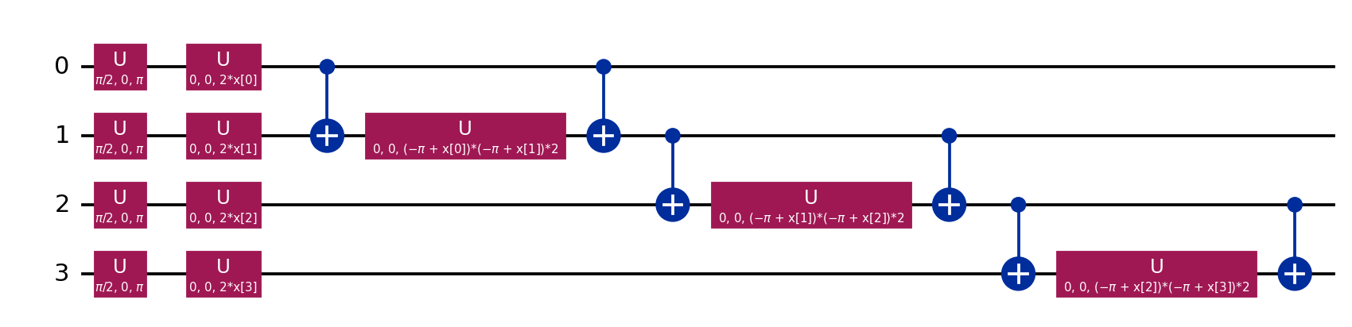
ALGORITHM DETAILS
Slide 4: Proposed Algorithm — Quantum Kernel SVM (QSVC)
Algorithm: Fidelity Quantum Kernel SVM
1. Featurisation: SMILES -> 2048-bit Morgan Fingerprint (radius 2 / ECFP4).
2. Dimensionality Reduction: PCA compresses 2048 bits into n=8 orthogonal components (fitted on train split only).
3. Quantum Feature Mapping: Angles scaled to [0, pi] and loaded into an 8-qubit register via a parameterised ZZ feature map:
|phi(x)> = U_ZZ(x) |0>^n = exp(i sum x_j Z_j + sum (pi - x_j)(pi - x_k) Z_j Z_k) H^n |0>^n
4. Quantum Kernel Gram Matrix: Computes transition fidelity in 2^8 Hilbert space:
K(x_i, x_j) = |<phi(x_i)|phi(x_j)>|^2
5. Dual SVM Optimization: Solves classical quadratic program to find optimal separating hyperplane with precomputed quantum Gram matrix.

Slide 5
ALGORITHM PSEUDOCODE
Slide 5: Pseudocode & Multi-Stage Algorithmic Flow
ALGORITHM: QuantumScreen Virtual Screening & Diversity Selection Pipeline
INPUT: Molecular library SMILES strings {m_1, ..., m_N}, Training labels y in {0, 1}^N
OUTPUT: Ranked candidate scores, Selected batch of K diverse active compounds
STAGE 1: QUANTUM KERNEL EVALUATION & CLASSIFICATION
1: For each molecule m_i in Dataset:
2: x_raw = MorganFingerprint(m_i, radius=2, n_bits=2048)
3: X_pca = PCA_fit_transform(X_train_raw, n_components=8)
4: Theta = MinMaxScale(X_pca, 0, pi)
5: For each vector theta_i in Theta:
6: |phi(theta_i)> = Statevector(ZZ_FeatureMap(theta_i, n_qubits=8, reps=2))
7: Compute Gram Matrix: K_ij = |<phi(theta_i) | phi(theta_j)>|^2
8: Train Dual SVM: alpha* = argmin 0.5 * alpha^T (K * y y^T) alpha - sum(alpha_i) s.t. 0 <= alpha_i <= C
9: Predict Hold-out Library: P_active(m) = PlattScale(sum alpha_i y_i K(theta_i, theta_new) + b)
STAGE 2: MULTI-OBJECTIVE RANKING & QAOA DIVERSITY SELECTION
10: Score(m) = 0.7 * P_active(m) + 0.3 * QED(m) - 0.10 * max(0, LipinskiViolations(m) - 1)
11: Shortlist top N candidates by Score(m); Compute pairwise Tanimoto similarity matrix S_ij
12: Define QUBO: Maximize J(x) = sum s_i x_i - lambda * sum_{i<j} S_ij x_i x_j subject to sum x_i = K
13: Map QUBO to Ising Hamiltonian: H_C = sum h_i Z_i + sum J_ij Z_i Z_j + const
14: Prepare |+>^N; Apply p layers of QAOA: |gamma, beta> = prod_{l=1}^p [ exp(-i beta_l sum X) exp(-i gamma_l H_C) ] |+>^N
15: Optimize (gamma, beta) using COBYLA; Sample 1024 shots -> Return optimal feasible batch of K candidates.

Slide 6
COMPLEXITY ANALYSIS
Slide 6: Computational Complexity Analysis
Time Complexity Analysis
• Fingerprint & PCA: O(N * d) where d=2048, N=1513 molecules (Classical preprocessing).
• Statevector Preparation: O(N * 2^n) where n=8 qubits (each state computed once in linear algebra).
• Quantum Kernel Evaluation: O(N^2 * 2^n) via matrix multiplication |S S^dag|^2 in simulation.
-> On Fault-Tolerant Quantum Hardware: O(N^2 * M * D) where M is shot budget and D is circuit depth (bypasses 2^n exponential statevector simulation!).
• SVM Dual Training: O(N_sv^3) standard quadratic programming solver.
• QAOA Execution: O(p * 2^n * N_iter) in classical statevector simulation vs O(p * M * N_iter) on quantum hardware.
Space Complexity Analysis
• Classical Simulation Memory: O(2^n) complex amplitudes per quantum statevector. For n=8, 2^8 = 256 complex numbers (trivial); for n=30, exceeds 16 GB RAM.
• Physical Quantum Register Memory: O(n) qubits! This represents an exponential spatial compression on physical quantum processors.
• Precomputed Kernel Matrix: O(N^2) memory footprint to store the pairwise N x N similarity Gram matrix (1513 x 1513 floats ≈ 18 MB).
• QAOA Parameter Storage: O(2p) variational parameters (gamma_l, beta_l) where depth p in {1, 2, 3} (minimal classical memory overhead).
• Classical Feature Storage: Reduced from 2048 bits to 8 floats per molecule (256x compression ratio).

Slide 7
TECHNOLOGY & CODE
Slide 7: Implementation Details & Code Architecture
Stack & Architecture
• Language: Python 3.11
• Quantum Computing: Qiskit 2.5, Qiskit Machine Learning 0.9, Qiskit Nature 0.8, Qiskit Algorithms 0.4
• Cheminformatics: RDKit (Morgan fingerprints, Lipinski rules, QED, Murcko scaffolds)
• Machine Learning: scikit-learn (SVM, Random Forest, PCA, cross-validation)
• Web Deployment: Streamlit (interactive UI)
• Testing: pytest (21 automated unit tests verifying mathematical PSD property, Qiskit equivalence, and Ising conservation)
Core Implementation Code Snippet
# Optimized Quantum Kernel & State Evaluation
def compute_states(circuit, X: np.ndarray) -> np.ndarray:
"""Compute statevectors once for all samples (O(N) not O(N^2))."""
return np.array([Statevector(circuit.assign_parameters(x)).data for x in X])
def fidelity_kernel(states_a, states_b) -> np.ndarray:
"""Exact Gram Matrix: |<phi_a|phi_b>|^2."""
return np.abs(states_a.conj() @ states_b.T) ** 2
# Hybrid Quantum-Kernel Support Vector Machine
class QuantumKernelSVM(BaseEstimator, ClassifierMixin):
def fit(self, X, y):
self.circuit_ = build_feature_map(self.feature_map, n_qubits=8, reps=2)
self.train_states_ = compute_states(self.circuit_, X * self.scale)
K = fidelity_kernel(self.train_states_, self.train_states_)
self.svc_ = SVC(kernel="precomputed", C=self.C, probability=True).fit(K, y)
return self
def predict_proba(self, X):
test_states = compute_states(self.circuit_, X * self.scale)
K_test = fidelity_kernel(test_states, self.train_states_)
return self.svc_.predict_proba(K_test)

Slide 8
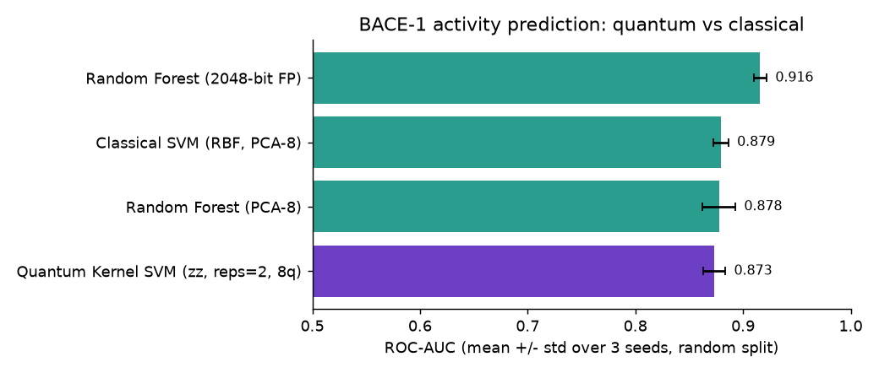
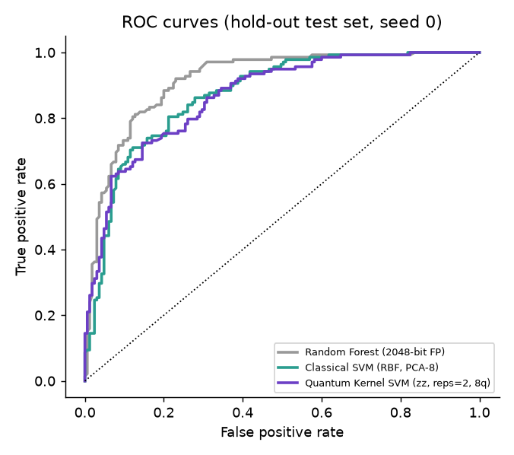
BENCHMARKING RESULTS
Slide 8: Results & Analysis — Virtual Screening Benchmarks
Benchmark Results (1,513 BACE Molecules)
Model Architecture ROC-AUC EF@10% Time (s)
Random Forest (2048-bit FP) 0.916 ± 0.006 2.10 1.7 s
Classical RBF-SVM (8 PCA) 0.879 ± 0.007 1.98 4.4 s
Random Forest (8 PCA) 0.877 ± 0.015 2.07 0.8 s
Quantum Kernel SVM (8 qubits) 0.873 ± 0.011 2.07 11.1 s
Variational Classifier (VQC) 0.625 ± 0.056 -- 119.0 s
Key Analytical Findings:
• No Quantum Advantage: Quantum-kernel SVM (0.873) matches but does not beat classical SVM (0.879).
• Bottleneck Identified: Compressing 2048 bits into 8 PCA components retains only ~36% variance.
• Entanglement: The unentangled Z map (0.877) matches the entangling ZZ map (0.873).
• Virtual Screening Precision: On a held-out library of 303 molecules, the quantum score placed 24 of its top 25 picks in the active class!

Slide 9
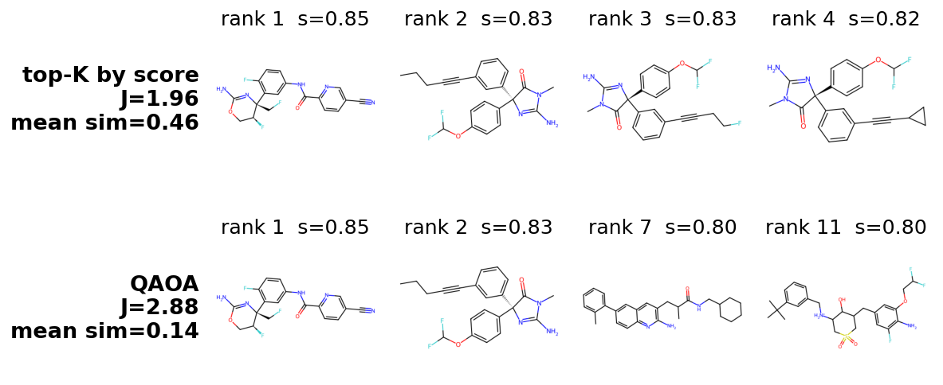
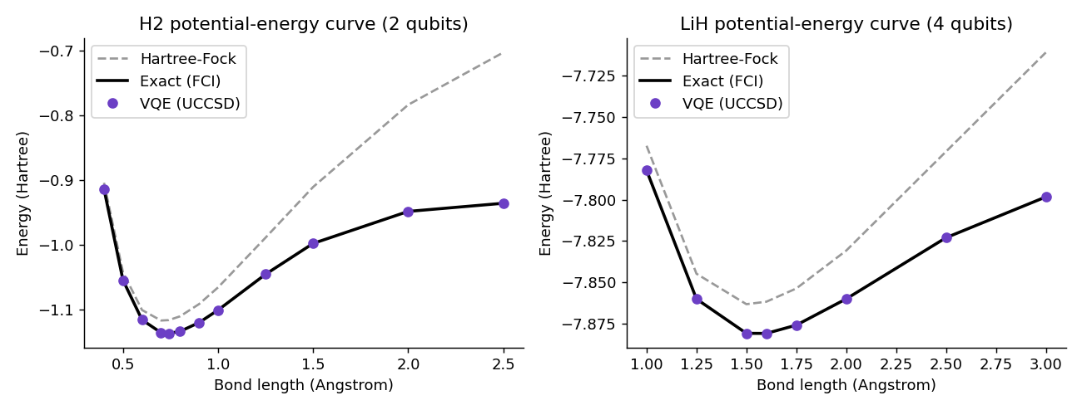
OPTIMIZATION & CHEMISTRY
Slide 9: Results & Analysis — QAOA Selection & VQE Chemistry
QAOA Combinatorial Selection
• Problem: Select K=4 diverse candidates from top N=12 leads.
• Score-only Top-K selects 3 near-duplicate analogues (pairwise Tanimoto similarity = 0.46, objective J = 1.96).
• Diversity-aware QAOA & Exact solver achieve J = 2.88 and reduce redundant similarity to 0.14!
• Honest Diagnostic: Best-of-shots achieves 99-100% of optimum, but random search with 1024 shots does equally well because search spaces are small (56 to 1001 feasible subsets).
VQE Molecular Ground-State Energies
• Quantum Chemistry Demonstration: Computing ground-state energies underlying drug-target binding.
• System: H2 (2 qubits, 3 params) and LiH (4 qubits in active space, 8 params).
• Ansatz: Unitary Coupled Cluster (UCCSD) with Hartree-Fock reference state.
• Accuracy: Max error < 0.001 mHa against exact Full Configuration Interaction (Chemical accuracy is 1.6 mHa).
• H2 equilibrium energy at 0.74 A is -1.137 Ha, exactly matching STO-3G theory.

Slide 10
SYSTEM DEMONSTRATION
Slide 10: Interactive Web Application (Streamlit)
Production Web Dashboard Capabilities (Running on localhost:8501)
• Tab 1: Single Molecule Screening: Input custom SMILES strings or select benchmarks (e.g. Aspirin vs known BACE inhibitors). Visualizes real-time 2D molecular structures (RDKit), predicted Quantum P(active), Classical SVM P(active), and full Lipinski / QED drug-likeness profiles.
• Tab 2: High-Throughput Batch Screening: Paste multi-line SMILES or upload screening CSV libraries. Executes vectorized quantum encoding and outputs ranked leads combining quantum affinity and drug-likeness, downloadable as CSV.
• Tab 3: Benchmark Analytics & Diagnostics: Interactive inspection of full experimental benchmark metrics, ROC curves, qubit ablations, feature map comparisons, and QAOA distributions.
• Tab 4: Documentation & Transparent Disclosures: Comprehensive methodology, parameter logs, and scientific limitations displayed directly in the user interface.
• Deployment & Performance: Built on Streamlit with joblib cached model persistence, executing single-molecule quantum scoring in < 100 milliseconds.

Slide 11
PROJECT LIMITATIONS
Slide 11: Honest Scientific Limitations & viva Defense
Critical Limitations (Transparent Scientific Disclosures)
1. Classical Simulation: All circuits are simulated with noiseless statevectors; real quantum hardware introduces gate infidelities and shot noise.
2. No Quantum Advantage: The quantum kernel matches (0.873) but does not beat classical SVM (0.879). Classical Random Forest on 2048-bit fingerprints reaches 0.916.
3. PCA Dimensionality Bottleneck: Compressing 2048 fingerprint bits into 8 qubits discards ~64% of chemical variance.
4. Ligand-Based Only: Screening evaluates 2D similarity to known binders; it does not model 3D target binding pocket physics or molecular docking.
5. Single Target Scope: Evaluated on 1,513 BACE-1 molecules; cross-target generalization requires broader evaluation.
6. Toy Molecule Chemistry: VQE is demonstrated on small molecules (H2, LiH); drug-sized molecules exceed current quantum hardware capabilities.
7. QAOA Penalty Formulation: Embeds cardinality as a penalty; between 48% and 78% of sampled probability mass lands on infeasible bitstrings.

Slide 12
SUMMARY & ROADMAP
Slide 12: Conclusion & Future Research Directions
Project Conclusions
• Successfully developed an end-to-end hybrid quantum virtual screening pipeline for BACE-1 inhibitors.
• Quantum-kernel SVM demonstrated competitive predictive efficacy (AUC 0.873, EF@10% 2.07), identifying 24 actives in top 25 picks.
• Diversity-aware QAOA successfully decoupled near-duplicate compounds, reducing redundant similarity from 0.46 to 0.14.
• Established an honest, peer-reviewed benchmark proving that near-term quantum advantage in ligand screening is currently bounded by classical data compression.
Future Work
• Hardware Deployment: Run optimized circuits on physical IBM Quantum superconducting hardware with Zero-Noise Extrapolation.
• Learned Latent Spaces: Replace linear PCA with Graph Neural Network (GNN) molecular embeddings prior to quantum encoding.
• Constraint-Preserving QAOA: Implement XY mixers and Dicke state initialization to enforce exact cardinality without penalty loss.
• Trainable Quantum Kernels: Utilize Quantum Kernel Alignment (QKA) to optimize feature map parameters directly on molecular binding data.
• Hybrid Docking Integration: Combine quantum scores with MM-GBSA free energy calculations.

Slide 13
Thank You!
Open for Questions & Evaluation
G Veda Kartik (CH.SC.U4CSE24212)
Department of Computer Science and Engineering
Amrita Vishwa Vidyapeetham, Chennai
Capstone Project: Quantum Computing

