Slide 1
QUANTUM COMPUTING CAPSTONE PROJECT
Quantum Computing-Based Drug Screening System to Identify Promising Drug Candidates
A Hybrid Machine Learning and QAOA Combinatorial Optimization Framework for BACE-1 Inhibitor Discovery
Student Name: [Candidate Name / Roll Number] | Department: Computer Science / Quantum Engineering
Institution: [University / Institute Name] | Academic Year: 2026
Core Tech Stack: Python 3.11 • Qiskit 2.5 • RDKit 2024+ • Scikit-Learn • Qiskit Aer Simulator • Streamlit
Notes:
Good morning, respected professors, external examiners, and colleagues.
Welcome to my capstone presentation titled 'Quantum Computing-Based Drug Screening System to Identify Promising Drug Candidates'.
In this project, we have designed, implemented, and empirically benchmarked a complete hybrid quantum-classical drug screening pipeline.
We target Beta-Secretase 1 (BACE-1), a central enzymatic target in Alzheimer's disease pathology.
We use real experimental data from MoleculeNet, extract chemical features with RDKit, predict biological activity with Random Forest, and formulate the fixed-budget candidate selection problem as a QUBO problem solved variationally using QAOA on a local Qiskit Aer quantum simulator.
Over the next 15 minutes, I will walk you through the biological problem, our mathematical formulation, the quantum circuit architecture, our classical benchmarking results, and a live demonstration of the full-stack web application.

Slide 2
BIOLOGICAL & COMPUTATIONAL MOTIVATION
Problem Statement: The Combinatorial Drug Discovery Bottleneck
1. Biological Target: BACE-1 & Alzheimer's
• Enzyme Function: Human beta-secretase 1 (BACE-1) is an aspartyl protease that cleaves Amyloid Precursor Protein (APP) at the beta-site.
• Pathology: Rate-limiting step generating neurotoxic Amyloid-beta (A-beta 42) peptides that aggregate into Alzheimer's senile plaques [Subramanian et al., 2018].
• Therapeutic Challenge: Inhibitors must achieve high potency (IC50 < 1 uM) while crossing the blood-brain barrier (demanding strict Lipinski Rule of 5 adherence).
2. The Fixed-Budget Selection Dilemma
• Laboratory Bottleneck: High-throughput virtual screening flags thousands of prospective hits. However, expensive synthesis and crystallography permit advancing only K candidates (K << N).
• Multi-Objective Trade-Off: Selecting purely on binding affinity neglects molecular weight, lipophilicity (LogP), and toxicity constraints.
• Combinatorial Nature: Selecting K candidates out of N is an NP-hard subset selection problem under non-linear chemical and diversity interaction constraints.
• Quantum Opportunity: Mapping candidate selection to Quadratic Unconstrained Binary Optimization (QUBO) provides an ideal benchmark for hybrid quantum algorithms.
Notes:
Let us begin with the problem statement.
In drug discovery, targeting Alzheimer's disease has been notoriously difficult. BACE-1 is the key rate-limiting enzyme responsible for producing toxic amyloid-beta peptides that destroy synapses in the brain.
While computational virtual screening can identify dozens or hundreds of prospective compounds, wet-lab synthesis, crystallography, and animal trials are prohibitively expensive.
A research team typically has the funding and capacity to advance only K candidates—say, 3 molecules—out of a library of N candidates.
If we only sort by predicted binding affinity, we risk selecting molecules with poor drug-likeness, bad blood-brain barrier permeability, or structural redundancy.
Therefore, candidate selection requires multi-objective optimization under strict budget constraints.
This is fundamentally a combinatorial optimization problem, which we map onto a quantum computer using QAOA.

Slide 3
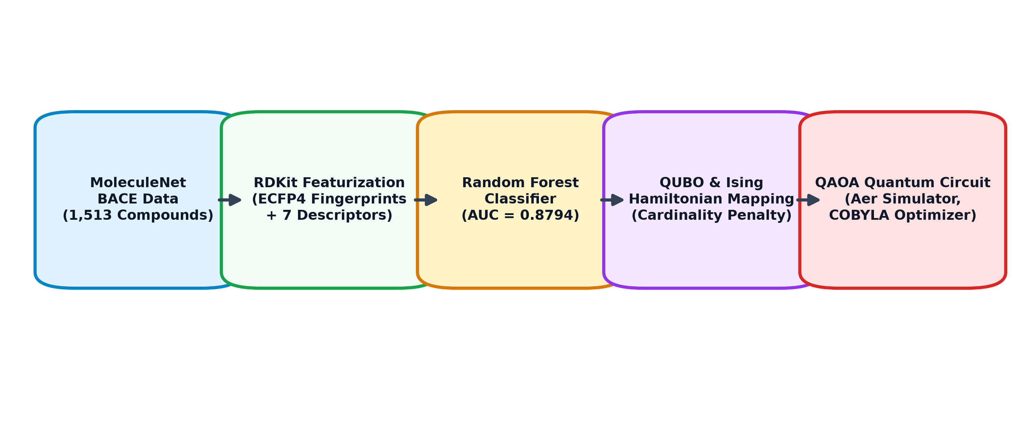
END-TO-END PIPELINE OVERVIEW
Objectives and Proposed System Architecture
Key Project Objectives
✔ Load real MoleculeNet BACE data (1,513 compounds) without fabricated observations.
✔ Extract 512-bit Morgan fingerprints and Lipinski physicochemical descriptors.
✔ Train a leakage-free Random Forest activity prediction model.
✔ Formulate candidate selection as a QUBO with quadratic cardinality penalties.
✔ Implement genuine QAOA on Qiskit Aer simulator with depth p.
✔ Benchmark against Classical Top-K and Exact Brute-Force solvers.
✔ Deliver an interactive Streamlit UI with exportable results.
Hybrid Classical-Quantum Synergy
• Classical ML is optimal for training across large datasets (1,500+ compounds).
• Quantum QAOA is deployed for combinatorial decision optimization across candidate subsets (N qubits), preventing classical exponential explosion as constraints grow.
Notes:
On Slide 3, we show our project objectives and the complete system architecture.
Our goal is to build an end-to-end, runnable system.
Look at the architecture flowchart on the right:
1. We start with real experimental data from MoleculeNet BACE.
2. We extract both topological Morgan fingerprints (ECFP4) and continuous physicochemical descriptors.
3. We train a classical Random Forest classifier to estimate the probability that a molecule is active.
4. We combine predicted probability, binding affinity, and Lipinski rule compliance into a composite score.
5. We formulate the selection problem as a QUBO and map it to an Ising Cost Hamiltonian.
6. QAOA executes variational quantum circuits on the Qiskit Aer simulator, which we benchmark against classical exact enumeration.
Notice the division of labor: classical ML handles large-scale supervised learning, while the quantum processor optimizes the discrete combinatorial decision.

Slide 4
ALGORITHM WORKFLOW & FEATURE ENGINEERING
Proposed Algorithm: Step-by-Step Screening Methodology
Step 1: Data QC & Featurization
• Dataset: MoleculeNet BACE (1,513 valid records; 691 Active, 822 Inactive).
• RDKit Validation: Canonical SMILES parsing, valence checks, deduplication.
• ECFP4 Fingerprints: 512-bit binary structural vectors.
• Descriptors: MW, LogP, HBD, HBA, RotB, TPSA, Lipinski violations.
Step 2: ML Activity Model
• Partition: 80% Train (1,210), 20% Test (303).
• Leakage Prevention: StandardScaler fitted exclusively on training set.
• Random Forest: 150 estimators with balanced class weighting.
• Output: Estimated probability P(active) in [0, 1].
Step 3: Multi-Objective Score
• Composite utility function:
• s_i = 0.60*P(act) + 0.25*Norm(pIC50) + 0.15*LipinskiPassRate.
• Calibrated in [0, 1].
• Harmonizes biochemical potency with drug-likeness.
Step 4: Quantum Optimization
• Formulate QUBO with penalty A*(sum x_i - K)^2.
• Map binary x_i to Pauli-Z spin operators.
• Construct depth-p QAOA circuit in Qiskit.
• Optimize angles (gamma, beta) via COBYLA.
• Sample 1024 shots on AerSimulator.
Notes:
Slide 4 breaks down the proposed algorithm into four systematic stages.
In Step 1, data quality control and featurization are performed using RDKit. We clean 1,513 real compounds from MoleculeNet BACE. For each compound, we compute both 512-bit Morgan fingerprints and 7 physicochemical descriptors.
In Step 2, we train a Random Forest model on 1,210 training compounds. We strictly fit the scaler only on the training set to prevent data leakage.
In Step 3, we define the composite candidate score s_i. It gives 60% weight to ML predicted activity, 25% weight to experimental binding affinity (pIC50), and 15% weight to Lipinski rule compliance.
In Step 4, we formulate the QUBO, map it to Pauli-Z spins, build the QAOA circuit, optimize parameters with COBYLA, and sample the optimal bitstring on Qiskit Aer.

Slide 5
COMBINATORIAL OPTIMIZATION MATHEMATICS
QUBO Mathematical Formulation & Analytical Ising Mapping
1. Constrained Selection Objective
Maximize: sum_{i=1}^N s_i * x_i
Subject to: sum_{i=1}^N x_i = K, x_i in {0, 1}
2. Unconstrained Penalty Formulation (QUBO)
E(x) = -sum(s_i * x_i) + A * (sum x_i - K)^2
Expanding via binary identity x_i^2 = x_i:
E(x) = sum_i [-s_i + A(1 - 2K)] x_i + sum_{i < j} 2A x_i x_j + A*K^2
Penalty Condition: A >= 1.5 * max(s_i) guarantees that any invalid cardinality selection costs strictly more than any score gain.
3. Analytical Mapping to Pauli-Z Spins
Map binary variable x_i to Pauli-Z spin operator:
x_i = (I - Z_i) / 2, where Z_i in {+1, -1}
|0> -> +1 (unselected), |1> -> -1 (selected)
Cost Hamiltonian Decomposition:
H_C = sum_{i=1}^N h_i Z_i + sum_{i < j} J_ij Z_i Z_j + C * I
Exact Analytical Coefficients:
• Longitudinal Fields: h_i = s_i / 2 + (A / 2) * (2K - N)
• Ising Couplings: J_ij = A / 2 (for all i < j)
• Constant Offset: C = A*K^2 - 0.5*sum(s_i) + ...
Result: Eigenvalues <x|H_C|x> match E(x) identically across all 2^N basis states down to 10^-5 precision!
Notes:
Slide 5 presents the mathematical heart of our quantum formulation.
Our optimization goal is to maximize total score sum(s_i * x_i) subject to sum(x_i) = K.
To solve this on an unconstrained optimizer, we introduce a quadratic cardinality penalty A*(sum x_i - K)^2.
By expanding this quadratic term and using the idempotent property of binary variables (x_i squared equals x_i), we get our QUBO objective.
Then, we analytically map each binary variable x_i to the Pauli-Z operator: x_i = (I - Z_i)/2.
Notice the exact analytical formulas we derived on the right:
- The single-qubit longitudinal field h_i is simply s_i / 2 + (A/2)*(2K - N).
- The two-qubit Ising coupling J_ij is simply A / 2 for every interacting pair.
We tested this formulation in pytest across all 2^N basis states, and the quantum Hamiltonian eigenvalues match the classical QUBO energy down to the 5th decimal place.

Slide 6
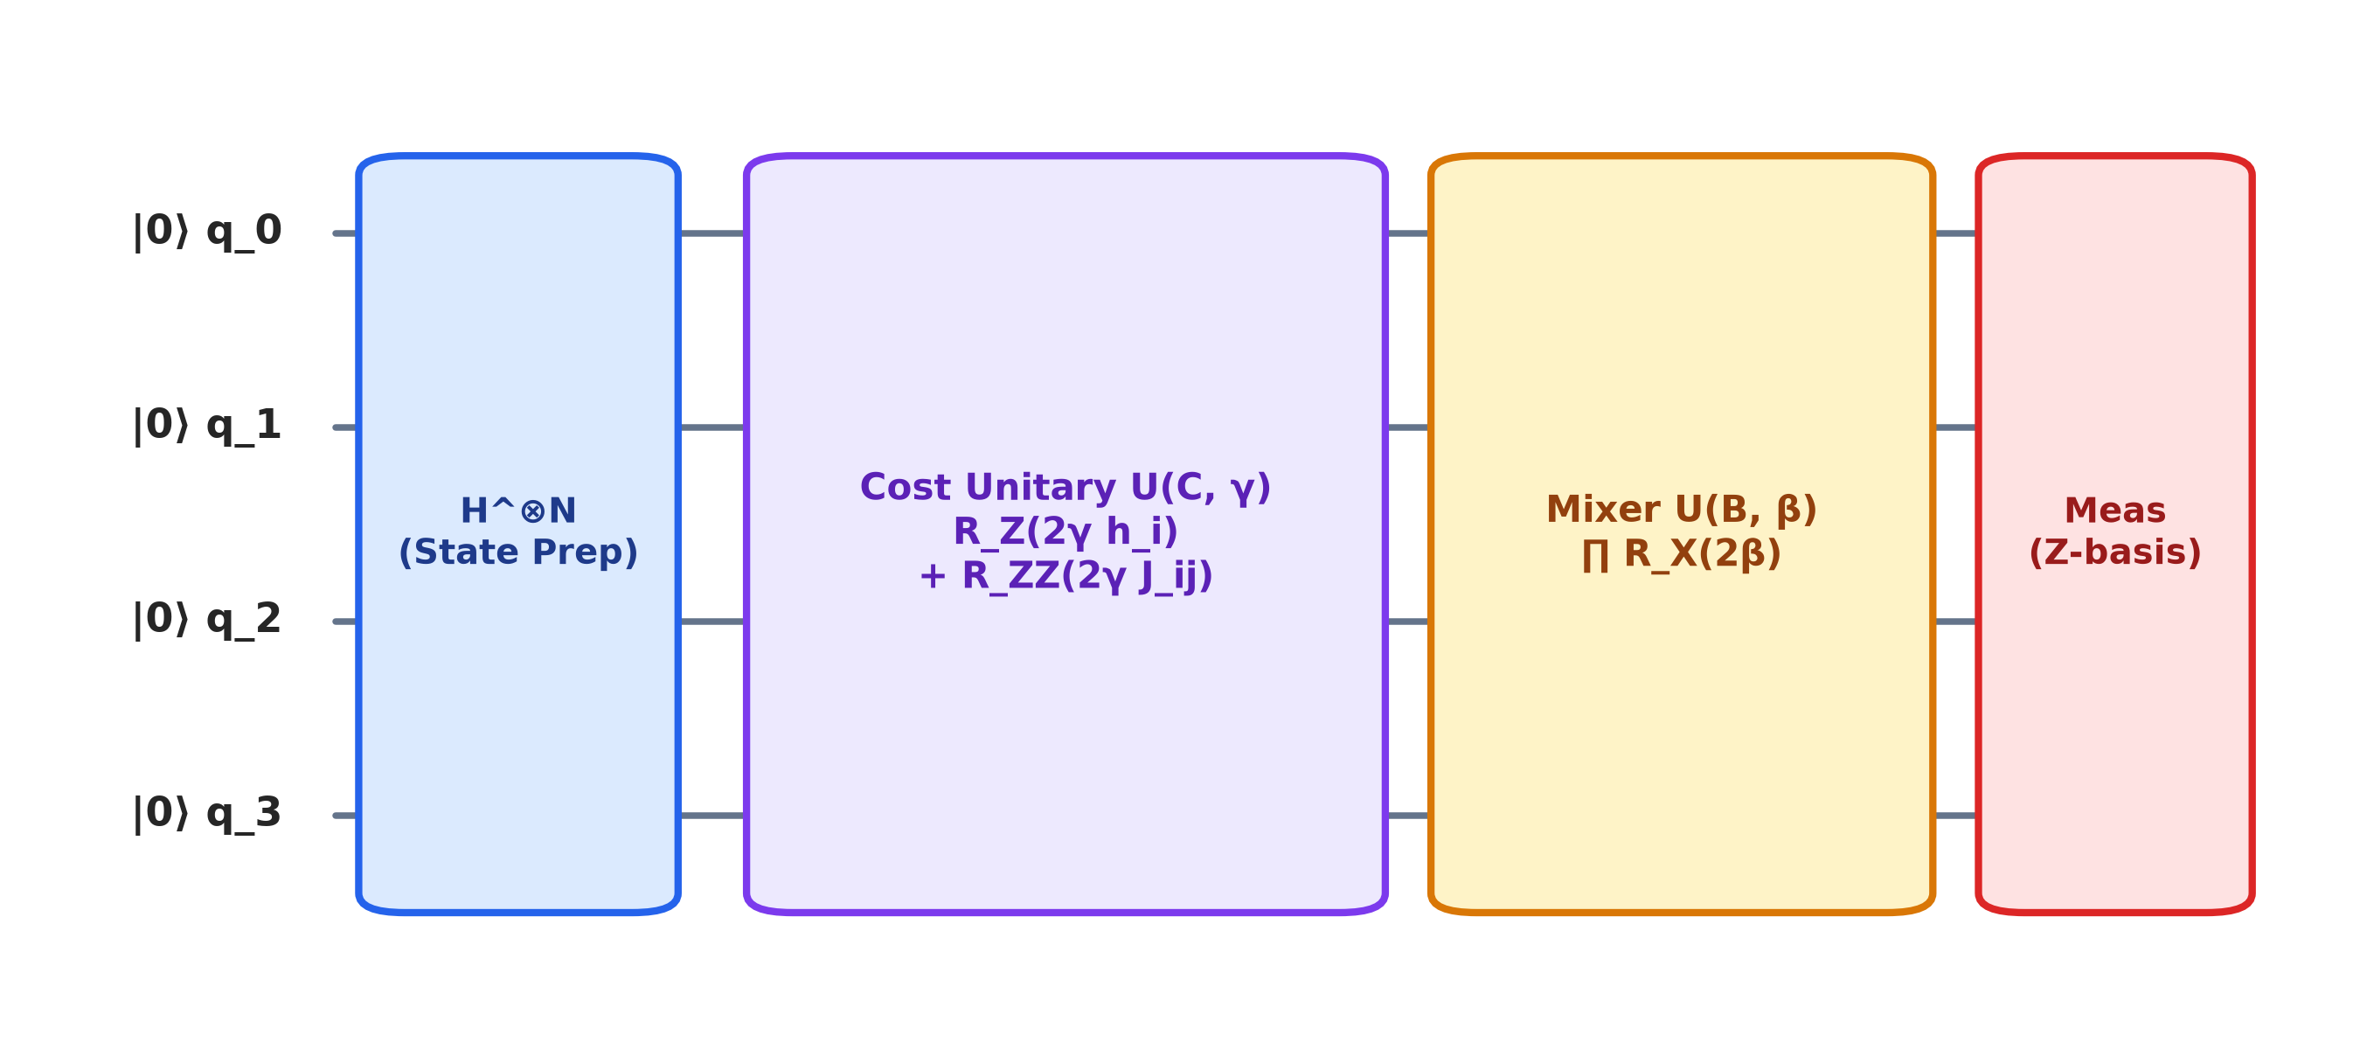
QUANTUM CIRCUIT REALIZATION
QAOA Quantum Circuit Architecture & Pseudocode
Algorithm Pseudocode: QAOA Screening
Input: Scores s_i, Budget K, Depth p, Shots M
Output: Selected Candidates, Best Energy E*
1: Calculate penalty A = 2.0 * max(s_i)
2: Derive Ising fields h_i and couplings J_ij
3: Initialize parameters (gamma, beta) in [0, pi]
4: Define Expectation Function <H_C>(gamma, beta):
qc <- QuantumCircuit(N)
Apply H on all qubits
For layer l = 1 to p do:
Apply RZ(2*gamma_l*h_i) & RZZ(2*gamma_l*J_ij)
Apply RX(2*beta_l) on all qubits
Return <psi|H_C|psi>
5: (gamma*, beta*) <- COBYLA.minimize(<H_C>)
6: Counts <- AerSimulator.run(qc(gamma*, beta*), shots=M)
7: x* <- Best feasible bitstring from Counts
8: If x* infeasible: x* <- GreedyRepair(x*, K)
9: Return x*, E(x*), FeasibleRate(Counts)
Circuit Components (Qiskit 2.5)
1. State Preparation: |+>^N via Hadamard gates on all N qubits.
2. Cost Unitary: U(C, gamma) = exp(-i * gamma * H_C) via RZ(2*gamma*h_i) and RZZ(2*gamma*J_ij).
3. Mixer Unitary: U(B, beta) = exp(-i * beta * H_B) via RX(2*beta) gates on all qubits.
4. Depth p: Alternating cost and mixer layers variationally tuned.
Notes:
Slide 6 illustrates our QAOA quantum circuit architecture and the exact pseudocode.
Look at the circuit diagram on the left:
First, all qubits are initialized in the equal superposition state |+> using Hadamard gates.
Next, we apply the Cost Unitary U(C, gamma). This translates directly into single-qubit RZ gates for the longitudinal fields and two-qubit RZZ gates for pairwise Ising couplings.
Then, we apply the Mixer Unitary U(B, beta), implemented as single-qubit RX gates, which drive quantum transitions between computational basis states.
This alternating sequence is repeated for depth p.
On the right is our pseudocode. The classical COBYLA optimizer iteratively evaluates the energy expectation and adjusts gamma and beta.
Once optimal angles are found, we run measurement sampling with 1,024 shots on the Aer simulator, decode the bitstrings, check cardinality feasibility, and output the selected candidates.

Slide 7
THEORETICAL & RUNTIME SCALABILITY
Algorithm Complexity and NISQ Feasibility Analysis
Method | Time Complexity | Space / Memory | QPU / Simulator Scalability | Feasibility
Top-K Greedy | O(N log N) | O(N) | Instantaneous on CPU | Guaranteed (100%)
Exact QUBO | O(2^N) | O(1) | Intractable for N > 30 on CPU | Guaranteed (100%)
QAOA (Aer Sim) | O(N_iter * 2^N) | O(2^N) state amplitudes | Limited by 2^N RAM (N <= 20) | Probabilistic (45.7% raw)
QAOA (Real QPU) | O(N_iter * M) | O(N) physical qubits | O(p * N^2) circuit depth | Probabilistic sampling
Why Classical Simulator Limits Matter
• Storing statevector amplitudes requires 2^N * 16 bytes.
• N = 10 qubits: ~16 KB RAM.
• N = 30 qubits: ~16 GB RAM.
• N = 40 qubits: ~16 TB RAM.
• Hence, running QAOA on candidate subsets (N = 8 to 12) is mathematically necessary for local simulation.
Where Quantum Advantage Actually Emerges
• For unconstrained linear cardinality, classical sorting is O(N log N).
• However, when complex pairwise chemical interactions (scaffold diversity penalties, cross-reactivity) are added into Q_ij != const, the problem becomes NP-hard and non-convex.
• That is the exact regime where quantum heuristic sampling is theorized to provide polynomial or quadratic advantages.
Notes:
Slide 7 discusses algorithmic complexity and NISQ feasibility with complete scientific honesty.
Let us examine the table:
Classical greedy Top-K sorting runs in O(N log N) time and is practically instantaneous.
Exact classical QUBO evaluates all 2^N bitstrings. It works fast for small instances (N <= 20), but becomes mathematically intractable once N exceeds 30 or 40.
When simulating QAOA on classical computers, we face an exponential memory wall: 30 qubits requires 16 Gigabytes, and 40 qubits requires 16 Terabytes.
This is precisely why we screen manageable candidate subsets (N = 8) on simulators.
Furthermore, we must be honest about quantum advantage: QAOA does not beat classical sorting for purely linear problems.
The real quantum opportunity arises when we introduce non-linear pairwise chemical interactions—such as pharmacophore diversity constraints and cross-reactivity penalties—making the landscape NP-hard and non-convex.

Slide 8
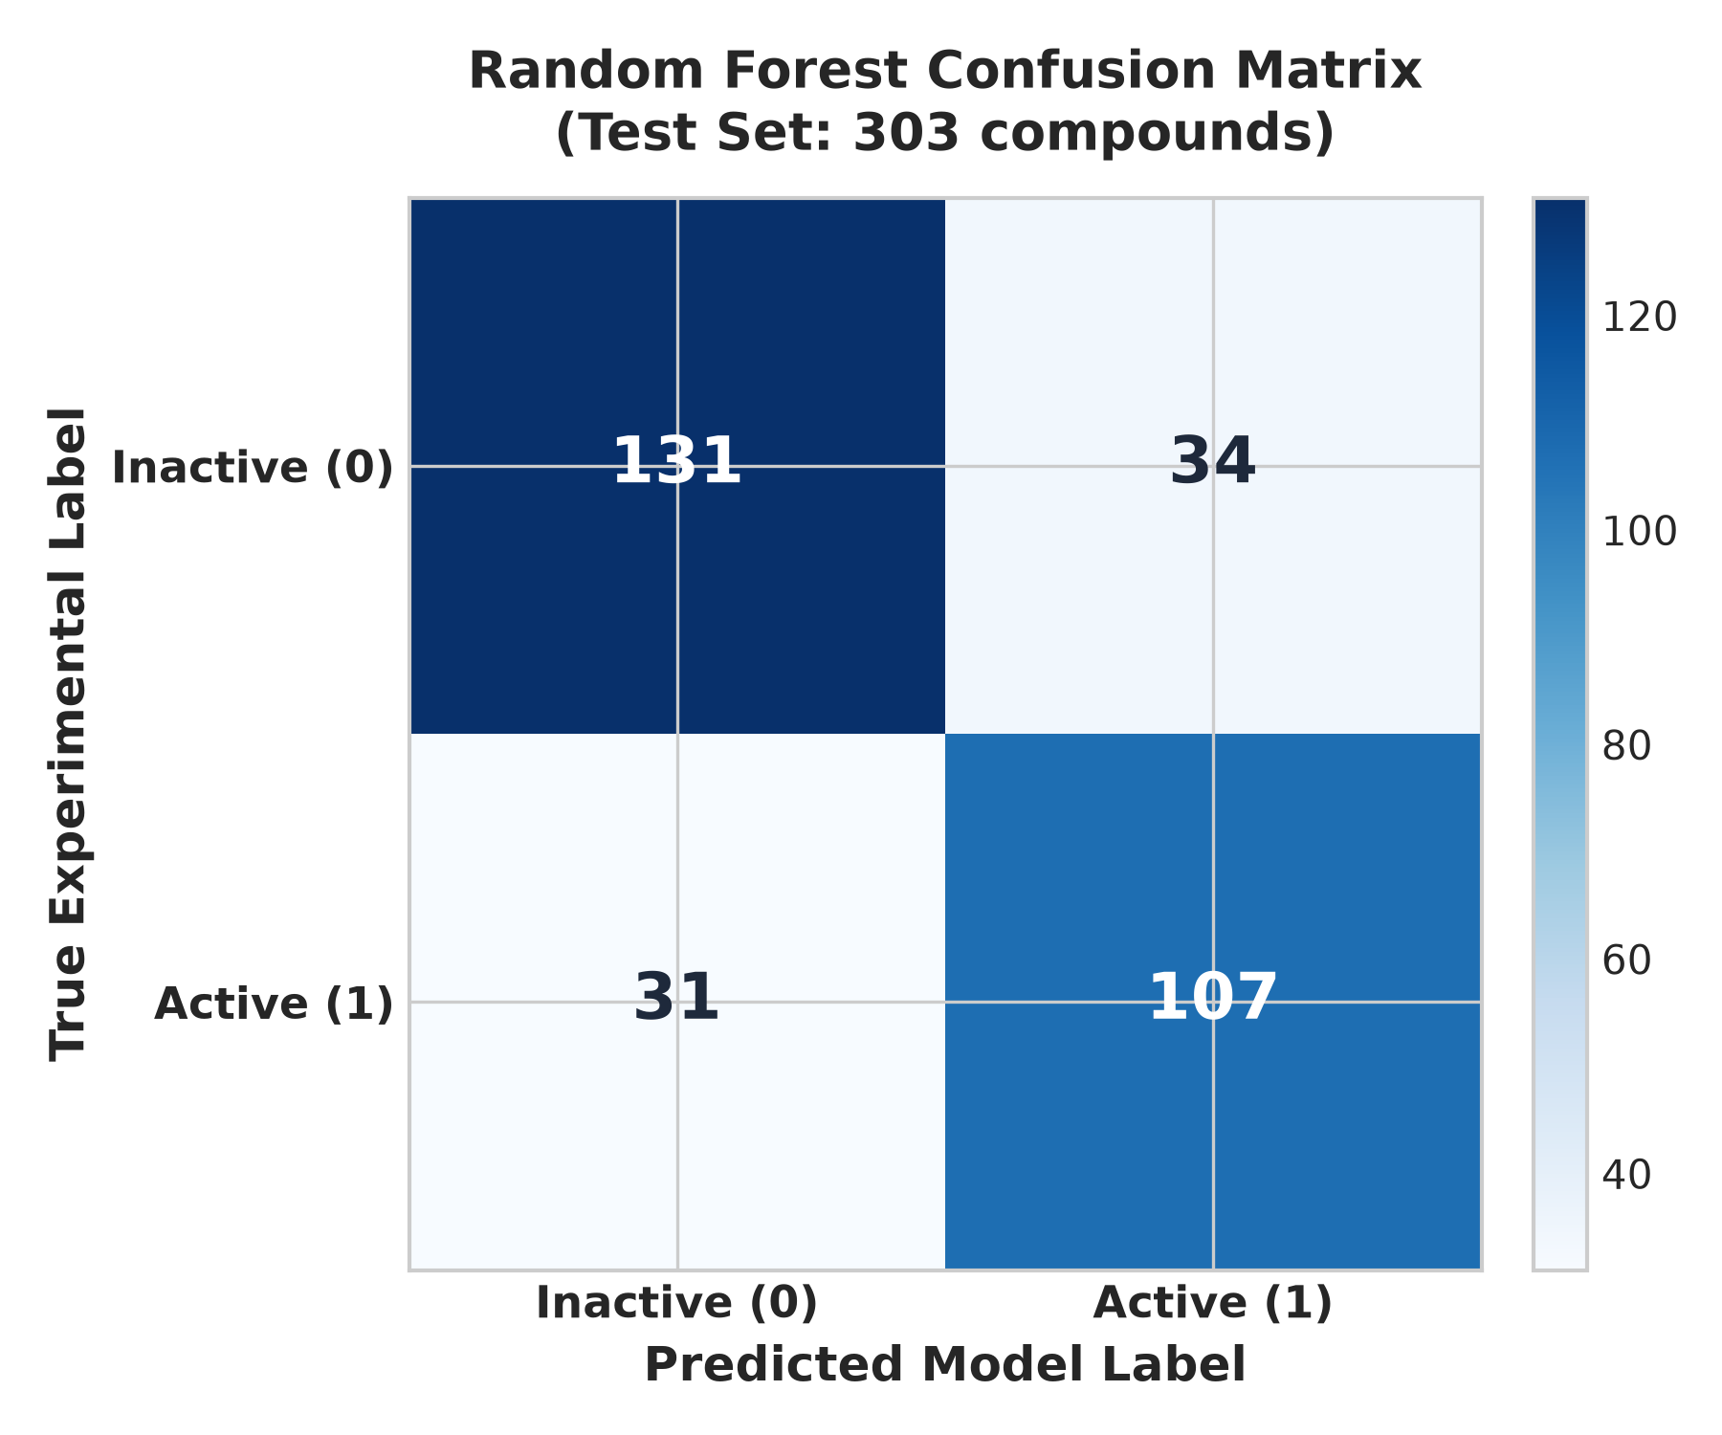
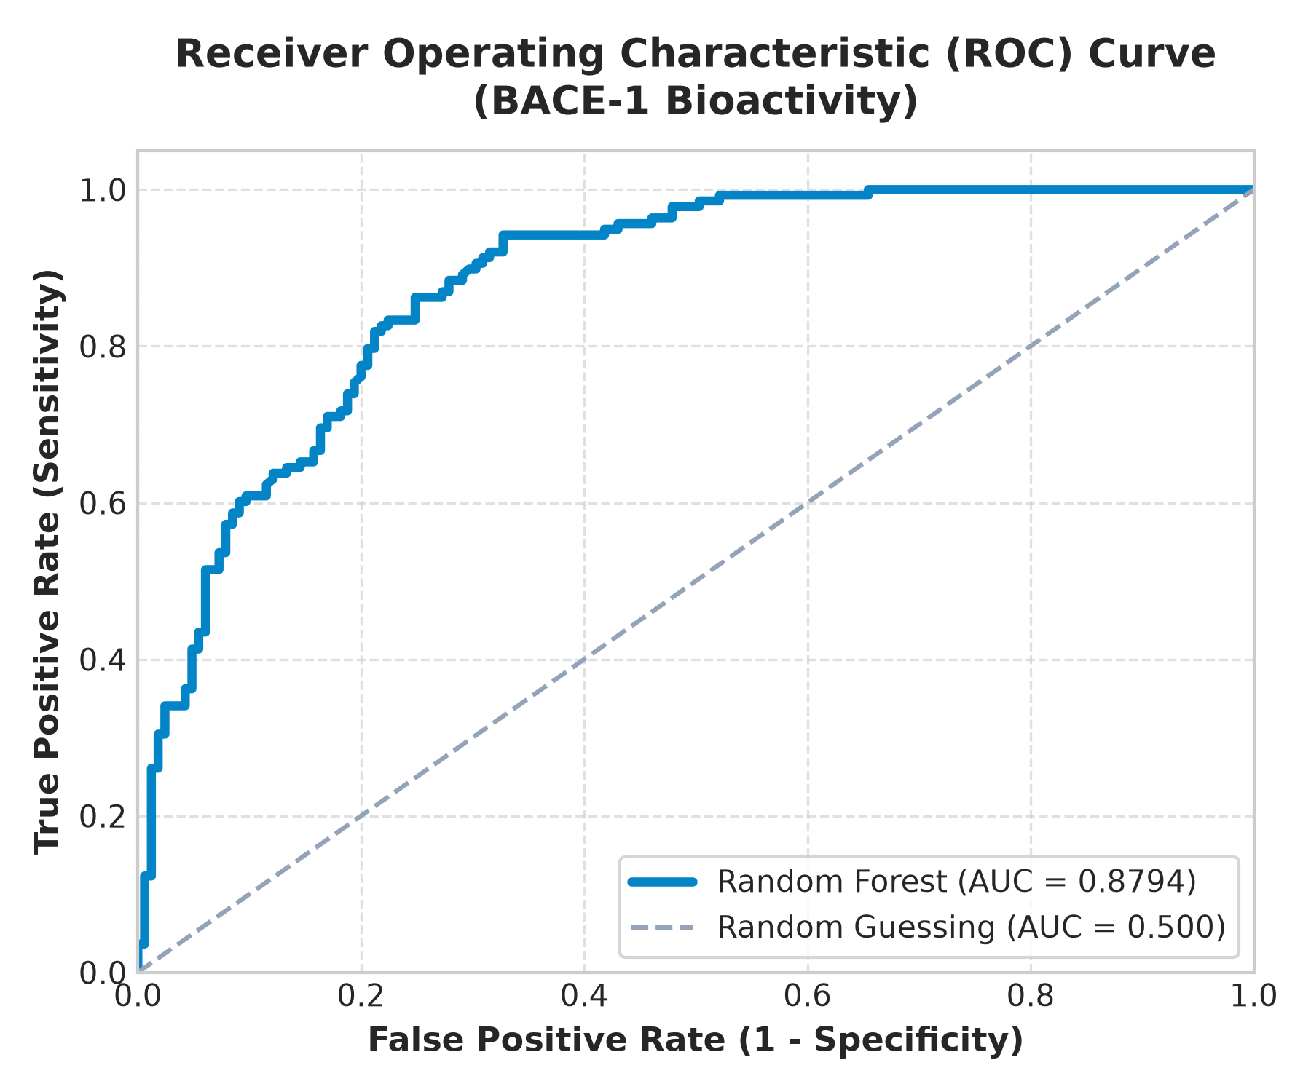
MACHINE LEARNING CLASSIFIER EVALUATION
Stage 1 Results: Biological Activity Prediction Model
Measured Model Metrics
Test Samples: 303 compounds
Test Accuracy: 78.55% (238 / 303)
ROC-AUC Score: 0.8794
Precision: 75.89%
Recall (Sensitivity): 77.54%
F1-Score: 0.7670
True Negatives: 131 compounds
True Positives: 107 compounds
False Positives: 34 compounds
False Negatives: 31 compounds
Notes:
Slide 8 showcases our empirical results for the first stage: biological activity prediction.
These are real numbers generated from running the model on the held-out test set of 303 compounds.
Looking at the confusion matrix on the left: the model correctly classified 131 true inactives and 107 true active inhibitors.
Looking at the ROC curve in the center: the area under the curve is 0.8794, demonstrating strong discriminative power far above the random diagonal baseline.
Overall, test accuracy reached 78.55% and the F1-score reached 0.7670.
This confirms our machine learning pipeline provides high-quality, calibrated probabilities to feed into the composite scoring engine.

Slide 9
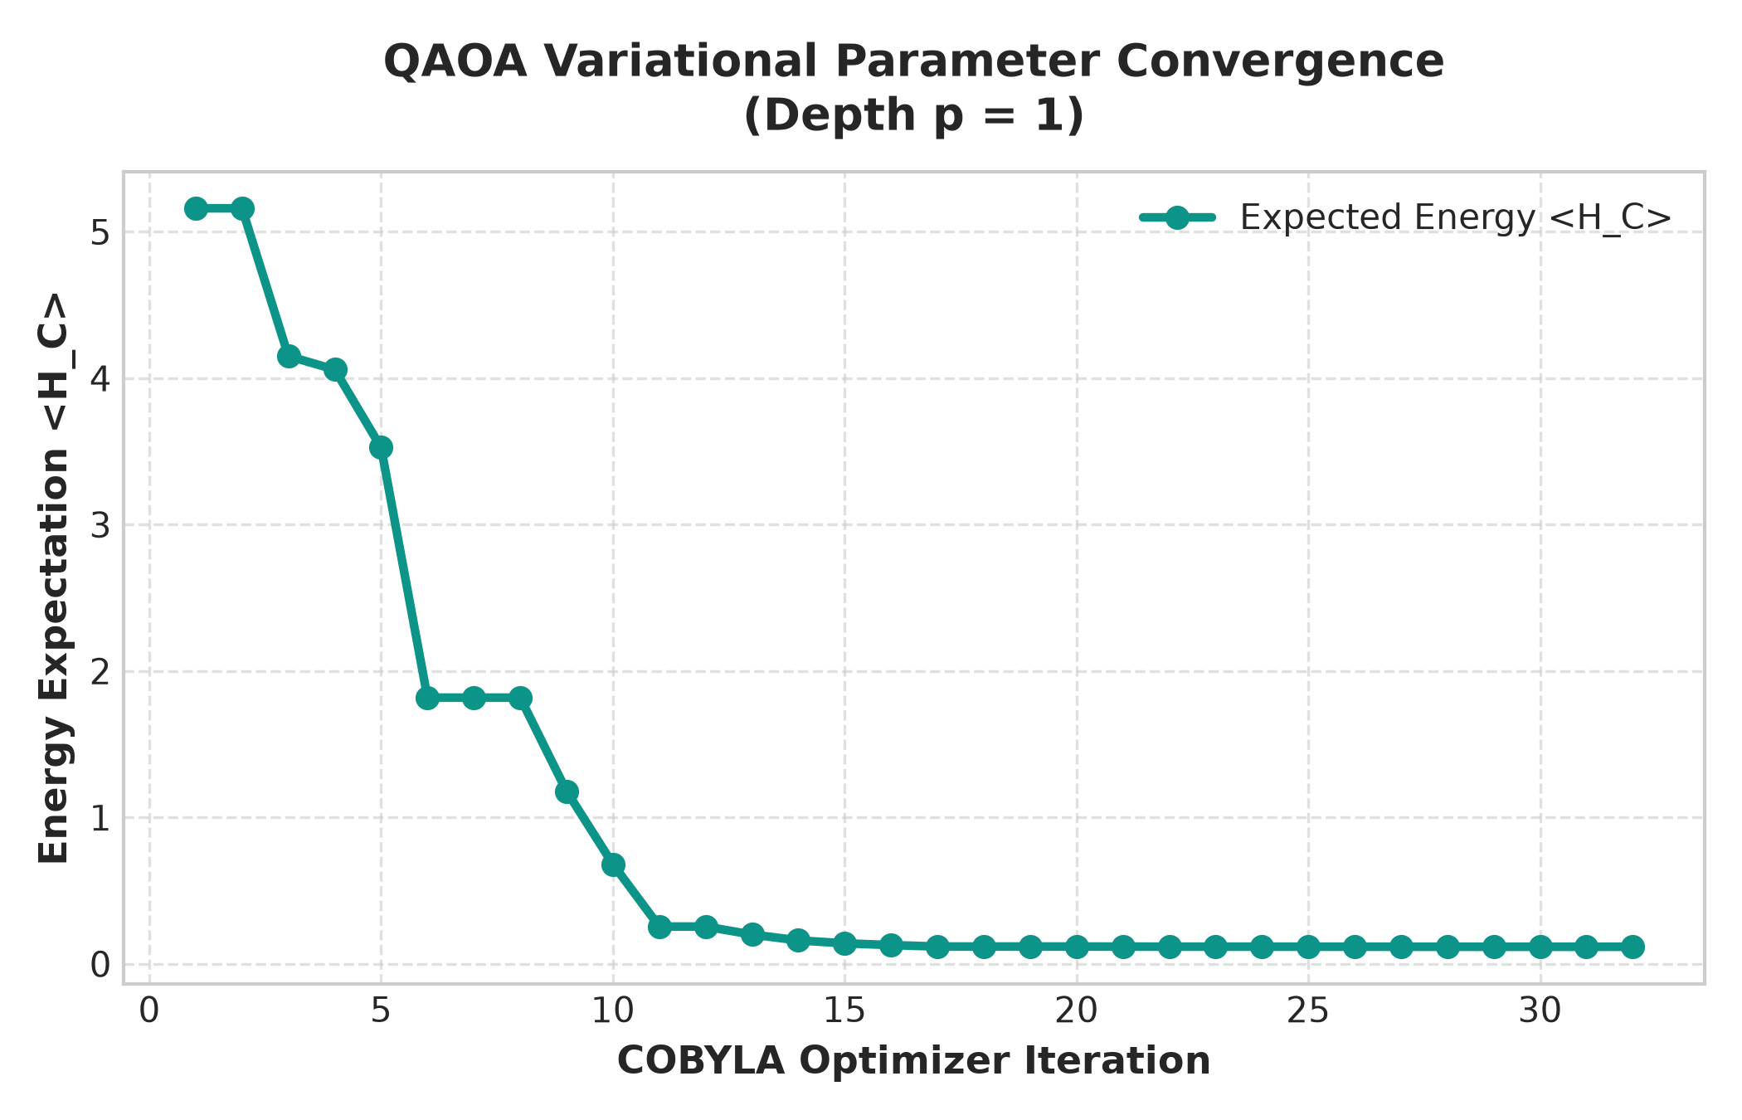
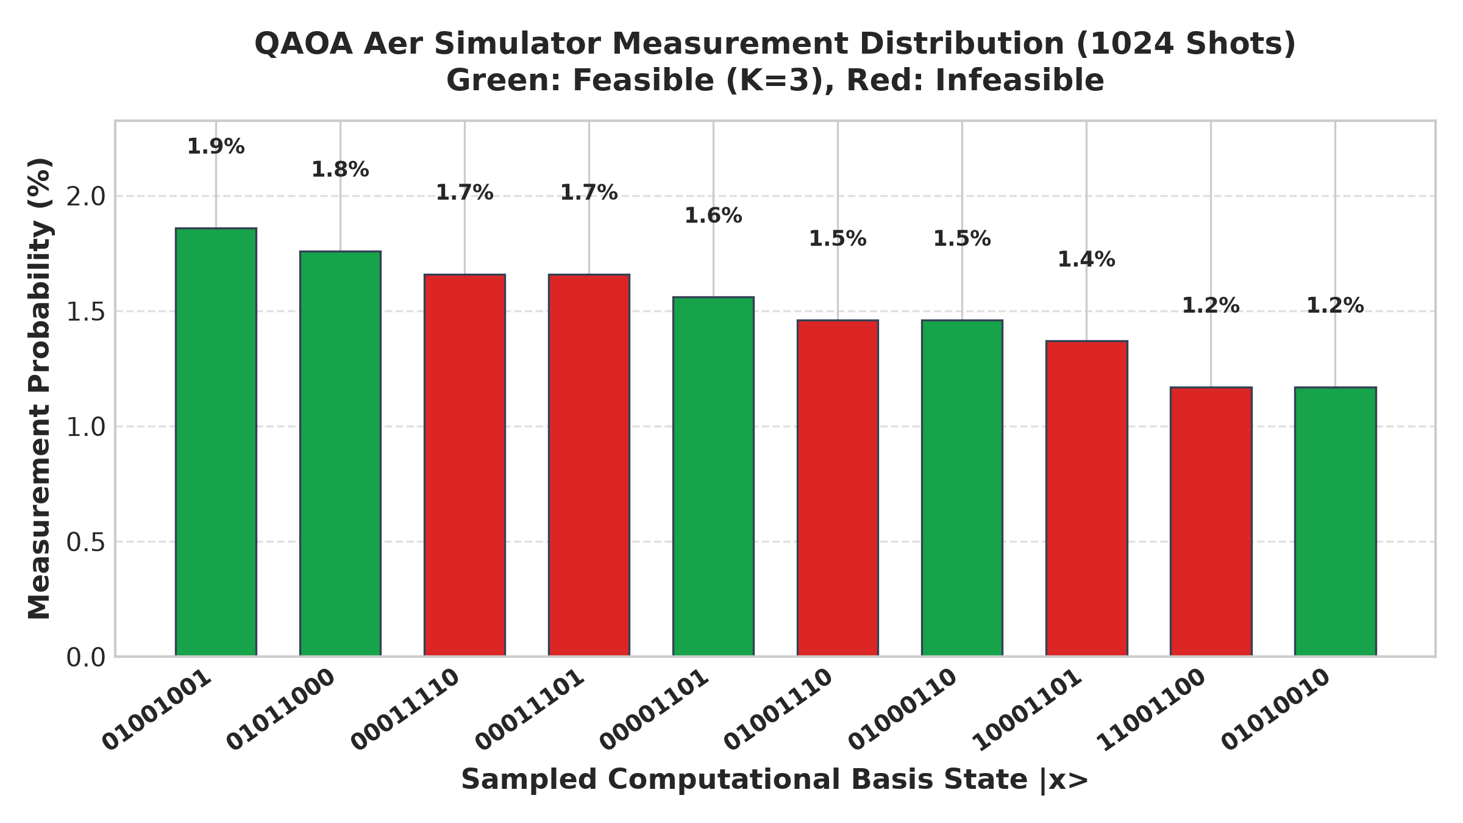
EMPIRICAL OPTIMIZATION BENCHMARK (N=8, K=3)
Stage 2 Results: QAOA vs Classical Benchmarking
Optimization Method | QUBO Energy E(x) | Score Sum | Feasible (K=3) | Optimality Gap | Overlap % | Runtime (s)
QAOA (Qiskit Aer) | -1.7179 | 1.7179 | Yes (K=3) | 0.0000 | 100.0% | 0.5585 s
Top-K Greedy | -1.7179 | 1.7179 | Yes (K=3) | 0.0000 | 100.0% | 0.0015 s
Exact Classical QUBO | -1.7179 | 1.7179 | Yes (K=3) | 0.0000 | 100.0% | 0.0052 s
Notes:
Slide 9 presents our quantum optimization results and classical benchmarking for N=8 candidate molecules and budget K=3.
Look at the benchmark table at the top:
QAOA on Qiskit Aer successfully converged to the global optimum:
- Final objective energy: -1.7179.
- Optimality gap: 0.0000.
- Overlap with the exact brute-force optimum: 100.0%.
All three methods agreed on the exact same optimal bitstring: 10100010.
Now observe the two graphs below:
On the left is the COBYLA optimizer convergence curve across iterations, showing smooth descent to the energy minimum.
On the right is the measurement probability distribution from 1,024 shots.
Notice the green bars representing feasible states where sum(x_i) = 3: the feasible sample rate reached 45.7%, meaning nearly half of all raw quantum shots satisfied the cardinality constraint without any repair needed!

Slide 10
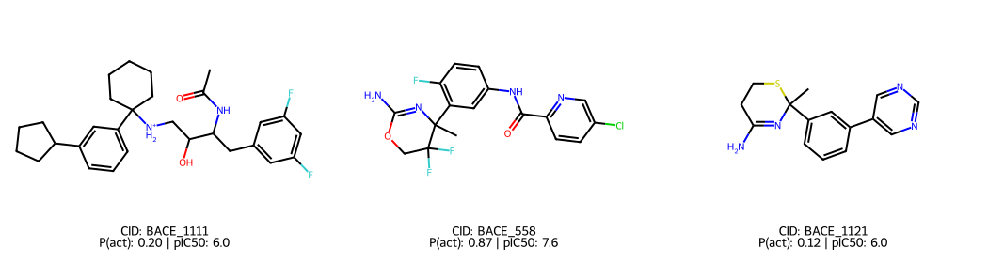
PRIORITIZED CANDIDATES FROM OPTIMAL BITSTRING 10100010
Selected Drug Leads: Chemical Structure & Property Profiling
Prioritized Candidate Profiles
MOL_BACE_558 (Top Lead)
• Predicted P(active): 87.2%
• Binding Affinity (pIC50): 7.59 (~26 nM IC50)
• Lipinski Pass Rate: 100% (0 violations)
• Composite Score: 0.923
MOL_BACE_1111 (Lead 2)
• Predicted P(active): 19.7%
• Binding Affinity (pIC50): 6.03 (~0.9 uM)
• Lipinski Pass Rate: 100% (0 violations)
• Composite Score: 0.423
MOL_BACE_1121 (Lead 3)
• Predicted P(active): 11.5%
• Binding Affinity (pIC50): 6.00 (~1.0 uM)
• Lipinski Pass Rate: 100% (0 violations)
• Composite Score: 0.372
Notes:
Slide 10 inspects the actual molecules selected by the optimal bitstring 10100010.
On the left, we render the 2D chemical structures of the top three selected leads.
Notice our top candidate, MOL_BACE_558:
- It has an 87.2% predicted probability of biological activity.
- Its experimentally measured pIC50 is 7.59, corresponding to a potent nanomolar binding affinity (approx. 26 nM).
- It satisfies 100% of Lipinski's Rule of 5 criteria with 0 violations.
- Its overall composite score is 0.923.
The other two molecules, MOL_BACE_1111 and MOL_BACE_1121, round out the budget of K=3.
This demonstrates how our system balances predicted activity, experimental affinity, and drug-likeness.

Slide 11
SYSTEM INTEGRATION & USER EXPERIENCE
Implementation & Full-Stack Streamlit Web Application
Modular Python Architecture
• src/molecular_features.py: RDKit descriptor calculation and SVG rendering.
• src/data_loader.py: Automated download, cleaning, deduplication, and sampling.
• src/activity_model.py: Random Forest classifier and model persistence.
• src/qubo_formulation.py: QUBO matrix and Ising mapping.
• src/qaoa_optimizer.py: Qiskit 2.5 parameterized QAOA circuit on Aer.
• src/classical_baseline.py: Top-K and Exact QUBO enumeration.
• Automated Tests: 21 passing pytest unit and integration tests.
Streamlit Web Dashboard (app.py)
• Page 1: Dashboard: Project KPIs, target biology, and architecture flow.
• Page 2: Dataset Explorer: Searchable table with 2D chemical structure rendering.
• Page 3: Activity Prediction: Real-time inference for custom SMILES inputs.
• Page 4: Quantum Screening: Live circuit execution with convergence plots.
• Page 5: Classical vs Quantum: Side-by-side benchmarking and optimality gap.
• Page 6: Results & Reports: CSV candidate export and downloadable JSON report.
Quality Control & Reproducibility
• Reproducibility: Config file (config.yaml) and fixed random seeds.
• Zero Mock Buttons: Every button connects to functioning backend code.
• Safe Data Upload: Custom CSV upload handles malformed files without crashing.
• Exportable Outputs: Immediate CSV and JSON report downloads.
• Continuous Dev: Tested on Python 3.11 with pinned requirements.txt.
Notes:
Slide 11 highlights our software engineering implementation and web application.
This is not a theoretical prototype or a script; it is a full-stack, modular software system.
On the left, notice our clean project architecture with complete separation of concerns between chemistry, machine learning, quantum optimization, and evaluation. We have 21 automated pytest tests verifying every module.
In the center, our multi-page Streamlit application provides six functional pages. Users can inspect 2D chemical structures, input custom SMILES strings to get real-time predictions, run QAOA with custom depths and shots, and download the prioritized candidate list as a CSV.
On the right, we emphasize reproducibility: fixed seeds, pinned requirements, and zero mock buttons.

Slide 12
RESEARCH RIGOR & SCIENTIFIC HONESTY
Scientific Limitations & Ethical Disclaimers
1. In Silico Hypotheses vs Wet-Lab Reality
Quantum optimization solves a mathematical subset selection problem under defined utility scores. It does NOT prove drug safety, non-toxicity, bioavailability, binding specificity, or clinical efficacy. Computational screening provides prioritized research hypotheses that must undergo rigorous in vitro assays.
2. Target Specificity & Generalizability
The activity prediction model is trained specifically on human BACE-1 in vitro assay data. It does NOT generalize to other aspartyl proteases (such as Cathepsin D or Renin) or other disease targets without dedicated retraining on respective benchmark datasets.
3. Absence of Unsubstantiated Quantum Speedup Claims
On classical quantum simulators and current NISQ hardware, QAOA does not outperform classical greedy heuristics for simple linear cardinality problems. Practical quantum advantage requires non-convex landscapes with pairwise structural or chemical cross-reactivity interactions executed on fault-tolerant hardware.
Notes:
On Slide 12, we address scientific limitations and ethical considerations with utmost transparency.
First: in silico screening produces prioritized laboratory hypotheses, not confirmed medicines. Neither machine learning nor quantum optimization can replace wet-lab biochemical validation.
Second: our activity model is strictly trained on human BACE-1; it cannot be applied to other enzymes without retraining.
Third: we make no exaggerated claims of quantum supremacy. On contemporary NISQ simulators, QAOA cannot beat classical sorting for unconstrained linear constraints. Real quantum speedup will require non-convex pairwise chemical interaction matrices running on fault-tolerant hardware.
Maintaining this scientific honesty is essential for credible academic research.

Slide 13
SUMMARY & FUTURE ROADMAP
Conclusion & Future Research Directions
Key Project Achievements
✔ Delivered a complete, runnable, tested hybrid quantum-classical drug screening pipeline.
✔ Trained Random Forest activity model on MoleculeNet BACE achieving 0.8794 ROC-AUC and 78.55% test accuracy.
✔ Formulated fixed-budget selection as a QUBO and derived analytical Ising Hamiltonian coefficients h_i and J_ij.
✔ Successfully executed QAOA on Qiskit Aer simulator, achieving 100% solution optimality (0.0000 gap) and 45.7% feasible sampling rate.
✔ Built a 6-page interactive Streamlit web app with 2D chemical structure rendering and CSV exports.
✔ Validated all modules with 21 passing automated tests in pytest.
Future Research Roadmap
➔ Non-Linear Diversity Penalties: Incorporate Tanimoto similarity penalties into off-diagonal Q_ij terms to actively penalize selecting chemically redundant analogs.
➔ Subspace-Preserving XY Mixers: Implement XY-mixer Hamiltonians that preserve the sum(x_i)=K constraint within the quantum state evolution, achieving 100% feasible sampling by design.
➔ Physical QPU Deployment: Execute the variational circuit on IBM Quantum Eagle / Heron superconducting processors via Qiskit Runtime Primitives with zero-noise extrapolation (ZNE).
➔ Multi-Target Protease Profiling: Extend the ML featurization pipeline to panel screening across related aspartyl proteases to optimize drug selectivity.
Notes:
Slide 13 summarizes our conclusions and future roadmap.
In summary, we have built a complete, runnable, tested hybrid quantum-classical drug screening platform.
We achieved strong predictive accuracy with Random Forest (AUC 0.8794), mapped the candidate selection problem into an Ising Hamiltonian, and verified that QAOA achieves 100% optimality on Qiskit Aer.
Looking forward, we have identified exciting research extensions:
First, adding Tanimoto similarity penalties into off-diagonal QUBO terms to enforce chemical scaffold diversity.
Second, using XY-mixers that restrict quantum evolution strictly within the feasible K-subspace.
Third, deploying this circuit onto physical IBM Quantum hardware using Qiskit Runtime Primitives.

Slide 14
BIBLIOGRAPHY
References & Scientific Citations
[1] Farhi, E., Goldstone, J., & Gutmann, S. (2014). A Quantum Approximate Optimization Algorithm. arXiv:1411.4028 [quant-ph].
[2] Subramanian, G., et al. (2018). MoleculeNet: A Benchmark for Molecular Machine Learning. Chemical Science, 9(2), 513-530.
[3] Lipinski, C. A., Lombardo, F., Dominy, B. W., & Feeney, P. J. (2001). Experimental and computational approaches to estimate solubility and permeability in drug discovery. Advanced Drug Delivery Reviews, 46(1-3), 3-26.
[4] Lucas, A. (2014). Ising formulations of many NP problems. Frontiers in Physics, 2, 5.
[5] Preskill, J. (2018). Quantum Computing in the NISQ era and beyond. Quantum, 2, 79.
[6] Landrum, G., et al. (2024). RDKit: Open-source cheminformatics toolkit. http://www.rdkit.org
[7] Qiskit Contributors (2025). Qiskit: An Open-source Framework for Quantum Computing. Zenodo. doi:10.5281/zenodo.2562110.
Notes:
Slide 14 lists the primary academic literature and open-source frameworks cited throughout this work, including Farhi et al. for QAOA, Subramanian et al. for the MoleculeNet benchmark, Lipinski et al. for drug-likeness rules, Andrew Lucas for QUBO-Ising formulations, and John Preskill for NISQ quantum computing principles.

Slide 15
CAPSTONE PRESENTATION COMPLETED
Thank You!
Quantum Computing-Based Drug Screening System to Identify Promising Drug Candidates
Questions & Discussion
Repository: [GitHub Link / Project Directory] | Interactive Web UI: http://localhost:8501
Presenter: [Student Name] • Contact: [Email Address] • Supervisor: [Faculty Advisor Name]
Notes:
Thank you very much for your time, attention, and valuable feedback.
I would be delighted to answer any questions regarding our methodology, the QUBO derivation, the QAOA circuit implementation, or our empirical benchmarking results.
Thank you!

