Slide 1
Week 06

Slide 2
Warm-up (10 minutes)
Open the intro to data viz notebook from last week and make the graphs look better (add labels, etc)!
If you don’t have time to make them all look great, that’s fine! Focus instead on making one really good.

Slide 3
Today's Activities
Warmup (15 mins)
Homework Answers/Q&A (30 mins)
Install postgres and pgadmin (25 mins)
Intro to Databases (20 mins)
Break (15 mins)
Intro to SQL (15 mins)
Group Exercise (60 mins)

Slide 4
Class Requirements
You must have turned in at least 4 of the first 5 assignments by today to continue in this course!
You need to have 70% or above on those assignments.
Going forward you must ALSO have an average of 70% or higher on your in-class activities at each checkpoint (next one in 6 weeks). Not completing an in-class activity will count as a 0.
I will NOT be grading in-class activities that are more than a week late.
If your homework is more than two days late (after Friday) you will now begin to lose points (1 pt a day)
Make sure you are completing the DataCamp and including screenshots of your completed exercises when required.

Slide 5

Some of you are really on top of stuff. What are your secrets?

Slide 6
Homework Clarity
You need to make sure each question is marked clearly with the number of the question indicated.
If it is hard for us to grade your homework you will need to redo it.

Slide 7
Homework Answers (30 mins)
To save some time I will discuss a subset of answers.
Voluntarily slack answers to the #datascience channel
Don't be shy!

Slide 8
Install postgres and pgadmin (20 mins)
Go to https://www.postgresql.org/download/ and select your OS
Click on “Download the Installer” and then download the most recent version available (V 13 as of this documentation)
Run the installer from the download in browser or your Downloads folder
Follow the setup prompt with defaults until it asks for a superuser password
Enter a password you’ll be sure to remember (this will be used later to access the DB)
Continue the setup with defaults until installation begins
Click finish (This will launch Stack Builder)
In Stack builder, select the “PostgreSQL 13 (x64) on port 5432” option and click Next
From the next screen, we can install additional add ons or drivers as wanted, but we don’t need any right now so hit “Cancel”
Open the start menu and locate the PostgreSQL 13 folder, expand it and click on pgAdmin 4

Slide 9
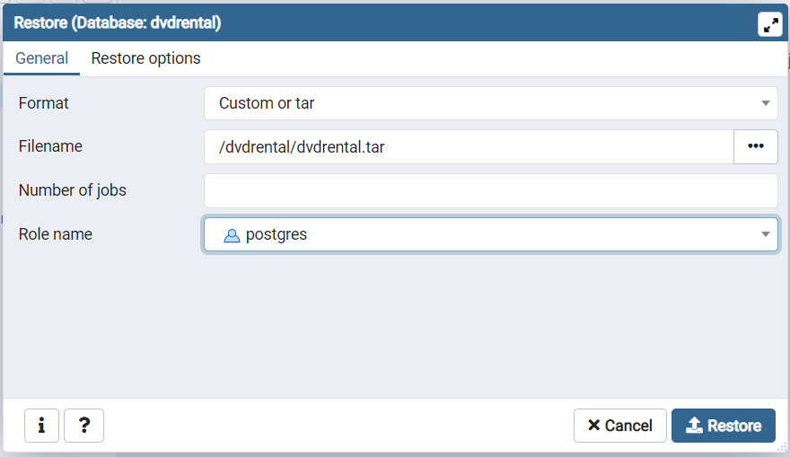
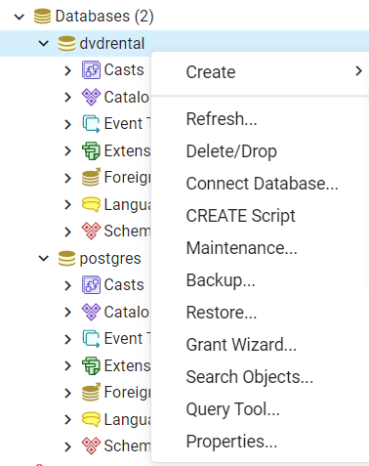
Connect to Homework Database
create database dvdrental;
**Be sure to copy the full path for the tar file and paste it into the file name**

Slide 10

Intro to Databases (15 mins)
https://www.edureka.co/blog/what-is-a-database/
Database Management Systems (DBMS)
Database – collection of records that can be added, modified, and managed AND processed into useful information
Many different types of databases, but we will mostly use RDBMS
Schema – logical configuration of all the tables in a relational database

Slide 11
DBMS
Collection of interrelated data
Set of programs to access the data
DBMS contains information about a particular enterprise
DBMS provides an environment that is both convenient and efficient to use.
Database Applications:
Banking: all transactions
Airlines: reservations, schedules
Universities: registration, grades
Sales: customers, products, purchases
Manufacturing: production, inventory, orders, supply chain
Human resources: employee records, salaries, tax deductions
Databases touch all aspects of our lives

Slide 12
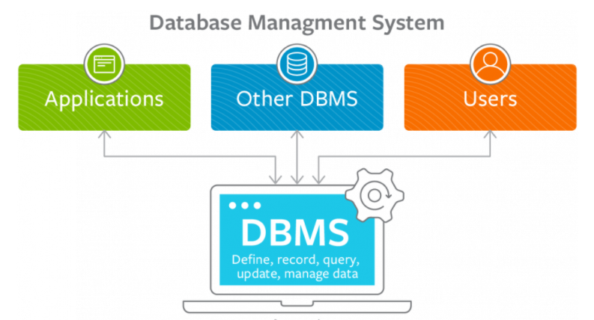

Slide 13
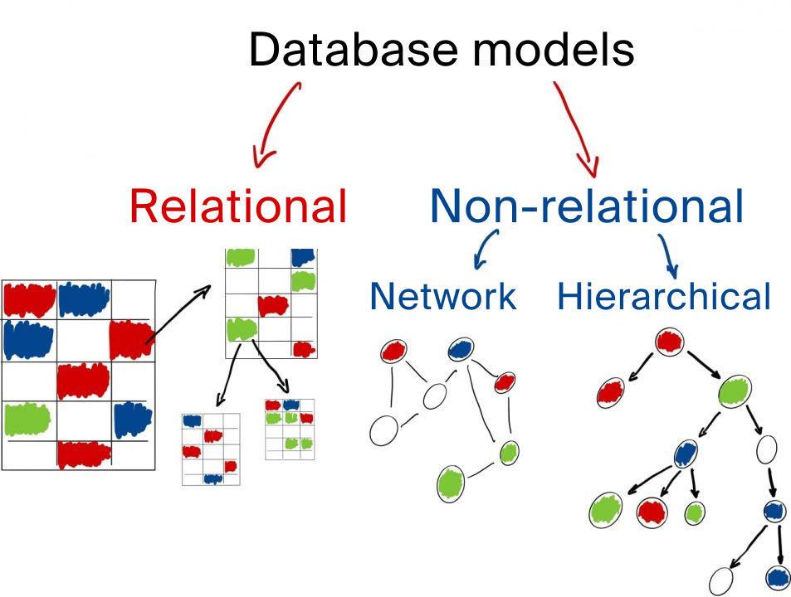

Slide 14
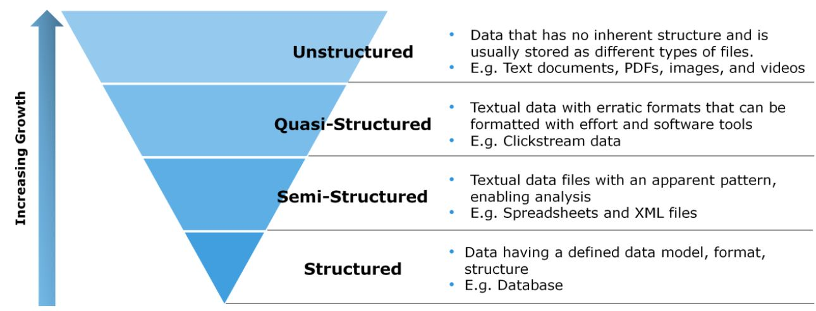
Types of Data

Slide 15
ACID
Properties of all databases transactions, that guarantee accuracy of database
Atomicity – The whole transaction either succeeds or fails when a changes is made to a database. “All or nothing”
Consistency – All data will follow rules, including constraints, cascades, and triggers
Isolation – All transactions will occur in isolation. So, no transaction can alter another uncommitted transaction
Durability – Once a transaction is committed it will stay in the system. Even if the system crashes, the data will persist.

Slide 16
Review (3 mins)
What is data?
What is a database?
What are the different types of data? Which is/are found in RDBMS?

Slide 17
Break (15 Minutes)
Word of the Day: SoftwareStar

Slide 18
Intro to SQL
https://www.tutorialspoint.com/sql/sql-overview.htm
Structured Query Language
We can define data AND manipulate data

Slide 19
Select Statements
SELECT column1, column2, ... FROM table_name;
SELECT * FROM table_name;
Is this a DDL or DML command?

Slide 20
Limit
SELECT column_name(s) FROM table_name WHERE condition LIMIT number;
Different dialects of SQL have different ways of limiting
ROWNUM in Oracle
TOP in SQL Server
Can run:
SELECT count(*)
FROM table_name
To see how risky a select * is, but its always safer to use LIMIT

Slide 21
Where Clause
SELECT column1, column2, ... FROM table_name WHERE condition;
Operator | Meaning
= | Equals
> | Greater Than
< | Less Than
>= | Greater Than or Equal
<= | Less Than or Equal
<> (or !=) | Not Equal (depends on dialect)
BETWEEN | Between a range
LIKE | Pattern matching
IN | To specify multiple values

Slide 22
Data Model

Slide 23
Practice SQL
How many rows are in the payments table?
Select the first 5 records in the payments table.

Slide 24
Week 6 Group Exercise
Once you finish and have submitted your exercise properly, please feel free to go back to any previous homeworks and ask questions you have about them OR start working on next week’s assignment!

