Slide 1
Welcome!
CODER gIRL dATA sCIENCE tRACK

Slide 2
Today's Activities
Introduction by Alexis McKenzie
Introduction by Mentors
Introduction by Students
Install help
Intro to git and bash
Python data types
Python flow control*
Please bear with us as we fully expect some speedbumps today!

Slide 3
Introductions
Alexis McKenzie
Mentors
Nicole Bridgland
Brittany Minor
Maya Carnie
Roopa Desai
Students
After you have introduced yourself, please fill out our google form!
https://docs.google.com/forms/d/e/1FAIpQLSe9GJFSnHSms6vpiHdTk-JKAE83koC6czCHFQImiNHWtmXhKw/viewform
Please do this after you have introduced yourself.

Slide 4
Short Break – 5 minutes
Timer

Slide 5
Is Your System 32 bit or 64 bit?
Your computer is either 32 bit or 64 bit.
64 bit can run 32 bit programs but not vice versa
You need to install 64 bit if you have it to avoid problems later.
You will need to install either 32 bit or 64 bit files
If you are a PC user and don't have Windows 10 let your instructors know
If you are a Mac User and 32-bit let your mentors know!
This Mac Links are for 64 bit only!
Windows 10 Users Click Here
Mac Users Click Here

Slide 6
Tool Installation
Please read and follow installation instructions carefully.
It's a pain to reconfigure these if they are setup incorrectly.
This may take a while and there may be issues...
Tools to install:
Python 3.8
If you already have python 3.X please consider adding 3.8.
Anything newer/older may have compatibility issues. It's your call though.
Python 2.X will not work.
Pip
Python's package manager. Only needed if it doesn’t come with Python
Git-bash
Version control and a linux terminal emulator. (Macs already have Terminal)
VSCode
Popular text editor. If you already have a favorite text editor (other than Jupyter) it's not required.
Pip installs
Install Jupyter and Jupyter lab

Slide 7
Install Git, Python, and Jupyter notebook
Head into your breakout room so your mentor can help you with any install issues you might be having.
There are several ways to install python and jupyter notebook

Slide 8

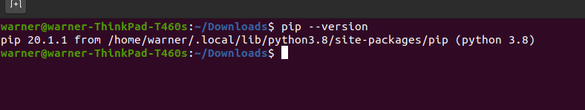
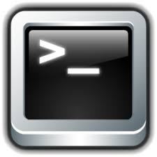
Pip Installs
Windows Git-Bash
Pip should come with your Python installation
Windows
Open Git Bash Terminal and type 'pip --version'
If you get an error let your Mentors know
Mac:
Open Terminal:
Type 'pip --version' and hit enter
If you get an error let your Mentors know
Everyone:
In the same terminal type 'pip install jupyter' and hit enter
Type 'pip install jupyter lab' and hit enter
Mac Terminal

Slide 9
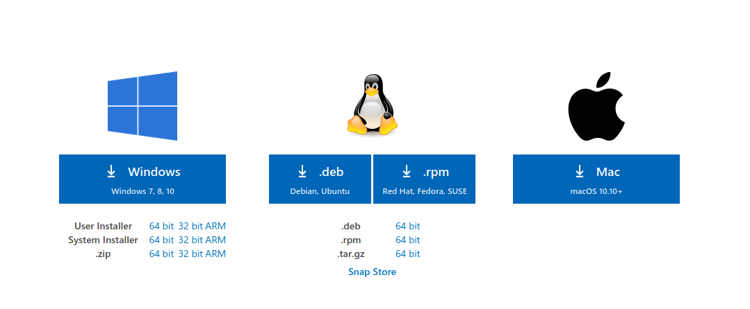
Install Visual Studio Code
See this link
Choose your machine type.
Suggest "System Installer"

Slide 10
Congratulations!
Installs are never fun but you made it!
If you haven't finished the installs please work with your mentors to get this done ASAP.
Time for a Short Break (if needed)

Slide 11
Course Overview
You will learn:
Git
Python and many modules
SQL
ETL/ELT
Data Modeling
Data Visualization
Supervised and Unsupervised Machine Learning model creation and tuning
API Creation in Flask (A python framework)
MongoDB
Basic Azure services

Slide 12
Expectations
We will have check-ins every 6 weeks.
If you have not completed all the assignments (or all minus one) at the time of the check-in, you will be dropped from the class
You must get at least a 70% on all assignments
If you plagiarize the internet or other students, you will be dropped
You will have in-class group activities each class
You are expected to complete them to the best of your abilities
You will have three projects
These are to be completed in groups from 1-3 people.
I will assign groups for the first project, but you will pick your groups for the two other projects
Projects are: exploratory data analysis, ETL, machine learning project

Slide 13
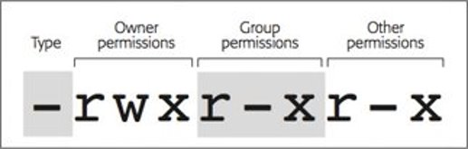
Intro to Git and bash
cd
ls
touch
mkdir
aliases​
ls –l <file name> to see permissions and ownership

Slide 14
Git clone the Repo
Git allows us to have multiple versions of directories and text files and keep them neatly organized
Allows for easy sharing of source code
Git is meant for text files however it can handle some binary files (.docx, .ppt, .jpg etc..)
Create a folder called “data-science-class" on your computer
Open git-bash/terminal and run the following command
Cd into directory you want:
Cd somefollder/anotherfolder/anotherfolder/
Type 'mkdir data-science-class' and hit enter
‘cd data-science-class/'
'git clone …....'
Windows users can open Explorer and right click in a directory to 'git bash here'

Slide 15
Git practice
Make a directory to store all your homework assignments in (or just for the first homework- up to you!)
Create a repo for your first homework assignment
I suggest creating one on github and then cloning it
Think about where you should be cloning it to (many right answers and some wrong ones)
Create the repo with a readme.md file
Edit the readme.md file with your name and a title
Push your changes to github
Git add .
OR Git add readme.md
Git commit –m “<your message>”
Git push

Slide 16
Break (10 Mins)
Attendance word will be posted in chat

Slide 17
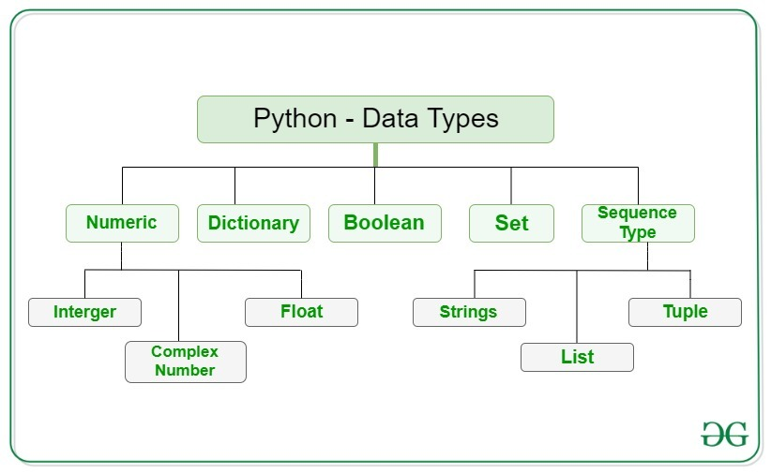
Python Data types
Notes:
https://www.geeksforgeeks.org/python-data-types/ yeah “integer” is spelled wrong

Slide 18
In Class Activity: 30 mins
Document the main datatypes in a Jupyer notebook. Use markdown and headings and provide an example of each datatype and print the type to confirm you’re right:
Numeric (integers and floats)
Dictionary
Boolean
Sequence (string, list, tuple)
Set

Slide 19
Python Flow control
If… elif… else
for
While
Range (if we have time)
There’s a lot more to this, but were just going over the basics today!

Slide 20
Practice Flow Control
#whats wrong with this code? (Hint: there are 4 issues)
#what is it doing?
num = str(input("Enter a number: "))
if num % 2 = 0:
print("Even")
else
print("Odd)

Slide 21
Homework
Install anything that hasn't been installed
Readings
Homework Assignment
Save a copy of your homework assignment OUTSIDE of your git repo.
Suggest creating a folder called "homework"
If it's inside the git repo you will run into issues.

