Slide 1
Week 07

Slide 2
Warm-up (10 minutes)
What does ACID stand for and why is it so important for databases?
Create a table in the default postgres database (called “postgres”) called either “cats” or “dogs”. Include at least three columns in your create statement. Use https://www.postgresql.org/docs/9.1/sql-createtable.html to help you

Slide 3
Today's Activities
Warmup (15 mins)
Homework Answers/Q&A (25 mins)
Data Modeling Basics (50 mins)
Break (15 mins)
Subqueries and Joins (30 mins)
Group Exercise (45 mins)

Slide 4
Class Reminders
At each checkpoint, your in-class assignments grade needs to average >= 70%
I will not be grading in-class assignments that are more than a week late.
You will now start to lose points if assignments are more than 2 days late. This starts with the week 6 SQL homework (due today)
So, if you turn it in after Friday, you lose one point per day.
ALL corrections for past assignments (first 5 HW and in-class assignments) need to be in by this Friday in order for us to review them.
You are only allowed to miss one assignment in the whole course, so choose wisely.
Getting below 70% on an assignment counts as missing it.

Slide 5

In what ways is SQL different from python?

Slide 6
Homework Answers (25 mins)
To save some time I will discuss a subset of answers.
Voluntarily slack answers to the #datascience channel
Don't be shy!

Slide 7


Slide 8
Why do we model data?

Slide 9
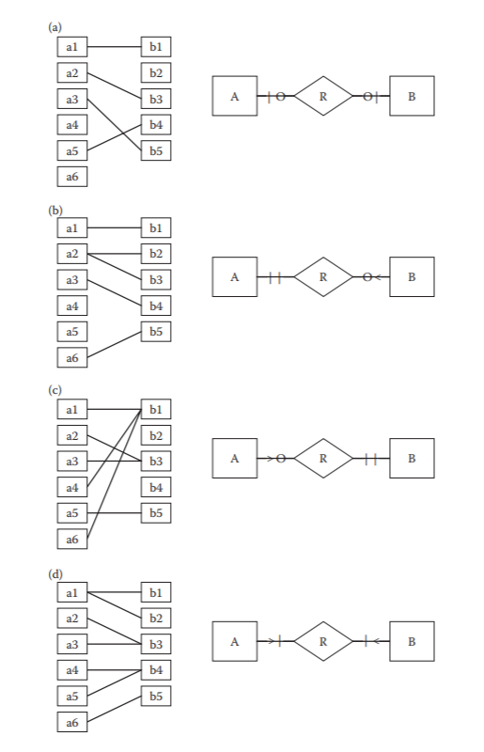
Degrees of relationships
Relationship can be mandatory or optional
O = optional
| = mandatory
Cardinality = relationship of data in one entity to another entity (table to another table)
O = zero
| = one
> = many

Slide 10
Look at the DVD rental data model, and identify two relationships clearly. Is it correct? Does it make sense?

Slide 11
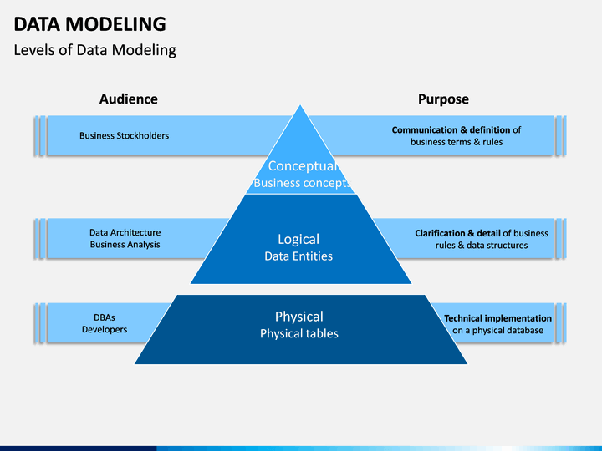

Slide 12

Data Stewardship
Rule of thumb for what data documentation needs to achieve

Slide 13
Practice (10 minutes)
1. Create an account on lucidchart.com
2. Create a basic ERD for a gym. You can just use entities, you do not need to use tables. Include the relationship and cardinality

Slide 14
Break (15 Minutes)
Attendance word: TopTechnologist

Slide 15
Subqueries
A subquery is a query nested in a larger query
In the SELECT, FROM, or WHERE clauses
The inner query executes before the parent query so the inner query result can be used in the parent query
Should rarely use in production systems BECAUSE joins are almost always more efficient. BUT:
Not always possible to use a join
Subqueries often used with update, insert, and delete
SELECT column_name(s) FROM table_name WHERE column_name operator ANY/ALL (SELECT column_name FROM table_name
WHERE condition);or subquery);

Slide 16
Practice (10 mins)
Write a subquery that finds the film_id, title, and replacement_cost for reach film where the replacement_cost is greater than the average.

Slide 17
Week 7 Group Exercise
Once you finish and have submitted your exercise properly, please feel free to go back to any previous homeworks and ask questions you have about them OR start working on next week’s assignment!

