Slide 1
Exploratory Data Analysis Project
Balazs Varga
Amulya

Slide 2
Objective and Hypotheses:
To analyze the price relations between certain cryptocurrencies and the equities market over a 32 months period and to determine possible correlations.
Hypothesis (1): Price of cryptocurrencies (BTC and ETH) strongly correlate, but do not correlate with the broader equities market (SPY).
Hypothesis (2): Price of blockchain related stocks correlates better with BTC than with the prices of other stocks.
List of Figures:
1(A) Analysis of prices between Bitcoin(BTC) and Ethereum(ETH) using Scatter plots, Timeseries and Rolling correlation.
1(B) Linear Regression model to display the correlation between Bitcoin and Ethereum.
2. Analysis of prices between Bitcoin(BTC) and S&P500(SPY) using Scatter plots, Timeseries and Rolling correlation.
3(A) Analysis of prices between Bitcoin(BTC) and HIVE Stock using Scatter plots, Timeseries and Rolling correlation.
3(B) Linear Regression model to display the correlation between Bitcoin and HIVE Stock prices.
4. Analysis of prices between S&P500(SPY) and HIVE using Scatter plots, Timeseries and Rolling correlation.
5. Analysis of prices between BTC and BBKCF using Scatter plots, Timeseries and Rolling correlation.
6. Analysis of prices between S&P500(SPY) and BBKCF using Scatter plots, Timeseries and Rolling correlation.

Slide 3
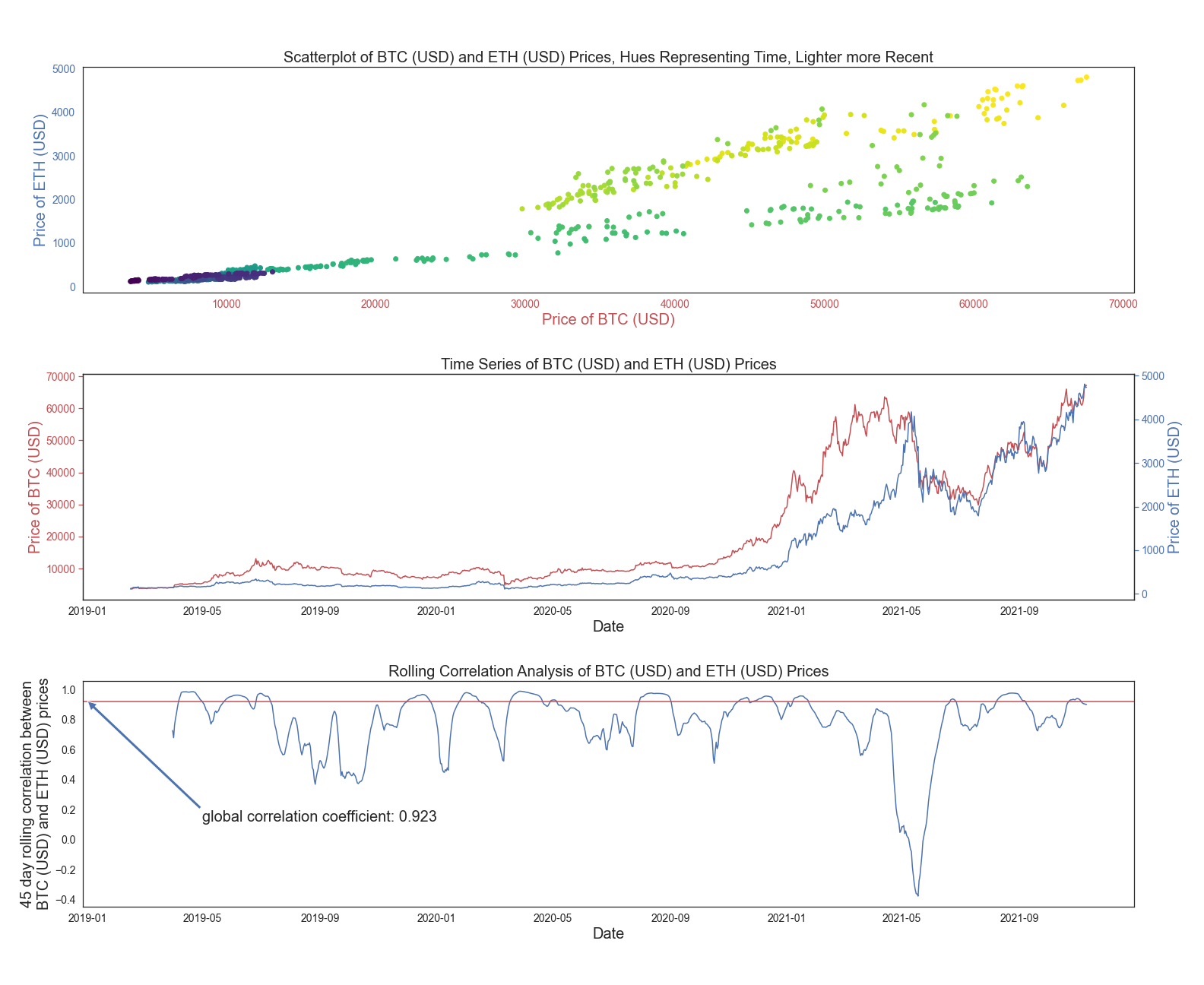
1(A)

Slide 4
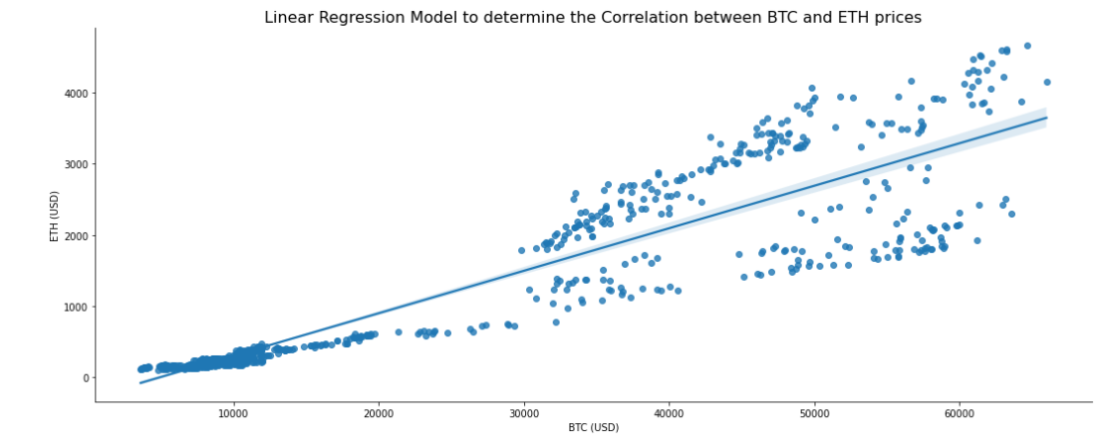
1(B)

Slide 5
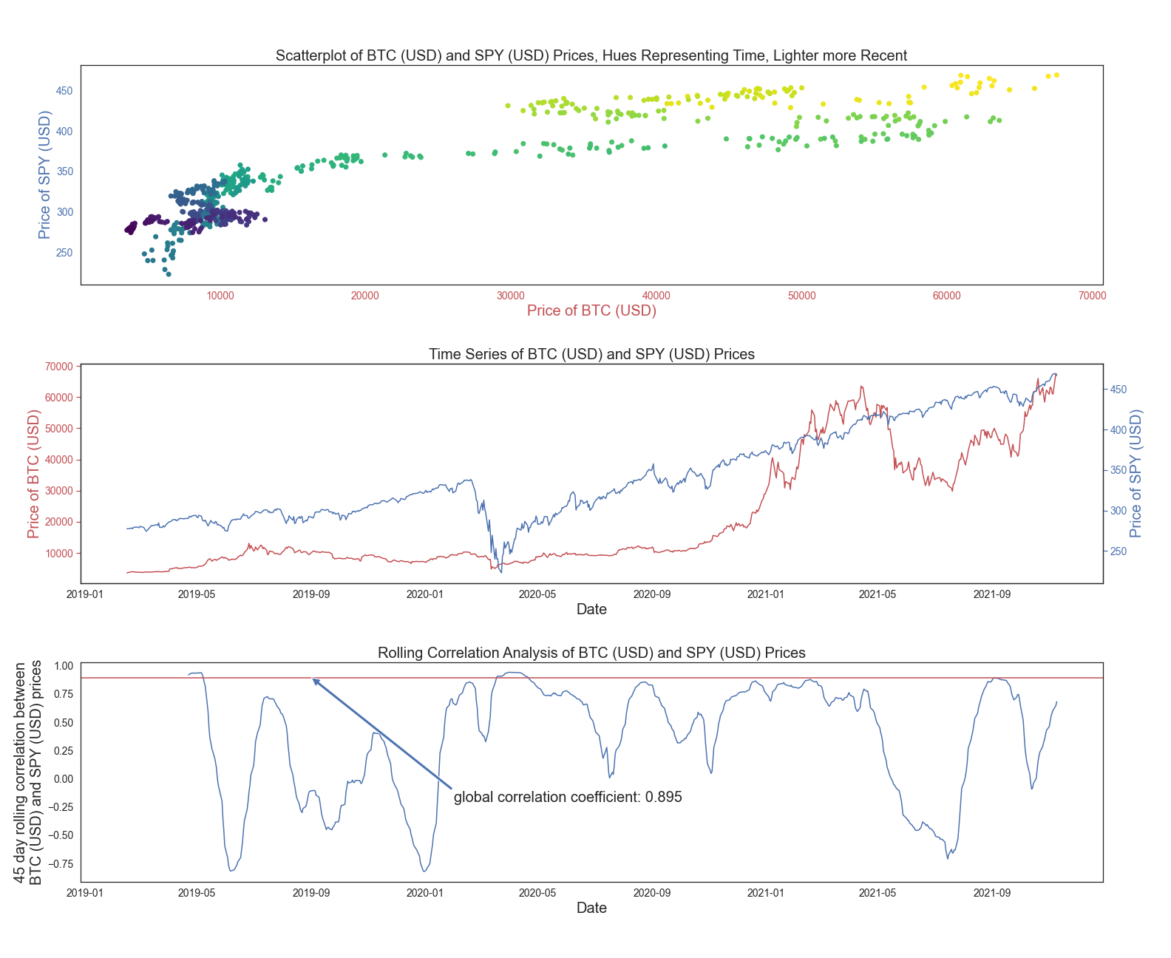
2.

Slide 6
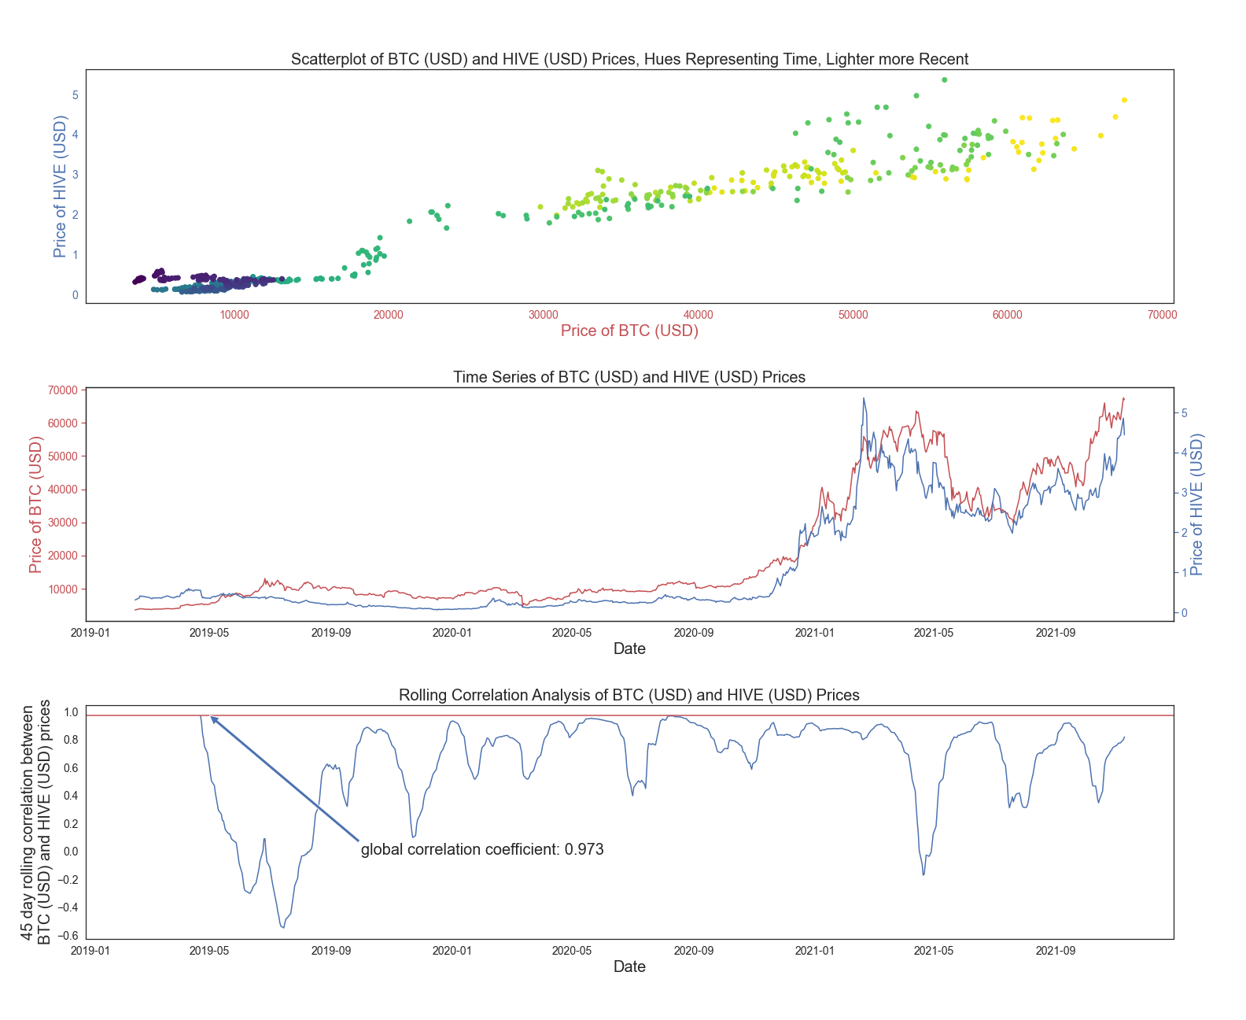
3(A)

Slide 7
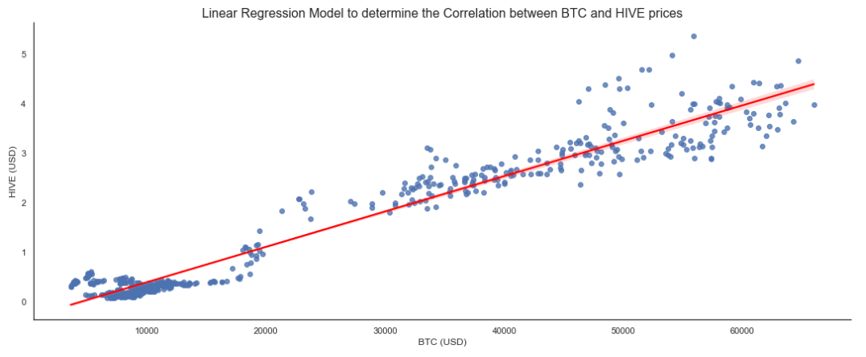
3(B)

Slide 8
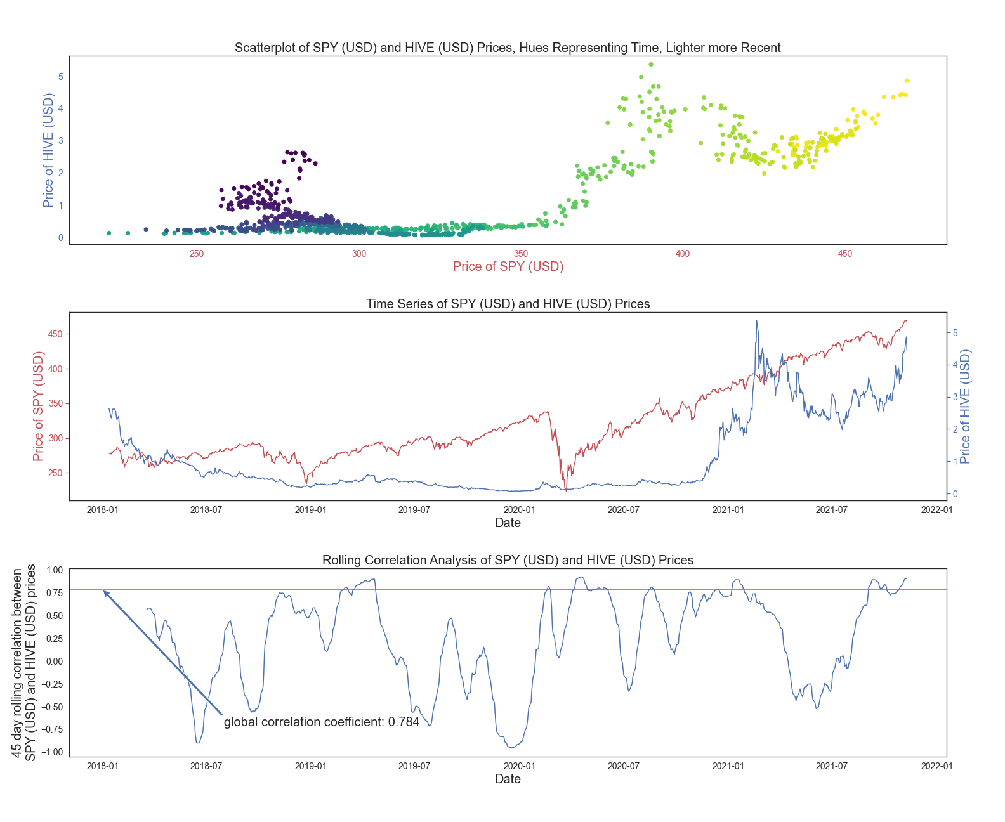
4.

Slide 9
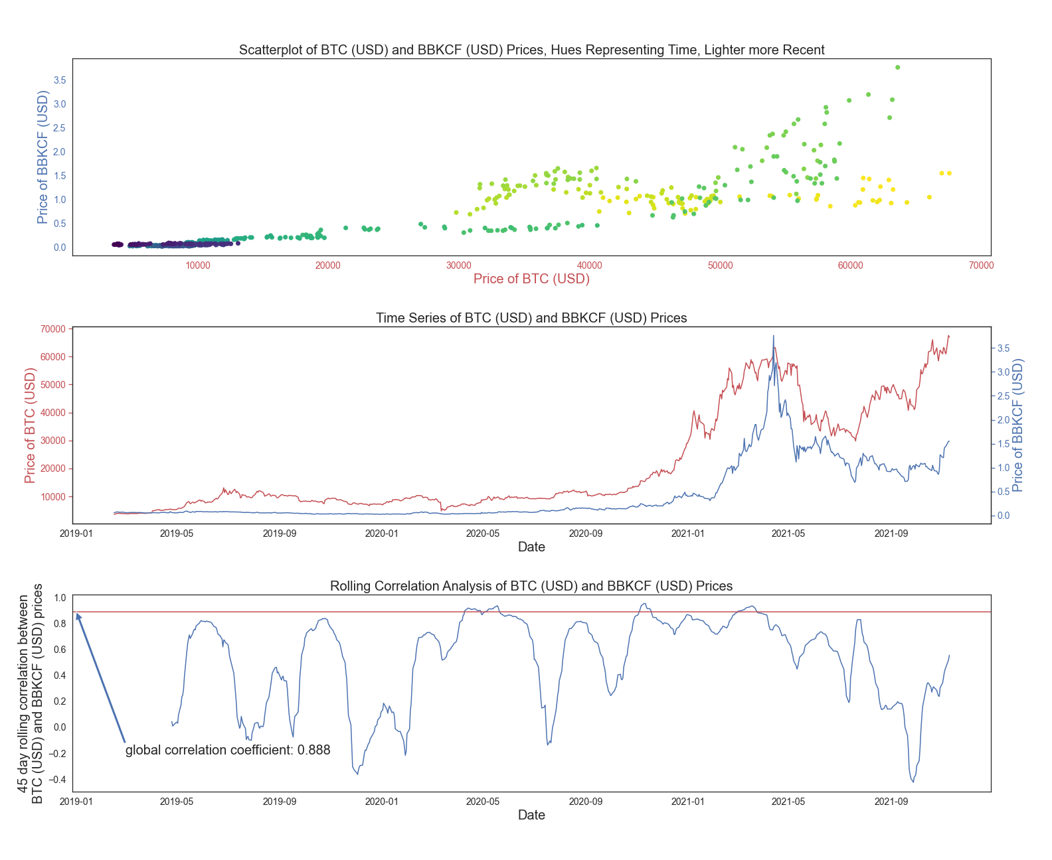
5.

Slide 10
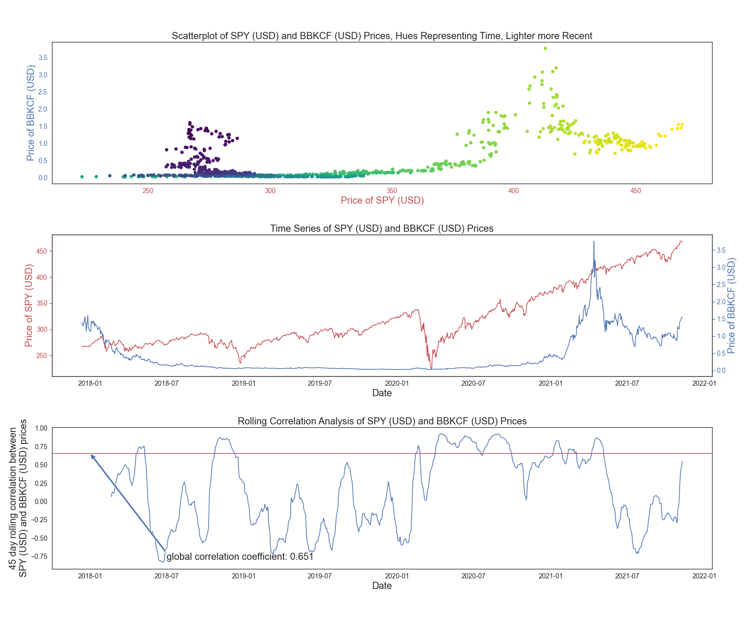
6.

Slide 11
Conclusion:
Hypothesis (1): In general, BTC and ETH correlate well (corr. coeff = 0.92) over the examined time period, however, as demonstrated by the scatterplots and rolling correlation, there was a 2 months period recently when the correlation broke down completely. These assets are yet again highly correlated, but their relationship is significantly different than prior to 04/2021.
A bit unexpectedly, BTC and SPY were also correlated globally (corr. coeff = 0.88), however, much more so after the start of the pandemic, than previously.
Hypothesis (2): As expected, both blockchain technology related stocks correlated much better with BTC than with the broader equities market.

Slide 12
References:
https://www.alphavantage.co/documentation/
https://www.alphavantage.co/academy/#lstm-for-finance
https://pythonrepo.com/repo/RomelTorres-alpha_vantage-python-finance
https://seaborn.pydata.org/generated/seaborn.lmplot.html
https://seaborn.pydata.org/generated/seaborn.scatterplot.html
Hilpisch: Python for Finance - Mastering Data-Driven Finance (2nd Ed., 2018)

Slide 13

Any Questions?

