Slide 1
IT SUPPORT TICKET ANALYSIS
Two-Year Deep Dive into Help-Desk
Performance & Agent Effectiveness
Vedang Pandey | Excel Final Project
Dataset: 97,498 tickets across 50 agents, 2016 – 2020

Slide 2
Introduction
This project analyzes five years of IT help-desk activity — every ticket logged for login, hardware, software, and system issues — to understand how the support team performs and where it can improve. Raw ticket records and agent profiles were cleaned in Excel, then explored with pivot tables, pivot charts, and an interactive dashboard.
97,498
Total support tickets logged (2016–2020)
50
IT agents handling requests, avg. age 41
Objectives
Analyze ticket volume, category mix, and severity
Measure resolution time and customer satisfaction
Evaluate individual agent performance and workload
Identify peak periods and long-term ticket trends
Build an interactive Excel dashboard for monitoring
4
Ticket categories: Login, Hardware, Software, System
4.10 / 5
Average customer satisfaction rating
IT Support Ticket Analysis
2

Slide 3
Problem Statement
The help desk logs tens of thousands of tickets a year, but that volume makes it hard to see, by eye, which categories take longest to resolve, which agents are overloaded or underperforming, and whether service quality is improving as the company grows. Without a structured analysis, staffing and training decisions are made on instinct rather than evidence.
Rising Demand
+122%
growth in ticket volume from 2016 (13,051) to 2020 (29,088)
This project turns raw ticket logs into clear, quantified answers — so operational and staffing decisions can be based on the data rather than assumption.
22.2%
CAGR, 2016 → 2020
IT Support Ticket Analysis
3

Slide 4
Dataset Summary
Raw fields (Tickets sheet, 97,498 rows)
97,498
ID Ticket
Fecha (date)
Employee ID
Agent ID
Request Category
Issue Type
Severity
Priority
Resolution Time (days)
Satisfaction Rate
Agent Name
...
Cleaned ticket records, Dec 2015 – Dec 2020
24
Columns after cleaning (11 raw + 13 derived)
Cleaning & preparation
Removed duplicate ticket records
Handled missing / unassigned values
Standardized date and time formats
Added helper columns: Severity Score, Year, Agent Age, Age Bracket
50
Agents profiled (name, email, age)
5 yrs
Continuous daily ticket history analyzed
IT Support Ticket Analysis
4

Slide 5
Analytical Methods
1
→
2
→
3
→
4
Why this approach
Raw Data
Cleaning
Pivot Tables
& Charts
Dashboard
& Insights
No coding environment required — the full analysis lives inside one workbook
Pivot tables recompute instantly as new tickets are appended
Slicers let any stakeholder filter by year, category, or agent without touching formulas
Charts are wired directly to pivot data, so the dashboard always reflects the latest numbers
Excel functions & tools used
COUNTIFS()
SUMIFS()
AVERAGEIFS()
IF() / IFERROR()
CORREL()
RIGHT / FIND (text extraction)
Pivot Tables & Pivot Charts
Slicers for interactive filtering
IT Support Ticket Analysis
5

Slide 6
Ticket Category Distribution
Key insight
System issues are the largest single category — 40% of all tickets — followed by Login Access at 30%. Together, System and Login Access make up 7 out of every 10 tickets the help desk handles.
39,002
System tickets — the largest category (40%)
9,733
Hardware — the smallest category (10%)
IT Support Ticket Analysis
6

Slide 7
Issue Type & Severity Breakdown
75% of tickets are IT Requests (routine asks) rather than IT Errors. Severity skews heavily toward “Normal” (91% of tickets) — very few tickets are ever flagged Urgent (1.4%), suggesting the severity field is under-used for triage.
IT Support Ticket Analysis
7

Slide 8
Monthly Ticket Volume Trend
53.4 / day
Oct: 8,495
~17%
Average daily ticket volume across the full period
Busiest month; Jan lowest at 7,242
Swing between the quietest and busiest month
IT Support Ticket Analysis
8

Slide 9
Resolution Time Analysis
Key insight
Hardware tickets take longest to close (7.6 days on average) — over 24× longer than Login Access issues, which are resolved almost immediately (0.3 days). System tickets, the highest-volume category, also run slow at 6.6 days.
Severity ↔ Resolution Time
r = −0.04
Essentially no correlation — a ticket's declared severity does not predict how long it takes to resolve, pointing to inconsistent triage rather than case complexity.
IT Support Ticket Analysis
9

Slide 10
Year-over-Year Growth
+122.9%
Total ticket growth from 2016 to 2020
22.2%
Compound annual growth rate (CAGR)
2019’20
Steepest single-year jump (+35%)
Demand is accelerating faster than headcount — agent count has stayed near 50 while ticket volume more than doubled.
IT Support Ticket Analysis
10

Slide 11
Agent Workload & Demographics
50 agents
handling the full ticket load, avg. age 41
≈ 1,950
tickets handled per agent on average
42,840
tickets (44% of all volume) handled by the 41–50 age bracket — the heaviest-loaded group
Agents aged 41–50 carry the heaviest workload (44% of tickets) yet post the lowest satisfaction score (4.05) of any age group — worth investigating for burnout or workload balance.
IT Support Ticket Analysis
11

Slide 12
Agent Performance: Who Needs Support
Agents whose resolution time is above average AND satisfaction is below average
What the data shows
10 of 50 agents (20%) sit above the 4.55-day average resolution time and below the 4.10 satisfaction average — the clearest candidates for coaching or process support.
4.55 days
Company-wide average resolution time (benchmark)
4.10 / 5
Company-wide average satisfaction (benchmark)
IT Support Ticket Analysis
12

Slide 13
Customer Satisfaction Analysis
Key insight
Satisfaction stays remarkably flat (4.07–4.17) regardless of ticket severity — customers rate their experience on how they were treated, not on how serious the underlying issue was. This means service quality, not issue type, drives ratings.
4.10 / 5
Overall average satisfaction across all 97,498 tickets
0.10 pts
Widest gap between any two severity levels
IT Support Ticket Analysis
13

Slide 14
Recommendations
1
Coach the bottom 20% of agents
2
Prioritize Hardware & System fixes
Action: Targeted coaching and workload rebalancing for the 10 agents running above-average resolution time and below-average satisfaction.
Action: Streamline parts availability and escalation paths for Hardware (7.6-day avg) and System (6.6-day avg), the two slowest categories.
Expected impact: closing half their gap to benchmark cuts their avg. resolution time from ~5.4 to ~5.0 days and lifts satisfaction toward the 4.10 company average.
Expected impact: a 1-day cut in Hardware's resolution time alone removes ≈ 9,700 ticket-days of backlog per year.
3
Standardize severity tagging
4
Scale staffing ahead of demand
Action: Define clear criteria for Minor / Normal / Major / Urgent — severity currently shows almost no link to resolution time (r = −0.04), and 91% of tickets sit in “Normal” by default.
Action: Plan hiring or automation in line with the 22.2% CAGR in ticket volume, rather than holding headcount near 50.
Expected impact: Major-tagged tickets already resolve 0.75 days faster than Normal-tagged ones (3.91 vs 4.66 days) — correctly flagging true priority cases inside the 88,656-ticket Normal bucket could extend that speed-up, cutting backlog risk with zero added headcount.
Expected impact: keeps per-agent load near today's ≈1,950 tickets/year and protects the current 4.10 satisfaction score as volume keeps climbing.
IT Support Ticket Analysis
14

Slide 15
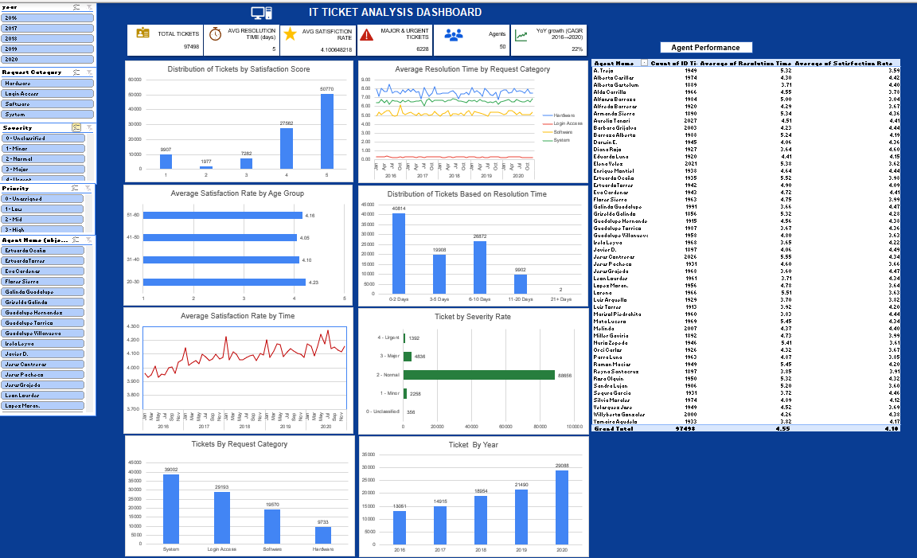
Interactive Performance Dashboard
Live workbook dashboard — pivot tables, pivot charts, and five slicers, all wired together
IT Support Ticket Analysis
15

Slide 16
Dashboard Highlights
What the dashboard reveals
80% of tickets are rated 4 or 5 satisfaction (27,562 + 50,770 of 97,498) — service quality is strong overall
89.8% of tickets close within 10 days (40,814 in 0–2 days, 19,908 in 3–5, 26,872 in 6–10 — 87,594 of 97,498) — only 2 tickets ever exceed 21 days
Resolution time by category is flat over the full 2016–2020 span — Hardware stays ≈7–8 days and Login Access ≈0.3 days year after year, so there's no seasonal or year-over-year improvement to rely on
The agent table (right panel) ranks every one of the 50 agents by ticket count, resolution time, and satisfaction — the same data used on the training-needs slide
Interactive features
Slicers for Year, Request Category, Severity, Priority, and Agent Name
Every chart and KPI card updates together on any filter
No formulas to edit — a manager clicks a slicer and instantly sees performance by year, category, or agent
Source
Pivot Tables, Pivot Charts & Dashboards — ExcelFun (YouTube)
IT Support Ticket Analysis
16

Slide 17
Conclusion
✓
Ticket volume grew 122% over five years while headcount stayed flat — the team is doing more with the same resources.
✓
System and Login Access dominate ticket volume, but Hardware and System tickets take the longest to resolve.
✓
Customer satisfaction (4.10/5) is stable across severity levels — driven by service quality, not issue type.
✓
20% of agents are clear candidates for coaching based on resolution time and satisfaction data.
✓
The interactive dashboard turns this analysis into an ongoing monitoring tool, not a one-time report.
IT Support Ticket Analysis
17

Slide 18
Thank You
Vedang Pandey · IT Support Ticket Analysis · Excel Final Project
IT Support Ticket Analysis
18

