Slide 1

MACHINE LEARNING BASED ANALYSIS FOR POSITION FLUIDITY IN BASKETBALL

Slide 2
BASKETBALL
Basketball is a team sport in which two teams, most commonly of five players each, opposing one another on a rectangular court, compete with the primary objective of shooting a basketball through the defender's hoop high to a backboard at each end of the court, while preventing the opposing team from shooting through their own hoop. A field goal is worth two points, unless made from behind the three-point line, when it is worth three. After a foul, timed play stops and the player fouled or designated to shoot a technical foul is given one, two or three one-point free throws. The team with the most points at the end of the game wins, but if regulation play expires with the score tied, an additional period of play (overtime) is mandated.

Slide 3

NBA
The National Basketball Association (NBA) is a professional basketball league in North America. The league is composed of 30 teams (29 in the United States and 1 in Canada) and is one of the major professional sports leagues in the United States and Canada. It is the premier men's professional basketball league in the world.
The NBA is an active member of USA Basketball (USAB), which is recognized by the FIBA (International Basketball Federation) as the national governing body for basketball in the United States. The league's several international as well as individual team offices are directed out of its head offices in Midtown Manhattan, while its NBA Entertainment and NBA TV studios are directed out of offices located in Secaucus, New Jersey.

Slide 4
POSITIONS IN BASKETBALL
Point Guard: The point guard (PG) also known as the one, is typically the team's shortest player and best ball handler and passer. They usually are very fast and are good at driving and short-range.
Shooting Guard: The shooting guard (SG) — also known as the two or the off guard—along with the small forward, is often referred to as a wing because of its use in common positioning tactics. As the name suggests, most shooting guards are prolific from the three-point range and long mid range.
Small Forward: The small forward (SF), also known as the three, is considered to be the most versatile of the main five basketball positions.

Slide 5
4. Power Forward: The power forward (PF), also known as the four, often plays a role similar to that of the center, down in the "post" or "low blocks". The power forward is often the team's most powerful and dependable scorer, being able to score close to the basket while also being able to shoot mid-range jump shots from 10 – 15 feet from the basket.
5. The center (C)—also known as the five, the pivot or the big man—usually plays near the baseline or close to the basket (the "low post"). They are usually the tallest players on the floor. Centers usually score "down low", or “in the paint”.

Slide 6
PROPOSED METHOLOGY
DATA COLLECTION
PLAYER NAME
MACHINE LEARNING MODEL
(SVM)
WEB SCRAPPING
PLAYER STATISTICS
DATA CLEANING
RESULT
MACHINE LEARNING MODEL
(KNN)
TEAM NAME
FLOWCHART

Slide 7
DATA COLLECTION
PLAYER NAMES (PRE 2015)
https://basketball-reference.com
TEAM NAMES
DATA CLEANING
PLAYER NAMES (POST 2015)

Slide 8
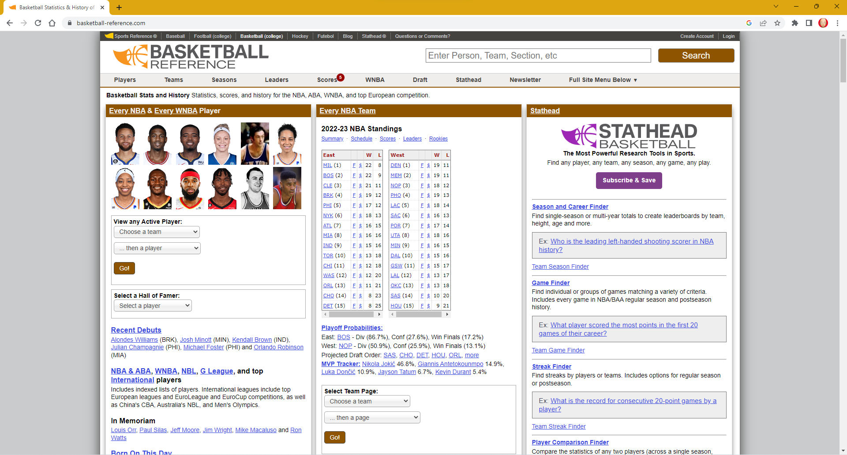
https://www.basketball-reference.com
Basketball Reference is a sports statistic website mainly for NBA player and season statistics. Includes indexed lists of players. International leagues include top European leagues and EuroLeague and EuroCup competitions, as well as China's CBA, Australia's NBL, and Men's Olympics.
Home Page of Basketball Reference

Slide 9
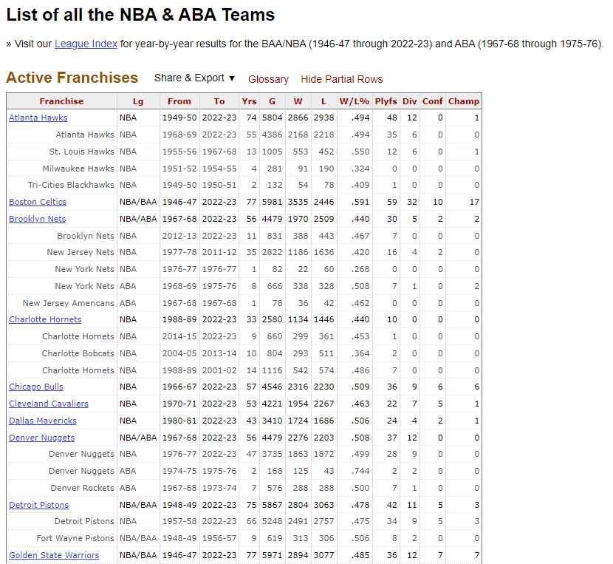
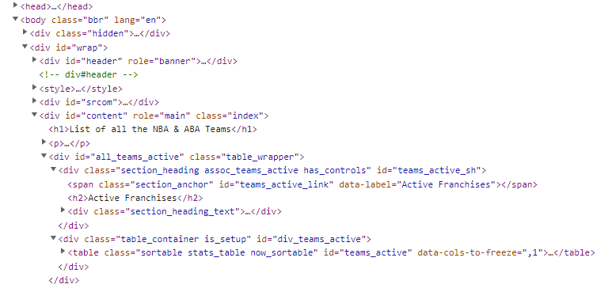
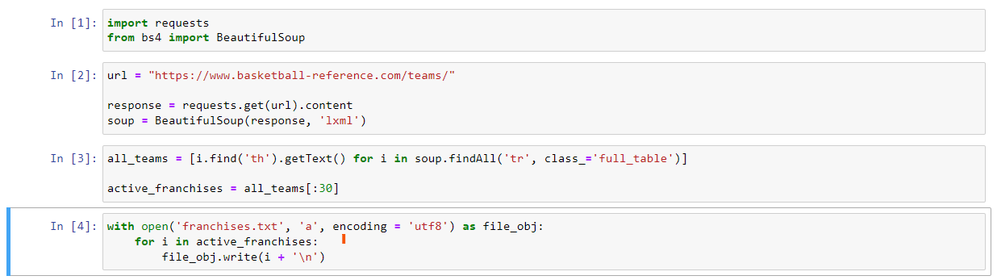
TEAM NAMES

Slide 10
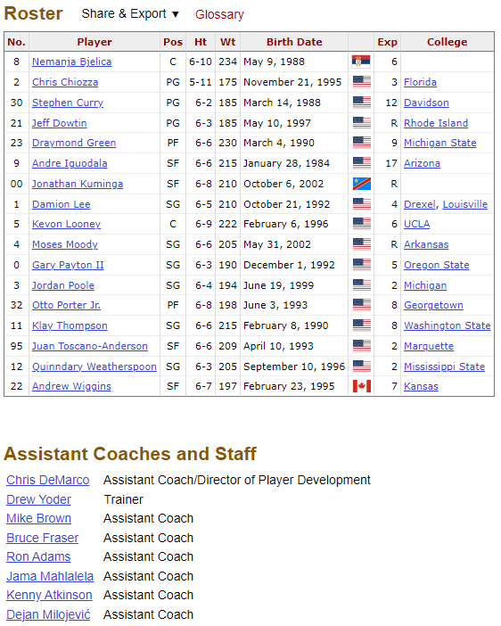
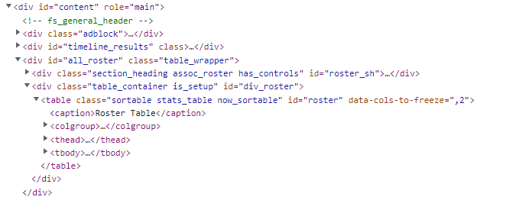
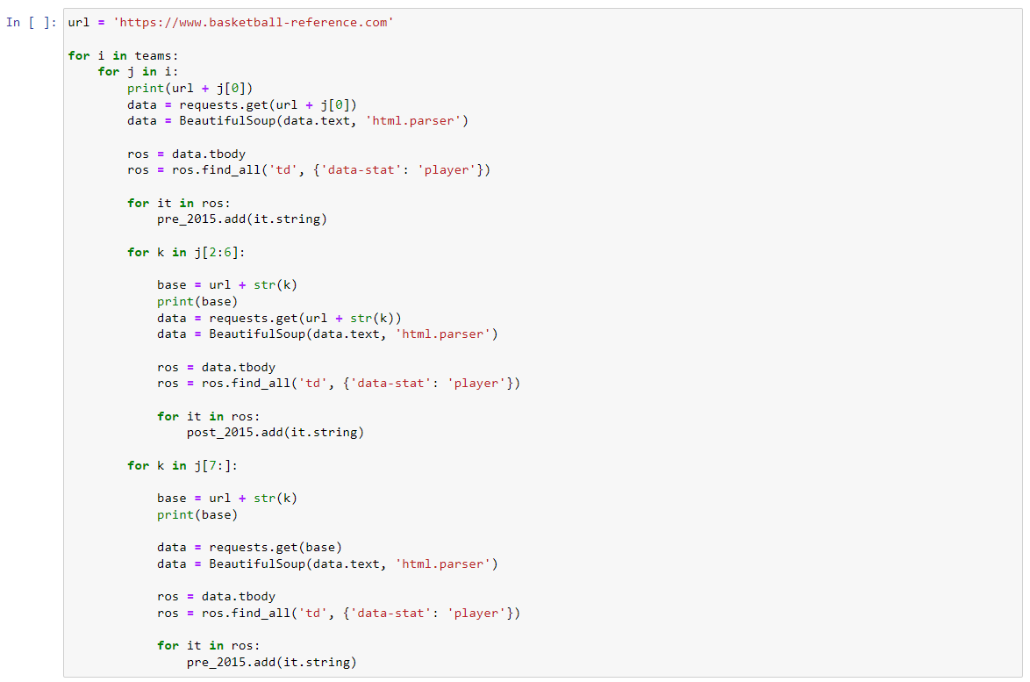
PLAYER NAMES

Slide 11
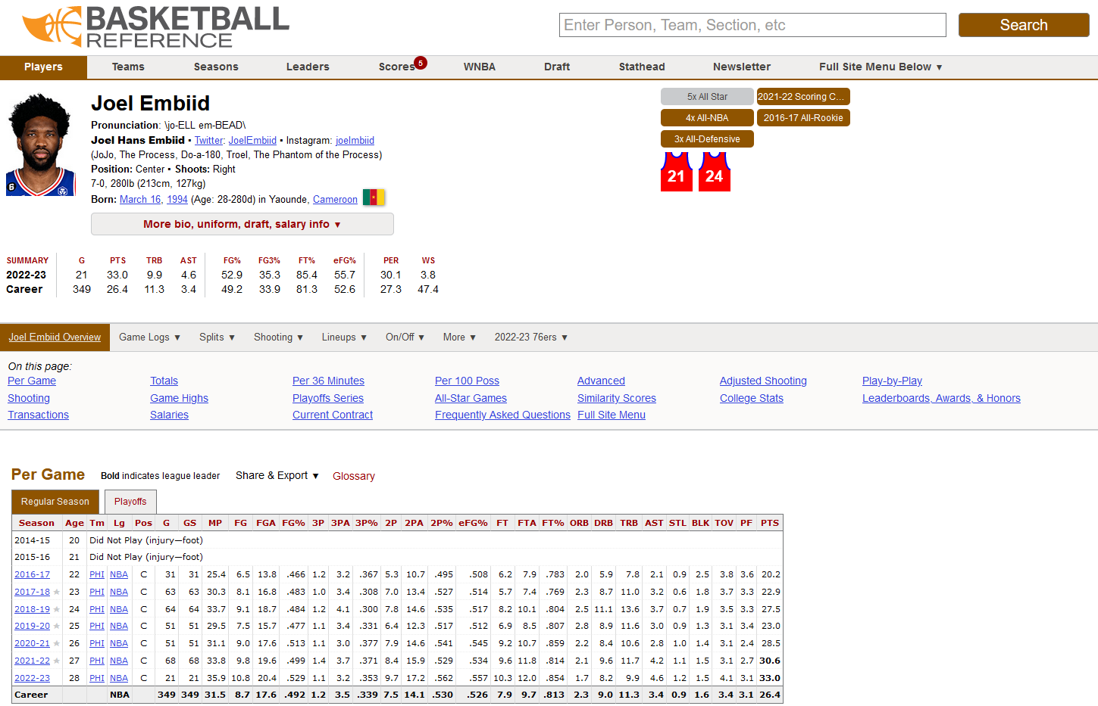
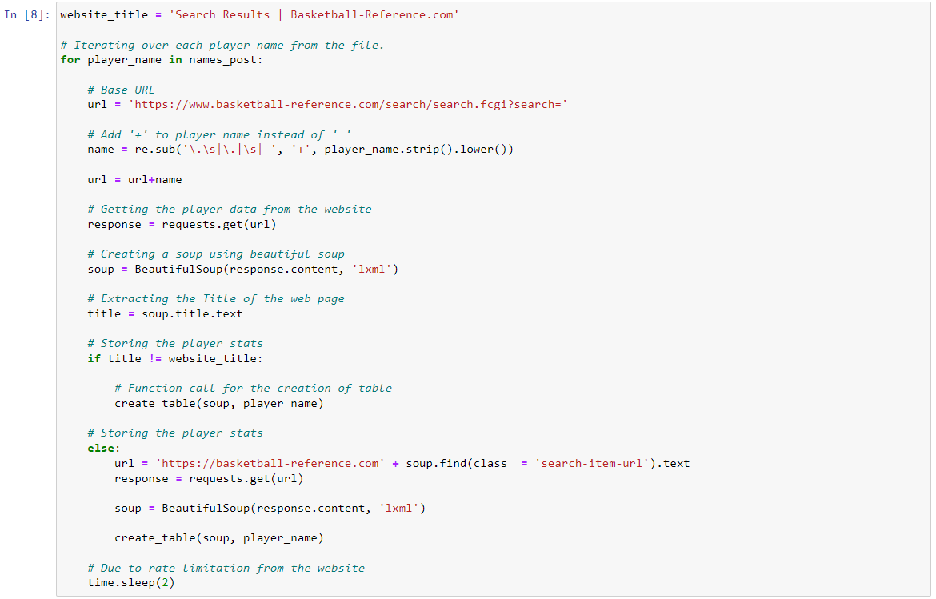

CHALLENGE FACED
OR
Solution for the problem

Slide 12
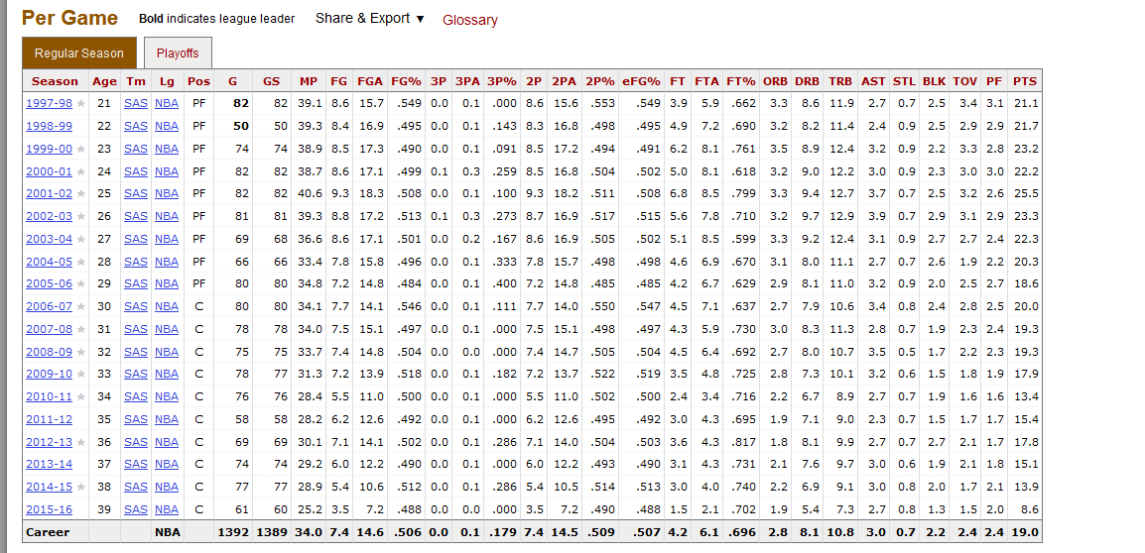
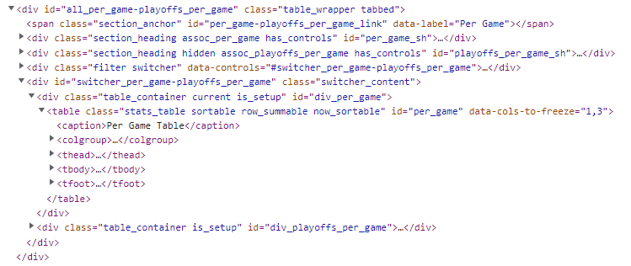
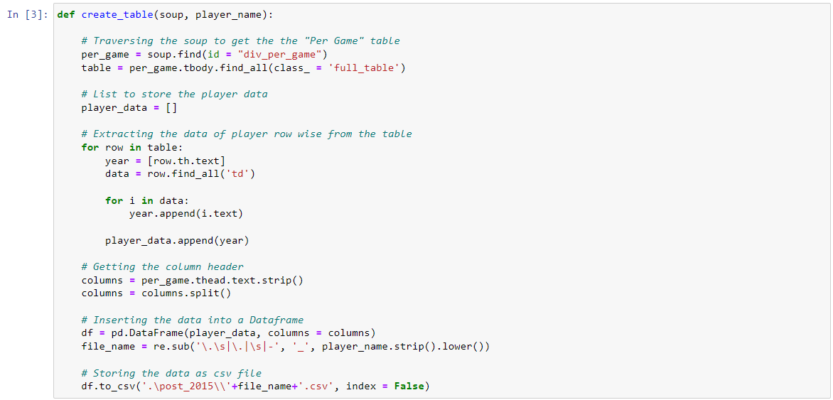
PLAYER STATISTICS

Slide 13
LIST OF REFERENCES
S NO. | REFERENCES
1. | (PDF) Determine The Position of Basketball Players Using SMART (Simple Multi-Attribute Rating Technique) Method
2. | A Decade of Euroleague Basketball: an Analysis of Trends and Recent Rule Change Effects
3. | The inside game in World Basketball. Comparison between European and NBA teams | Request PDF
4. | Trends in NBA and Euroleague basketball: Analysis and comparison of statistical data from 2000 to 2017 - PMC
5. | Players, Positions, and Probability in the NBA | by Jeremy Lee | Towards Data Science
6. | NBA Machine Learning Position Predictor | by Ben Fischler | Analytics Vidhya | Medium
7. | Predicting NBA Positions Using Machine Learning Algorithms | by Claire Miao | Nerd For Tech | Medium
8. | Redefining Basketball Positions with Unsupervised Learning | by Evan Baker | Towards Data Science
9. | Simple Modeling of NBA positions using the K-Nearest Neighbors Machine Learning Algorithm

Slide 14
END

