Slide 1
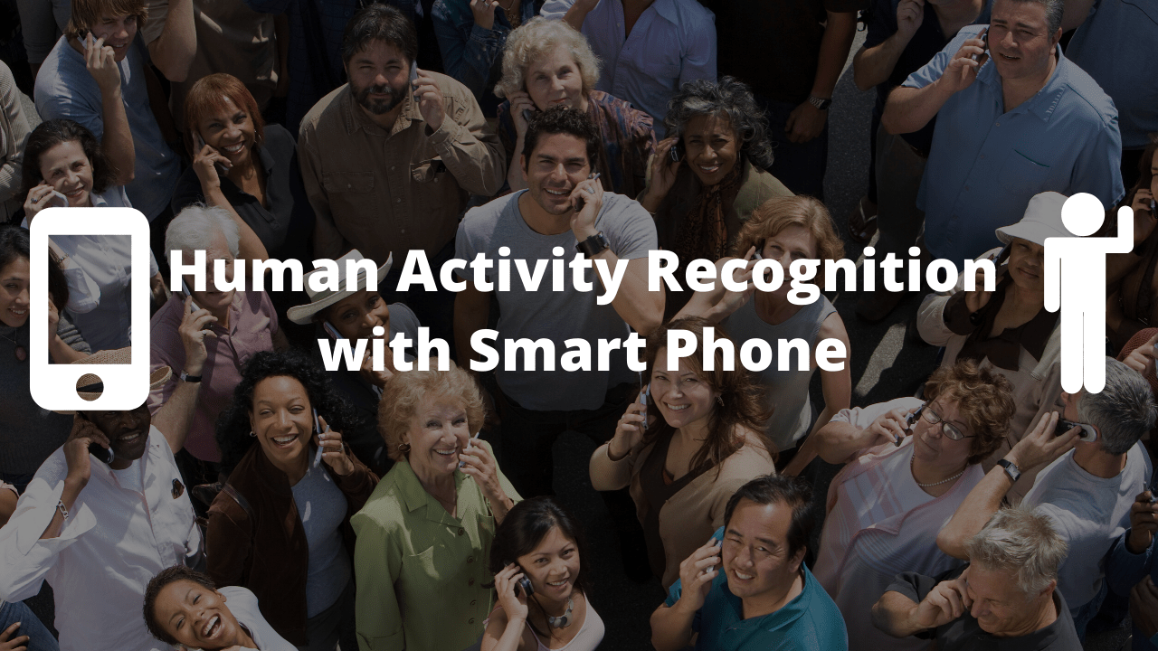
Submitted by
Vedant Rathi (16)
Shivani Khandelwal (34)
Jhanvi Sheth (43)
Vedang Sawant (58)

Slide 2
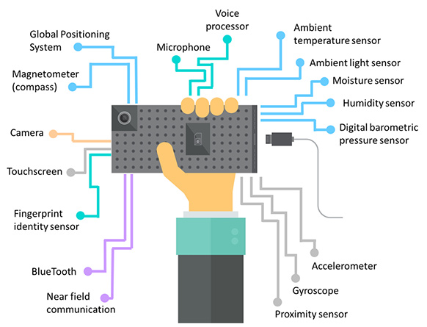
Objective:
The major objective of this project is to understand the ‘Human Activity Recognition’ database built from the recordings of 30 subjects performing activities of daily living (ADL) while carrying a waist-mounted smartphone with embedded inertial sensors.

Slide 3
Why this Dataset?
The dataset we have chosen gives an overview of 30 particular subjects under the age bracket of 19-48.
Every particular subject under observation was to perform six activities (Walking, Standing, Laying, Sitting, Walking Upstairs and Downstairs).
The dataset also aims at capturing the human behavior based on its external and internal environment.
This dataset helps us to estimate the human characteristics of live subjects and hence the use of such dataset can prove authentic and the analysis of the same can be used for real time and business use.
The subjects are accompanied with IoT devices (inertial sensors), which are used to gauge their activities.

Slide 4
About the Dataset
As mentioned above, this dataset basically contains data of different activities of 30 human captured using a Samsung Smartphone
The dataset is a live time series and multivariate dataset.
The sensor acceleration signal, which has gravitational and body motion components, was separated using a Butterworth low-pass filter into body acceleration and gravity.
This activities are further divided into Static and dynamic activities.
The obtained dataset are divided into 7:3 ratio randomly into train and test dataset.
Original Source of the dataset: https://archive.ics.uci.edu/ml/datasets/human+activity+recognition+using+smartphones

Slide 5
Summarizing the Dataset
No. of Instances - 5150
No. of Attributes - 561
No. of Duplicates - 0
Missing Values - 0
For each record in the dataset the following information is provided:
Triaxial acceleration from the accelerometer (total acceleration) and the estimated body acceleration
Triaxial Angular velocity from the gyroscope
A 561-feature vector with time and frequency domain variables.
Its activity label.(only in train dataset)
An identifier of the subject who carried out the experiment

Slide 6
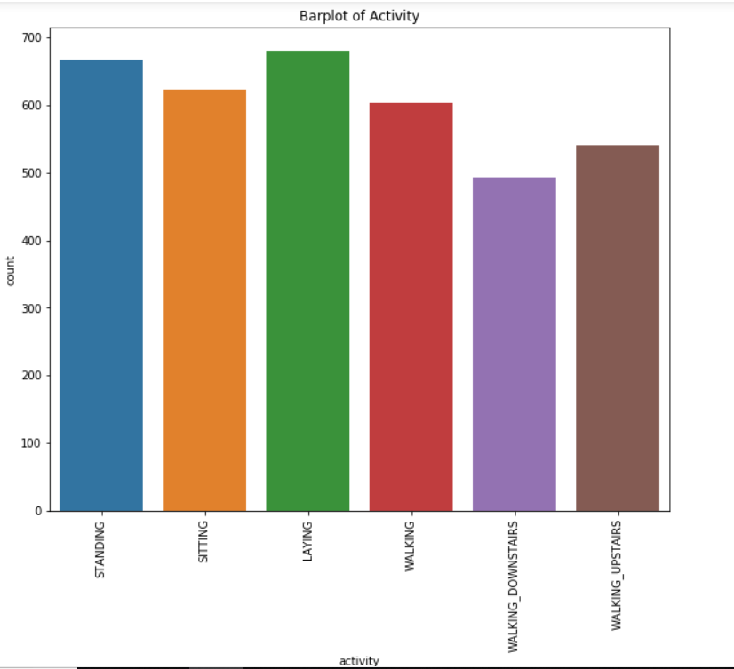
EDA:
Based on the common nature of activities we can broadly put them in two categories.
Static and dynamic activities :
SITTING, STANDING, LAYING can be considered as static activities with no motion involved
WALKING, WALKING_DOWNSTAIRS, WALKING_UPSTAIRS can be considered as dynamic activities with significant amount of motion involved
Class Imbalance:
From the graph we can see there is almost same number of observations across all the six activities so this data does not have class imbalance problem.

Slide 7
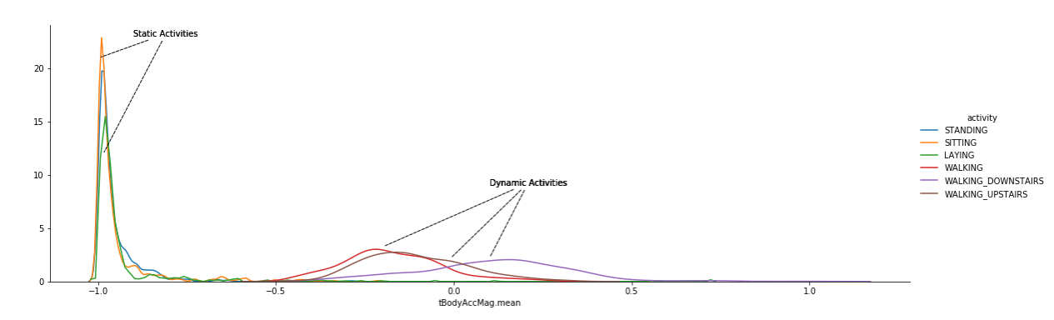
Class Differentiation:
Using the device the linear acceleration and angular velocity were derived to obtain jerk signals.
The above graph was plotted using magnitude to these 3- dimension signal(tbodyAccMag.mean).
Observing the graph we can differentiate the static activity from dynamic activity.
Activities with signal(tbodyAccMag.mean) less than equal to -0.5 can be considered as static activities otherwise activities are considered dynamic.

Slide 8
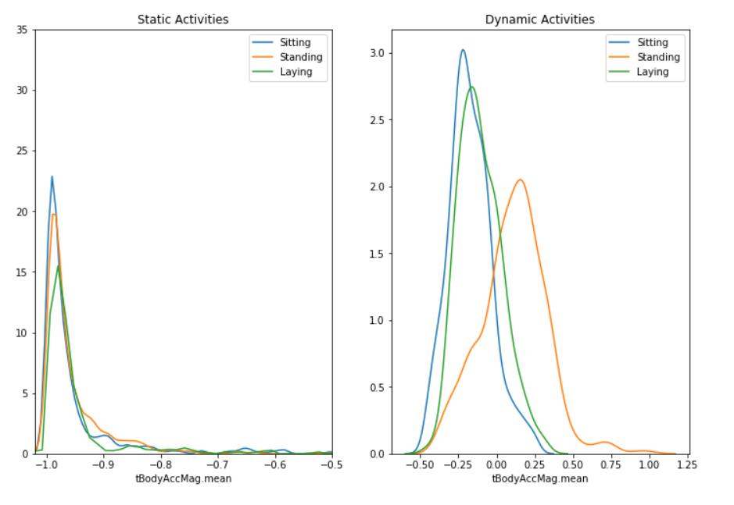
Probability Distribution Function for Static and Dynamic Activities
We have classified the activity using tBodyAccMag- probability density function(PDF) is very helpful to assess importance of a continuous variable.
Static activities:-1 to -0.5
Dynamic activities:-0.5 to 1.25

Slide 9
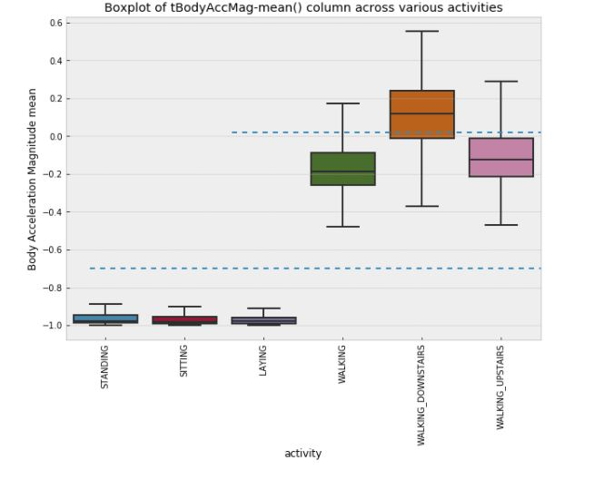
Boxplot of Body Acceleration Magnitude mean(tBodyAccMag-mean()) across all the six categories
From the visualization we can understand how the various activities other than static activities vary.

Slide 10
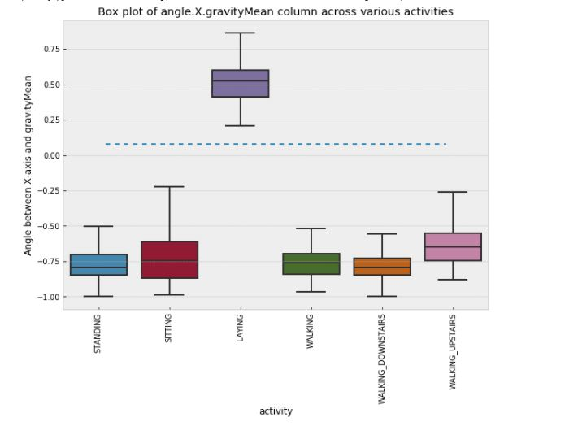
Analysing angle vectors:
Additional vectors like gravity mean, tBodyAccMean tBodyAccJerkMean etc were obtained by averaging the signals and angle were calculated.
The boxplot plotted between gravity mean and various activities shows angle(X,gravityMean) perfectly seperates LAYING from other activities.
We can conclude that if the angle(X,gravityMean) is greater than 0.01 then we can predict the person is LAYING.

Slide 11
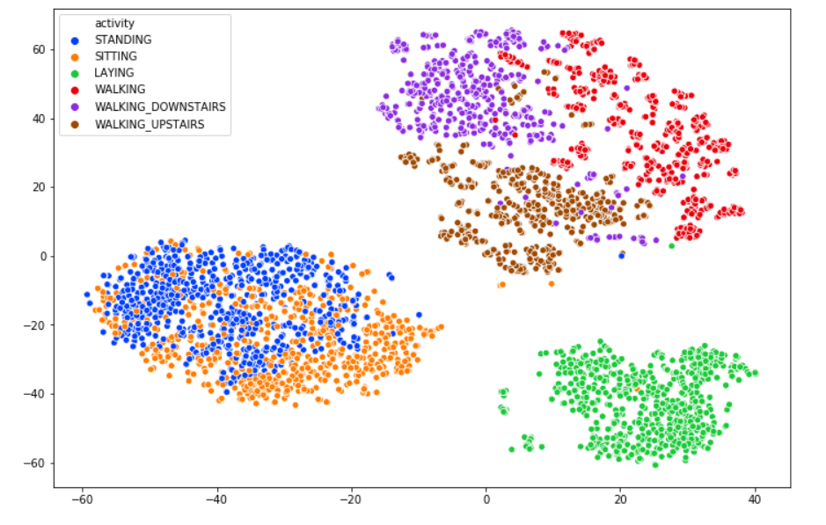
Clusters formed from the dataset
Using t-SNE training data having (561 features) can be visualized from a extremely high dimensional space to a low dimensional space(2D space) and still it retains lots of actual information.
Using the two new components obtained through t-SNE we can visualize and separate all the six activities in a 2D space.

Slide 12
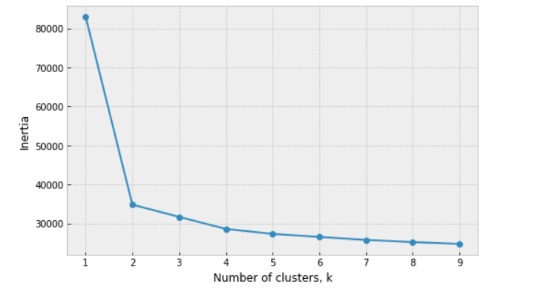
KMeans - ELBOW PLOT
The Elbow plot signifies the total number of clusters that are best suited for our dataset.
Hence we can see that the first and the second cluster are very highly heterogeneous.
After the fourth cluster the slope of the elbow plot does not has a considerably large variation and hence we can say that we can have 2-4 clusters for our dataset.

Slide 13
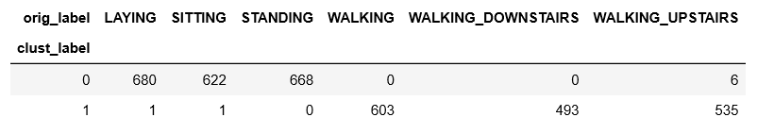
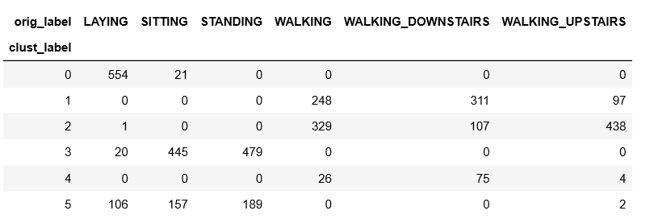
Model run for value k=2.
It can be seen the model found patterns for moving and non-moving activities with high level of accuracy.
Model run for value k=6.
The model couldn’t find proper patterns in differentiating all 6 activities.

Slide 14
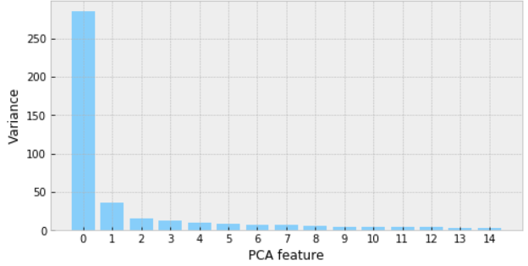
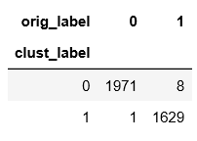
Principal Component Analysis (PCA)
The principal component analysis is a method used for dimension reduction.
Below is the graph of PCA feature extraction, which helps us to visualise the total features that can be extracted from the dataset
The data is reduce to 2 components.
Model could predict between Moving and non moving activities with high accuracy.

Slide 15
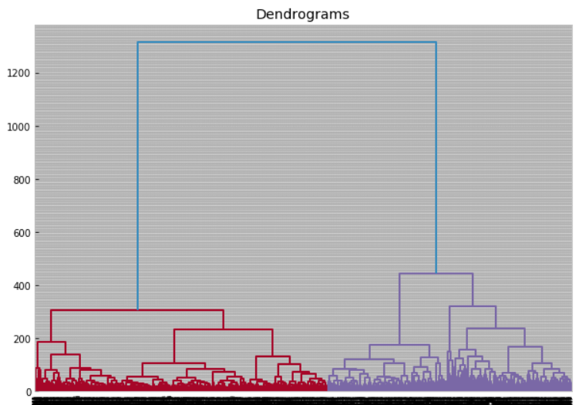
Hierarchical Clustering - Agglomerative
Agglomerative clustering uses a bottom-up approach, wherein each data point starts in its own cluster. These clusters are then joined greedily, by taking the two most similar clusters together and merging them.
Here the activities like WALKING,WALKING_DOWNSTAIrS, WALKING_UPSTAIRS can cluster together to form Moving activites while SITTING, STANDING, LAYING can be clustered into non-moving activites.

Slide 16

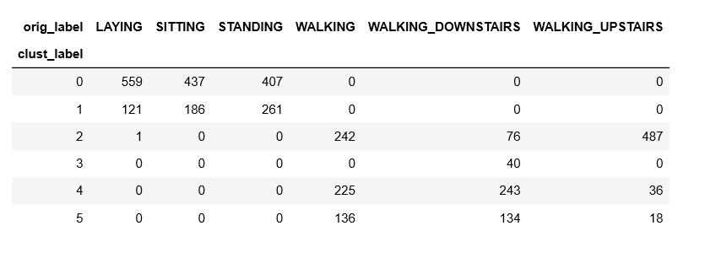
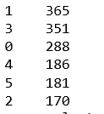
2 cluster
1 839
0 702
6 cluster

Slide 17
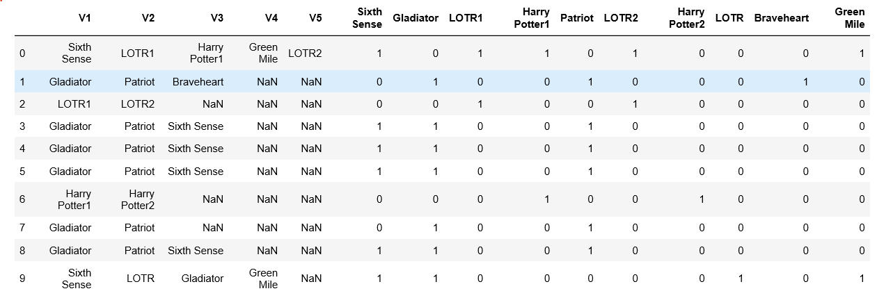
Apriori Algorithm.
Apriori Algorithm algorithm that is used to gain insight into the structured relationships between different items involved. It’s a data mining technique that is used for mining frequent item sets and relevant association rules.
Example: Recommending products based on your purchased items. You can see this in different e-commerce websites. (Recommendation system).
We have applied this algorithm on a “Movies” dataset.

Slide 18
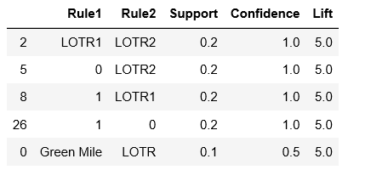
Apriori Algorithm.
We find out the Support, Confidence and lift of all the movies with one another and determine which products are currently seen together.
We can see movie LOTR1 is often followed by LOTR2. Also the lift for this association is found out to be 5.0.
There is a increase in the view of movie LOTR2 after LOTR1

Slide 19
Conclusion
We can have 2 clusters for our dataset which can be subdivided into 6.
Body Acceleration Magnitude will help to notify the human activity -< -0.5 is static otherwise dynamic.
Model can also predict the human activity using Angle attribute ( > o.o1 is laying)
K-mean Model is predicting Moving and non moving activities with high accuracy.
Using PCA we have reduced the data to 2 - components giving high accuracy for classify activities into Moving and Non moving .
Hierarchical Clustering for both 2 and 6 clusters couldn’t provide high accuracy.

Slide 20
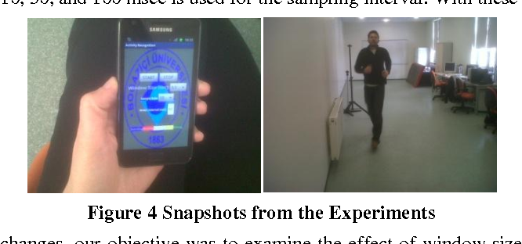
Future Work
Implementing the hardware systems with IoT devices can increase the overall cost of the device (i.e. Smartphones) and considering the sensors the increased radiations can have effect on the subjects which have not been considered in this particular dataset.
Using and applying deep learning methods to capture the human decisions taken and then take the same decision independently.
Thus, the results and outcomes of these devices can be used to implement smart machines.

Slide 21
THANK YOU https://github.com/vedang13sawant/Human-activity-recognition-with-smart-phone.git

