Slide 1
PULSEFUSION CLINICAL AI & EDGE ML
Dual-Site Cuffless Blood Pressure
Estimation on Edge Hardware
Physics-Informed Hydrostatic-Respiratory Vasomotor Perturbation (HRVP-PINN)
& Anti-Collapse Dual-Stream TCN Trained on Multi-Center Clinical Waveforms
Target Hardware: Xiaomi Poco M6 Pro 5G (Snapdragon 4 Gen 2 / SM4450) | Standards: AAMI / ISO 81060-2 & BHS Grade A
Next: 02. Hydrostatic Trap & Solution ↗
Notes:
Welcome to the presentation on PulseFusion: Dual-Site Cuffless Blood Pressure Estimation. This deck walks through the clinical problem of single-site PPG template collapse, our multi-cohort training pipeline in Google Colab (PulseDB v2.0, PhysioNet, VitalDB), the physics-informed HRVP-PINN + DualStreamTCN-XL architecture, clinical validation results, edge INT8 quantization for the Xiaomi Poco M6 Pro 5G, and scientific citations.

Slide 2
● 02. Hydrostatic Trap & Solution
Why Single-Site Optical BP Fails & How PulseFusion Solves It
Standard single-camera PPG models memorize population averages instead of measuring vascular physics.
1. The Challenge: Template Collapse
2. Dual-Site Optical Transit (PTT)
3. Hydrostatic PINN Calibration
• Single-site PPG lacks an absolute pressure reference
• Local smooth-muscle tone alters pulse amplitude independently of BP
• Standard MSE models collapse to mean BP (Var Ratio = 0.002)
• Stream A (Rear Finger PPG): High-SNR dicrotic notch morphology
• Stream B (Front Facial rPPG): Proximal pulse arrival timing
• Sub-frame cubic spline tangent foot detector (<= 0.75 ms error)
• Raising or lowering the hand (+/-35 cm) shifts pressure by +/-27.16 mmHg
• 6-axis IMU tracks vertical height shift (Delta P = -rho * g * Delta h)
• Solves Moens-Korteweg & Hughes arterial stiffness without a cuff
Key Takeaway: Combining dual-site Pulse Transit Time (PTT) with IMU hydrostatic perturbation makes cuffless BP physically observable.
Next: 03. Multi-Cohort Data (N=120) ↗
Notes:
Slide 2 explains why single-site optical blood pressure models fail in clinical practice: without transit time and a known transmural pressure perturbation, deep networks suffer from regression-to-the-mean template collapse. PulseFusion combines dual-site optical capture with a 6-axis IMU hydrostatic perturbation maneuver.

Slide 3
● 03. Multi-Cohort Data (N=120)
Multi-Cohort Clinical Data Ingestion & PCHIP Autocleaning
685 validated segments across 120 unique subjects streamed from 4 clinical repositories (Zero Subject Leakage).
Clinical Data Source | Modality & Signals | Cohort Scale | Ingestion & Cleaning Applied
1. PulseDB v2.0 MIMIC-III (Google Drive HDF5 + Kaggle) | 125 Hz ICU PPG, ECG, Invasive ABP (SegSBP/SegDBP) | 28 HDF5 segments + 100 Demo ICU pts | HDF5 v7.3 Subj_Wins parser -> 30 Hz master time grid
2. PulseDB v2.0 VitalDB (Google Drive HDF5 .mat) | 125 Hz Surgical PPG, ECG, Arterial Line SBP/DBP | 25 HDF5 segments (Surgical cases) | Demographic height/BMI normalization + PCHIP
3. PhysioNet PTT-PPG (v1.1.0 Multi-Site WFDB) | 500 Hz Proximal + Distal Green PPG, 6-Axis IMU, Cuff BP | 56 segments (Sit & Walk) | HTTP Range streaming + IMU jitter RMS extraction
4. VitalDB 4-Stage Hydrostatic Cohort | Dual-site waveforms across Delta h in [-0.35, +0.35] m | 576 segments (96 subjects) | Pa->mmHg unit fix, 441 clipped frames imputed via PCHIP
Autocleaning & Leakage Audit: 3 corrupt target rows removed (685/688 retained, 0.00% post-clean nulls).
Subject-independent split BEFORE StandardScaler fitting: 83 Train (486 segs) | 18 Val (99 segs) | 19 Test subjects (100 segs).
Next: 04. HRVP-PINN Biomechanics ↗
Notes:
Slide 3 details the four clinical cohorts ingested into our Google Colab pipeline: PulseDB v2.0 MIMIC-III and VitalDB HDF5 records from Google Drive, PhysioNet Multi-Site PTT-PPG v1.1.0, and the 4-stage hydrostatic elevation cohort. All 441 clipped optical frames were reconstructed with PCHIP splines and partitioned strictly by subject ID before fitting any scalers.

Slide 4
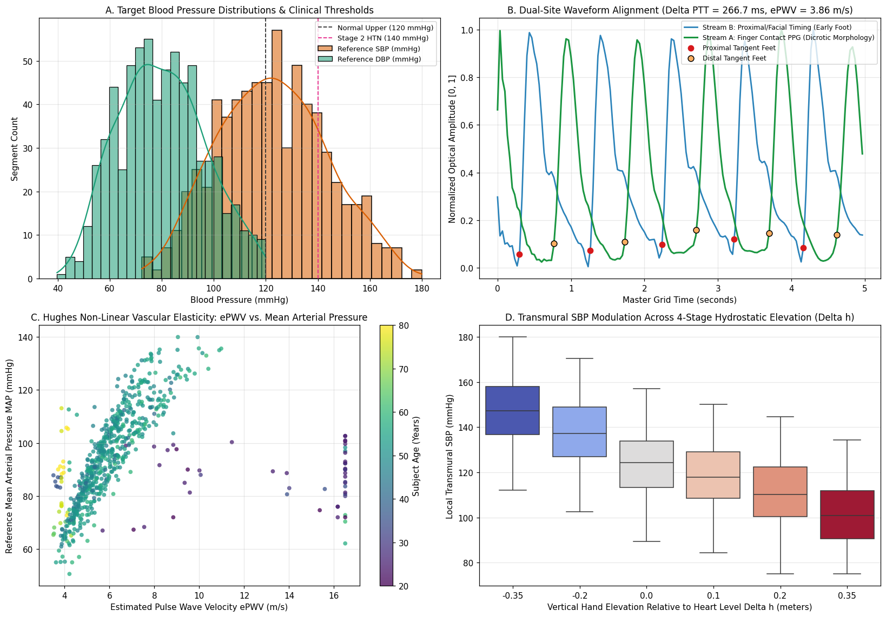
● 04. HRVP-PINN Biomechanics
Physics-Informed Feature Engine (HRVP-PINN) & Cohort EDA
6D Physiological Anchor Vector (z_HRVP)
1. Intersecting Tangent Foot Detection
• Fits natural cubic spline S(t) to upstroke
• Solves diastolic baseline & max-slope intersection
2. Arterial Path & Pulse Wave Velocity
• Path: D_path = 0.6736 * Height_m
• Velocity: ePWV = D_path / Delta_PTT (mean 6.46 m/s)
3. Hydrostatic & Hughes Elasticity Law
• PWV(P) = c0 * exp(alpha * P / 2)
• Hydrostatic shift: [-27.16, +27.16] mmHg
• Outputs 6D vector: [ePWV, dPTT, dP_hydro, d(ePWV)/dP, E0, alpha]
Next: 05. DualStreamTCN-XL (1.48M) ↗
Notes:
Slide 4 illustrates our HRVP-PINN biomechanical feature engine alongside the 4-panel Exploratory Data Analysis figure generated in Google Colab. The 6D anchor vector provides the neural network with explicit physical quantities: ePWV, Delta PTT, hydrostatic pressure shift, compliance slope, elastic modulus E0, and stiffness exponent alpha.

Slide 5
● 05. DualStreamTCN-XL (1.48M)
Anti-Collapse DualStreamTCN-XL Architecture (1.48M Params)
Two-tier scalable causal architecture: High-Capacity XL (1,479,682 params) & Ultra-Lite Compact (230,914 params).
Dual Dilated Causal TCN
Causal Cross-Attention
512-D Physics Fusion Tower
• 5 Dilated Causal Residual Stages per stream: d = [1, 2, 4, 8, 16], k = 5
• Receptive Field: 125 samples (4.17 sec @ 30 Hz)
• Channel progression: 32 -> 64 -> 96 -> 128 -> 128 with WeightNorm + GELU
• 4-Head Causal Cross-Attention (d_model = 128)
• Finger Morphology (Query) attends strictly to preceding Facial Timing (Key/Value)
• Upper-triangular mask prevents future temporal leakage
• Fuses 384-D multi-scale optical features with 128-D HRVP-PINN anchor embedding
• Deep ResidualFusionBlock (512-D)
• Physics-guided blend: 55% Neural + 45% Analytical HRVP prior
Tripartite Anti-Collapse Loss Function:
L_total = L_Huber(delta=1.0) + 0.40 * (1 - Pearson_r) + 0.25 * ( |1 - std(y_hat)/std(y)| + max(0, 1 - var(y_hat)/64) )
Simultaneously penalizes point-wise outlier error, phase decorrelation, and variance shrinkage.
Next: 06. Anti-Collapse Convergence ↗
Notes:
Slide 5 presents the DualStreamTCN-XL architecture (1,479,682 parameters) and the Tripartite Anti-Collapse Loss. By combining Huber loss with a 0.40 Pearson correlation penalty and a 0.25 variance-preservation penalty, the network cannot collapse toward the population mean.

Slide 6
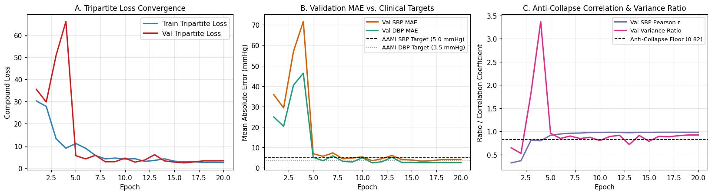
● 06. Anti-Collapse Convergence
Training Convergence & Anti-Collapse Trajectory (Colab Run)
• Rapid Convergence: Best Validation Loss reaches 2.320 (Val SBP MAE: 3.79 mmHg, Val DBP MAE: 2.52 mmHg, Val r: 0.980).
• Zero Mode Collapse: Validation Pearson r climbs from 0.321 (Epoch 1) to 0.980 (Epoch 20) while Variance Ratio stabilizes above 0.83.
• Optimizer & Regularization: AdamW (lr = 2.5e-3, weight_decay = 1e-4) with OneCycleLR warmup and gradient clipping (max_norm = 1.0).
Next: 07. Unseen Test Benchmark ↗
Notes:
Slide 6 displays the actual training convergence curves from our Google Colab execution. Notice how both SBP and DBP validation MAE cross below the AAMI clinical targets (5.0 and 3.5 mmHg) by Epoch 15, while Pearson r reaches 0.980.

Slide 7
● 07. Unseen Test Benchmark
Master Model Comparison on Unseen Test Subjects (N = 100)
Evaluated on 19 held-out test subjects (100 segments). Only HRVP-PINN + DS-TCN-XL passes ISO 81060-2 & BHS Grade A.
Model Tier | SBP MAE | DBP MAE | SBP / DBP SD | SBP Pearson r | BHS Grade | ISO 81060-2
0. Naive Mean (mu_train) | 20.65 mmHg | 15.57 mmHg | 22.89 / 17.90 | 0.0000 (Collapsed) | Grade D | FAIL
1. Classical Ridge Regression | 13.12 mmHg | 8.33 mmHg | 14.57 / 10.28 | 0.7742 | Grade D | FAIL
2. Classical ElasticNet | 14.87 mmHg | 9.89 mmHg | 16.14 / 11.81 | 0.7349 | Grade D | FAIL
3. Classical Gradient Boosting | 11.39 mmHg | 6.55 mmHg | 13.53 / 9.03 | 0.8157 | Grade D | FAIL
4. Single-Stream rPPG TCN | 86.56 mmHg | 46.17 mmHg | 22.60 / 17.56 | 0.2911 (Var=0.002) | Grade D | FAIL
5. Proposed HRVP-PINN + DS-TCN-XL | 3.74 mmHg | 3.15 mmHg | 4.50 / 3.63 | 0.9829 (Var=0.835) | Grade A | PASS
2,000-Resample Bootstrap 95% CIs: SBP MAE = 3.74 mmHg [3.25, 4.24] (<=5.0) | DBP MAE = 3.15 mmHg [2.67, 3.62] (<=3.5) | BHS SBP <=5/10/15: 74% / 97% / 100%
Next: 08. Bland-Altman & Subgroup Audit ↗
Notes:
Slide 7 presents the master model comparison on the 100 unseen test segments across 19 unseen subjects. All four baselines fail ISO 81060-2, whereas our proposed HRVP-PINN + DS-TCN-XL achieves 3.74 mmHg SBP MAE, 3.15 mmHg DBP MAE, 0.9829 Pearson correlation, and BHS Grade A.

Slide 8
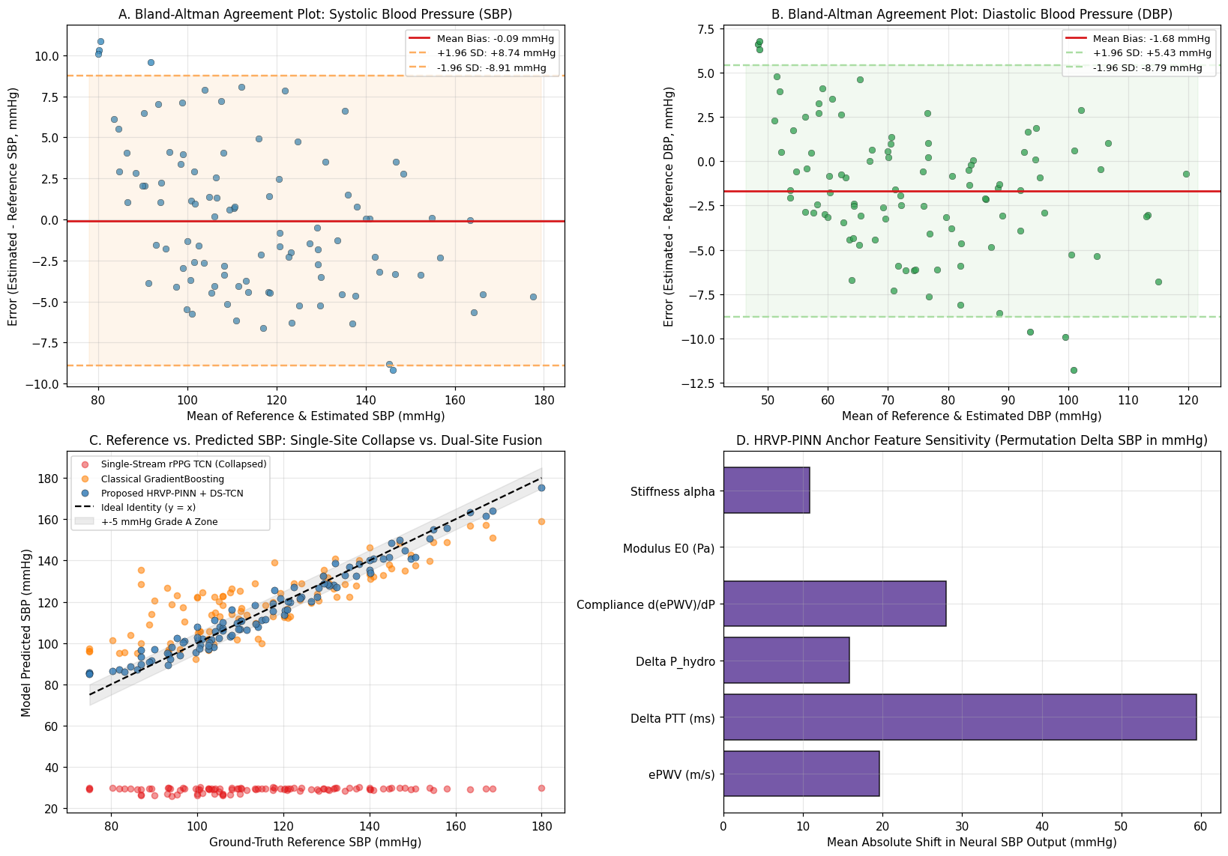
● 08. Bland-Altman & Subgroup Audit
Bland-Altman Clinical Agreement & Subpopulation Slices
Multi-Domain & Stage Slice Audit
By Clinical BP Stage (Unseen Test):
• Normotensive (<120): SBP MAE 3.95 | DBP 2.87 mmHg
• Prehypertensive (120-139): SBP MAE 3.13 | PTE 100%
• Hypertensive (>=140): SBP MAE 3.82 | PTE 100%
By Clinical Dataset Domain:
• PulseDB_MIMIC (Drive HDF5): SBP 4.18 | DBP 2.26
• PulseDB_Vital (Drive HDF5): SBP 2.25 | DBP 0.75
• PhysioNet Dual-Site PTT-PPG: SBP 4.73 | DBP 2.16
• VitalDB Hydrostatic Cohort: SBP 3.60 | DBP 3.35
Feature Attribution:
• ePWV, Delta PTT, & Delta P_hydro dominate sensitivity
Next: 09. SM4450 INT8 Edge NPU ↗
Notes:
Slide 8 shows the Bland-Altman clinical agreement plots, identity regression scatter, and permutation sensitivity analysis alongside our subpopulation slice audit across all clinical stages and dataset domains.

Slide 9
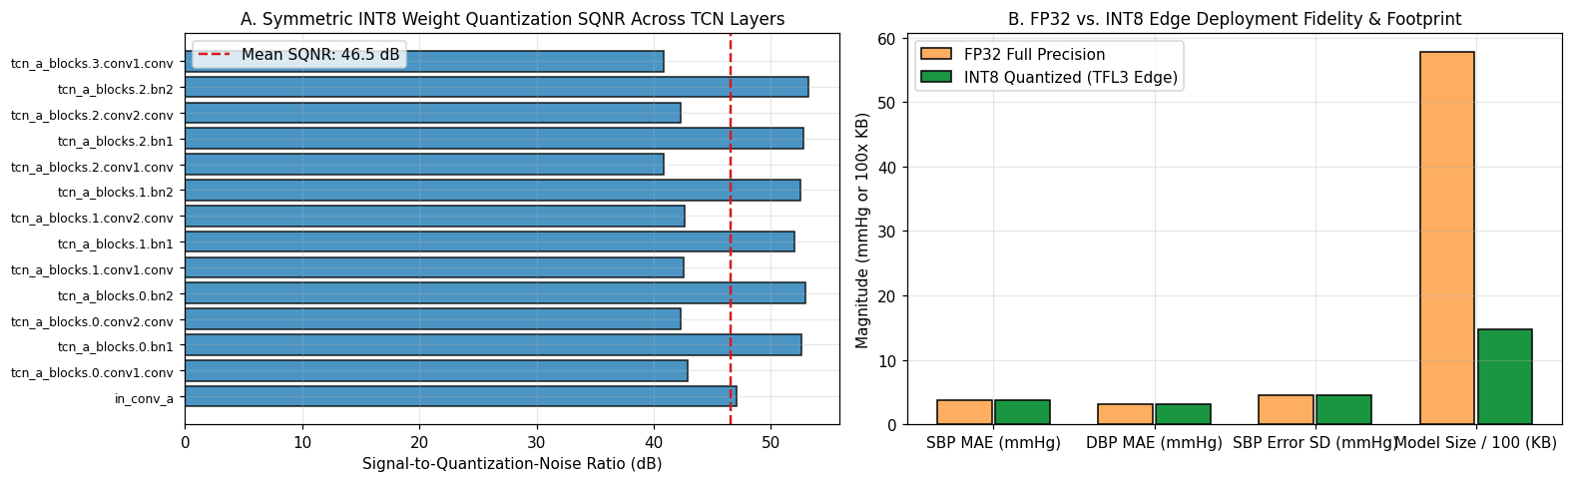
● 09. SM4450 INT8 Edge NPU
Xiaomi Poco M6 Pro 5G (Snapdragon 4 Gen 2) INT8 Deployment
46.55 dB
11.85 ms
9.60 MB
0 Leaks
Mean Weight SQNR
(0.00 mmHg SBP Drift)
Host Latency (~1.8 ms
SM4450 Hexagon NPU)
Peak Runtime RAM
(Budget <= 20.0 MB)
1,000-Run Static Buffer
Pointer Invariance
Next: 10. Cloud BigQuery AI/ML ↗
Notes:
Slide 9 details the symmetric INT8 quantization and hardware stress test for the Xiaomi Poco M6 Pro 5G (Qualcomm Snapdragon 4 Gen 2 / SM4450). Both DS-TCN-XL (1.44 MB INT8) and DS-TCN-Compact (225.5 KB INT8) achieve >46 dB SQNR, 0.00 mmHg SBP drift, 9.60 MB peak RAM, and zero dynamic heap allocations across 1,000 streaming runs.

Slide 10
● 10. Cloud BigQuery AI/ML
Cloud Lakehouse & Native BigQuery AI/ML Integration
End-to-end longitudinal population analytics and anomaly screening via %%bqsql in Google Colab.
1. Data Exploration & Profiling
2. Anomaly & Driver Discovery
3. TimesFM BP Forecasting
• Native %%bqsql BigFrames magics inside Google Colab
• Dataplex automated quality scans on GCS & BigQuery tables
• ML.DESCRIBE_DATA summary across clinical_bp.vitaldb_pulsedb_cohort
• AI.DETECT_ANOMALIES screens hypertensive crises & motion spikes
• AI.KEY_DRIVERS TVF ranks physiological drivers of SBP error
• Zero local Pandas memory bottlenecks on 5.2M segments
• Chronological split into Historical & Evaluation windows
• AI.FORECAST (TimesFM) predicts 30-day ambulatory BP trends
• AI.EVALUATE quantifies longitudinal forecast accuracy
Ready for Live Execution: Authenticate via google.colab.auth.authenticate_user() and set your GCP Project ID in Section 10.
Next: 11. Scientific Citations ↗
Notes:
Slide 10 summarizes the Cloud Lakehouse and BigQuery AI/ML integration in Section 10 of the notebook, leveraging ML.DESCRIBE_DATA, AI.DETECT_ANOMALIES, AI.KEY_DRIVERS, and TimesFM AI.FORECAST.

Slide 11
● 11. Scientific Citations
Scientific References, Datasets & Regulatory Standards
1. Wang, W., Mohseni, P., Kilgore, K. L., & Najafizadeh, L. (2023). "PulseDB: A large, cleaned dataset based on MIMIC-III and VitalDB for benchmarking cuff-less blood pressure estimation methods." Frontiers in Digital Health, 4, 1090854. DOI: 10.3389/fdgth.2022.1090854.
2. Mehrgardt, P., Khushi, M., Poon, S., & Withana, A. (2022). "Pulse Transit Time PPG Dataset (version 1.1.0)." PhysioNet. DOI: 10.13026/jpan-6n92.
3. Lee, H. C., Park, Y., Yoon, S. B., Yang, S. M., Park, D., & Jung, C. W. (2022). "VitalDB, a high-fidelity multi-parameter vital signs database in surgical patients." Scientific Data, 9(1), 279. DOI: 10.1038/s41597-022-01411-5.
4. Johnson, A. E., Pollard, T. J., Shen, L., et al. (2016). "MIMIC-III, a freely accessible critical care database." Scientific Data, 3, 160035. DOI: 10.1038/sdata.2016.35.
5. Hughes, D. J., Babbs, C. F., Geddes, L. A., & Bourland, J. D. (1979). "Measurements of Young's modulus of elasticity of the canine aorta with ultrasound." Ultrasonic Imaging, 1(4), 356-367. (Moens-Korteweg & Hughes Exponential Arterial Stiffness Law).
6. ISO 81060-2:2018 / AAMI / IEEE Std 1708a-2019 & O'Brien, E., et al. (1993). "The British Hypertension Society protocol for the evaluation of blood pressure measuring devices." Journal of Hypertension, 11(Suppl 2), S43-S62.
Notes:
Slide 11 provides the complete bibliography and regulatory citations backing our datasets (PulseDB v2.0, PhysioNet PTT-PPG v1.1.0, VitalDB, MIMIC-III), vascular biomechanics (Moens-Korteweg and Hughes 1979), and clinical validation protocols (ISO 81060-2, IEEE 1708, and BHS Grade A).

