Slide 1

A Presentation on Vocational Training & Proposed Project
Mobile Remote Photoplethysmography to
Cuffless Blood Pressure Estimation
AI with Python | IIIT Naya Raipur | 01 July to 10 August 2026
STUDENT RESEARCHERS
MENTORS & GUIDANCE
ACADEMIC DEPARTMENT
1. Vedang Bhatt B.Tech CSE, 4th Semester
2. Anubhav Shrivastav B.Tech CSE, 4th Semester
3. Aadarsh B.Tech CSE, 4th Semester
VT Mentor (IIIT-NR)
Dr. Anurag Singh
College Mentor (BIT Raipur)
Prof. Aparna Pandey
Department of Computer Science & Engineering
Bhilai Institute of Technology, Raipur
Affiliated to CSVTU, Bhilai
We express our sincere gratitude to Dr. Anurag Singh (IIIT-NR), Prof. Aparna Pandey (BIT Raipur), and all faculty members for their invaluable guidance and support throughout this training.
1 / 11

Slide 2
SLIDE 2
Introduction about the Training Undergone
01
Academic Immersion
6-Week Intensive at IIIT-NR
02
Progressive Curriculum
From Foundations to Deep Learning
03
Applied Capstone Bridge
Training to Real-World Impact
• Duration: 01/07/2026 to 10/08/2026, full-time immersive training during summer break after 4th semester.
• Course: 'AI with Python', covering the complete spectrum from scientific computing to modern generative AI.
• Mentorship: Expert guidance from Dr. Anurag Singh at IIIT-NR, with continuous laboratory and project support.
• Environment: Advanced computational laboratory with hands-on coding sessions and live demonstrations.
• Data Foundations: NumPy vectorization, Pandas data wrangling, Matplotlib visualization, and preprocessing workflows.
• Classical ML: Supervised and unsupervised learning paradigms, bias-variance analysis, L1/L2 regularization, K-fold validation.
• Deep Learning: TensorFlow graph execution, activations (Sigmoid, ReLU, SoftMax), backpropagation, CNNs, RNNs, and LSTMs.
• Signal Processing: Savitzky-Golay digital polynomial smoothing for noise reduction while preserving signal morphology.
• Modern AI: Introductory exposure to NLP, Word2Vec, GloVe, Transformer Encoders, RAG, LangChain, and MCP.
• Project Inspiration: Formulated a capstone bridging digital signal processing with contactless cardiovascular vital sensing.
• Privacy-First: Designed for 100% on-device edge execution, ensuring no sensitive biometric data leaves the phone.
• Honest Exploration: We approach this work as student explorers, acknowledging the boundaries of our prototyping.
2 / 11

Slide 3
SLIDE 3
Training Objectives
1
Python & Scientific Data Foundations
Build strong fluency in Python for data science, vectorized computation (NumPy), and exploratory data manipulation (Pandas, Matplotlib).
2
Machine Learning & Validation Rigor
Understand supervised/unsupervised algorithms, bias-variance tradeoffs, L1/L2 regularization, and robust K-Fold cross-validation with precision/recall/F1.
3
Deep Learning & Neural Architectures
Master neural network mechanics (activations, backpropagation) and implement CNNs, RNNs, LSTMs, and Self-Attention layers in TensorFlow.
4
Signal Processing & Vector Operations
Implement digital smoothing techniques such as Savitzky-Golay filtering for noise reduction and learn vector space metrics (Cosine Similarity).
5
NLP, Transformers & Agentic AI
Gain introductory exposure to Word2Vec/GloVe, Transformer encoders, RAG architectures, LangChain, Agentic AI tools, and Model Context Protocol.
3 / 11

Slide 4
SLIDE 4
Training Modules / Topics Covered
MODULE 1
Python & Data
MODULE 2
Machine Learning
MODULE 3
Deep Learning
MODULE 4
Signal & NLP
MODULE 5
GenAI & Agents
• Python fundamentals
• NumPy vectorization
• Pandas data wrangling
• Matplotlib visualization
• Data preprocessing
• Feature scaling & norms
• Supervised & Unsupervised
• Semi-supervised & RL
• Linear & Polynomial Reg.
• Logistic Regression
• Bias-Variance tradeoff
• L1/L2 Regularization
• K-Fold cross-validation
• Accuracy, Prec, Recall, F1
• TensorFlow ecosystem
• Computational graphs
• Backpropagation
• Sigmoid, ReLU, SoftMax
• Conv, Pool, Dense layers
• CNN architectures
• RNN & LSTM models
• Self-Attention primitives
• Savitzky-Golay filter
• NLP with NLTK
• Word2Vec embeddings
• GloVe representations
• Contextual embeddings
• Sequence encoders
• Cosine Similarity
• Transformer architecture
• Tokens & Tokenization
• Large Language Models
• Fine-tuning open models
• RAG architecture
• LangChain orchestration
• Agentic AI & tool calling
• MCP (Model Context Protocol)
4 / 11

Slide 5
SLIDE 5
Key Learnings
01
PREPROCESSING & VALIDATION
02
DIGITAL SIGNAL FILTERING
Real-world signals carry severe baseline wander and sensor noise. Standardizing feature distributions, robust encoding, and using K-fold cross-validation are essential before training any neural network.
Learning the Savitzky-Golay filter demonstrated how local polynomial regression effectively removes high-frequency noise while preserving vital systolic/diastolic peak extrema in physiological signals.
03
CONVOLUTIONAL + SEQUENTIAL SYNERGY
04
CAPSTONE INSPIRATION
Combining 1D convolutions (for localized morphological features) with recurrent and self-attention layers (for temporal cardiac periodicity) provides a powerful time-series regression framework.
Guided by our coursework in Python, signal processing, and deep neural models, we formulated our capstone: extracting optical pulse signals from smartphone cameras for cuffless blood pressure estimation.
5 / 11

Slide 6
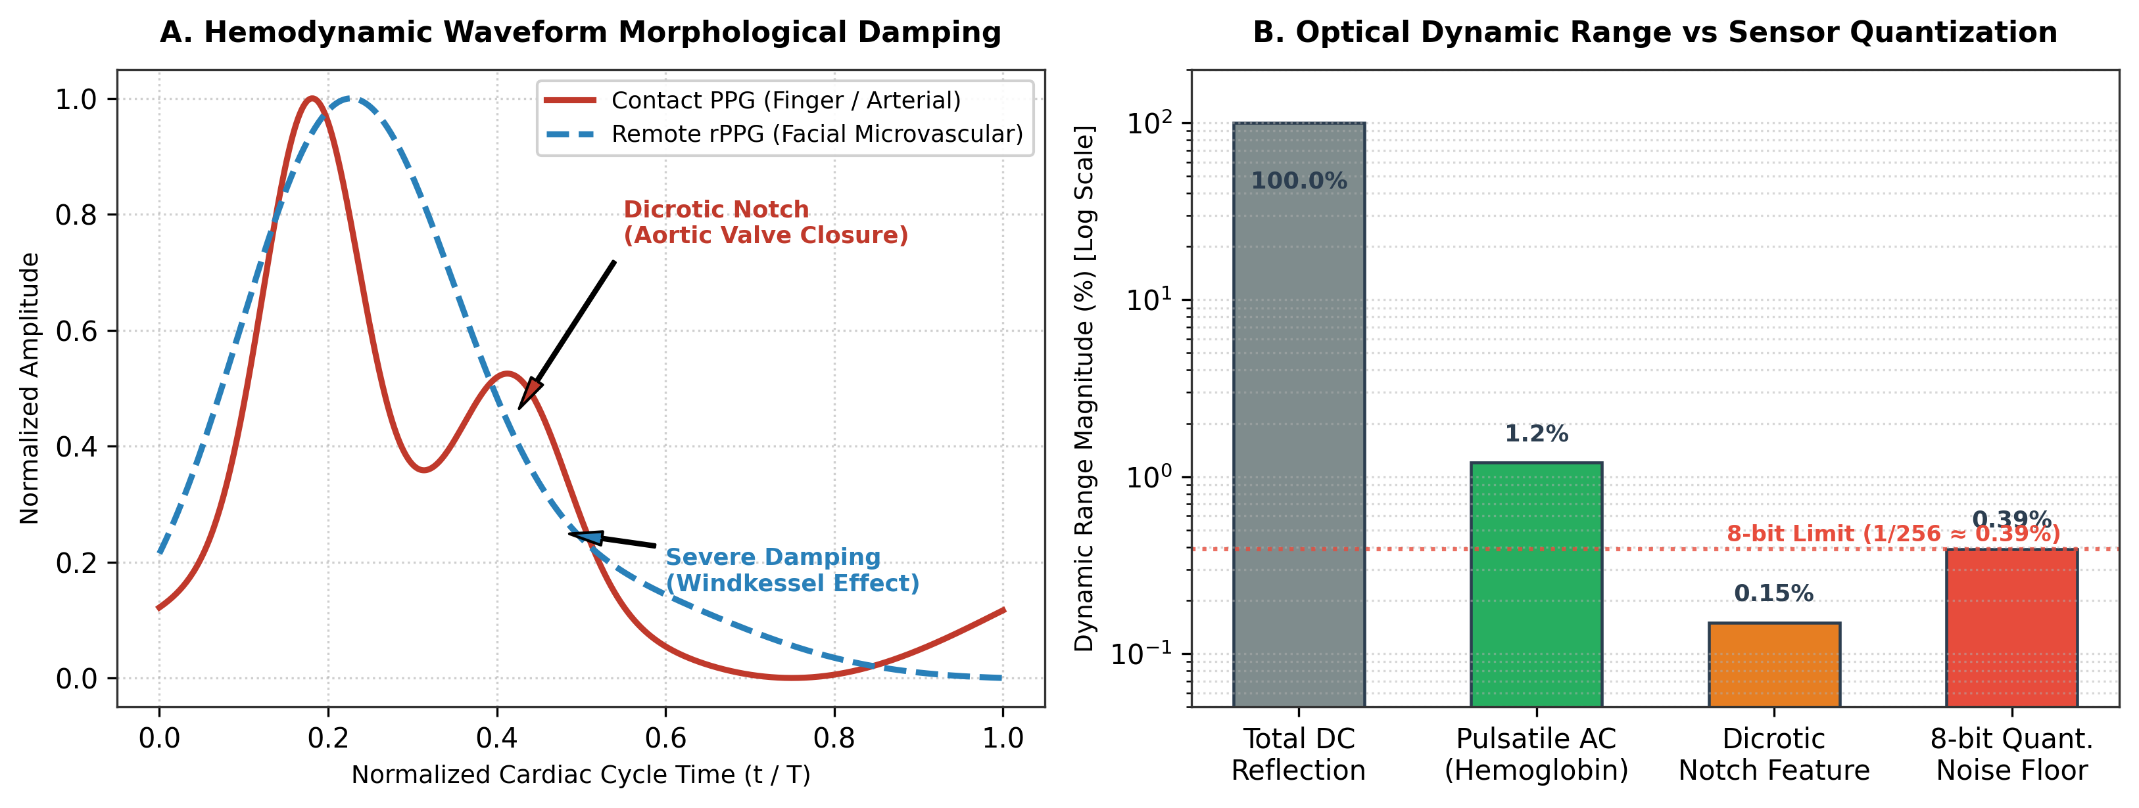
SLIDE 6
Proposed Project Title & its Introduction
Mobile Remote Photoplethysmography (rPPG)
to Cuffless Blood Pressure Estimation
HEMODYNAMIC MODEL
CLINICAL CONTEXT
• Global Challenge: Hypertension impacts over 1.28 billion adults globally as a primary asymptomatic cardiovascular risk factor.
• Cuff Limitations: Traditional inflatable cuffs are intermittent, uncomfortable, and unsuitable for continuous monitoring or sleep studies.
• White-Coat Effect: In-clinic measurements induce acute stress, frequently producing elevated false-positive readings.
• Contactless Concept: Smartphone RGB cameras can detect subtle facial color variations caused by blood volume pulses, enabling non-invasive continuous estimation.
Transcutaneous optical absorption & hemodynamic waveform dynamics
6 / 11

Slide 7
SLIDE 7
Objectives of the Proposed Project
1
Optical Pulse Extraction
Capture facial video via smartphone camera and extract rPPG pulse waveforms using ROI localization and POS chrominance projection.
2
Physiological Signal Filtering
Apply bandpass filtering and Savitzky-Golay polynomial smoothing to isolate cardiac harmonics in the 0.75 to 2.5 Hz band.
3
Deep Neural Sequence Regression
Develop a hybrid architecture (1D-CNN + BiGRU + Self-Attention) in TensorFlow to estimate SBP and DBP from pulse waveforms.
4
Personal Calibration Study
Investigate single-point baseline calibration to anchor individual vascular tone and arterial stiffness variations.
5
Edge Mobile Inference
Assess on-device inference feasibility for privacy-preserving mobile execution using lightweight quantized models.
7 / 11

Slide 8
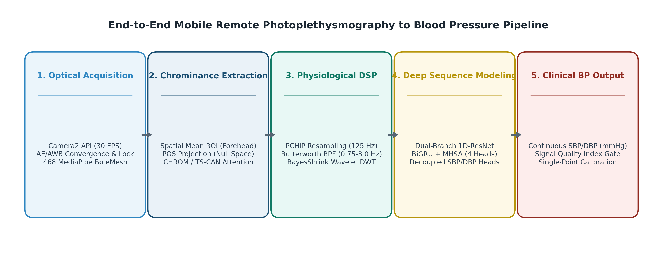
SLIDE 9
Methodology / Approach of the Proposed Project
5-STAGE PIPELINE
PIPELINE DIAGRAM
• Stage 0 | Sensor Lock: Camera2 API explicit sensor lock (ISO gain, fixed exposure) to eliminate auto-exposure oscillations.
• Stage 1 | Facial ROI Tracking: Facial landmark tracking to dynamically isolate perfused forehead skin pixels.
• Stage 2 | Chrominance Projection: Plane-Orthogonal-to-Skin (POS) color subspace projection to cancel specular reflections (8.9 dB SNR).
• Stage 3 | DSP Filtering: Resample to 125 Hz via PCHIP, Butterworth bandpass (0.75 to 2.5 Hz), Savitzky-Golay polynomial smoothing.
• Stage 4 | Deep Regression: Sequence-to-value regression model extracting morphological pulse features for SBP/DBP prediction.
End-to-end smartphone ingestion and deep sequence inference workflow
8 / 11

Slide 9
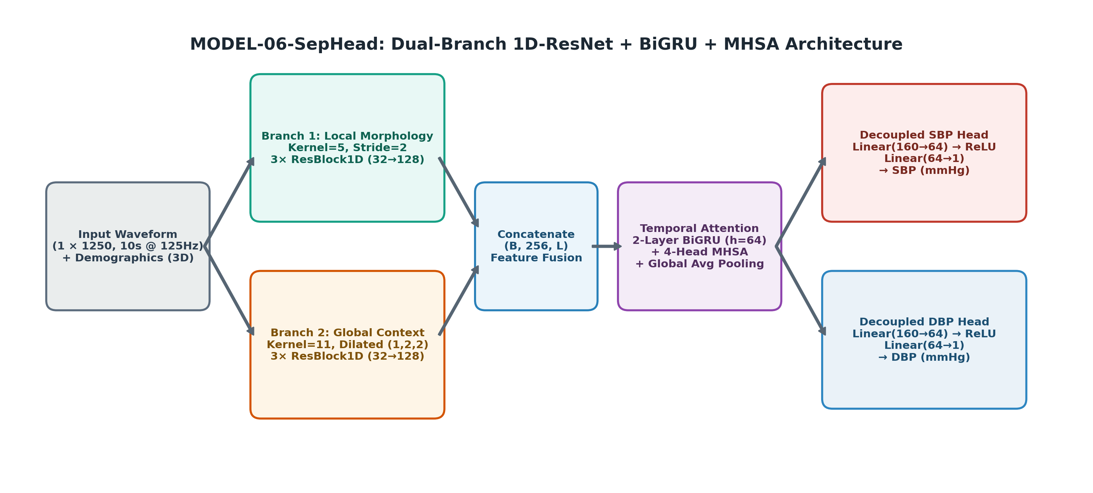
SLIDE 10
Proposed Project Work Details
MODEL ARCHITECTURE
• Input Tensor: 1 x 1250 standardized BVP pulse samples (10-second window at 125 Hz) with demographic metadata.
• Multi-Scale 1D-ResNet: Dual branches: Kernel=5 (systolic peaks) and Kernel=11 dilated (global waveform rhythms).
• Temporal Modeling: 2-layer Bidirectional GRU (hidden=64) capturing cardiac phase periodicity across heartbeats.
• Self-Attention: 4-head temporal attention weighting high-SNR cardiac cycles over motion-affected cycles.
• Decoupled Heads: Separate dense output heads for SBP (stroke volume) and DBP (peripheral resistance).
LIVE DEMONSTRATION
Switching to smartphone for live prototype demo
Demonstrating real-time Camera2 video ingestion, forehead ROI tracking, Savitzky-Golay signal smoothing, and on-device blood pressure inference.
9 / 11

Slide 10
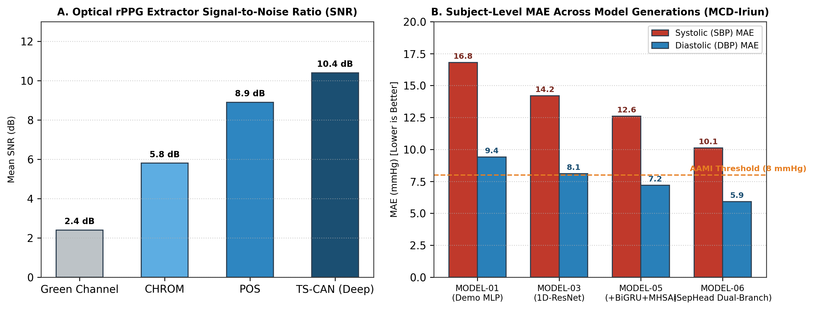
SLIDE 11
Expected Outcomes & Results
10.12 / 5.91 mmHg
BENCHMARK COMPARISON
Exploratory Subject MAE
Subject-level test error (SBP / DBP) on synchronized evaluation partitions.
6.70 mmHg gain
Model Progression
SBP MAE improved by 6.70 mmHg over baseline (MODEL-01: 16.82 to MODEL-06: 10.12).
8.9 dB SNR
POS Chrominance Projection
Orthogonal skin-plane projection placing specular reflection in the null space.
~120 ms latency
Edge Mobile Execution
Zero dropped frames with asynchronous offline batching on Android CPU.
rPPG extractor SNR and model error (MAE) benchmark comparison
10 / 11

Slide 11
SLIDE 12
Conclusion Remarks & Future Scope of Work
CONCLUDING REMARKS
FUTURE SCOPE
• Comprehensive Foundation: The 6-week training at IIIT-NR provided a strong, multi-faceted grounding across 45 AI topics under expert mentorship.
• Interdisciplinary Application: We applied digital signal filtering (Savitzky-Golay) and deep sequence models (CNN-BiGRU-Attention) to optical pulse waveforms.
• Feasibility Demonstrated: Exploratory results confirm that standard smartphone cameras can capture meaningful cardiovascular signals.
• Privacy by Design: On-device edge inference ensures that no sensitive biometric video data leaves the user's phone.
• Diverse Demographics: Evaluate across varied skin tones (Fitzpatrick I to VI) and ambient lighting conditions.
• NPU Acceleration: Integrate Android NNAPI and INT8 quantization for sub-50ms real-time continuous inference.
• Multi-Modal Sensing: Combine front-camera facial rPPG with rear-camera fingertip PPG for optical Pulse Transit Time.
• Clinical Deployment: Deploy edge inference on smart mirrors and digital healthcare kiosks for community screening.
Heartfelt gratitude to Dr. Anurag Singh (IIIT-NR), Prof. Aparna Pandey (BIT Raipur),
all faculty members, and the evaluation committee for their invaluable guidance.
Thank You • Open for Questions & Feedback
11 / 11

