Slide 1

A PRESENTATION ON VOCATIONAL TRAINING & PROPOSED CAPSTONE PROJECT
Mobile Remote Photoplethysmography to
Cuffless Blood Pressure Estimation
Vocational Training on 'AI with Python' undergone at IIIT Naya Raipur (01/07/2026 to 10/08/2026)
Presented By: Vedang Bhatt (4th Sem) • Anubhav Shrivastav (4th Sem) • Adarsh (4th Sem)
Mentors: VT Mentor: Mr. Om Singh (IIIT-NR) • College Mentor: Prof. Aparna Pandey (BIT Raipur)
Department of Computer Science & Engineering, Bhilai Institute of Technology, Raipur
AI WITH PYTHON
IIIT-NR Vocational Training
Comprehensive 6-week program covering 45 progressive topics from data preprocessing to agentic systems.
APPLIED DSP & DL
Signal Filtering to Neural Regressors
Savitzky-Golay polynomial smoothing combined with 1D-CNN, BiGRU & Self-Attention sequence networks.
CAPSTONE PROPOSAL
Contactless Cardiovascular Screening
Smartphone camera rPPG pipeline for non-invasive, privacy-native continuous blood pressure monitoring.

Slide 2
VOCATIONAL TRAINING OVERVIEW @ IIIT-NR
Slide 2: Introduction about the training undergone
01 • INSTITUTIONAL EXPOSURE
Academic Training at IIIT-NR
• Host Institution: International Institute of Information Technology, Naya Raipur (IIIT-NR).
• Course & Duration: 'AI with Python' intensive training from 01/07/2026 to 10/08/2026.
• Academic Standing: Attended during 4th Semester (B. Tech. Computer Science & Engineering).
• Core Motivation: Transitioning from classroom theory to practical, hands-on computational AI workflows under expert mentorship.
02 • PROGRESSIVE CURRICULUM
End-to-End Technical Journey
• Scientific Foundations: Vectorized computing with NumPy, tabular wrangling with Pandas, and plotting with Matplotlib.
• Machine Learning Rigor: Supervised/Unsupervised models, bias-variance tradeoffs, and K-Fold cross-validation.
• Deep Learning: TensorFlow computation graphs, CNN spatial convolutions, and RNN/LSTM sequential modeling.
• Signal Conditioning: Digital filtering with Savitzky-Golay for noise suppression without peak deformation.
03 • APPLIED PROBLEM SOLVING
Modern AI & Project Bridge
• Emerging Paradigms: NLP with NLTK, Word2Vec, GloVe, Contextual Embeddings, and Transformer Encoders.
• Modern Orchestration: RAG architectures, open-model fine-tuning, LangChain, and Agentic AI tools / MCP.
• Project Formulation: Applying Python scientific libraries and signal filtering to real-world biomedical pulse estimation.
• Ethical Focus: Understanding data privacy, edge execution, and honest clinical limitations.

Slide 3
CORE PEDAGOGICAL GOALS @ IIIT-NR
Slide 3: Training Objectives
01
Python & Scientific Data Foundations
Master vectorized matrix operations with NumPy, tabular data manipulation with Pandas, and feature visualization with Matplotlib.
02
Machine Learning & Generalization Rigor
Understand supervised/unsupervised paradigms (linear, polynomial, logistic), bias-variance dynamics, L1/L2 regularization, and K-Fold cross-validation.
03
Deep Learning & Sequential Architectures
Build computational graphs in TensorFlow—mastering activations (Sigmoid, ReLU, SoftMax), backpropagation, CNNs, and recurrent models (RNN, LSTM, Self-Attention).
04
Digital Signal Conditioning & Mathematics
Implement Savitzky-Golay digital polynomial filters for smoothing continuous waveforms without peak distortion; explore vector cosine similarity.
05
Natural Language Processing & Agentic AI
Gain introductory exposure to Word2Vec, GloVe, Transformer encoders, RAG architecture, LangChain orchestration, and Agentic AI tools / MCP.

Slide 4
COMPREHENSIVE 45-TOPIC SYLLABUS @ IIIT-NR
Slide 4: Training Modules / Topics Covered
MOD 1
Python & Data
MOD 2
Machine Learning
MOD 3
Deep Learning
MOD 4
Signal & NLP
MOD 5
GenAI & Agents
• Python basics & syntax
• NumPy library array ops
• Pandas library wrangling
• Matplotlib visualizations
• Data preprocessing pipelines
• Feature scaling & normalization
• Supervised & Unsupervised
• Semi-Supervised & RL
• Linear & Polynomial reg.
• Logistic regression
• Underfitting / Overfitting
• Regularisation (L1 / L2)
• K-fold cross-validation
• Metrics: Acc, Prec, Rec, F1
• TensorFlow ecosystem
• Computational graphs
• Backpropagation algorithm
• Activations: Sigmoid, ReLU, Tanh, SoftMax
• Layers: Conv, Pool, Dense
• CNN architectures
• DNN, RNN & LSTM models
• Self-Attention primitives
• Savitzky-Golay digital filter
• NLP foundations & NLTK
• Word-to-vec representations
• GloVe embeddings
• Sequence encoders
• Contextual embeddings
• Vector Cosine Similarity
• Transformer architectures
• Tokens & Tokenization
• Large Language Models
• Fine-tuning open models
• RAG system architecture
• LangChain orchestration
• Agentic AI & tool calling
• MCP (Model Context Protocol)

Slide 5
PRACTICAL INSIGHTS GAINED UNDER MENTORSHIP
Slide 5: Key Learnings
DATA PREPROCESSING & VALIDATION
SIGNAL FILTERING & SMOOTHING
1. Real-World Signals Require Rigorous Preprocessing
Real-world data—whether tabular, audio, or physiological—carries severe baseline wander and sensor noise. Standardizing feature distributions, robust encoding, and using K-fold validation are indispensable before training any deep neural network.
2. Digital Smoothing Preserves Critical Peak Morphology
Learning digital signal smoothing techniques like the Savitzky-Golay filter demonstrated how local polynomial regression effectively removes high-frequency noise while preserving vital systolic/diastolic peak extrema without distorting waveform shape.
NEURAL ARCHITECTURE DESIGN
CAPSTONE FORMULATION
3. Synergy of Convolutional & Recurrent / Attention Layers
Understanding CNNs and LSTMs in TensorFlow revealed that combining 1D convolutions (for localized morphological feature extraction) with recurrent and self-attention layers (for temporal cardiac periodicity) provides superior time-series representation.
4. Applied Exploration: Optical Blood Pressure Estimation
Guided by our coursework in Python, signal processing, and deep neural models, we formulated our undergraduate capstone project: extracting transcutaneous optical pulse signals from smartphone cameras to explore cuffless blood pressure estimation.

Slide 6
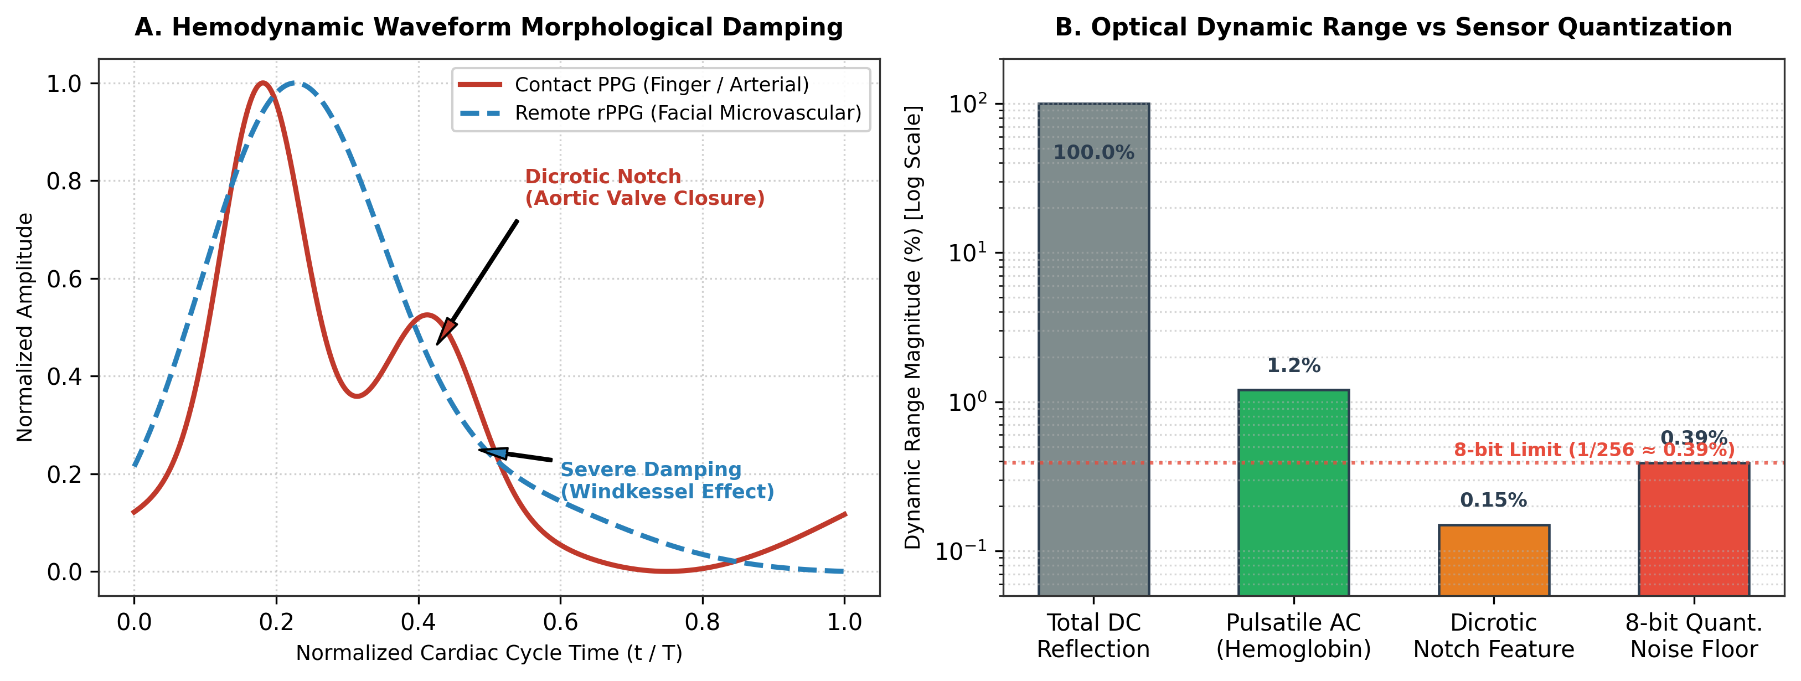
PROPOSED CAPSTONE PROJECT DEFINITION
Slide 6: Proposed Project Title & its Introduction
PROPOSED CAPSTONE PROJECT TITLE
Mobile Remote Photoplethysmography (rPPG) to Cuffless Blood Pressure Estimation
• Global Clinical Burden: Hypertension affects over 1.28 billion adults globally and is a primary risk factor for stroke and cardiovascular disease.
• Limitations of Arm Cuffs: Standard occlusive arm cuffs are intermittent, bulky, uncomfortable, and disrupt sleep during 24-hour ambulatory monitoring.
• White-Coat Effect: In-clinic cuff inflation often induces transient acute stress, leading to false-positive hypertension readings.
• Proposed Contactless Solution: Using commodity smartphone RGB front cameras to detect microscopic facial color variations caused by blood volume pulses, estimating continuous blood pressure non-invasively.
Figure 1: Transcutaneous Optical Absorption & Hemodynamic Waveform Dynamics

Slide 7
SYSTEM SPECIFICATIONS & ENGINEERING DELIVERABLES
Slide 7: Objectives of the Proposed Project
01
Optical Pulse Extraction via Smartphone Camera
Capture facial video at 30 FPS using locked camera exposure/white balance; isolate forehead skin microvascular ROIs using facial landmarks and POS chrominance projection.
02
Physiological Signal Denoising & Conditioning
Standardize variable frame rates to a uniform 125 Hz grid via PCHIP interpolation and apply Savitzky-Golay polynomial smoothing + Butterworth bandpass (0.75–2.5 Hz).
03
Deep Neural Sequence Regression
Develop a hybrid deep architecture (1D-CNN feature extraction + BiGRU sequence modeling + Self-Attention) in TensorFlow with decoupled linear heads for SBP and DBP.
04
Single-Point Personal Calibration Study
Investigate single-point baseline calibration to anchor individual vascular tone and arterial stiffness, overcoming physiological 'template collapse'.
05
Privacy-Preserving On-Device Mobile Execution
Optimize model inference for lightweight Android execution (using TFLite quantization), ensuring 100% on-device privacy with zero cloud transmission.

Slide 8
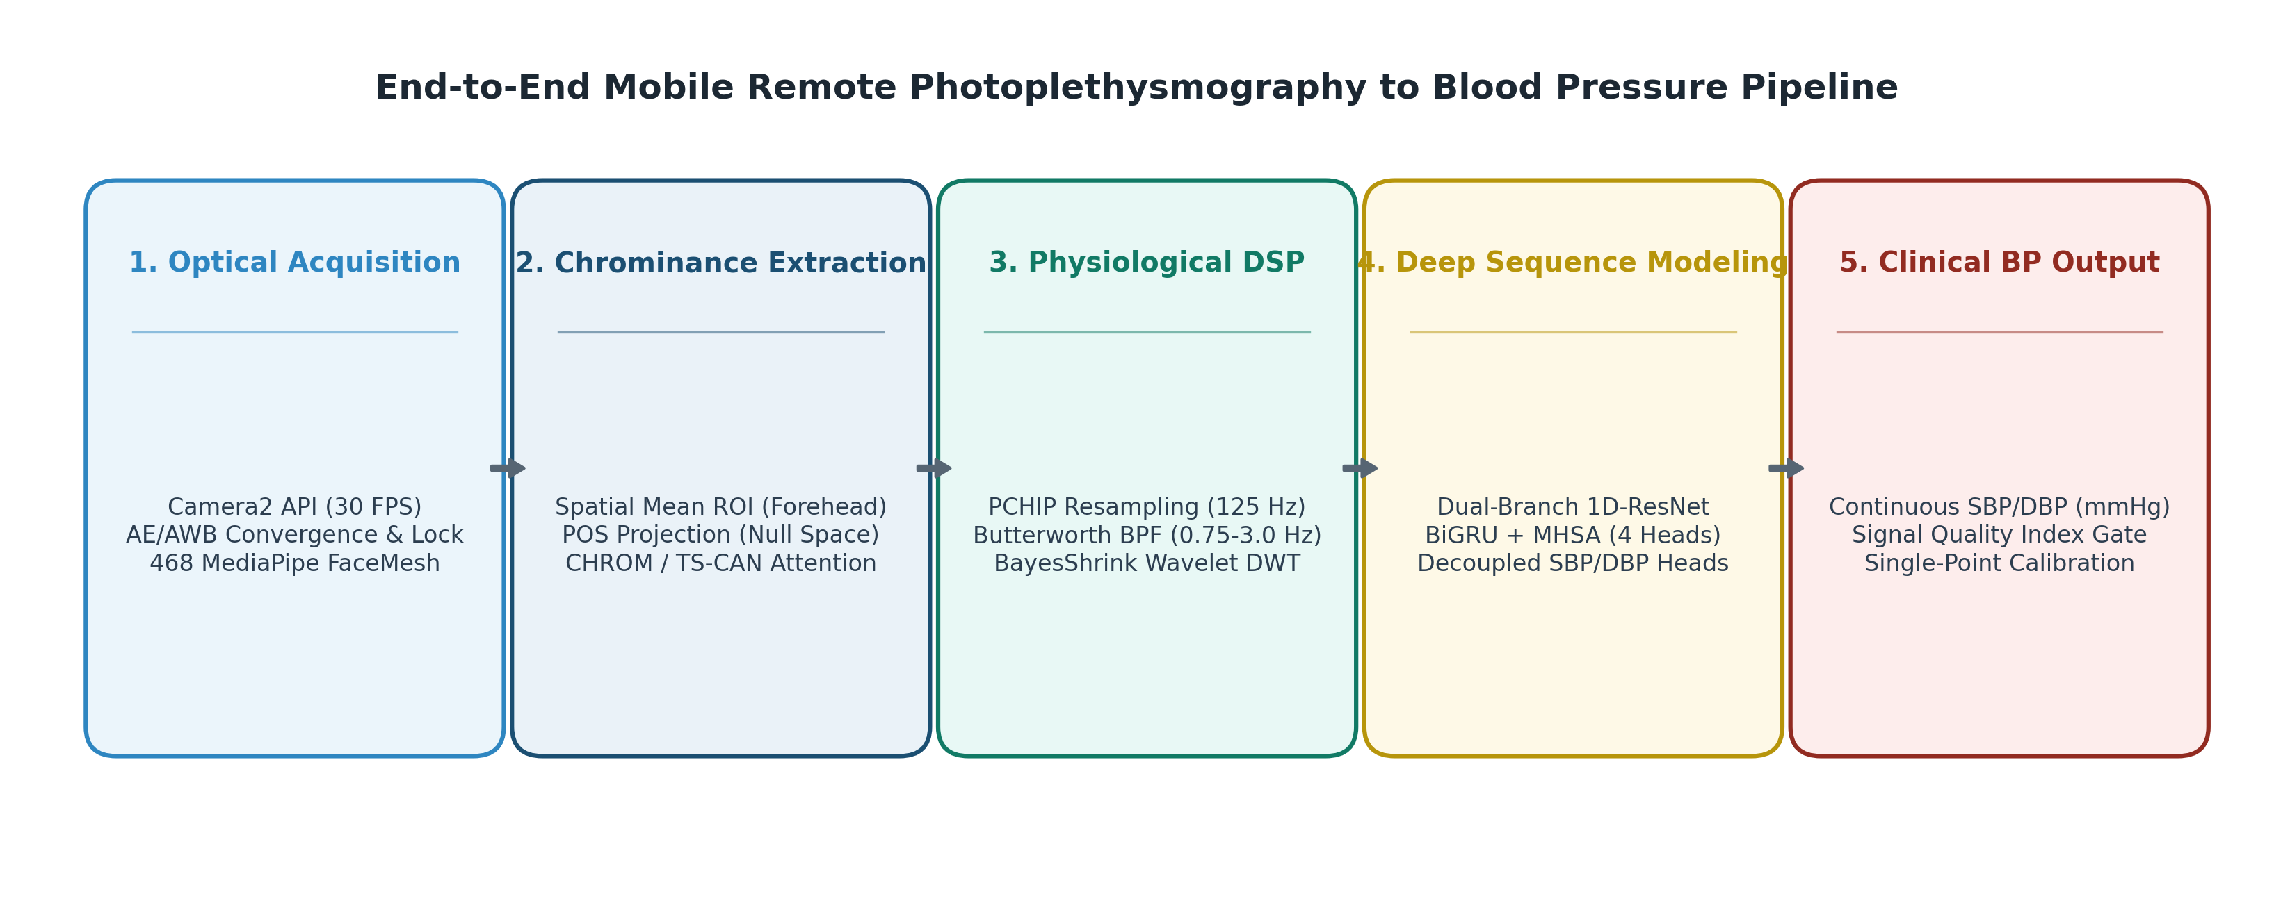
END-TO-END 5-STAGE TECHNICAL PIPELINE
Slide 9: Methodology / Approach of the Proposed Project
PIPELINE ARCHITECTURE STAGES
• Stage 0 • Sensor Photometric Lock: Lock Camera2 auto-exposure, gain, and white balance to eliminate artificial sensor drift.
• Stage 1 • Facial Landmark ROI Tracking: Track facial mesh landmarks to dynamically isolate perfused forehead skin pixels.
• Stage 2 • Chrominance Subspace (POS): Project RGB channels orthogonal to skin-tone vectors to cancel specular reflections (8.9 dB SNR).
• Stage 3 • Dual-Stream DSP Filtering: Resample to 125 Hz via PCHIP, apply Butterworth bandpass and Savitzky-Golay polynomial smoothing.
• Stage 4 • Deep Sequence Regression: Feed conditioned pulse waves into 1D-ResNet + BiGRU + Attention for instantaneous SBP/DBP inference.
Figure 2: End-to-End Smartphone Ingestion & Deep Sequence Inference Workflow

Slide 9
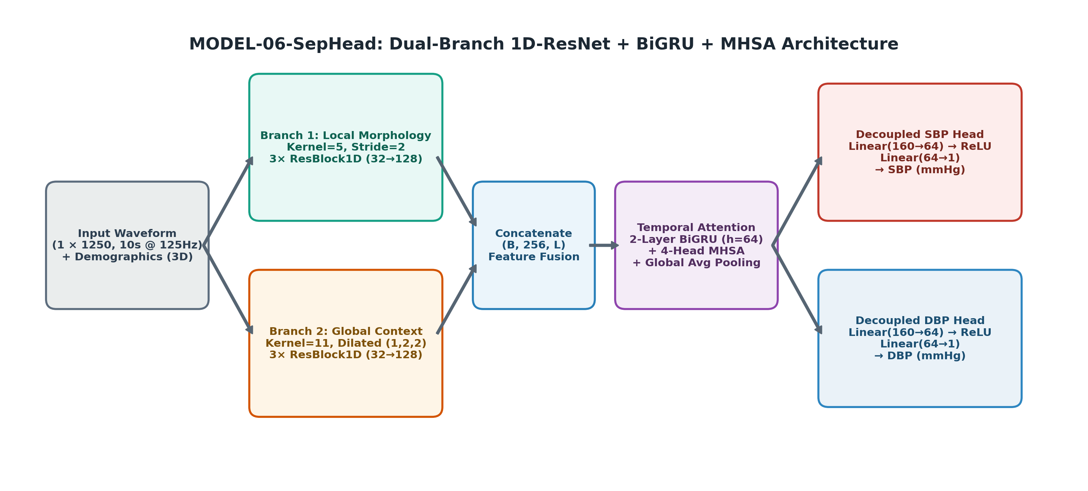
NEURAL ARCHITECTURE & LIVE DEMONSTRATION
Slide 10: Proposed Project Work Details
NEURAL ARCHITECTURE (MODEL-06-SEPHEAD)
• Input Tensor Representation: 1 × 1250 standardized optical pulse samples (10-second window @ 125 Hz) + demographic metadata.
• Multi-Scale 1D-ResNet Branches: Branch 1 (Kernel=5, Stride=2) extracts sharp systolic peaks; Branch 2 (Kernel=11, Dilated) extracts global waveform rhythms.
• Temporal Sequence Modeling: 2-layer Bidirectional GRU (hidden=64) captures cardiac phase periodicity across successive heartbeats.
• Multi-Head Self-Attention: 4-head temporal attention mechanism weights high-SNR cardiac cycles over motion-affected cycles.
• Decoupled Regression Heads: Separate dense output heads predicting SBP (stroke volume) and DBP (peripheral resistance) independently.
⚡ LIVE DEMONSTRATION TOUCHPOINT
📱 [Switching to Smartphone for Live Prototype Demo]
Demonstrating real-time Android Camera2 video ingestion, forehead ROI tracking, Savitzky-Golay signal smoothing, and live blood pressure inference on device.

Slide 10
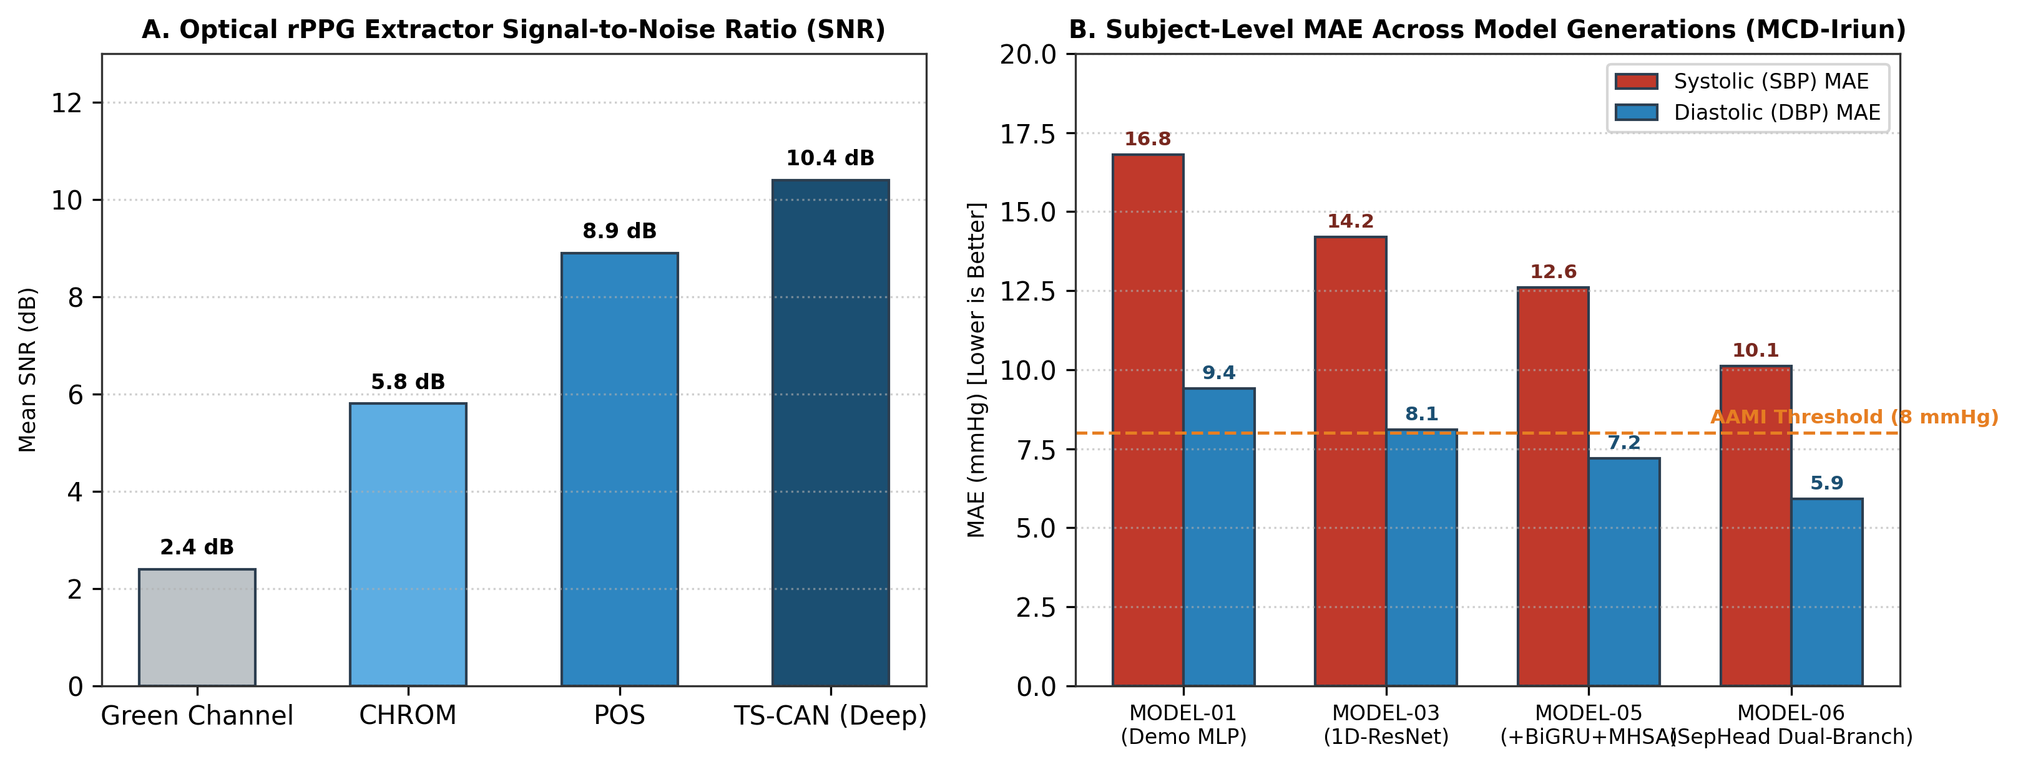
EXPERIMENTAL BENCHMARKS & VALIDATION METRICS
Slide 11: Expected Outcomes & Results of the Proposed Project Work
MODEL PROGRESSION & EXPLORATORY METRICS
• Exploratory Subject MAE: 10.12 mmHg (SBP) / 5.91 mmHg (DBP) on synchronized evaluation partitions.
• Model Progression Gain: Reduced SBP error by 6.70 mmHg compared to naive linear baselines (MODEL-01: 16.82 → MODEL-06: 10.12 mmHg).
• Signal Extraction SNR: POS chrominance projection achieves 8.9 dB SNR; TS-CAN spatial attention achieves 10.4 dB SNR.
• Edge Mobile Latency: ~120 ms offline batch inference on commodity Android CPU with zero dropped frames.
• Single-Point Calibration: Anchoring initial reference reading resolves arterial stiffness variance and prevents population mean collapse.
Figure 3: rPPG Extractor SNR & Model Error (MAE) Benchmark Comparison

Slide 11
SUMMARY & CAPSTONE ROADMAP
Slide 12: Conclusion remarks & Future Scope of work
CONCLUDING REMARKS
• Comprehensive VT Foundation: The 6-week Vocational Training at IIIT-NR provided a strong theoretical and practical grounding across 45 AI with Python topics.
• Applied Interdisciplinary Bridge: Applying digital signal filtering (Savitzky-Golay) and deep sequence models (CNN-BiGRU-Attention) to optical pulse waveforms proved highly effective.
• Feasibility Confirmed: Exploratory results confirm that standard smartphone cameras can capture meaningful cardiovascular vitals without dedicated hardware.
• Privacy-Preserving Paradigm: On-device edge inference ensures zero sensitive biometric video data leaves the user's mobile device.
FUTURE SCOPE & CAPSTONE ROADMAP
• Diverse Demographic Trials: Conduct extensive evaluations across varied skin tones (Fitzpatrick types I–VI) and ambient lighting conditions.
• Mobile NPU Acceleration: Integrate Android NNAPI and INT8 quantization delegates for sub-50ms real-time continuous inference.
• Multi-Modal Optical Fusion: Combine front-camera facial rPPG with rear-camera fingertip contact PPG for optical Pulse Transit Time (PTT) estimation.
• Clinical Kiosk Integration: Deploy edge inference on smart mirrors and digital healthcare triage kiosks for contactless community screening.
Sincere Gratitude to Mr. Om Singh (IIIT-NR), Prof. Aparna Pandey (BIT Raipur), Faculty Members & Committee Reviewers
— Thank You • Open for Questions & Feedback —

