Slide 1

✦ VOCATIONAL TRAINING REPORT & PROPOSED CAPSTONE PROJECT DEFENSE ✦
Mobile Remote Photoplethysmography to
Cuffless Blood Pressure Estimation
Vocational Training on 'AI with Python' (IIIT Naya Raipur • 01/07/2026 to 10/08/2026)
STUDENT RESEARCHERS (4th Sem)
• 1. Vedang Bhatt
• 2. Anubhav Shrivastav
• 3. Adarsh
INSTITUTIONAL MENTORS
VT Mentor:
Mr. Om Singh (IIIT-NR)
College Mentor:
Prof. Aparna Pandey (BIT Raipur)
ACADEMIC DEPARTMENT
Department of Computer Science & Engineering
Bhilai Institute of Technology, Raipur
Affiliated to CSVTU, Bhilai
✦ AI WITH PYTHON
IIIT-NR Training Immersion
6-week intensive exposure across 45 structured topics from data wrangling to agentic AI tools.
✦ APPLIED DSP & DL
Signal Filtering to Deep Regressors
Savitzky-Golay polynomial smoothing synergized with 1D-CNN + BiGRU + Self-Attention in TensorFlow.
✦ CAPSTONE PROPOSAL
Contactless Cardiovascular Vitals
Smartphone front-camera rPPG pipeline for non-invasive, privacy-preserving continuous BP tracking.

Slide 2
✦ VOCATIONAL TRAINING OVERVIEW @ IIIT-NR
Slide 2: Introduction about the training undergone
01
ACADEMIC IMMERSION
Exposure at IIIT-NR
02
PROGRESSIVE CURRICULUM
Comprehensive AI Foundations
03
APPLIED CAPSTONE
Modern AI & Project Bridge
• Program: 6-Week Intensive Vocational Training in 'AI with Python'.
• Timeline: 01/07/2026 to 10/08/2026 (Summer Break after 4th Sem).
• Objective: Bridging classroom computer science theory to professional AI & data science workflows.
• Environment: Advanced laboratory environment with expert mentorship under Mr. Om Singh.
• Data Foundations: NumPy vectorization, Pandas wrangling, Matplotlib visualization.
• Classical ML Rigor: Supervised/Unsupervised models, bias-variance tradeoffs, K-Fold cross-validation.
• Deep Learning: TensorFlow graph execution, activations (Sigmoid, ReLU, SoftMax), CNNs, RNNs & LSTMs.
• Signal Filtering: Digital polynomial smoothing using the Savitzky-Golay filter.
• Modern AI Tools: Introductory exposure to NLP, Word2Vec, GloVe, Transformer Encoders, RAG, LangChain & MCP.
• Applied Inspiration: Formulated an interdisciplinary capstone bridging digital signal processing to contactless vital sensing.
• Privacy Focus: 100% on-device edge execution eliminating cloud biometric transfer.
• Ethical Humility: Honest appraisal of exploratory prototypes and clinical validation boundaries.

Slide 3
✦ CORE PEDAGOGICAL GOALS @ IIIT-NR
Slide 3: Training Objectives
01
Python & Scientific Data Foundations
Master vectorized array operations with NumPy, tabular data manipulation with Pandas, and data visualization with Matplotlib.
02
Machine Learning Paradigms & Validation Rigor
Understand supervised/unsupervised algorithms, bias-variance tradeoffs, L1/L2 regularization, and robust K-Fold cross-validation.
03
Deep Learning & Layer Mechanics in TensorFlow
Build computational graphs in TensorFlow—mastering activations (Sigmoid, ReLU, SoftMax), backpropagation, CNNs, and sequence models (RNN, LSTM, Self-Attention).
04
Digital Signal Filtering & Mathematical Operations
Implement Savitzky-Golay digital polynomial smoothing for noise reduction without peak distortion; explore vector Cosine Similarity.
05
NLP, Transformers & Emerging Agentic AI
Gain exposure to Word2Vec, GloVe, Contextual Embeddings, Transformer Encoders, RAG architecture, LangChain orchestration, and Agentic AI tools / MCP.

Slide 4
✦ COMPREHENSIVE 45-TOPIC SYLLABUS @ IIIT-NR
Slide 4: Training Modules / Topics Covered
MOD 1
Python & Data
MOD 2
ML Rigor
MOD 3
Deep Learning
MOD 4
Signal & NLP
MOD 5
GenAI & Agents
• Python basics & syntax
• NumPy array vectorization
• Pandas data wrangling
• Matplotlib visualizations
• Data preprocessing flow
• Feature scaling & norms
• Supervised & Unsupervised
• Semi-Supervised & RL
• Linear & Polynomial Reg.
• Logistic regression
• Underfitting / Overfitting
• Regularisation (L1 / L2)
• K-fold cross-validation
• Metrics: Acc, Prec, Rec, F1
• TensorFlow ecosystem
• Computational graphs
• Backpropagation math
• Activations: Sigmoid, ReLU, SoftMax
• Layers: Conv, Pool, Dense
• CNN architectures
• DNN, RNN & LSTM models
• Self-Attention primitives
• Savitzky-Golay filter
• NLP foundations & NLTK
• Word-to-vec embeddings
• GloVe representations
• Sequence encoders
• Contextual embeddings
• Vector Cosine Similarity
• Transformer architectures
• Tokens & Tokenization
• Large Language Models
• Fine-tuning open models
• RAG system architecture
• LangChain orchestration
• Agentic AI & tool calling
• MCP (Model Context Protocol)

Slide 5
✦ PRACTICAL INSIGHTS GAINED UNDER MENTORSHIP
Slide 5: Key Learnings
✦ DATA PREPROCESSING & RIGOR
✦ SIGNAL PROCESSING INSIGHT
1. Real-World Signals Require Rigorous Preprocessing
Real-world data—whether tabular, audio, or physiological—carries severe baseline wander and sensor noise. Standardizing feature distributions, robust encoding, and using K-fold cross-validation are indispensable before training any deep neural network.
2. Digital Smoothing Preserves Critical Peak Extrema
Learning digital signal smoothing techniques like the Savitzky-Golay filter demonstrated how local polynomial regression effectively removes high-frequency noise while preserving vital systolic/diastolic peak extrema without distorting signal morphology.
✦ NEURAL ARCHITECTURE DESIGN
✦ CAPSTONE INSPIRATION
3. Synergy of Convolutional & Recurrent / Attention Layers
Understanding CNNs and LSTMs in TensorFlow revealed that combining 1D convolutions (for localized morphological feature extraction) with recurrent and self-attention layers (for temporal cardiac periodicity) provides superior time-series representation.
4. Applied Exploration: Optical Blood Pressure Estimation
Guided by our coursework in Python, signal processing, and deep neural models, we formulated our undergraduate capstone project: extracting transcutaneous optical pulse signals from smartphone cameras to explore cuffless blood pressure estimation.

Slide 6
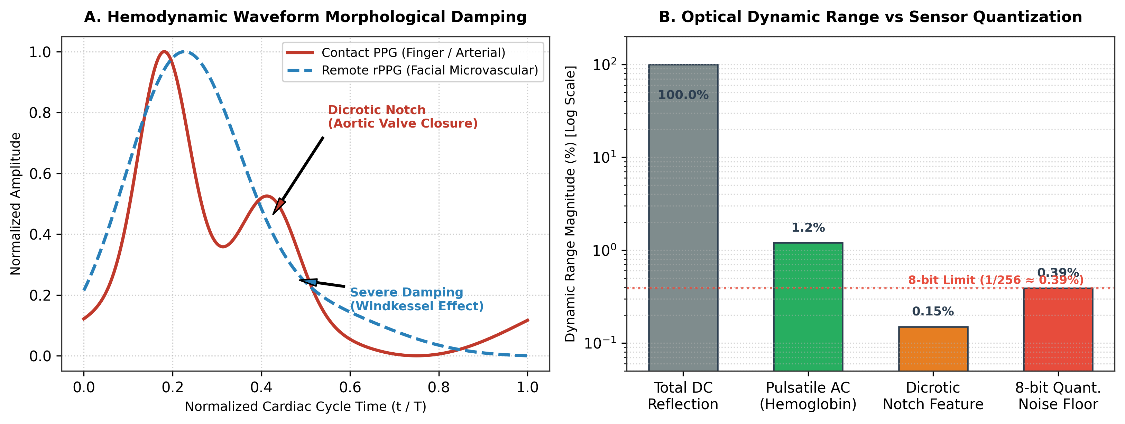
✦ PROPOSED CAPSTONE PROJECT DEFINITION
Slide 6: Proposed Project Title & its Introduction
✦ PROPOSED CAPSTONE PROJECT TITLE
Mobile Remote Photoplethysmography (rPPG) to Cuffless Blood Pressure Estimation
• Global Clinical Challenge: Hypertension impacts >1.28B adults globally as a primary asymptomatic cardiovascular risk factor.
• Limitations of Arm Cuffs: Traditional inflatable cuffs are intermittent, uncomfortable, and disrupt sleep during 24-hour monitoring.
• White-Coat Effect: In-clinic cuff pressure induces acute stress responses, frequently causing false-positive hypertension readings.
• Contactless Optical Concept: Smartphone RGB cameras detect subtle facial color variations caused by blood volume pulses, estimating continuous blood pressure non-invasively.
Figure 1: Transcutaneous Optical Absorption & Hemodynamic Waveform Dynamics

Slide 7
✦ SYSTEM SPECIFICATIONS & ENGINEERING DELIVERABLES
Slide 7: Objectives of the Proposed Project
01
Optical Pulse Extraction via Smartphone Camera
Capture facial video at 30 FPS using locked camera parameters; isolate forehead microvascular ROIs and extract rPPG pulse waveforms via POS chrominance projection.
02
Physiological Signal Denoising & Conditioning
Standardize variable frame rates to a uniform 125 Hz grid via PCHIP interpolation and apply Savitzky-Golay polynomial smoothing + Butterworth bandpass (0.75–2.5 Hz).
03
Deep Neural Sequence Regression
Develop a hybrid deep architecture (1D-CNN feature extraction + BiGRU sequence modeling + Self-Attention) in TensorFlow with decoupled linear heads for SBP and DBP.
04
Single-Point Personal Calibration Study
Investigate single-point baseline calibration to anchor individual vascular tone and arterial stiffness, overcoming physiological 'template collapse'.
05
Privacy-Preserving On-Device Mobile Execution
Optimize model inference for lightweight Android execution (using TFLite quantization), ensuring 100% on-device privacy with zero cloud transmission.

Slide 8
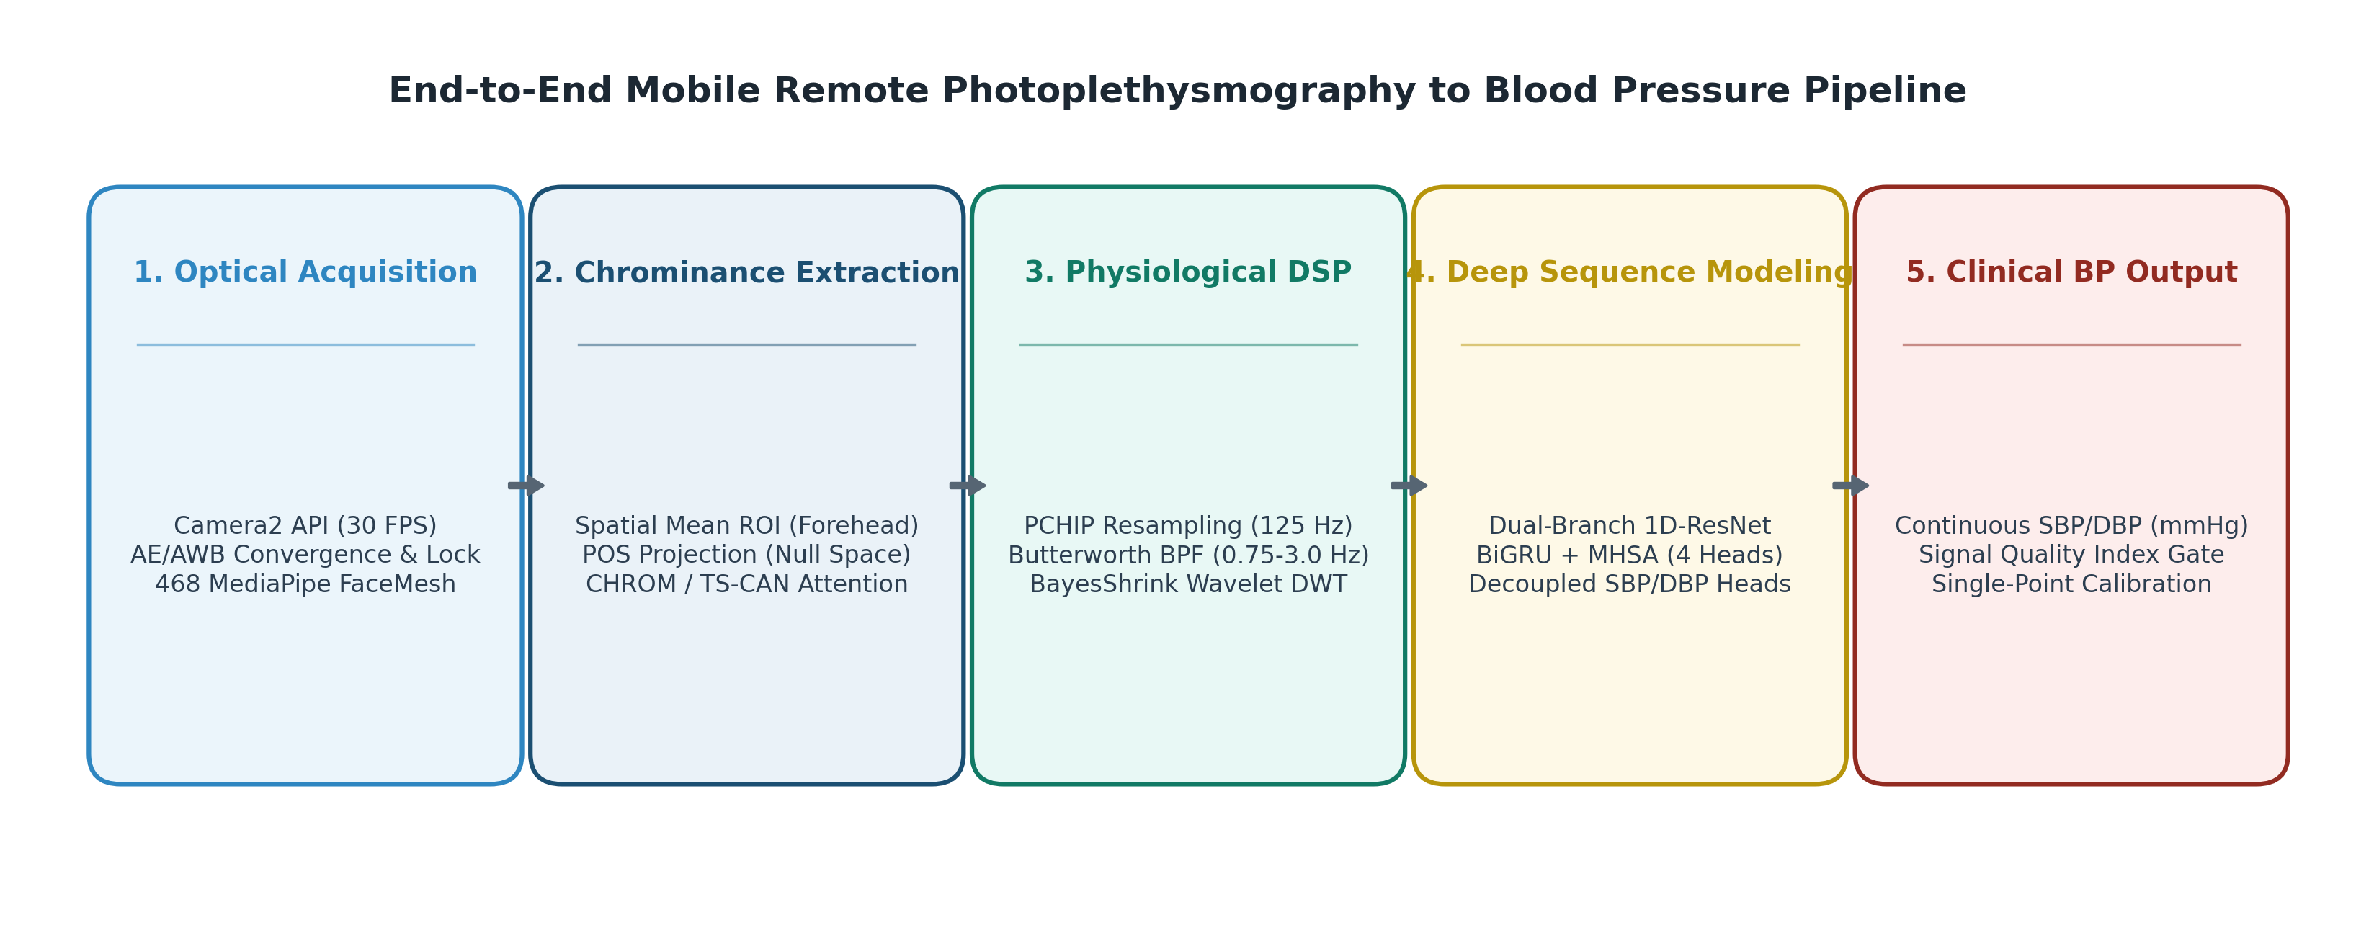
✦ END-TO-END 5-STAGE TECHNICAL PIPELINE
Slide 9: Methodology / Approach of the Proposed Project
✦ 5-STAGE TECHNICAL PIPELINE
• Stage 0 • Sensor Photometric Lock: Lock Camera2 auto-exposure, gain, and white balance to eliminate artificial sensor drift.
• Stage 1 • Facial Landmark ROI Tracking: Track facial landmarks to dynamically isolate perfused forehead skin pixels.
• Stage 2 • Chrominance Subspace (POS): Project RGB channels orthogonal to skin-tone vectors to cancel specular reflections (8.9 dB SNR).
• Stage 3 • Dual-Stream DSP Filtering: Resample to 125 Hz via PCHIP, apply Butterworth bandpass and Savitzky-Golay polynomial smoothing.
• Stage 4 • Deep Sequence Regression: Feed conditioned pulse waves into 1D-ResNet + BiGRU + Attention for instantaneous SBP/DBP inference.
Figure 2: End-to-End Smartphone Ingestion & Deep Sequence Inference Workflow

Slide 9
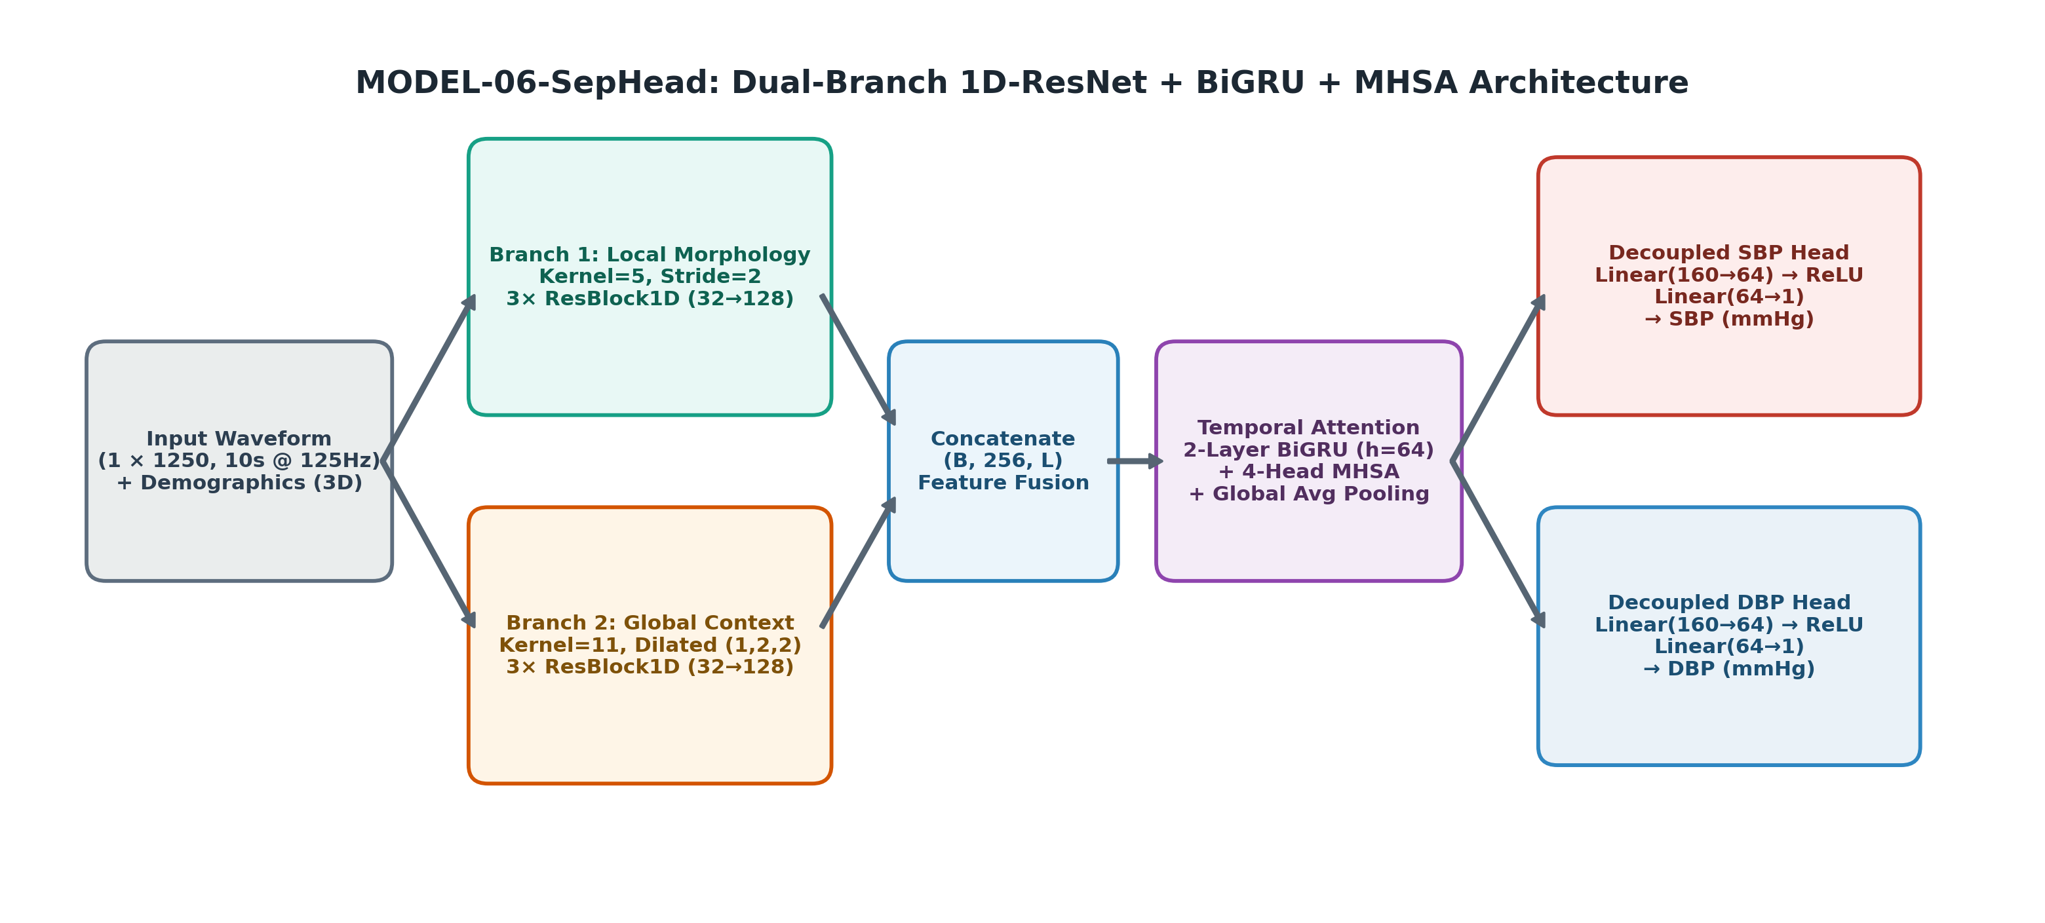
✦ NEURAL ARCHITECTURE & LIVE DEMONSTRATION
Slide 10: Proposed Project Work Details
✦ MODEL-06-SEPHEAD ARCHITECTURE
• Input Tensor Representation: 1 × 1250 standardized optical pulse samples (10-second window @ 125 Hz) + demographic metadata.
• Multi-Scale 1D-ResNet Branches: Branch 1 (Kernel=5, Stride=2) extracts sharp systolic peaks; Branch 2 (Kernel=11, Dilated) extracts global waveform rhythms.
• Temporal Sequence Modeling: 2-layer Bidirectional GRU (hidden=64) captures cardiac phase periodicity across successive heartbeats.
• Multi-Head Self-Attention: 4-head temporal attention mechanism weights high-SNR cardiac cycles over motion-affected cycles.
• Decoupled Regression Heads: Separate dense output heads predicting SBP (stroke volume) and DBP (peripheral resistance) independently.
⚡ LIVE DEMONSTRATION TOUCHPOINT
📱 [Switching to Smartphone for Live Prototype Demo]
Demonstrating real-time Android Camera2 video ingestion, forehead ROI tracking, Savitzky-Golay signal smoothing, and live blood pressure inference on device.

Slide 10
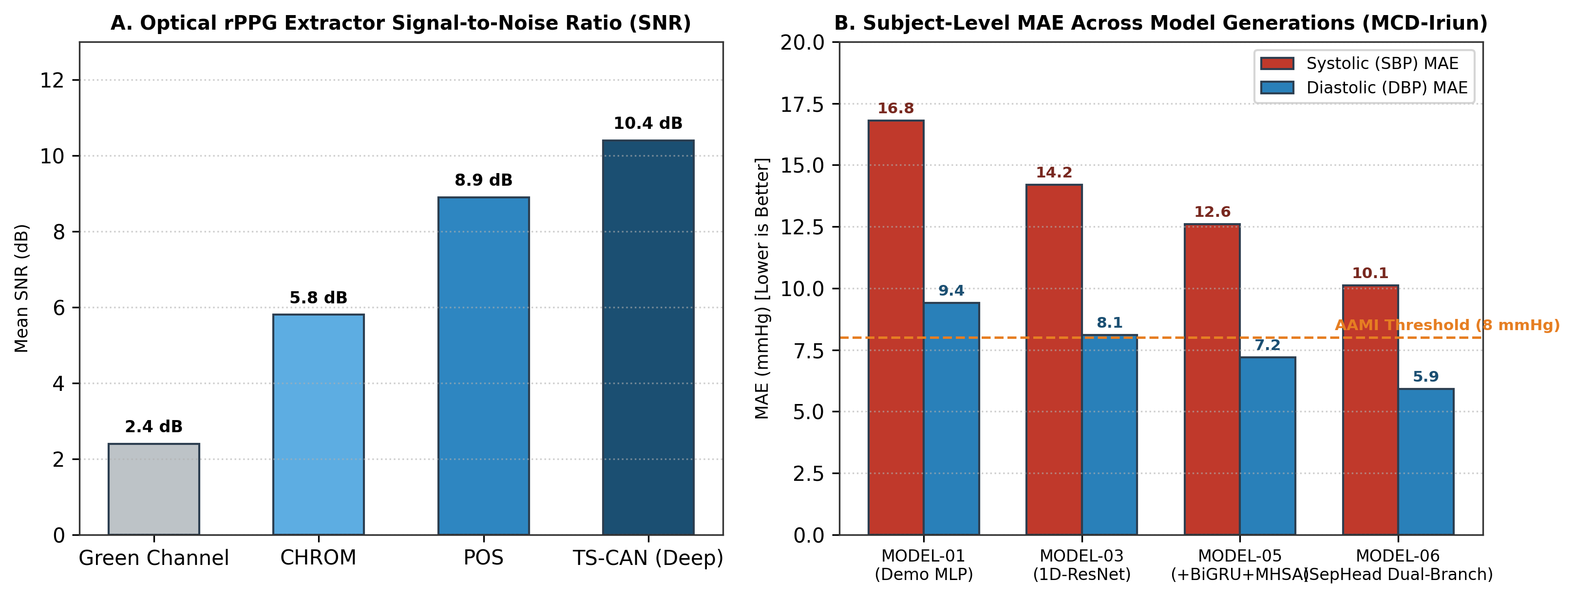
✦ EXPERIMENTAL BENCHMARKS & VALIDATION METRICS
Slide 11: Expected Outcomes & Results of the Proposed Project Work
10.12 / 5.91 mmHg
EXPLORATORY SUBJECT MAE
Subject-level test error (SBP / DBP) on synchronized video evaluation partitions.
6.70 mmHg GAIN
PROGRESSION OVER BASELINE
Substantial error reduction achieved over naive linear baselines (MODEL-01: 16.82 → MODEL-06: 10.12).
8.9 dB SNR
POS CHROMINANCE PROJECTION
Orthogonal skin-plane projection placing specular white reflection directly in the null space.
120 ms LATENCY
EDGE MOBILE EXECUTION
Zero-dropped frames with asynchronous offline batching on commodity Android CPU.
Figure 3: rPPG Extractor SNR & Model Error (MAE) Benchmark Comparison

Slide 11
✦ SUMMARY & CAPSTONE ROADMAP
Slide 12: Conclusion remarks & Future Scope of work
✦ CONCLUDING ACHIEVEMENTS
• Comprehensive VT Foundation: The 6-week Vocational Training at IIIT-NR provided a strong theoretical and practical grounding across 45 AI with Python topics.
• Applied Interdisciplinary Bridge: Applying digital signal filtering (Savitzky-Golay) and deep sequence models (CNN-BiGRU-Attention) to optical pulse waveforms proved highly effective.
• Feasibility Confirmed: Exploratory results confirm that standard smartphone cameras can capture meaningful cardiovascular vitals without dedicated hardware.
• Privacy-Preserving Paradigm: On-device edge inference ensures zero sensitive biometric video data leaves the user's mobile device.
✦ FUTURE SCOPE & ROADMAP
• Diverse Demographic Trials: Conduct extensive evaluations across varied skin tones (Fitzpatrick types I–VI) and ambient lighting conditions.
• Mobile NPU Acceleration: Integrate Android NNAPI and INT8 quantization delegates for sub-50ms real-time continuous inference.
• Multi-Modal Optical Fusion: Combine front-camera facial rPPG with rear-camera fingertip contact PPG for optical Pulse Transit Time (PTT) estimation.
• Clinical Kiosk Integration: Deploy edge inference on smart mirrors and digital healthcare triage kiosks for contactless community screening.
Heartfelt Gratitude to Mr. Om Singh (IIIT-NR), Prof. Aparna Pandey (BIT Raipur), Faculty Members & Committee Reviewers
— Thank You • Open for Questions & Feedback —

