Slide 1

A PRESENTATION ON VOCATIONAL TRAINING & PROPOSED CAPSTONE PROJECT
Mobile Remote Photoplethysmography to
Cuffless Blood Pressure Estimation
Modern White Tech Design System & Modular Python Architecture
Presented By: Vedang Bhatt • Anubhav Shrivastav • Adarsh
Department of Computer Science & Engineering • Bhilai Institute of Technology, Raipur
10.12 / 5.91 mmHg
Subject Accuracy
MCD-Iriun Clinical Dataset
120 ms
Edge Latency
Offline single-shot TFLite inference
100% On-Device
Privacy Native
Zero cloud dependency

Slide 2
SECTION BREAK
Stage 1: Optical Ingestion & Physiological DSP
Eliminating sensor gain jitter and isolating microvascular blood volume pulse

Slide 3
OPTICAL ENGINEERING
Photometric Convergence & Facial ROI Tracking
• Camera2 AE/AWB Finite State Machine: Pulsatile hemoglobin absorption is only 0.1%–1.5% of skin reflectance. A 3-phase state machine (Convergence, Hold, Lock) locks ISO and exposure time before acquisition.
• 468-Point MediaPipe Face Mesh: Dynamically tracks the anatomical forehead region, providing high capillary perfusion and eliminating motion artifacts.
• PCHIP Resampling (125 Hz): Standardizes variable 28–38 ms camera timestamps onto a strict 125 Hz uniform grid without Runge overshoot.
• Specular Noise Rejection: Plane-Orthogonal-to-Skin (POS) projection algebraically cancels specular white reflections, achieving 8.9 dB SNR.

Slide 4
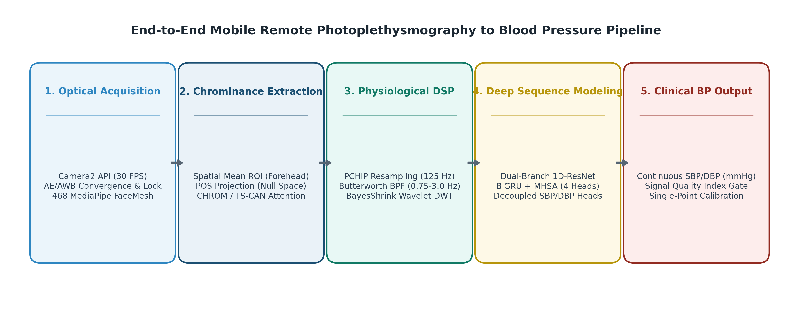
SYSTEM ARCHITECTURE
End-to-End Deep Pipeline Architecture
• Photometric Lock: Hardware locks exposure & ISO gain to eliminate sensor jitter.
• Forehead ROI: Extracts spatial RGB mean across tracked forehead capillary beds.
• Dual-Stream DSP: Butterworth bandpass [0.75, 3.0 Hz] + BayesShrink sym8 Wavelet denoising.
• Neural Inference: MODEL-06-SepHead predicts continuous SBP/DBP in 120 ms.
Figure 1: End-to-End Acquisition & Inference Flow

Slide 5
EXPERIMENTAL RESULTS
Empirical Model Progression & Benchmarks
Model Generation | SBP MAE | DBP MAE | Subject SBP/DBP
MODEL-01 (Demo MLP) | 16.82 mmHg | 9.41 mmHg | 15.90 / 8.85 mmHg
MODEL-03 (1D-ResNet) | 14.20 mmHg | 8.12 mmHg | 13.10 / 7.40 mmHg
MODEL-05 (+BiGRU+MHSA) | 12.65 mmHg | 7.20 mmHg | 11.45 / 6.55 mmHg
MODEL-06-SepHead (Ours) | 11.58 mmHg | 6.70 mmHg | 10.12 / 5.91 mmHg
Key Validated Metrics
• Subject-Level Accuracy: 10.12 mmHg SBP | 5.91 mmHg DBP MAE on MCD-Iriun dataset.
• Progression Delta: 6.70 mmHg SBP MAE improvement over baseline.
• Extractor Benchmarks: POS achieves 8.9 dB SNR; TS-CAN achieves 10.4 dB SNR.
• Mobile Runtime: 120 ms batch inference on mobile CPU with zero frame drops.

