Slide 1
IBM University Engagement Project Submission
“Exploring the Power of Agentic AI with IBM Cloud and Orchestrate”

Slide 2

Project Tile – [Recipe Preparation Agent]
Domain of Project – [Food & Nutrition]
Student Name | Recent Passport Photo | Email ID | Mobile number [WhatsApp]
Vedangi Eknath Patil |  | 202401040058@mitaoe.ac.in | 9359887931

Slide 3
Problem Statement -
Problem Statement : Recipe Preparation Agent
The Challenge
Many people already have the ingredients they need at home but often don't know what meals they can prepare with them. Most existing recipe platforms require users to search for recipes manually and frequently suggest dishes that need extra ingredients. As a result, people end up wasting food, spending more money on unnecessary groceries, and taking extra time to plan their meals.
The Objective
Develop an AI-powered Recipe Preparation Agent using IBM Granite Models, IBM watsonx.ai, and Retrieval-Augmented Generation (RAG) that helps users cook meals using the ingredients already available in their kitchen.
The solution should provide:
Recipe suggestions based on available ingredients
Step-by-step cooking instructions
Ingredient substitution recommendations
Dietary preference support (vegetarian, vegan, diabetic, etc.)
Cooking tips and preparation guidance
RAG-based retrieval of trusted recipe information
A user-friendly web interface for everyday cooking assistance

Slide 4
Proposed Solution -
Proposed Solution: AI-Powered Smart Recipe Preparation Assistant
The proposed solution is a multi-agent AI-powered Smart Recipe Preparation Assistant built using IBM watsonx.ai, IBM Granite Model, Flask, ChromaDB, and Retrieval-Augmented Generation (RAG) to provide personalized recipe recommendations, step-by-step cooking guidance, and smart ingredient substitutions. At its core, the solution uses a Retrieval-Augmented Generation (RAG) pipeline to retrieve accurate recipe information from a trusted recipe knowledge base. This information is embedded and stored in a vector database, enabling the system to provide relevant recipes, cooking instructions, nutritional information, and personalized meal recommendations using IBM Granite Model.
The system consists of four key agents:
Ingredient Analysis Agent – Identifies and analyzes the ingredients entered by the user to determine the possible meal options.
Recipe Retrieval Agent – Retrieves relevant recipes, cooking methods, and ingredient information using the RAG pipeline.
Recipe Generation Agent – Generates personalized recipes with step-by-step cooking instructions using IBM Granite AI.
Recommendation Agent – Suggests ingredient substitutions, dietary modifications, cooking tips, and suitable meal recommendations.

Slide 5
Proposed Solution -
Proposed Solution: AI-Powered Smart Recipe Preparation Assistant
The solution includes a modern recipe preparation dashboard built using Flask, where users can enter available ingredients, receive personalized recipe suggestions, view detailed cooking instructions, explore ingredient substitutions, analyze nutritional information, and customize recipes based on their dietary preferences through an intuitive interface.
IBM watsonx.ai manages AI model deployment, embeddings, and prompt execution, while ChromaDB enables efficient semantic retrieval through the RAG pipeline. IBM Granite Model power intelligent recipe generation, ingredient analysis, cooking guidance, and personalized meal recommendations.
Overall, this solution delivers an end-to-end AI-powered Recipe Preparation Assistant that helps users prepare delicious meals using available ingredients, reduces food waste, saves time, and makes everyday cooking easier through a simple and user-friendly platform.

Slide 6
Technology Used
IBM Cloud- Provides a secure cloud platform for developing, managing, and deploying the application.
IBM watsonx.ai- Used to access AI models, execute prompts, and generate intelligent recipe recommendations.
IBM Granite 3.2-8B- Power the AI assistant by generating personalized recipes, cooking instructions, and ingredient recommendations.
Retrieval-Augmented Generation (RAG)- Retrieves relevant recipe information from the knowledge base before generating responses, improving accuracy and reducing incorrect results.
ChromaDB- Stores recipe document embeddings and enables fast semantic search for relevant cooking information.
Flask (Python)- Used to develop the backend APIs and integrate the AI model with the web application.
HTML5, CSS3 & JavaScript- Used to build a responsive, interactive, and user-friendly web interface.
Bootstrap- Provides a modern and mobile-friendly user interface with responsive design components.

Slide 7
LangFlow Component Used:
1. Chat Input
Accepts recipe-related queries and available ingredients from the user.
2. Prompt Template
Structures the user's query before sending it to the AI model.
3. RAG Retriever
Retrieves relevant recipe information from the knowledge base using semantic search.
4. ChromaDB Vector Store
Stores recipe embeddings and enables fast similarity-based retrieval.
5. IBM watsonx.ai Model
Processes the retrieved information and generates intelligent recipe responses.
6. Output Parser
Formats the generated response into a clear and readable recipe.
7. Chat Output
Displays recipe suggestions, cooking instructions, ingredient substitutions, and cooking tips to the user.

Slide 8
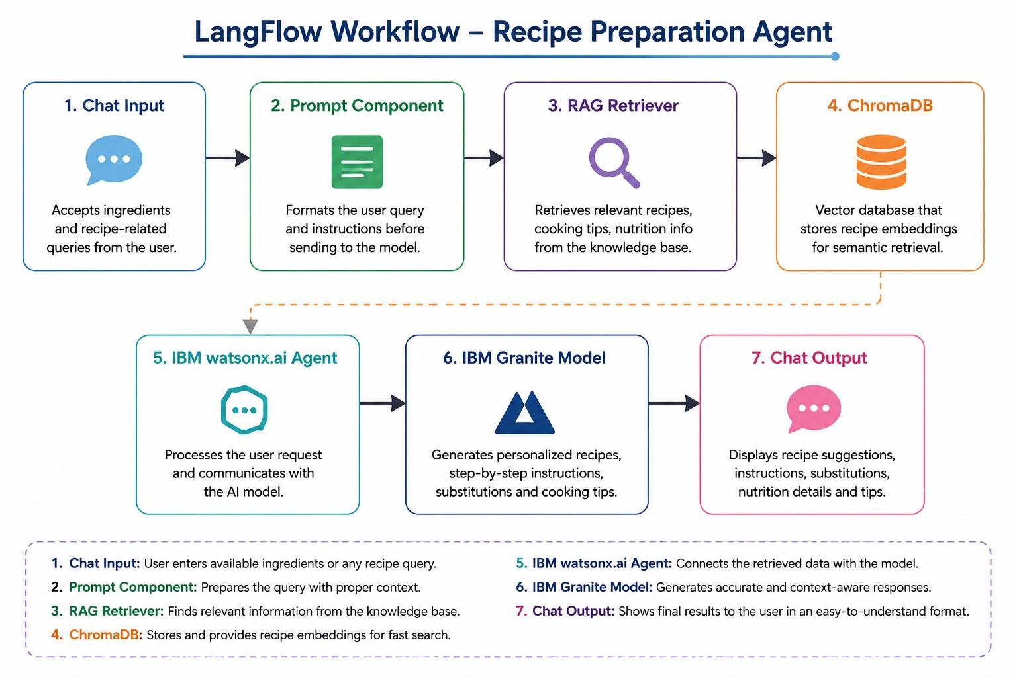
LangFlow workflow

Slide 9
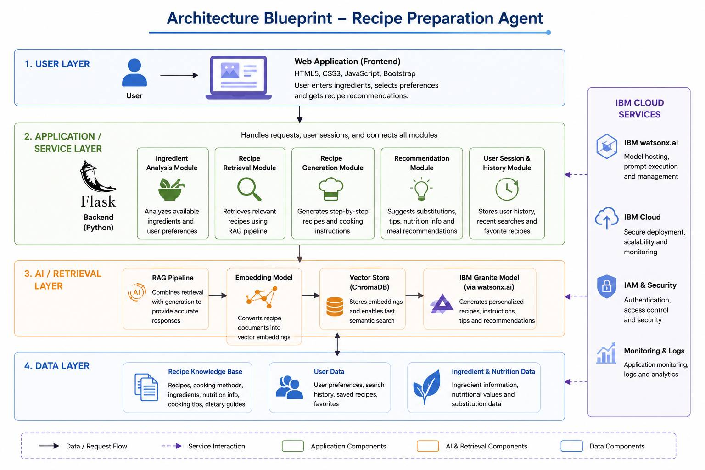
Architecture blueprint

Slide 10

Role of Agentic AI in the solution
Role of Agentic AI in Recipe Preparation Assistant Agent
Agentic AI acts as an intelligent cooking assistant that understands the user's available ingredients and provides practical recipe suggestions instead of generic recommendations.
Different AI agents work together to make the cooking experience simple and personalized.
Ingredient Analysis Agent identifies the ingredients entered by the user.
Recipe Retrieval Agent searches the recipe database using RAG to find the most suitable recipes.
Recipe Generation Agent uses IBM Granite to generate clear, step-by-step cooking instructions.
Substitution Agent suggests alternative ingredients when some items are unavailable.
Dietary Preference Agent modifies recipes based on vegetarian, vegan, or other dietary requirements.
Cooking Tips Agent provides useful cooking tips and preparation guidance.
Together, these agents help users prepare meals easily, reduce food waste, save time, and make better use of the ingredients already available at home.

Slide 11
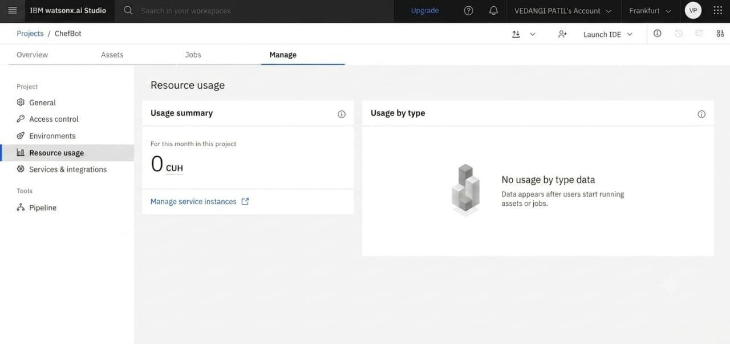
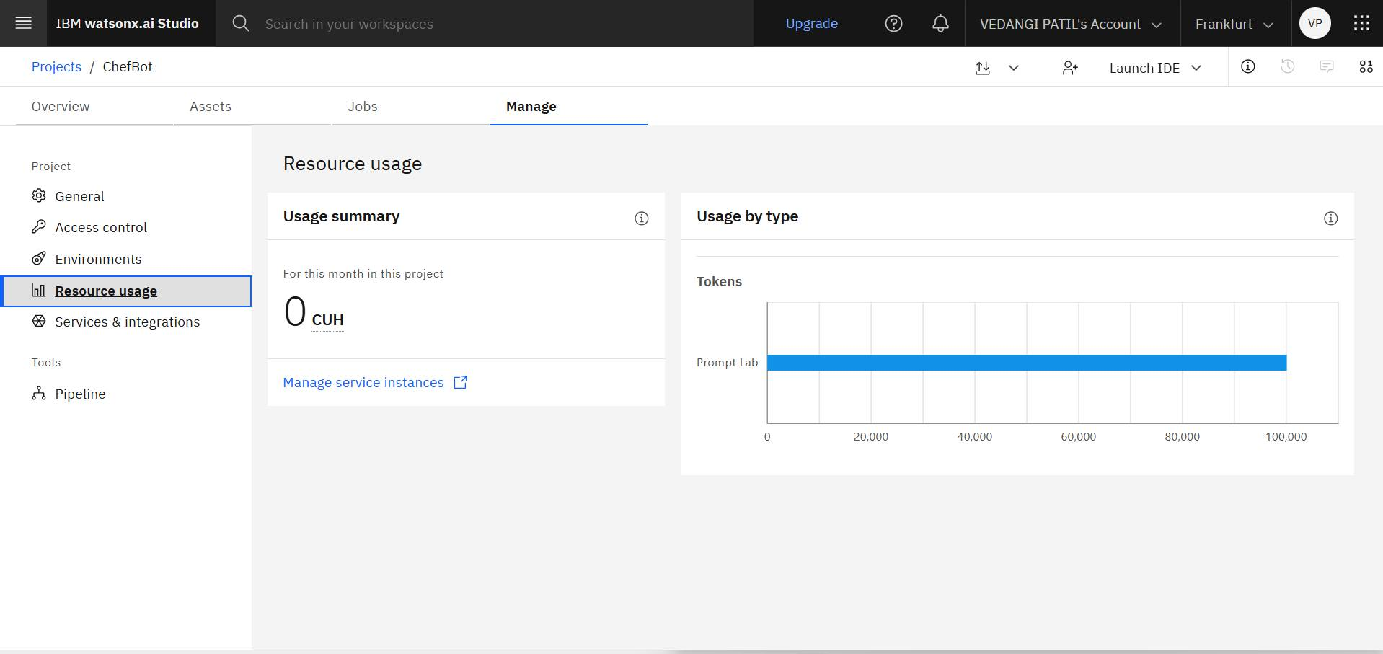
Token Usage
Before prompt:
After prompt:

Slide 12
Novelty and Uniqueness
RAG-Based Recipe Retrieval Retrieves recipes from a trusted knowledge base instead of generating random results.
Smart Ingredient Matching Suggests recipes based only on the ingredients available with the user.
Ingredient Substitution Support Recommends suitable alternatives when certain ingredients are missing.
Personalized Dietary Recommendations Adjusts recipes according to vegetarian, vegan, diabetic, or other dietary preferences.
Step-by-Step Cooking Guidance Provides clear and easy-to-follow cooking instructions for every recipe.
Interactive AI Chat Assistant Allows users to ask cooking-related questions and receive instant guidance.
User-Friendly Web Interface Simple, responsive, and easy to use on both desktop and mobile devices.

Slide 13
GitHub Link
AI-powered Recipe Preparation Agent using IBM Granite Models, IBM watsonx.ai, and Retrieval-Augmented Generation (RAG) that helps users prepare meals using available ingredients and provides personalized cooking guidance.
GitHub Repository:
https://github.com/vedangi481/Recipe-Agent-Chef-Bot

Slide 14
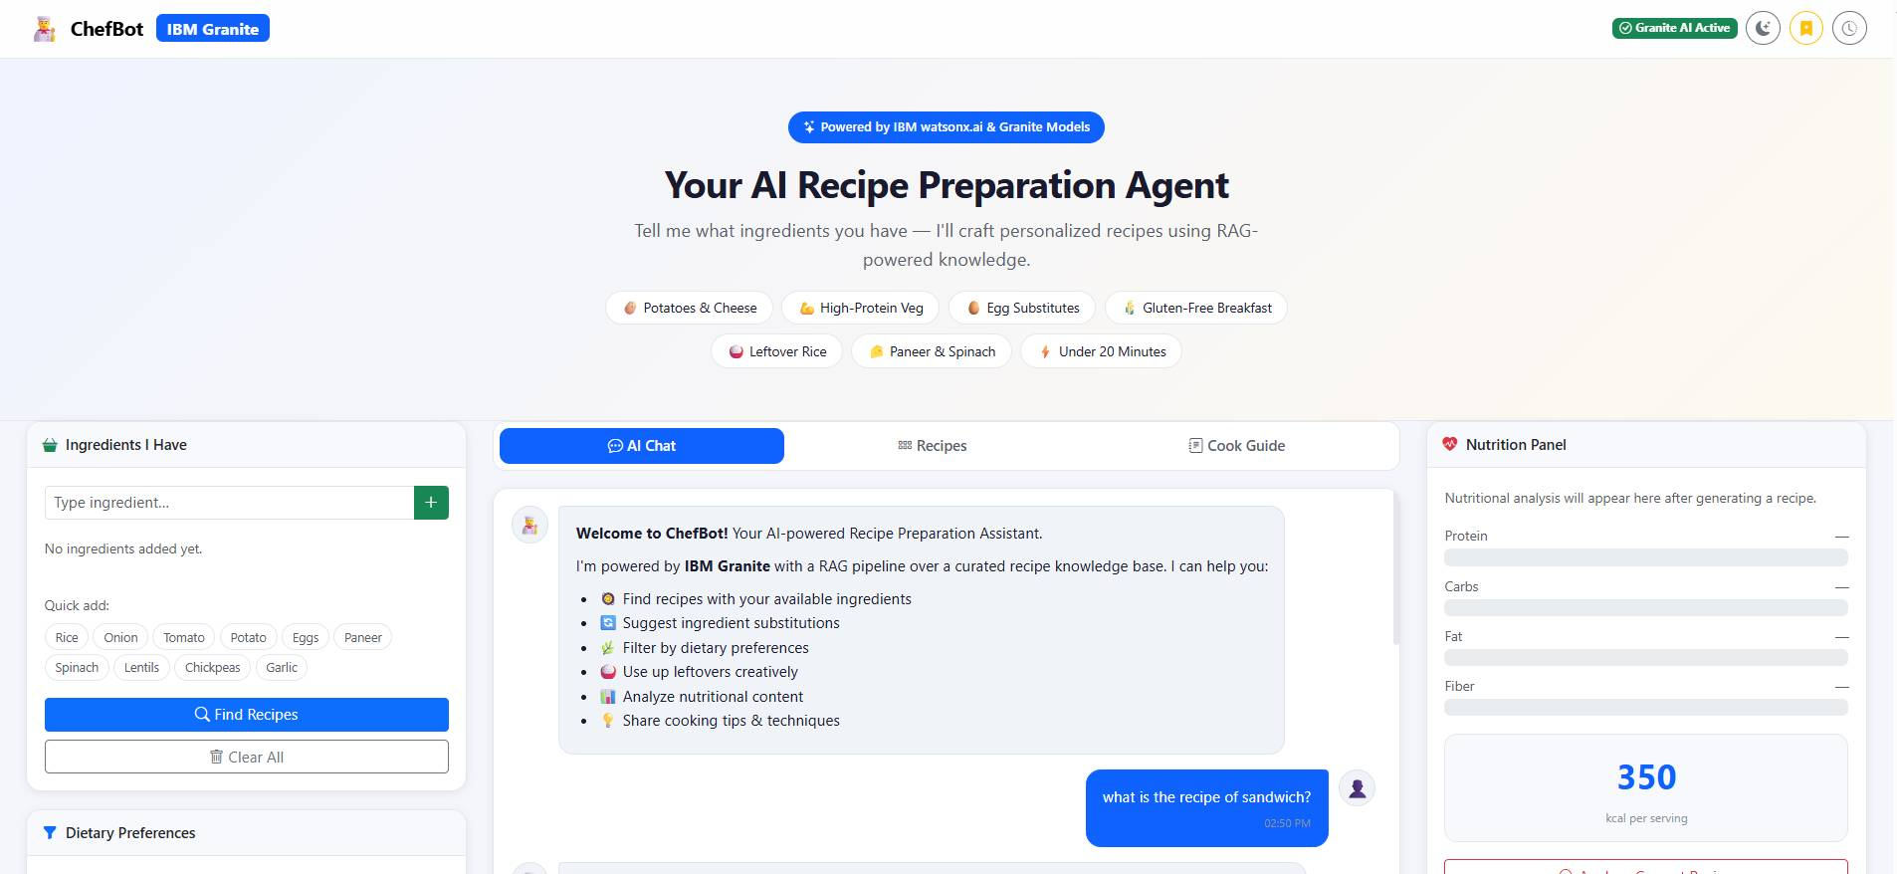
Screenshot of Project-

Slide 15
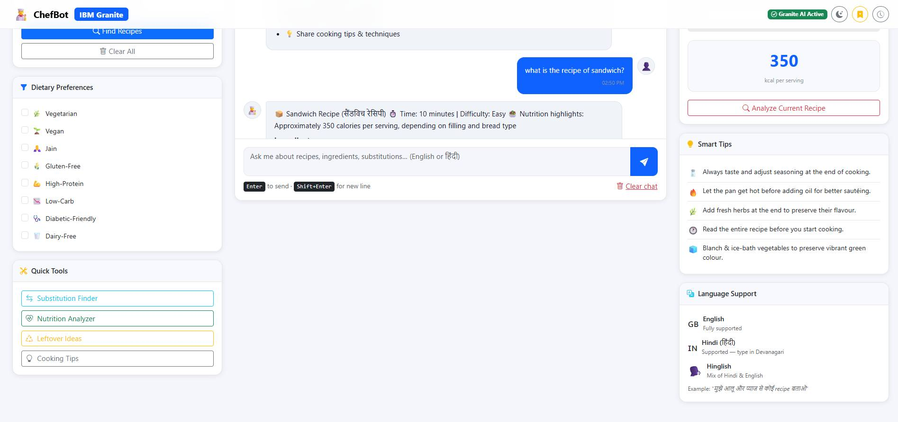
Screenshot of Project-

Slide 16
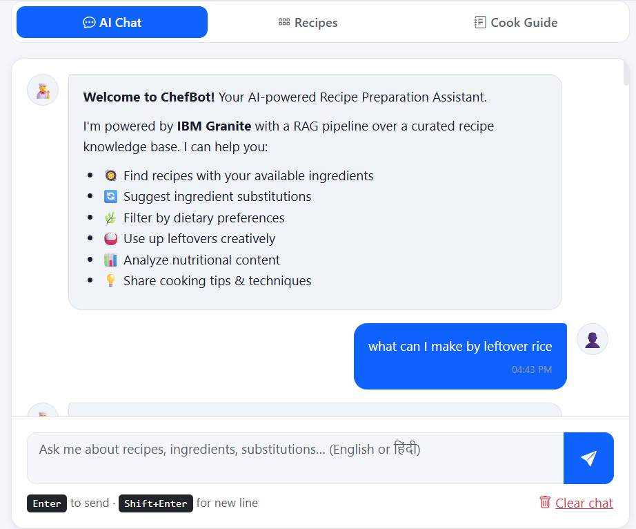
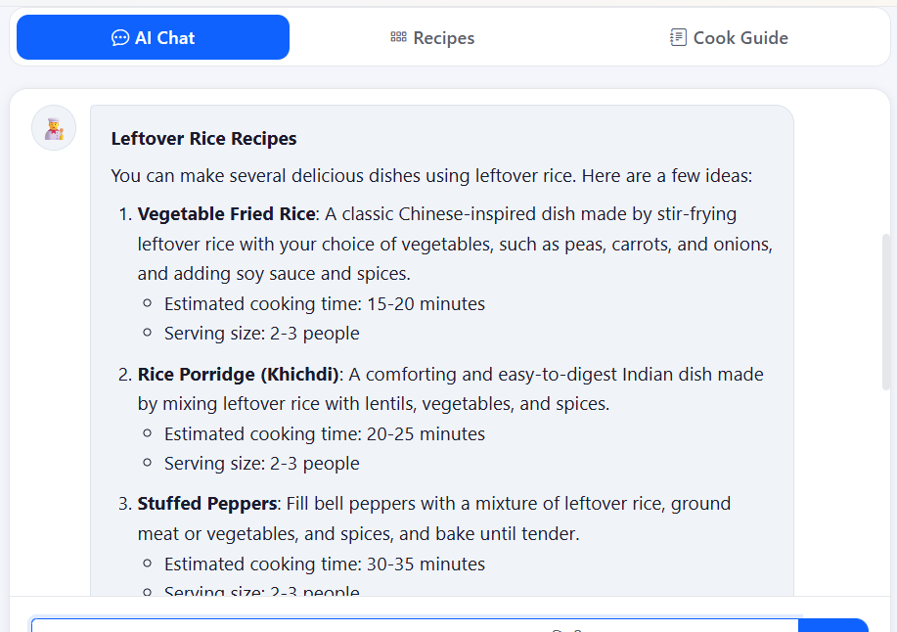
Screenshot of Project-

Slide 17
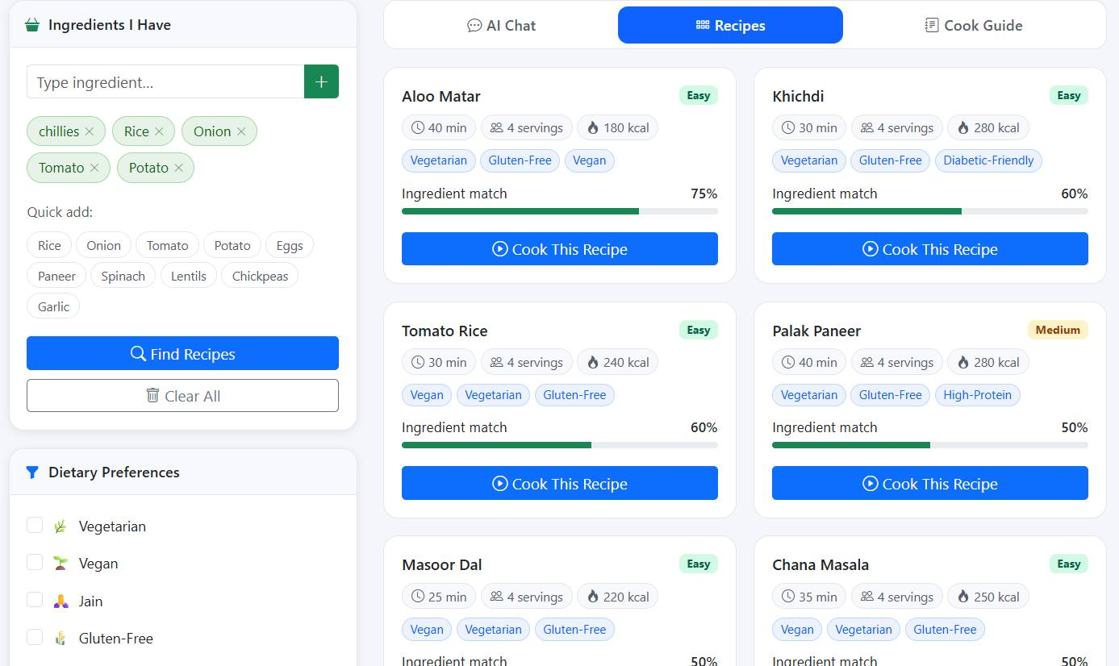
Screenshot of Project-

Slide 18
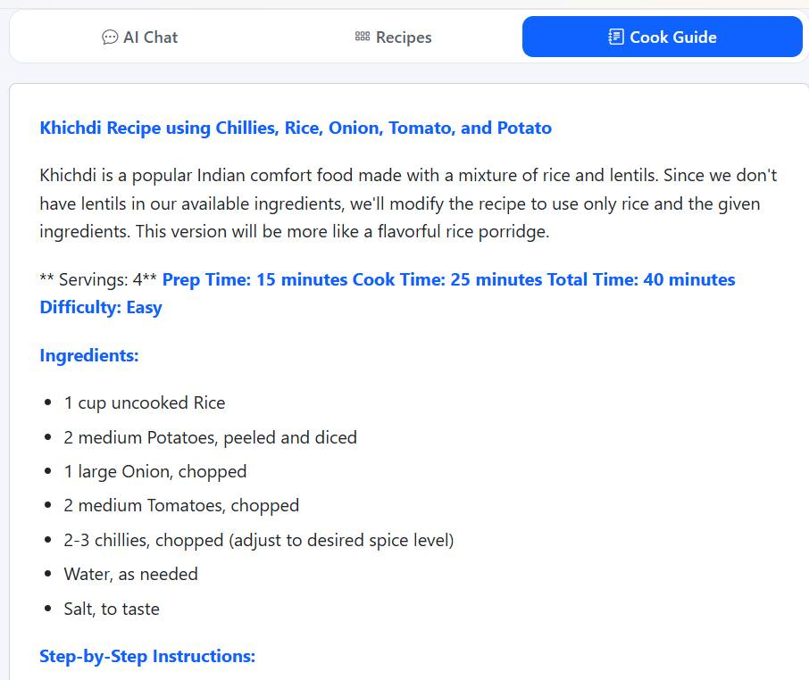
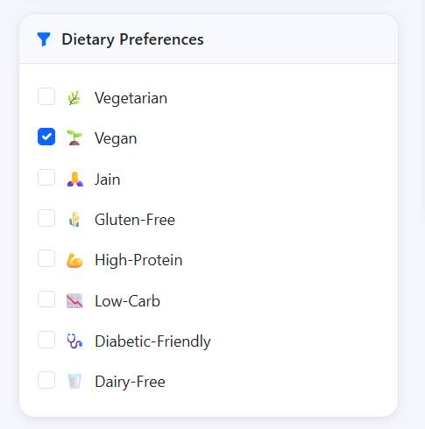
Screenshot of Project-

Slide 19
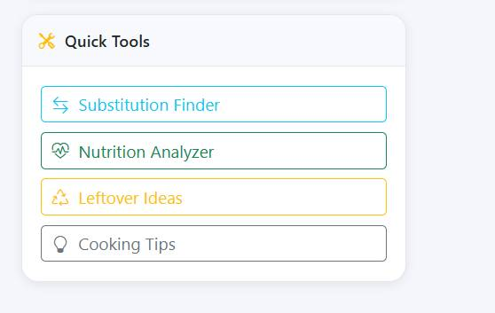
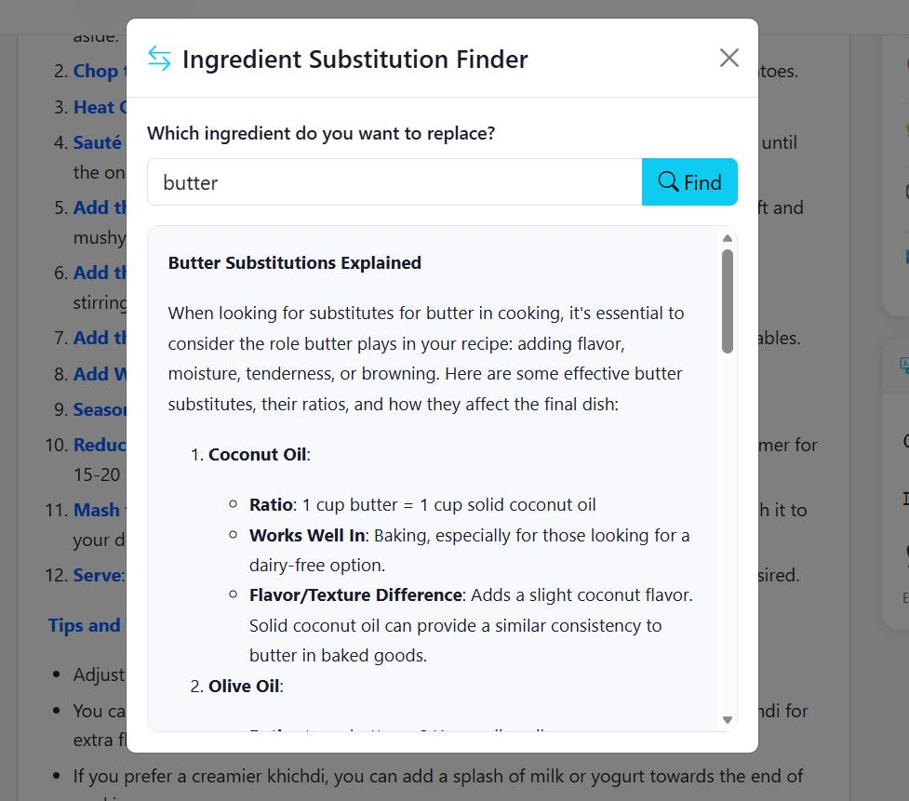
Screenshot of Project-

Slide 20
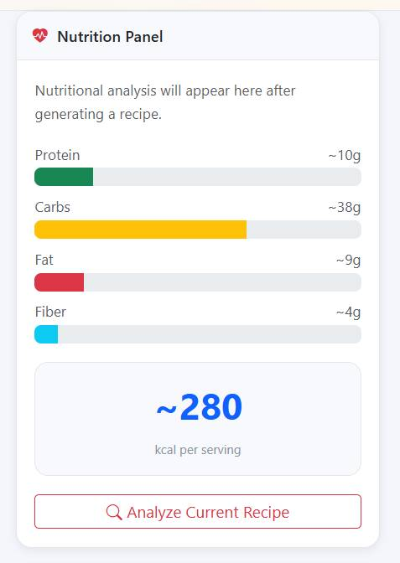
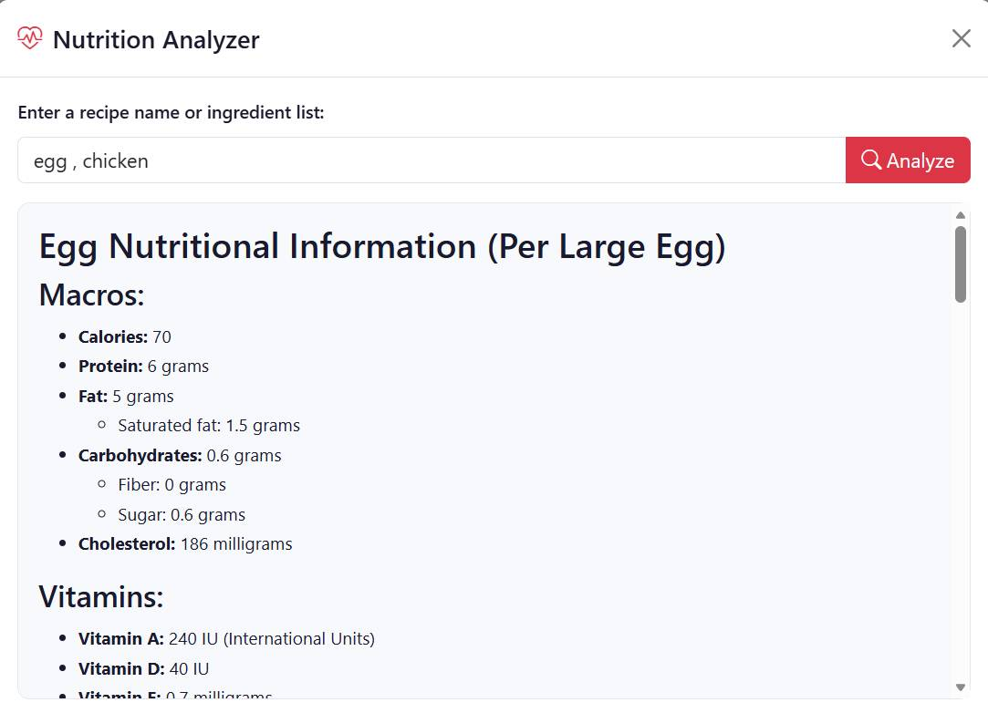
Screenshot of Project-

Slide 21
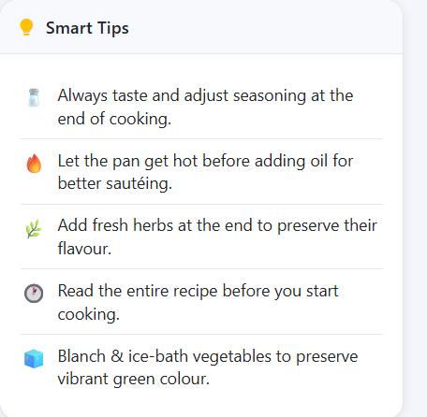
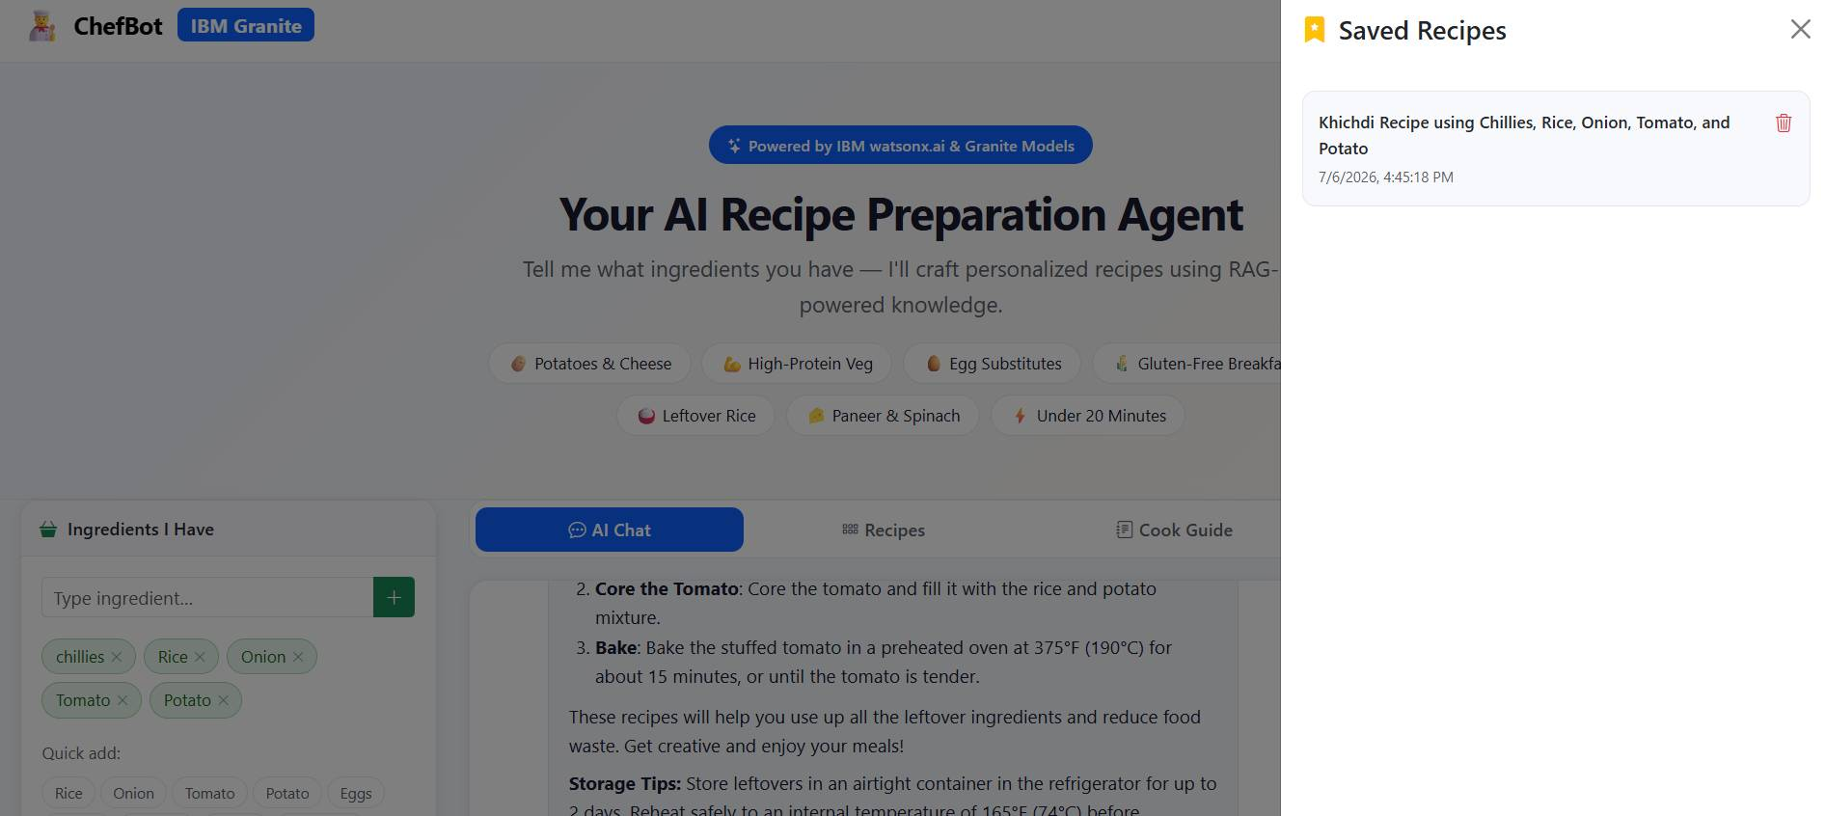
Screenshot of Project-

Slide 22
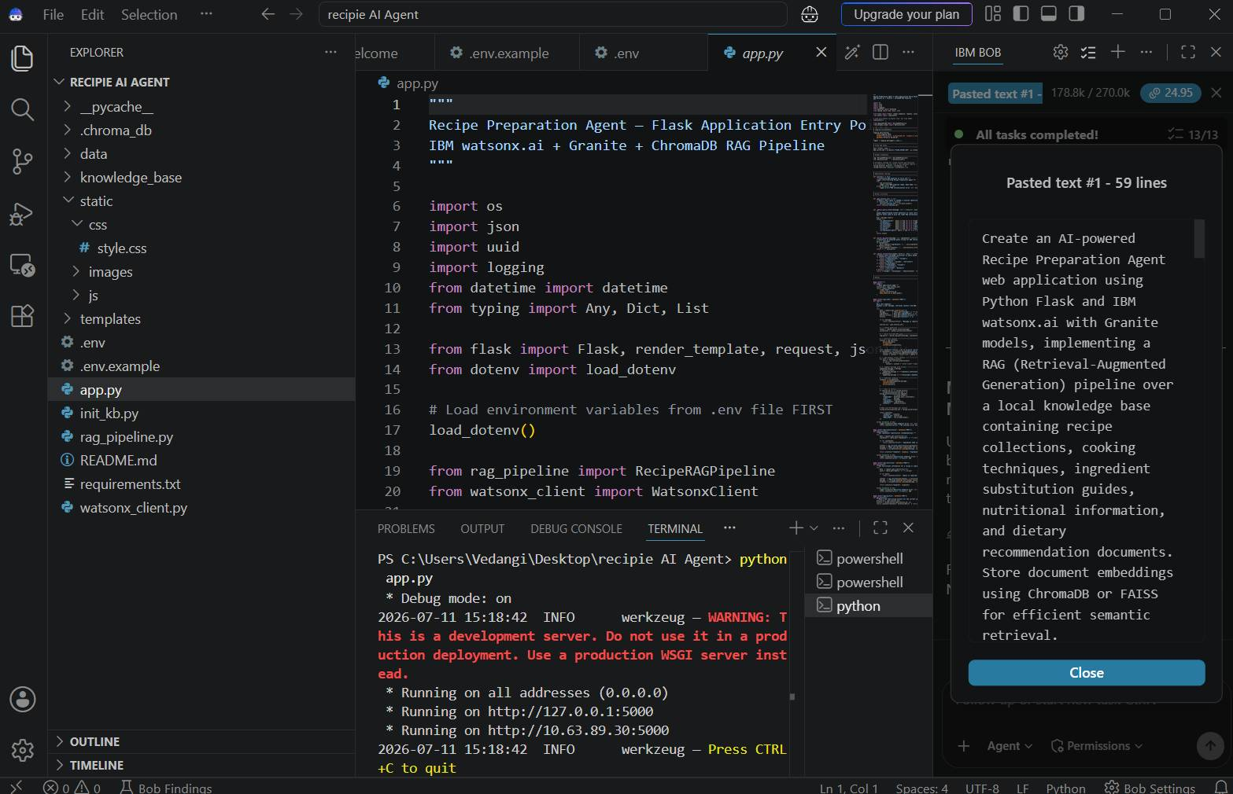
Screenshots of ibm bob-
·
·
·

Slide 23
Future Scope
Voice-enabled recipe assistant for hands-free cooking.
Mobile application for Android and iOS users.
Image-based ingredient recognition using the device camera.
Personalized meal plans based on user preferences and health goals.
Nutrition and calorie tracking for healthier food choices.
Smart grocery list generation for missing ingredients.
Multi-language support for regional and international users.
Integration with grocery delivery services for easy ingredient ordering.
Cloud deployment to support a larger number of users.
Future Goal : To develop the Recipe Preparation Agent into a smart kitchen assistant that helps users prepare healthy, personalized meals while reducing food waste and making everyday cooking easier through AI-powered recommendations.

Slide 24
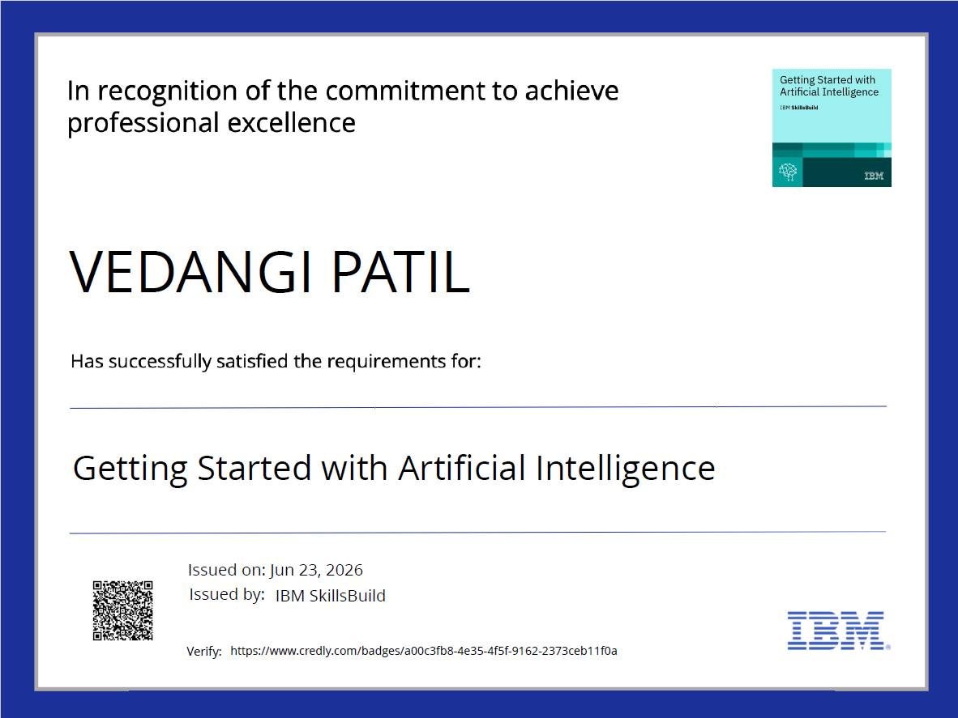
Certificates Earned:

Slide 25
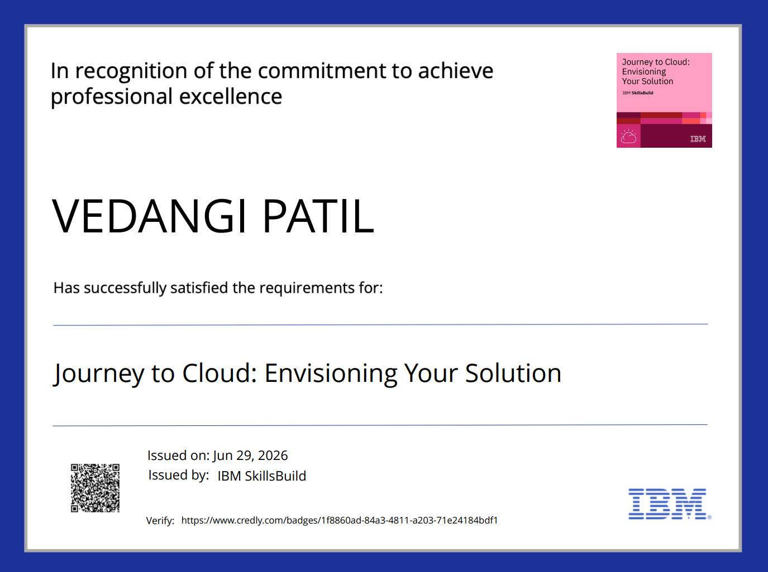
Certificates Earned:

Slide 26
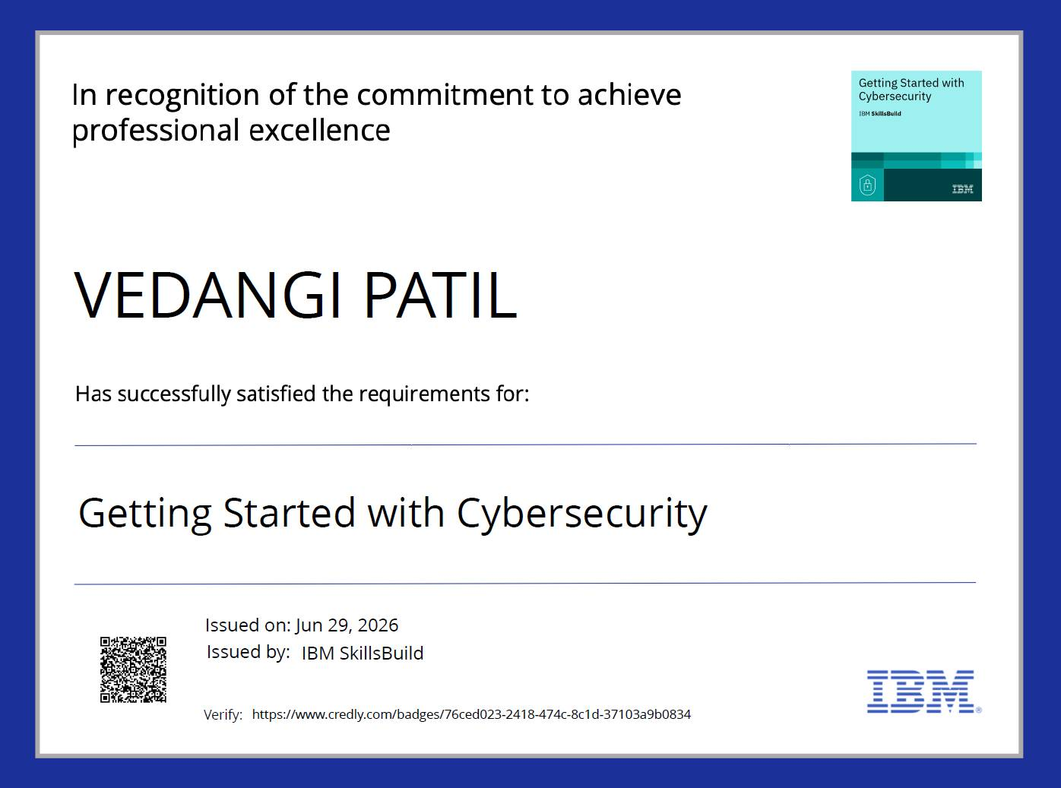
Certificates Earned:

Slide 27
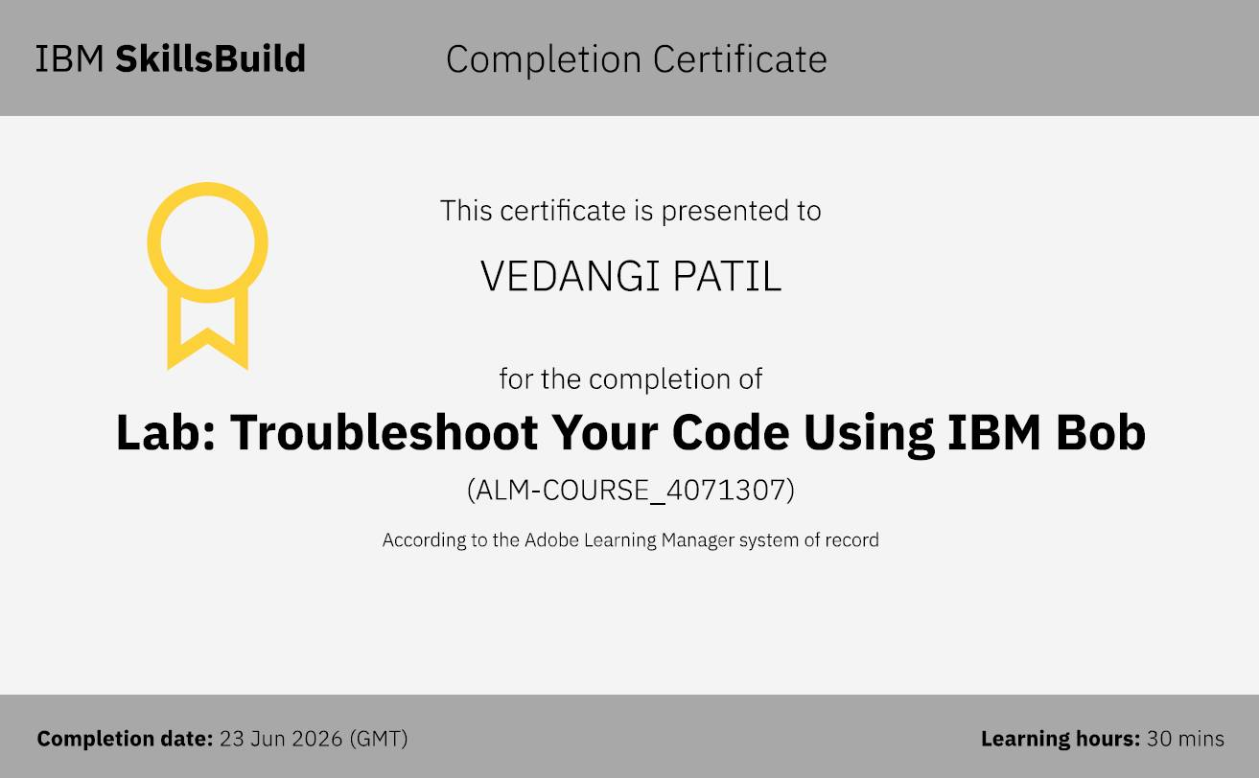
Certificates Earned:​

Slide 28
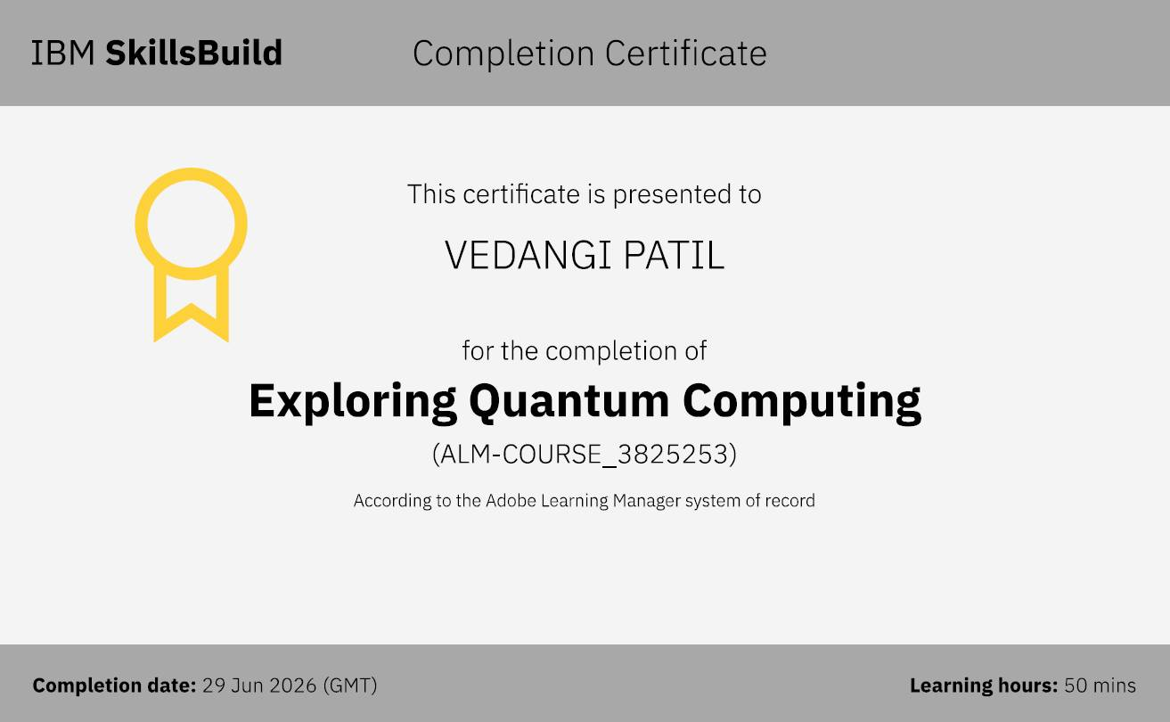
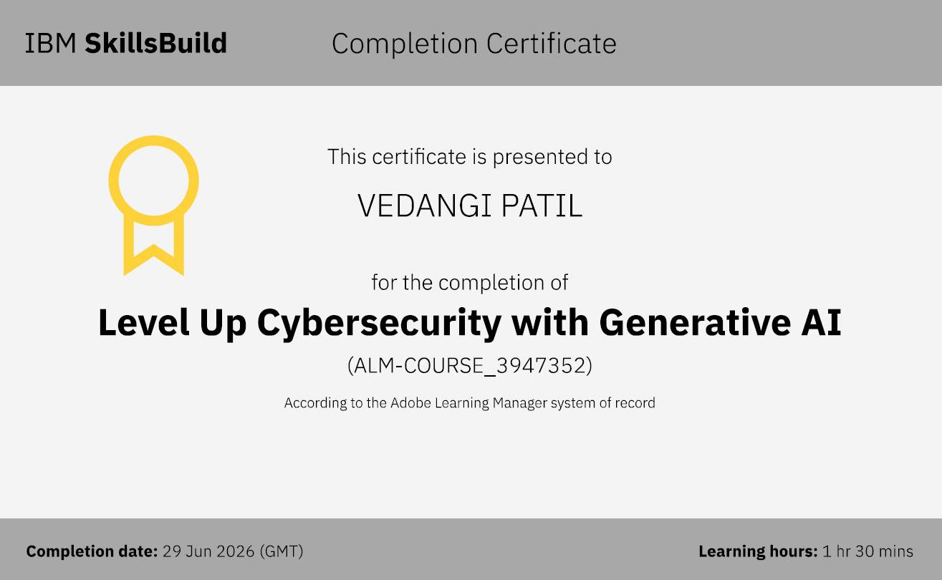
Certificates Earned:​

Slide 29


