Slide 1
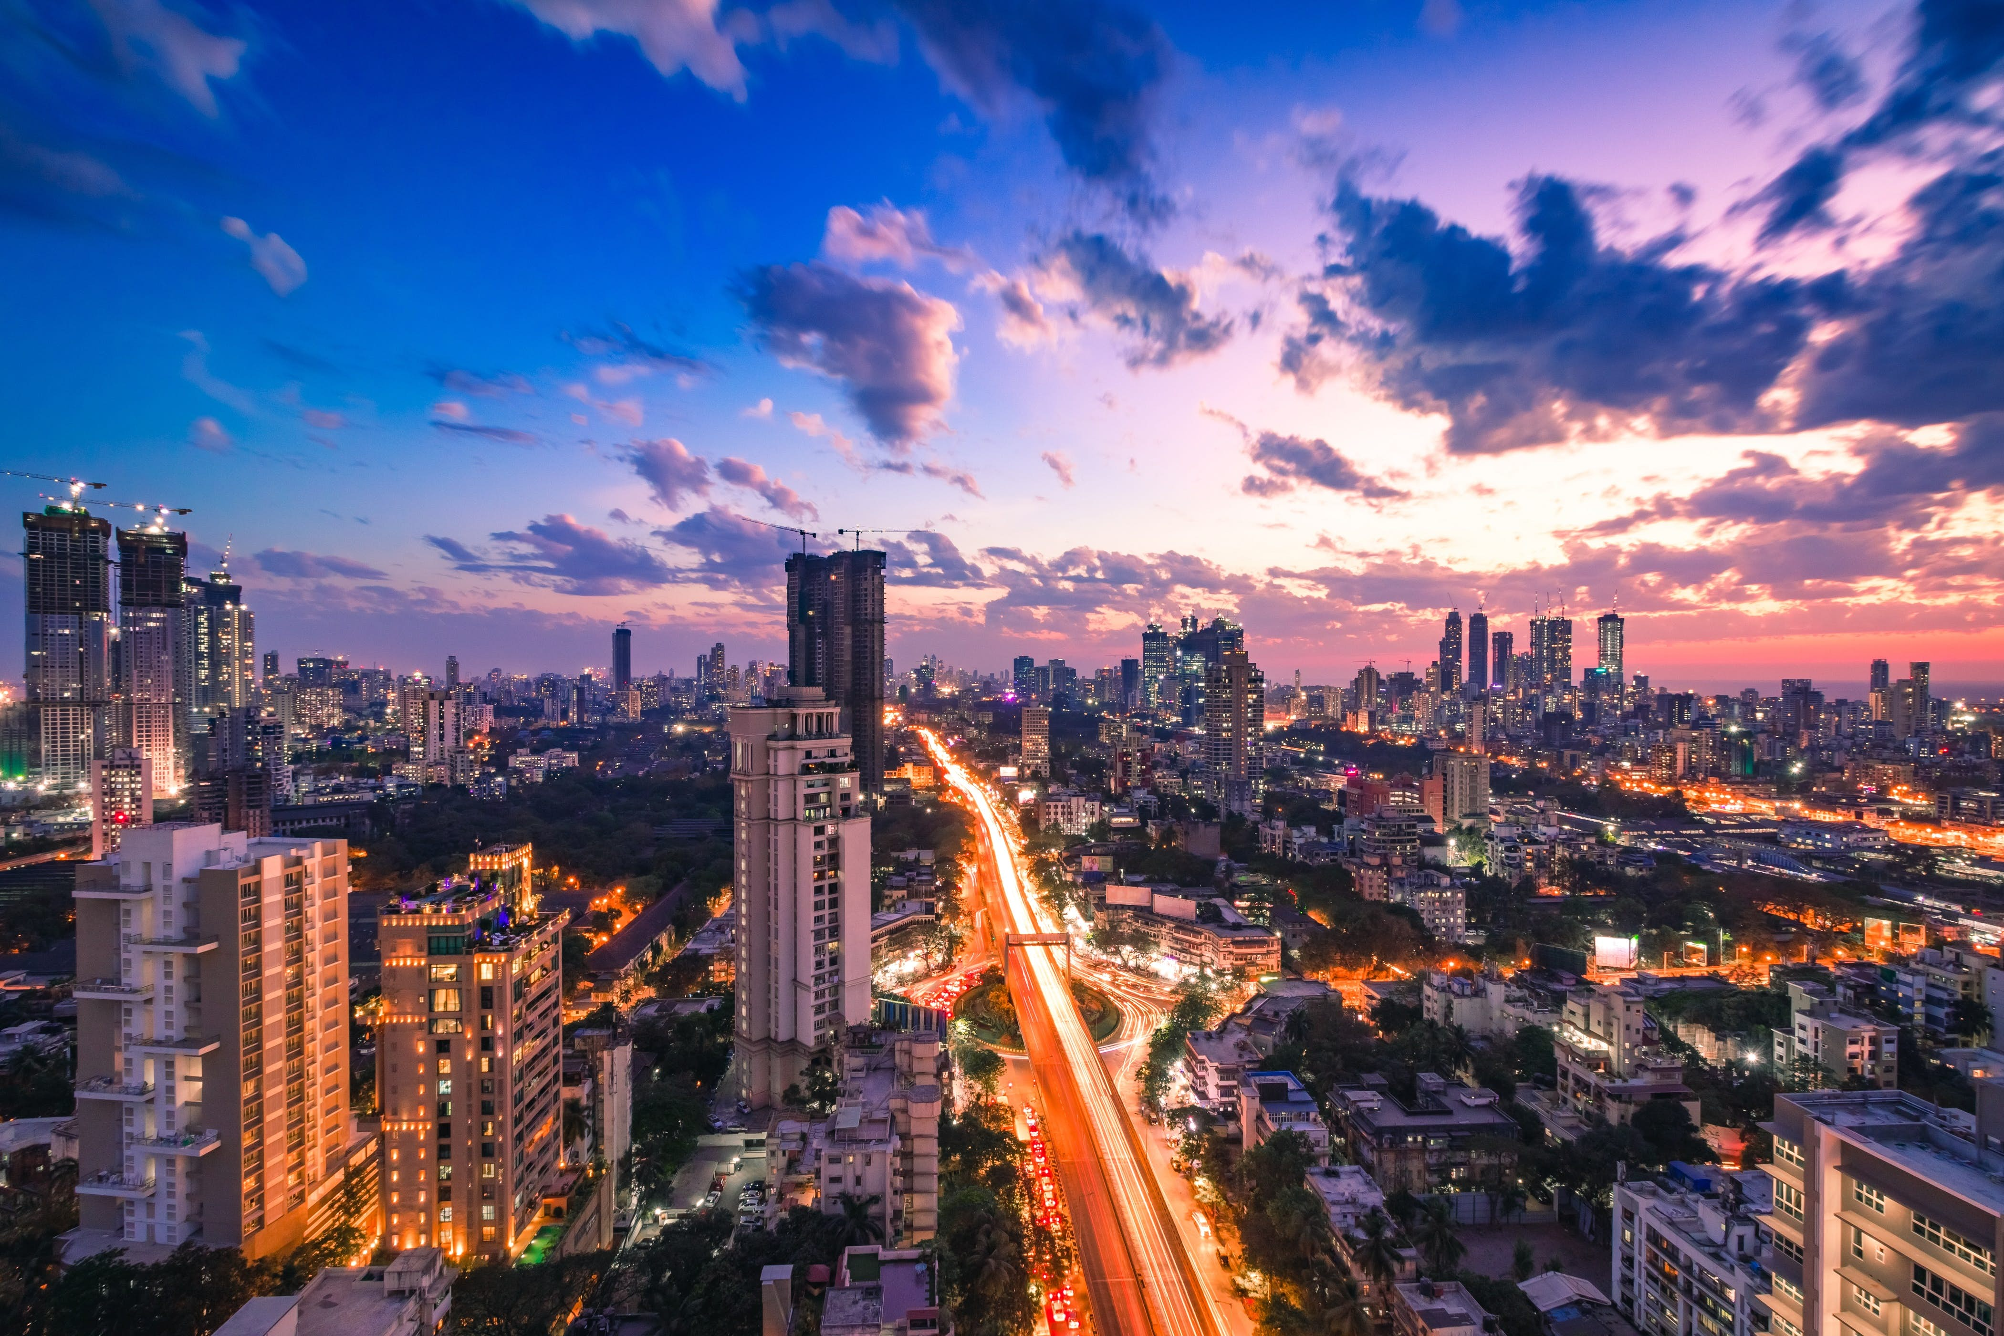
Restaurants in Mumbai
Applied data science capstone project
-Vedang Pandya

Slide 2
Introduction
Mumbai has a population of about 22 million people which creates a high demand for places like restaurants and cafes where people can socialize in a preordained ambiance.
Mumbai is known to be a melting pot of all regional tastes of India. It is not a surprise that a city like Mumbai that offers impeccable and varied flavours for all palates and all pocket sizes stands for a unique gastronomical experience. From roadside food stalls to hoity-toity restaurants, Mumbai serves it all.
The overall Indian foodservice industry is estimated to be Rs 5.99 trillion by 2022-23, growing at a compounded annual growth rate of 9 percent, a National Restaurant Association of India (NRAI) report said. Pegging Mumbai's organized foodservice market at Rs 40,480 crore, the report noted it was the highest amongst metros in the country.

Slide 3
Target Audience
Entrepreneurs interested in the opening Fast Food Restaurant in Mumbai, who may require external advice concerning what type of restaurants are in trend and where exactly it should be originated which could create a high chance of being successful. Fast Food Restaurant category is based on personal preference but this analysis can be applied to any business.

Slide 4
Data Description
1. Neighbourhood Data
Using pandas converted the table on https://www.mapsofindia.com/pincode/india/maharashtra/mumbai/ website consisting name of the neighborhood with respect to its Pin code.
2. Geopy.geocoders
Using geopy.geocoders library to get the latitude and longitude of each neighborhood in Mumbai.
3. Foursquare API
Using Foursquare API to explore venue information for each neighborhood in the Mumbai city. Some features extracted include ‘Venue’, ‘Venue Category’, ‘Venue Latitude’, ‘Venue Longitude’, etc.

Slide 5
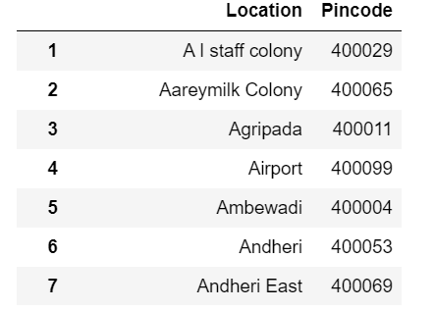
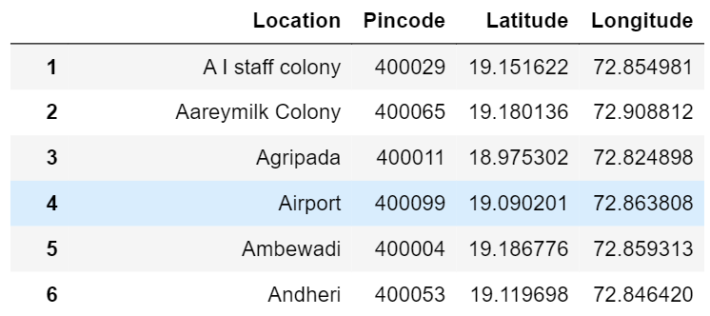
Methodology
After extracting the data of Mumbai neighborhoods and grouping them by their pin codes I got the following data frame containing 182 neighborhoods.
I used the goepy library to pass the name to get the latitudes and longitudes and merged the data into the above dataset.

Slide 6
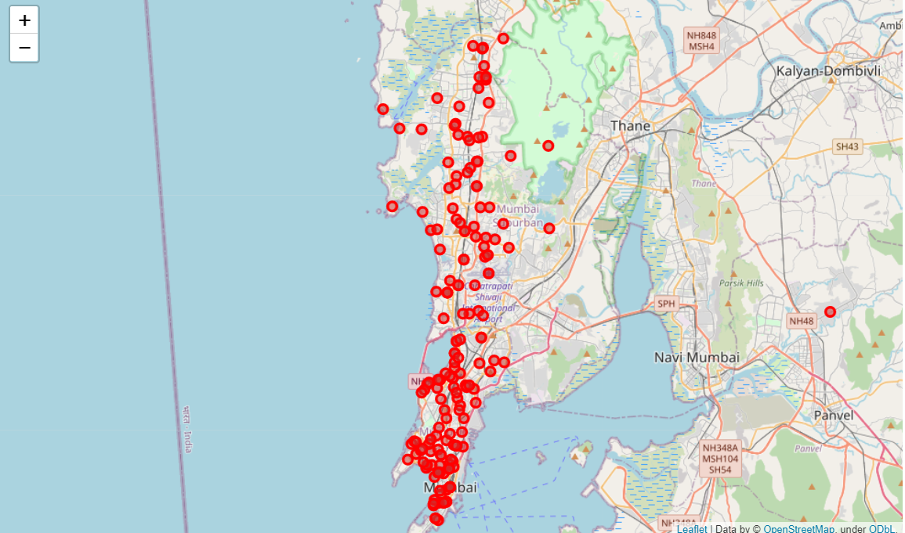
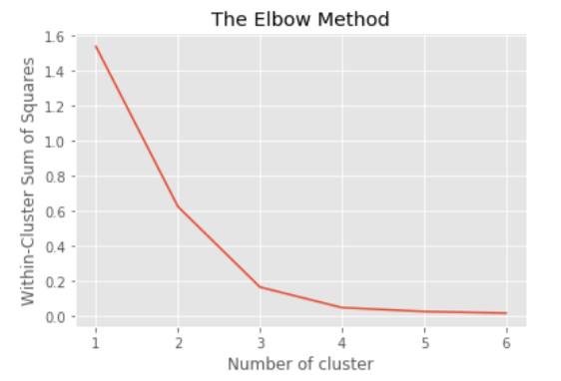
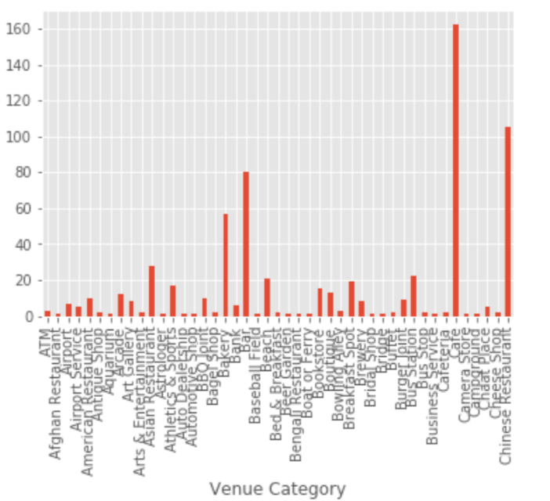

Slide 7
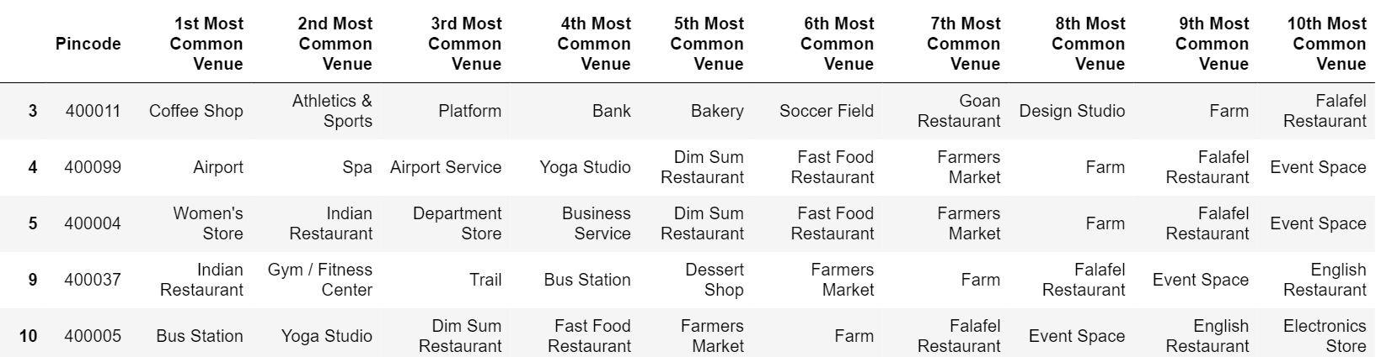
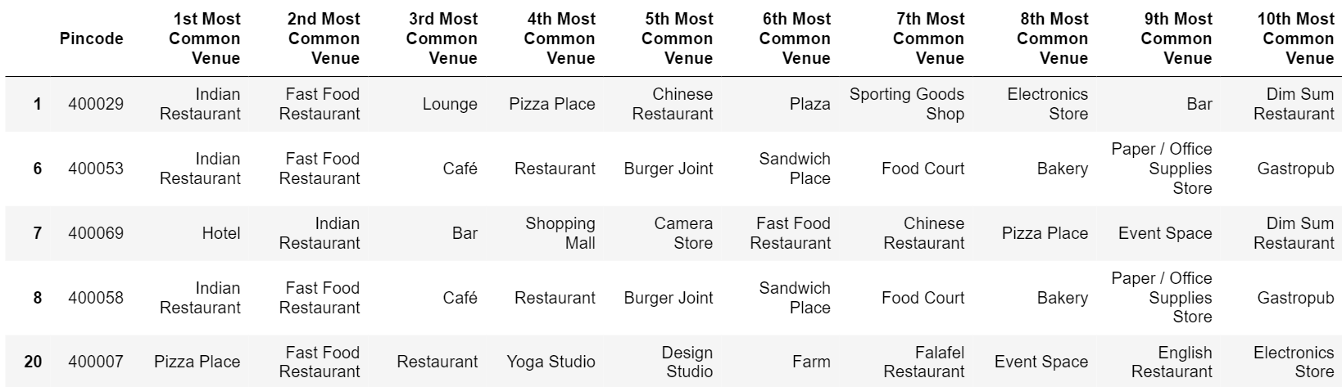
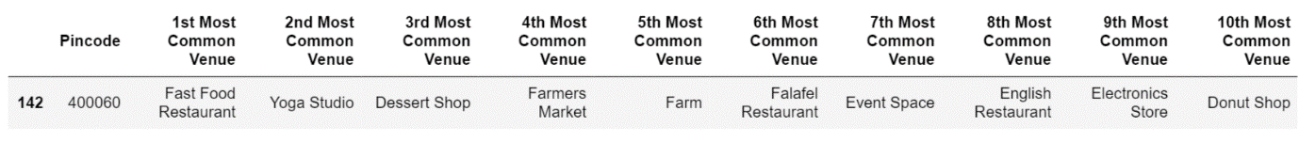
Result
Cluster 1: Neighborhoods where Fast Food Restaurants aren't a common venue
Cluster 2: Neighborhoods where Fast Food Restaurant are a common venue
Cluster 3: Neighborhoods where Fast Food Restaurant are the most common venue

Slide 8
Conclusion
This project was concerned with the data science methodology where one identified a business problem, collected the data required, processed the data, used relevant methods to prepare data for analysis by the appropriate machine learning techniques, and lastly used the results to recommend solutions to relevant entrepreneurs.
Based on the Clusters formed it would be a good idea to open a restaurant in Clusters 0 & 1 since the other clusters already have fast-food restaurants in their vicinities. Also, clusters 0 & 1 have many restaurants in the vicinity (Pizza restaurants, cafe, coffee shop, Indian restaurants) so one will be able to attract a good crowd.

