Slide 1

CS 6375.004 Machine Learning Project Presentation
Problem Statement
Predict schedule-wise matches of the FIFA 2022 World Cup and find out which team has highest possibility of qualifying to the next round and eventually winning the World Cup Title
Vedang Wartikar (vpw210000)
Shlok Urmil Pujara (sxp220146)

Slide 2
Problem Description
Why this problem statement?
With the FIFA 2022 World Cup currently going on, we can compare our model’s accuracy with the real data.
About the dataset:
International matches CSV (Build the models)
FIFA 2022 rankings CSV (Make the predictions)
Qatar Schedule CSV (Make stage-wise predictions as per the schedule)
Features:
Rankings of the 2 playing countries (home/away)
Official FIFA points of the countries
Type of the matches played (Filter out Friendlies ,etc.)
Goals scored by the teams for each match
Offense/Defense score of the 2 playing teams*
Outcome of the matches between the countries
Models used:
Logistic Regression (Own implementation + sklearn)
Decision Tree (Own implementation + sklearn)
Predictions:
As per the Qatar 2022 World Cup’s schedule, predict with what probability which team will win and qualify to the next stage and eventually win the World Cup title

Slide 3
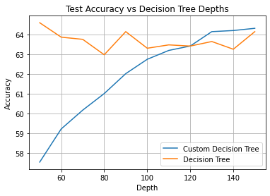
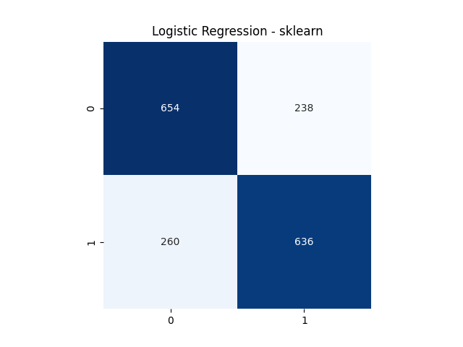
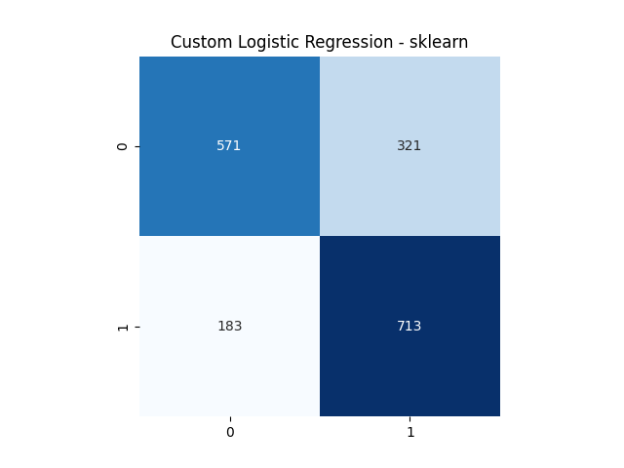
Results
Comparing the Model’s prediction with the actual World Cup results for the first stage
Group Stage (December 2 2022)
Netherlands | Belgium | Brazil | France | Portugal | Argentina | Spain | England
Mexico | Uruguay | Senegal | Denmark | Croatia | Germany | USA | Switzerland
Group Stage clearance accuracy: 11/16 = 68.75%
Continuing the predictions (as per the schedule and qualifiers), the winner is
Brazil

