Slide 1

Major Project Presentation on Sudarshan – An Automated Web Vulnerability Scanner for the End Sem Exam BCA VI Sem
Vedansh Gupta 2023PUFCEBCAX13516
BCA - General
Tanishqa Sharma 2023PUFCEBCAX1440
BCA - General
Tushant Yadav 2023PUFCEBCAX14146
BCA - General
Under supervision of Ms Anushka Bhardwaj Assistant Professor Department of Computer Science & Applications
Faculty of Computer Science and Applications Poornima University, Jaipur

Slide 2

Contents
Introduction (Overview, Problem Statement, Importance)
Objectives (Key goals of the project)
Literature Review (Background research and related works)
Methodology (Tools, techniques, and framework used)
System Design (Architecture, flowcharts, block diagrams)
Implementation (Programming languages, tools, datasets)
Results & Analysis (Graphs, tables, performance metrics)
Challenges & Limitations (Issues faced, constraints)
Future Scope (Possible enhancements, scalability)
Conclusion (Summary of findings)
References

Slide 3
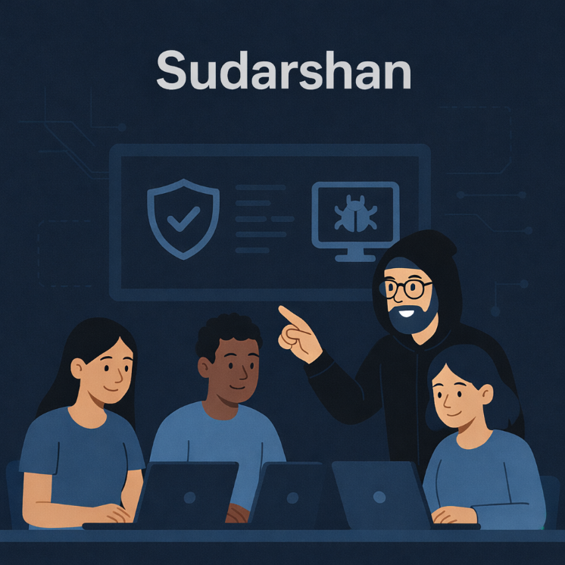
Introduction
Sudarshan is a web-based cybersecurity platform designed to help developers, students, and security analysts identify common security weaknesses in web applications. The system focuses on automating vulnerability detection and providing clear insights into potential security risks during the early stages of application deployment.
By combining automated crawling, payload injection, and response analysis, the platform assists in identifying vulnerabilities such as SQL Injection, Cross-Site Scripting (XSS), and security misconfigurations. The tool emphasizes usability, real-time feedback, and educational value, making it suitable for academic and authorized security testing.
“Detect vulnerabilities before attackers do.”

Slide 4
Problem Statement
Why SUDARSHAN?
With the rapid growth of web applications, security vulnerabilities have become one of the most critical challenges in software development. Many applications are deployed without proper security testing due to time constraints, lack of expertise, or dependence on costly commercial tools.
Key Issues:
Manual vulnerability assessment is time-consuming and requires expert knowledge.
Many applications are deployed without proper security testing.
Existing commercial security tools are often expensive and complex.
Students and small developers lack access to easy-to-use security tools.
There is a need for an automated, user-friendly, and educational vulnerability scanning solution.

Slide 5
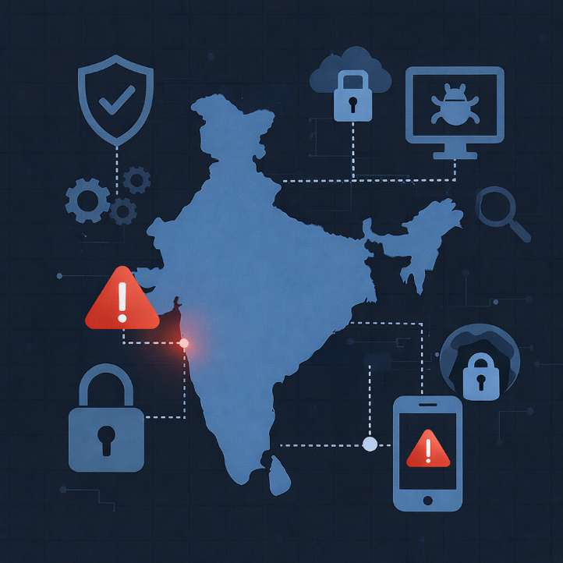
Importance
Enhances awareness of common web application security vulnerabilities.
Helps identify security issues at an early stage of development.
Reduces dependency on costly and complex commercial security tools.
Provides an educational platform for students to learn cybersecurity concepts.
Encourages secure coding and regular security testing practices.
Assists developers in improving the overall security posture of web applications.
Supports ethical and authorized security assessment.

Slide 6
Objectives
To design and develop an automated web vulnerability scanning platform.
To detect common web application vulnerabilities such as SQL Injection, XSS and security misconfigurations.
To analyze web application responses for potential security weaknesses and threats.
To provide real-time scan progress and vulnerability insights with visualization.
To generate detailed security reports with remediation suggestions.
To promote secure coding practices and cybersecurity awareness in students and developers.
To support ethical and authorized security testing.

Slide 7
Literature Review
Background Research & Related Works
Increasing Web Application Vulnerabilities: Reports from organizations such as OWASP and CERT-In indicate a continuous rise in web-based attacks, including SQL Injection, Cross-Site Scripting (XSS), and insecure authentication mechanisms affecting public and private web applications.
Existing Security Testing Tools: Tools such as OWASP ZAP, Nikto, and Burp Suite are widely used for vulnerability assessment. However, these tools often require advanced technical knowledge and are complex for beginners and academic users.
Limitations of Manual Testing: Manual penetration testing is time-consuming, resource-intensive, and prone to human error, making it unsuitable for frequent or large-scale security assessments.
Need for Automated and Educational Tools: Existing tools primarily focus on professional usage and lack simplicity and educational clarity. There is a need for an automated, beginner-friendly platform that integrates vulnerability detection and reporting in a unified system.

Slide 8

Methodology
Tools, Techniques, and Framework Used
Development Framework: The system is developed using Python Flask, which provides a lightweight and flexible backend framework for handling scan requests, processing results, and managing reports.
Scanning Techniques: Automated vulnerability scanning is performed using web crawling, payload injection, and HTTP response analysis techniques to identify security weaknesses such as SQL Injection and XSS.
Frontend Technologies: The user interface is designed using HTML, CSS, Bootstrap, and JavaScript to ensure a responsive, user-friendly, and interactive web experience.
Database and Storage: SQLite is used for storing scan details, detected vulnerabilities, logs, and report metadata in a structured manner.
Reporting Mechanism: The system generates detailed vulnerability reports in PDF format using automated report generation libraries, providing severity levels and remediation guidelines.

Slide 9
Workflow
Architecture, Flowcharts, and Block Diagrams
System Architecture: The system follows a web-based client–server architecture where the user interacts with the scanner through a web interface, and the backend processes scan requests, performs vulnerability analysis, and generates reports.
Process Flow: The scanning workflow includes target URL input, web crawling, vulnerability detection, Proof-of-Concept verification, and report generation, ensuring systematic security assessment.
Data Flow Diagrams (DFD): Data Flow Diagrams are used to represent the movement of data between the user, scanner engine, target web application, and database at different levels of abstraction.
Entity Relationship Diagram (ERD): The ER diagram defines relationships between entities such as users, scans, vulnerabilities, logs, and reports for efficient data management.
Block Diagram Representation: Block diagrams illustrate the interaction between major system components, including the frontend, scanner engine, database, and reporting module.

Slide 10

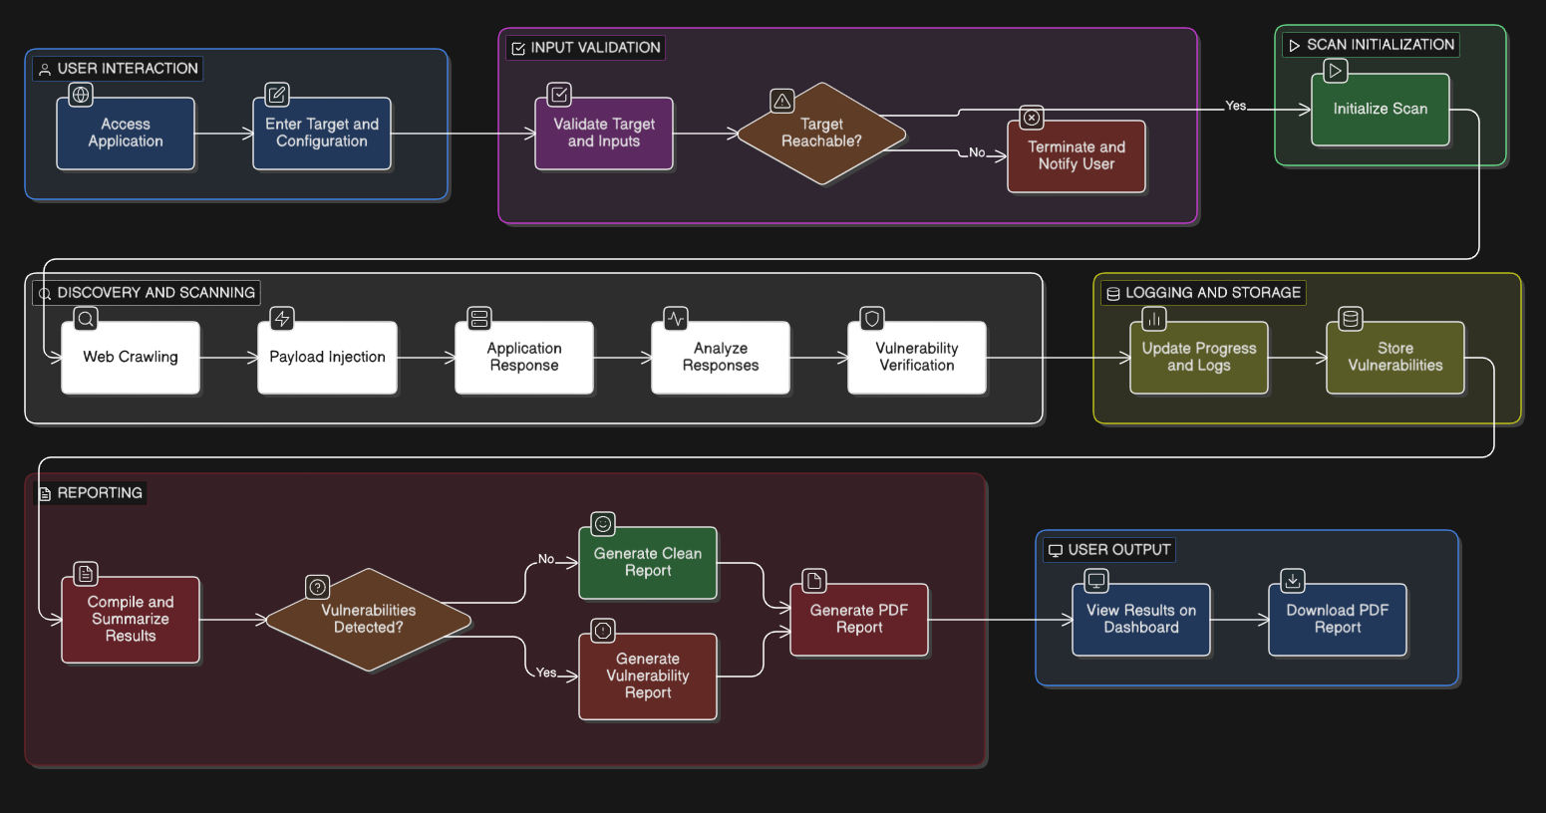
Workflow

Slide 11
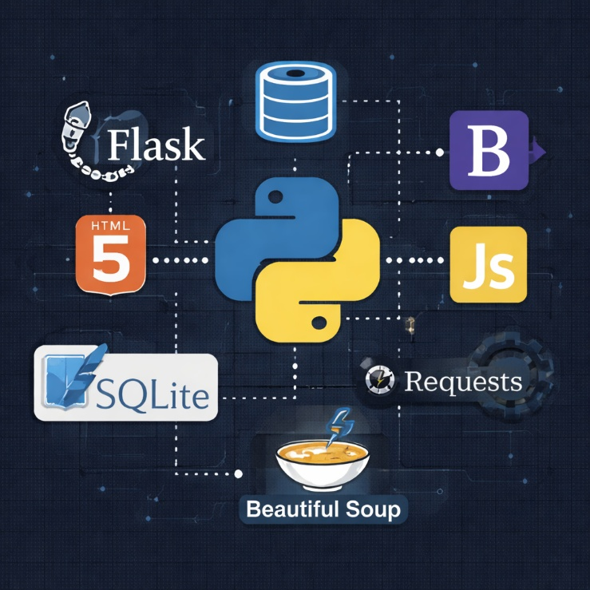
Implementation
Programming Languages, Tools, and Datasets
Programming Languages: The backend of the system is implemented using Python, while the frontend is developed using HTML, CSS, JavaScript, and Bootstrap for responsive and interactive user interfaces.
Framework and Libraries: Flask is used in backend framework with libraries, Requests and BeautifulSoup for web crawling, HTTP communication, and data extraction.
Database Management: SQLite is used to store scan information, vulnerability details, logs, and report metadata in a lightweight and structured format.
Datasets and Test Environment: The system is tested using intentionally vulnerable web applications and sample datasets designed for educational and authorized security testing.
Reporting Tools: Automated PDF report generation is implemented using reporting libraries to provide detailed vulnerability summaries and remediation guidance.

Slide 12
Challenges & Limitations
Challenges & Limitations:
Website Protection Mechanisms: Many web applications implement security measures such as CAPTCHA, WAFs, or IP blocking, which can restrict automated scanning and limit vulnerability detection.
False Positives and Accuracy: Automated vulnerability scanning may sometimes generate false positives, requiring manual verification to confirm actual security risks.
Legal & Ethical Constraints: Vulnerability scanning must be performed only on authorized targets, as unauthorized scanning may lead to legal and ethical issues.
Rate Limiting and Request Blocking: Frequent scan requests may trigger rate limiting or temporary blocking by the target server, affecting scan continuity.
Limited Vulnerability Coverage: The system primarily focuses on common vulnerabilities and may not detect advanced or zero-day exploits.

Slide 13
Future Scope
Possible Enhancements and Scalability:
Expansion of Vulnerability Coverage: The system can be enhanced to detect advanced vulnerabilities such as CSRF, SSRF, insecure deserialization, and authentication bypass issues.
Authenticated Scanning Support: Future versions can include authenticated and session-based scanning to analyze secured areas of web applications.
Improved Accuracy and Intelligence: Machine learning techniques can be applied to reduce false positives and improve vulnerability detection accuracy.
Cloud Deployment and Scalability: Deploying the system on cloud platforms can improve scalability, performance, and support for scanning large-scale applications.
Enhanced Reporting and Visualization: Advanced dashboards, visual analytics, and customizable reports can be added for better vulnerability analysis and management.

Slide 14
References
OWASP Foundation, OWASP Top 10 – Web Application Security Risks, https://owasp.org/www-project-top-ten/
Flask Documentation, Flask Web Framework, https://flask.palletsprojects.com/
Python Software Foundation, Python 3 Documentation, https://docs.python.org/3/
OWASP Zed Attack Proxy (ZAP), Official Documentation, https://www.zaproxy.org/documentation/
W3C, HTML5 and Web Security Standards, https://www.w3.org/

Slide 15
Thank You

