Slide 1

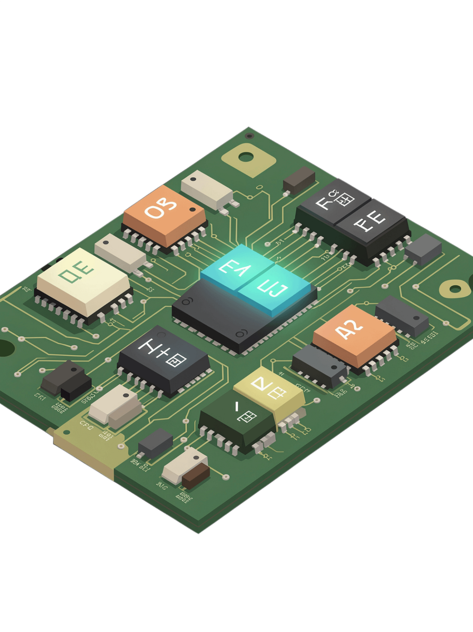
Design and Simulation of a Multi-Bit Binary Adder and Subtractor
A structured introduction to binary arithmetic circuits for students of digital logic design.

Slide 2
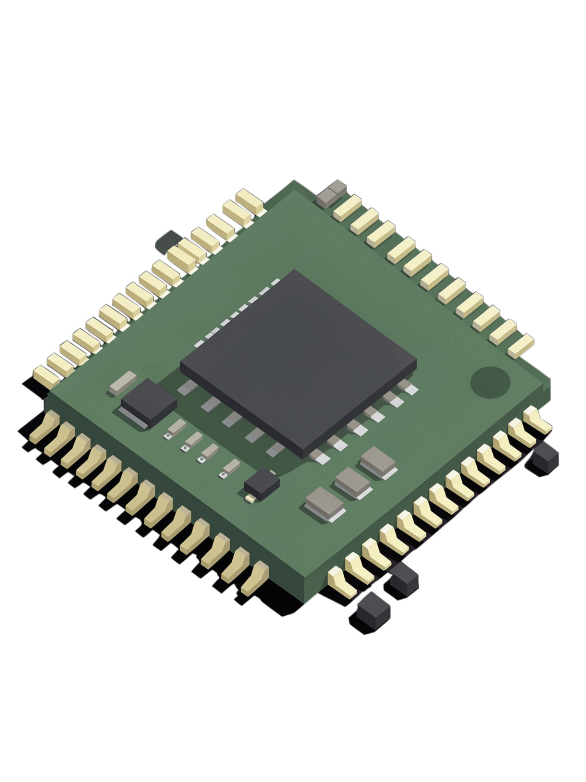
Why Binary Addition Matters
Foundation of Arithmetic
Inside Every Calculation
Multiplication, division, and floating-point operations all reduce to sequences of additions in hardware.
Every digital system — from microcontrollers to supercomputers — performs all arithmetic using binary addition at its core.
Gateway to Circuit Design
Understanding adders unlocks the fundamentals of combinational logic, timing, and digital system architecture.

Slide 3

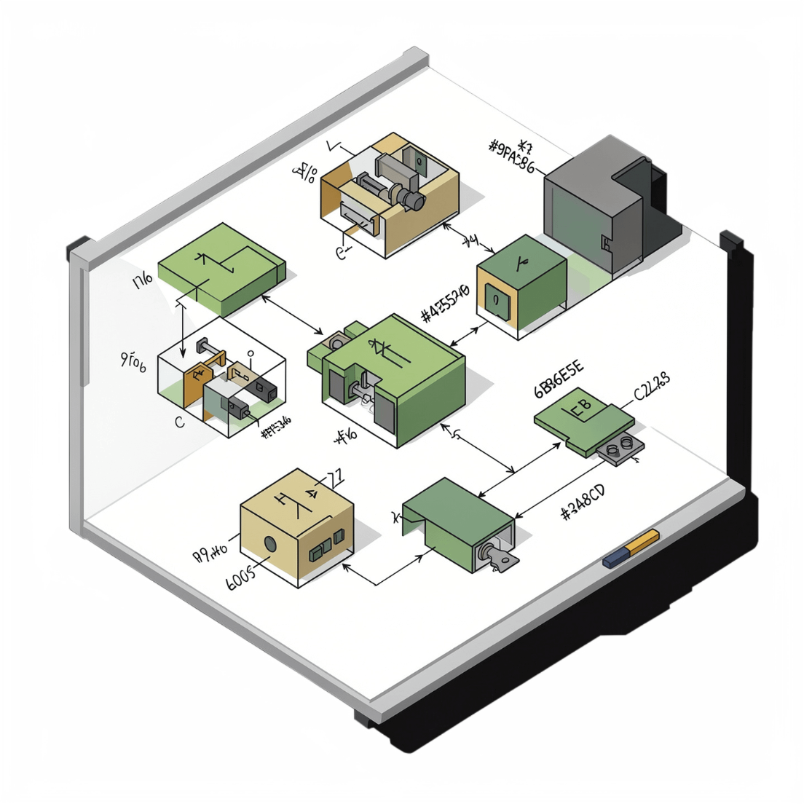
Logic Gates: Building Blocks
AND
OR
Output is 1 only when both inputs are 1. Used to compute the carry bit in addition.
Output is 1 when at least one input is 1. Combines partial carry signals.
XOR
NOT
Output is 1 when inputs differ. The key gate for computing the sum bit.
Inverts the input: 0→1, 1→0. Essential for 2's complement subtraction.

Slide 4
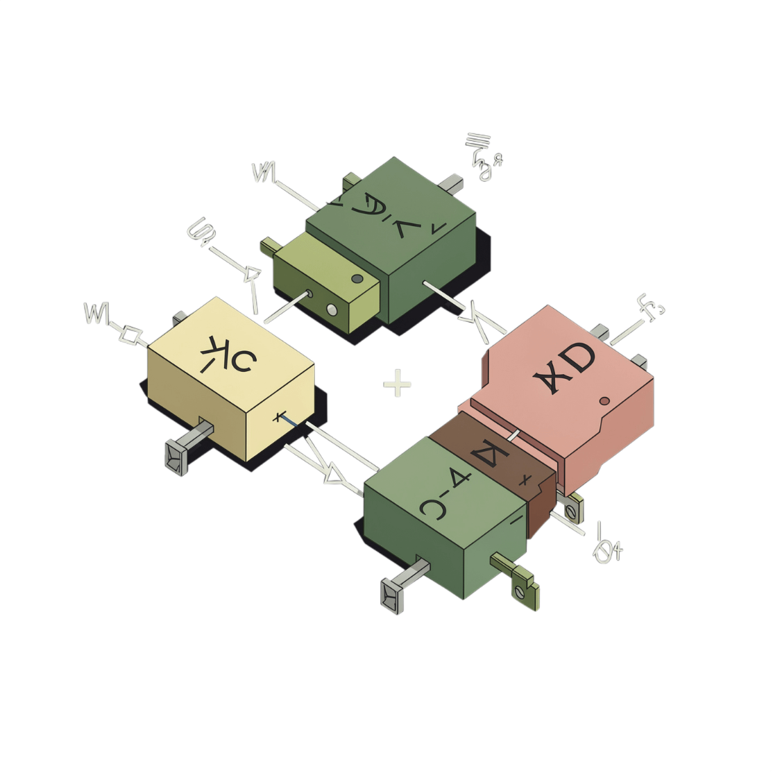

The Half Adder
What It Does
The half adder is the simplest arithmetic circuit — it adds two single bits, A and B, producing two outputs.
Limitation: Cannot accept a carry-in from a previous bit stage — making it unsuitable alone for multi-bit addition.
Sum
Carry
A XOR B
A AND B

Slide 5
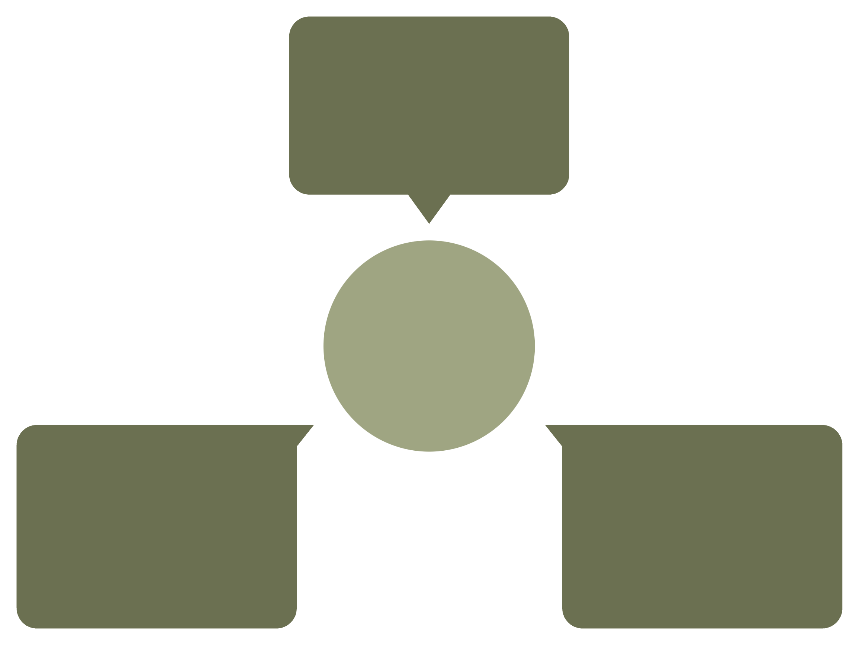
The Full Adder
Inputs
A, B, Cin signals
Three‑Input Full Adder
Carry‑out
Sum
Cout = (A AND B) OR (Cin AND (A XOR B))
Sum = A XOR B XOR Cin
The full adder extends the half adder by accepting a Carry-in (Cin) from a previous stage. This makes it the essential building block for cascading into multi-bit adders — each stage passes its carry-out to the next.

Slide 6
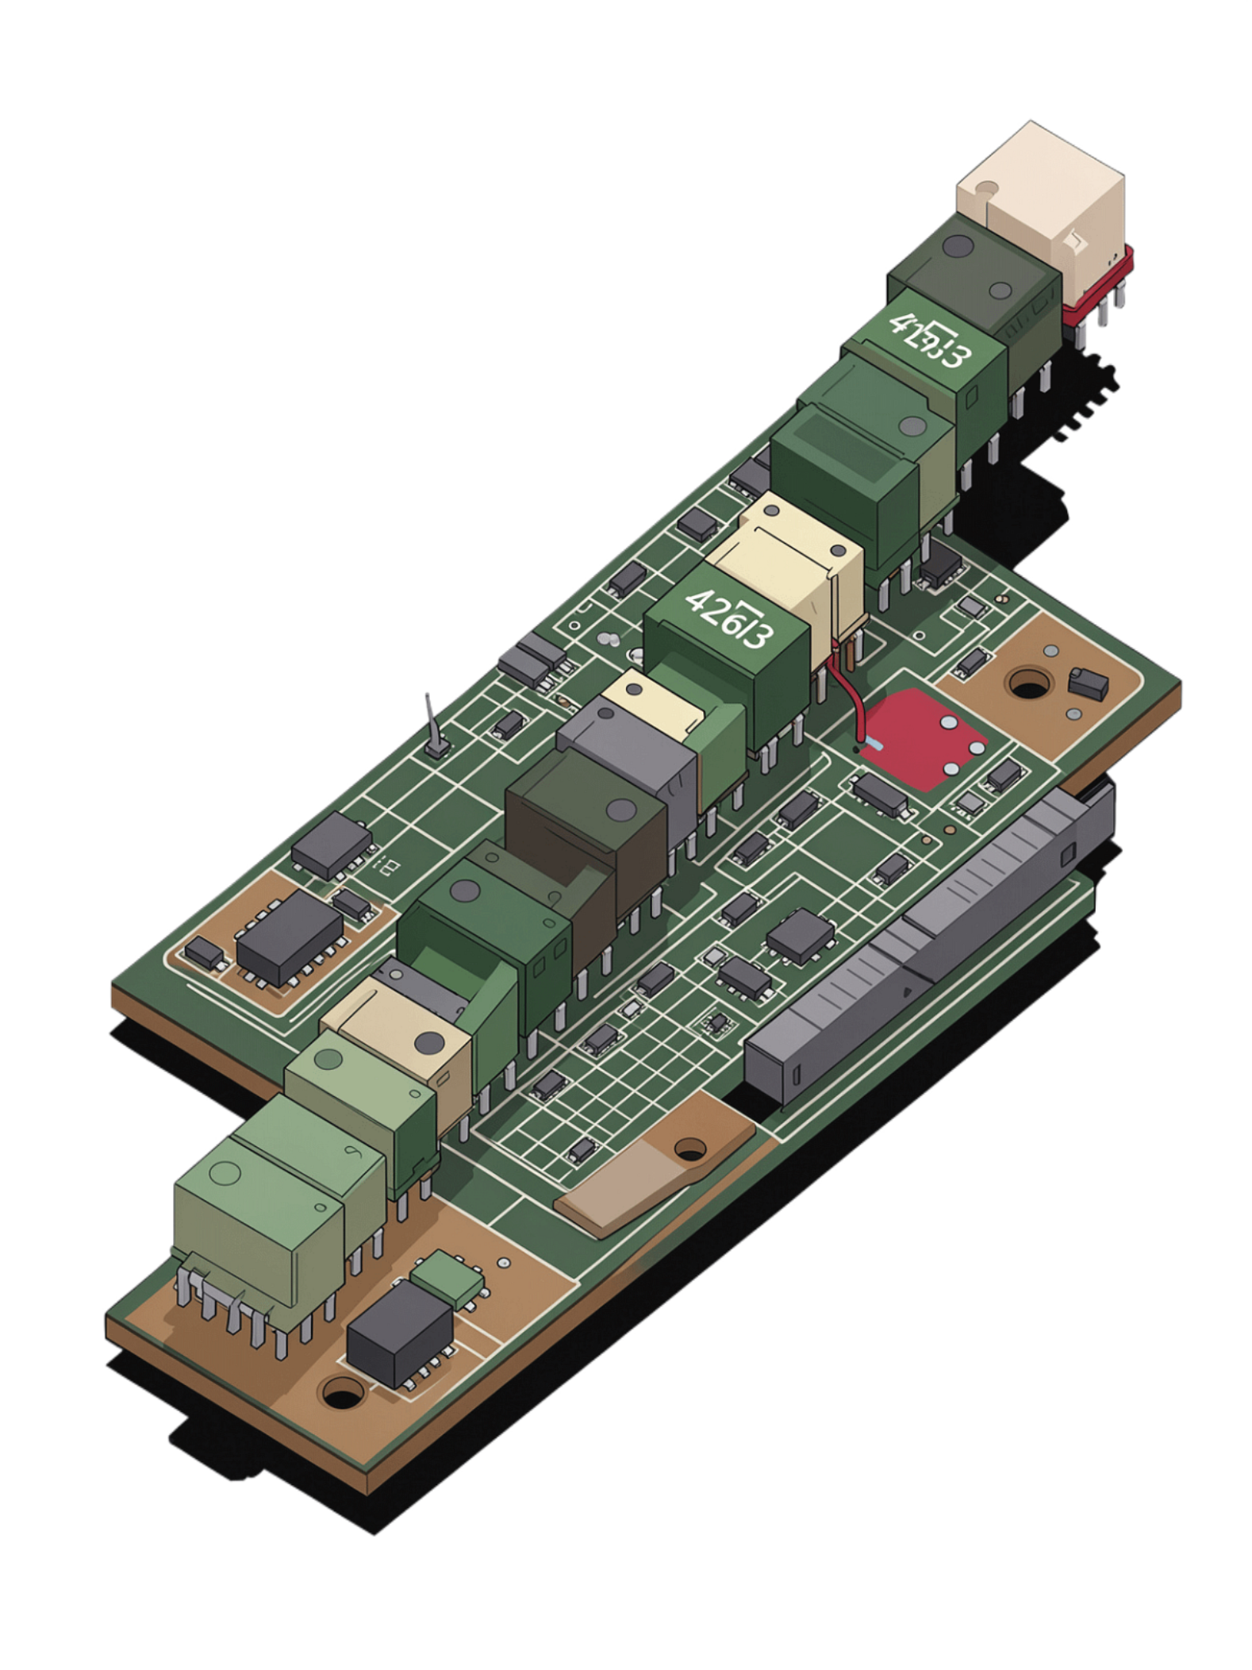



Multi-Bit Adder Architecture
LSB Stage
Full Adder #1 receives Cin = 0 and processes the least significant bits.
Carry Ripple
Each adder's Carry-out feeds the next adder's Carry-in — the carry "ripples" upward.
MSB Stage
The final full adder produces the most significant sum bit and the final carry-out.
A 4-bit ripple carry adder chains 4 full adders in series. Propagation delay grows with bit width — each stage must wait for the previous carry to settle.

Slide 7
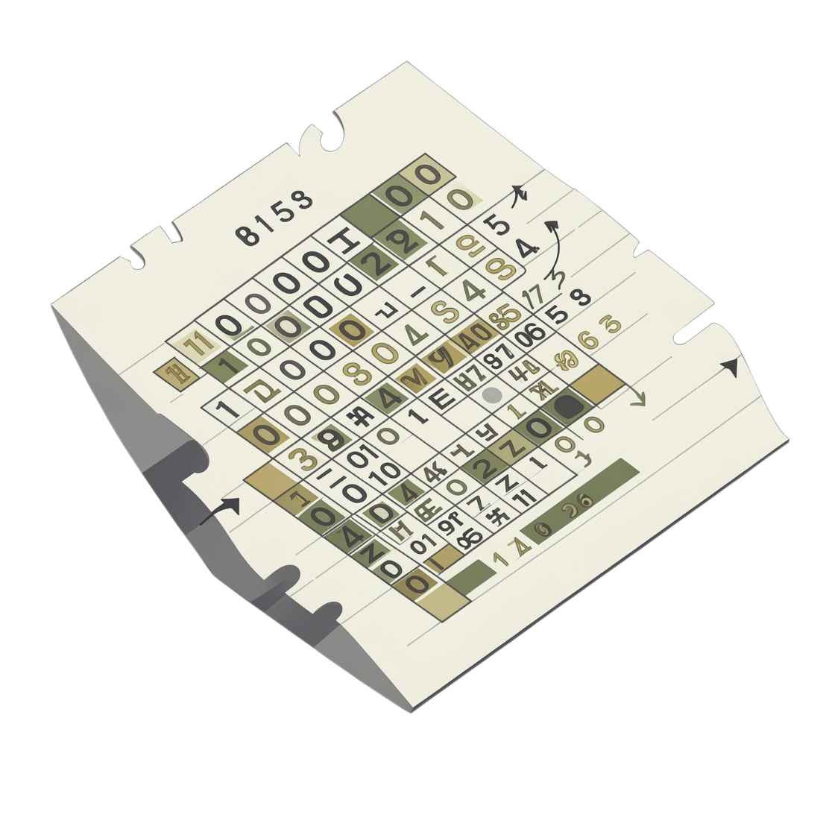
Binary Subtraction: 2's Complement Method
How It Works
Rather than building a separate subtractor circuit, we reuse the same adder by converting the subtrahend using 2's complement.
1
Invert all bits
2
Add 1
3
Add to minuend
Apply NOT to every bit of the subtrahend (1's complement).
Increment the result by 1 to complete the 2's complement.
Feed both values into the adder. Discard any final carry-out.

Slide 8
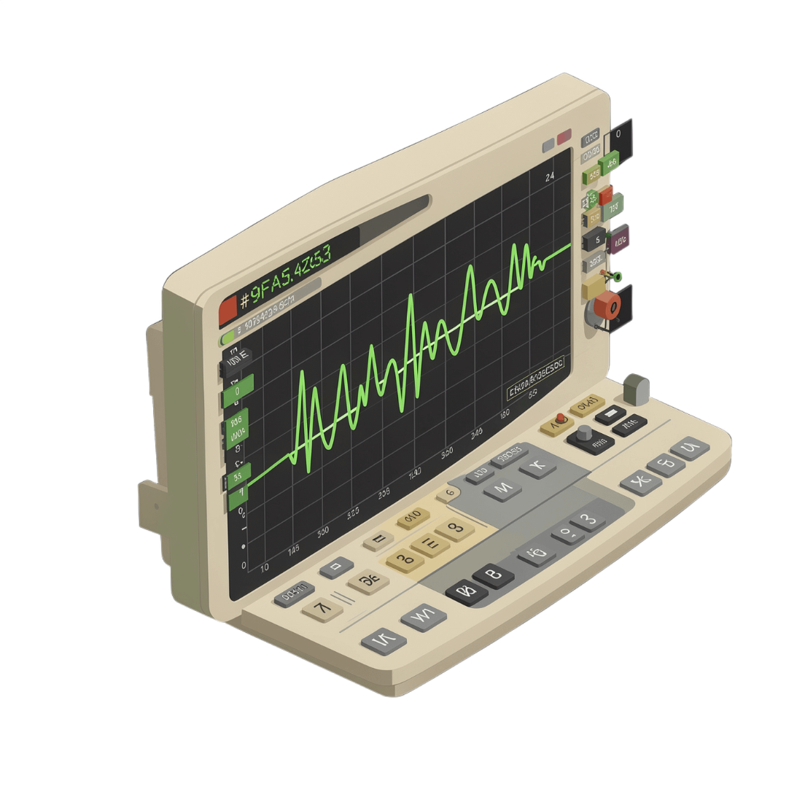

Simulation & Testing
What to Verify
Simulation is the critical step between design and hardware. A thorough test plan covers:
Edge cases: 0+0, all-ones inputs, and overflow scenarios
Carry propagation: Confirm carry ripples correctly through every stage
Waveform analysis: Inspect timing diagrams for signal transitions and propagation delay
Subtraction validation: Verify 2's complement results match expected differences
Passing simulation confirms the design is logically correct before committing to physical hardware.

Slide 9




Key Takeaways
Adders Are the Foundation
Cascade for Scale
Half and full adders are the fundamental arithmetic circuits from which all digital computation is built.
Multi-bit adders chain full adders in series, with carry rippling from the least to most significant bit.
2's Complement Unifies Arithmetic
Simulate Before You Build
Subtraction requires no separate circuit — 2's complement lets the same adder handle both operations.
Waveform simulation validates logic correctness and timing behavior before any hardware is fabricated.

