Slide 1
TripSolve: An Optimization-Grade Group Itinerary Planner for Jaipur Tourism
Vidushi Himmatramka (BTECH/25139/23)
Vedanshi Goyal (BTECH/25167/23)
Class: CSE-7B
Under the Supervision of
Dr. Seema Gaur
Assistant Professor, CSE
BIT Jaipur Off-Campus
Notes:
TripSolve is a web-based system that generates an optimized sightseeing itinerary based on the user's available time, interests, attraction timings, actual travel time, and group preferences.
The main idea of our project is that we don't simply ask an AI model to generate an itinerary. Instead, we use mathematical optimization to decide the route, while using an LLM for natural-language understanding and explanation."

Slide 2
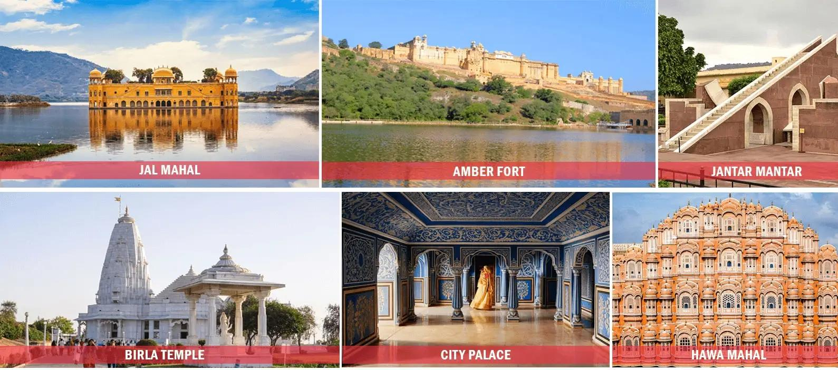
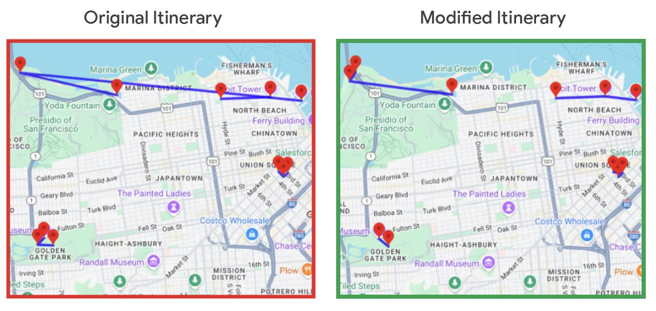
Table of contents
Introduction
Problem Statement / List of Objectives
Dataset description
Design and Methodology
Research Contributions
Conclusions
References
Notes:
I'll first explain the problem we are solving and our objectives, then I'll cover our dataset, methodology, system architecture and workflow. Finally, I'll discuss our research contributions, expected outcomes and future scope

Slide 3
Introduction
Planning a multi-stop tourist itinerary in a city like Jaipur is a genuinely hard combinatorial problem, requiring attractions to be chosen and sequenced within opening/closing hours and real travel times
Existing tools (Wanderlog, TripIt, LLM-based generators) rely on a language model to produce a "plausible-looking" plan, which often violates hard constraints such as time windows
For groups, conflicting member preferences are usually ignored or left to dominate silently, with no transparency in the trade-off
TripSolve grounds route generation in real optimization (TOPTW, solved via Google OR-Tools) instead of an LLM's guess, using the LLM only to parse free-text input and explain the solver's choices — and to fairly combine multiple travelers' preferences into one shared route
Notes:
Planning a multi-stop trip in a city like Jaipur is actually a difficult computational problem.
We have to decide which attractions to visit and in what order, while making sure that every attraction is visited during its opening hours.
We also have to consider the actual travel time between attractions, because road travel time is different from simply measuring straight-line distance.
And when we're planning for a group, everyone may have different interests. One person may prefer monuments, another may prefer shopping, and someone else may prefer food.
Existing itinerary generators can produce plans that look realistic, but they may violate these hard constraints.
So TripSolve takes a different approach. We use optimization for making the routing decision, and use the LLM only for understanding free-text input and explaining the final decision.

Slide 4
Problem Statement / List of Objectives
Problem Statement
Attraction choice/ordering must respect each site's opening/closing time window
Real road-network travel time between stops, not straight-line distance
Conflicting interests/priorities of different group members
Pure LLM-based planners (per the TravelPlanner benchmark, ICML 2024) frequently violate hard constraints
List of Objectives
Ground itinerary generation in real optimization over real-world constraints, not an LLM's guess
Guarantee time-window feasibility for every visited attraction
Fairly balance multiple travelers' preferences into one shared route
Make the reasoning behind the chosen route transparent and explainable to users
Build a modular, city-agnostic backend that can extend beyond Jaipur
Notes:
There are three major challenges we are addressing.
First, time-window constraints — attractions have specific opening and closing times.
Second, real road-network travel time — we need realistic travel times between attractions rather than straight-line distances.
Third, conflicting group preferences — different travelers may want completely different experiences.
Therefore, our objectives are to generate routes using real optimization, ensure time-window feasibility, combine multiple travelers' preferences into one shared route, make the reasoning behind the route explainable, and design the backend so it can eventually support cities beyond Jaipur.

Slide 5
How TripSolve Solves It — TOPTW at a Glance
INPUTS
Time budget & start location
Interests / must-visit POIs
Opening & closing time windows
Travel times between stops
OR-TOOLS
Team Orienteering Problem
with Time Windows (TOPTW)
Maximizes visitor utility
subject to: time windows, travel
times, and total time budget
OUTPUT
A single, near-optimal route
Every stop inside its time window
Explained in plain language
by the LLM layer
The LLM only parses free text and explains results — it never decides the route.
Notes:
This is the core technical part of our project.
We model the itinerary planning problem as a Team Orienteering Problem with Time Windows, or TOPTW.
The basic idea is that every attraction has a certain utility or score, an opening and closing time, and a visit duration.
At the same time, the traveler has a limited amount of time.
So the system has to decide:
Which attractions should we select?
And:
In what order should we visit them?
The objective is to maximize the total utility of the selected attractions while satisfying all the constraints — including opening and closing times, travel time between attractions, visit duration and the overall time budget.
We use Google OR-Tools to solve this optimization problem.
And one of the most important design decisions in our project is that the LLM does not decide the route.
The LLM understands the user's natural-language input and later explains the result, but OR-Tools actually makes the routing decision.
So, in one line:
The LLM understands, OR-Tools optimizes, and the LLM explains

Slide 6
Dataset Description
Seeded database of Jaipur Points of Interest (POIs): monuments, markets and eateries, each with geolocation, opening/closing time window, average visit duration, and category tags
Attraction data stored in PostgreSQL with the PostGIS extension for spatial queries
Road-network data sourced from OpenStreetMap, geocoded via Nominatim
Realistic travel-time matrices between POIs computed via a self-hosted OSRM instance loaded with the Jaipur road-network extract
Exact POI count to be finalized after the data-collection phase; backend schema is designed to be city-agnostic
Notes:
For our system, we maintain a seeded database of Jaipur Points of Interest, including monuments, markets and eateries.
Each attraction contains information such as its geographical location, opening and closing time, average visit duration and category.
This data is stored in PostgreSQL with PostGIS, which allows us to perform spatial queries.
For road-network information, we use OpenStreetMap.
We use Nominatim for geocoding and OSRM — Open Source Routing Machine — for realistic road travel times between the attractions.
So our routing isn't based simply on geographical distance; it uses road-network travel time

Slide 7
Design and Methodology
Methods / Techniques / Algorithms
Attraction selection and sequencing modeled as a Team Orienteering Problem with Time Windows (TOPTW), solved using Google OR-Tools
Group trips: individual preference scores combined into one shared multi-objective utility score per POI
LLM (Llama 3.3) used only for parsing free-text input into structured preferences and generating plain-language explanations — never for routing decisions
Architecture Diagrams
Layered architecture: Next.js + Leaflet.js (presentation) → FastAPI (API) → OR-Tools optimization layer → LLM client (parsing/explanation) → PostgreSQL/PostGIS (data), with OSRM and Nominatim as external services
Notes:
Coming to our methodology, attraction selection and sequencing is modeled as TOPTW and solved using Google OR-Tools.
For group trips, each member provides their own preferences. We calculate individual preference scores and combine them into a shared utility score for each attraction.
This shared utility is then provided to the optimization engine.
We use Llama 3.3 as our language model.
Its role is limited to two tasks:
First, parsing free-text input into structured preferences.
And second, generating a plain-language explanation of the route.
It is never used to directly generate or modify the optimized route.

Slide 8
System Architecture
Presentation Layer
Next.js + Leaflet.js — trip forms, interactive map, explanations
EXTERNAL SERVICES
OSRM
Real road-network travel times — feeds the API & Optimization layers
API Layer
FastAPI — REST endpoints for trips, preferences, editing, auth
Optimization Layer
Google OR-Tools — builds & solves the TOPTW model
Nominatim
Geocoding free-text place names — feeds the Data layer
AI Layer
LLM client — free-text parsing & explanation only, never routing
LLM API (Groq / Llama 3.3)
Parsing & explanation — feeds the AI layer
Data Layer
PostgreSQL + PostGIS — POIs, users, trips, preferences
Layers are decoupled behind clear internal APIs, so any one component can be swapped independently.
Notes:
Our system follows a layered architecture.
At the presentation layer, we use Next.js and Leaflet.js for the interface and interactive map.
The API layer uses FastAPI to handle communication between the frontend and backend.
The optimization layer contains our Google OR-Tools TOPTW solver.
The AI layer contains the LLM client, which is restricted to parsing and explanation.
And the data layer uses PostgreSQL and PostGIS for storing POIs, users, trips and preferences.
We also have three important external services:
OSRM for travel times,
Nominatim for geocoding,
and the LLM API for natural-language processing.
These layers are kept decoupled, so individual components can be replaced without changing the entire system.

Slide 9
How It Works — Request to Route
1
2
3
4
User Submits Trip Info
Time budget, start point, interests — form or free text
LLM Parses Free Text
Converts input into structured preference data
Fetch Candidate POIs
PostGIS query by interest, radius & open hours
OSRM Travel-Time Matrix
Real road-network times, not straight-line distance
8
7
6
5
Render & Save Route
Shown on the Leaflet.js map; saved if logged in
LLM Explains Trade-offs
Plain-language rationale for the chosen route
OR-Tools Solves TOPTW
Selects & sequences a feasible, near-optimal route
Aggregate Group Prefs
Combine members' scores into one shared utility
Notes:
Now I'll explain the complete flow of the system.
First, the user enters their available time, starting point, interests and possibly must-visit attractions.
Second, if the user enters this information in free text, the LLM converts it into structured preferences.
Third, our backend queries the PostGIS database and finds candidate attractions based on interests, location and opening hours.
Fourth, OSRM provides the real travel-time matrix between these attractions.
Fifth, for group trips, we combine the preferences of all members into a shared utility score.
Sixth, we pass all these inputs — attractions, utility scores, time windows, travel times and time budget — to the OR-Tools TOPTW solver.
The solver then selects and orders the attractions to produce a feasible route.
Seventh, the LLM explains the important trade-offs behind the result.
And finally, the route is displayed on the Leaflet map, and authenticated users can save the trip.

Slide 10
Research Contributions
An optimization-grounded alternative to pure-LLM itinerary generation, replacing pattern-matched plans with a provably time-window-feasible TOPTW solution
A fair multi-objective preference-aggregation scheme that combines several travelers' interests into one shared, balanced route
A reusable evaluation methodology — logging travel time and time-window violations — for apples-to-apples comparison against future itinerary-planning approaches
A hybrid solver + LLM architecture where the LLM is strictly confined to parsing and explanation, keeping route decisions auditable and constraint-safe
A documented head-to-head evaluation of the OR-Tools pipeline against a baseline pure-LLM planner on identical Jaipur test scenarios
An accessible presentation layer (interactive map + plain-language explanations) that makes optimization-grade planning legible to non-technical travelers
Notes:
Our project has several contributions.
First, it provides an optimization-grounded alternative to pure LLM itinerary generation.
Second, it supports group planning by combining multiple travelers' preferences into a shared utility.
Third, it uses a hybrid architecture where the LLM is restricted to parsing and explanation, keeping routing decisions auditable.
Fourth, we have a planned evaluation where the same scenarios are given to both our OR-Tools pipeline and a pure-LLM baseline.
We compare metrics such as total travel time, time-window violations and the number of requested attractions successfully included.
So the project isn't only about generating an itinerary — it also provides a way to evaluate the quality of optimization-based planning against an LLM-based baseline.

Slide 11
Conclusions
Expected Outcome
A working prototype, seeded with real Jaipur attraction data, that returns provably time-window-feasible, near-optimal routes for solo and group travelers
Measurable improvement over naive/manual planning in total travel time and time-window violations avoided, backed by a documented comparison against a pure-LLM baseline
A reproducible, seeded Jaipur dataset and evaluation pipeline that future work can extend to other cities
Future Scope
Extend the city-agnostic backend to additional cities beyond Jaipur
Add live re-optimization over a WebSocket channel for real-time group edits
Refine the group-fairness weighting scheme identified as a TBD item during design
Incorporate live/time-of-day traffic-aware travel times and multi-day itinerary planning
Notes:
To conclude, TripSolve aims to provide a working optimization-based itinerary planner for Jaipur that can handle both individual and group travelers.
The system combines real attraction data, road-network travel times, group preferences and mathematical optimization to generate a feasible route.
For future work, we can extend the backend to other cities, introduce real-time re-optimization for group changes, incorporate traffic-aware travel times, refine the group preference weighting, and support multi-day itineraries.
So the current project establishes the optimization-based foundation, while these features can make it more dynamic and scalable in the future.

Slide 12
References
Xie, J. et al., "TravelPlanner: A Benchmark for Real-World Planning with Language Agents," ICML 2024
Google OR-Tools Documentation — developers.google.com/optimization
Vansteenwegen, P., Souffriau, W., & Van Oudheusden, D. (2011). "The Orienteering Problem: A Survey." European Journal of Operational Research, 209(1), 1–10
Masthoff, J. (2011). "Group Recommender Systems: Combining Individual Models." In Recommender Systems Handbook, Springer
OSRM Project Documentation — project-osrm.org
IEEE Std 830-1998, IEEE Recommended Practice for Software Requirements Specifications
Jones, M., Bradley, J., & Sakimura, N. (2015). RFC 7519: JSON Web Token (JWT), IETF — datatracker.ietf.org/doc/html/rfc7519
PostGIS Documentation — postgis.net
Notes:
These are the major references used in our project, including the TravelPlanner benchmark, Google OR-Tools documentation, research on the Orienteering Problem and group recommender systems, along with the documentation for OSRM, PostGIS and JWT

Slide 13
Thank you
Vidushi Himmatramka (BTECH/25139/23)
Vedanshi Goyal (BTECH/25167/23)
Under the Supervision of
Dr. Seema Gaur

