Slide 1
SmartIrrigate
Soil-moisture-driven irrigation scheduling for water savings: a simulation study on AquaCrop-OSPy
Team Codexa
Vedanshi Goyal · Apoorva Singh · Soumyadip Manna · Pranay Maheshwari
EcoLogic 1.0 Sustainability Hackathon | Theme: Smart Agriculture
Code: https://github.com/vedanshigoyal/ecologic-hackathon
SIMULATED with AquaCrop-OSPy (FAO AquaCrop model). Not field-measured.
Notes:
Introduce the team. Say up front: every result in this deck is simulated.

Slide 2
Calendar irrigation wastes water and pump energy
• Many farms irrigate on a fixed calendar: a set depth every few days, whatever the soil or rain.
• When rain has already wetted the root zone, the extra water drains past the roots or evaporates.
• Every wasted litre was also pumped, so it wastes electricity and adds CO₂.
• Goal: irrigate only when the crop needs it, without losing yield.
725 mm
applied per season by a 25 mm / 7-day schedule (simulated)
98.5%
of that schedule's yield reached with no irrigation at all (simulated, sample climate)
In our simulation, most of the calendar schedule's water does not turn into extra grain.
SIMULATED with AquaCrop-OSPy (FAO AquaCrop model). Not field-measured.
Notes:
Numbers are from our simulation, not national statistics.

Slide 3
One rule: water only when the root zone runs dry
Simulation pipeline (built, runs in this repository)
Weather, soil, crop inputs
AquaCrop-OSPy, 8 strategies
Pre-registered selection rule
impact.json: L, kWh, ₹, CO₂
Charts, README, deck
Field deployment concept (not built or tested in this submission)
Capacitive soil-moisture probes
Microcontroller runs the same rule
Relay on pump or valve
Water applied only when needed
Dashboard and logs
• Rule: when root-zone water falls below the threshold (selected: smt_40, i.e. 40% of available water), refill it; otherwise do nothing.
• The controller logic is a few lines and runs offline; per-farm work is sensor calibration.
SIMULATED with AquaCrop-OSPy (FAO AquaCrop model). Not field-measured.

Slide 4
Method: same seasons and weather, new rule
Baseline: fixed_7d
Scheduler: smt_40 … smt_90
• 25 mm every 7 days from planting
• Predefined schedule (AquaCrop method 3)
• Stylised farmer practice
• Irrigate when root-zone water < 40 … 90% of available
• Soil-moisture targets (AquaCrop method 1)
• 6 thresholds tested
Selection rule, fixed before any results were seen
Choose the SMT strategy with the lowest mean seasonal irrigation (mm) among those whose mean dry yield is at least 98% of the fixed_7d mean yield. If none qualify, report that plainly and show the best yield-preserving trade-off without claiming it meets the rule.
Model: FAO AquaCrop via AquaCrop-OSPy. Crop Wheat, soil SandyLoam, planting 1 October.
Weather: Tunis, Tunisia (AquaCrop-OSPy bundled sample climate); 23 seasons, 1979-80 to 2001-02. Not an Indian site.
SIMULATED with AquaCrop-OSPy (FAO AquaCrop model). Not field-measured.

Slide 5
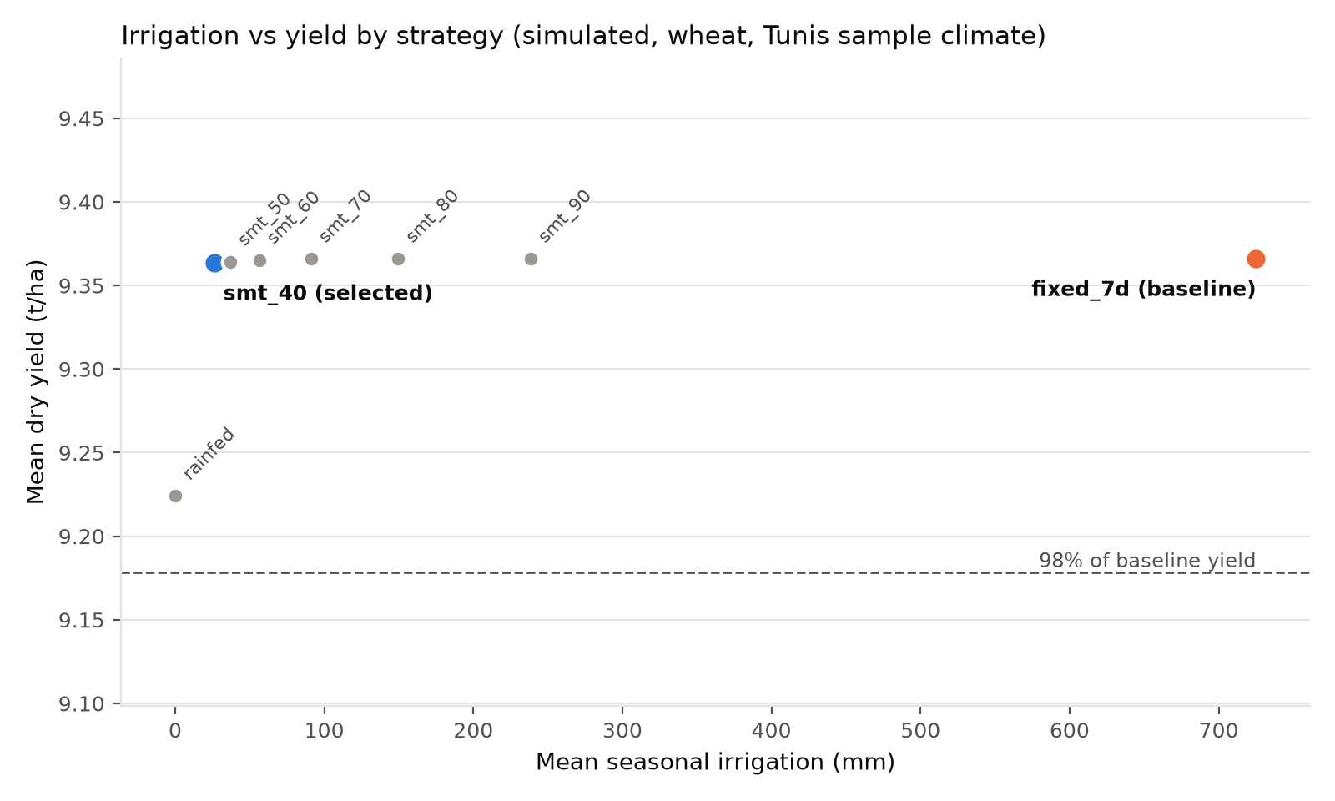
Result: smt_40 keeps yield with far less water
725 → 26.1 mm
mean irrigation per season, baseline → scheduler
9.37 → 9.36 t/ha
mean dry yield (-0.03%)
1.29 → 35.9
kg grain per m³ irrigation water (inflated: rain does most of the work)
Selection rule met: Yes. Less water in 23 of 23 seasons; yield within 2% in 23 of 23 seasons. Rainfed alone reaches 98.5% of baseline yield here, so the baseline over-irrigates.
SIMULATED with AquaCrop-OSPy (FAO AquaCrop model). Not field-measured.

Slide 6
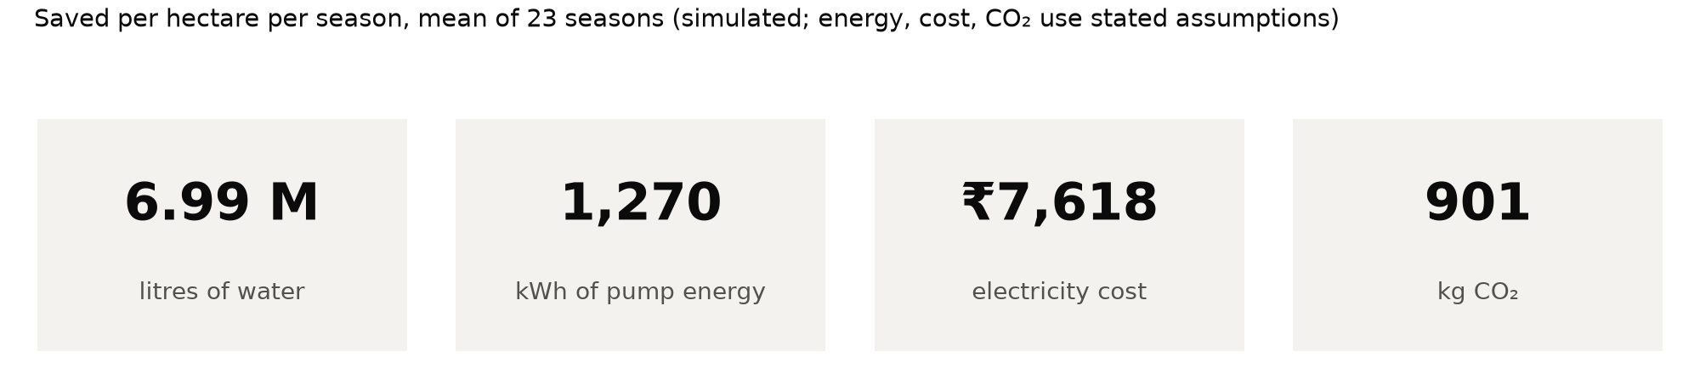
Impact per hectare per season (simulated)
Pump head | kWh/m³ | kWh saved | ₹ saved | kg CO₂ saved
15 m | 0.091 | 635 | ₹3,809 | 451
30 m | 0.182 | 1,270 | ₹7,618 | 901
60 m | 0.363 | 2,539 | ₹15,236 | 1,803
Sensitivity: savings scale with pump head, so we show 15, 30 and 60 m.
Base case: head 30 m, efficiency 0.45, tariff ₹6.00/kWh, grid 0.71 kg CO₂/kWh.
All four are assumptions to verify (docs/ASSUMPTIONS.md).
SIMULATED with AquaCrop-OSPy (FAO AquaCrop model). Not field-measured.

Slide 7
Path to the field, and what this does not show
Scalability
Commercial viability
• Rule runs on low-cost hardware, offline
• One controller can serve several valves
• Re-run per region with local weather and soil
• Saving = water + pump electricity
• Fits pump-solarisation and drip programmes
• No payback model yet: capex and tariffs unverified
Deployment path
Limitations
• Capacitive probes, ESP32-class controller, relay
• Calibrate probes to local soil
• Pilot: one field, control vs treatment plot
• Simulated only; sample climate (Tunis), not local
• Single crop and soil; baseline over-irrigates
• Threshold scheduling is a modest, known idea
SIMULATED with AquaCrop-OSPy (FAO AquaCrop model). Not field-measured.

