Slide 1
3DKneeNet

Slide 2
Point cloud approach
Train 3D point cloud auto-encoder to get get latent embedding.
Learn a mapping from 2D image to corresponding learnt embedding.
For uncertainty in reconstruction, predict multiple reconstructions
Learn a probabilistic distribution in the latent space that is capable of generating multiple plausible outputs (second phase)

Slide 3
Challenges
Generation of point clouds from .iv files
Generation of mesh from point cloud
Remove redundant points from the point cloud

Slide 4
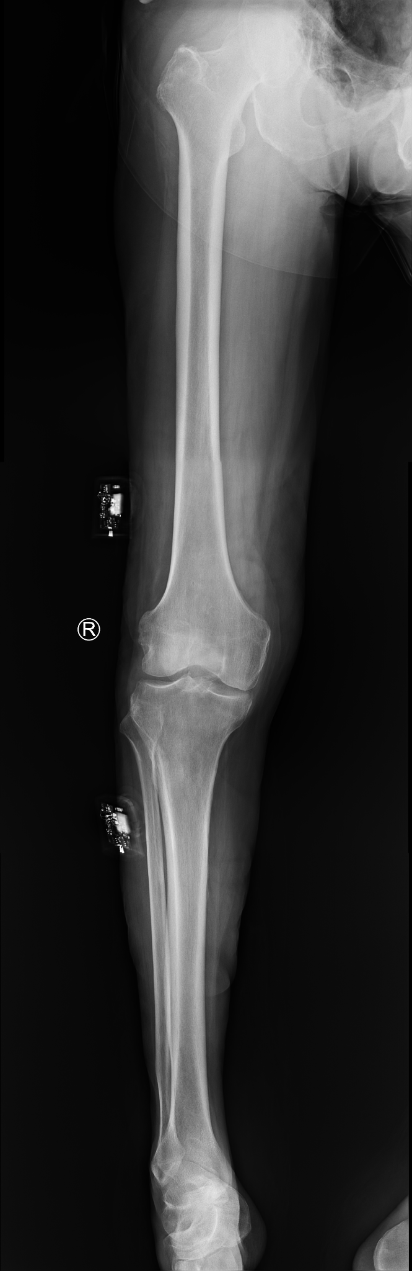
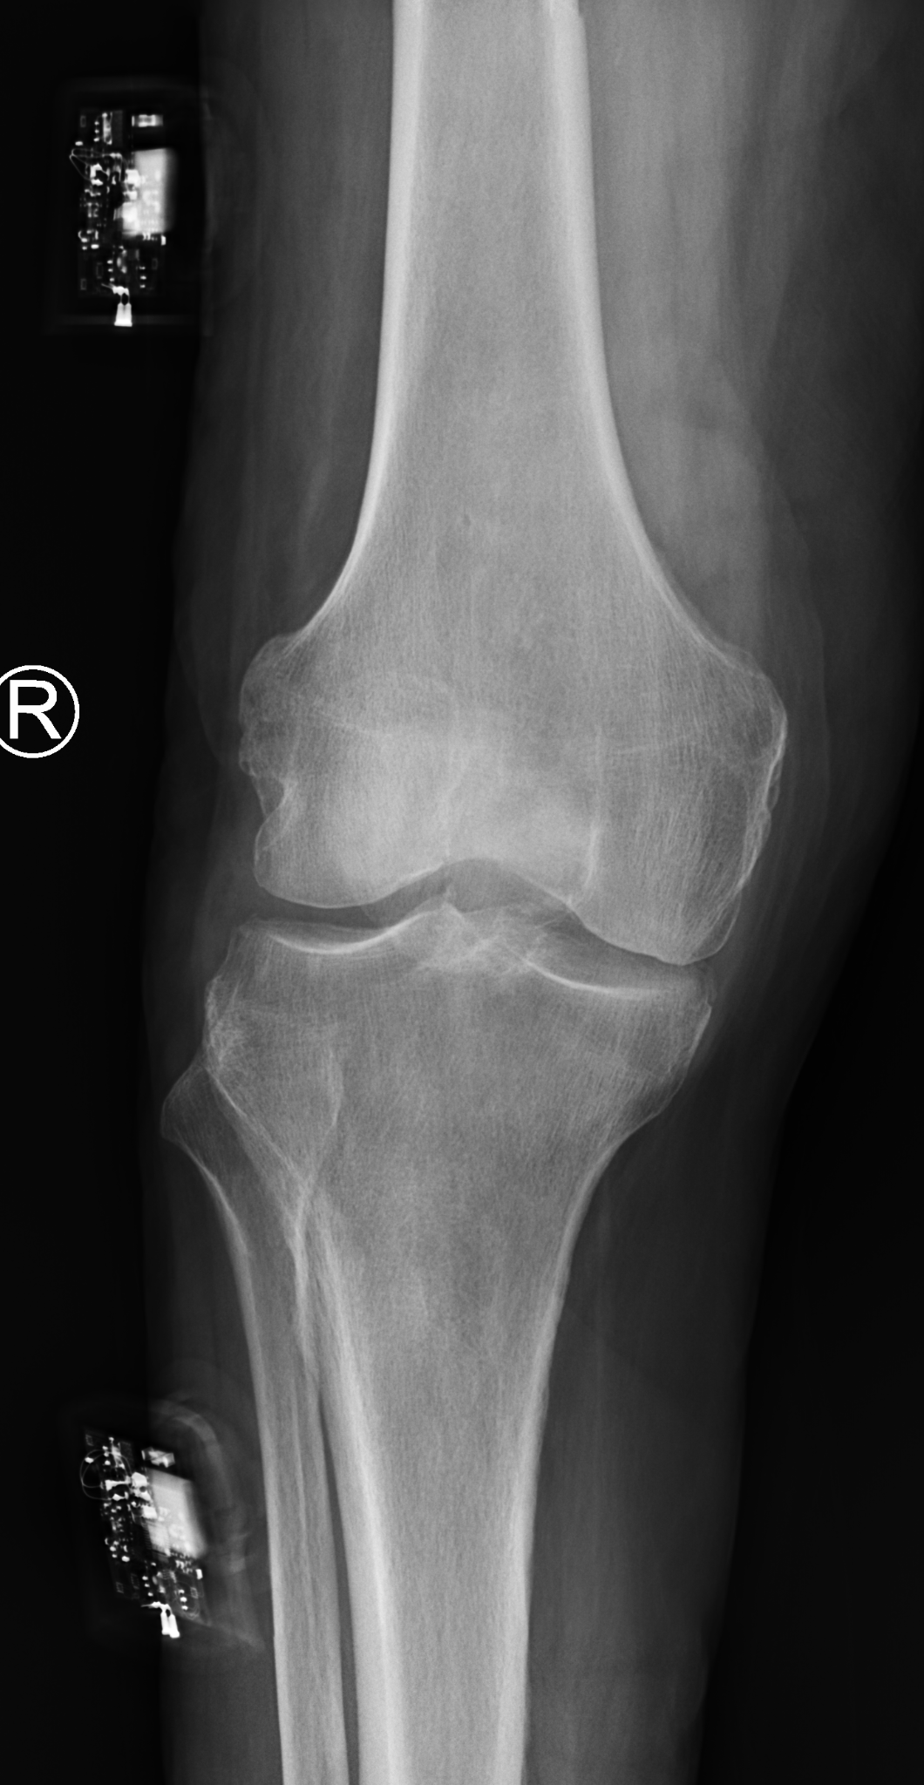
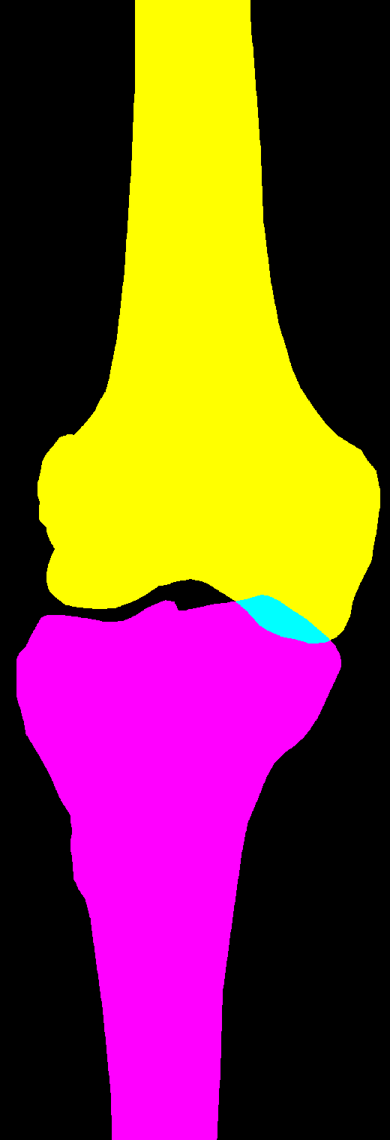

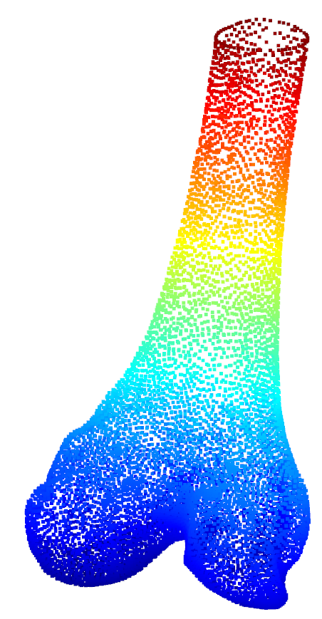
Testing / Inference Time
NEW CNN
CNN
Cropped X-ray
Bone Segmentation
Femur/Tibia Extraction
3D Point Cloud
Full X-ray
Notes:
Alignment of femur and tibia after reconstruction might be challenging. Try reconstruction of femur and tibia together.
Conversion of point cloud to planner compatible format → mesh

Slide 5


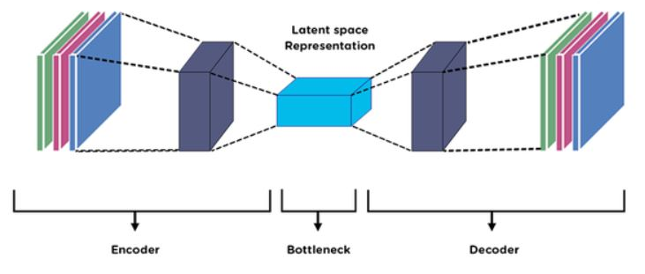
Implementation Details: mapping 3D to 3D to by learning latent space representation
Stage 1: 3D to 3D (minimize chamfer distance between GT and Predicted points of point cloud)
3D point cloud
3D point cloud
Ep
Dp
Parameters updated at each training step
Parameters updated at each training step

Slide 6
Implementation Details: mapping the image to learnt latent space representation
Stage 2: 2D to 3D (minimize L2 distance between GT and generated latent space representation)
2D Image
3D Model
Ei
Dp
Parameters updated at each training step
Parameters Fixed

Slide 7
Point Cloud Encoder (Ep)
Learn a strong prior over the 3D point clouds in the dataset.
For this purpose, train an encoder-decoder network (Ep , Dp ) that takes in a ground truth point cloud and outputs a reconstructed point cloud
where N is the number of points in the point cloud (Slide 5).
Since point cloud is an unordered data, an architecture is required that is invariant to relative ordering of input points. For this, 1D CONV layers are used that acts independently on each input point.
To achieve order-invariance of point features in the latent space, we apply the maxpool symmetry function to obtain a bottleneck Z of dimension k.

Slide 8

Point Cloud Decoder (Dp)
The decoder consists of fully-connected layers operating on Z to produce the reconstructed point cloud.
Since the loss function for optimization also needs to be order-invariant, Chamfer distance between and is chosen as the reconstruction loss.
Once the auto-encoder is trained, the next stage consists of training an image encoder (Ei) to map to this learnt embedding space.

Slide 9


Image Encoder (Ei)
Transfer the knowledge learnt in the 3D point cloud domain to the 2D image domain.
Train image encoder Ei that takes an input image I and outputs a latent vector representation Z of dimension k.
During training, the latent vector (Zi) is matched to the latent vector generated by its corresponding point cloud (Zp) in stage 1.
For the latent loss L, experiment with the squared euclidean error
and the least absolute error for matching the latent vectors.
During inference, we obtain the predicted point cloud by passing the image through Ei followed by Dp .

Slide 10
Hyperparameter Choice for Neural Net
-For point cloud encoder (Ep)
- 5 CONV layers with 1x1 filters with depth [64,128, 128, 256].
- A max pool layer resulting in a fully connected layer with 512 neurons.
- For point cloud decoder (Dp)
- 3 fully connected layers with [256, 256, Nx3] neurons respectively .
N = 2048 is the number of points predicted by the network.
- ReLU and batch normalization layers throughout the network.
- For image encoder (Ei)
- CONV layers with 3x3 filters which maps the input image to 512 dimensional vector.
- Minimize the loss using Adam optimizer with learning rate 10e-5 with batch size 32.

Slide 11
Point Cloud Encoder Architecture
S.No. | Layer | Filter Size | Filter Depth | Parameters(depends on input size)
1 | conv | 1x1 | 64
2 | conv | 1x1 | 128
3 | conv | 1x1 | 128
4 | conv | 1x1 | 256
5 | conv | 1x1 | 512
6 | max pool

Slide 12
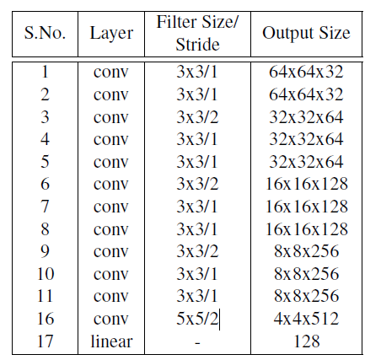
Image Encoder Architecture

Slide 13
Next Step
Train the network end-to-end on shape net dataset.
Test the network

