Slide 1
LabBoard
A tracker for DevOps lab work
Vedanshu Nishad
Session 21 Final Project
01
Notes:
Hello, I am Vedanshu Nishad. LabBoard is my Session 21 project: a website for tracking DevOps lab work. I will explain what it does, why I built it, the tools behind it and the evidence that its delivery process works.
Sources:
session21-python/README.md

Slide 2
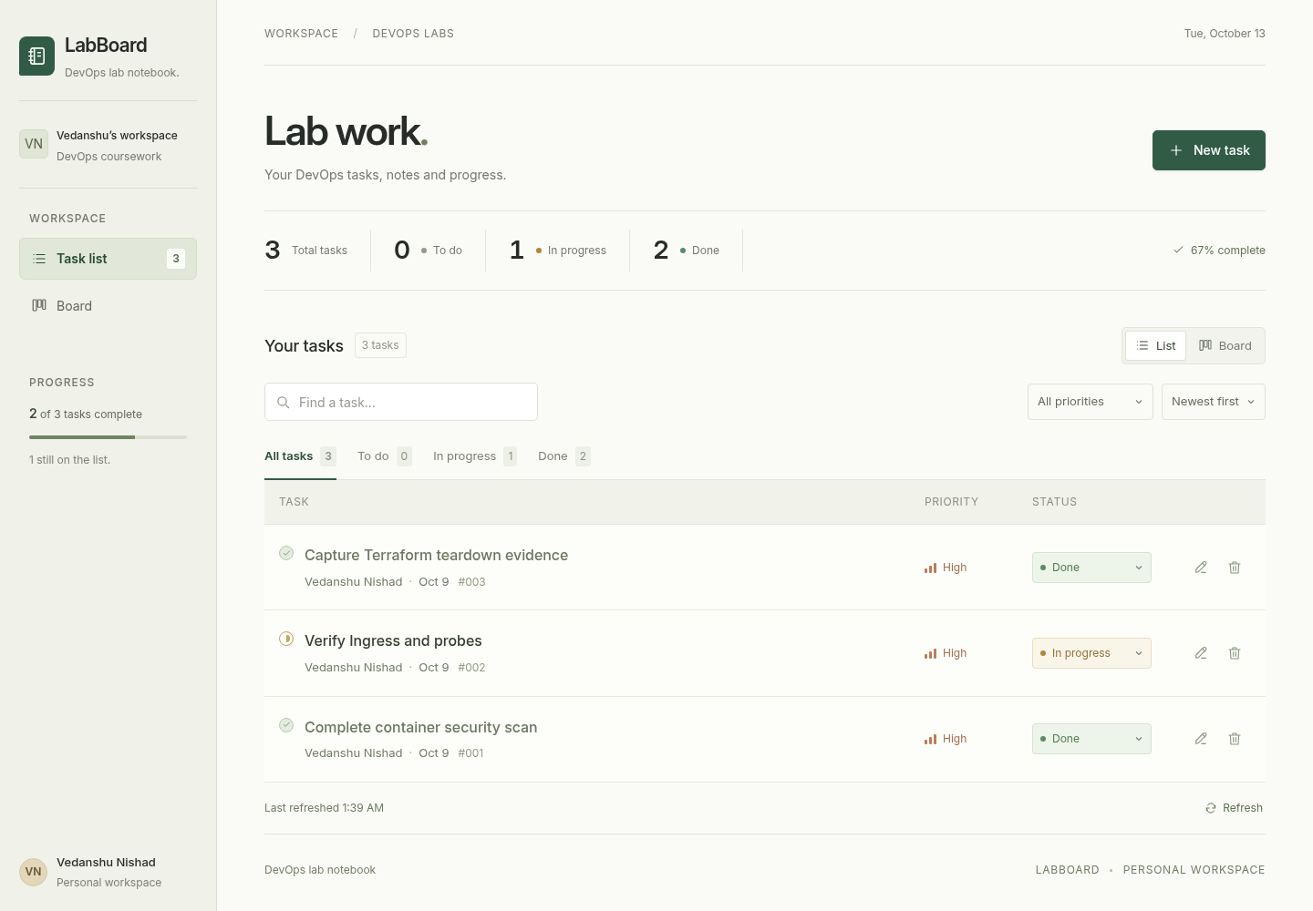
What I built
Keep work organised
Add tasks and notes.
Set a priority and an owner.
See progress
Use a list or board.
Move work through its stages.
Save changes
Tasks remain available
after a page refresh.
02
Notes:
LabBoard is a small website for organising my coursework. I can add tasks and notes, choose their priority and update their progress. A list and a board are two views of the same saved work. The database keeps changes after the page is refreshed. This screenshot shows the actual application.
Sources:
session21-python/README.md
session21-python/frontend/src/main.jsx
session21-python/Outputs/ui-list.png

Slide 3
Why I built it
A useful coursework tool
Keep lab tasks and notes together.
See what is pending and what is finished.
A complete delivery exercise
Practise how a code change becomes
a checked, running application.
The goal: make the app useful and its delivery repeatable
03
Notes:
The practical purpose is to keep DevOps lab tasks and notes in one place. The learning purpose is broader: a feature also needs a dependable way to reach a running application. This project connects the application to repeatable checks, packaging, deployment and monitoring.
Sources:
session21-python/README.md
../DevOps Homework.md

Slide 4
Technology stack: the application
Part | Tools used | What it does
Website | React / Nginx | Displays pages and task controls
Application logic | Python / FastAPI | Handles requests and task changes
Saved data | PostgreSQL | Stores tasks and notes
Packaging | Docker / Compose | Runs the three parts together
04
Notes:
The technology stack is simply the set of tools used to build the project. React creates the pages and task controls, while Nginx serves the finished website. Python and FastAPI process requests such as creating a task. PostgreSQL stores the saved data. Docker packages the parts, and Compose starts the website, application service and database together.
Sources:
session21-python/frontend/package.json
session21-python/frontend/Dockerfile
session21-python/backend/app/main.py
session21-python/docker-compose.yml

Slide 5
Technology stack: delivery and operations
Purpose | Tools used | What it does
Code and history | Git / GitHub | Keeps files and change history
Release checks | GitHub Actions / GHCR | Checks and stores new versions
Running the app | Kubernetes / Helm | Manages copies and their setup
Health and activity | Prometheus / Grafana | Displays application measurements
Setup consistency | Argo CD | Keeps the app aligned with Git
Cloud infrastructure | Terraform / AWS | Defines and creates cloud resources
05
Notes:
These tools help deliver and operate the application. Git and GitHub keep the code and its history. GitHub Actions runs automated checks, and GHCR stores packaged versions. Kubernetes manages running copies, with Helm holding their setup. Prometheus and Grafana show application activity. Argo CD keeps the running setup aligned with the version saved in Git. Terraform describes the cloud infrastructure that AWS provides.
Sources:
.github/workflows/session21-ci-cd.yml
session21-python/helm/taskboard/
session21-python/gitops/application.yaml
session21-python/monitoring/prometheus-values.yaml
session21-python/terraform/main.tf

Slide 6
How I built it
1. Adapt the reference app
4. Automate the checks
Turn the supplied TaskBoard starter
into a DevOps lab tracker.
Run tests and security scans
before publishing a version.
2. Build the interface
5. Verify the deployment
Add task views, search, filters
and clear editing controls.
Check recovery, saved data
and application activity.
3. Package the parts
6. Record the cloud lifecycle
Define how the website, service
and database run together.
Create the practice infrastructure,
save evidence and remove it.
06
Notes:
I started with the supplied TaskBoard reference, then adapted it for DevOps lab work. My changes include the interface, tests, security fixes and delivery automation. I packaged the application with Docker, automated the checks, and verified a Kubernetes deployment. I checked that tasks survived a database restart and that monitoring and automatic setup repair worked. I also provisioned a temporary cloud environment with Terraform, saved the results and cleaned it up.
Sources:
session21-python/README.md
.github/workflows/session21-ci-cd.yml

Slide 7
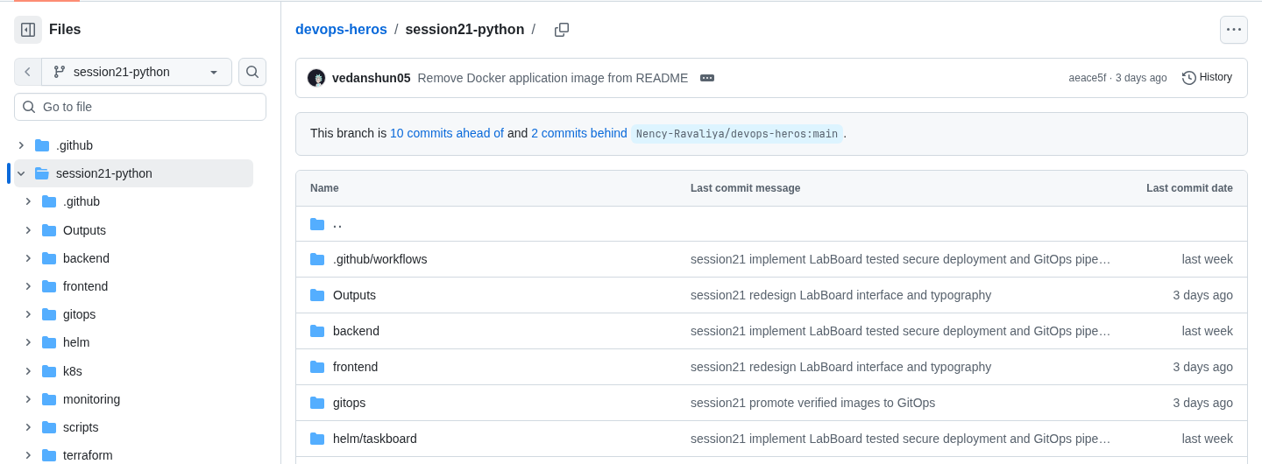
The project repository
GitHub stores the source code, setup files and change history
Repository = project files with a record of changes
07
Notes:
A repository is the project folder plus its change history. This is the actual GitHub page for my Session 21 branch. It keeps the application, setup files, workflow and evidence together, so someone else can inspect the work and follow the instructions.
Sources:
https://github.com/vedanshun05/devops-heros/tree/session21-python/session21-python
session21-python/Outputs/github-repository.png

Slide 8
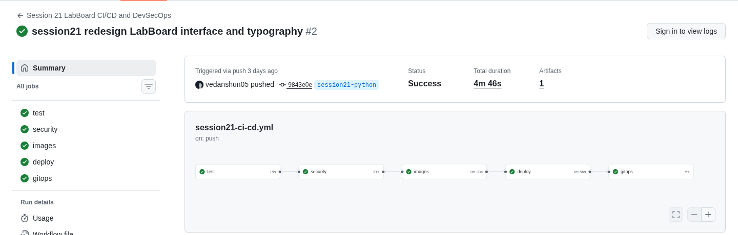
CI/CD: automated release checks
A code change starts the checks. Each green tick marks a completed stage.
Five jobs passed in the recorded run
08
Notes:
CI/CD means continuous integration and continuous delivery. In plain language, a code change starts an automated sequence of checks and release steps. This actual GitHub Actions run completed five jobs successfully. It tested the application, ran security checks, published packaged versions, verified deployment in a temporary Kubernetes environment and updated the saved deployment configuration. A failed required check stops the later stages.
Sources:
https://github.com/vedanshun05/devops-heros/actions/runs/38303472047
.github/workflows/session21-ci-cd.yml
session21-python/Outputs/github-pipeline.png

Slide 9
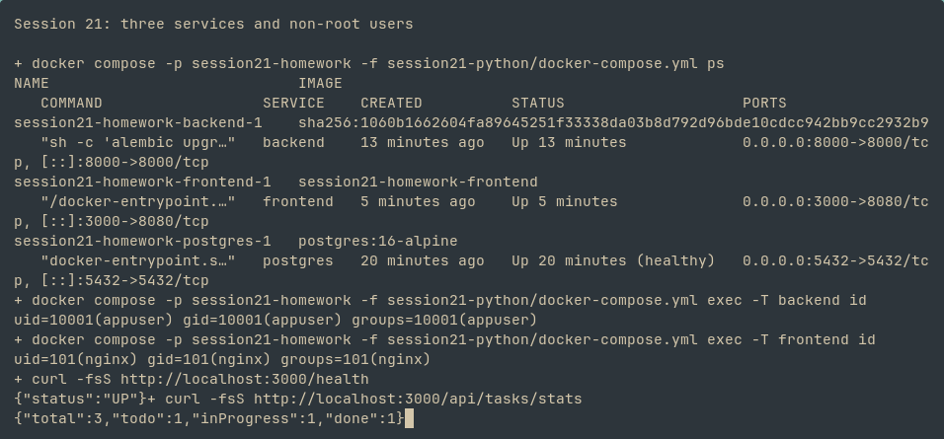
Docker Compose: running the parts together
One setup starts the website, application service and database
Recorded result: three services running and the database healthy
09
Notes:
A container is a packaged part of the application. Docker Compose starts the website, application service and PostgreSQL database together using one setup file. In this recorded output, all three services are Up and the database is healthy. The health request also succeeds. This screenshot records the working check, rather than claiming the services are running at the moment the slides are viewed.
Sources:
session21-python/docker-compose.yml
session21-python/Outputs/docker-verification.png

Slide 10
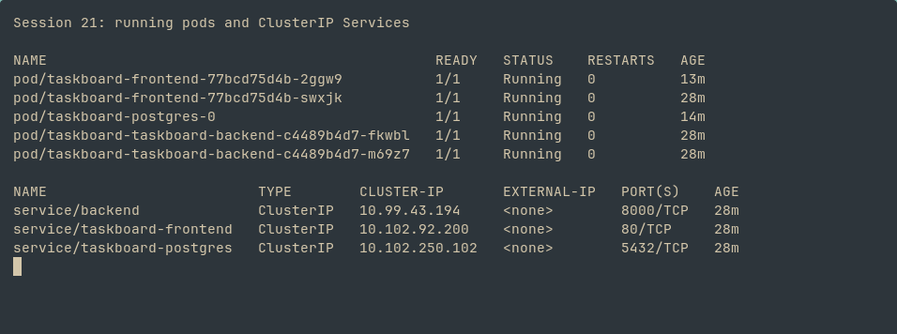
Kubernetes: managing the running app
Kubernetes manages running copies and can replace failed copies
A pod is a running unit of the application
10
Notes:
Kubernetes manages running copies of the application. It can replace failed copies and scale the backend according to the configured rules. Each small running unit is called a pod. The recorded screenshot shows two website pods, two application-service pods and one database pod in the local Minikube environment. The rows marked Running are the evidence to focus on.
Sources:
session21-python/helm/taskboard/templates/
session21-python/helm/taskboard/values.yaml
session21-python/Outputs/kubernetes.png

Slide 11
How I checked that it works
Question | Evidence from the project
Do the features behave correctly? | 10 automated application tests passed
Does saved work survive a restart? | The same task survived database pod replacement
Can I see application activity? | The dashboard showed activity and computer resource use
Can the setup correct unwanted changes? | Argo CD restored the number of app copies saved in Git
11
Notes:
I checked behaviour beyond whether the home page loads. Ten automated tests cover task handling, validation and service checks. A saved task survived replacing the database pod. Monitoring displayed request counts and resource use. Argo CD also repaired a manual difference between the running setup and the configuration saved in Git. These are recorded checks, with the detailed evidence retained in the repository.
Sources:
session21-python/backend/tests/test_api.py
session21-python/Outputs/pvc-persistence.png
session21-python/Outputs/grafana-dashboard.png
session21-python/Outputs/gitops-self-heal.png
session21-python/README.md

Slide 12
Alternatives and trade-offs
Comparison of options, explained after building the project
Used here | Alternative | What changes
PostgreSQL | SQLite | PostgreSQL provides a shared database. SQLite needs less setup for local storage.
GitHub Actions | Jenkins | GitHub runs the release checks. Jenkins gives more server control and upkeep.
Kubernetes / Helm | Compose only | Kubernetes adds scaling and recovery practice. Compose keeps the local setup simpler.
12
Notes:
This is a comparison of options explained after the build, rather than a claim that I benchmarked alternatives. PostgreSQL suits the shared database used by several application copies. SQLite is simpler for local storage and is already used for isolated tests here. GitHub Actions fits this GitHub repository, while Jenkins gives more control over a separate automation server and also requires its upkeep. Kubernetes and Helm demonstrate scaling and recovery, while a Compose-only setup is simpler for a small local tracker. These are choices for the course objectives, not a claim that every small application needs Kubernetes.
Sources:
session21-python/docker-compose.yml
session21-python/backend/tests/test_api.py
https://www.sqlite.org/whentouse.html
https://docs.github.com/en/actions/get-started/understand-github-actions
https://www.jenkins.io/doc/book/installing/
https://kubernetes.io/docs/concepts/overview/

Slide 13
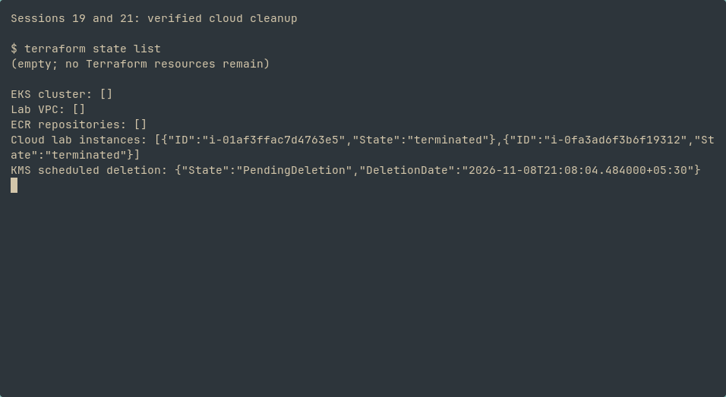
Cloud setup and cleanup
Terraform describes the setup. AWS supplies the cloud resources.
Practice infrastructure
Create the environment,
record the checks and clean up.
Application demo:
local Kubernetes
Main lab resources removed. Encryption-key deletion scheduled for 8 November 2026.
13
Notes:
Terraform describes the cloud setup as repeatable instructions, and AWS provides the resources. I created a temporary practice network, managed Kubernetes infrastructure and image storage. I recorded the provisioning and cleanup results, then removed the main lab resources. The application demonstration runs locally on Minikube, while the cloud exercise verified infrastructure. The encryption key has a scheduled deletion date of 8 November 2026, as shown in the saved output.
Sources:
session21-python/terraform/main.tf
session21-python/Outputs/aws-infrastructure.png
session21-python/Outputs/aws-cleanup.png
session21-python/README.md

Slide 14
Project results
A working tracker
Tasks and notes stay organised,
and saved changes survive a refresh.
A repeatable delivery process
Automated checks, packaged releases
and verified deployment.
github.com/vedanshun05/devops-heros
14
Notes:
LabBoard is a working task tracker with a repeatable delivery process. The project demonstrates how an application can be checked, packaged and run with operational evidence. The slides include the four requested screenshots: the repository, CI/CD pipeline, Docker Compose output and Kubernetes deployment. The repository contains the detailed technical instructions and recorded results for anyone who wants to inspect further.
Sources:
session21-python/README.md
https://github.com/vedanshun05/devops-heros/tree/session21-python/session21-python

