Slide 1

F
a
r
m
F
e
e
d
By
VEDANT PANDURANG DIVATE –MS2503
PANKAJ RAJENDRA JADHAV -MS2509
SANIKA NIVAS MAHIND -MS2517
Guide
Ichchyakant Sharma sir
Department of Scientific Computing Modeling and Simulation
Savitribai Phule Pune University,Pune
Date: 8 November 2025

Slide 2
Introduction
FarmFeed is a web-based platfor designed for farmers and gardeners to buy fertilizers easily from one place.
It provides details of various fertilizers, their prices, and helps users place online orders quickly.

Slide 3
Problem Statement
Farmers face problems finding the right fertilizers at the right time.
Many have to travel long distances on local shops.
Farmers face fertilizer shortages during peak farming seasons..

Slide 4
Objective
To provide clear product details and prices.
To help farmers save time by ordering from home.
To manage fertilizer information and orders digitally
.

Slide 5
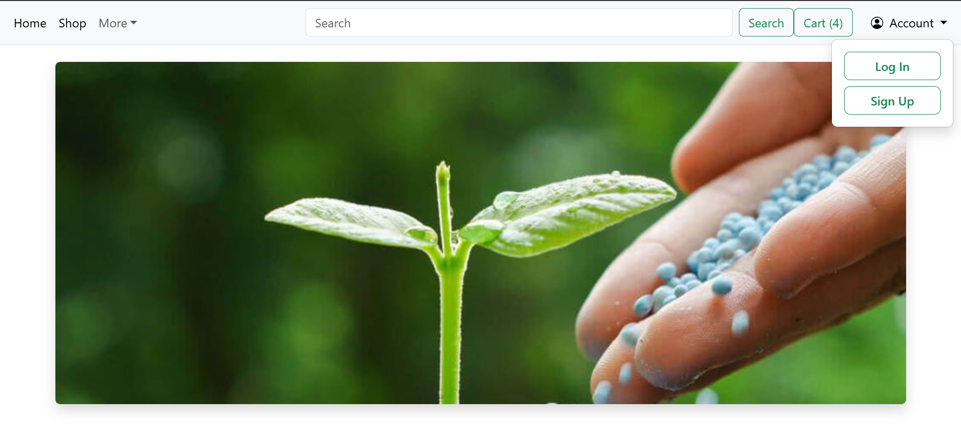
Proposed Solution
FarmFeed offers an online solution where:
Users can browse fertilizers by type and price.
Add them to cart and order online.
Shopkeeper can manage fertilizer details, prices, and orders.

Slide 6








Technologies Used
Frontend:
Backend:
Database:

Slide 7
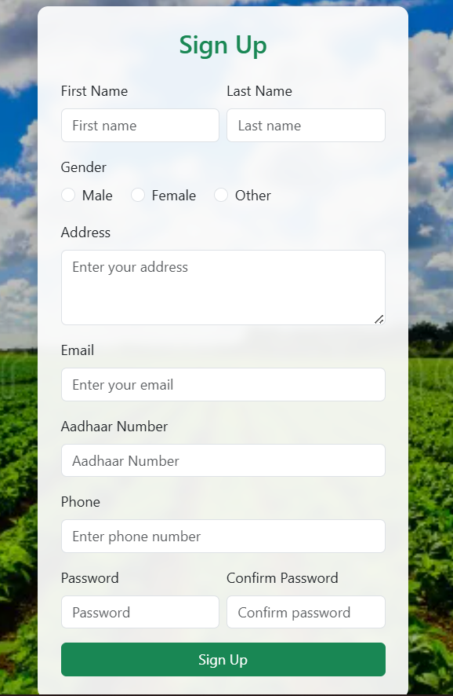
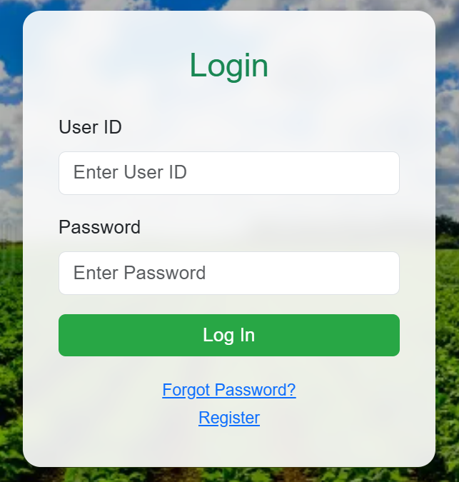
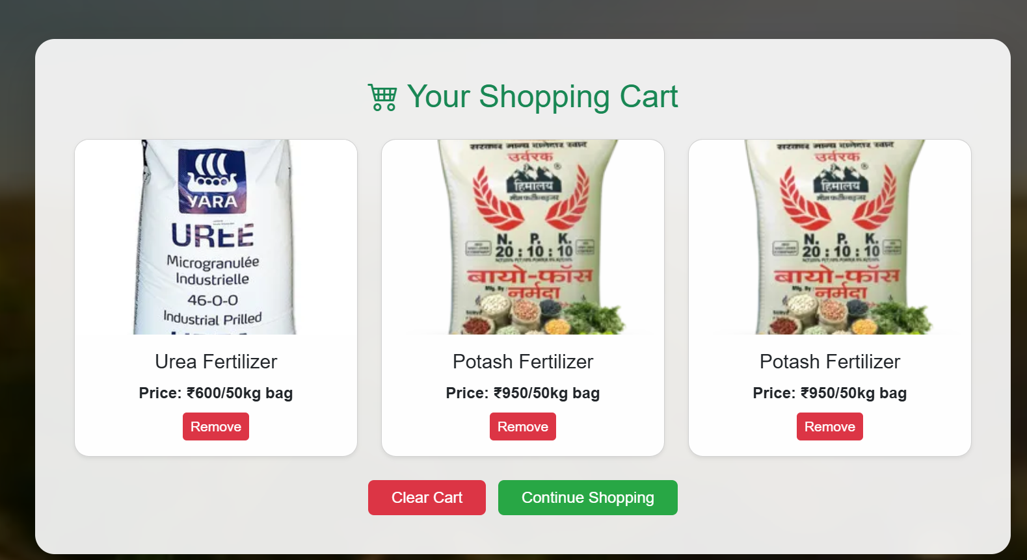
System Modules
User Module:
Register(Sign UP)
Login
Browse Fertilizers
Add to Cart

Slide 8
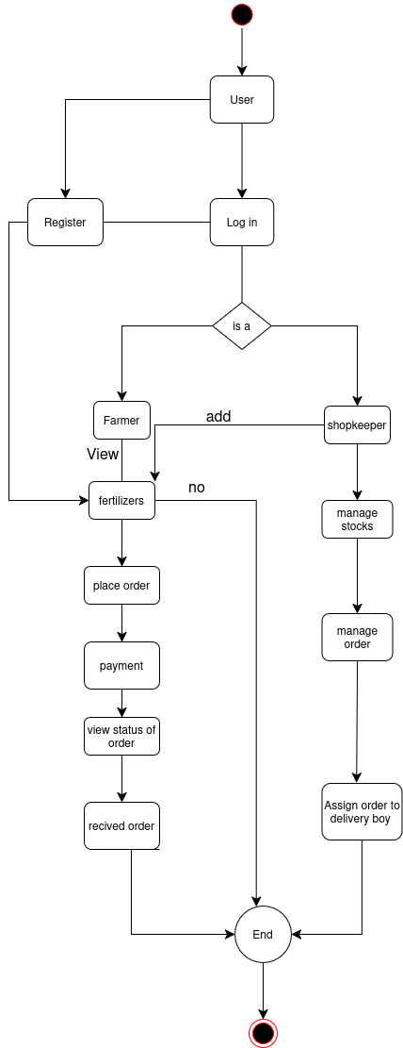
Activity Diagram

Slide 9
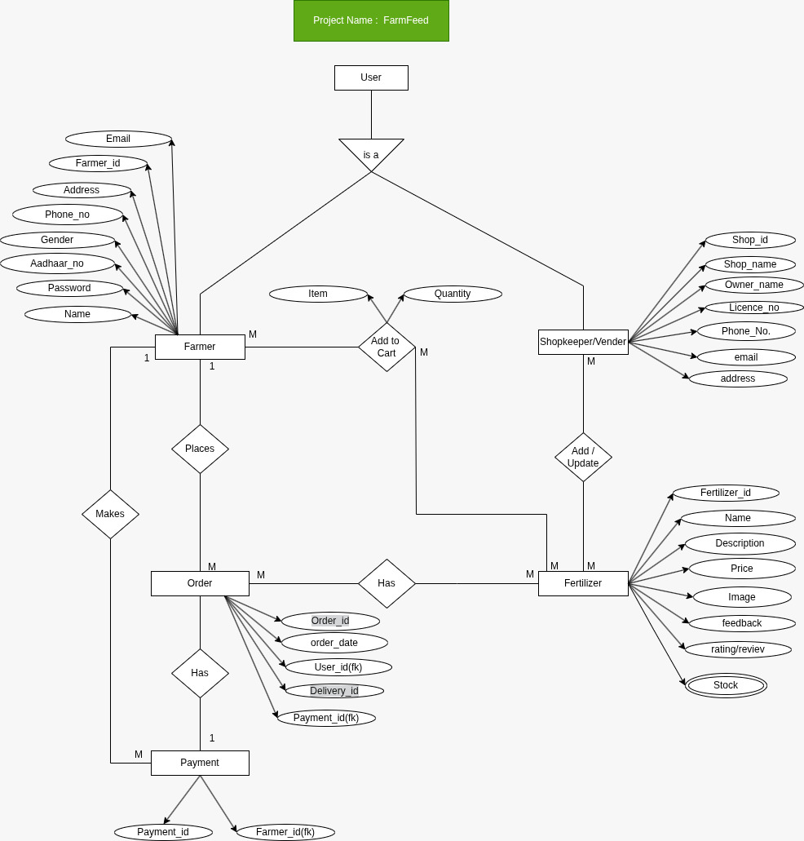
Database Design (ER Diagram)

Slide 10
Conclusion & Future Work
Conclusion:
FarmFeed helps farmers order fertilizers easily and manage their purchases online.
Future Enhancements:
Payment gatway
Order Tracking
Shopkeeper dashbord
Admin Module

Slide 11
Thank You…!

