Slide 1



FarmFeed
By
VEDANT PANDURANG DIVATE -MS2503
PANKAJ RAJENDRA JADHAV -MS2509
SANIKA NIVAS MAHIND -MS2517
Ichchyakant Sharma sir
Guide
Department of Scientific Computing Modeling and Simulation
Savitribai Phule Pune University,Pune
Date: 20 December 2025

Slide 2

01
INTRODUCTION
  FarmFeed is an online platform that connects farmers and shopkeepers.
  Farmers can search and order fertilizers online, while shopkeepers manage products and orders digitally.
  The platform reduces manual work and makes fertilizer buying simple and fast.

Slide 3

02
PROBLEM
  Farmers find it difficult to get the right fertilizer at the right time.
  Many farmers need to travel long distances to local shops, which wastes time and money.
  Fertilizer prices and availability are not clear, so farmers cannot easily compare products.

Slide 4

03
OBJECTIVE
  To make fertilizer buying easy for farmers using an online platform.
  To save farmers time and travel cost by allowing online ordering from home.
  To provide clear fertilizer details, prices, and availability in one place.

Slide 5

04
SOLUTION
  Farmers can search, compare, and order fertilizers online.
  Shopkeepers can manage products, stock, and orders digitally.
  The system supports order tracking and delivery updates.

Slide 6
05
USER MODULES
Farmer Module
Shopkeeper (Vendor) Module
  Register and log in to the system
  Search and view fertilizers with
  Place orders and track delivery status
  Register with shop and license details.
  Add, update, and manage fertilizer products
  Accept or reject orders and manage stock

Slide 7



06
TECHNOLOGY
website view
Browser
BackEnd Spring Boot
Databace MySQL
FrontEnd
Java Script

Slide 8


07
DATABASE DESIGN
  User - Stores user login details
  Fertilizer - Contains product info, price and image
  Orders - Stores customer order
  Cart - Temporary Storage for selected items

Slide 9
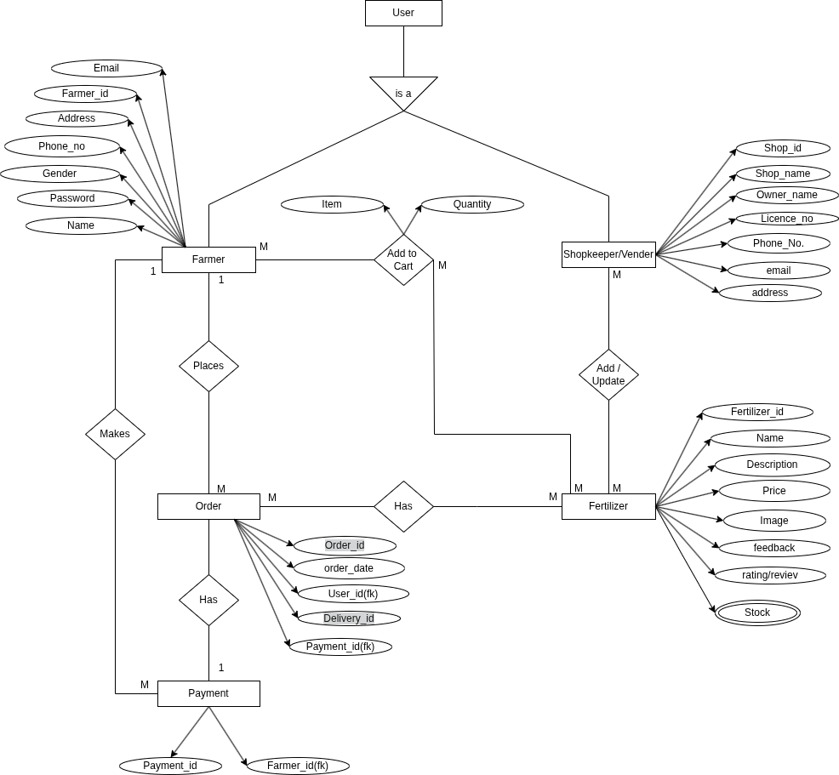
ER-DIAGRAM
07

Slide 10

08
FUTUER ENCHANCEMENT
  Online Payment Integration
  Order Tracking
  Delivery Partner Module
  Admin Module
  Develop as an App
CONCLUSION
  FarmFeed helps farmers order fertilizers easily and manage their purchases online.

Slide 11

THANK YOU…!

