Slide 1

INTRODUCTION
Mastering AI-Powered Presentation Design
Transform your workflow from manual labor to creative excellence.
Notes:
Welcome everyone. Today we are diving into the world of AI-powered presentation tools. We will explore how to stop fighting with formatting and start focusing on your message. Let's see how these tools change the game.

Slide 2
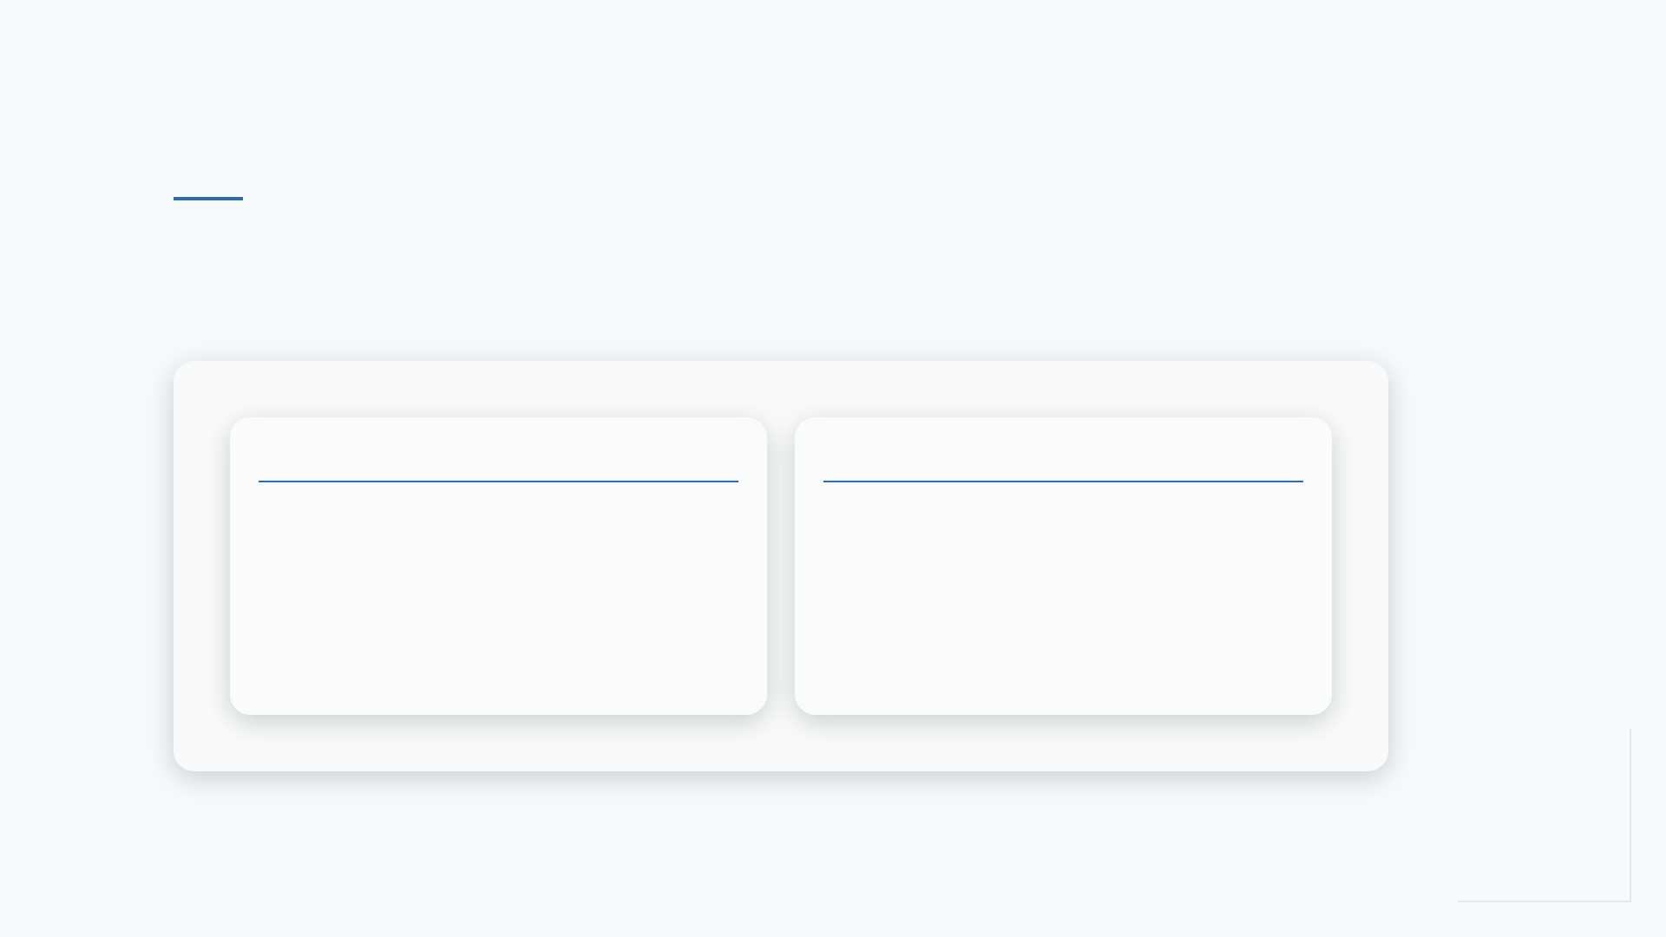
THE CHALLENGE
The Old Way vs. The AI Way
Traditional Workflow: Manual template formatting, Hours spent aligning icons, Complex data visualization, Static, non-responsive design
AI-Assisted Workflow: Automated layout generation, Instant asset sourcing, Dynamic data storytelling, Responsive, adaptive themes
Notes:
Think back to the last time you built a deck. How much time did you spend aligning boxes instead of writing your script? AI shifts that balance back to your ideas.

Slide 3
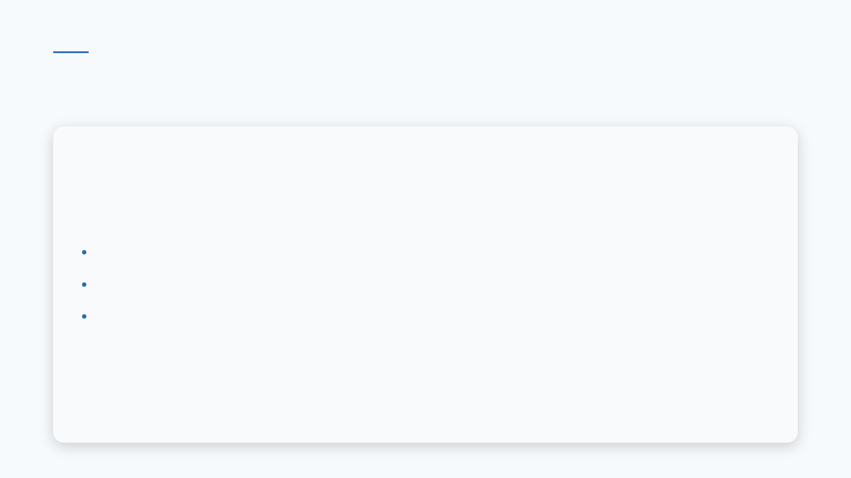
THE CORE VALUE
Three Pillars of AI Presentation Design
• Simplified Content Creation: Draft outlines in seconds.
• Enhanced Design Quality: Professional aesthetics automatically applied.
• Improved Productivity: Reduce creation time by over 60%.
Notes:
These tools don't just make things look pretty. They act as a creative assistant, handling the heavy lifting of design so you can focus on the narrative arc of your story.

Slide 4
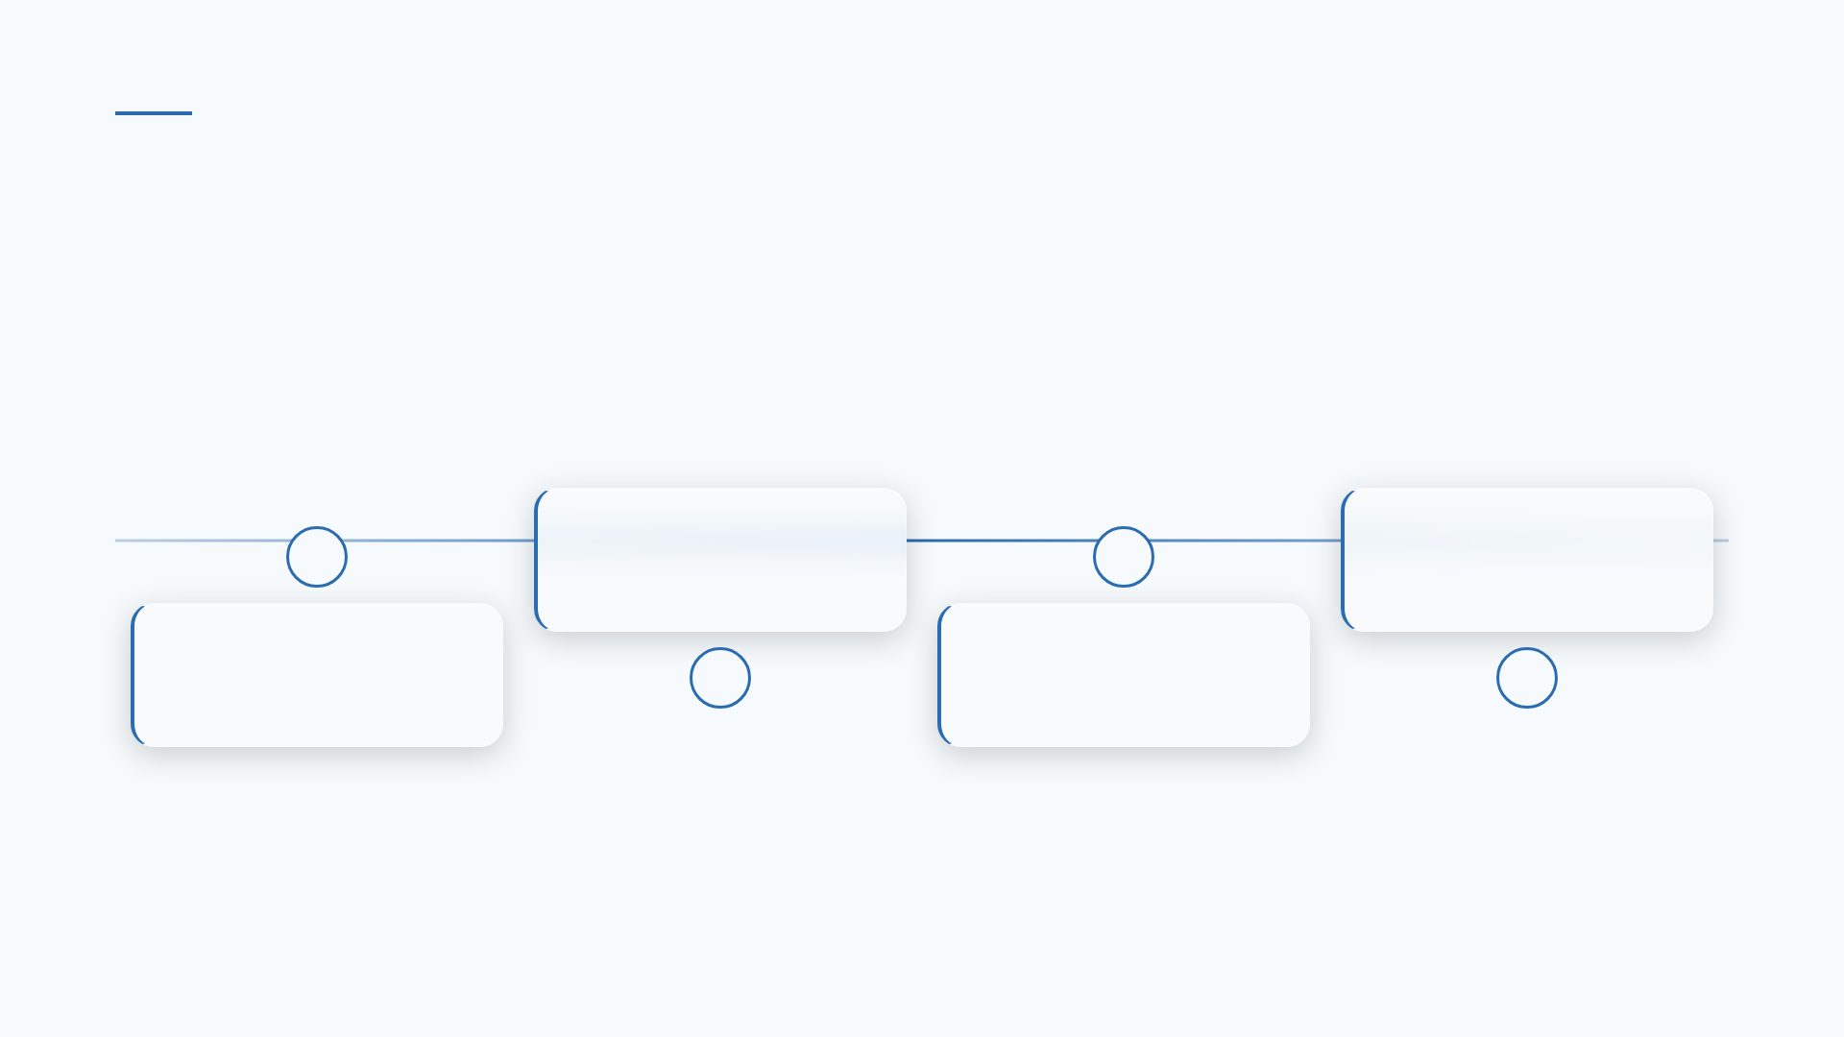
THE WORKFLOW
From Prompt to Presentation in Four Steps
Define: Input your core topic and target audience.
Style: Select a visual theme or brand style.
Generate: Review AI-generated slide structure.
Polish: Refine content and export for delivery.
Notes:
It is surprisingly simple. You provide the intent, and the AI handles the structure. It is like having a designer sitting right next to you, ready to execute your vision instantly.

Slide 5

PERSPECTIVE
"AI allows us to focus on the story, while the machine handles the canvas."
— — Modern Presentation Expert
Notes:
This is the core shift. When we stop worrying about the pixels, we start worrying about the impact. That is where true communication happens.

Slide 6
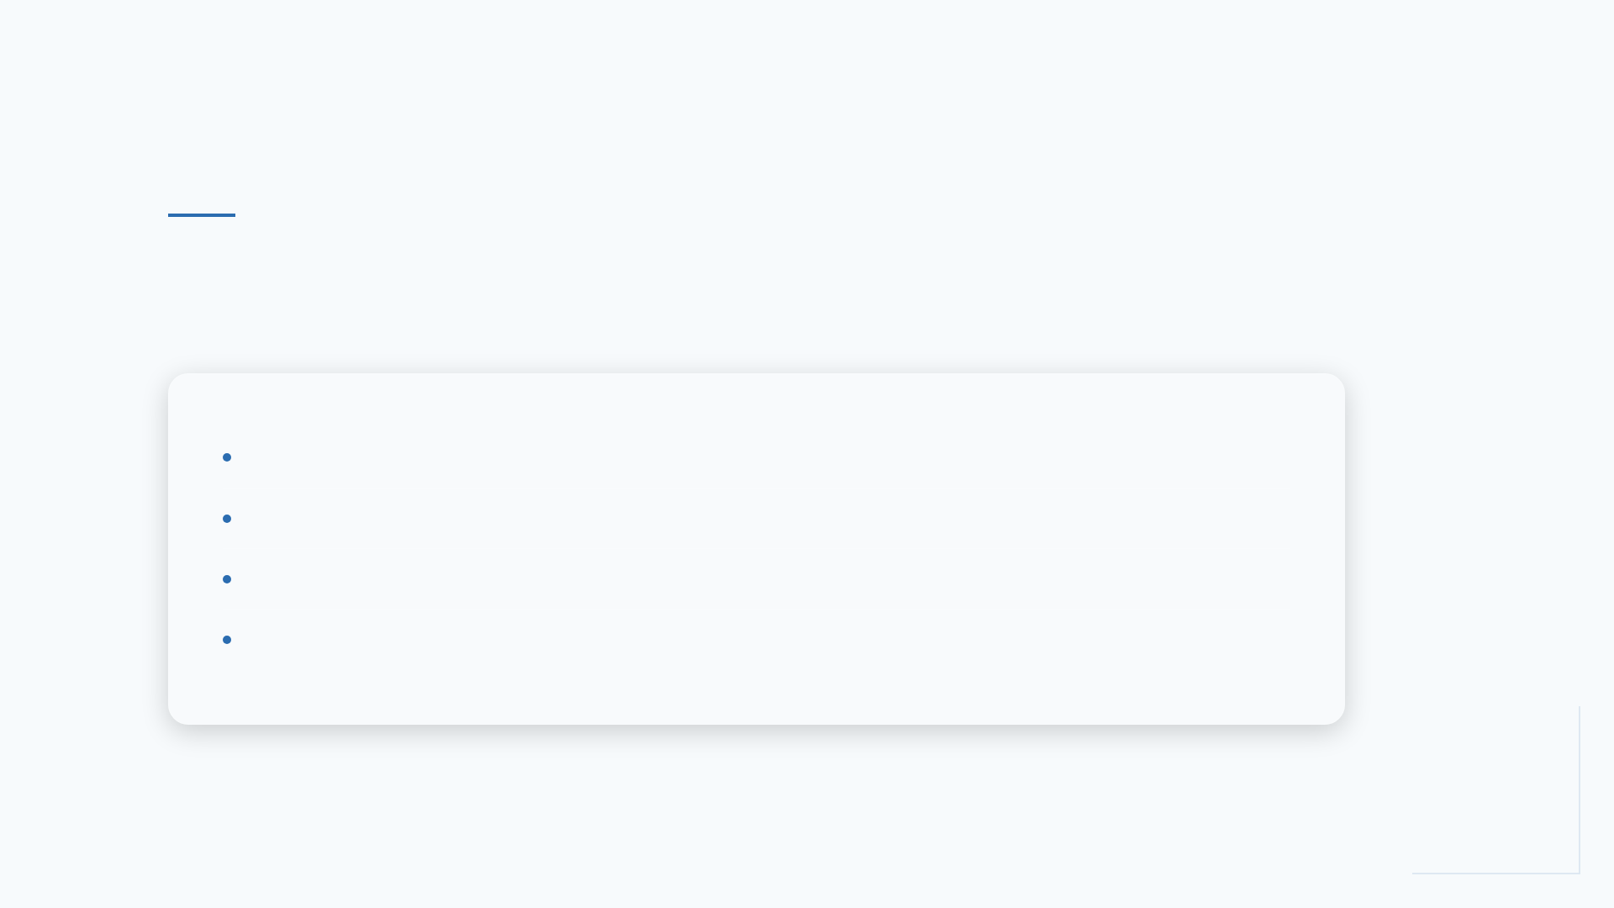
APPLICATION
Real-World Use Cases for AI Tools
• Sales teams creating rapid-response pitch decks.
• Students building complex academic summaries.
• Professionals turning long reports into visual briefs.
• Startups iterating on investor pitch narratives.
Notes:
Whether you are a student or a CEO, the bottleneck is always the same: time. These tools are being used right now to solve that exact problem across every industry.

Slide 7
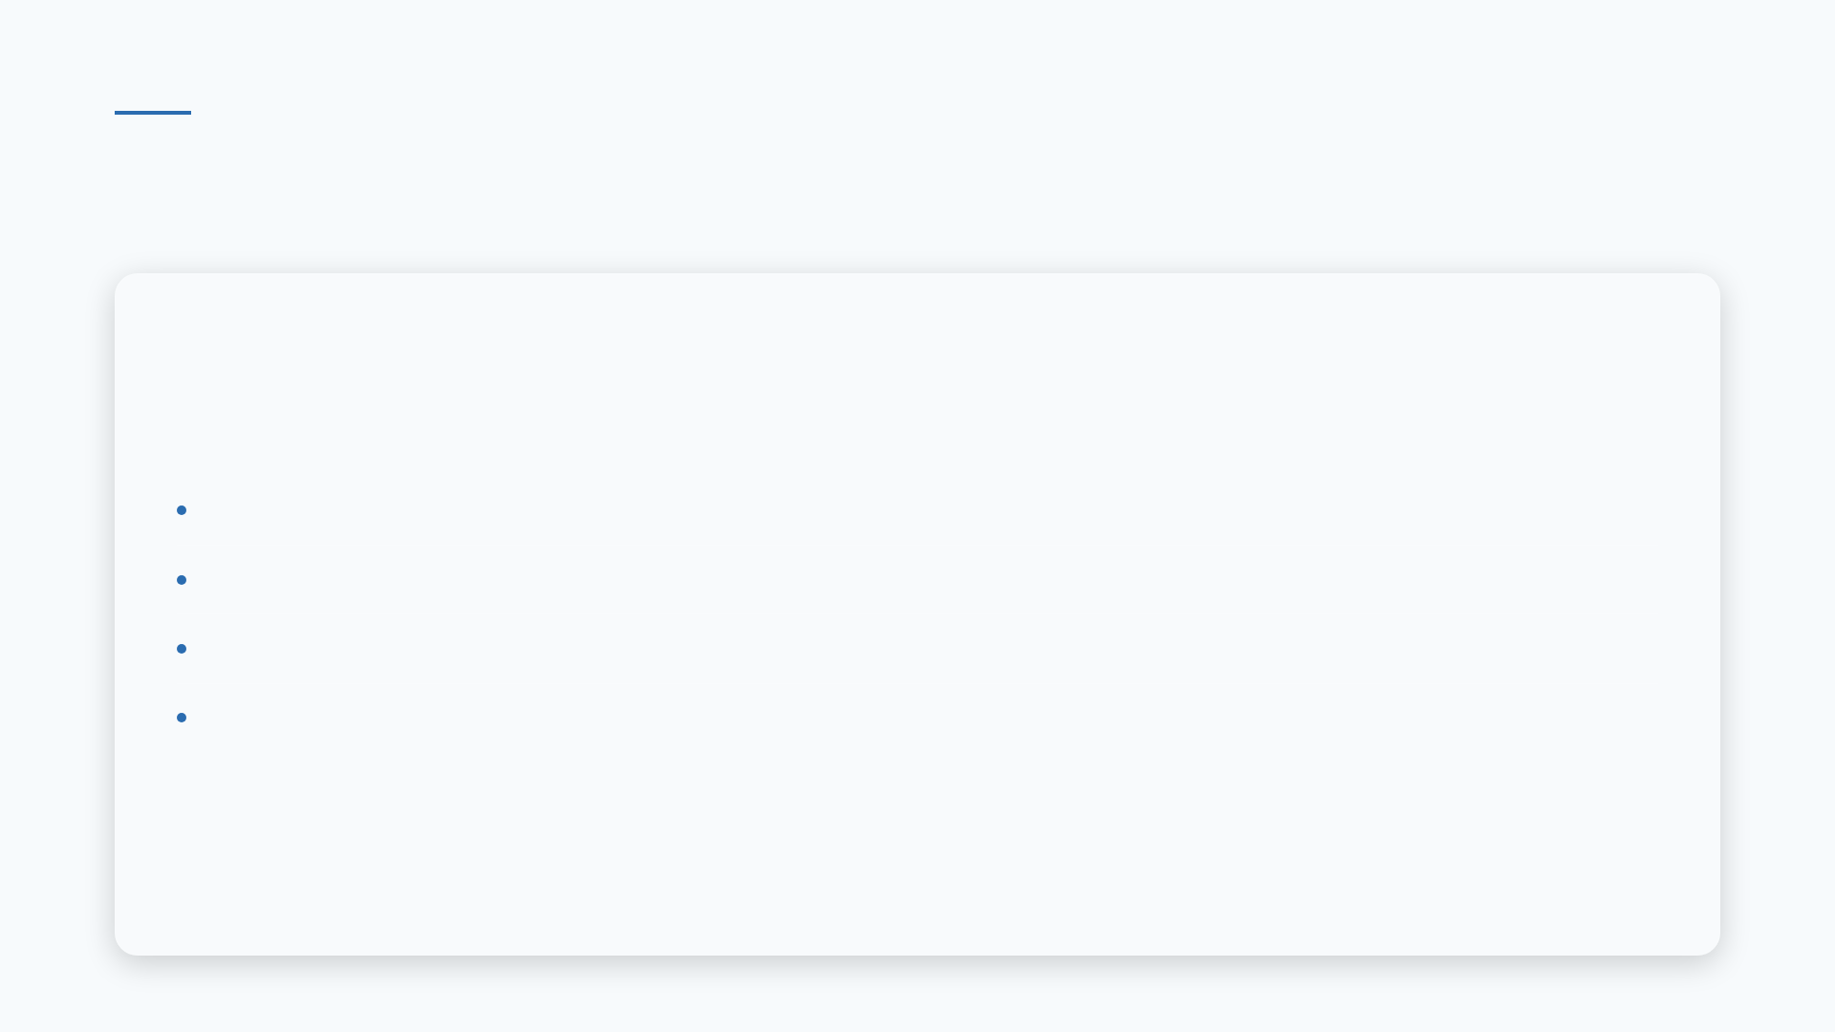
TOOL SELECTION
Key Features to Look For
• Natural Language Processing for slide generation.
• Automatic brand color and font matching.
• Smart image suggestions based on slide context.
• Real-time collaboration and cloud syncing.
Notes:
When you are choosing your tool, look for these four features. They are the baseline for a modern experience that actually saves you time.

Slide 8
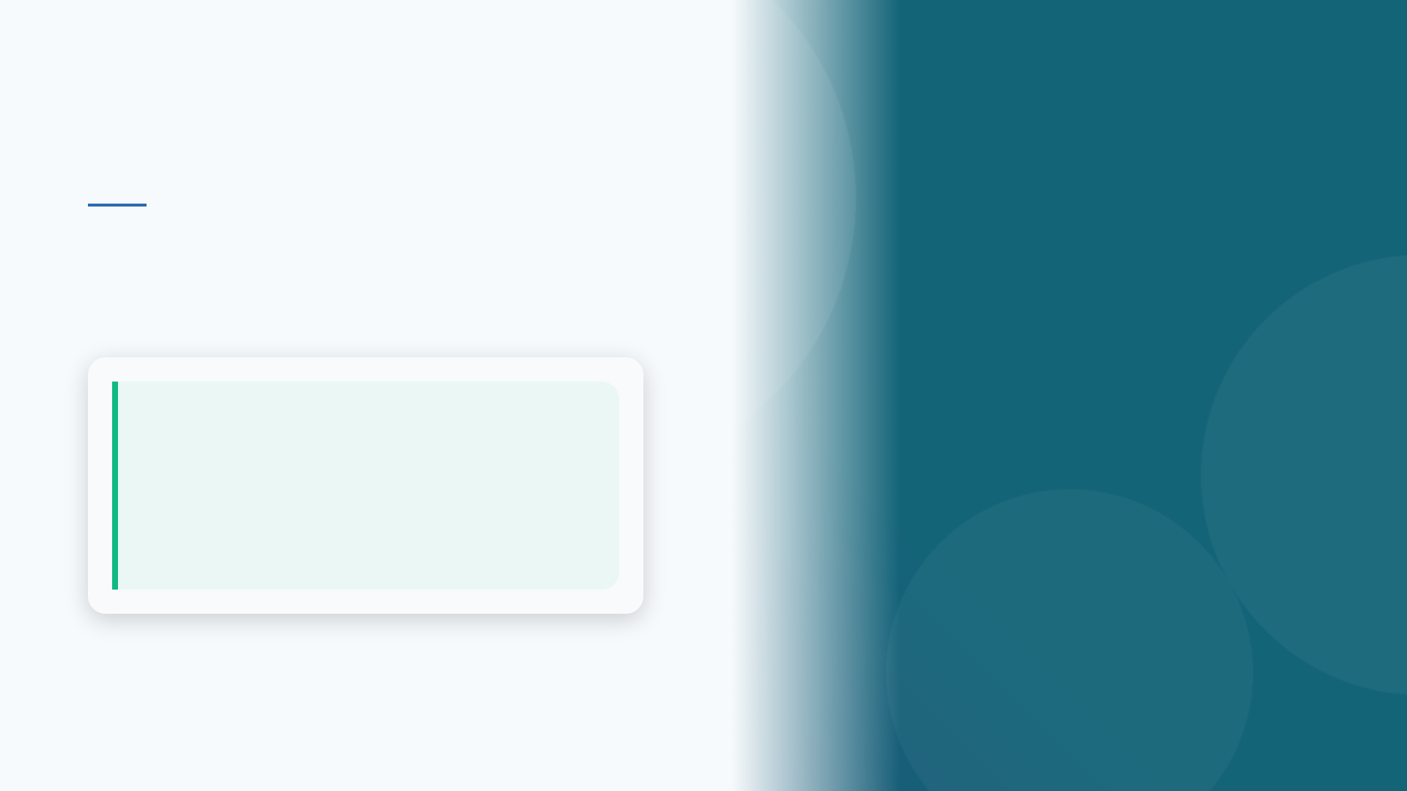
BEST PRACTICES
Enhancing Your Visual Storytelling
💡 AI handles the structure, but you provide the soul. Always review generated text for tone and accuracy.
Notes:
The AI is a tool, not a replacement for your voice. Use it to build the foundation, then bring your own unique insights to the final product.

Slide 9

THE IMPACT
Efficiency at Scale
75%
Time Saved
Notes:
Imagine getting three-quarters of your time back. What would you do with those extra hours? That is the scale of the productivity shift we are talking about.

Slide 10
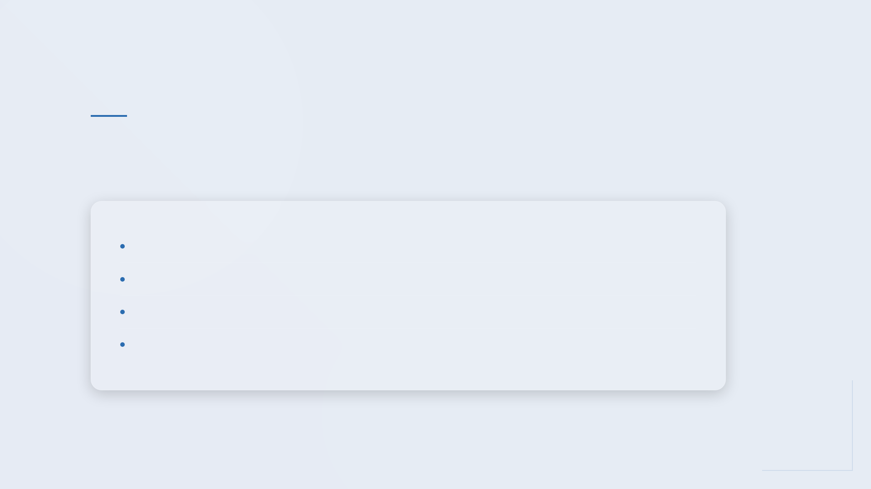
GETTING STARTED
Overcoming Common Adoption Barriers
• Start small with simple presentation outlines.
• Use built-in templates to learn the UI.
• Customize AI suggestions to maintain brand voice.
• Experiment with different prompt styles.
Notes:
Don't feel like you need to automate everything at once. Start with one slide, then one section. Build your confidence as you go.

Slide 11
TRENDS
The Future of Presentation Tech
• Hyper-personalization for specific audiences.
• Real-time data integration from live APIs.
• Interactive slides that respond to audience feedback.
Notes:
We are just scratching the surface. Soon, your presentations will be living documents that update themselves based on the data they display.

Slide 12
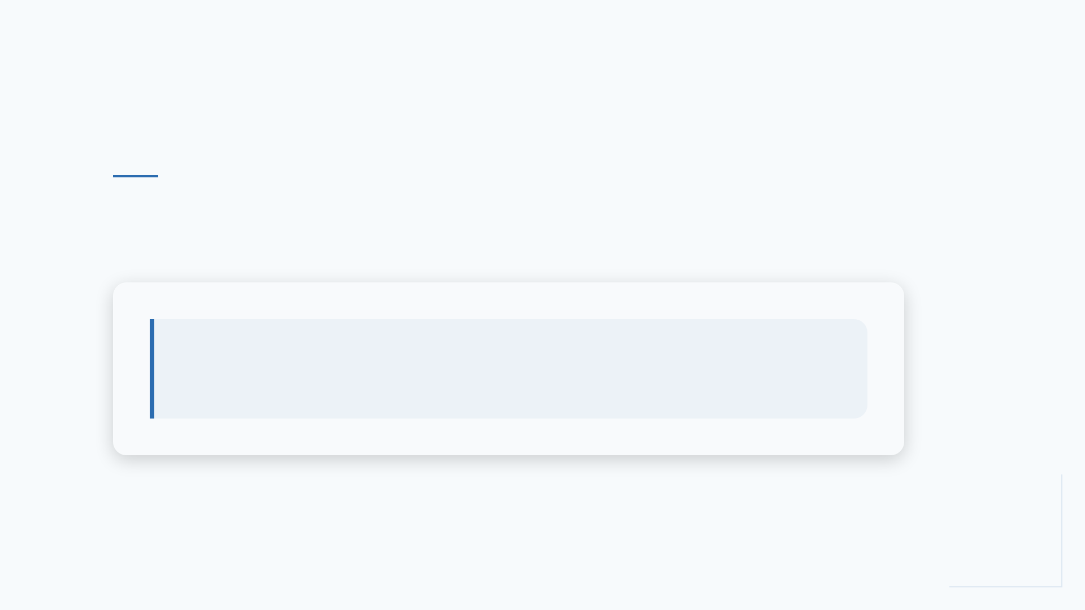
CALL TO ACTION
Start Creating Your Next Presentation Today
💡 Choose one AI tool this week and build a 5-slide deck. Experience the efficiency yourself.
Notes:
The best way to learn is to do. Pick a topic, open an AI tool, and see how it changes your workflow. Thank you for your time today.

