Slide 1
Suicide Rate Prediction

Slide 2
Introduction

Slide 3
Suicide is a serious public health problem. According to World Health Organization (WHO) every year close to 800 000 people take their own life, i.e. one person attempts suicide every 40 seconds and there are many more people who attempt suicide. Suicide is the second leading cause of death across the world. The main purpose of this project is to bring awareness to people and the government about how suicides are increasing every year due to different reasons and the need to control/take necessary steps. Classification and prediction of suicide attempts is important for preventing suicide. The project shows the comparison between Male and Females who have committed suicide over a span of 12 Years (2001-2012), due to different reasons/situations.

Slide 4
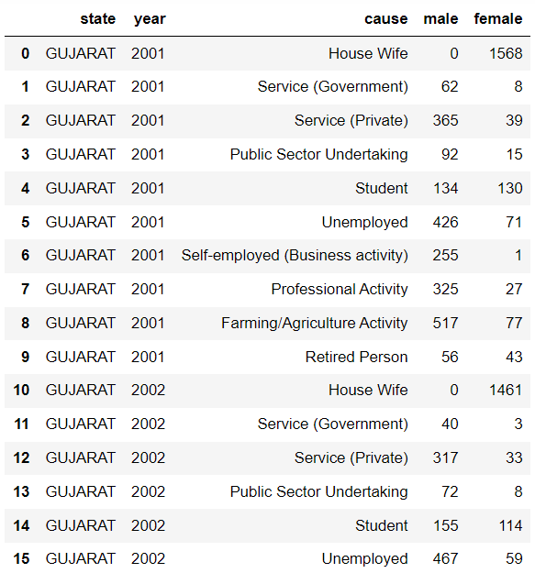
Dataset
The dataset we have used contains the name of the given state (Gujarat). Further, it is classified into two categories Male and Female. The reason/cause due to which the deceased took such steps and the years i.e. from 2001-2012 in which the deceased had attempted suicide. The data is collected with help from different websites on google and the overall idea for the dataset was taken from Kaggle.

Slide 5
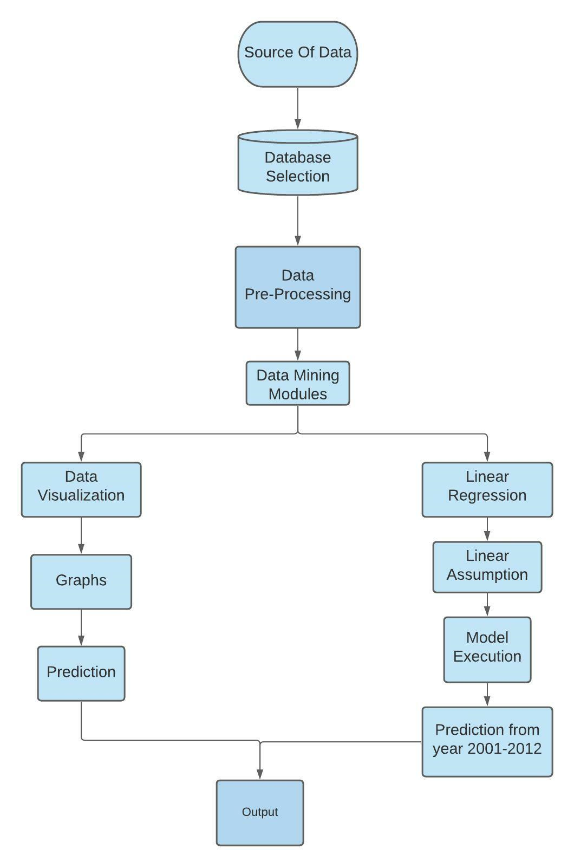
Architecture
Steps showing how we have coded the actual architecture:
Importing necessary libraries like pandas, NumPy and matplotlib.
Importing CSV file.
Finding the values of ‘m’ and ‘c’, so for that, we need to find the mean of X & Y values.
Calculating m & c using the formulas.
Plotting the input points and the regression line.

Slide 6
Result
Using linear regression we have successfully implemented a regression line for both Male and Female deaths.
The result shows that with time the number of suicides attempts had been increasing for the year 2001-2012.
The R-squared value for the Female regression graph is 85.909%.

Slide 7
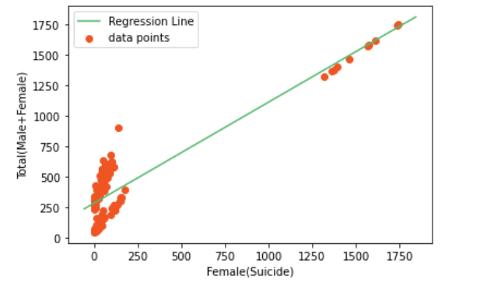
Linear Regression plot for number of female suicides.

Slide 8
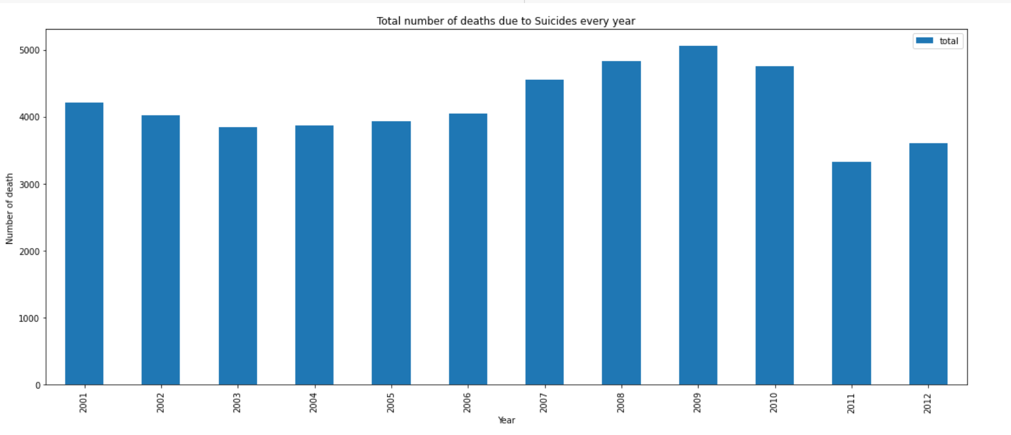
Total number of suicides every year

Slide 9
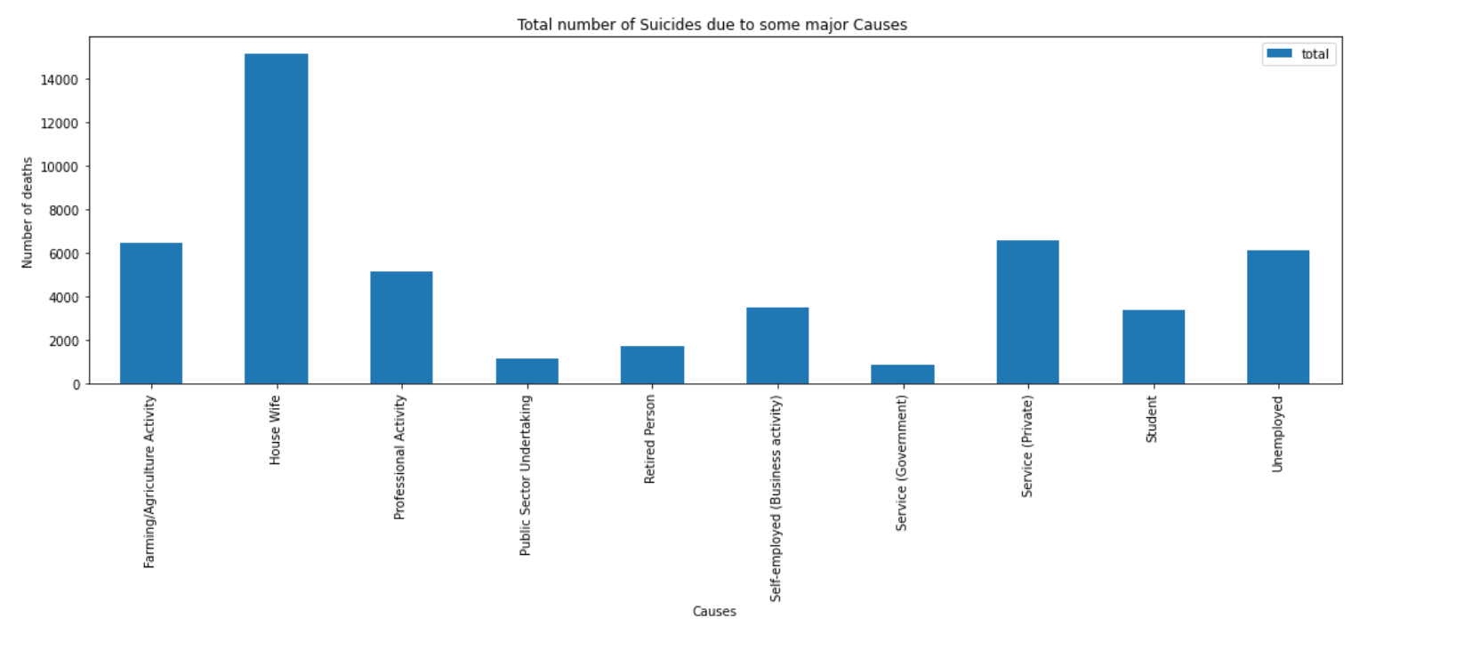
Number of suicides from 2001-2012 due to some major causes.

Slide 10
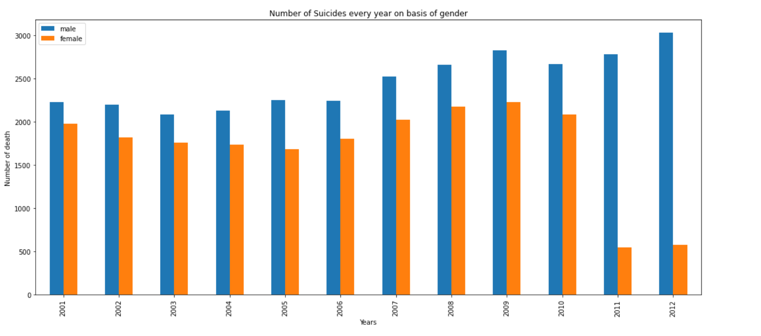
Total number of suicides every year on basis of gender

Slide 11
Some Major Causes
From Graph and linear progression
Depression
Depression is classified as a mood disorder. It may be described as feelings of sadness, loss, or anger that interfere with a person’s everyday activities.
Study Pressure
Academic pressure is the stress experienced by students because they fear that they will be unable to perform well enough in school/college.
Family-Related Problems
Financial problems, problems with in-laws (females) etc.
Unemployment
In India, due to huge population many people are unemployed and due to which they are not able to help their family in financial way.
Farming
Usually, farmers take loans from local moneylenders at very high rates of interest for farming inputs like seeds, fertilizers, pesticides, etc. which they are not able to repay due to some reason.

Slide 12
Conclusion
From graph-plotting and linear regression, it can be highlighted that what are the major causes, responsible for the most number of suicides attempts such as unemployment, farming/Agriculture, etc.
Societal Problems in the project were what causes a person to give up on his/her life. With the help of the project, the major cause can be easily found and can provide help to the person who is suffering from such problems.
Shortcomings in the project are that the linear regression model gives less accuracy i.e. 85%, we can try to use other models that can give more than 90% accuracy for the best predictions so that major causes for the suicide deaths can be highlighted.

Slide 13
Thank You

Slide 14



Team Presentation
Parva Barot
19BCP092
Atharva Patel
19BCP014
Vedant Patel
19BCP138

