Slide 1

Road Obstacle Detection Using Accelerometer Data
Presenter: Vedant Shah
Date: 30 Sep 2024

Slide 2
TABLE OF CONTENTS
o1
04
02
05
03
Problem & Dataset
Clustering Approach
Data Preprocessing
Results & Visualisation
Feature Engineering

Slide 3
Problem Overview
Goal: Detect obstacles on roads (potholes, speed bumps) using accelerometer data from vehicles.
Application: Monitor road quality and safety, create a digital twin for road conditions.
Potential Obstacles: Potholes, Speedbumps, Other irregularities

Slide 4
Dataset Overview
Data Source: 10Hz accelerometer data from a single vehicle in Bilbao, Spain.
Features:
Time, latitude, longitude
X, Y, Z acceleration values
Speed, heading, road type
Objective: Cluster the data into potholes, speed bumps, and normal driving conditions.

Slide 5
02
Data Preprocessing

Slide 6
Steps Taken
Smoothing Acceleration Data: Applied a 10-point rolling average to reduce noise and identify trends in the Z-axis and magnitude of acceleration.
Feature Creation: Calculated acceleration magnitude (X, Y, Z combined) and speed difference.
Handling Missing Values: Used forward fill for missing values and filled NaNs with the mean during feature scaling.

Slide 7
03
Feature Engineering

Slide 8
Feature Engineering
Key Features for Clustering:
Smoothed Z-axis acceleration
Smoothed acceleration magnitude
Speed difference
Why These Features?
Acceleration captures the vehicle’s vertical and horizontal motion, critical for detecting road obstacles.
Smoothing helps remove noise and reveals important patterns.

Slide 9
04
Clustering Approach

Slide 10
Clustering Approach
K-Means Clustering:
Since this is unsupervised learning a multiclass clustering algorithm would be required, K-means was the chosen approach
Chose 3 clusters to represent normal driving, potholes, and speed bumps.
Standardized features to ensure equal importance for each.
Mapped cluster labels to human-readable classes: "Probably Normal," "Probably Pothole," and "Probably Speed Bump."

Slide 11
05
Results & Visualisation

Slide 12
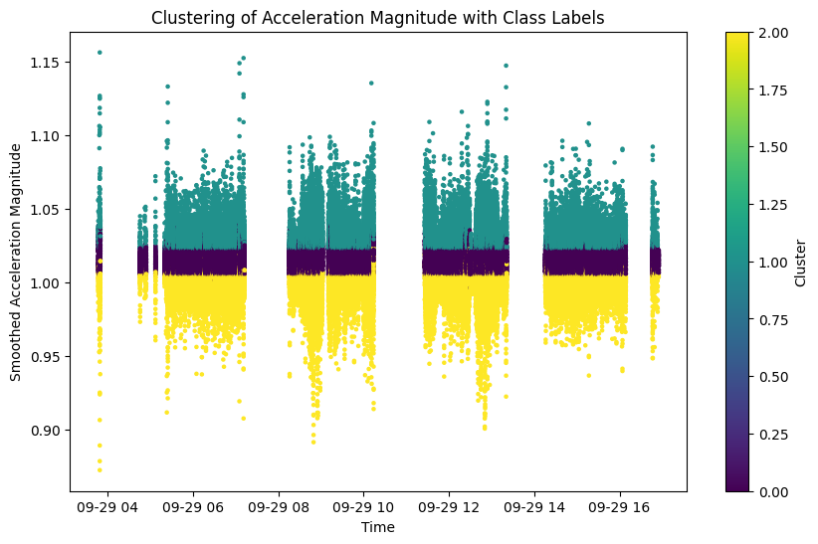
Class Distribution
Class | Count
Probably Normal | 155074
Probably Speed Bump | 55734
Probably Pothole | 51635
Centroid Pair Distances

Slide 13
Thank You

