Slide 1

Road Obstacle Detection Using Accelerometer Data
Presenter: Vedant Shah
Date: 30 Sep 2024

Slide 2
TABLE OF CONTENTS
o1
04
02
05
03
Problem & Dataset
Clustering Approach
Data Preprocessing
Results & Visualisation
Feature Engineering

Slide 3
Problem Overview
Goal: Detect obstacles on roads (potholes, speed bumps) using accelerometer data from vehicles.
Application: Monitor road quality and safety, create a digital twin for road conditions.
Potential Obstacles: Potholes, Speedbumps, Other irregularities

Slide 4
Dataset Overview
Data Source: 10Hz accelerometer data from a single vehicle in Bilbao, Spain.
Features:
Time, latitude, longitude
X, Y, Z acceleration values
Speed, heading, road type
Objective: Cluster the data into potholes, speed bumps, and normal driving conditions.

Slide 5
02
EDA

Slide 6
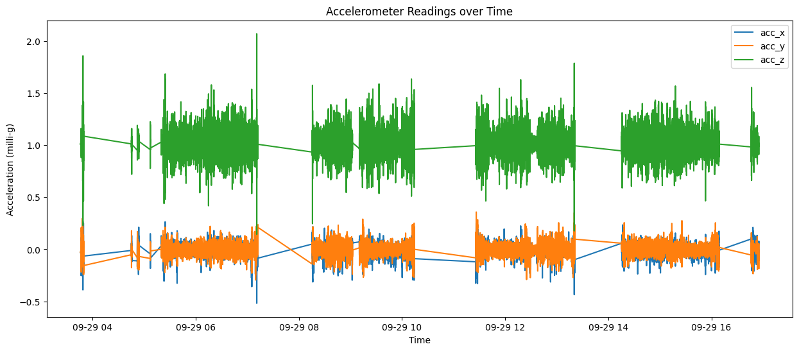

Slide 7
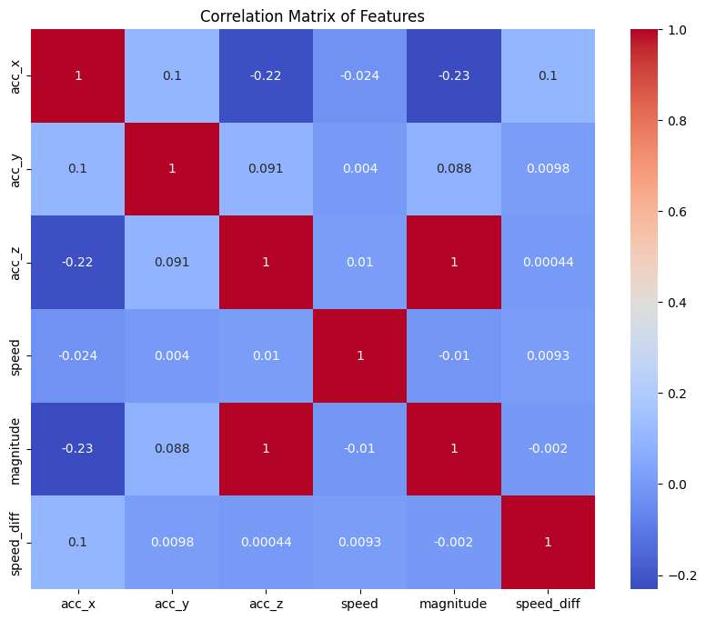

Slide 8
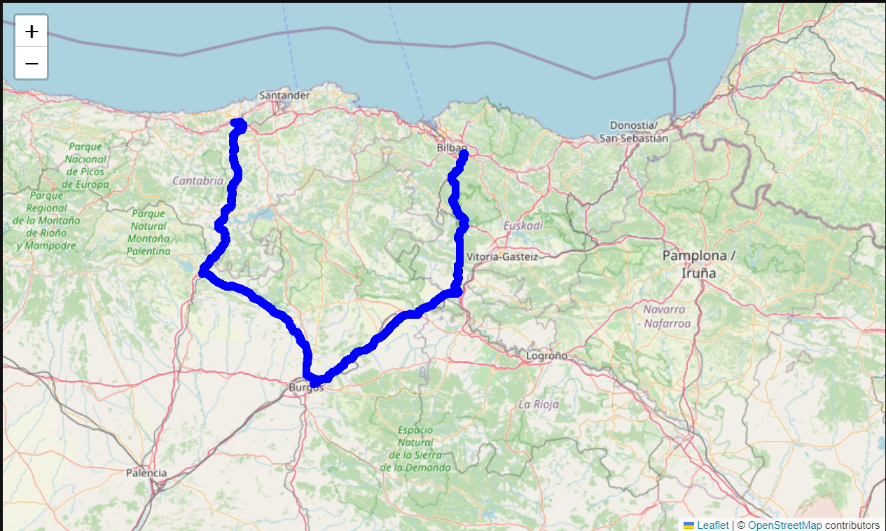

Slide 9
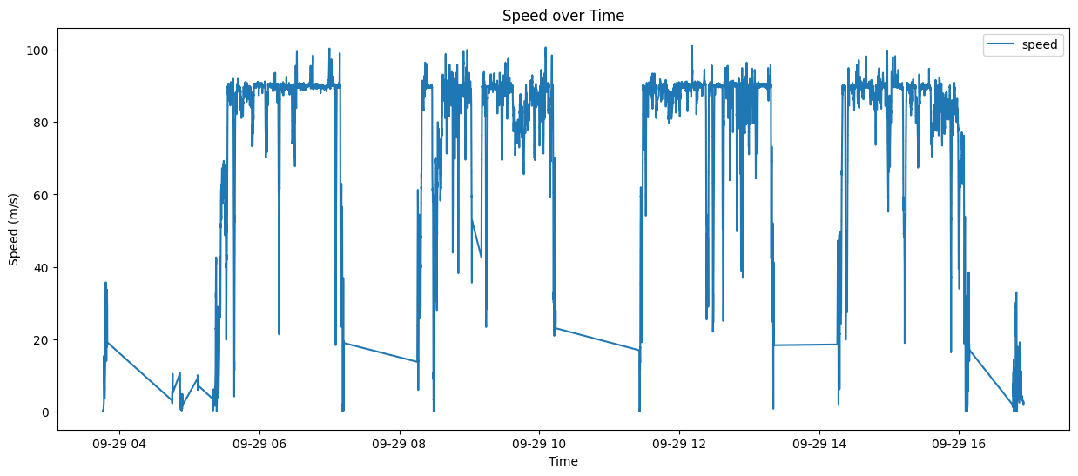

Slide 10
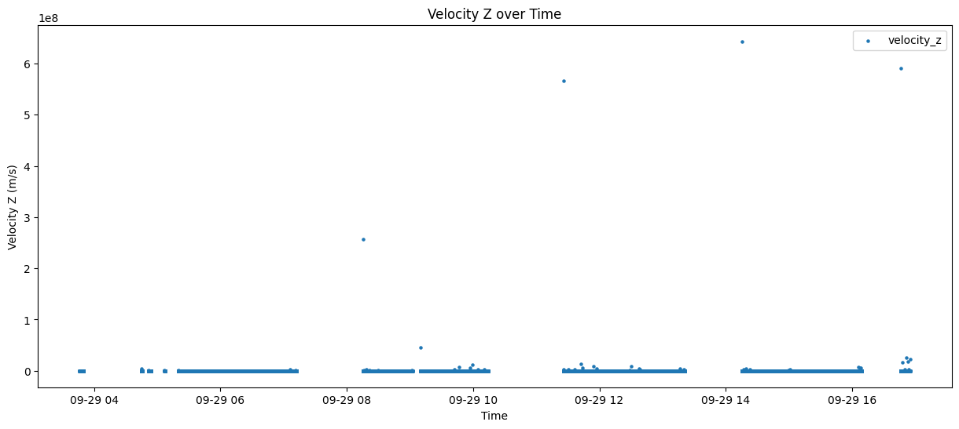

Slide 11
Problem Solving Approach
The idea is to find anomalies in the data, and then label them as either of speedbumps, potholes, other obstacles, normal driving.
The proposed solution uses a combination of 2 techniques.
Isolation Forest to separate out the anomalies and a k-means clustering approach on the anomalies itself.

Slide 12
03
Feature Engineering

Slide 13
Feature Engineering
Since we saw a perfect co-relation between acc_z and the magnitude, it becomes redundant to include both together as a critical feature.
Speed variations can also be considered important.

Slide 14
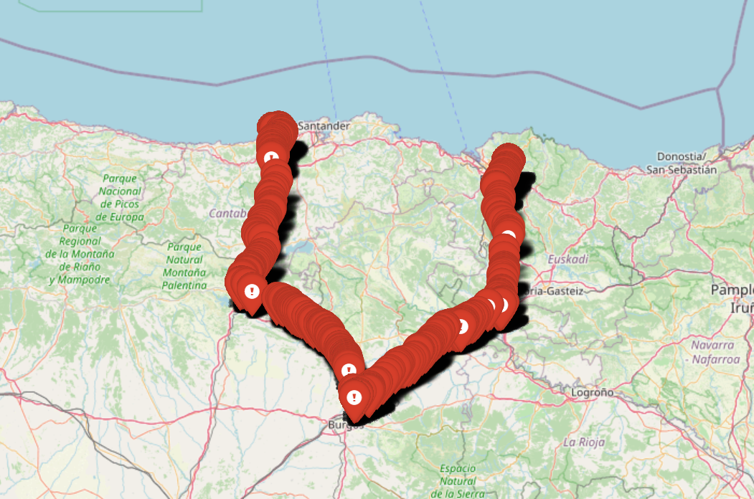

Slide 15
04
Clustering Approach

Slide 16
Clustering Approach
K-Means Clustering:
Since this is unsupervised learning a multiclass clustering algorithm would be required, K-means was the chosen approach
Chose 3 clusters to represent cracks, smaller obstacles and speed bumps.
Standardized features to ensure equal importance for each.

Slide 17
05
Results & Visualisation

Slide 18
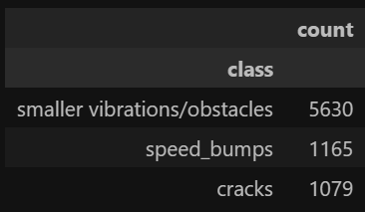
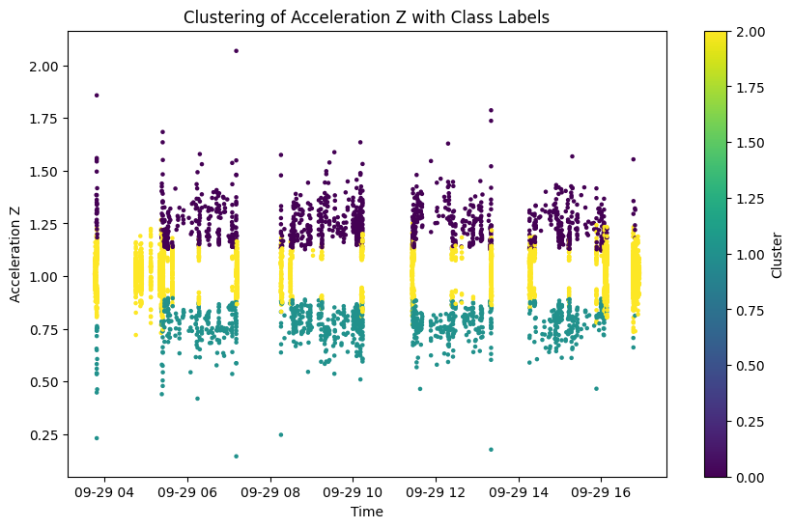

Slide 19
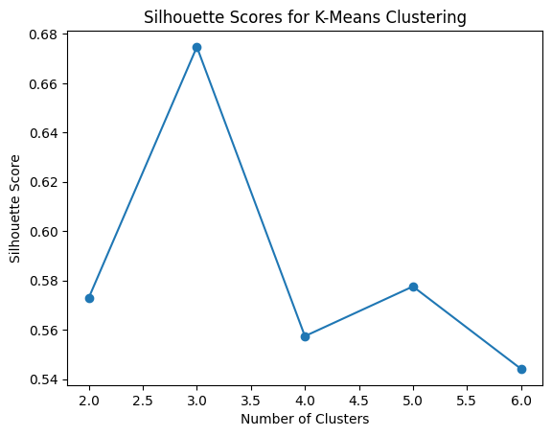

Slide 20
Inconsistencies in the Dataset

