Slide 1
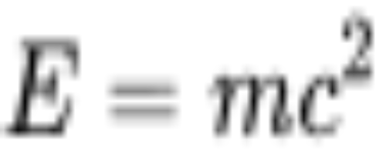
Math Equation Demo
An introduction to Einstein's famous formula
Einstein said:
revolutionized physics.

Slide 2
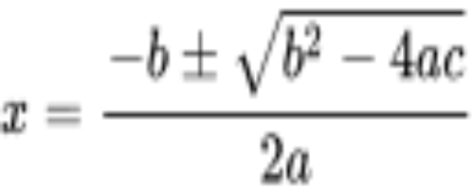
Quadratic Formula
Solving quadratic equations in algebra
The formula is
. It is widely used in algebra.

