Slide 1
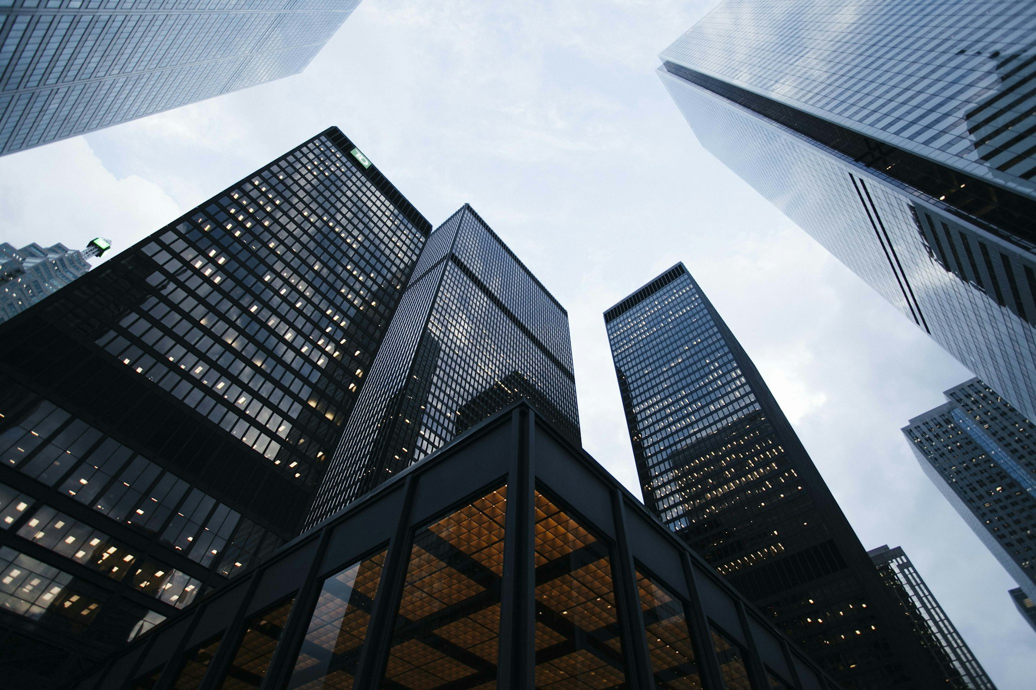
New Test
FINANCIAL & INVESTMENT ANALYSIS
© 2025 AIRE Software - All rights reserved.
Notes:
SPEAKER NOTES - Opening Slide Opening: "Good morning/afternoon, everyone. Thank you for joining us today." Introduction: "I'm pleased to present our investment opportunity in Bangaloree , mumbai , delhi's commercial , residential , mixed-use , tech parks , retail sector - New Test." Set the Context: "Bangaloree , mumbai , delhi is experiencing unprecedented growth in the commercial , residential , mixed-use , tech parks , retail space, driven by: - Strong economic fundamentals - Infrastructure development - Demographic tailwinds - Limited premium supply" Preview: "Today, I'll walk you through: 1. The investment thesis and market opportunity 2. Detailed financial projections and returns 3. Risk mitigation strategies 4. Next steps for interested investors" Build Credibility: "Our team has successfully delivered [X] projects in Bangaloree , mumbai , delhi, with a track record of: - On-time delivery - Superior returns for investors - Strong occupancy/sales performance" Engagement: "I encourage you to ask questions as we go through the presentation. Our goal is to provide complete transparency and address all your concerns." Transition: "Let's begin by examining the Bangaloree , mumbai , delhi commercial , residential , mixed-use , tech parks , retail market dynamics..." Tone & Body Language: - Confident and professional - Make eye contact with key decision-makers - Use hand gestures to emphasize key points - Smile and show enthusiasm for the project - Pause after important statements for impact

Slide 2
TABLE OF CONTENTS
1. Executive Summary
2. Market Analysis
3. Competitor Landscape
4. Strategic Recommendations
5. Financial Projections
6. Next Steps

