Slide 1
Feasability Study

Slide 2
TABLE OF CONTENTS
01. Project Background
....
02. Executive Summary
....
03. Site Assessment
....
04. Market Overview
....
05. Development Recommendations
....
06. Financial & Investment Analysis
....
07. Disclaimer
....
© 2025 AIRE Software - All rights reserved.

Slide 3

PROJECT BACKGROUND
© 2025 AIRE Software - All rights reserved.

Slide 4
EXECUTIVE SUMMARY

Slide 5

EXECUTIVE SUMMARY
MARKET OUTLOOK AND OPPORTUNITIES
hhhahah
,,^kpkpkpk
J
J
J
huhuhu
jiji
Koko
J
J
J
j

Slide 6
EXECUTIVE SUMMARY
PRICING RATIONALE
juhiihi
jij
ji
ji
Criteria | Rationale | Level of Premium
 |  | ijiji
 |  | jiji
 |  | ihji
 |  |  |  | Price |  |  |  |  |  |  |  | Premium (%) | Adjusted prices
Name of Project | Location | Completion Year | Specification
Average |  |  |  | -
Source: AIRE

Slide 7
EXECUTIVE SUMMARY
SIZING RATIONALE
jijijijojoji
Name of Project | Location | Completion Year | Specification | Studio
Average
Source: AIRE
jijijijij.

Slide 8
EXECUTIVE SUMMARY
DEVELOPMENT BRIEF
jjjjijij
Asset Type | Category | Specifications | Asset segment
Source: Client, AIRE
jijijijijkjoi

Slide 9
EXECUTIVE SUMMARY
FINANCIAL RESULTS SUMMARY
iughiuhuhiuh
Source: AIRE

Slide 10
1. SITE ASSESSMENT

Slide 11
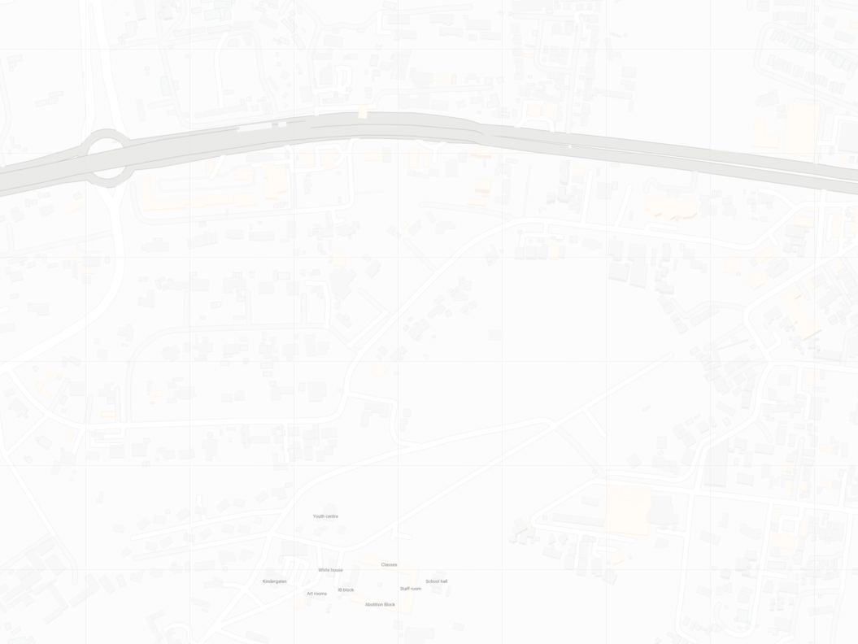


SITE ASSESSMENT
LOCATION MAP AND SWOT ANALYSIS
Redhill
Link
Road
juihugredredtyugijijklo
Safaricom
HQ
Waiyaki Way
ABC Place
James Gichuru Road
Muthangari Drive
Kanjata Crescent
Kanjata Road
St. Marys Schools
Source: Google Maps, AIRE
 | Proposed Development Site |  | Key Roads |  | Schools
 | Waiyaki Way |  | Commercial Uses

Slide 12
2. MARKET OVERVIEW

Slide 13
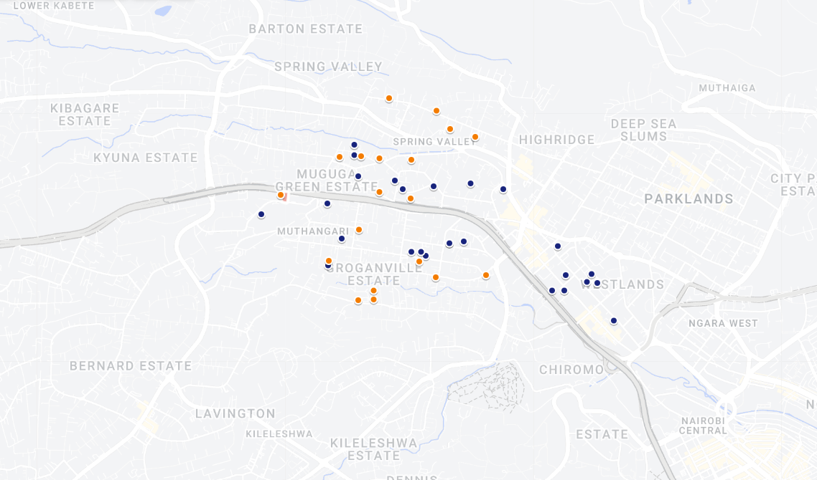
MARKET OVERVIEW
RESIDENTIAL SUPPLY
48485165312
Dubai Residential Apartments Luxury
gvfcdxs
Source: My Maps, AIRE

Slide 14
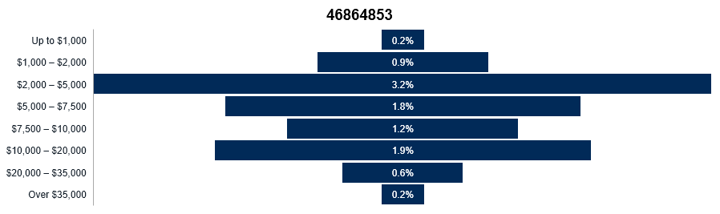
MARKET OVERVIEW
RESIDENTIAL DEMAND DRIVERS
84565
4684861
tfgrds
4865
gy
46185
fguyijgiu
ftyf
516
84964

Slide 15
MARKET OVERVIEW
KEY MARKET INDICATORS

Slide 16
MARKET OVERVIEW
MARKET OUTLOOK AND OPPORTUNITIES
dtryf
drtyu
sdtrfvgj
fjguyih
drtyfu
drtycft
dyftuyg
dryftuygih

Slide 17
3. DEVELOPMENT RECOMMENDATIONS

Slide 18
DEVELOPMENT RECOMMENDATIONS
METHODOLOGY
zrsetdyf
zrsedt
rsetdyfv
srdtryf
edtrfyg
dtryftuvgy
rcyvbhkj
restdryftu
xtrcyvubh
dryftugy

Slide 19
DEVELOPMENT RECOMMENDATIONS
© 2025 AIRE Software - All rights reserved.

Slide 20
CONCEPT DESIGN & PROGRAMMING
The development vision integrates smart-living technologies with biophilic design to create a sanctuary of luxury in the heart of the city.
Component | Strategic Justification
Infinity Sky Pool | Enhances premium positioning and capital appreciation
Smart Hub Integration | Targets tech-savvy mid-high income demographics
Wellness Center | Addresses post-pandemic health & lifestyle trends
© 2025 AIRE Software - All rights reserved.

Slide 21
MARKET COMPARABLES
Project | Price/sqft | Amenities
The Ritz | $1,800 | Full
Luxury Tower | $1,650 | Partial
© 2025 AIRE Software - All rights reserved.

Slide 22
DEVELOPMENT BRIEF
Spec | Recommendation
Units | 240
Finishing | Ultra-Premium
© 2025 AIRE Software - All rights reserved.

Slide 23
DEVELOPMENT RECOMMENDATIONS
© 2025 AIRE Software - All rights reserved.

Slide 24
CONCEPT DESIGN & PROGRAMMING
The development vision integrates smart-living technologies with biophilic design to create a sanctuary of luxury in the heart of the city.
Component | Strategic Justification
Infinity Sky Pool | Enhances premium positioning and capital appreciation
Smart Hub Integration | Targets tech-savvy mid-high income demographics
Wellness Center | Addresses post-pandemic health & lifestyle trends
© 2025 AIRE Software - All rights reserved.

Slide 25
MARKET COMPARABLES
Project | Price/sqft | Amenities
The Ritz | $1,800 | Full
Luxury Tower | $1,650 | Partial
© 2025 AIRE Software - All rights reserved.

Slide 26
DEVELOPMENT BRIEF
Spec | Recommendation
Units | 240
Finishing | Ultra-Premium
© 2025 AIRE Software - All rights reserved.

Slide 27

4. FINANCIAL & INVESTMENT ANALYSIS

Slide 28
FINANCIAL AND INVESTMENT ANALYSIS
ASSUMPTIONS
erdtfgy
srdtrguyh
Source: AIRE

Slide 29
FINANCIAL AND INVESTMENT ANALYSIS
ASSUMPTIONS
srdytug
Source: AIRE

Slide 30
FINANCIAL AND INVESTMENT ANALYSIS
ASSUMPTIONS
dfgyhu
Source: AIRE

Slide 31
FINANCIAL AND INVESTMENT ANALYSIS
ASSUMPTIONS
drftugy
 |  |  |  |  |  |  |  |  |  |  | Year 5
 |  |  |  |  |  |  |  |  |  |  | %
 |  |  |  |  |  |  |  |  |  |  | kjhgf
Source: AIRE

Slide 32
FINANCIAL AND INVESTMENT ANALYSIS
ASSUMPTIONS
ftgkhj
Source: AIRE

Slide 33
FINANCIAL AND INVESTMENT ANALYSIS
FINANCIAL RESULTS SUMMARY
Description
Project
sydtkgu
gftrde

Slide 34
FINANCIAL AND INVESTMENT ANALYSIS
CASH FLOW STATEMENTS
 |  |  | hbgftdtrufgyh
Debt Service Coverage Ratio (DSCR) | {{ | {{ConsoCF-ProjLevel} | { | gftr | nbgtfrd

Slide 35
FINANCIAL AND INVESTMENT ANALYSIS
RETURN ANALYSIS

Slide 36
FINANCIAL AND INVESTMENT ANALYSIS
SENSITIVITY ANALYSIS
gvfytiugyhj
g |  |  |  |  |  |  |  |  | fcdrtugy
 |  | Construction Cost |  |  |  |  |  |  |  |  | vfgt
 | ####### | 130% | 120% | 110% | 100% | 90% | 80% | 70% |  | 41% | 130% | 120% | 110% | 100% | 90% | 80% | 70%
bhjgvfrtd | 130%
 | 120% |  |  |  |  |  |  |  |  |  |  | vfcdtrfkuygjh
 | 110%
 | 100% |  |  |  | vftiègoyuihl
 | 90%
 | 80%
 | 70%
vgtfuyihijkn
 | #######
vfytiguh | 130%
 | 120%
 | 110% |  |  |  |  |  |  |  |  |  |  |  |  | ghcfftiugybuin
 | 100%
 | 90%
 | 80%
 | 70%

Slide 37
DISCLAIMER
This feasibility study has been prepared by AIRE Software exclusively for informational purposes. The projections and data contained herein are based on market conditions as of the date of publication and are subject to change. AIRE Software makes no representation or warranty, express or implied, as to the accuracy or completeness of the information. Investors should conduct their own independent due diligence before making any commitment.
© 2025 AIRE Software - All rights reserved.

