Slide 1
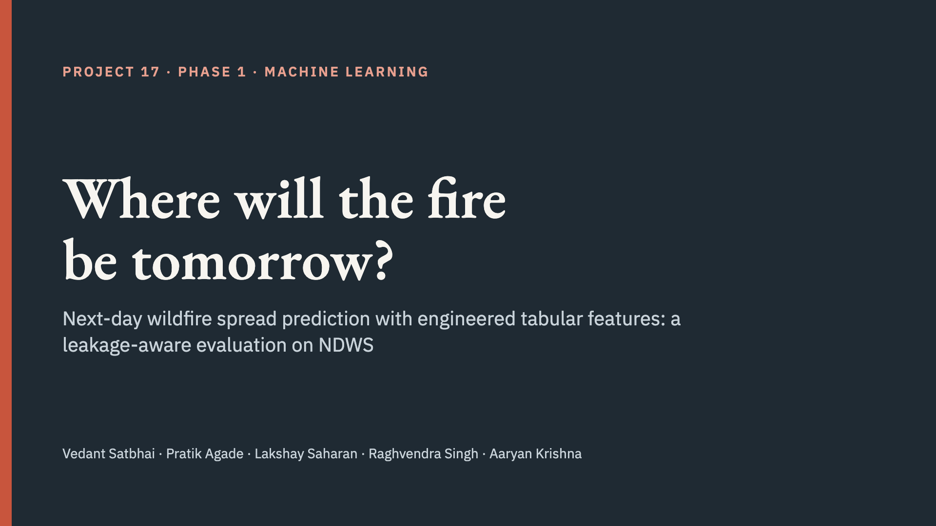
Notes:
Presenter: Aaryan (opening). One-line pitch: for every 1 km pixel near an active fire, we predict whether it will be burning tomorrow, and we test whether the standard benchmark’s numbers can be trusted.

Slide 2
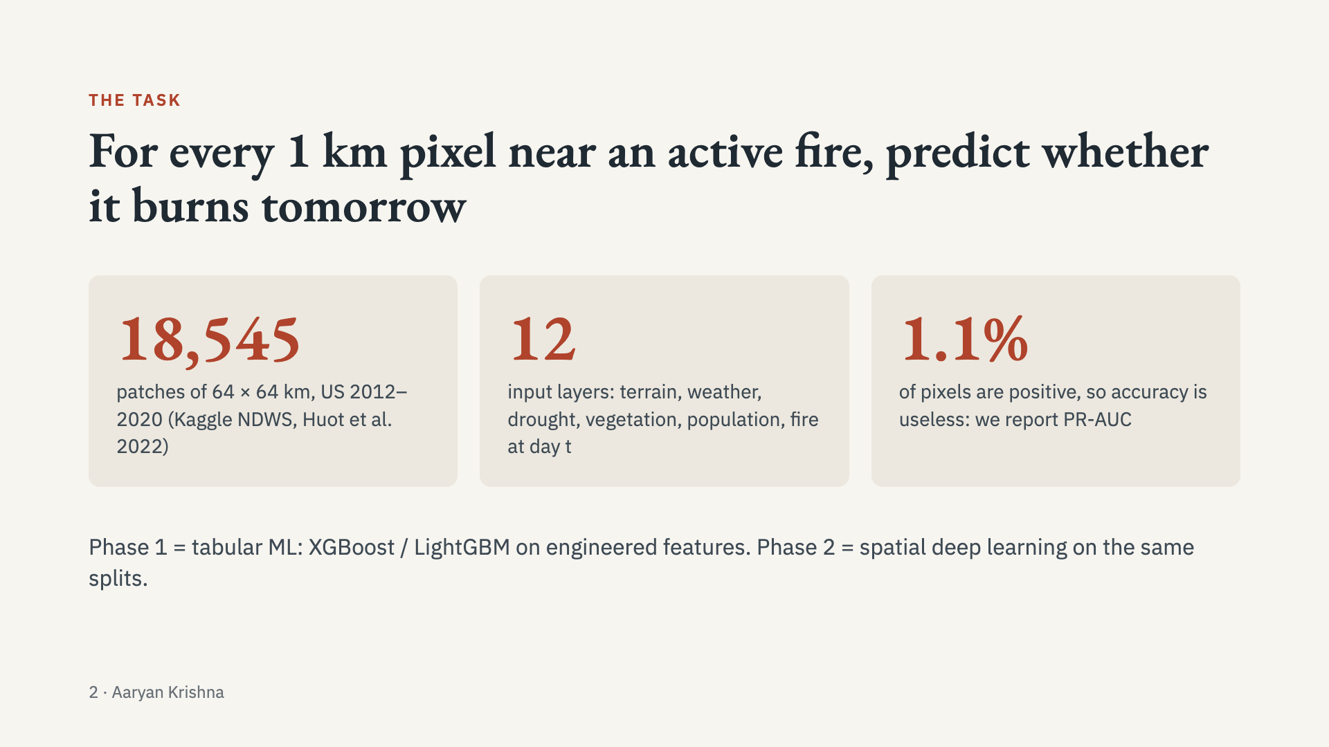
Notes:
Presenter: Aaryan. Explain the framing: binary classification per pixel. Stress the imbalance: predicting “no fire” everywhere is 99% accurate, which is why PR-AUC (chance level = prevalence) is the headline metric.

Slide 3
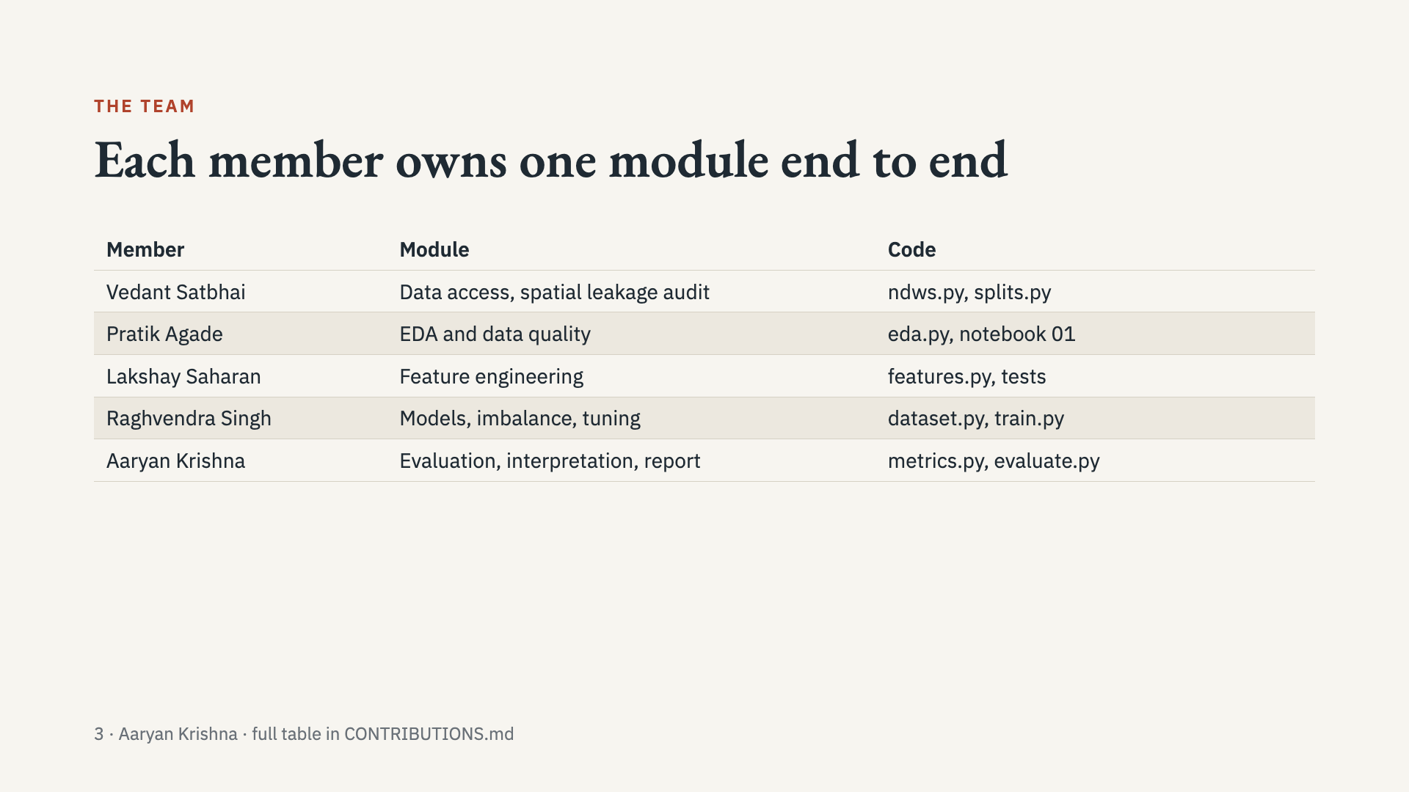
Notes:
Presenter: Aaryan. Introduce each member and say they will present their own part. Hand over to Vedant for the data.

Slide 4
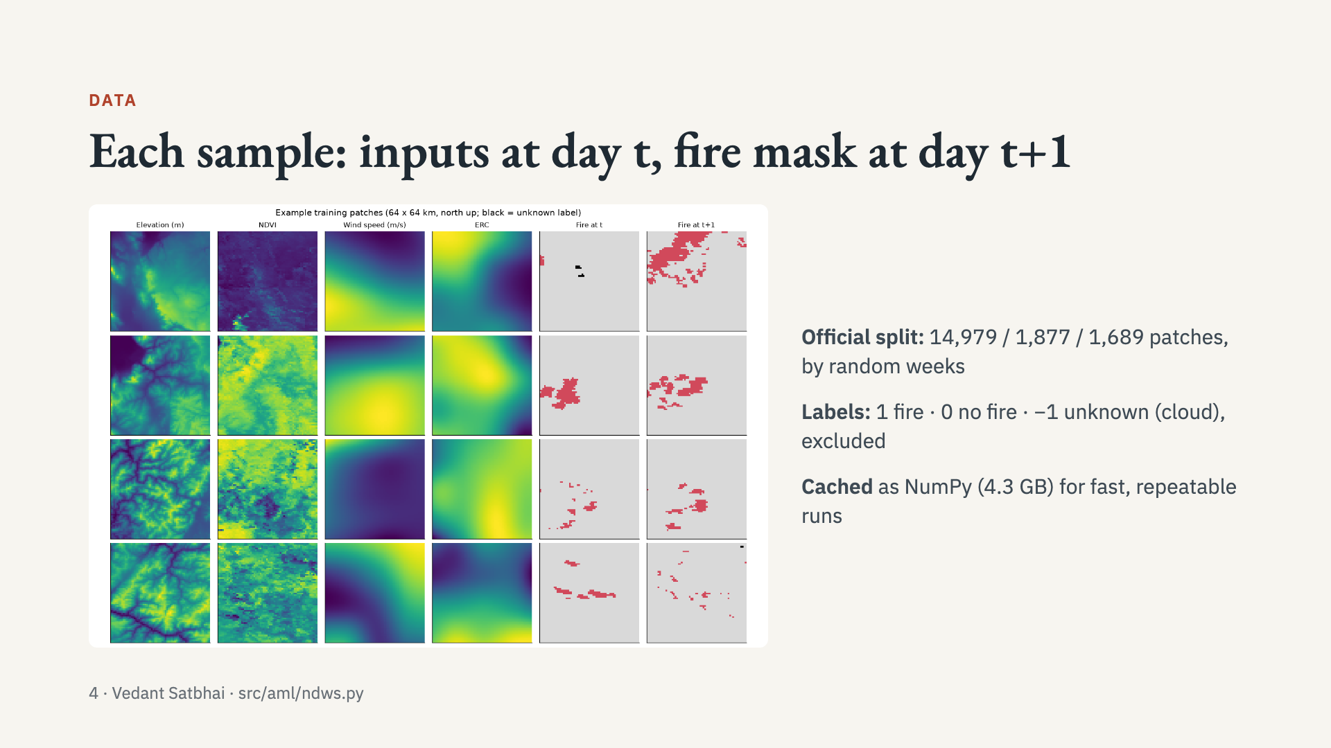
Notes:
Presenter: Vedant. Walk through one row of the figure: weather fields are smooth (≈4 km source), elevation and NDVI are detailed. The last two columns are day t and day t+1 fire. The official split assigns random weeks 8:1:1 with a one-day buffer.

Slide 5
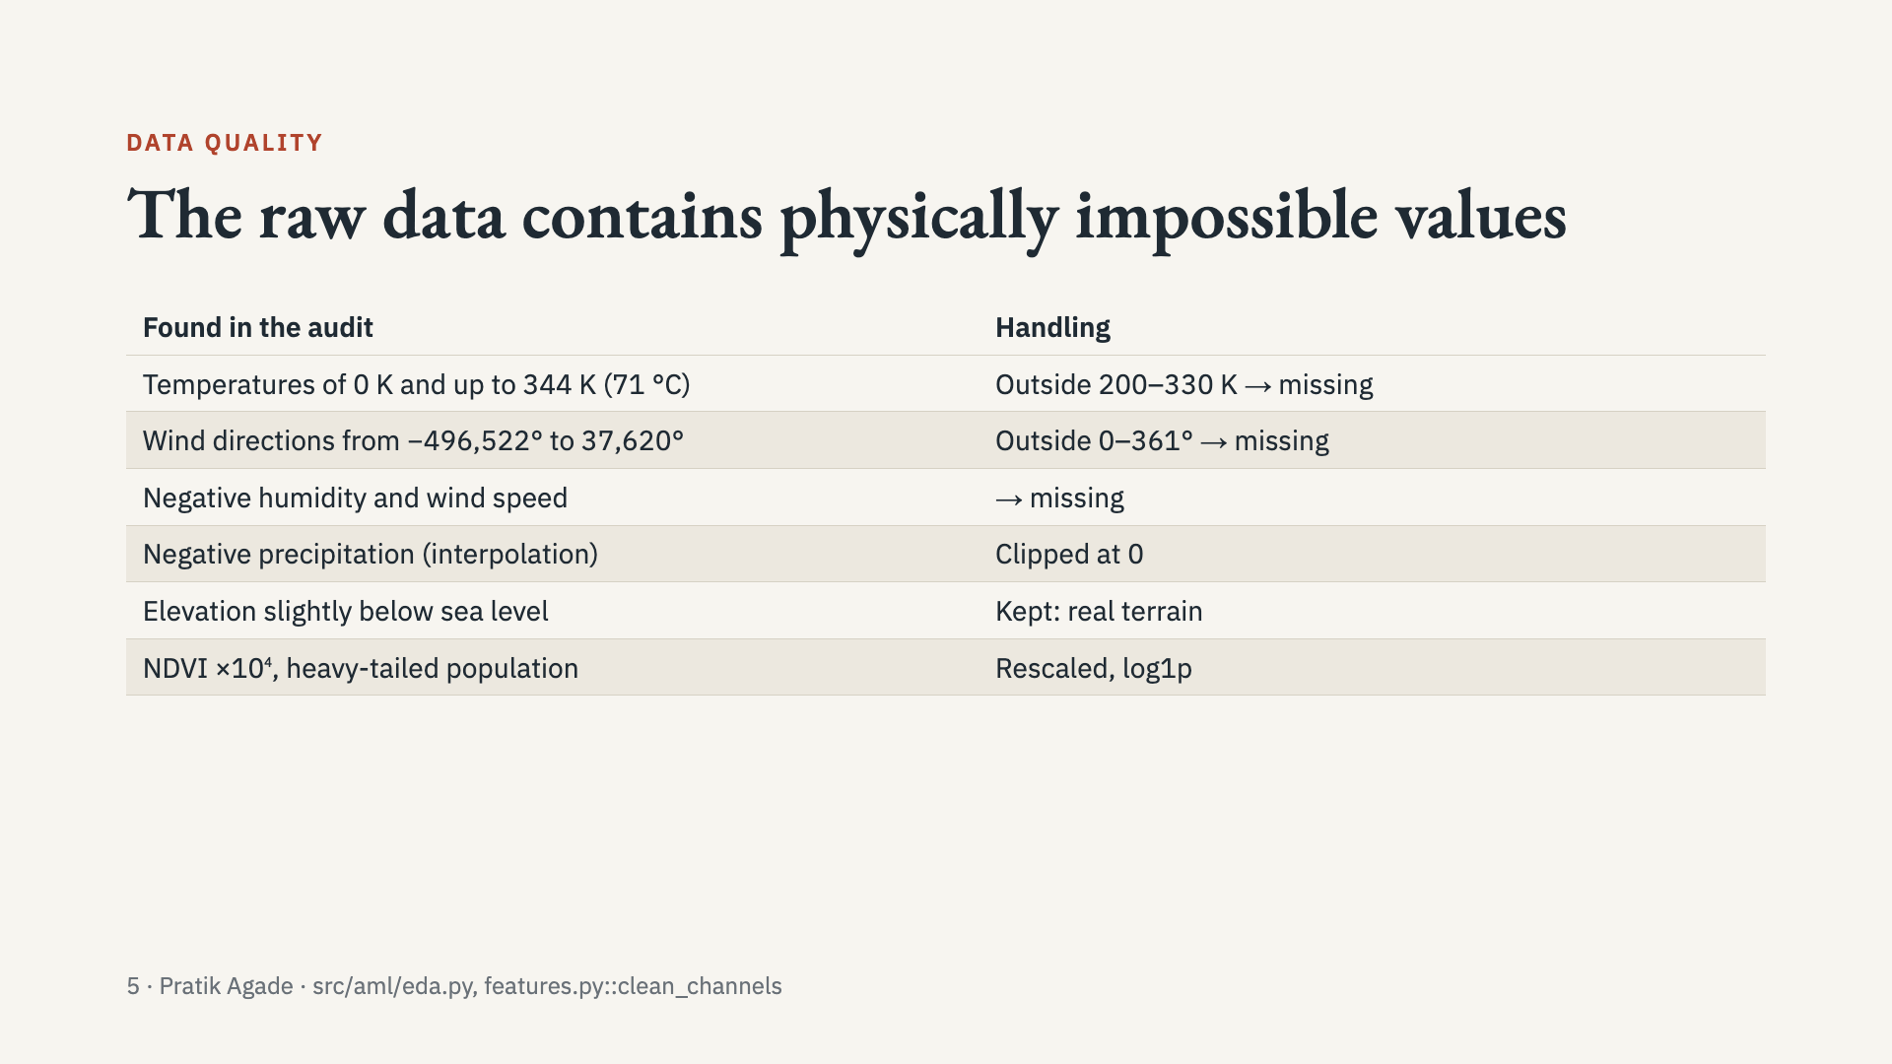
Notes:
Presenter: Pratik. Each rule is unit-tested. Trees route missing values natively; LR and RF use median imputation fitted on training data only.

Slide 6
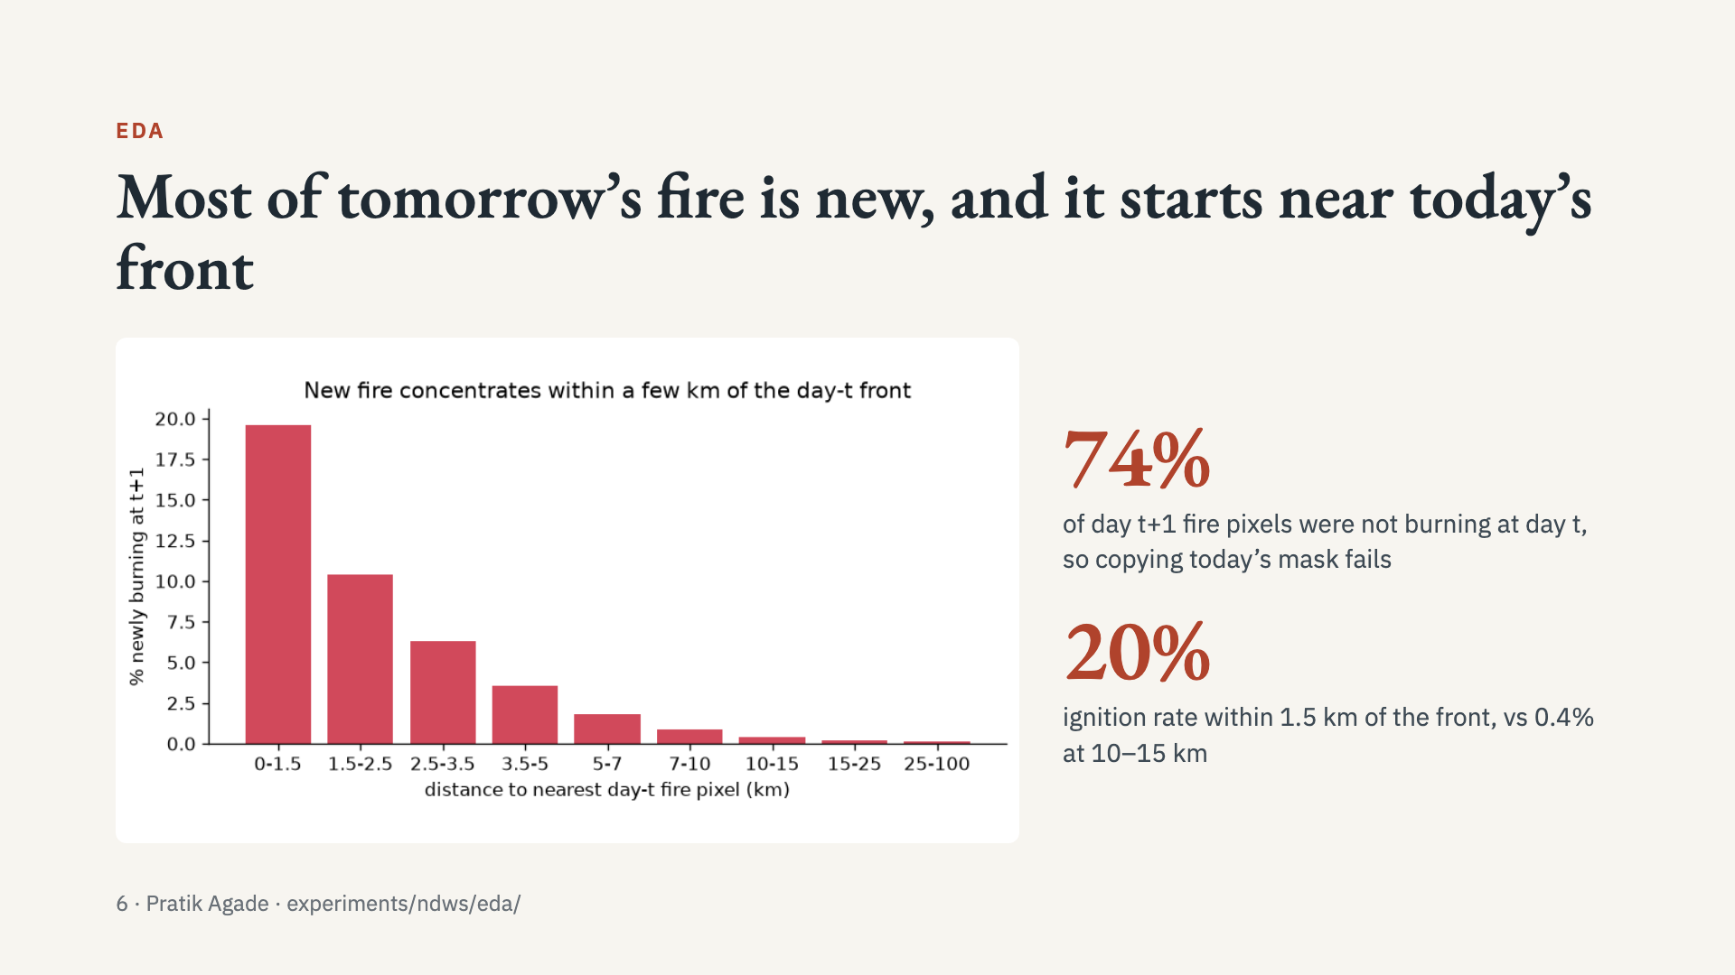
Notes:
Presenter: Pratik. Two lessons that shaped the features: (1) persistence is weak, the model must predict spread; (2) distance to the front is the dominant signal, motivating distance and multi-scale burn-fraction features. Raw weather channels overlap heavily between classes (see channel_distributions.png).

Slide 7
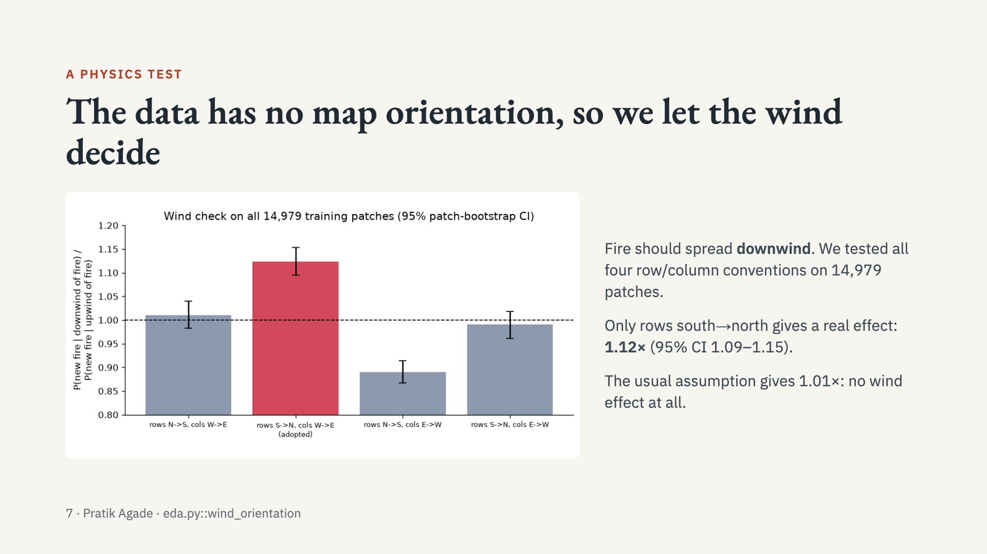
Notes:
Presenter: Pratik. Why it matters: every wind and slope feature depends on knowing which way is north. Confidence intervals come from resampling patches. The effect is modest because wind is a daily ~4 km average. Terrain: sloped ground near fire burns about 2× more than level ground.

Slide 8
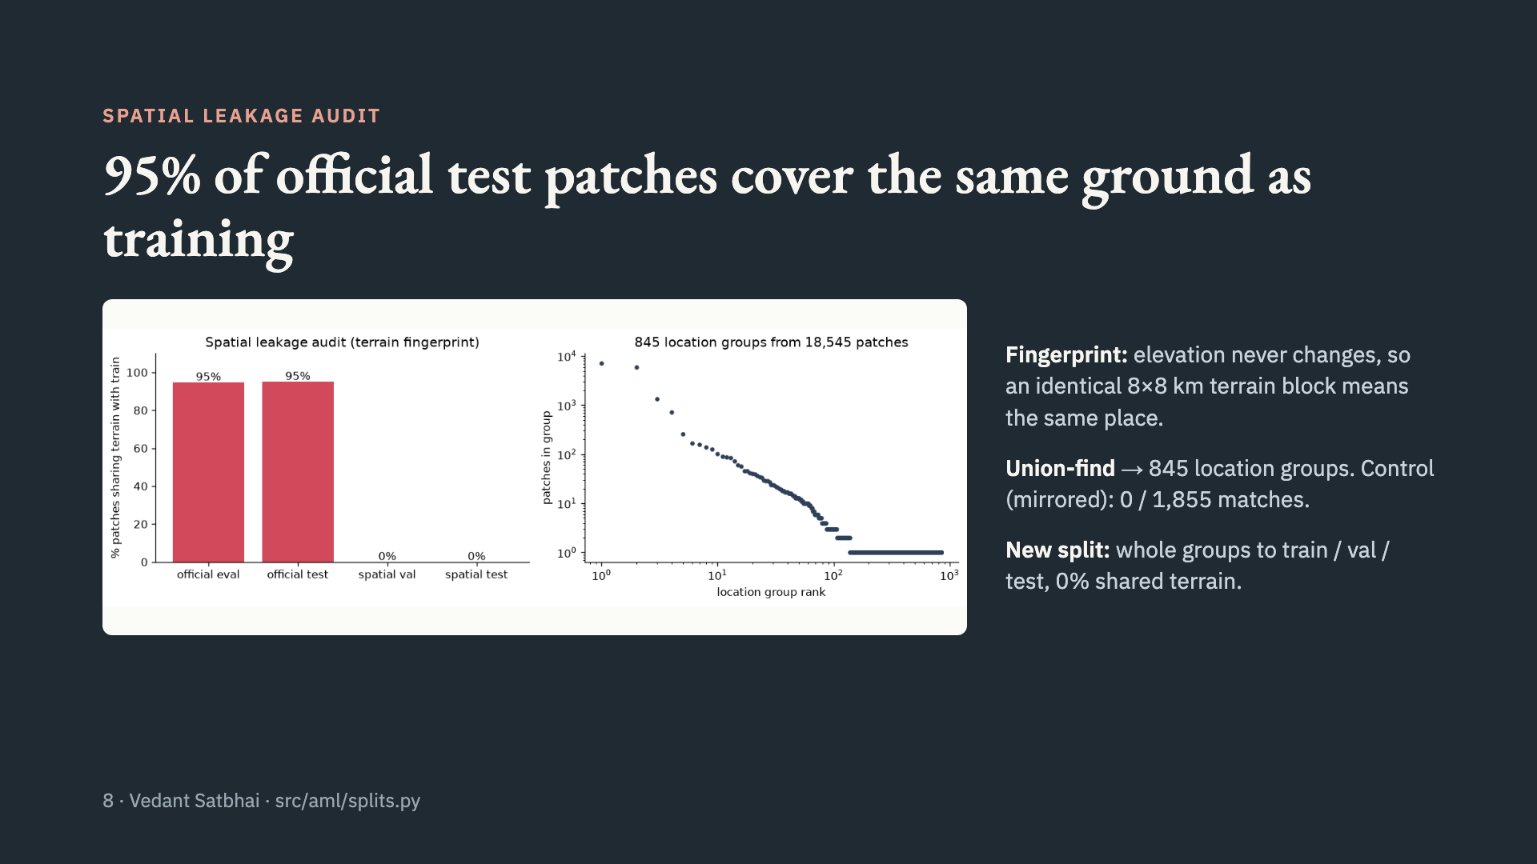
Notes:
Presenter: Vedant. The brief asks to separate events spatially and temporally. The official split separates weeks but not places. Consecutive days of one fire overlap and land in the same group, so the spatial split is also event-disjoint. We report both protocols.

Slide 9
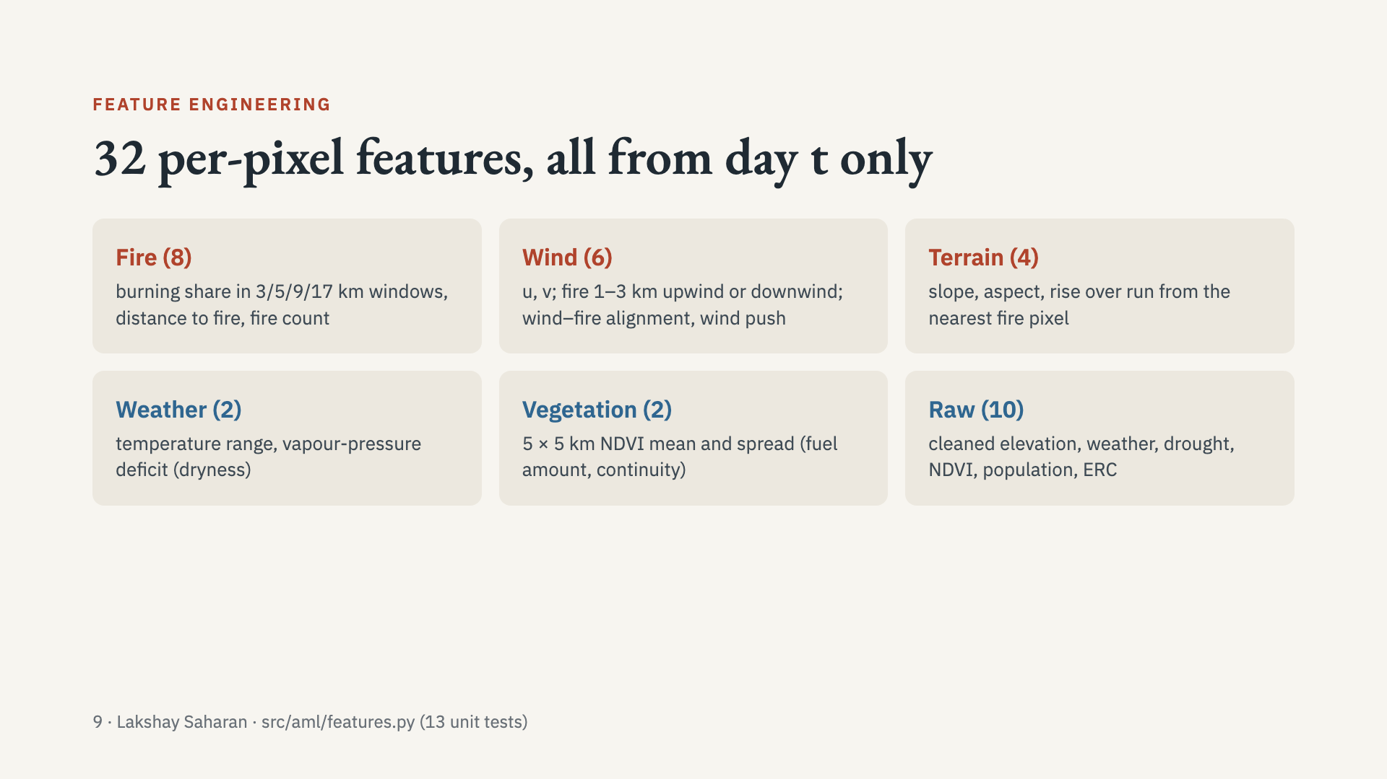
Notes:
Presenter: Lakshay. Leakage rule: a unit test changes the target mask and checks every feature is unchanged. Physics: VPD = e_s(Tmax) − e_a, Tetens equation; wind push = alignment × speed / (1 + distance). Tests also check wind and slope conventions on hand-built patches.

Slide 10
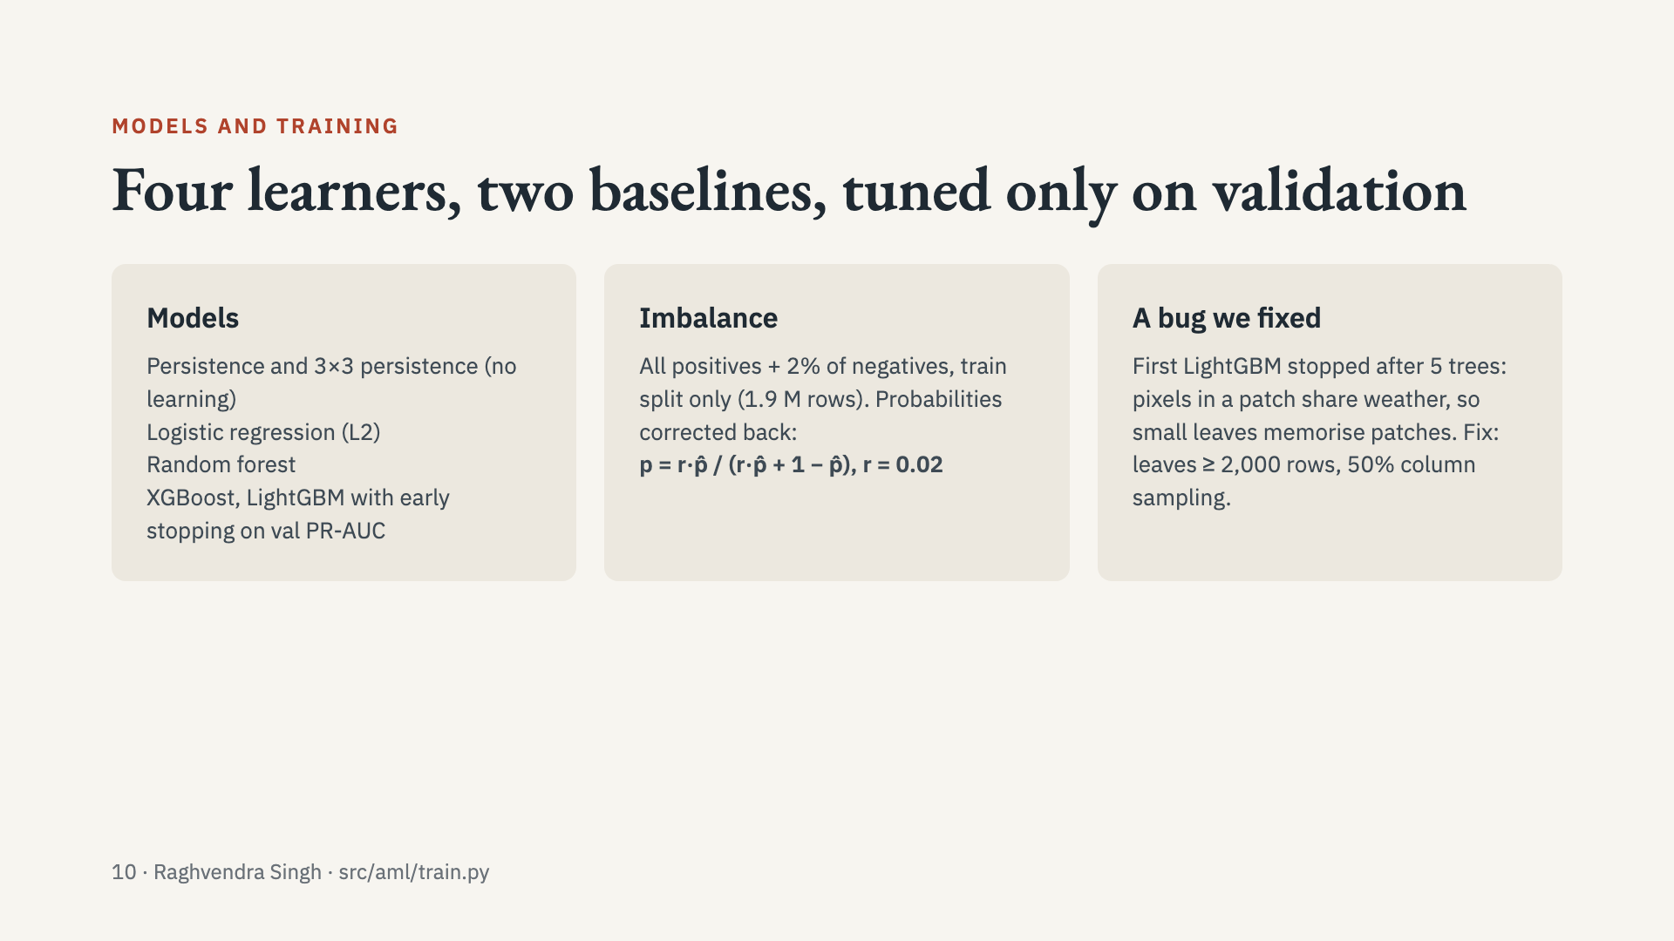
Notes:
Presenter: Raghvendra. Theory to know: boosting leaf weight w* = −G/(H+λ); RF variance ρσ² + (1−ρ)σ²/B. The prior correction is monotone, so ranking metrics don’t change; only calibration does. Weighted vs unweighted training was chosen per model on validation. Thresholds for F1 also come from validation; test is scored once.

Slide 11
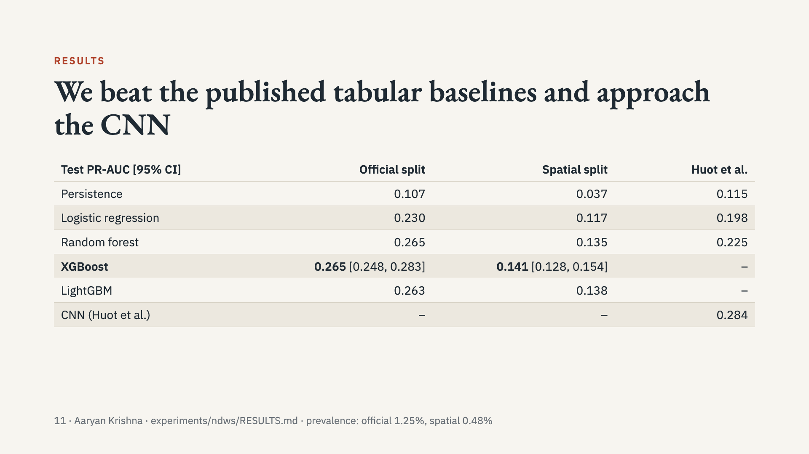
Notes:
Presenter: Aaryan. Our persistence matches the paper’s (0.107 vs 0.115), so numbers are comparable. Engineered features lift LR from 0.198 to 0.230 and RF from 0.225 to 0.265. CIs are from resampling patches, not pixels. Full metrics (ROC-AUC, F1, recall at 1%/5% FPR, Brier) are in RESULTS.md.

Slide 12
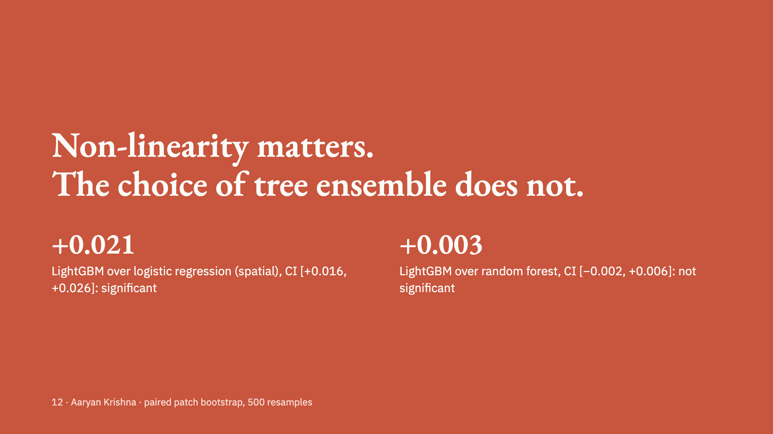
Notes:
Presenter: Aaryan. Paired bootstrap: the same resampled patches for both models, so the difference’s CI is tight. Official split shows the same picture (+0.032 over LR; −0.002 vs RF). XGBoost and LightGBM are tied. Be honest about this in the viva.

Slide 13
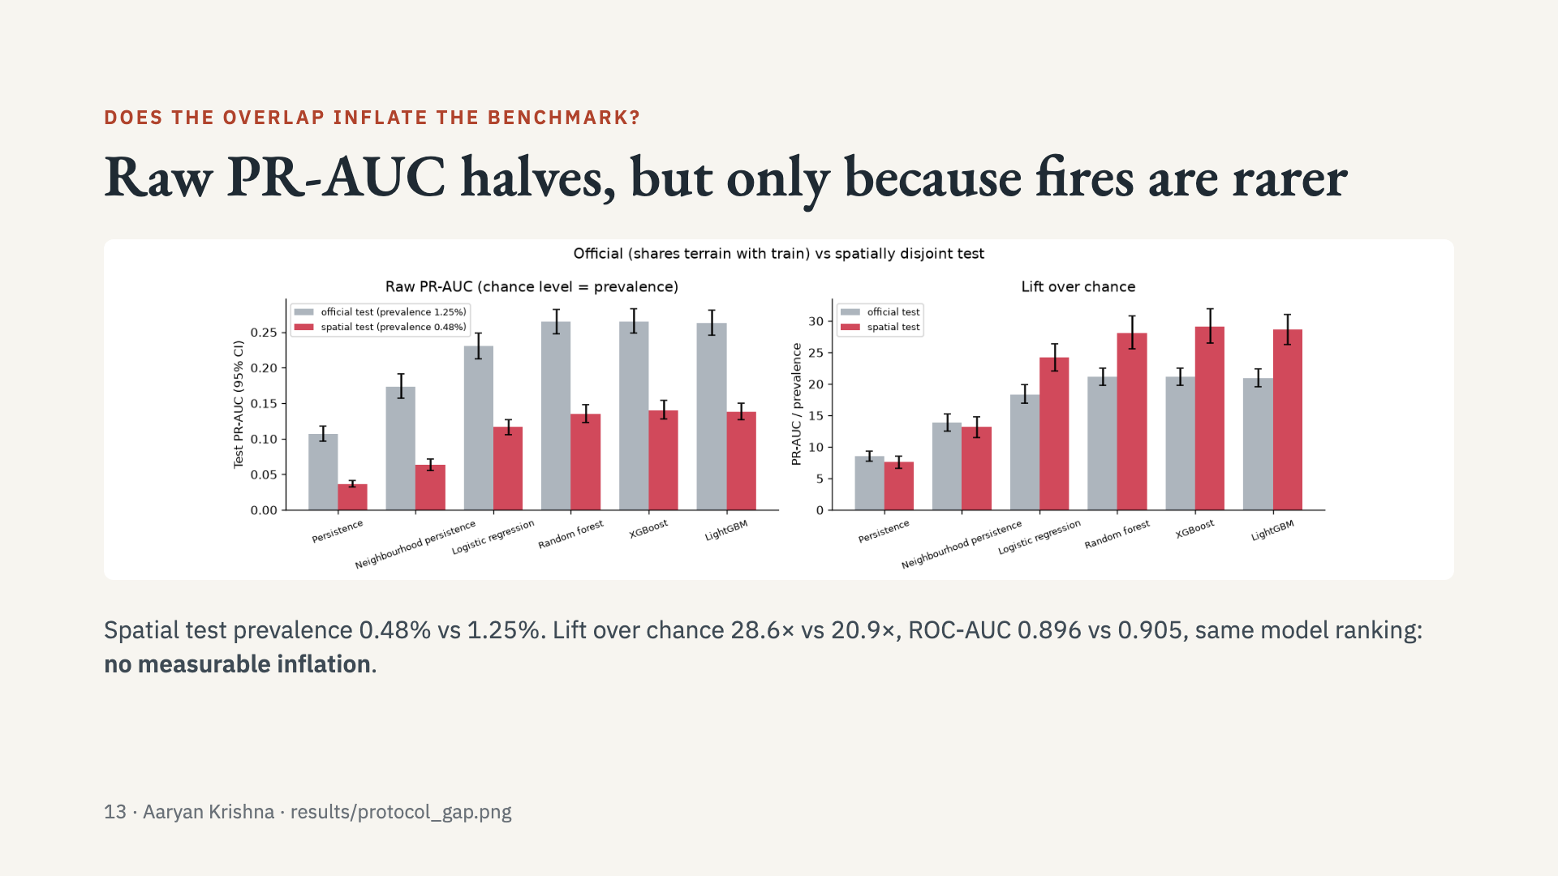
Notes:
Presenter: Aaryan. Key viva point: PR-AUC’s chance level is the positive rate, so compare across test sets with lift and ROC-AUC. Held-out location groups are smaller, isolated fires because the two giant recurring-fire regions must stay in training. Hint of memorisation only: elevation and population get more SHAP weight on the official split.

Slide 14
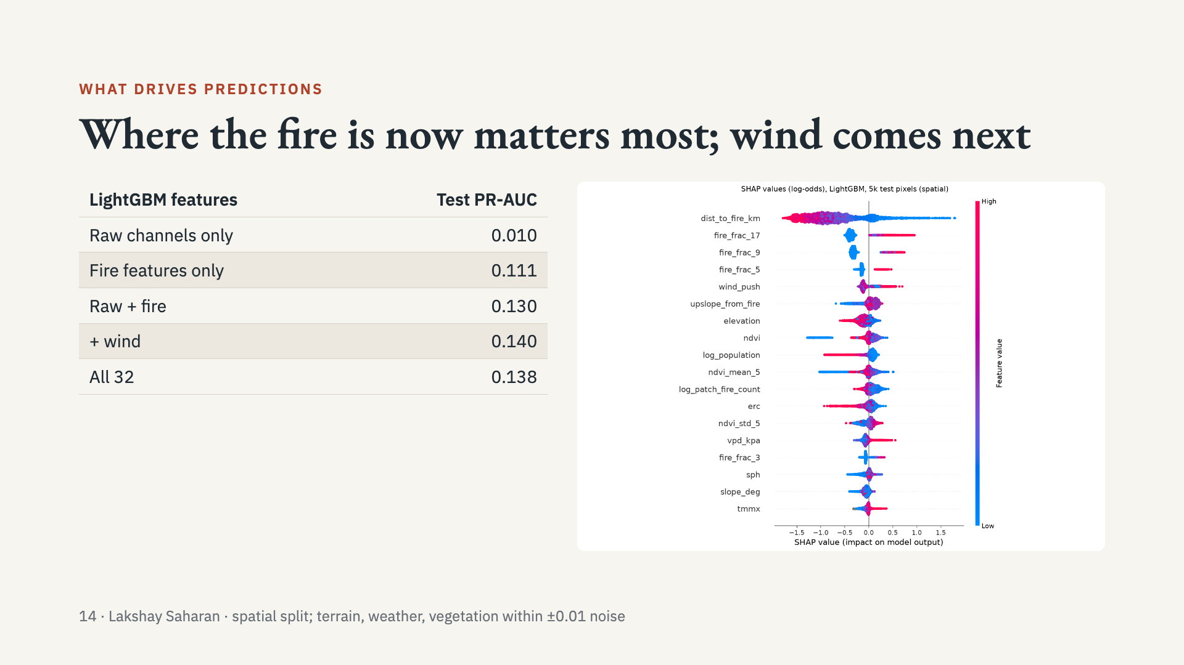
Notes:
Presenter: Lakshay. Raw weather is nearly constant across a patch, so alone it can’t say WHERE fire appears. Physics in the SHAP plot: closer to fire, more fire nearby, downwind push and higher VPD all raise risk. We don’t claim terrain, weather or vegetation help: their ablation changes are inside the bootstrap uncertainty.

Slide 15
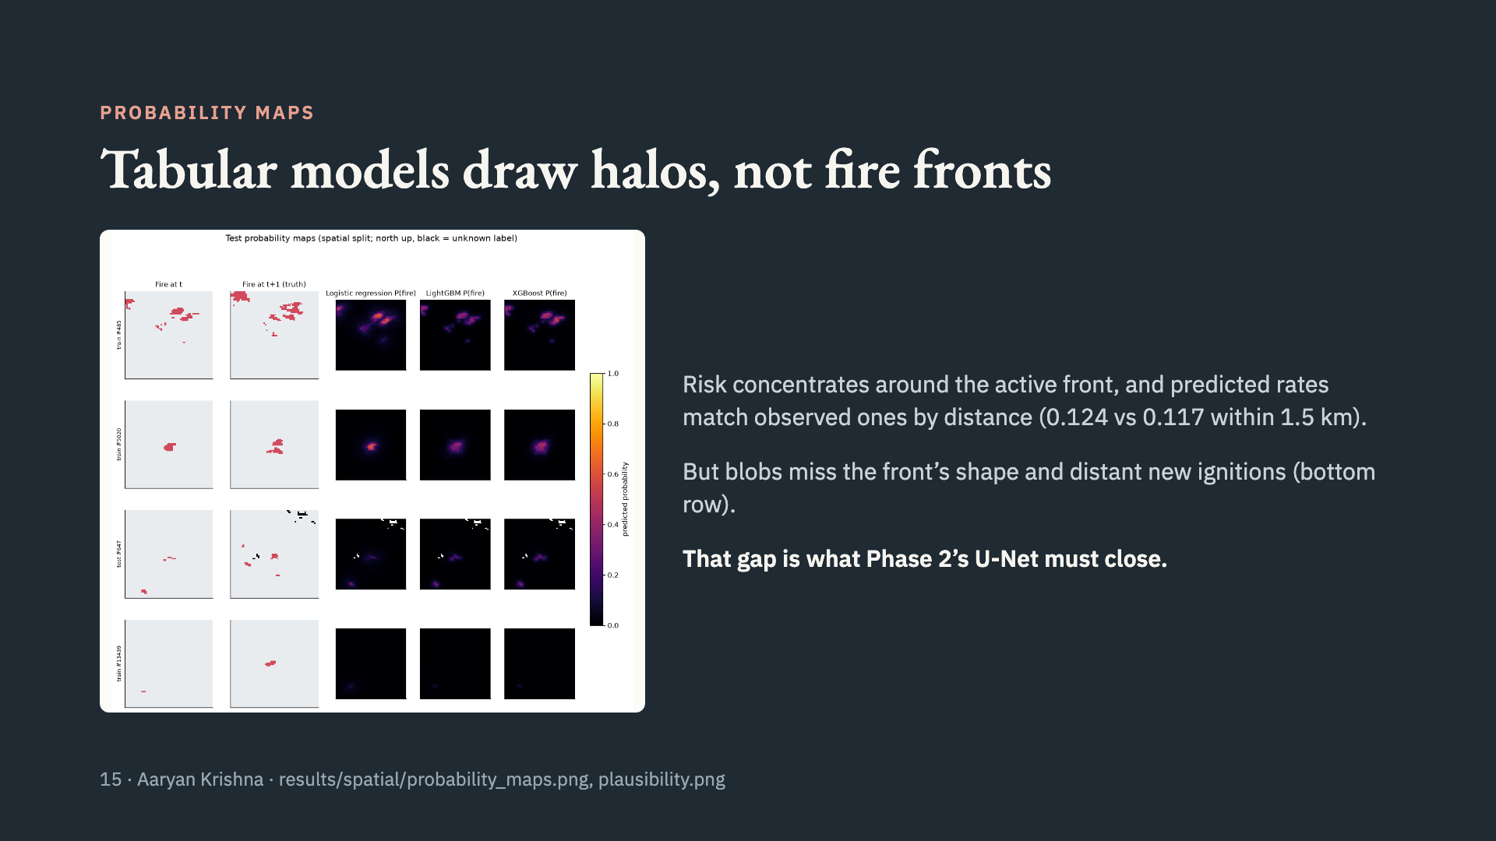
Notes:
Presenter: Aaryan. Plausibility checks: predicted risk rises from upwind to downwind pixels like the observed rate, and is higher on sloped than level ground near fire. Boosted models are also the best calibrated (Brier 0.0044).

Slide 16
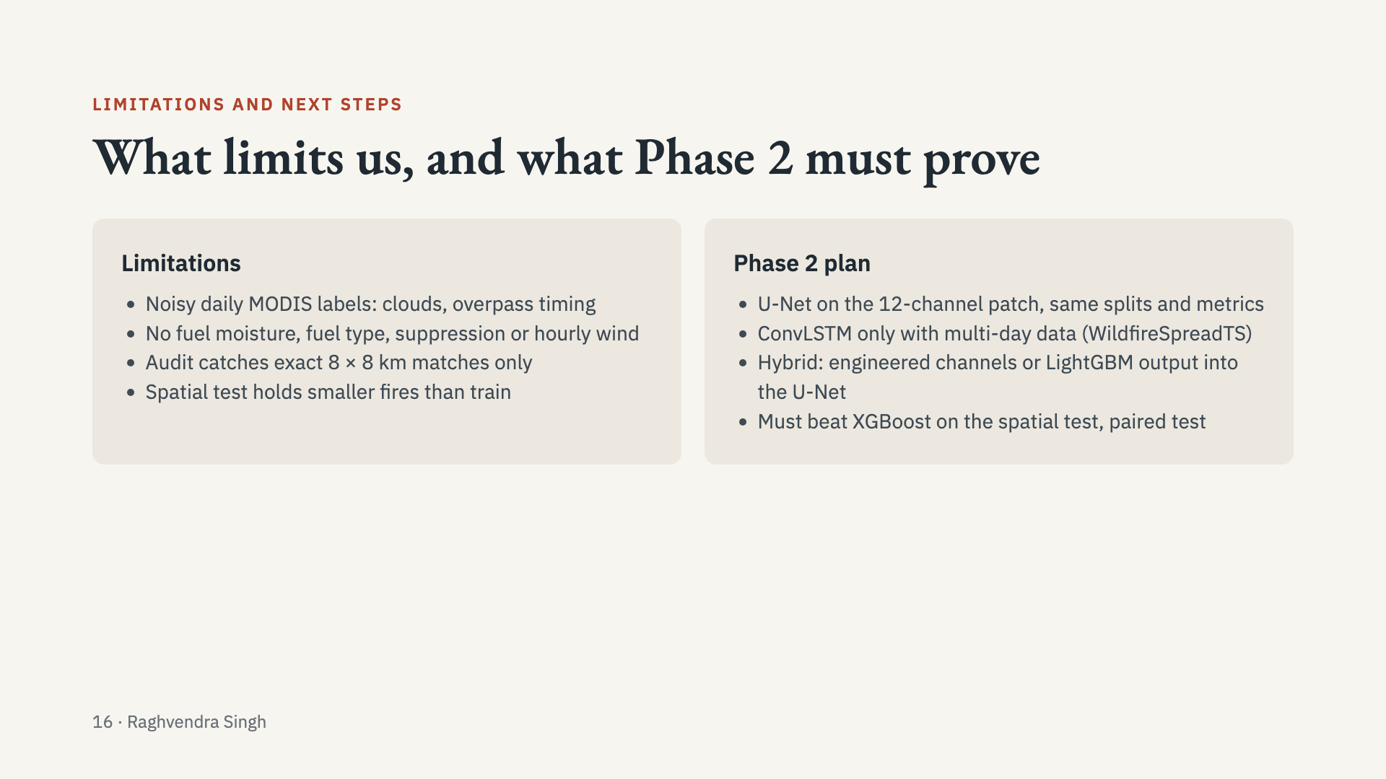
Notes:
Presenter: Raghvendra. The bar for Phase 2 is concrete: a CNN must beat 0.141 PR-AUC on the spatial test (and 0.265 official) under a paired patch bootstrap. A hybrid only earns extra marks if it shows real value, so we will ablate it.

Slide 17
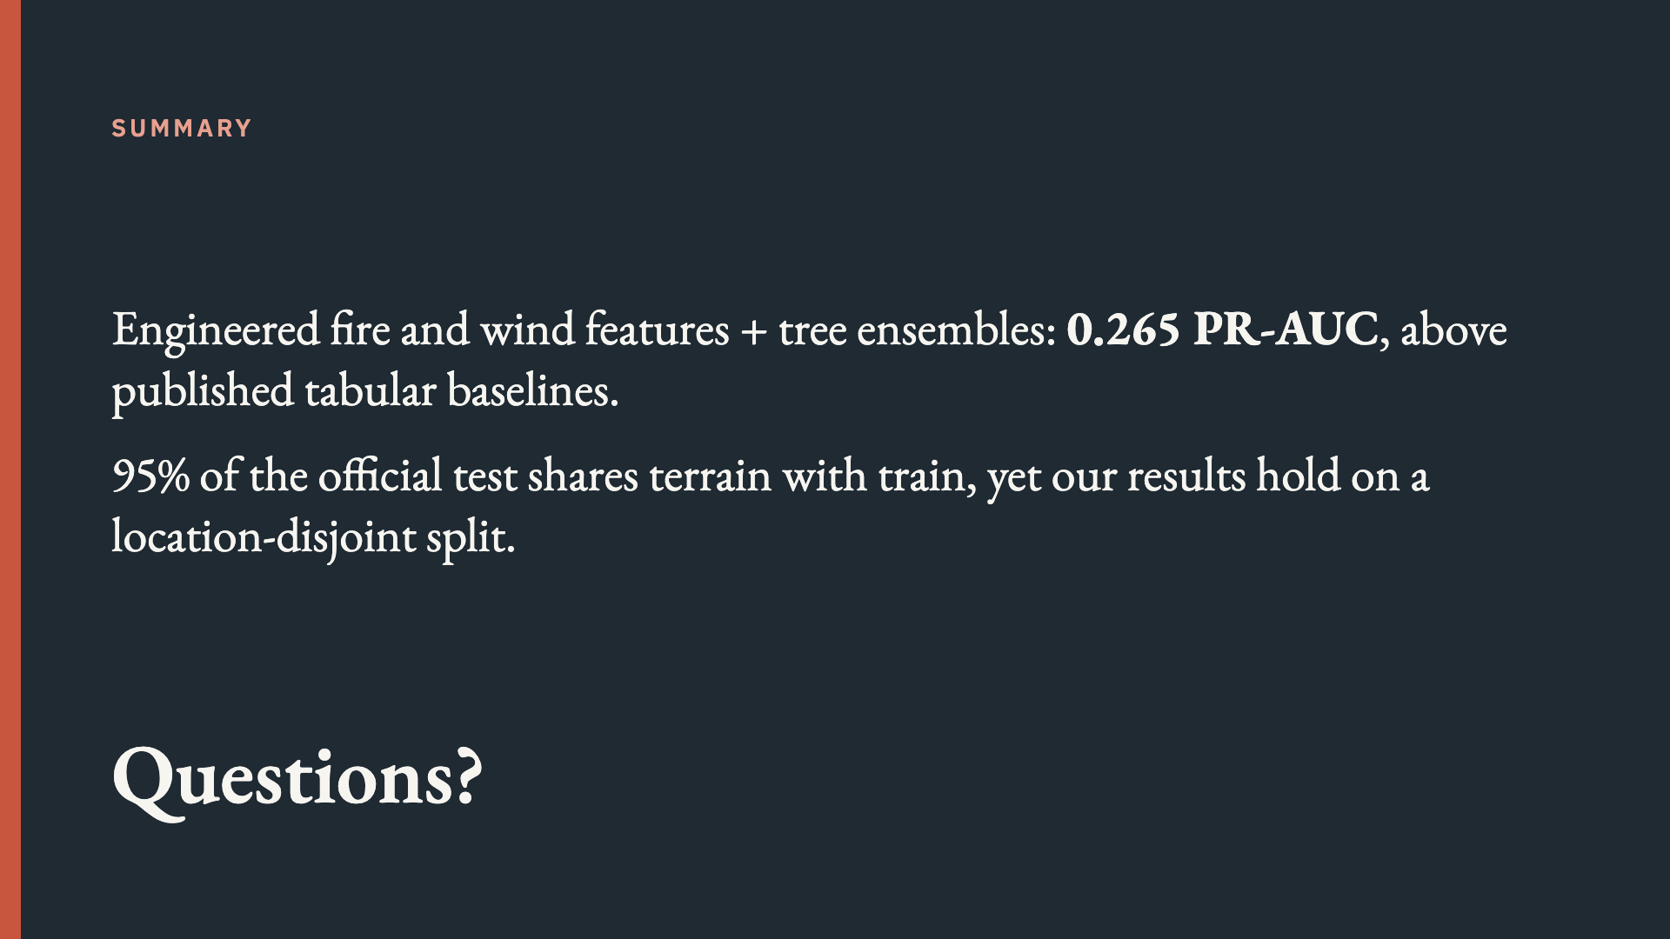
Notes:
Presenter: Aaryan. Close on the two takeaways, then open questions. Each member answers questions on their own module first.

