Slide 1
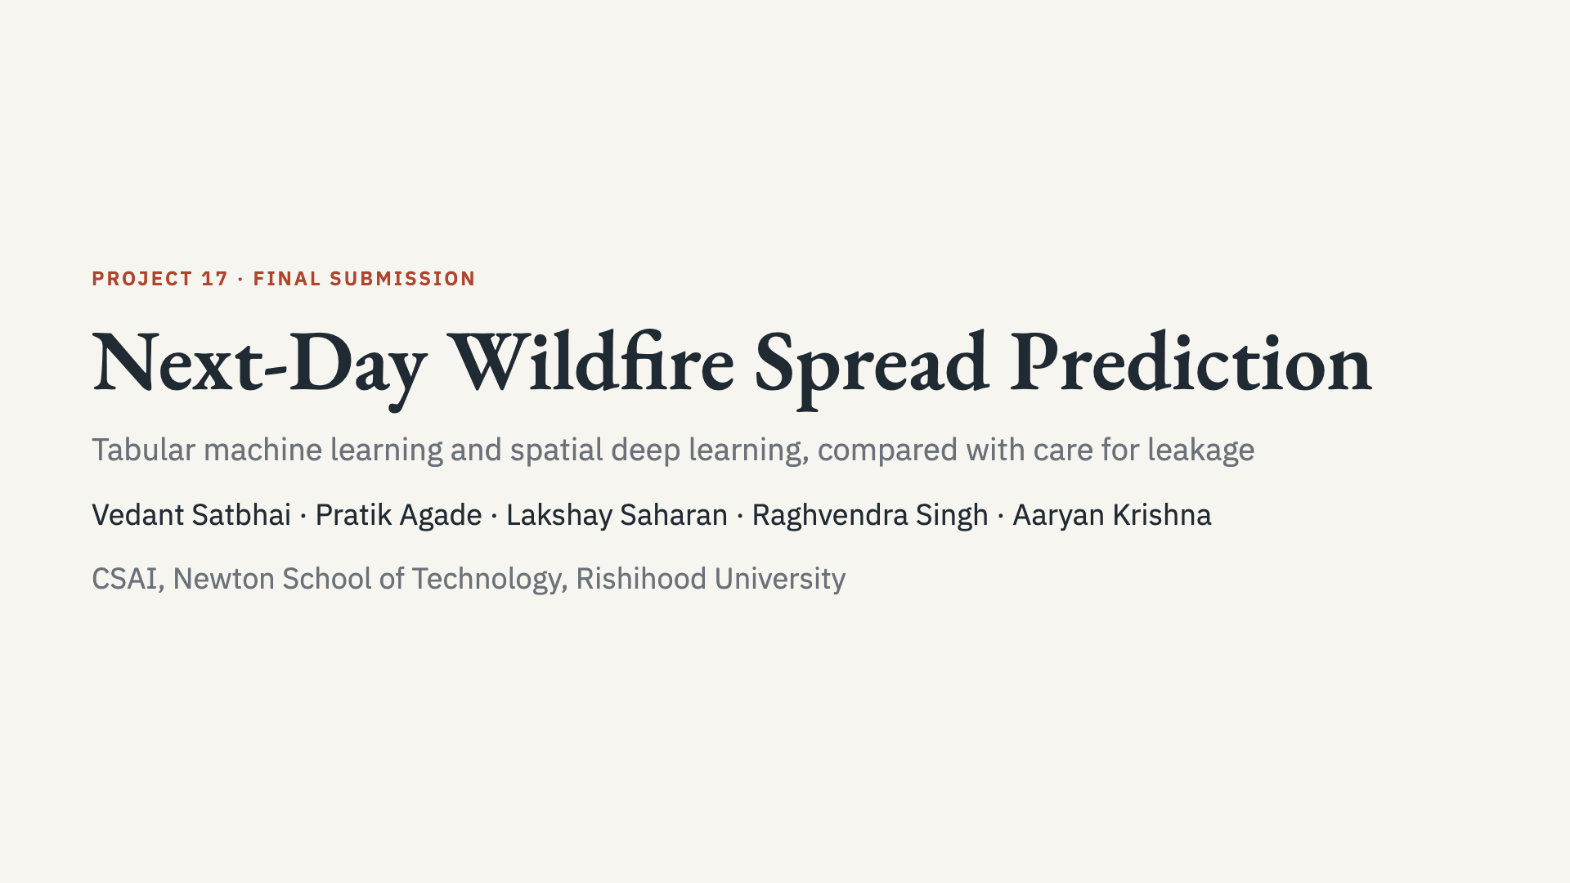
Notes:
Introduce the team and the single question: can we tell where a wildfire will be tomorrow, and how far can we trust the score?

Slide 2
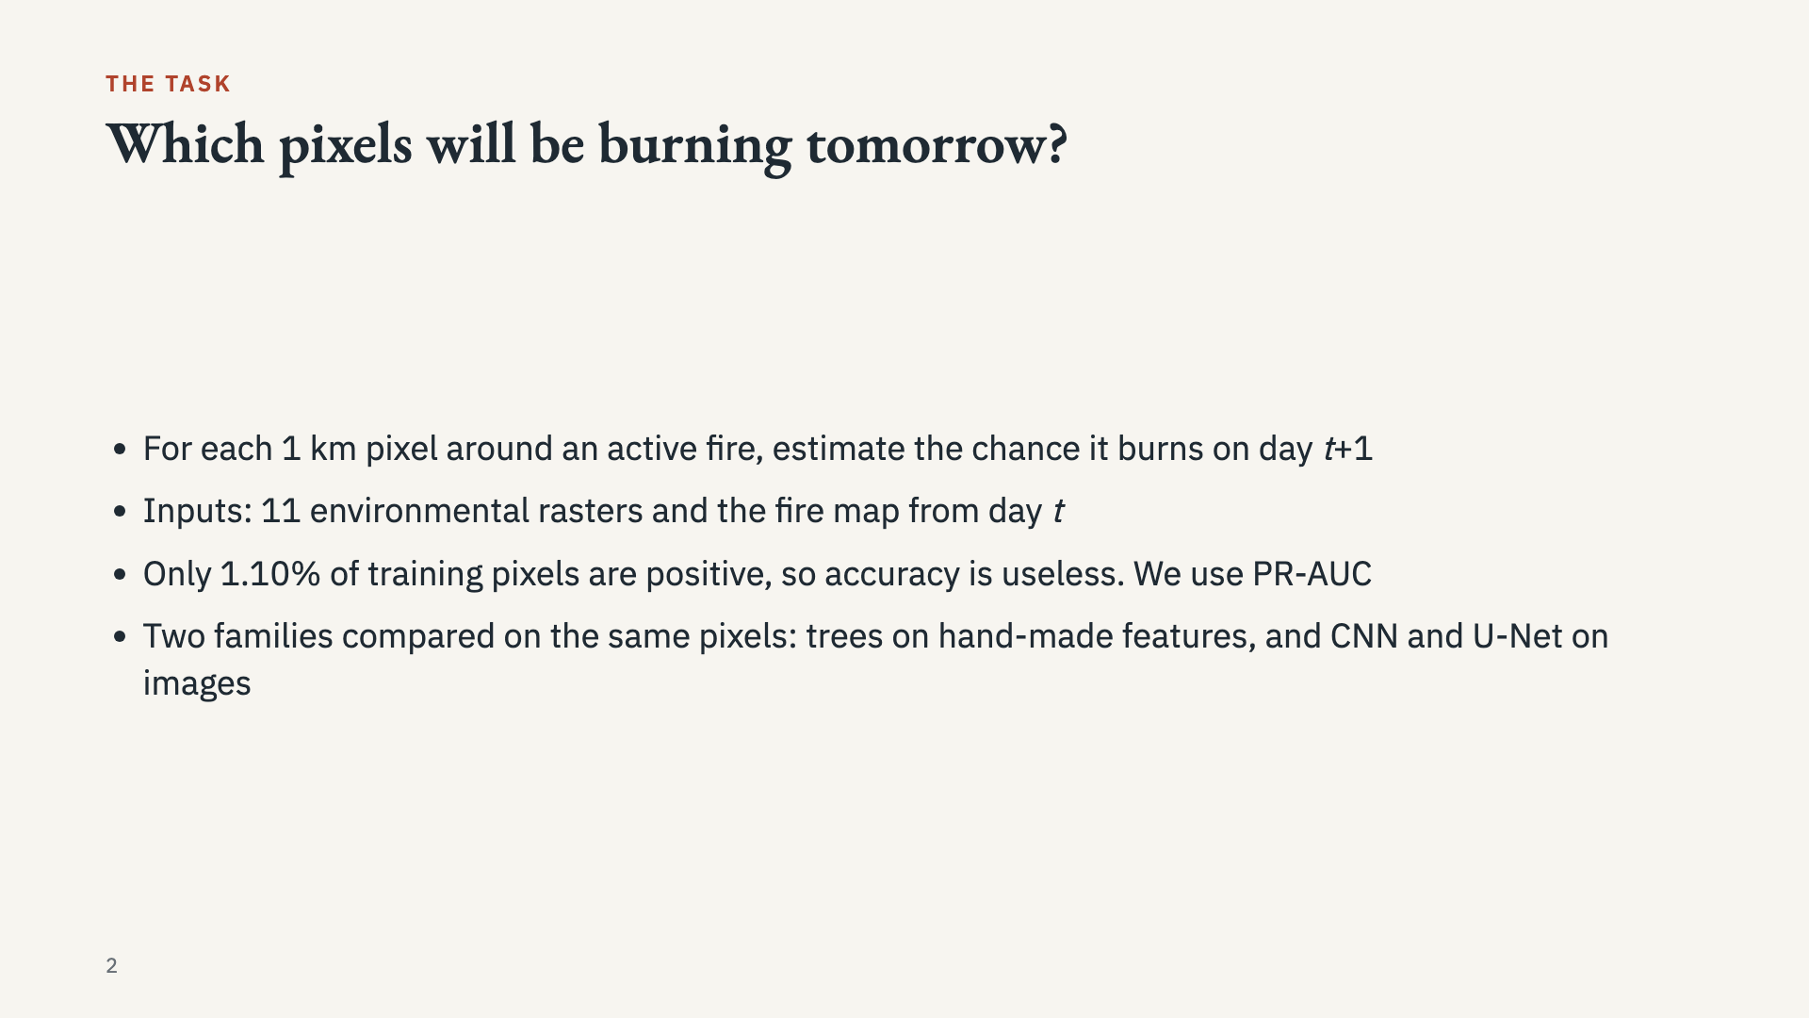
Notes:
State the question simply. A model that always says no fire would be about 99% accurate and useless, which is why PR-AUC is the main metric.

Slide 3
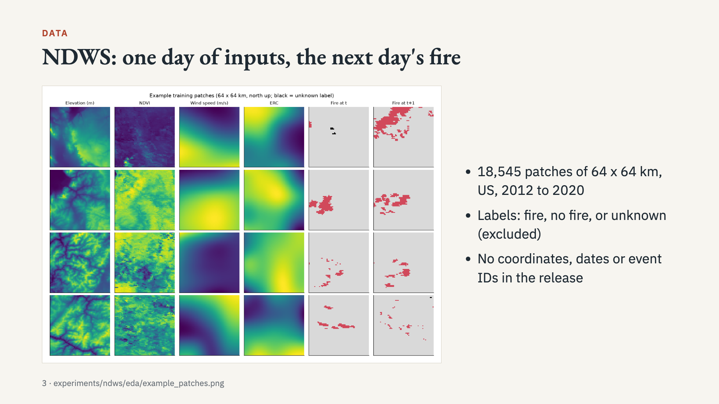
Notes:
Walk through one row of the figure. Stress that the release has no coordinates, dates or fire IDs, which limits what we can claim.

Slide 4
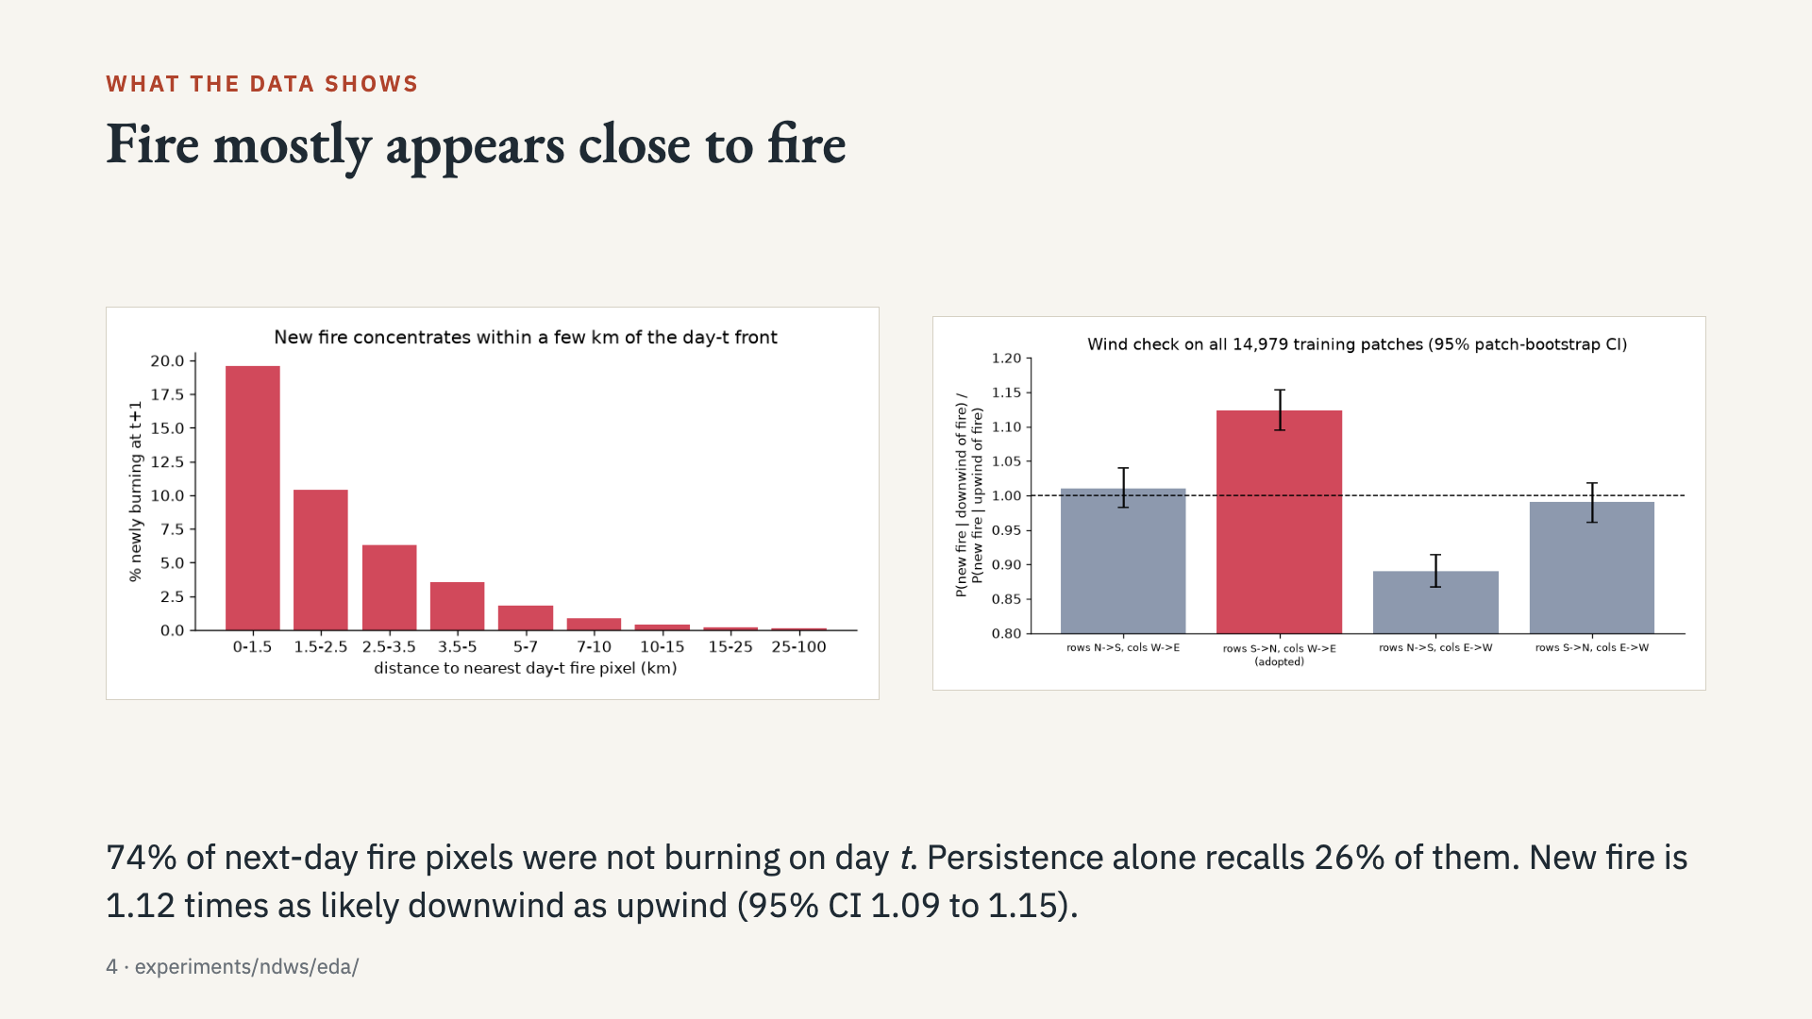
Notes:
The left chart motivates the distance features. The right chart is how we inferred image orientation, since the data has no georeferencing.

Slide 5
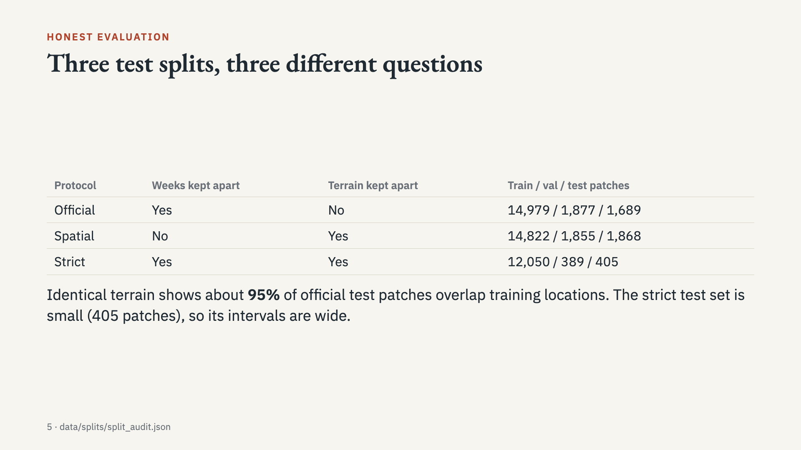
Notes:
Explain the terrain fingerprint: elevation barely changes between days, so identical terrain means the same place. Strict is the hardest test, and the smallest.

Slide 6
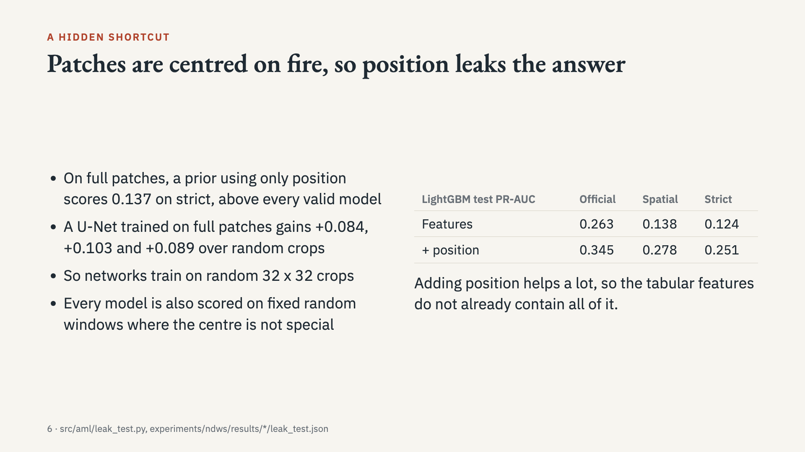
Notes:
Full-patch results are diagnostics and not valid forecasts. In a real forecast over a fixed map, the centre of an image means nothing.

Slide 7
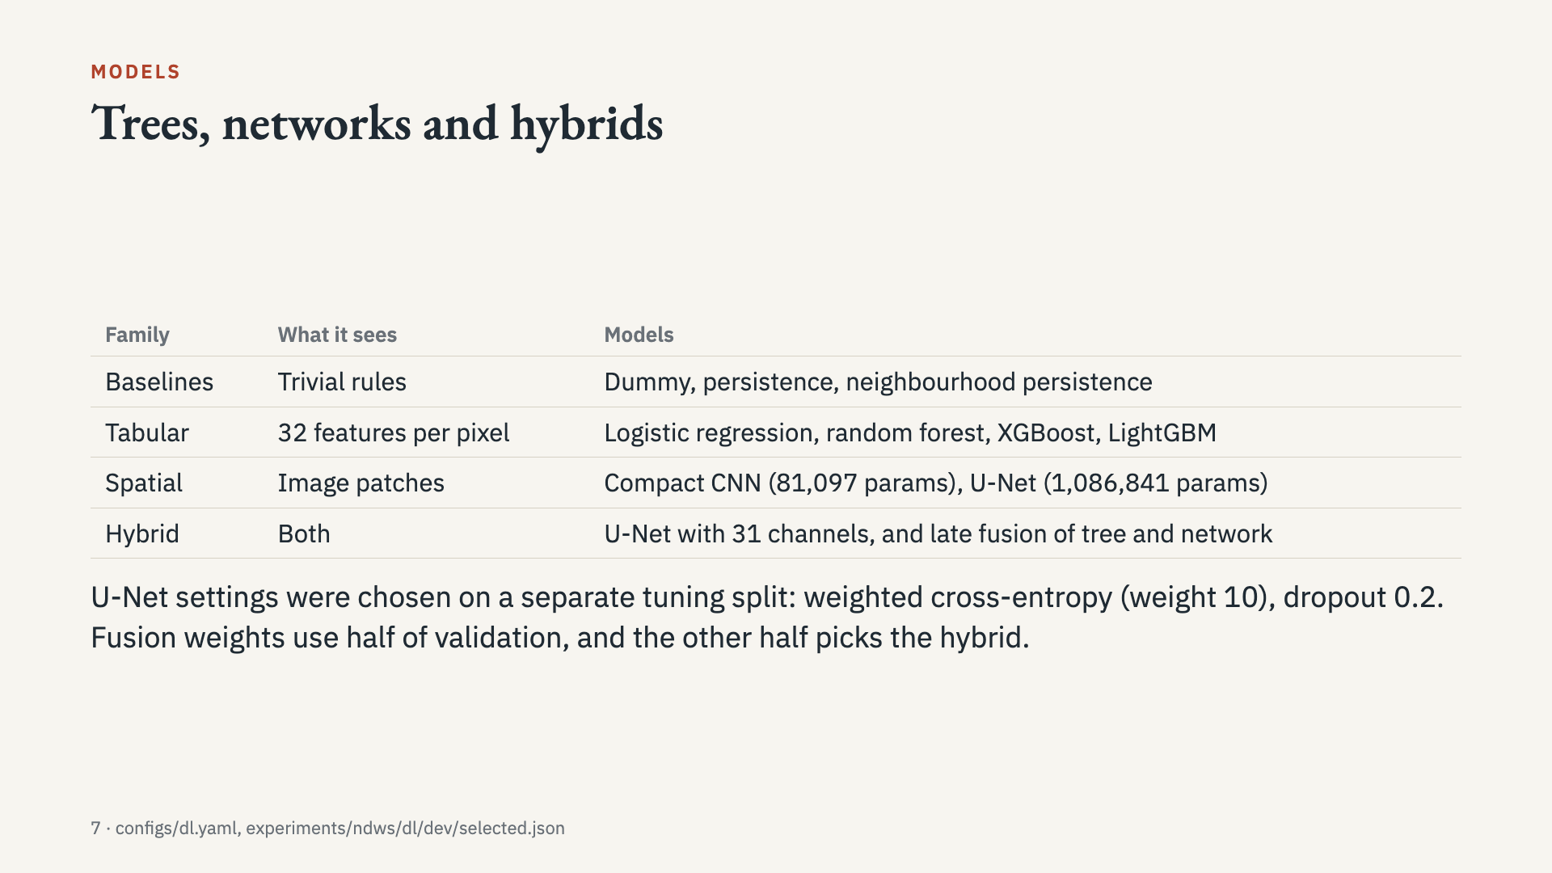
Notes:
Emphasise that tuning and hybrid selection never see test data.

Slide 8
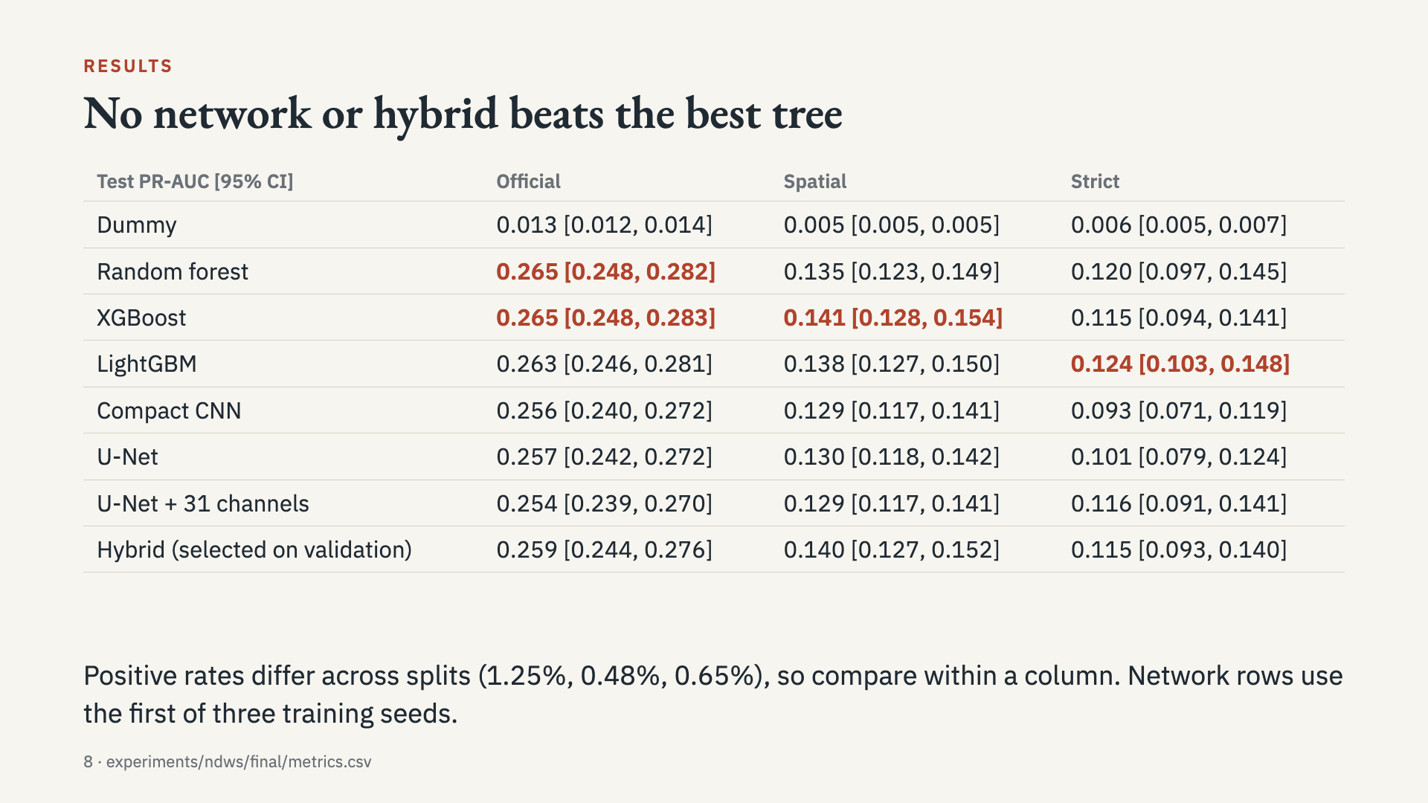
Notes:
Give the headline first: the best tree wins every column. The intervals overlap, so the next slide uses paired tests. Report this honestly, as the brief asks.

Slide 9
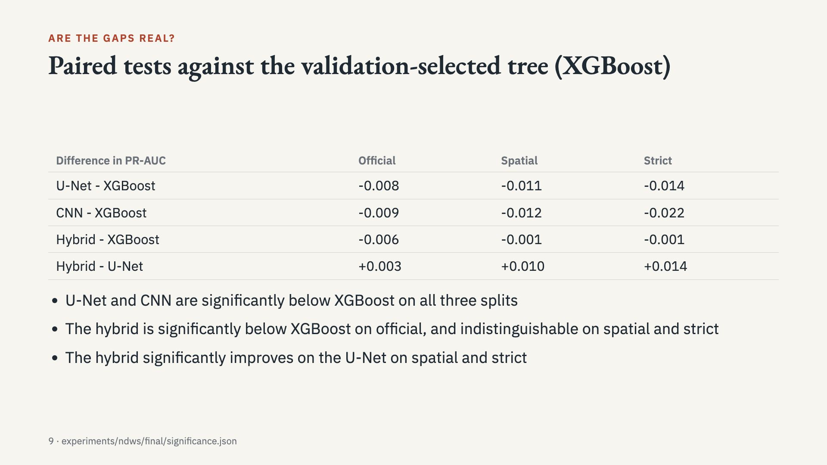
Notes:
Paired bootstrap on the same resampled patches. Intervals for each difference are in report tables. Strict's best test tree is LightGBM, but the test uses the tree chosen on validation.

Slide 10
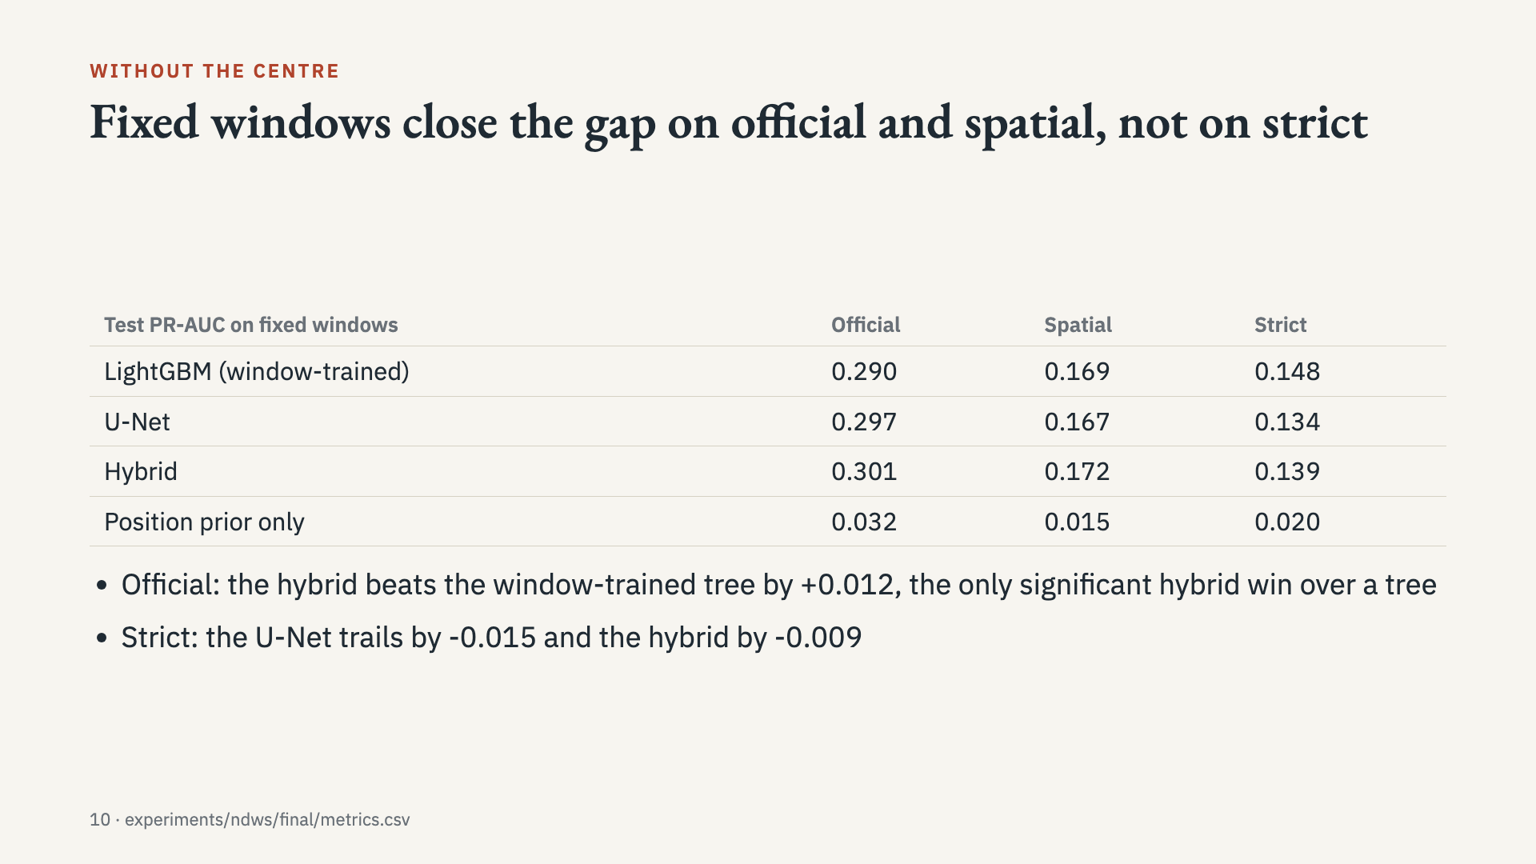
Notes:
Here position carries almost no information. On official the U-Net and hybrid match or beat the window-trained tree, on spatial they are within its interval, and on strict the tree is still ahead.

Slide 11
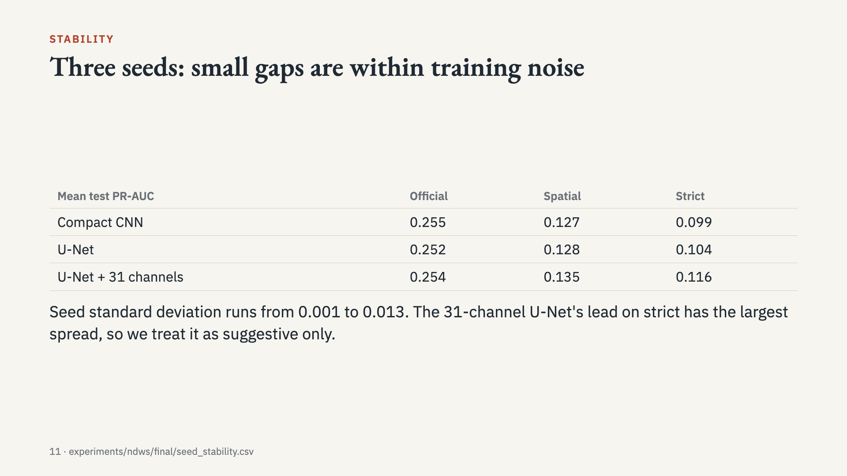
Notes:
These are means of three training runs, separate from the bootstrap on test patches.

Slide 12
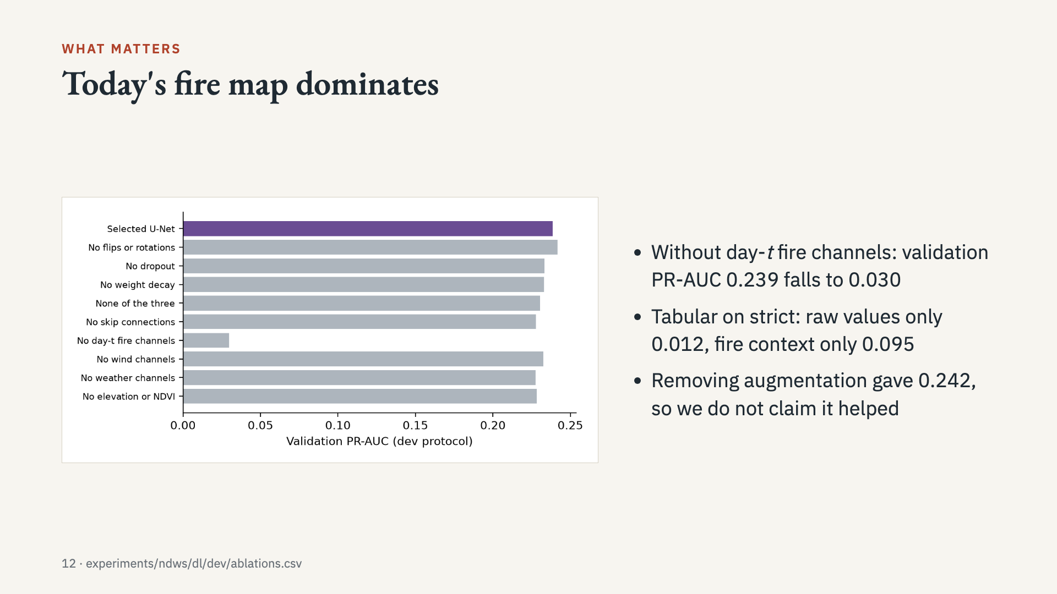
Notes:
Single-run ablations on the tuning split. Only the fire channels produce a large effect, so do not over-read the smaller bars.

Slide 13
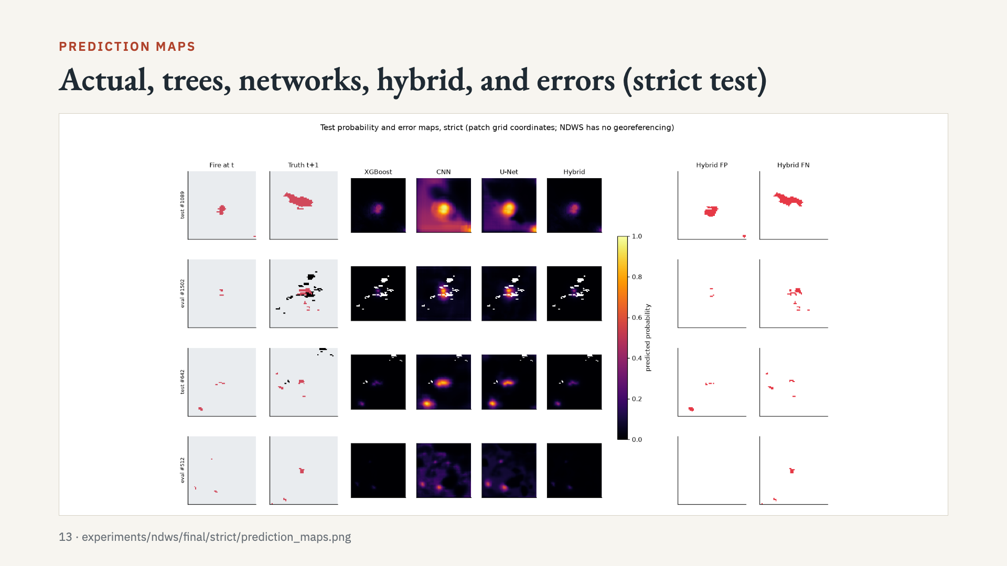
Notes:
Read one row from left to right. Trees and hybrid stay close to fire. Networks give smoother, wider areas. False negatives are mostly new fire away from the perimeter.

Slide 14
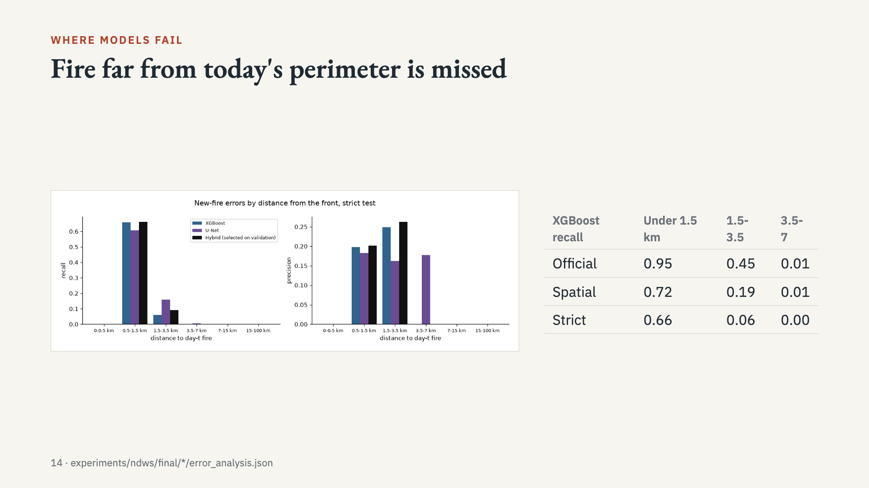
Notes:
Recall at the validation-chosen threshold, by distance to the nearest day-t fire pixel.

Slide 15
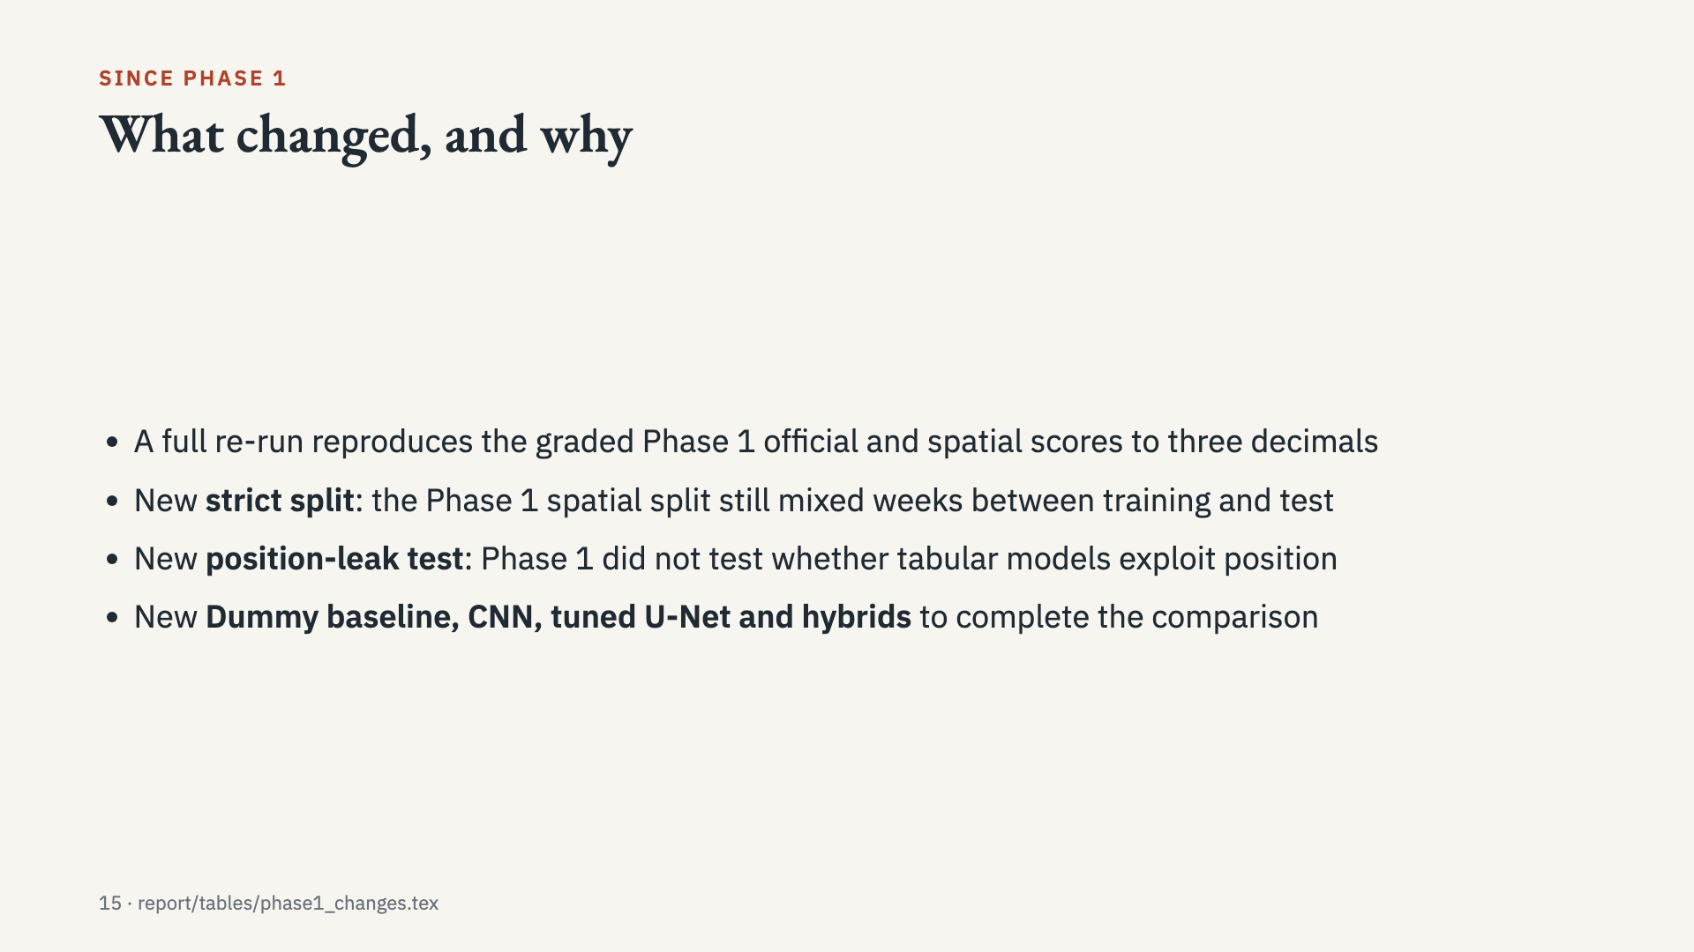
Notes:
The graders asked for this. The rerun matching Phase 1 shows the pipeline is reproducible.

Slide 16
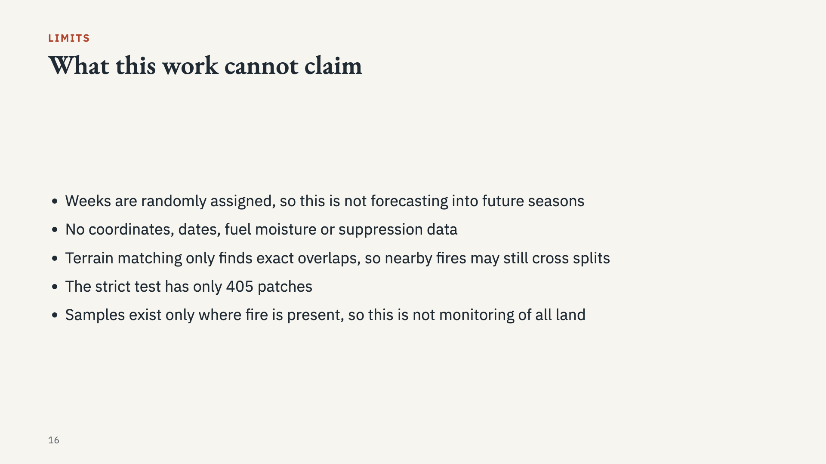
Notes:
Say these before the examiner does. Associations do not prove how a fire physically spread.

Slide 17
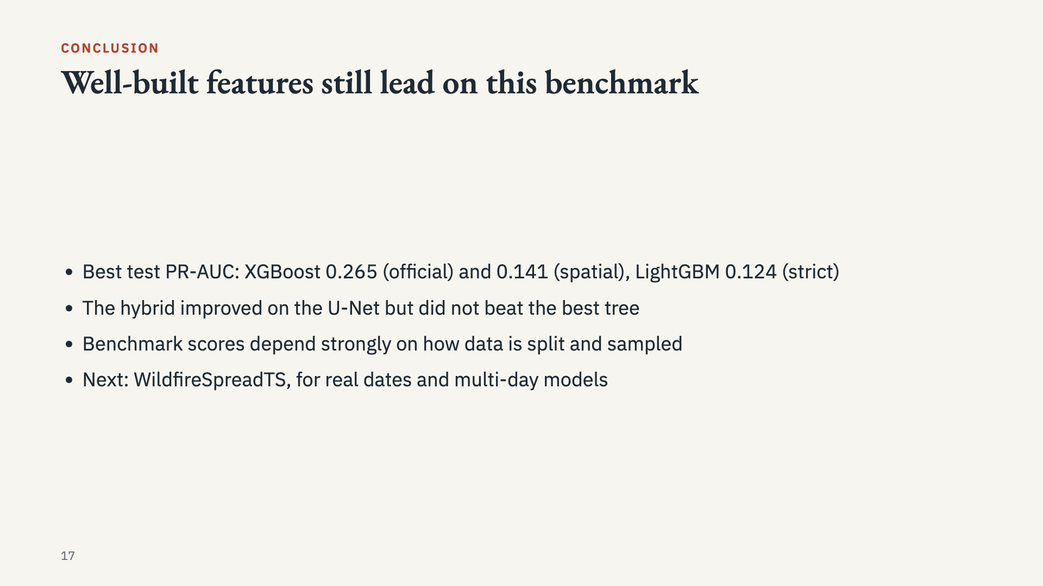
Notes:
End with the honest conclusion. Offer the viva guide and repository for detail.

