Slide 1
Title: MedPredict AI Domain: AIML Team Name: Vedant Alai
Hack Orbit 2025

Slide 2
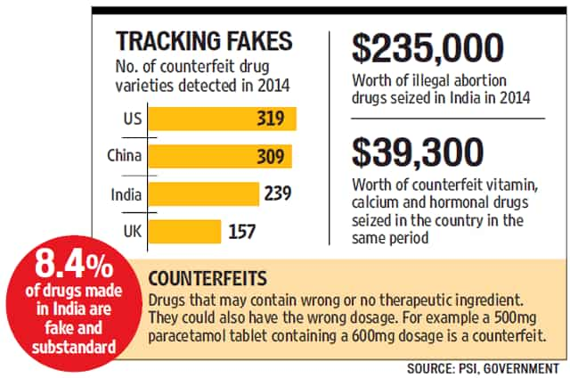
Problem Statement
India accounts for ~20% of the world’s counterfeit drugs .
In 2023, ~1 in 10 medicines in low-income countries was either falsified or substandard.
There is no current AI system that predicts counterfeit medicine before distribution or alerts regulators in advance.
Lack of awareness, pricing inconsistency, and unreliable manufacturers make it difficult to detect.

Slide 3
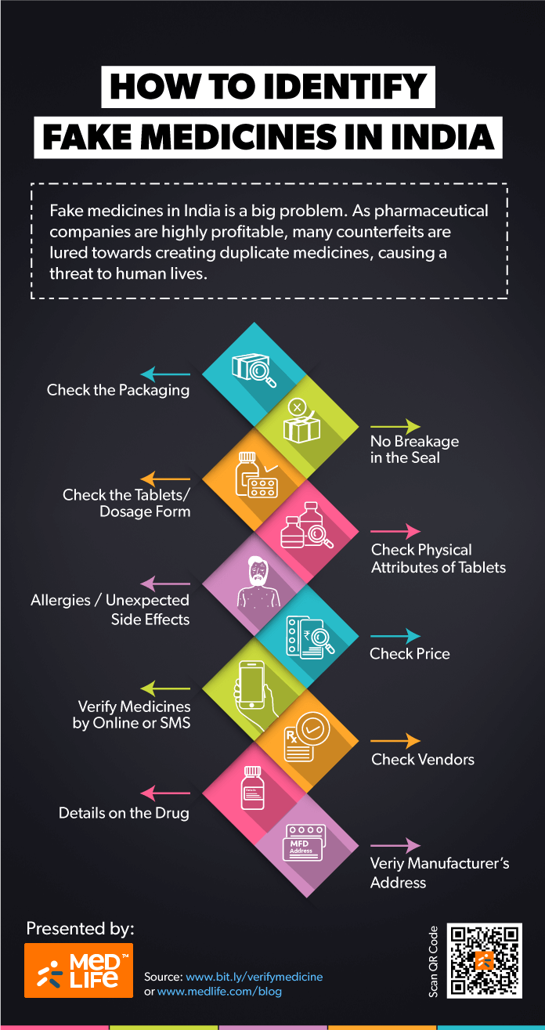
💡 Our Solution - MedPredict AI
✔ Predicts medicine risk using ML (Random Forest + Regression)
✔ Analyzes price deviation and manufacturer reliability
✔ Accepts user input and offers real-time results
✔ Works in both English and Hindi
✔ Supports rural access via simplified interface

Slide 4
Tech Stack
Machine Learning Approach:
Supervised Learning: Predicts counterfeit risk based on manufacturer history, pricing, batch records.
Anomaly Detection Algorithms: Detect suspicious trends like extremely low prices or bulk orders in remote regions.
Tech Stack :
Programming Language: Python
ML Libraries: Scikit-learn, TensorFlow
Database : MongoDB

Slide 5
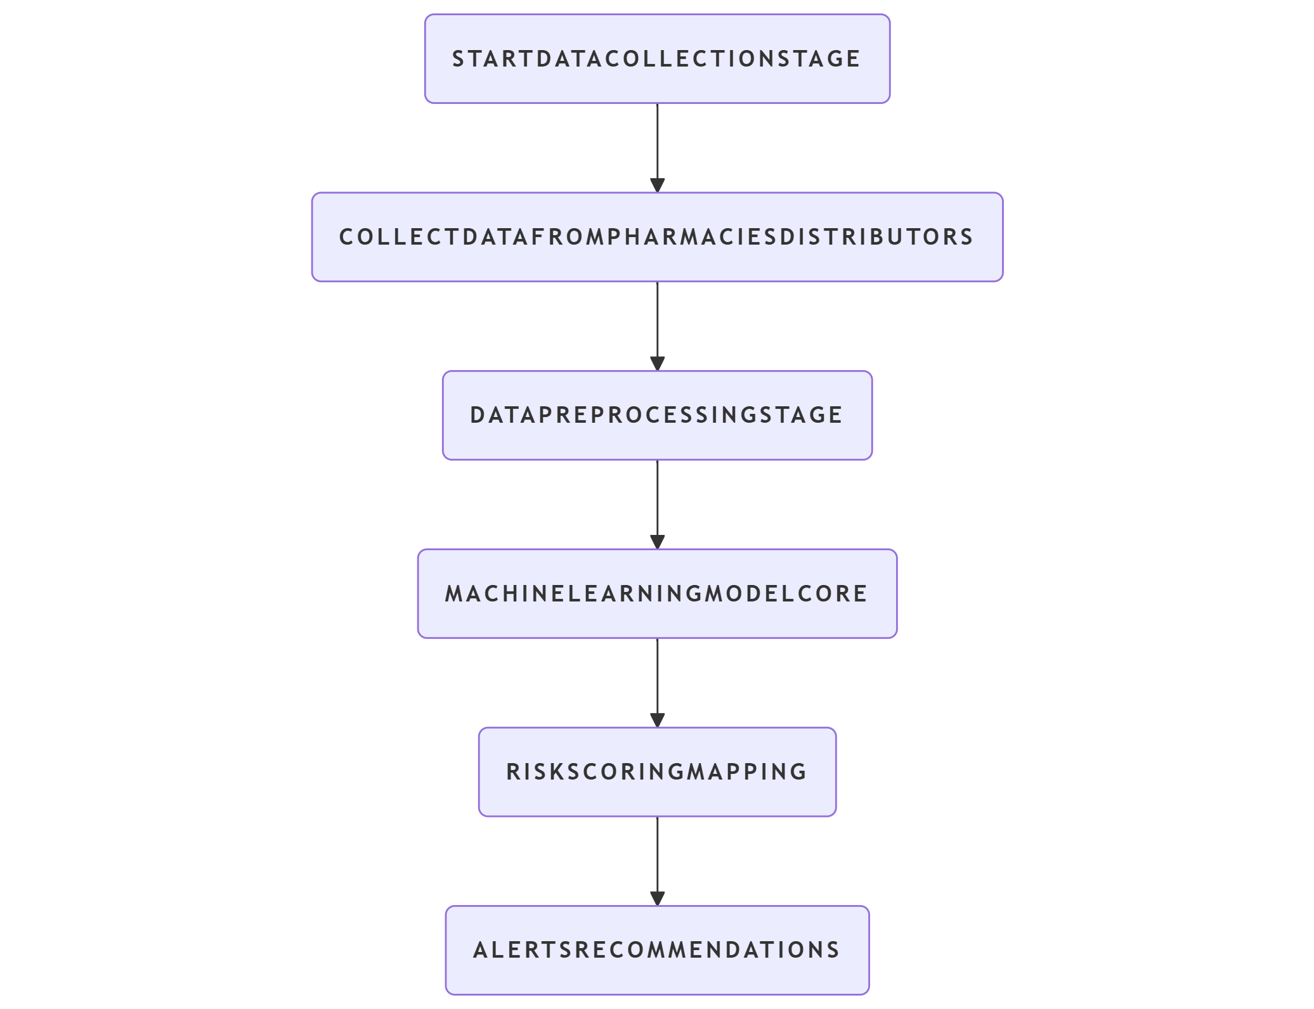
Architecture / Workflow Diagram
Data Sources:
OpenFDA Dataset
Medicine Dataset For India
Actual Price Dataset
Preprocessing & Feature Engineering:
ML Model:
Random Forest for risk score prediction
Regression model for manufacturer reliability
Prediction & Alert System:
Risk score generation for each batch
Telegram alerts to rural pharmacists
Dashboard for regulators to review

Slide 6
⚙️ System Architecture
1. User submits medicine info
2. ML model predicts risk score
3. MongoDB stores batch data
4. Flask API handles predictions and UI
5. Alerts sent if high-risk batches detected

Slide 7
🛠 Key Features
✅ Risk score prediction
✅ Manufacturer reliability scoring
✅ Hindi + English language support
✅ MongoDB backend
✅ Price deviation analysis

Slide 8
🚀 Future Scope
📱 Android app for wider access
🔗 Blockchain-based supply tracking
🌍 Integration with drug regulatory authorities
🧠 Deep learning for better NLP-based complaint analysis
🌐 Auto-scanning medicine QR/barcodes

Slide 9
Thank You

