Slide 1
Hypothesis Testing Lecture
Monica Goud

Slide 2
Overview of this Lecture
The problem of hypotheses testing
Elements and logic of hypotheses testing (hypotheses, decision rule, one- and two-tailed tests, significance level, Type I and Type II errors, power of test, implications of the decision, p-values)
Steps in performing a hypotheses test
Large-sample test for the population mean
Two-sample tests for the population means
Large-sample test for the population proportion
Two-sample tests for the population proportions

Slide 3
The problem of hypotheses testing
Statement of the Problem:
Given a population (equivalently a distribution) with a parameter of interest, θ, (which could be the mean, variance, standard deviation, proportion, etc.), we would like to decide/choose between two complementary statements concerning θ. These statements are called statistical hypotheses.
The choice or decision between these hypotheses is to be based on a sample data taken from the population of interest.
The ideal goal is to be able to choose the hypothesis that is true in reality based on the sample data.

Slide 4
Situations where Hypotheses Testing is Relevant
Example: A quality engineer would like to determine whether the production process he is charged of monitoring is still producing products whose mean response value is supposed to be μ₀ (process is in-control), or whether it is producing products whose mean response value is now different from the required value of μ₀ (process is out-of-control).
Statement 1 (Null): μ = μ₀ (process in-control)
Statement 2 (Alternative): μ ≠ μ₀ (process out-of-control)

Slide 5
Some Situations …
Example: An engineer would like to decide which of two computer chip manufacturers (say, Intel and Motorola) is more reliable in producing computer chips. If we denote by p₁ the proportion of defective chips for Intel, and p₂ the proportion of defective chips for Motorola, then the goal is to decide between the following competing statements:
Statement 1 (Null): p₁ < p₂ (Intel is more reliable);
Statement 2 (Alternative): p₁ > p₂ (Motorola is more reliable).

Slide 6
Elements and Logic of Statistical Hypotheses Testing
Consider a population or distribution whose mean is μ. To introduce the elements and discuss the logic of hypotheses testing, we consider the problem of deciding whether μ = μ₀, where μ₀ is a pre-specified value, or μ ≠ μ₀.
The first step in hypotheses testing, which should be done before you gather your sample data, is to set up your statistical hypotheses, which are the null hypothesis (H₀) and the alternative hypothesis (H₁).

Slide 7
The Statistical Hypotheses
The null hypothesis, H₀, is usually the hypothesis that corresponds to the status quo, the standard, the desired level/amount, or it represents the statement of “no difference.”
The alternative hypothesis, H₁, on the other hand, is the complement of H₀, and is typically the statement that the researcher would like to prove or verify.
These hypotheses are usually set-up in such a way that deciding in favor of H₁ when in fact H₀ is the true (called a Type I error) statement is a very serious mistake.

Slide 8
An Analogy to Remember
Setting the null and alternative hypotheses has an analog in the justice system where the defendant is “presumed innocent” until “proven guilty.”
In the court system, the null hypothesis corresponds to the defendant being innocent (this is the status quo, the standard, etc.).
The alternative hypothesis, on the other hand, is that the defendant is guilty.
Note that it is very difficult to reject the null (convict the defendant), and only “a proof (based on good evidence) beyond a reasonable doubt” will warrant rejection of H₀.

Slide 9
The Hypotheses in our Problem
For the problem we are considering, the appropriate hypotheses will be:
H₀: μ = μ₀
H₁: μ ≠ μ₀.
Another word of caution: It is not proper for a researcher to set up the hypotheses after seeing the sample data; however, a data maybe used to generate a hypotheses, but to test these generated hypotheses you should gather a new set of sample data!

Slide 10
Determine the Type of Sample Data that will be Gathered
The second step is to determine what kind of sample data you will be gathering. Is it a simple random sample? A stratified sample?
For the moment we will assume that a simple random sample of size n will be obtained, so the data will be representable by X₁, X₂, …, X_{n}, with n > 30.
Also, determine if you know the population standard deviation σ. We assume for the moment that we do.

Slide 11
The Decision Rule
The decision rule is the procedure that states when the null hypothesis, H₀, will be rejected on the basis of the sample data.
To specify the decision rule, one specifies a test statistic, which is a quantity that is computed from the sample data, and whose sampling distribution under H₀ is known or can be determined. Such a statistic measures the agreement of the sample data with the null hypothesis specification.
For our problem, a reasonable choice for the test statistic is:

Slide 12
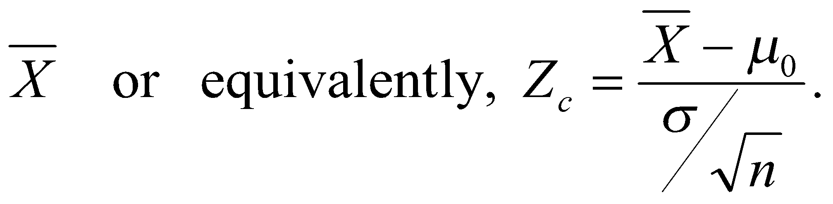
The Test Statistic
The latter is a reasonable choice since it measures how far the sample mean is from the population mean under H₀. The larger the value of |Z_{c}| the more it will indicate that H₀ is not true.
Furthermore, under H₀, by virtue of the Central Limit Theorem, the sampling distribution of Z_{c} will be approximately standard normal.

Slide 13
When to Reject H₀ and its Consequences
Having decided which test statistic to use, the next step is to specify the precise situation in which to reject H₀. We have said that it is logical to reject H₀ if the absolute value of Z_{c} is large.
But how “large” is “large”?
For the moment, let us specify a critical value, denoted by C, such that if
|Z_{c}| > C
then H₀ will be rejected.
Before deciding on the value of C, let us examine the consequences of our decision rule.

Slide 14
Possible Errors of Decision
Remember at this stage that either H₀ is correct, or H₁ is correct. Thus, there is a “true state of reality,” but this state is not known to us (otherwise we wouldn’t be performing a test).
On the other hand, our decision on whether to reject H₀ will only be based on partial information, which is the sample data.
We may therefore represent in a table the possible combinations of “states of reality” and “decision based on the sample” as follows:

Slide 15
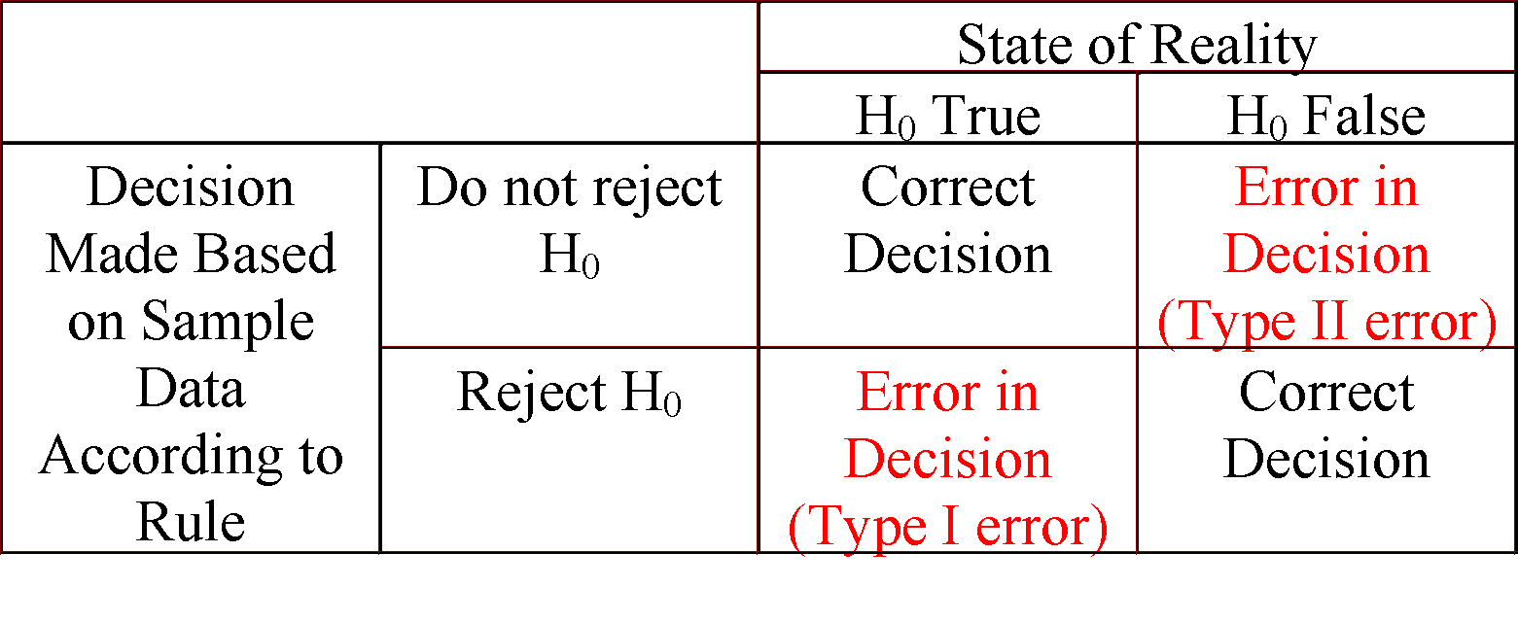
States of Reality and Decisions Made
In decision-making, there is therefore the possibility of committing an error, which could either be an error of Type I or an error of Type II.
Which of these two types of error is more serious??

Slide 16
Assessing the Two Types of Errors
From the table in the preceding slide, we have:
Type I error: committed when H₀ is rejected when in reality it is true.
Type II error: committed when H₀ is not rejected when in reality it is false.
Just like in the court trial alluded to earlier, an error of Type I is considered to be a more serious type of error (“convicting an innocent man”).
Therefore, we try to minimize the probability of committing the Type I error.

Slide 17
Setting the Probability of a Type I Error
In trying to minimize, however, the probability of a Type I error, we encounter an obstacle in that the probabilities of the Type I and Type II errors are inversely related. Thus, if we try to make the probability of a Type I error very, very small, then it will make the probability of a Type II error quite large.
As a compromise we therefore specify a maximum tolerable Type I error probability, called the significance level, and denoted by α, and choose the critical value C such that the probability of a Type I error is (at most) equal to α.
This α is conventionally set to 0.10, 0.05, or 0.01.

Slide 18
Determining the Critical Value, C
Let us now determine the critical value C in our test. Recall that our test will reject H₀ if |Z_{c}| > C.
P{Type I Error} = P{reject H₀ | H₀ true} = P{|Z_{c}| > C | H₀ true}.
But, under H₀, Z_{c} is distributed as standard normal, so if we want P{Type I error} = α, then we should choose the critical value C to be:
C = Z_{α/2}, which is the value such that P{Z > Z_{α/2}} = α/2.

Slide 19
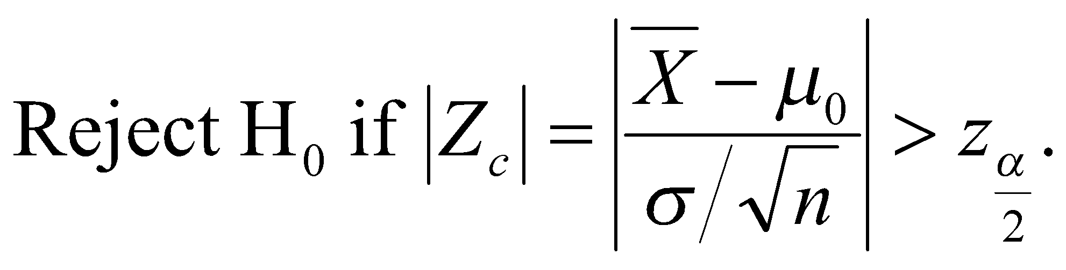
The Resulting Decision Rule
Given a significance level of α, for testing the null hypothesis H₀: μ = μ₀ versus the alternative hypothesis H₁: μ ≠ μ₀, the appropriate test statistic, under the assumptions that (a) σ is known, and (b) n > 30 is given by:

Slide 20
Data Gathering and Making the Decision
Having specified the final decision rule, the next step is to gather the sample data and to compute the sample mean and the value of Z_{c}.
If |Z_{c}| > z_{α/2} then H₀ is rejected; otherwise, we say that we “fail to reject H₀.”
Note: If σ is not known, then we could replace it in the formula of Z_{c} by the sample standard deviation S.
The final step is to make the relevant conclusion.

Slide 21
On the Conclusion that One Could Make
The final step in performing a statistical test of hypotheses is to make the conclusion relevant to the particular study, that is, not to simply say that “H₀ is rejected” or “H₀ is not rejected.”
When H₀ is rejected, then either that a correct decision has been made, or an error of Type I has been committed. But since we have controlled the probability of committing a Type I error (set to α, which we could tolerate), then we can conclude in this case that H₀ is not true, and hence that H₁ is correct.

Slide 22
On Conclusions … continued
On the other hand, if we did not reject H₀, then either we are making the correct decision, or we are making a Type II error.
However, since we did not control for the Type II error probability (when we set the Type I error probability to be α, we “closed our eyes to the probability of a Type II error”), if we do not reject H₀, we cannot conclude that H₀ is true. Rather, we could only say that we “failed to reject H₀ on the basis of the available data.”
This is the basis of the saying that: “you can never prove a theory, you can only disprove it.”

Slide 23
Recapitulation: Steps in Hypothesis Testing
Step 1: Formulate your null and alternative hypotheses.
Step 2: Determine the type of sample you will be getting with regards to sample size, knowledge of the standard deviation, etc.
Step 3: Specify your level of significance.
Step 4: State precisely your decision rule.
Step 5: Gather your sample data and compute the test statistic.
Step 6: Decide and make final conclusions.

Slide 24
The p-Value Approach
Another approach to making the decision in hypotheses testing is to compute the p-value associated with the observed value of the test statistic.
By definition, the p-value is the probability of getting the observed value or more extreme values of the test statistic under H₀.
In our situation, the p-value would then be:
p-value = P{|Z| > |z_{c}|} where z_{c} is the observed value of the test statistic.

Slide 25
Deciding Based on the p-Value
If the p-value exceed 0.10, then H₀ is not rejected and we say that the result is not significant.
If the p-value is between 0.10 and 0.05, we usually say that the result is almost significant or tending towards significance.
If the p-value is between 0.05 and 0.01, we reject H₀ and conclude that the result is significant.
If the p-value is less than 0.01 then H₀ is rejected and conclude that the result is highly significant.
Or, we may compare the p-value with the level of significance: if it is smaller, reject H₀.

Slide 26
Illustrative Problems
Example 1: According to the norms for a mechanical aptitude test, persons who are 18 years old should average 73.2 with a standard deviation of 8.6. If 45 randomly selected persons of that age averaged 76.7, test the null hypothesis that the mean is 73.2 against the alternative hypothesis that the mean is greater than 73.2 using a 1% level of significance.
Example 2: Five measurements of the tar content of a certain kind of cigarette yielded 14.5, 14.2, 14.4, 14.3, and 14.6 mg per cigarette. The manufacturer claims that the average tar content of their cigarette is 14.0. By assuming normality of the tar content, is the manufacturer’s claim valid in light of the sample data?

Slide 27
Example 3: (Two-Sample Problem)
Two training programs: Method A (straight-teaching machine instruction) and Method B (also involves personal attention by instructor). The following sample data were obtained.
Method A: 71, 75, 65, 69, 73, 66, 68, 71, 74, 68
Method B: 72, 77, 84, 78, 69, 70, 77, 73, 65, 75
Summary Statistics for these two samples
Variable N Mean Median TrMean StDev SE Mean
MethodA 10 70.00 70.00 70.00 3.37 1.06
MethodB 10 74.00 74.00 73.87 5.40 1.71
Variable Minimum Maximum Q1 Q3
MethodA 65.00 75.00 67.50 73.25
MethodB 65.00 84.00 69.75 77.25
Confidence Interval and test that method B is more effective.

Slide 28
Here’s the Output from Minitab Using a Two-Sample T-Test
Two Sample T-Test and Confidence Interval
Two sample T for MethodA vs MethodB
N Mean StDev SE Mean
MethodA 10 70.00 3.37 1.1
MethodB 10 74.00 5.40 1.7
95% CI for mu MethodA - mu MethodB: ( -8.2, 0.2)
T-Test mu MethodA = mu MethodB (vs <): T = -1.99 P = 0.031 DF = 18
Both use Pooled StDev = 4.50
Example for Inference for Variance: While performing a strenuous task, the pulse rate of 25 workers increased on the average by 18.4 beats per minute with a standard deviation of 4.9 beats per minute.
A) Construct a 95% confidence interval for the population standard deviation of the increase in pulse rate when performing this task.
B) Test the hypothesis that the population standard deviation of the increase in pulse rate is 30 beats per minute, versus the hypothesis that it is less than 30 beats per minute.

Slide 29
Inference for the Population Proportion
Example 1: In a random sample of 200 claims filed against an insurance company writing collision insurance on cars, 84 exceeded $1200.
A) Construct a 95% confidence interval for the population proportion (p) of claims that exceeds $1200 in value.
B) Based on the given data, test the null hypothesis that p < 0.40 versus the alternative that p > 0.40. Use a 5% level of significance.
C) If we desire a 95% confidence interval for p with margin of error at most equal to 0.03, how many claims (what sample size) should we examine?
Example 2: Effect of ionizing radiation in preserving horticultural products.
Data: For 180 irradiated garlic bulbs, 153 turned out to be still marketable after 240 days; while for 180 untreated bulbs, only 119 were still marketable after the same period of time. Could we conclude that ionizing radiation improves over no radiation in terms of preserving this type of garlic bulbs? Use a 5% level of significance.

