Slide 1
Introduction to
PIVOT TABLE AND PIVOIT CHART

Slide 2
What is pivot table ?
A Pivot Table is data summarization tool in excel used to :
Summarize large datasets.
Analyze patterns and trends.
Rearrange (pivot) data dynamically.

Slide 3
Why use a pivot table ?
We use a Pivot Table because it helps to :
Quick data summarization.
Easy comparison of data.
Saves time no formulas needed.
Interactive and flexible.
Great for reports and dashbords.

Slide 4
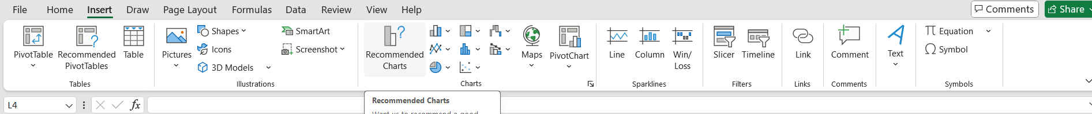
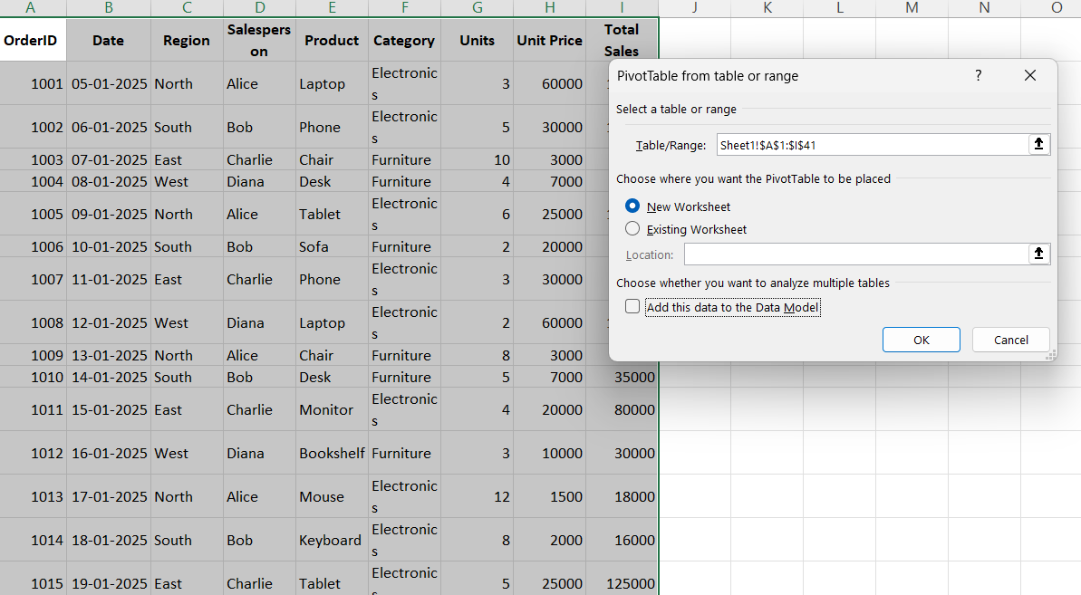
Creating a pivot table
Steps to create a Pivot Table in excel:
Select your dataset .
Go to Insert→ Pivot Table
Choose a data range
Drag fields to Rows ,Columns ,Values , and ,Filters

Slide 5
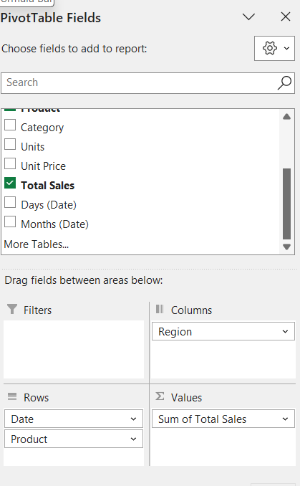
Customizing a pivot table
Pivot Table field list: this dialogue box appears
after a pivot table has been created.
Any time this is open, you are able
to edit a Pivot Table.
It is used to add and remove items from the
Pivot Table and contains afields for each of the
columns in your list.

Slide 6
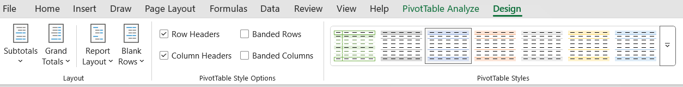
Customizing a pivot Table
Layout: edits the layout and display of the Pivot Table
Pivot Table Style: provide a list of present style to
choose from.
Pivot Table Style option: adds colunma/rows headers
And bands colunma/rows.

Slide 7
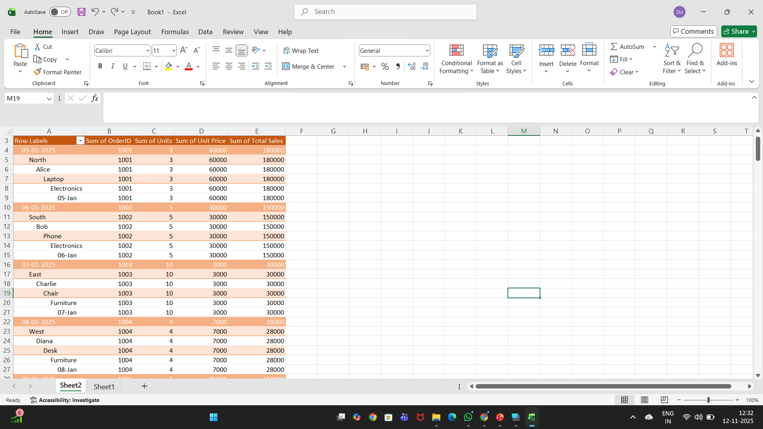
Sum calculatuion

Slide 8
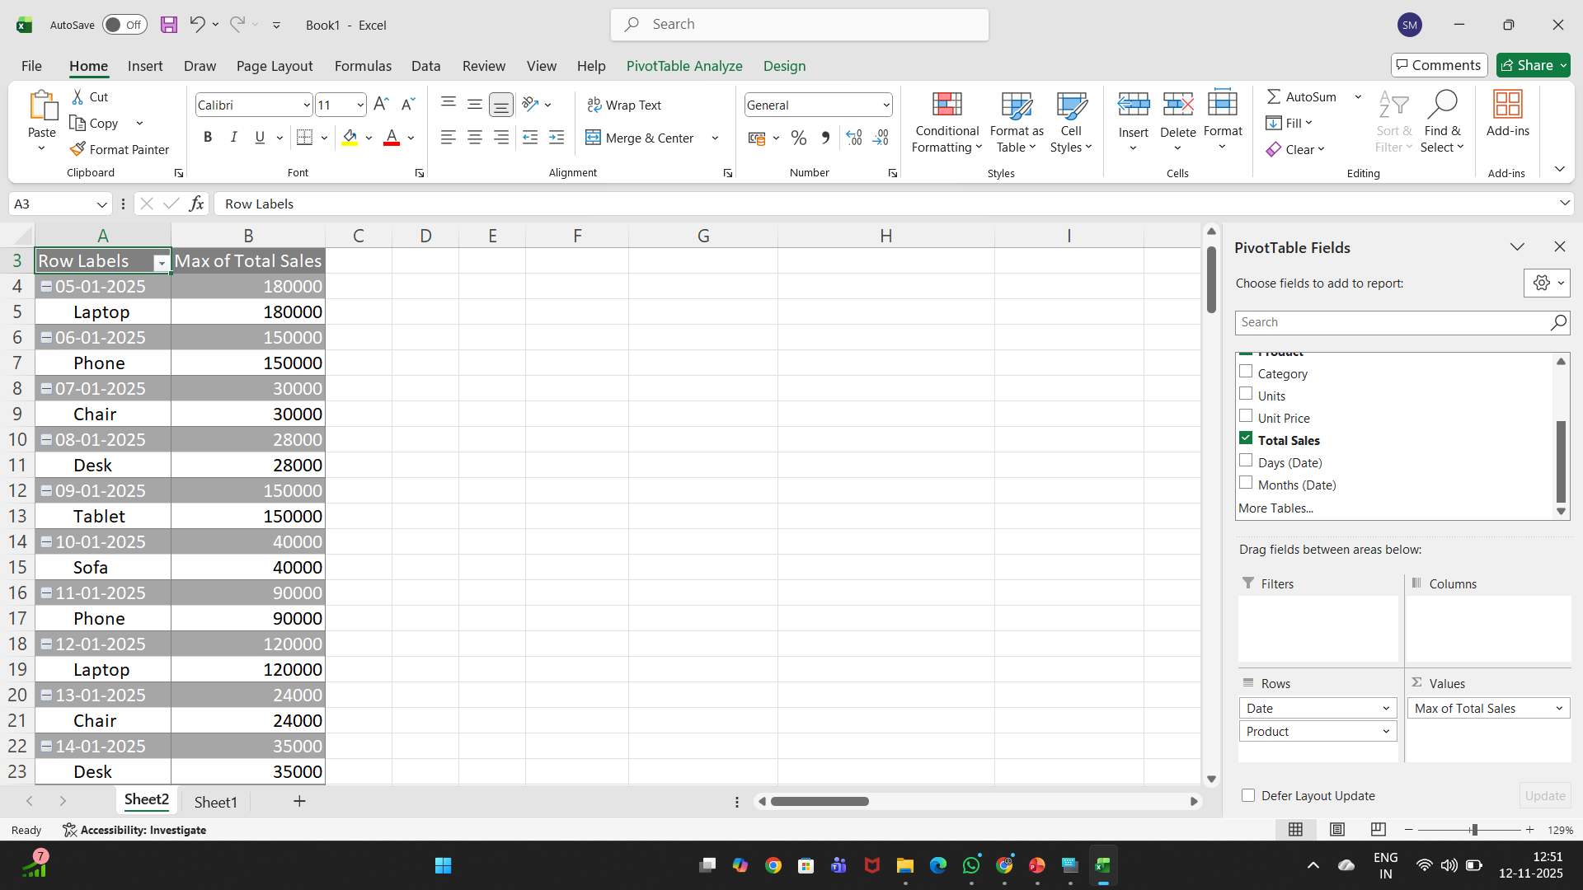
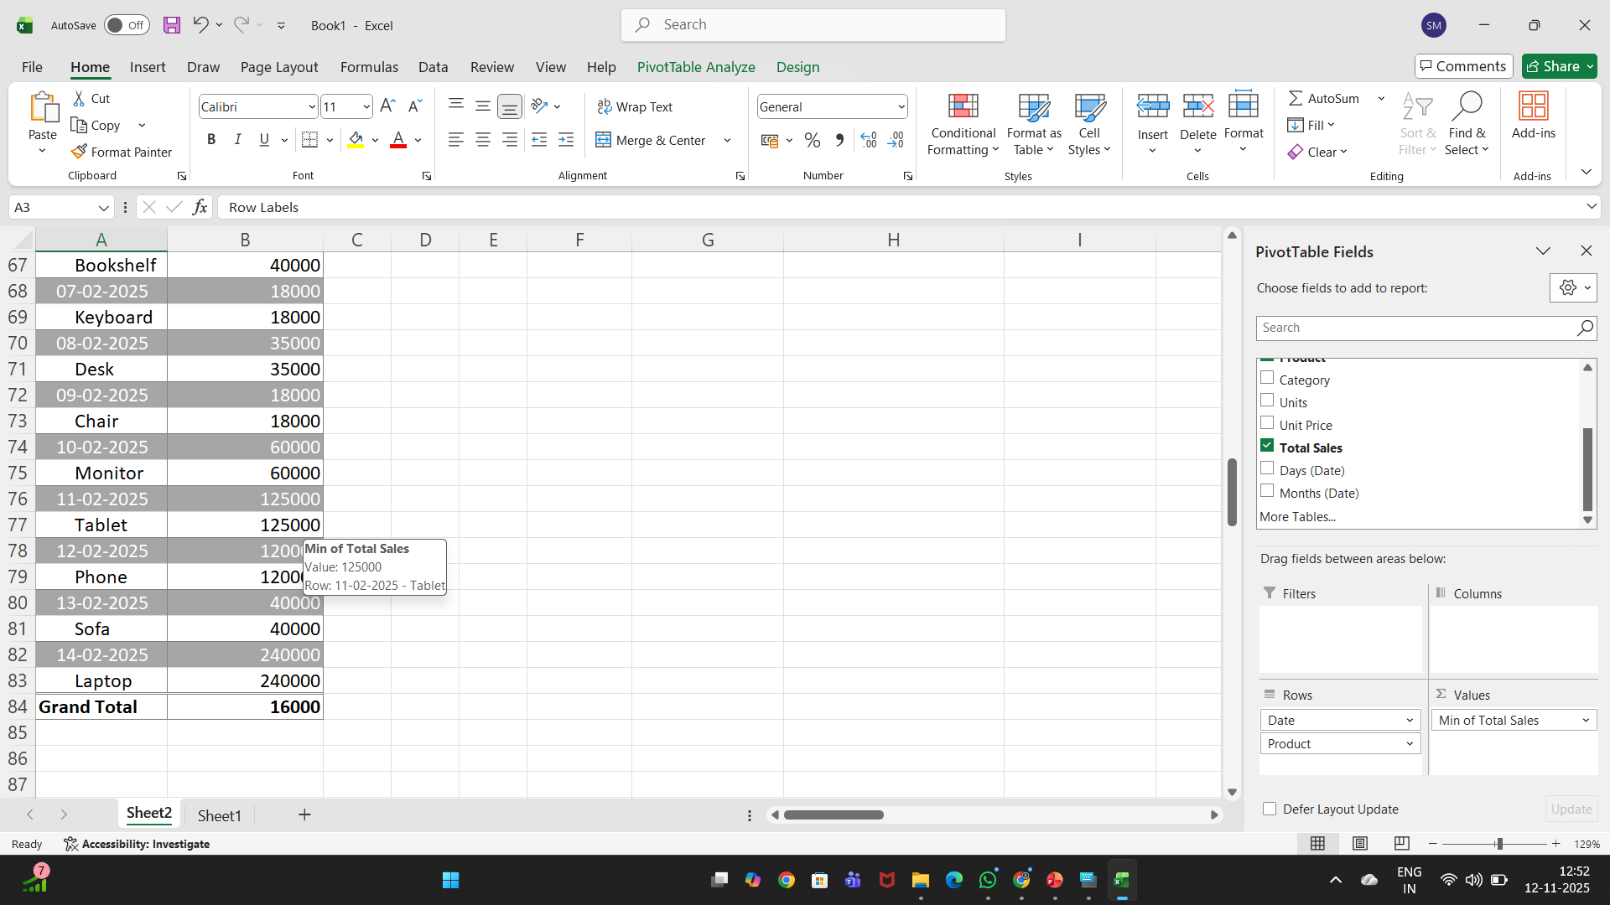
Min calculation

Slide 9
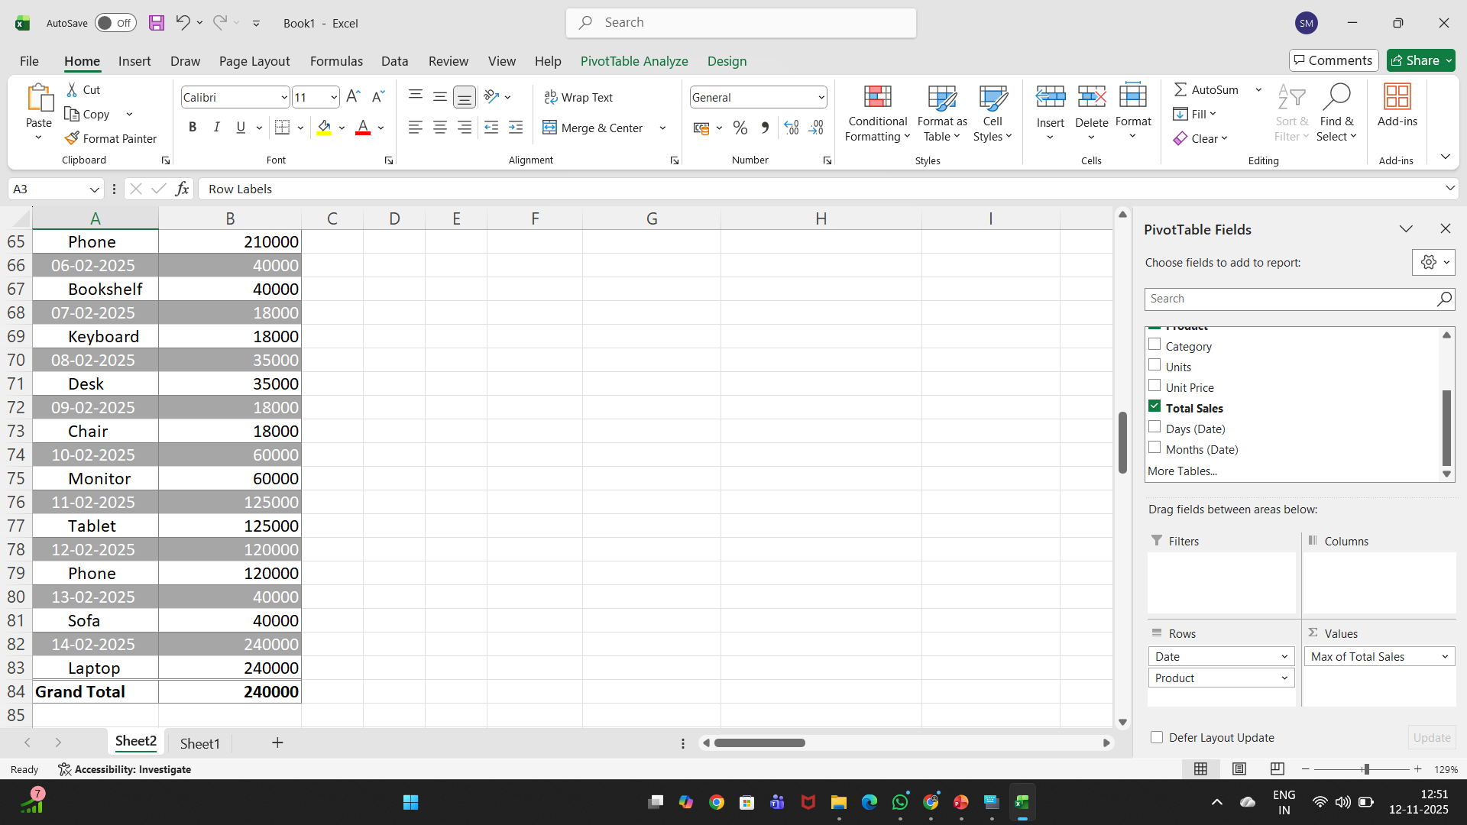
Max calculation

Slide 10
What is pivot chart?
A PivotChart is a visual representation of a PivotTable in Excel (or similar tools like Power BI, Google Sheets, or Pandas).
It’s a dynamic chart that automatically updates when you filter, group, or rearrange data in the PivotTable — helping you quickly visualize trends, comparisons, and summaries.

Slide 11
Creating pivot chart
Steps to Create a Pivot Chart :
Select your dataset → (A1:I41)
Go to Insert → PivotTable → choose New Worksheet → OK
In PivotTable Fields:
  Rows → Region
  Columns → Category
  Values → Sum of Total Sales
Click inside PivotTable → Insert → PivotChart
Choose Column Chart → OK
Add chart title → “Regional Sales by Category”

Slide 12
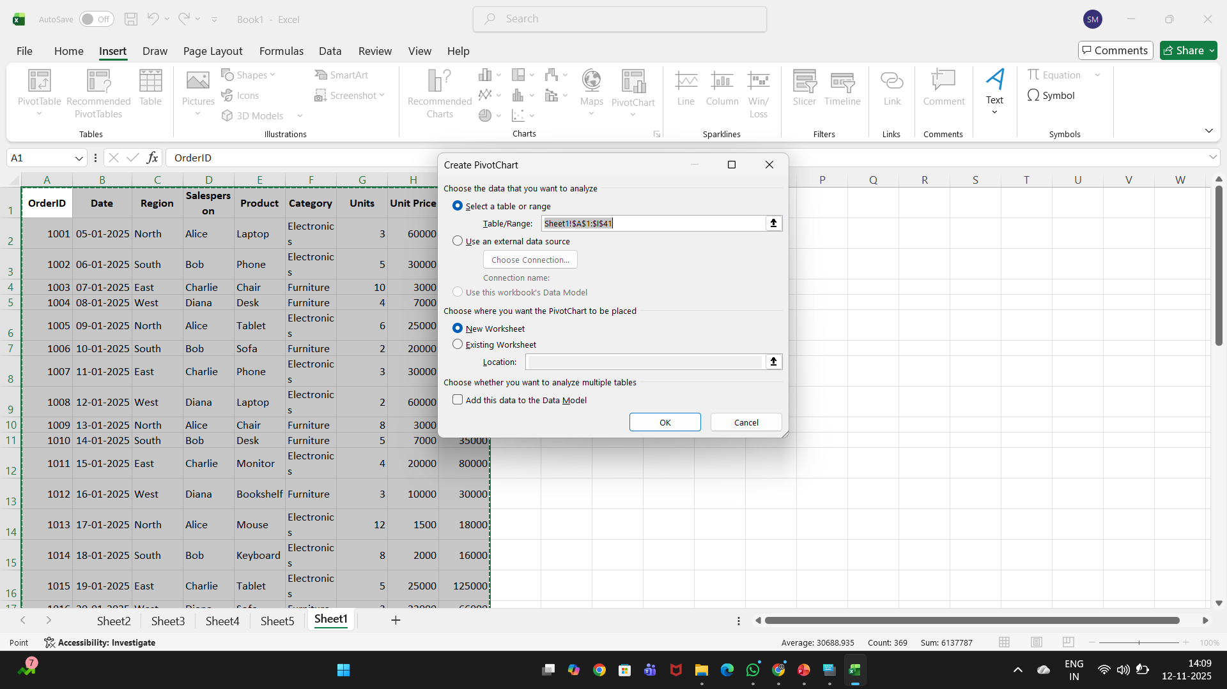
Creating pivot chart

Slide 13
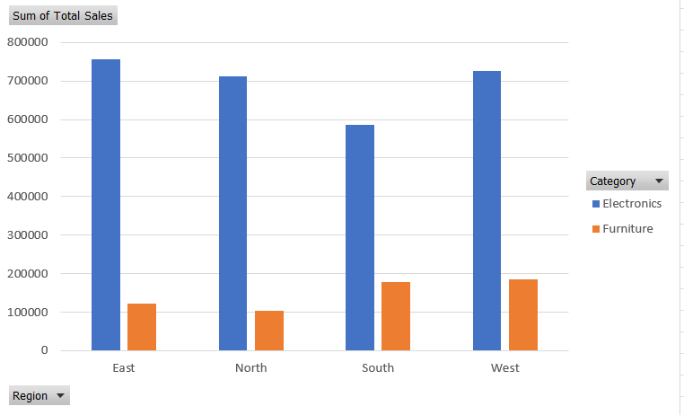
Creating a chart

Slide 14
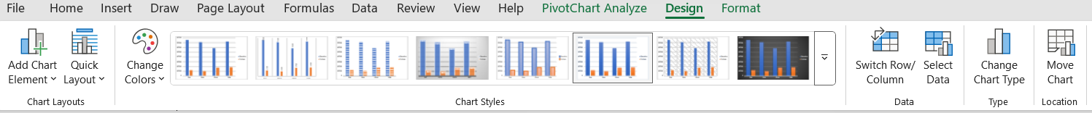
Customizing a chart
Once a chart has been created,a chart tools group asppers on the user interface ribbort.
Note: A chart must selected to use Chart Tools.
This group has three tabs that helps when customizing a chart: Design,Layout and Fromat.

Slide 15

What-If Analysis
in Excel

Slide 16
What is What-If Analysis?
It’s a powerful way to test different options in your Excel model before you make a real-world business decision.

Slide 17




Predicting Different Outcomes
Test Your Ideas Safely
What-If Analysis lets you explore multiple futures. You simply change one or more input values to see how the final result of your calculations changes.
Instead of just guessing what will happen, you use data to plan for the best-case, worst-case, and most-likely scenarios.
Best Case
Worst Case
Visualizing multiple paths before committing.
Example: What if we sell 10% more? What if costs increase by 5%?

Slide 18





How to Use What-If Analysis
Where to Find It
The What-If Analysis tools are all located in one convenient place on the Excel ribbon.
Step 1: Click on the Data tab.
Step 2: Look for the Forecast group.
Step 3: Click the "What-If Analysis" button.
Step 4: A dropdown menu will appear showing Scenario Manager..., Goal Seek..., and Data Table...

Slide 19






The Three Main Tools We Use
Scenario Manager
Goal Seek
Data Tables
Testing and comparing several different full plans (groups of inputs) at the same time.
Working backward to find the single input value you need to achieve a specific target result.
A quick way to see how one or two changing inputs affect all your results in one clean table.

Slide 20

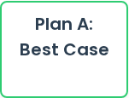
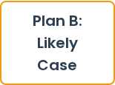
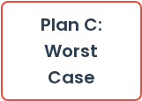

Tool 1: Scenario Manager
What It Is (The Meaning)
This tool is for comparing multiple different "what-if" situations at once.
Compare Full Plans
You save groups of different inputs as "Scenarios" (like a 'Best Case' plan or a 'Worst Case' plan).
Excel then creates a single summary report comparing all your plans side-by-side so you can see the final profit for each.

Slide 21

Scenario Manager: Example
You ask Excel to compare two scenarios: one with high sales (80%) and low costs ($10), and one with low sales (50%) and high costs ($15).
Result: Scenario Summary Report
Scenario | Best Case | Worst Case
% Sold High | 80% | 50%
Cost per Unit | $10 | $15
Total Profit | $4,800 | $1,750

Slide 22



Tool 2: Goal Seek
What It Is (The Meaning)
This tool works backward to find a specific number.
You know the result you want to get (your 'goal'), but you don't know the input needed to get it.
Goal Seek Calculates...
You ask Excel to find the single input value you need to change to achieve that exact goal.

Slide 23
Goal Seek: Example
Your question is: "We must make a total profit of $4,200. How many high-price books do we need to sell to hit this exact number?"
Goal Seek Setup:
Set cell (The Result): $D$10 (Total Profit)
To value (The Goal): 4200
By changing cell (The Input): $C$4 (% Sold High)
Result:
Excel finds the answer: You must sell 90% of books at the high price.

Slide 24



Tool 3: Data Tables
What It Is (The Meaning)
This is the fastest way to see how changing one or two variables affects a result. It's like a mini-experiment.
You give Excel a list of different input values you want to test (like 10 different prices).
Data Table Runs Calculations...
Excel creates a simple table showing all the possible outcomes automatically.

Slide 25

Data Tables: Example
Your question is: "How does our *total profit* change if we vary just the **% Sold at High Price** from 60% to 100%?"
Result: One-Variable Data Table
% Sold High | Total Profit
60% | $3,800
70% | $4,100
80% | $4,400
90% | $4,700
100% | $5,000

Slide 26
Summary: When to Use Which Tool
Use Scenario Manager... When you want to compare several complete plans (e.g., Best Case vs. Worst Case) that involve changing multiple inputs at once.
Use Goal Seek... When you know the final answer you need (like "$4,200 profit") and want to find the single input required to get it.
Use Data Tables... When you want to quickly see a range of results by changing just one or two variables (like testing 10 different prices).

Slide 27
Thank You !!

