Slide 1
Introduction to
PIVOT TABLE AND PIVOIT CHART

Slide 2
What is pivot table ?
A Pivot Table is data summarization tool in excel used to :
Summarize large datasets.
Analyze patterns and trends.
Rearrange (pivot) data dynamically.

Slide 3
Why use a pivot table ?
We use a Pivot Table because it helps to :
Quick data summarization.
Easy comparison of data.
Saves time no formulas needed.
Interactive and flexible.
Great for reports and dashbords.

Slide 4
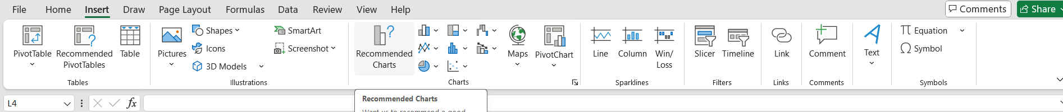
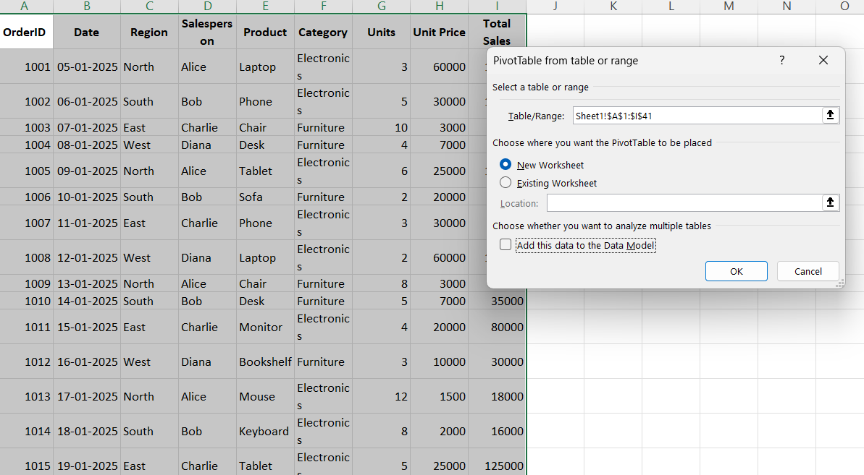
Creating a pivot table
Steps to create a Pivot Table in excel:
Select your dataset .
Go to Insert→ Pivot Table
Choose a data range
Drag fields to Rows ,Columns ,Values , and ,Filters

Slide 5
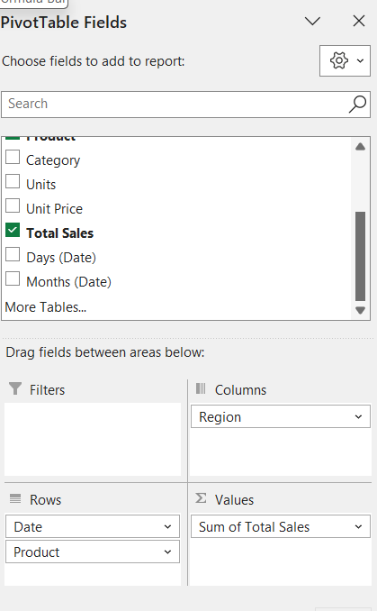
Customizing a pivot table
Pivot Table field list: this dialogue box appears
after a pivot table has been created.
Any time this is open, you are able
to edit a Pivot Table.
It is used to add and remove items from the
Pivot Table and contains afields for each of the
columns in your list.

Slide 6
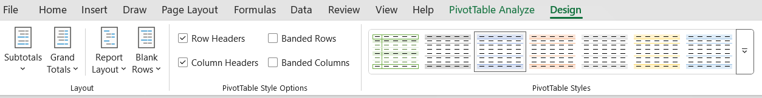
Customizing a pivot Table
Layout: edits the layout and display of the Pivot Table
Pivot Table Style: provide a list of present style to
choose from.
Pivot Table Style option: adds colunma/rows headers
And bands colunma/rows.

Slide 7
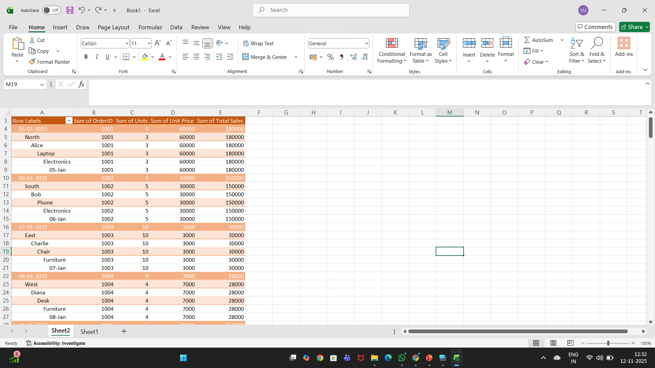
Sum calculatuion

Slide 8
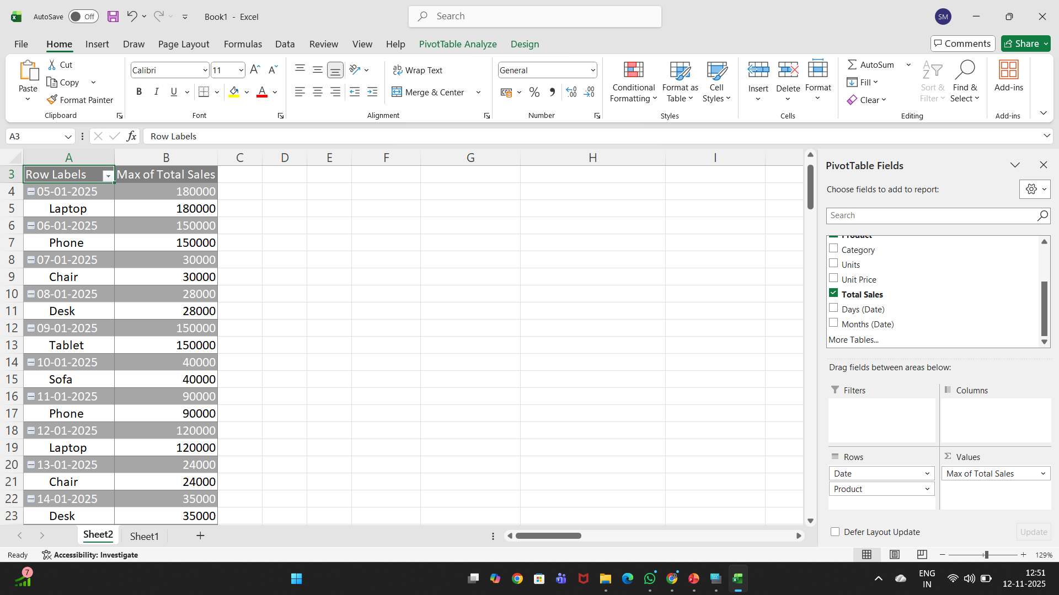
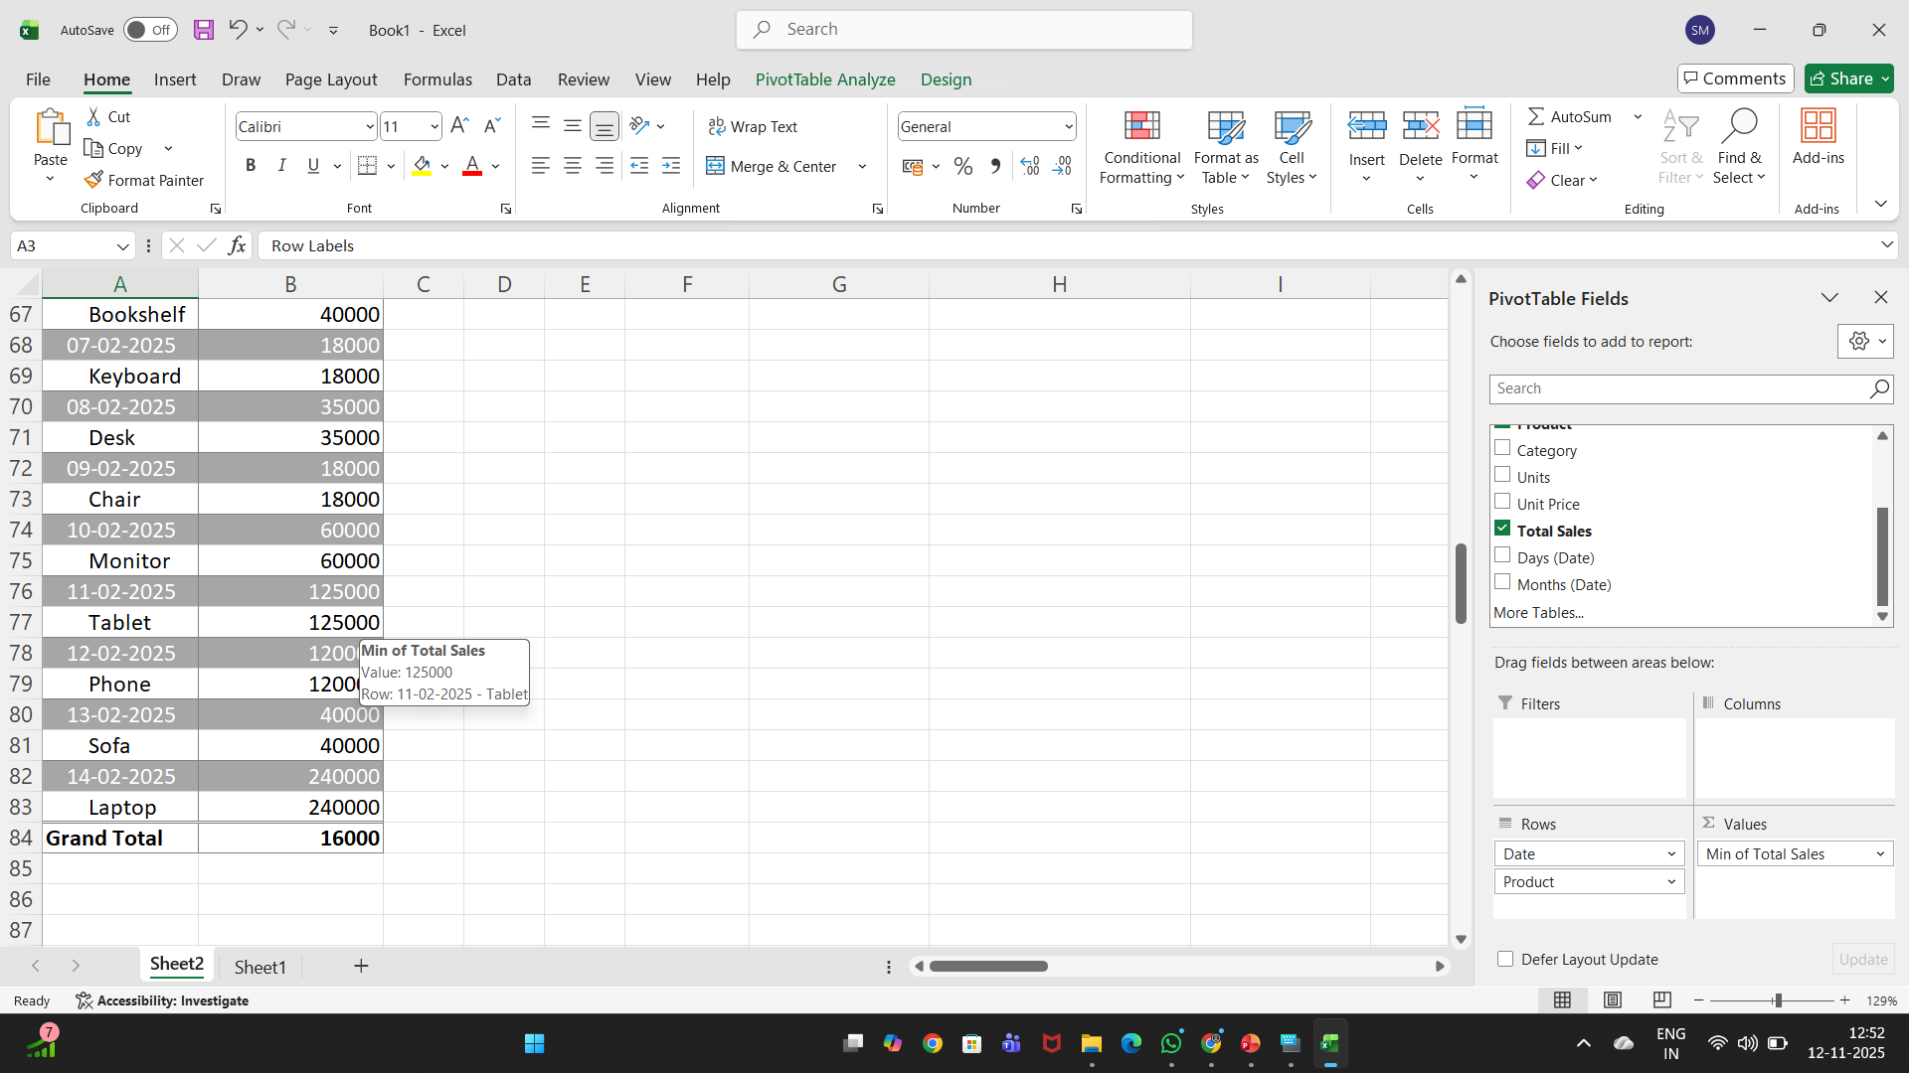
Min calculation

Slide 9
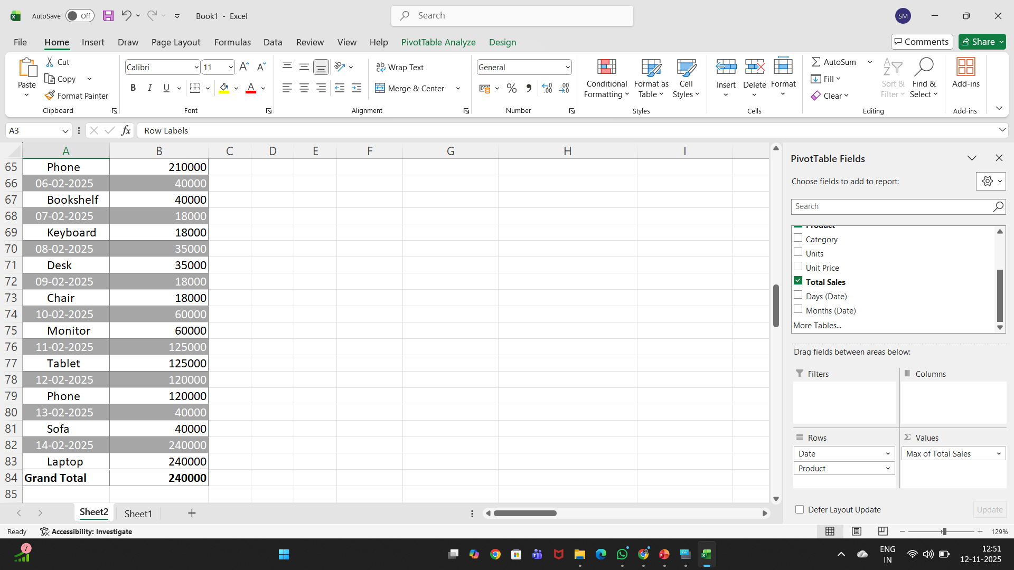
Max calculation

Slide 10
What is pivot chart?
A PivotChart is a visual representation of a PivotTable in Excel (or similar tools like Power BI, Google Sheets, or Pandas).
It’s a dynamic chart that automatically updates when you filter, group, or rearrange data in the PivotTable — helping you quickly visualize trends, comparisons, and summaries.

Slide 11
Creating pivot chart
Steps to Create a Pivot Chart :
Select your dataset → (A1:I41)
Go to Insert → PivotTable → choose New Worksheet → OK
In PivotTable Fields:
  Rows → Region
  Columns → Category
  Values → Sum of Total Sales
Click inside PivotTable → Insert → PivotChart
Choose Column Chart → OK
Add chart title → “Regional Sales by Category”

Slide 12
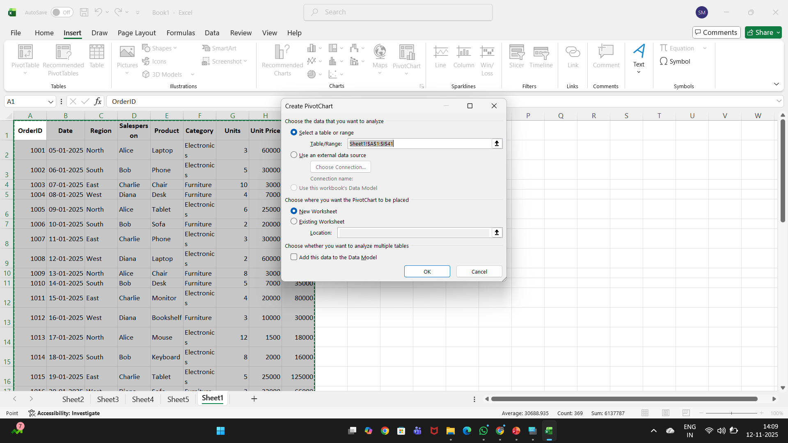
Creating pivot chart

Slide 13
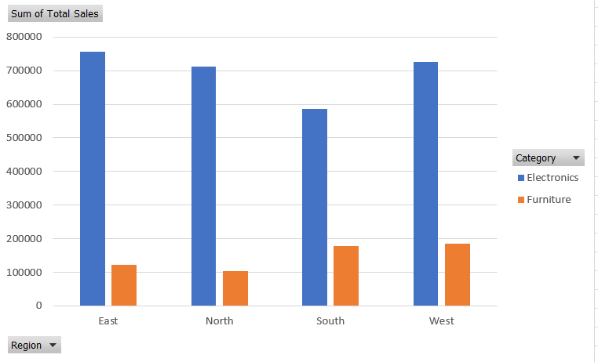
Creating a chart

Slide 14
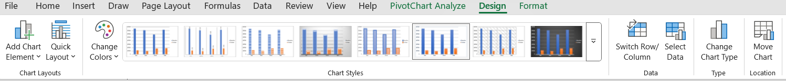
Customizing a chart
Once a chart has been created,a chart tools group asppers on the user interface ribbort.
Note: A chart must selected to use Chart Tools.
This group has three tabs that helps when customizing a chart: Design,Layout and Fromat.

