Slide 1
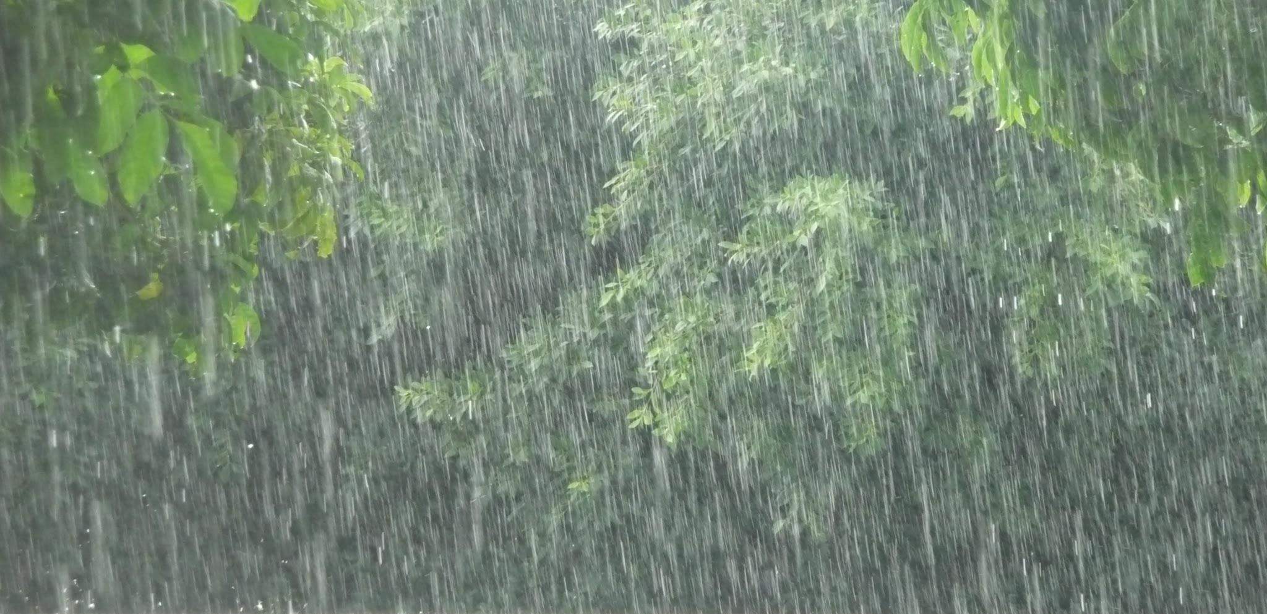
Rainfall Pattern Analysis and Prediction
(TEAM ID - 09)
VEDANT GOYAL - 2017A7PS0187H
VAIBHAV YADAV - 2017A7PS0107H
DHRUV SHAH - 2017A7PS0138H
ASHISH GUPTA - 2017A7PS0056H

Slide 2
TEAMWORK DIVISION
VEDANT GOYAL & DHRUV SHAH
Data Cleaning
Filling Missing Values by Subdivision Means
Data Preprocessing
Standardization
Aggregation (by decades)
Discretization with equal frequency
Region wise Preprocessing
Data Visualization before Processing -
Box Plot
Line Plot
Pie Chart
Bar Graph

Slide 3
VEDANT GOYAL & DHRUV SHAH
Data Processing -
Next Year Rainfall Prediction using Linear Regression
Predicting Fluctuations in rainfall over the last 100 years.
Implemented DBSCAN (Density Based Clustering) to find Flood and Drought Prone Areas.
Monsoon Season Prediction
Crop Shortage Prediction
Data Visualization after Processing -
Clustering Bar Plot (Flood, Drought Areas)
Predicted Rainfall Line Plot
Fluctuations Plot
Report Preparation

Slide 4
Vaibhav Yadav & Ashish Gupta
Data Preprocessing :
Filling missing value with median
Stratified Sampling with replacement
Min-Max normalization
State wise aggregation of dataset
Noise Reduction
Discretization with equal interval
Data Visualization for exploratory data analysis:
Cartographic projection of rainfall distribution.
Line Chart
Histogram and Bar Graph

Slide 5
Vaibhav Yadav & Ashish Gupta
Data Processing :
Temporal Clustering using k-means
Outlier analysis based on temporal-distance
Spatio-temporal Clustering
Outlier analysis based on spatio-temporal distance
Finding correlation between all states.
Discretization with equal interval
Data Visualization on processed data:
GIF showing change in rainfall over 100 years
Cartographic projection of temporal clustering on map of India
Cartographic projection of spatio-temporal clustering on map of India
Report Preparation

Slide 6
Project and Data Description
PROJECT DESCRIPTION -
The project aims to explore the data related to the rainfall pattern of India and predicts the rate of rainfall for the upcoming years based on the same. It also attempts to get more insights into the correlation between regional distribution of rainfall which can further provide assistance in policy-making, resource allocation, and a plethora of other useful activities.
DATA DESCRIPTION -
The data consists of the rainfall pattern from 1901 to 2017 for the Indian subcontinent as well as its individual regions. Rainfall data is available in monthly as well as quarterly manner (unit is mm). There are approximately 17 columns and 4190 rows in the Indian Subcontinent dataset.
DATA DESCRIPTION -

Slide 7
Reasons for Choosing The Techniques Used
Normalization(min-max and standardization) were used which would help us in clustering and for the prediction of rainfall and compare the results for the two methods of normalization
Discretization(Data binning wrt frequency,Data binning wrt interval) was used in which data was divided into 3 categories(low,medium,high) so as to get insights about the rainfall of different states during visualization
State-wise aggregation was done so as to compare rainfall of different states via visualization
Decade-wise aggregation was done so as to compare rainfall in different decades via visualization

Slide 8
Clustering Analysis
Temporal clustering
Clustering is used to identify and put clusters into bins based on their similarity.
K-means clustering technique is used with distance metric as Euclidean distance between rainfall pattern of two regions. Each region is treated as n-tuple, where n is number of years of data available. Each element in n-tuple is the annual rainfall.
Outlier analysis is done based on the clusters produced by k-means. For each region, the element that is farthest from the mean of cluster is classified as an outlier.

Slide 9
Clustering Analysis
Spatio-Temporal clustering
Spatio-temporal clustering is used to identify regions in close proximity having similar rainfall pattern.
Measure of similarity is calculated as sum of temporal distance between two regions as described in previous slide along with spatial distance between mid-points of two states. Temporal and spatial distance have equal weightage.
Outlier analysis is done similarly and all the regions in each cluster farthest from their mean are classified as outliers.

Slide 10
Next Year Rainfall Prediction
Predicted Rainfall for the year 2018 using Linear Regression on the past 100 years data.
Found and plotted Fluctuations in areas for all states over the past years by observing the standard deviation of rainfall in all those years.
Used DBSCAN clustering method to find the Drought and Flood Prone Regions as those can be recognized as outliers.

Slide 11
Monsoon Season Rainfall Prediction
Monsoon Season Prediction is also done by applying Linear Regression on the past dataset.
Fluctuation in monsoon was also observed and plotted. Also the Drought and Flood Prone Areas were identified.
Crop Shortages were predicted in those areas which were observed as outliers from the clustering method.(i.e., including both flood and drought prone areas)

