Slide 1
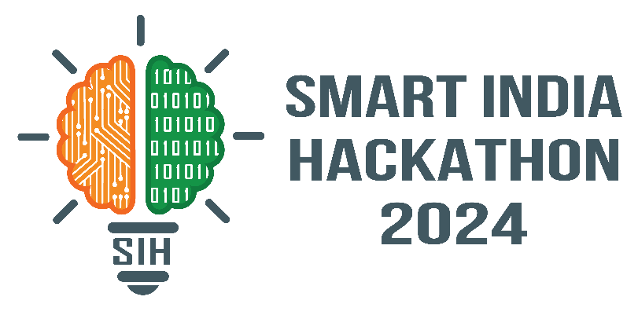
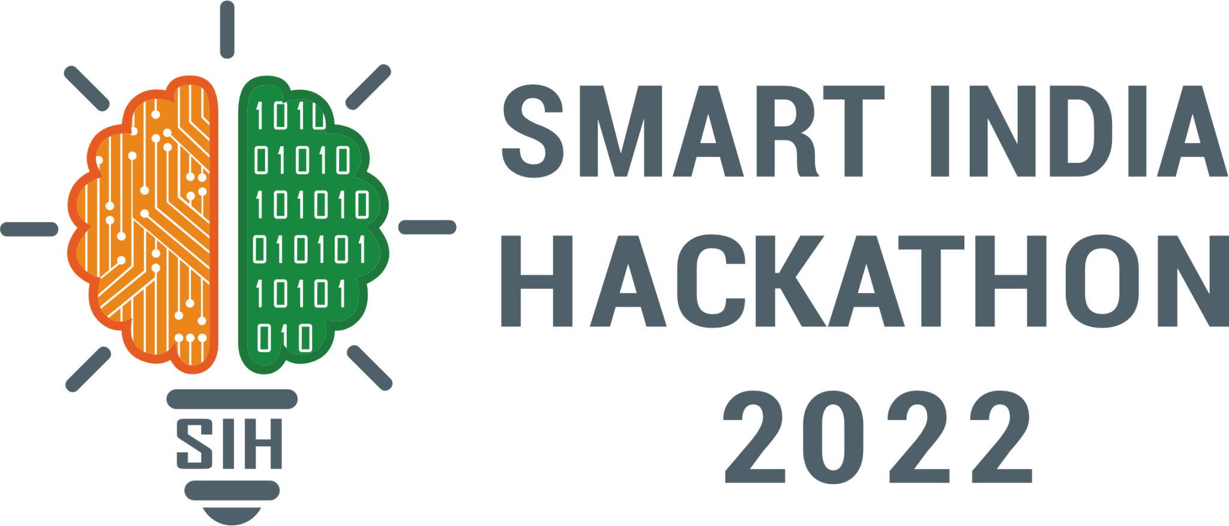
SMART INDIA HACKATHON 2024
Problem Statement ID – PS24
Problem Statement Title- Comprehensive Cloud-Based Practice Management & Nutrient Analysis Software for Ayurvedic Dietitians, Tailored for Ayurveda- Focused Diet Plans
PS Category- Software
Team ID –
Team Name – HerbByte

Slide 2
“Bridging Ayurveda and Modern Nutrition through Cloud Technology.”
TEAM
HerbByte
Solution : Cloud platform for Ayurvedic dietitians to manage patients, create personalized diet charts, and track progress. Integrates modern nutrition science (macro/micronutrients) with Ayurvedic principles (doshas, gunas, prakriti, seasonal diets). Provides web & mobile portals for doctors, dietitians, and patients.
Unique Value Propositions(UVP): Dual approach: Combines evidence-based nutrient analysis with Ayurvedic diet wisdom. Explainable diet charts: Each recommendation backed by both nutrient values & Ayurvedic reasoning. Localized & seasonal substitutions: Suggests alternatives based on local foods and availability. Multilingual & voice-based inputs: Patient-friendly, especially in rural areas. Future-ready with AI/ML: Personalized diet adjustments & digitization of handwritten charts.
Problem Resolution : Eliminates paper-based records → structured digital EMRs. Generates tailored diet plans aligned with Ayurveda + nutrient requirements. Tracks patient outcomes with analytics dashboards for better decisions. Improves accessibility with cloud storage, secure sharing, and multi-device access.

Slide 3
TECHNICAL APPROACH
TEAM
HerbByte
Frontend: React (Web) for practitioners React Native (Mobile App / PWA) for patients Backend: Node.js + Express (REST APIs & business logic) Deployed on AWS ECS (Fargate) for serverless container management Database: Amazon RDS (PostgreSQL) → Patient records, food database, diet history Cloud Infrastructure: AWS S3 → Secure storage for reports, diet charts, scanned records AWS ECS → Backend services AWS SageMaker (Future) → ML-driven personalized recommendations Nutrient & Ayurveda Engine: Rule-based mapping (nutrients + Ayurvedic parameters) AI/ML upgrade planned for intelligent auto-suggestions
Flowchart

Slide 4
FEASIBILITY AND VIABILITY
TEAM
HerbByte
Feasibility of the Idea : Technical Feasibility: Can be built using AWS cloud services (ECS, RDS, S3, API Gateway, Cognito) with React and Node.js. Operational Feasibility: Cloud-native design allows 24/7 availability, centralized patient records, and seamless multi-clinic adoption. Market Feasibility: Growing demand for digitized healthcare solutions and standardized Ayurvedic diet practices in India and abroad.
Potential Challenges and Risks : Data Collection: Difficulty in standardizing Ayurvedic food–dosha mappings. Data Privacy: Sensitive health data requires strict compliance with privacy laws. Connectivity Issues: Limited internet in rural areas may affect patient access.
Strategies for Overcoming These Challenges : Data Collection: Collaborate with Ayurvedic experts to validate food–dosha datasets. Data Privacy: Use AWS Cognito, IAM roles, and encryption to secure all health data. Connectivity Issues: Develop a PWA with offline caching so patients can access diet plans without continuous internet.
Business Model : Subscription-Based Model: Clinics pay tiered pricing based on number of patients and features used. Government & Institutional Partnerships: Collaborate with AYUSH, Ayurvedic colleges, and hospitals for large-scale adoption. Freemium Model:Basic patient-facing features free; premium analytics, AI-driven personalization, and advanced dashboards available as paid add-ons

Slide 5
IMPACT AND BENEFITS
TEAM
HerbByte
Impact on the Target Audience : For Dietitians & Doctors: Saves time by automating diet chart generation (from ~20 mins manual → ~5 mins digital).Provides standardized, explainable charts that combine Ayurveda with modern nutrition. For Patients:Get personalized diets that match health conditions, lifestyle, and dosha type.Track progress easily with mobile app & reminders, improving compliance. For Hospitals & Clinics:Centralized cloud records improve efficiency and reduce errors.Enables multi-clinic collaboration, useful for chains of Ayurveda centers. For Government & Institutions:Helps digitize Ayurveda practices and promote evidence-based healthcare.Provides anonymized data for research and policy-making in nutrition & public health. Helps digitize Ayurveda practices and promote evidence-based healthcare.Provides anonymized data for research and policy-making in nutrition & public health.
Benefits of the Solution : Healthcare Benefits: Reduces manual errors in diet planning by combining nutrient analysis + Ayurvedic rules. Improves treatment outcomes with continuous tracking of patient progress. Economic Benefits: Saves staff time and paperwork, cutting down clinic costs. Creates scope for subscription-based services, supporting startups and hospitals financially. Social Benefits: Provides multilingual and voice-based support, helping elderly and less tech-savvy patients. Makes Ayurvedic diet care more accessible in rural and urban areas through mobile and web.

Slide 6
RESEARCH AND REFERENCES
TEAM
HerbByte
Ayurveda & Nutrition References: Ministry of AYUSH, Government of India – Guidelines on Diet and Lifestyle. ICMR-NIN Food Composition Tables – Nutrient values for Indian foods. Charaka Samhita & Ashtanga Hridaya (Classical Ayurveda texts for dosha–diet mapping). Technology References: AWS Documentation: ECS, RDS, S3, API Gateway, Cognito, QuickSight. Firebase & React Documentation for frontend and PWA development. Research papers on AI in personalized nutrition and digital healthcare adoption in India. Supporting Work: Existing Ayurvedic apps (TridoshaLiving, Ayuvi, Diet Insight) analyzed for gaps. Case studies on digital EMR adoption in Indian healthcare. Hackathon reports showing success of cloud-first healthcare prototypes.

