Slide 1
Pune Vidyarthi griha’s college of Engineering
Topic: Remote monitoring weather system
Team Members
Ishita Kadam | 2077
Vedant Banaitkar | 3101
Pradnya gore Krishna Shah | 3102 2086

Slide 2
Need of Remote Weather Monitoring System:
Develop a user-friendly Weather Monitoring App for personalized weather forecasts.
Utilize modern web development techniques and reputable weather APIs.
Deliver accurate and up-to-date weather information to users.
Enhance users' ability to make informed decisions and stay prepared for changing weather conditions.
Gain practical experience in web development.
Contribute to meeting the growing demand for accessible weather monitoring solutions.

Slide 3
Introduction:
Weather impacts our daily lives, influencing activities, travel plans, and safety. Access to accurate weather information is crucial for informed decision-making. The Weather Monitoring App addresses this need by offering personalized weather forecasts in a user-friendly web-based platform. Leveraging reputable weather APIs, the app delivers reliable forecasts with a focus on user experience and accessibility.

Slide 4
Features
Location-based Weather Forecasts: Provide users with accurate and detailed weather forecasts for any location worldwide.
Location Search Functionality: Implement a user-friendly interface that allows users to easily search for weather information by entering specific locations.
User Account Creation: Enable users to create accounts, allowing them to personalize their weather experience and subscribe to daily updates for their chosen locations.
Daily Weather Updates Subscription: Allow users to subscribe to daily weather updates for their selected locations, ensuring they receive timely and relevant information.
Data Security and Authentication: Implement secure authentication mechanisms to protect user accounts and ensure data privacy.
Responsive Web Design: Develop a responsive and accessible web application that adapts seamlessly to various devices and screen sizes, providing a consistent user experience.

Slide 5
Scope
Development of a web application for weather monitoring.
User-friendly interface design for easy navigation and interaction.
Support for searching weather data by location, including cities or geographical coordinates.
Display of real-time weather conditions, such as temperature, humidity, wind speed, and weather forecast.
Integration with external weather APIs for data retrieval.
Implementation of user authentication and account management features.
Focus on delivering core functionality including weather search and data display.
Testing across various browsers and devices for compatibility.
Potential for future enhancements and additional features based on feedback.

Slide 6
Tools & Technology
Frontend:
HTML5: Used for structuring the content and layout of web pages.
CSS3: Used for styling the visual presentation of web pages.
Bootstrap v6: A front-end framework for building responsive and mobile-first web projects. It provides pre-designed components and styles to streamline development.
Backend:
JavaScript ES13 (Node.js): Used for server-side scripting and building the backend logic of the application.
SQLite: A lightweight, serverless relational database management system (RDBMS) used for storing and managing data in the backend.

Slide 7
Tools
Visual Studio Code (version 1.86):
Visual Studio Code is a lightweight and powerful source code editor developed by Microsoft. Used for writing and editing HTML, CSS, JavaScript code, and other project files.
Web Browsers (ES6 compatible):
Web browsers such as Google Chrome, Mozilla Firefox, and Microsoft Edge are essential tools for testing and previewing web pages and applications.
Used to ensure compatibility and responsiveness across different browsers and devices.
Version Control and Project Management:
Git is a distributed version control system for tracking changes in project files and coordinating collaboration among team members.
Jira (version 7.3.9) is a project management software developed by Atlassian, designed to help teams plan, track, and manage their work efficiently.
https://ishitakadam96.atlassian.net/secure/WelcomeToSD.jspa?decorator=jsd-onboarding

Slide 8
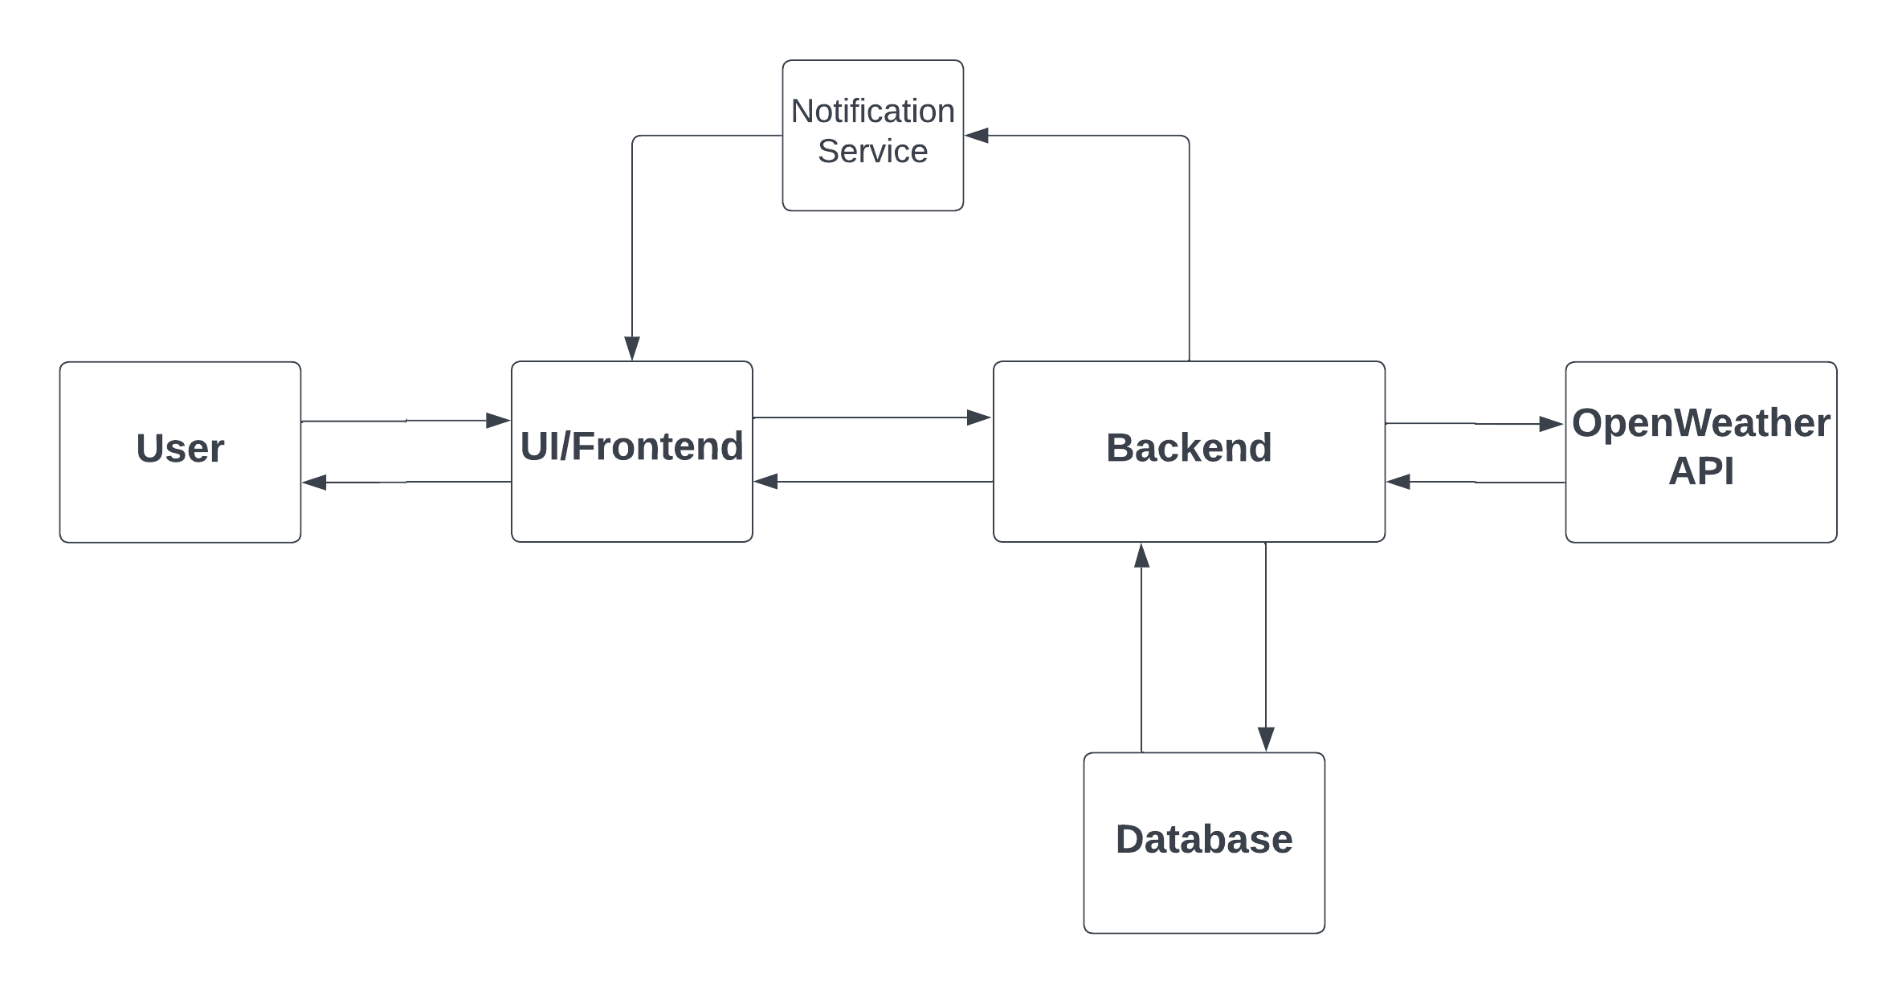
Block Diagram

Slide 9
Flow Diagram

Slide 10
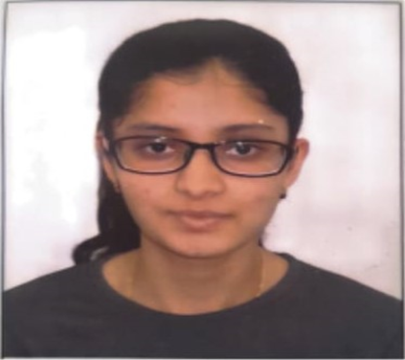
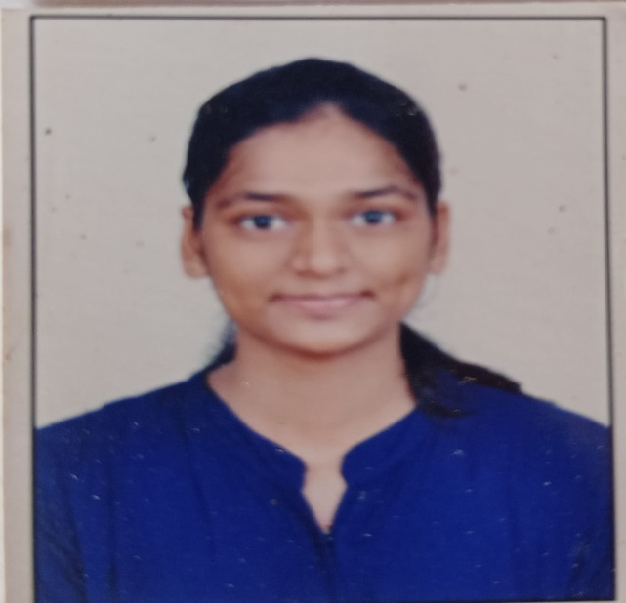
Team
Ishita Kadam
Pradnya Gore
2077
3102
Skills:
Python
C++
HTML
CSS
Javascript
Skills:
Python
C++
Java
Communication
Major Role: User Interface Designing
Minor Role: FRS
Major Role: Frontend Development
Minor Role: PPT

Slide 11


Team
Krishna
Shah
Vedant Banaitkar
2086
3101
Skills:
Python
C++
Javascript
Skills:
C/C++
Java
Python
HTML & CSS
Javascript
Major Role: Backend Development
Minor Role: FRS
Major Role: Backend Development & Database
Minor Role: Documentation

Slide 12
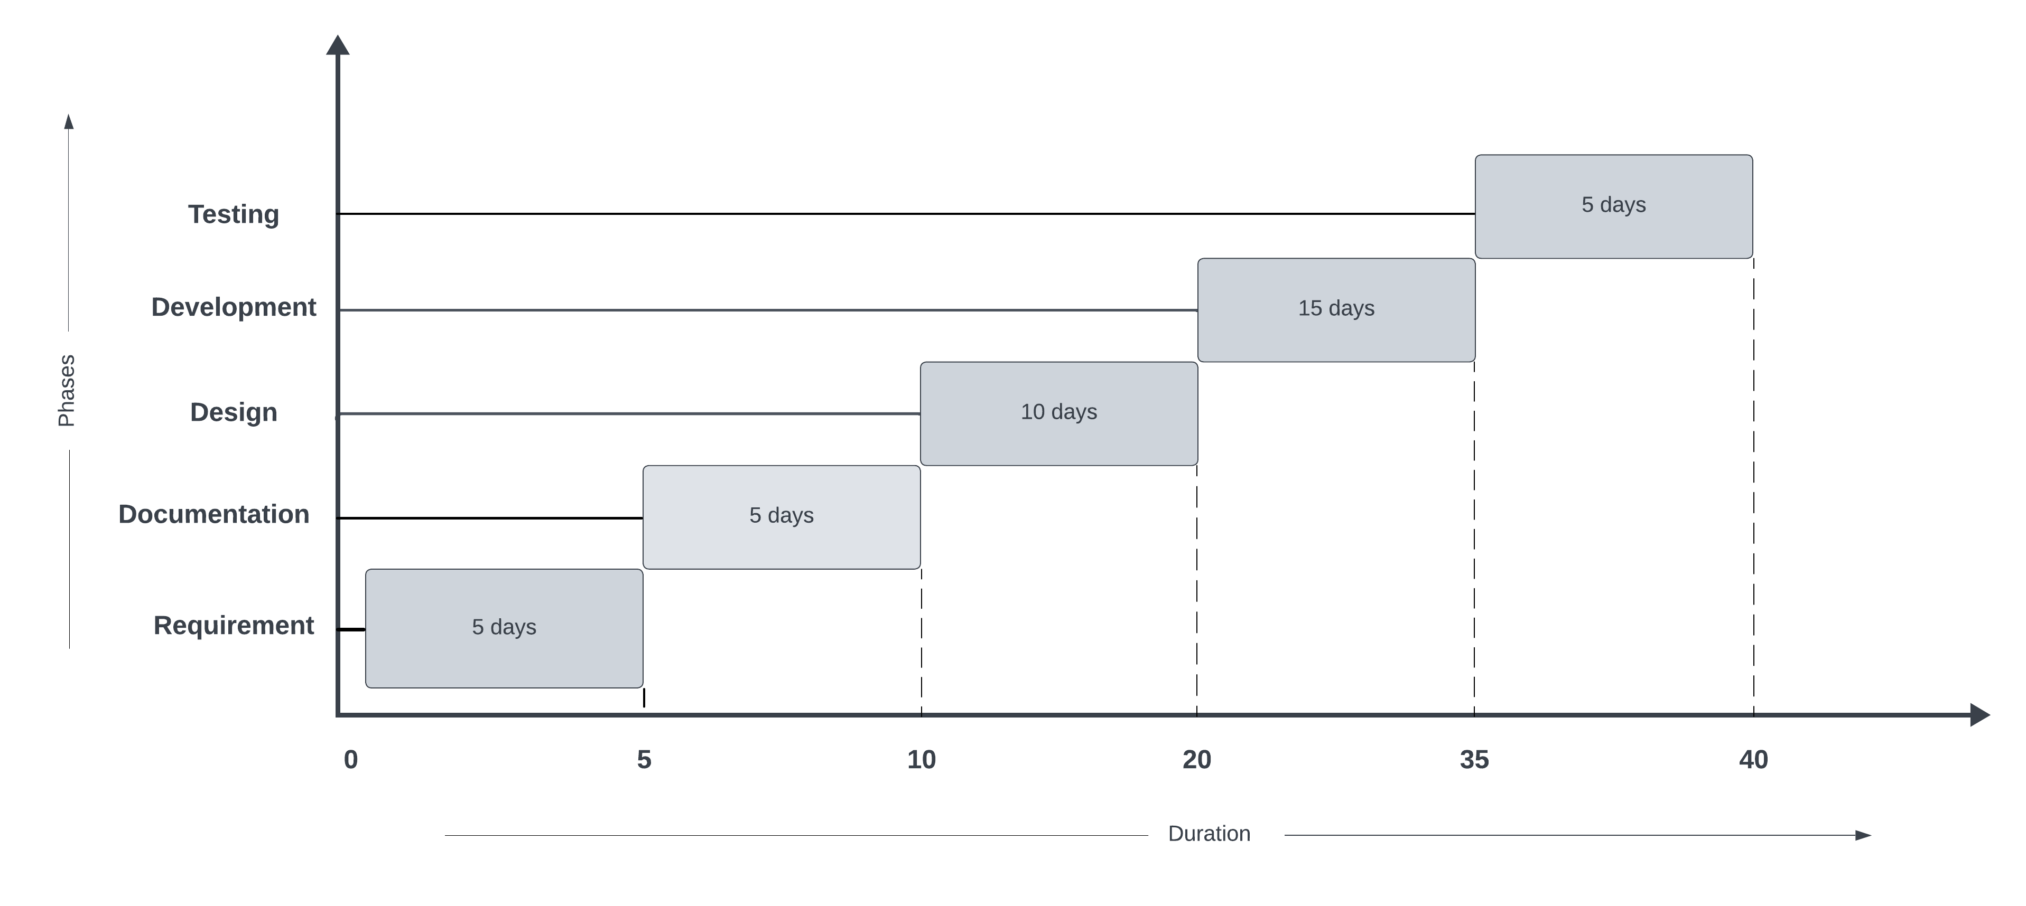
Timeline
Total Duration – 40 days

Slide 13
Further enhancement
Geolocation-based Weather Alerts:
Implement personalized weather alerts based on users' current location.
Interactive Weather Maps:
Integrate interactive maps for visualizing weather conditions with zoom and pan features.
Localized Weather Forecasts:
Provide tailored weather forecasts for specific regions, cities, or neighborhoods.
Multi-platform Support:
Develop versions of the app for various platforms, including iOS, Android, desktop, and wearables.

Slide 14
References:
https://developer.mozilla.org/en-US/docs/Web/HTML
https://getbootstrap.com/docs
https://nodejs.org/en/docs/
https://www.sqlite.org/docs.html
https://www.w3schools.com/html/
https://www.tutorialspoint.com/nodejs/index.htm
https://www.sqlitetutorial.net/

