Slide 1
BadUSB Domain : ES
Vedant Barve
Tanay Manerikar

Slide 2



What is an HID?
Human Interface Devices (HID) is a device class definition to replace PS/2-style connectors with a generic USB driver to support HID devices such as keyboards, mice, game controllers, and so on.

Slide 3
Before
After
Available
Memory
Bootloader
MICRONUCLEUS BOOTLOADER
Available
Memory
8KB
Flash
memory

Slide 4


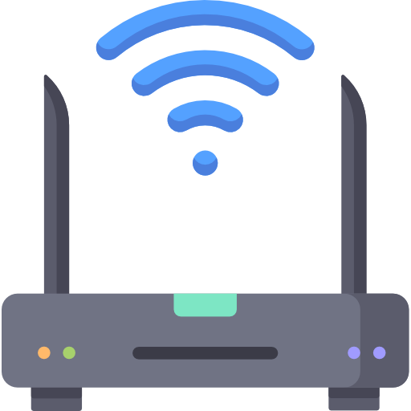
Attacker
Gateway
192.168.29.3
192.168.29.37
Victim
192.168.29.1
192.168.29.32
192.168.29.10
192.168.29.11
192.168.29.78

Slide 5

Victim
Attacker
PORTS
PORTS
GET the client.exe file
55225*
8000
Service : HTTP
client.exe
connect()
accept()
Service : Sockets
14254*
55555
send(),recv()
* This port is randomly selected by the host

Slide 6
Windows as attacker
(Winsock2 API)
PORT = 8000 (HTTP Server)
PORT = 55555(SOCKET Server)
Windows as victim
(Winsock2 API)
PORT = *
Attiny85
Micronucleus bootloader

