Slide 1
SANGYAN HACKATHON • DIGITAL FRAUD & SCAM RESILIENCE
♢
RAKSHAK AI
Detect. Understand. Stay Safe.
AI-powered investor scam & misinformation shield
Turn suspicious financial content into an evidence-first safety report.
TEXT
SCREENSHOT
URL
SANGYAN HACKATHON • RAKSHAK AI
Detect • Understand • Stay Safe

Slide 2
The Problem
02
The scam journey is fast; verification is slow.
01
Digital contact
What scammers exploit
WhatsApp • SMS • Social media • Email
GUARANTEED
“30% monthly”
02
Manipulative claim
Guaranteed returns • urgency • scarcity • fake authority
URGENCY
“Send today”
03
Investor confusion
AUTHORITY
“Officially approved”
“Is this legitimate? How do I verify it?”
SCARCITY
“Only 5 slots”
04
Potential loss
Money • credentials • trust
The gap
Binary warnings tell users WHAT to fear — not WHY.
SANGYAN HACKATHON • RAKSHAK AI
Detect • Understand • Stay Safe

Slide 3
Rakshak AI
03
An evidence-first safety layer between suspicious content and investor action.
1
2
3
4
5
INPUT
DETECT
EVIDENCE
EXPLAIN
ACT
Message • Screenshot • URL
Rules + pattern signals
Exact suspicious phrases
Plain-English reasoning
Safe next steps
Not just a label
Safety by design
Actionable clarity
Shows the exact evidence behind each warning.
No stock tips, buy/sell calls or price predictions.
Turns technical red flags into understandable steps.
CORE VALUE
“Before you invest, understand what you’re seeing.”
SANGYAN HACKATHON • RAKSHAK AI
Detect • Understand • Stay Safe

Slide 4
How It Works
04
A resilient pipeline: deterministic detection first, contextual explanation second.
FRONTEND
API LAYER
ANALYSIS
EXPLAIN
React + TypeScript + Vite
FastAPI / REST
Rules + OCR + URL
AI + demo mode
DETERMINISTIC RISK SCORER
0–100 heuristic safety indicator • signal weights • evidence pins
SAFETY REPORT
EVIDENCE
NEXT STEPS
HISTORY
Risk level + score
Exact quoted text
Safe verification actions
SQLite scan history
SANGYAN HACKATHON • RAKSHAK AI
Detect • Understand • Stay Safe

Slide 5
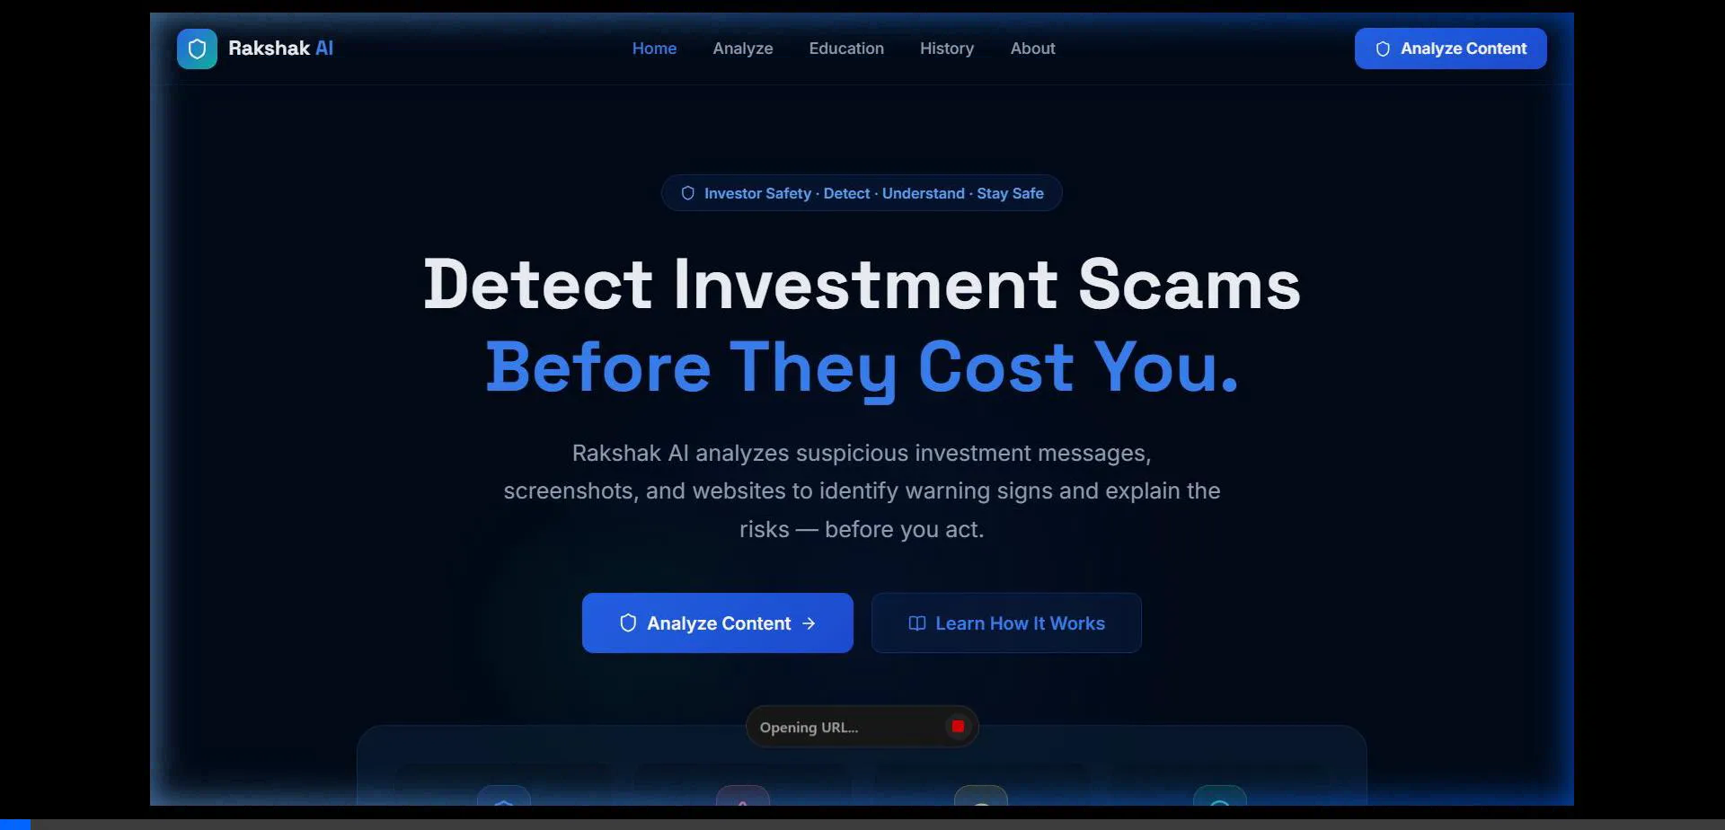
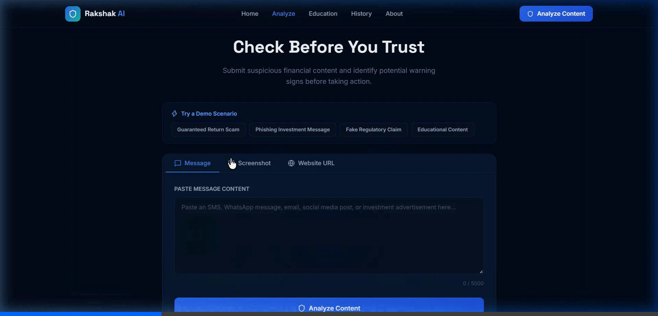
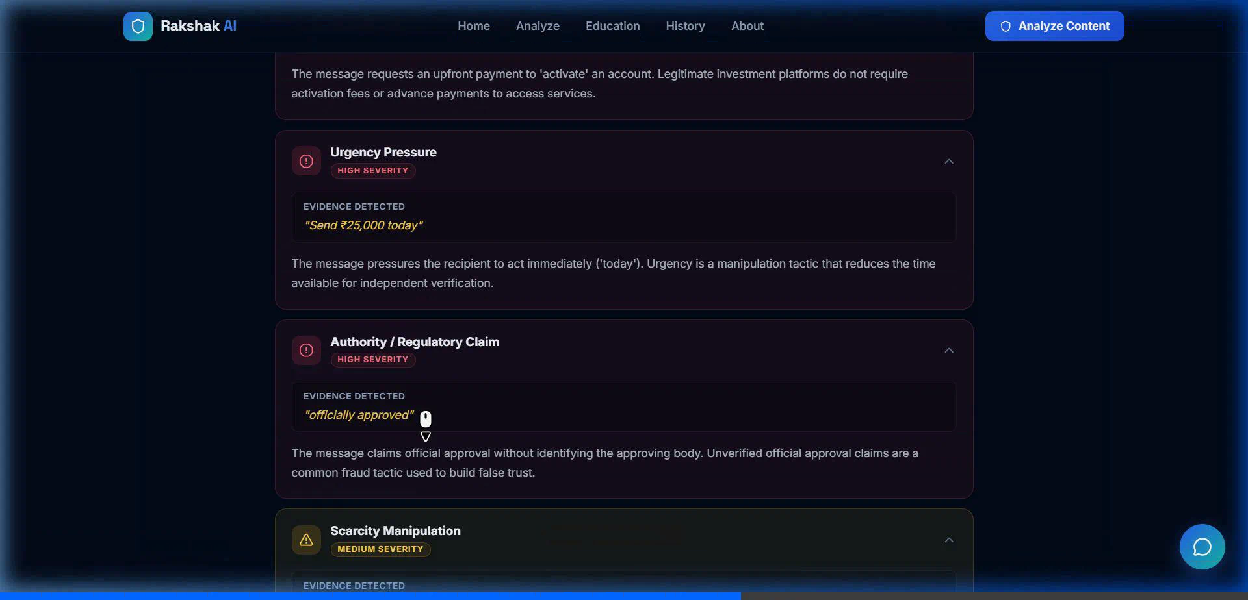
Prototype: From Message to Safety Report
05
The working interface is designed around a 3-step investor journey.
01 • Landing / threat-first entry
02 • Multimodal analyzer
03 • Evidence & warning signals
DEMO SCENARIO
“Guaranteed 30% monthly return… Send ₹25,000 today… officially approved… only 5 slots.”
HIGH RISK
91 / 100
Signals: guaranteed return • urgency • payment request • authority claim • scarcity
The product explains the evidence instead of asking the investor to trust an opaque AI verdict.
SANGYAN HACKATHON • RAKSHAK AI
Detect • Understand • Stay Safe

Slide 6
The Evidence Layer
06
Rakshak shows the phrase, the signal, and the reason — together.
GUARANTEED RETURN
“guaranteed 30% monthly”
SUSPICIOUS MESSAGE
Promises a fixed outcome with no uncertainty.
Exclusive investment opportunity.
AUTHORITY CLAIM
“officially approved”
Earn a guaranteed 30% monthly return.
Uses official-sounding language without verification evidence.
This opportunity is officially approved.
“Send ₹25,000 today”
URGENCY / PAYMENT
Pressures immediate payment before independent verification.
Send ₹25,000 today to activate your account.
SCARCITY
“Only 5 slots remain”
Only 5 slots remain.
Creates artificial pressure to act quickly.
SANGYAN HACKATHON • RAKSHAK AI
Detect • Understand • Stay Safe

Slide 7
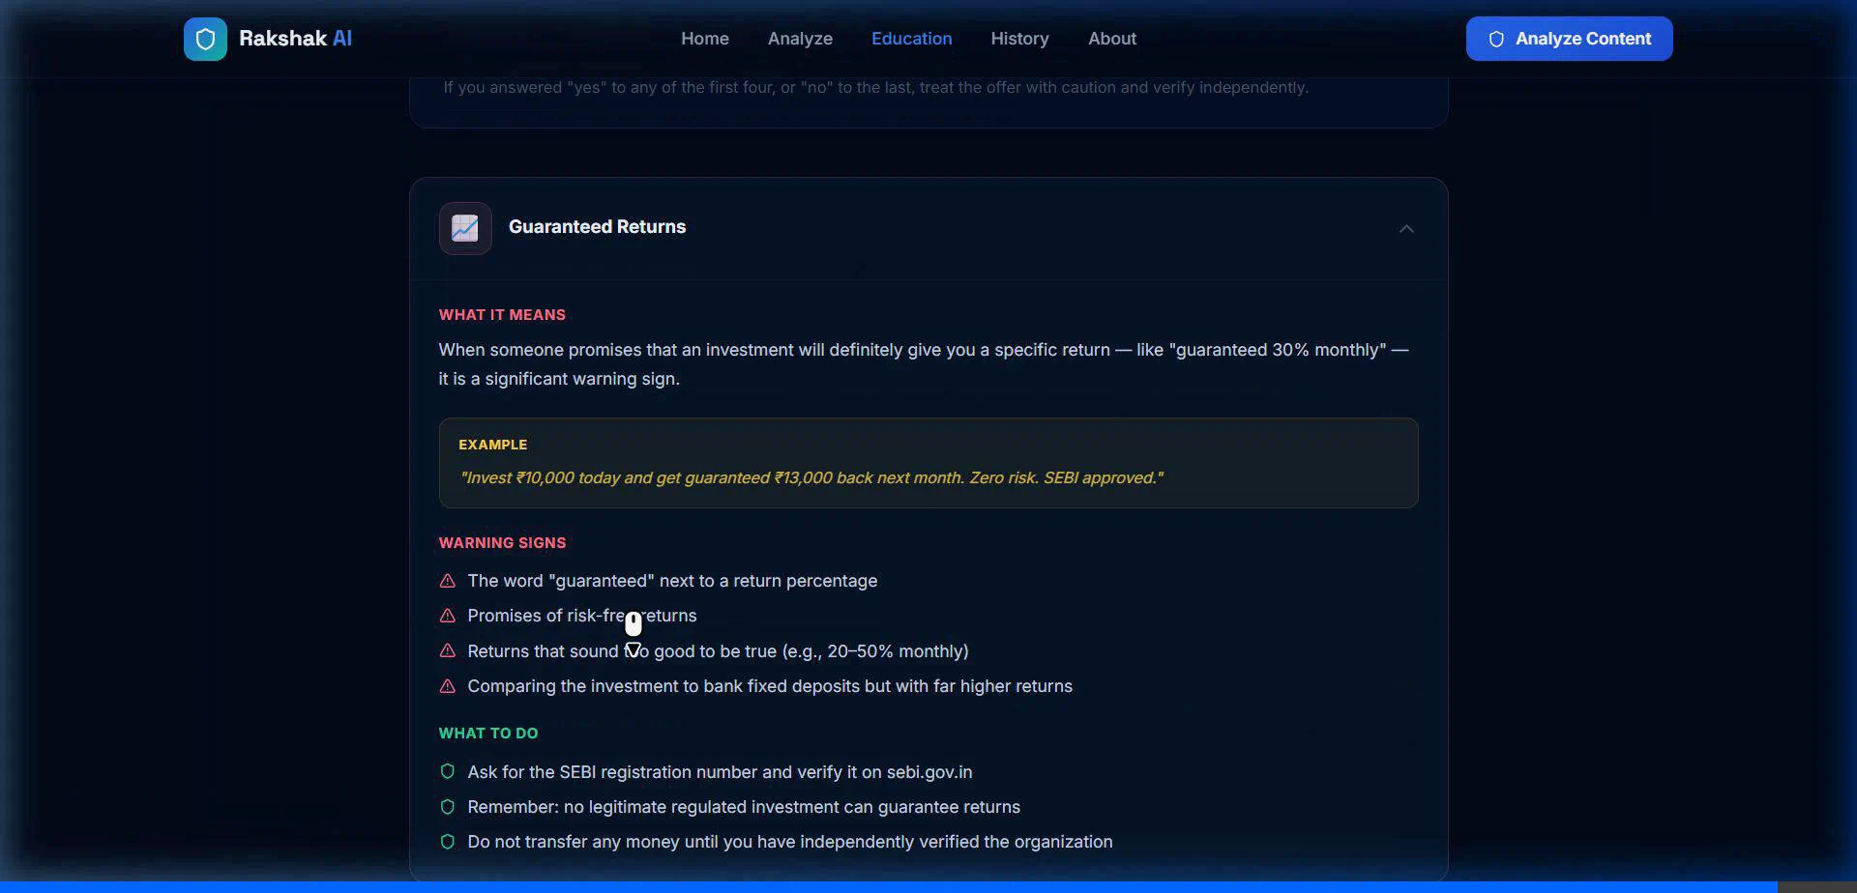
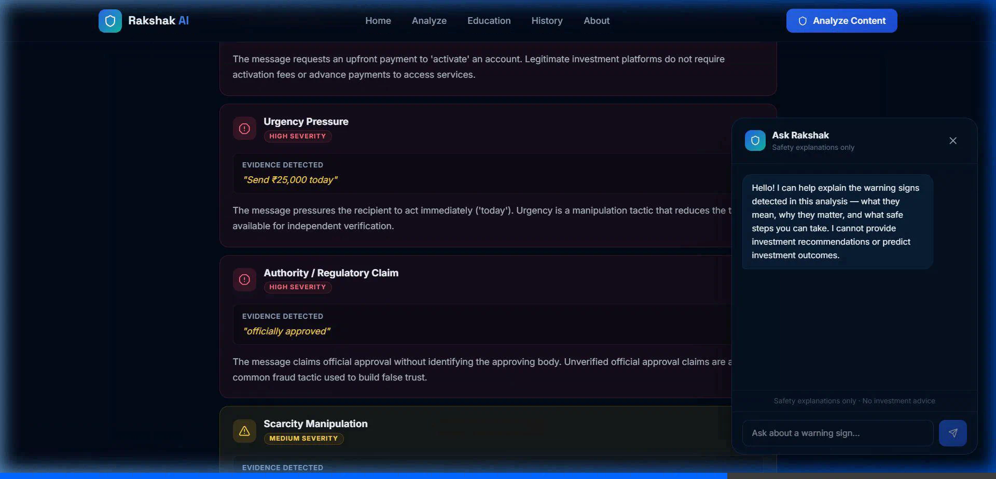
Investor Education + Safe Assistance
07
Protection should continue after the warning.
Education hub • explain the tactic, then verify independently
Ask Rakshak • contextual safety explanations only
EXPLAIN
VERIFY
DON’T RUSH
SANGYAN HACKATHON • RAKSHAK AI
Detect • Understand • Stay Safe

Slide 8
Why Rakshak AI?
08
Five design decisions that make the prototype safer and more defensible.
01
EVIDENCE FIRST
02
SAFETY FIRST
Exact quotes + named warning signal
No tips • no buy/sell • no price prediction
03
PLAIN ENGLISH
04
PRIVACY BY DESIGN
Jargon becomes understandable action
No OTP, bank credentials or PAN requested
05
DUAL-MODE
Deterministic demo mode + optional AI reasoning
Safety principle
AI helps explain risk signals — it does not decide what the investor should buy.
SANGYAN HACKATHON • RAKSHAK AI
Detect • Understand • Stay Safe

Slide 9
Impact & Future
09
A practical path from hackathon prototype to a broader investor-resilience layer.
TODAY • WORKING PROTOTYPE
NEXT • SCALE THE SHIELD
Text + screenshot + URL analysis
Multilingual Bharat-first support
Deterministic 0–100 safety indicator
Regulatory verification integrations
Evidence extraction & explanations
Deepfake video / voice scam detection
Investor education hub + checklist
Crowdsourced threat intelligence
Interactive safety-only assistant
WhatsApp / Telegram safety workflows
Before you invest, understand what you’re seeing.
SANGYAN HACKATHON • RAKSHAK AI • DIGITAL FRAUD & SCAM RESILIENCE
Detect • Understand • Stay Safe

