Slide 1
DESIGN PATTERNS • JAVA PROJECT
Smart Payment Processing
and Failure Handling System
An extensible payment workflow demonstrating 11 core design patterns across request creation, processing, and failure recovery.
FACTORY • BRIDGE • MEDIATOR • STRATEGY
Project presentation | Updated architecture, UML, and run instructions

Slide 2
SMART PAYMENT SYSTEM
Problem, solution & scope
THE PROBLEM
THE SOLUTION
SCOPE
Multiple payment methods and gateways create branching logic. Failures need different responses, and retry/escalation must remain understandable.
Separate object creation, provider integration, access checks, workflow coordination, and failure recovery using focused design patterns.
A runnable Java console simulation with UPI, Card, Net Banking, Wallet, three simulated gateways, transaction history, and failure demos.
Important: gateways and failures are simulated; transactions are in memory. No real money moves and no database is connected.
JAVA CONSOLE SIMULATION • NO REAL PAYMENT / DATABASE INTEGRATION
02

Slide 3
SMART PAYMENT SYSTEM
Architecture & payment flow
1
2
3
4
5
Request
Create components
Coordinate workflow
Guard & process
Recover failures
Builder + Prototype
Factory Method + Abstract Factory
Template Method + Mediator
Proxy + Bridge
Chain + Strategy + Memento
SUCCESS PATH
FAILURE PATH
Validate → authorize → process through gateway → generate receipt
Classify failure → retry if recoverable → escalate if unresolved
JAVA CONSOLE SIMULATION • NO REAL PAYMENT / DATABASE INTEGRATION
03

Slide 4
SMART PAYMENT SYSTEM
Core patterns already in the project
01
Factory Method
02
Abstract Factory
03
Bridge
PaymentProcessorFactory selects the method-specific processor.
Creates a matching validator and receipt generator family.
Payment type and gateway provider vary independently.
payment.factory
payment.abstractfactory
payment.bridge
04
Proxy
05
Chain of Responsibility
Authenticates a simulated user and checks amount limits before forwarding.
Routes failures through validation, gateway, retry, and support handlers.
payment.proxy
payment.chain
JAVA CONSOLE SIMULATION • NO REAL PAYMENT / DATABASE INTEGRATION
04

Slide 5
SMART PAYMENT SYSTEM
Six added patterns — now integrated
06
Builder
07
Prototype
08
Mediator
PaymentRequest.Builder assembles and validates request fields.
PaymentProfile clones a reusable profile for the selected method/provider.
PaymentMediator coordinates validator, payment service, and receipt generator.
09
Template Method
10
Strategy
11
Memento
PaymentWorkflowTemplate fixes workflow order; StandardPaymentWorkflow supplies hooks.
RetryStrategy separates retry decisions from RetryHandler.
TransactionMemento snapshots/restores status and failure reason during retry.
Supporting: Singleton TransactionStore
JAVA CONSOLE SIMULATION • NO REAL PAYMENT / DATABASE INTEGRATION
05

Slide 6
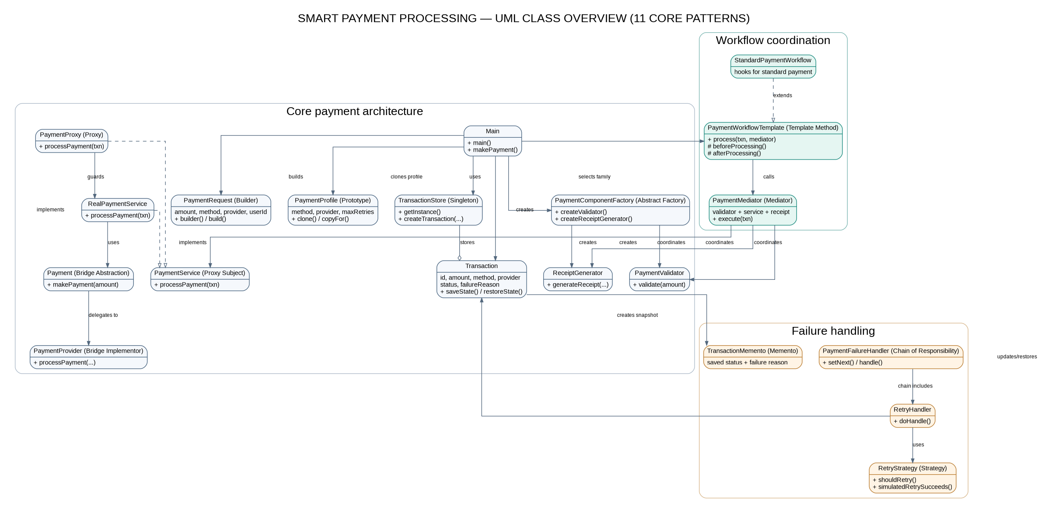
SMART PAYMENT SYSTEM
Updated UML class diagram
JAVA CONSOLE SIMULATION • NO REAL PAYMENT / DATABASE INTEGRATION
06

Slide 7
SMART PAYMENT SYSTEM
Run, test & demonstrate
RUN IN VS CODE
DEMO CHECKLIST
• Open the payment-processing-system folder.
• Use JDK 11+ and the VS Code Extension Pack for Java.
• Run Main.java, or execute javac -encoding UTF-8 -d out @sources.txt then java -cp out payment.Main.
• On Windows, run run.bat; on macOS/Linux, run ./run.sh.
• Successful payment with a valid user (e.g., user001).
• Authentication failure with an unknown user ID.
• Retry success using GATEWAY_TIMEOUT and retry option Yes.
• Escalation after retry attempts fail.
• View transaction history before exiting.
Files included: README • VIVA_GUIDE • UML documentation • editable DOT source • PNG/SVG UML diagram
JAVA CONSOLE SIMULATION • NO REAL PAYMENT / DATABASE INTEGRATION
07

