Slide 1

Network Error Detection And Correction Toolkit
Mini-project presentation
Computer Networks Laboratory (CSE20110)
Department of Computer Engineering and Technology
Vedant Bhosale - 1262251592 Riya Das - 1262251596
Sushant Pawar – 1262251598 Chinmay Bhole - 1262252266
Group 7 Panel E Batch E1
Faculty: Dr. Swati
Academic Year: 2026–2027
Presentation date: 22/10/26
Computer Networks Laboratory CSE20110
15 seconds
Notes:
Suggested time: 15 seconds. Replace all bracketed placeholders and prompts with your own project details. Keep explanations brief. Total time across slides 1–7 is 5 minutes, including the demonstration. Slide 8 is for reference during questions. Logo source: https://mitwpu.edu.in/uploads/images/MIT-WPU-logo-1.webp. Introduce only the title and team; do not read every PRN.

Slide 2
Problem and Objectives
Problem
Real-world communication channels are inherently prone to transmission impairments—such as burst noise, electromagnetic interference, and line attenuation—that corrupt data packets in transit, leading to application crashes and silent data errors.
Target users include computer engineering students, network administrators, and laboratory evaluators who need an interactive tool to study and demonstrate network data integrity protocols across client-router-proxy architectures.
Objectives
Design and implement a PyQt-based multi-process desktop architecture (launcher.exe, client_app.exe, and router_proxy_app.exe) to manage live socket connections and process orchestration.
Develop functional modules for data integrity verification incorporating Hamming(7,4) encoding/decoding, CRC-32 checksums, and 1D/2D parity check matrices.
Package the application using PyInstaller into a standalone, portable distribution package and evaluate system resilience under induced error conditions.
Computer Networks Laboratory CSE20110
40 seconds
Notes:
Suggested time: 40 seconds. Replace all bracketed placeholders and prompts with your own project details. Keep explanations brief. Total time across slides 1–7 is 5 minutes, including the demonstration. Slide 8 is for reference during questions.

Slide 3
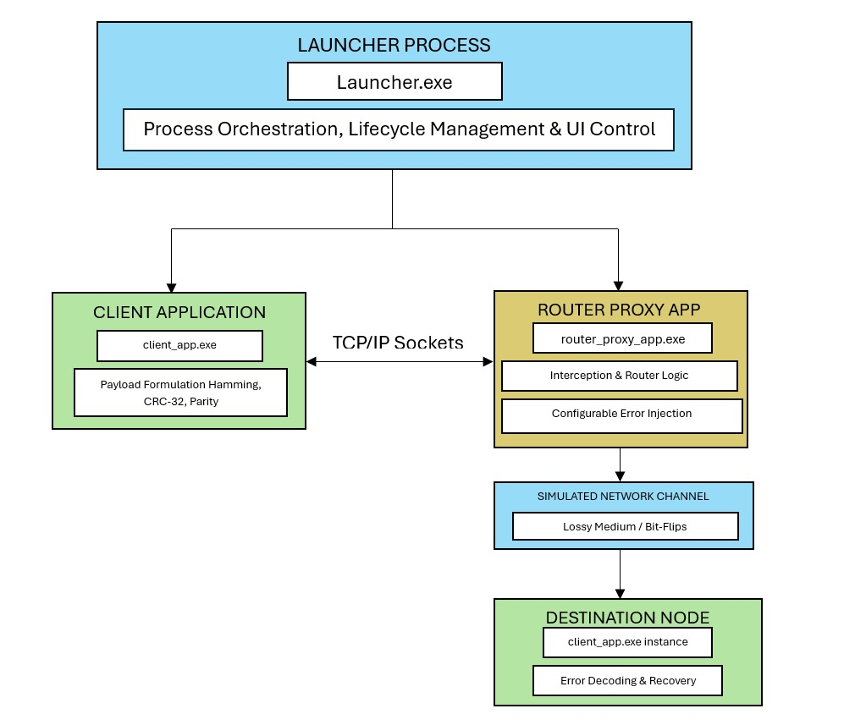
Proposed Design and Tools
Figure 2.1 Proposed architecture
Computer Networks Laboratory CSE20110
45 seconds
Notes:
Suggested time: 45 seconds. Replace all bracketed placeholders and prompts with your own project details. Keep explanations brief. Total time across slides 1–7 is 5 minutes, including the demonstration. Slide 8 is for reference during questions. Explain the diagram and only the most relevant design decisions. Use an actual project diagram with readable labels.

Slide 4
Proposed Design and Tools
Tools: Python 3.12.6, PyQt6 (v6.11.0), PyInstaller (v6.22.3), and Windows 10/11 (64-bit).
Protocols: TCP (Transmission Control Protocol) for reliable inter-process stream delivery and application-layer proxy interception.
Addressing: Loopback (127.0.0.1) or local LAN (192.168.x.x) subnet addresses, with the Router Proxy bound to port 5000.

Slide 5
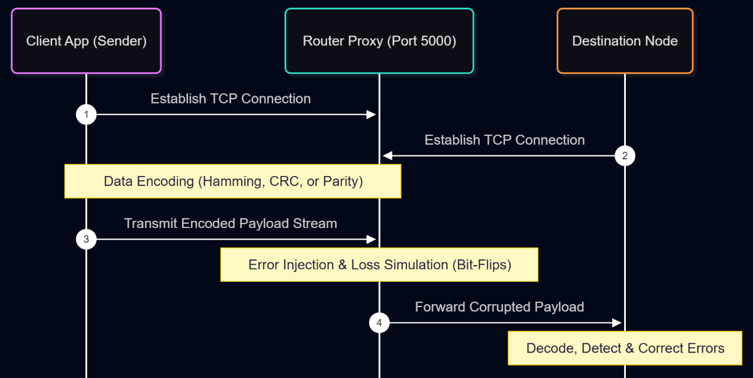
Implementation and Working
Figure 3.1 NECD Toolkit Message Sequence and Error-Injection Workflow
Implementation: Developed modular Python packages—gui/ (PyQt UI components), core/ (Hamming, CRC-32, Parity engines), and network/ (TCP socket handlers and router proxy logic).
Working: Client encodes raw payload and transmits via TCP to Router Proxy; Proxy injects configurable bit-flips/burst noise; Receiver decrypts/decodes frame and verifies checksums.
Troubleshooting: Socket Binding/Port Reuse Error (OSError: [Errno 98]) — Resolved by setting SO_REUSEADDR flag on socket initialization to permit immediate port rebound upon proxy restart
Computer Networks Laboratory CSE20110
55 seconds
Notes:
Suggested time: 55 seconds. Replace all bracketed placeholders and prompts with your own project details. Keep explanations brief. Total time across slides 1–7 is 5 minutes, including the demonstration. Slide 8 is for reference during questions.

Slide 6
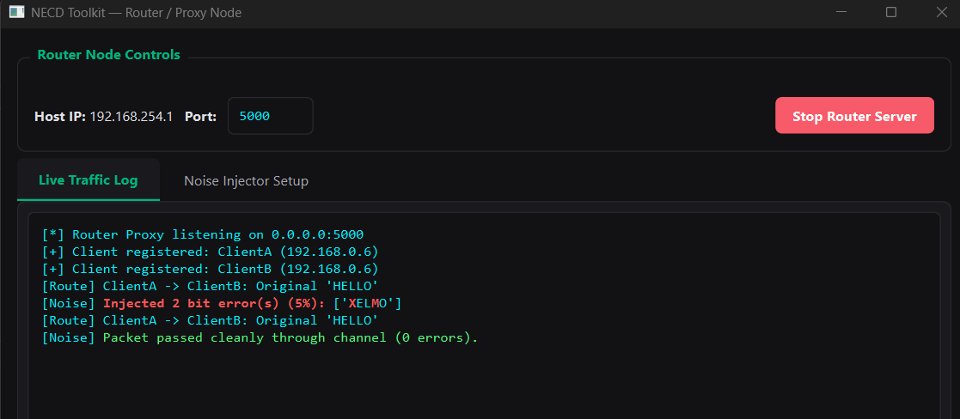
Testing and Results
Figure: Router Proxy Traffic Log — CRC-32 Payload Corruption & Noise Injection
Computer Networks Laboratory CSE20110
50 seconds
Notes:
Suggested time: 50 seconds. Replace all bracketed placeholders and prompts with your own project details. Keep explanations brief. Total time across slides 1–7 is 5 minutes, including the demonstration. Slide 8 is for reference during questions. Show actual evidence. Explain the output and mention any failed or partial tests. Do not invent performance figures.

Slide 7
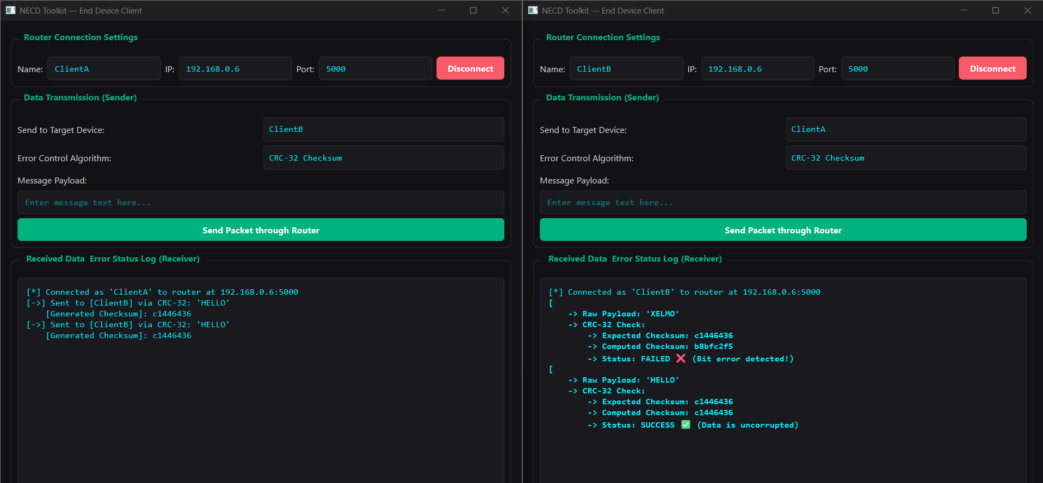
Figure: CRC-32 Checksum Verification and Error Detection
Test: Normal Operation (Hamming SEC): Input payload "HELLO" with Hamming(7,4) encoding selected and simulated bit errors injected by the Router Proxy.
Expected: The receiver identifies error syndromes, automatically corrects single-bit errors across the blocks, and perfectly recovers the original payload "HELLO".
Observed: Single-bit errors were successfully isolated and corrected (4 errors corrected); the recovered message matched the original input exactly, as shown in the console logs.
Objectives achieved: Validated functional error-correction modules and real-time fault resilience under simulated network conditions (Objective O2 & O4).

Slide 8
Working Demonstration
Function to demonstrate
Real-time channel error injection, automated single-bit error detection, and Hamming(7,4) forward error correction across a multi-process TCP socket network.
Steps:
Start the Router Proxy (router_proxy_app.exe) on port 5000 and launch/connect both Client A and Client B instances.
Select Hamming(7,4) Correction, input the message payload "HELLO", and transmit the packet through the router proxy under active bit-flip noise simulation.
Observe the router traffic log detailing the injected bit errors, and examine the receiver console displaying the corrected blocks, total error count, and recovered message.
Success criterion: The receiving node successfully computes error syndromes, corrects corrupted bits, and renders the exact original plaintext message ("HELLO") on the GUI dashboard without data loss.
Computer Networks Laboratory CSE20110
65 seconds
Notes:
Suggested time: 65 seconds. Replace all bracketed placeholders and prompts with your own project details. Keep explanations brief. Total time across slides 1–7 is 5 minutes, including the demonstration. Slide 8 is for reference during questions. Prepare the project before the timer starts. Keep the demo to about one minute. Keep a screenshot or short recording ready as a backup, and identify it as recorded evidence if used.

Slide 9
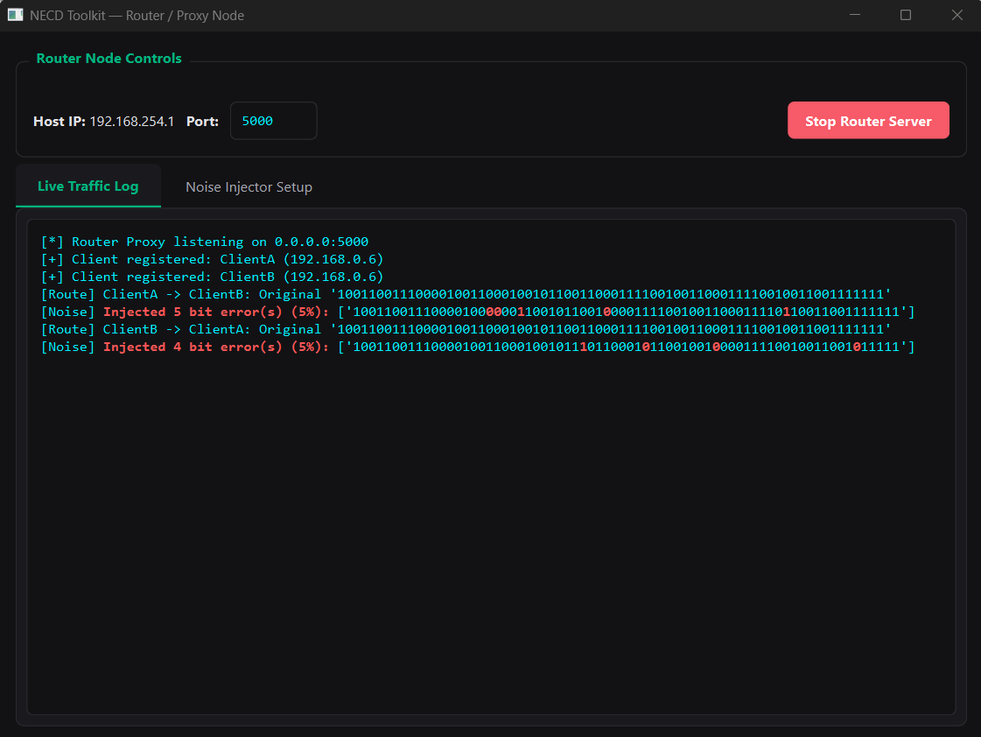
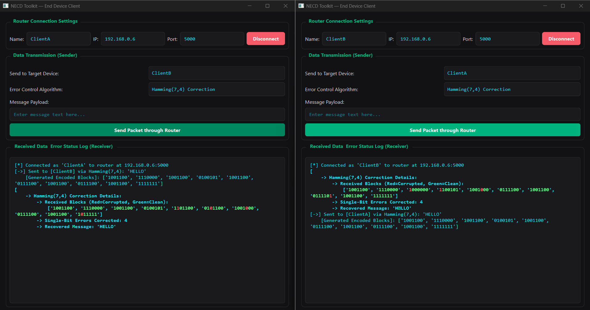
Figure 4.1 Test execution output and live console logging

Slide 10
Conclusion and Contributions
Outcome: Successfully built and packaged a modular PyQt6 desktop toolkit with interactive router proxy interception, validating real-time CRC-32 error detection and Hamming(7,4) single-bit error correction across TCP sockets.
Application: Interactive educational utility for networking laboratories to visualize data-link layer mechanics, forward error correction (FEC), and packet integrity under lossy conditions.
Limitation: Hamming(7,4) correction is strictly bounded to single-bit errors per nibble; multiple simultaneous bit-flips in a block result in uncorrectable flags.
Future scope: Integration of transport-layer Automatic Repeat reQuest (ARQ) feedback loops (such as Stop-and-Wait) to handle uncorrectable packet retransmissions.
Team contributions:
  Vedant Bhosale - System architecture design, Router Proxy module engineering, and core error-control algorithm implementation.
  Riya Das - PyQt6 UI dashboard development, asynchronous socket signal/slot integration, and application state management.
  Sushant Pawar - End-Device Client application development, packet framing/encoding logic, and loopback/LAN network testing.
  Chinmay Bhole - PyInstaller standalone compilation, cross-device deployment verification, and technical report/appendices compilation.
AI Use: Generative AI (Google Gemini) was used for language editing and documentation structuring; all technical content and test outcomes were verified against empirical logs.
Computer Networks Laboratory CSE20110
30 seconds
Notes:
Suggested time: 30 seconds. Replace all bracketed placeholders and prompts with your own project details. Keep explanations brief. Total time across slides 1–7 is 5 minutes, including the demonstration. Slide 8 is for reference during questions.

Slide 11
References
[1] R. W. Hamming, "Error detecting and error correcting codes," The Bell System Technical Journal, vol. 29, no. 2, pp. 147–160, 1950.
[2] W. W. Peterson and D. T. Brown, "Cyclic codes for error detection," Proceedings of the IRE, vol. 49, no. 1, pp. 228–235, 1961.
[3] J. F. Kurose and K. W. Ross, Computer Networking: A Top-Down Approach, 8th ed. Pearson, 2020.
[4] Python Software Foundation, "Python 3.12.6 Documentation," https://docs.python.org/3.12/ (accessed Oct. 16, 2026).
[5] PyQt Documentation Project, "PyQt6 Reference Guide," https://www.riverbankcomputing.com/static/Docs/PyQt6/ (accessed Oct. 16, 2026).
[6] PyInstaller Development Team, "PyInstaller Manual v6.x," https://pyinstaller.org/en/stable/ (accessed Oct. 16, 2026).
Computer Networks Laboratory CSE20110
Backup slide
Notes:
Suggested time: Backup slide. Replace all bracketed placeholders and prompts with your own project details. Keep explanations brief. Total time across slides 1–7 is 5 minutes, including the demonstration. Slide 8 is for reference during questions.

