Slide 1
Multi-Client Single Server Chat Application /Chat Room
Group 14
Gaurav Singh - 42
Jayant Singh - 43
Kapil Gattani - 44
Rahul Verma - 53
Vedant Bhutada - 69

Slide 2
Functionalities used
Socket
Tkinter
MySql

Slide 3
What is Socket :
►A socket is one endpoint of a two-way communication link between two programs running on a network.
► It is one of the most fundamental technologies of computer network programming. Sockets allow network software applications to communicate using standard mechanisms built into network hardware and operating systems.
► A socket represents a single connection between exactly two pieces of software (a so-called point-to-point connection). More than two pieces of software can communicate with client/server or distributed systems by using multiple sockets.
► Socket-based software usually runs on two separate computers on the network, but sockets can also be used to communicate locally (inter-process) on a single computer like our project.
► Sockets are bidirectional, meaning that either side of the connection is capable of both sending and receiving data. Sometimes the one application that initiates communication is termed the "client" and the other application the "server".

Slide 4
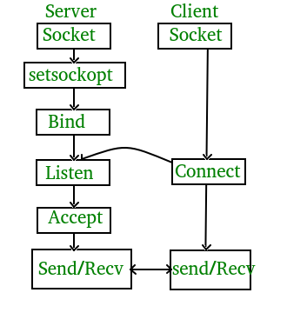
Server Client Process flow Diagram :

Slide 5
Functions used :
Server:
A computer or program that provides services to other computers or clients in a network.
Socket:
An endpoint for sending or receiving data across a computer network.
Client:
A computer or program that requests services or resources from a server in a network.
Socket (setsockopt):
A function to set socket options, such as configuring socket behavior or properties.
Bind:
Associates a socket with a specific network address (IP address and port number).
Listen:
Allows a server socket to accept incoming connection requests from clients.

Slide 6
Connect:
Establishes a connection from a client to a server using a specific network address.
Accept:
Accepts an incoming connection request on a server socket, creating a new socket for communication with the client.
Send/Recv:
Methods for sending and receiving data over a connected socket, commonly used in stream (TCP) communication.
Sendto/Recvfrom:
Methods for sending and receiving data over a socket, commonly used in datagram (UDP) communication.

Slide 7
Tkinter:
Tkinter is a standard Python library for creating graphical user interfaces (GUIs) that provides a set of tools for building windows, dialogs, buttons, and various other GUI elements.
Key Methods:
Tk(): Creates the main window.
Label(root, text='Hello'): Creates a text label.
Button(root, text='Click', command=callback): Creates a clickable button.
Entry(root, textvariable=my_var): Creates a single-line text entry.
Text(root): Creates a multi-line text entry.
Frame(root): Creates a container for organizing widgets.
pack(), grid(), place(): Geometry managers for widget placement.
bind(event, handler): Binds an event to a callback function.
config(options): Configures widget options dynamically.
mainloop(): Enters the main event loop, handling user inputs and events.

Slide 8
MySQL:
MySQL is an open-source relational database management system (RDBMS) that uses Structured Query Language (SQL) for managing and manipulating data. It is widely used for various applications, from small-scale projects to large enterprise systems.
MySQL Connector in Python:
MySQL Connector is a Python module that provides an interface to connect and interact with MySQL databases. It enables Python programs to communicate with MySQL servers, allowing the execution of SQL queries, insertion, retrieval, and modification of data.

Slide 9
connect(host, user, passwd, database): Establishes a connection to a MySQL database.
cursor(): Creates a cursor object for executing SQL queries.
execute(query, values): Executes an SQL query with optional values.
fetchone(): Fetches the next row of a query result set.
fetchall(): Fetches all rows of a query result set.
commit(): Commits changes to the database.
rollback(): Rolls back the current transaction.
close(): Closes the cursor and connection.
Key Methods in MySQL Connector:

Slide 10
Code illustration for Server :
import socket
# Server configuration
host = 'localhost'
port = 12345
# Create a socket object
server_socket = socket.socket(socket.AF_INET, socket.SOCK_STREAM)
# Bind the socket to a specific address and port
server_socket.bind((host, port))
# Listen for incoming connections (max 5 connections in the queue)
server_socket.listen(5)
print(f"Server listening on {host}:{port}")
while True:
# Wait for a connection from a client
client_socket, client_address = server_socket.accept()
print(f"Connection established with {client_address}")
# Send a welcome message to the client
welcome_message = "Welcome to the server!"
client_socket.send(welcome_message.encode('utf-8'))
# Receive data from the client
data = client_socket.recv(1024).decode('utf-8')
print(f"Received from client: {data}")
# Close the connection with the client
client_socket.close()

Slide 11
Code illustration for Client :
import socket
# Server configuration
host = 'localhost'
port = 12345
# Create a socket object
client_socket = socket.socket(socket.AF_INET, socket.SOCK_STREAM)
# Connect to the server
client_socket.connect((host, port))
# Receive the welcome message from the server
welcome_message = client_socket.recv(1024).decode('utf-8')
print(f"Server says: {welcome_message}")
# Send a message to the server
message_to_server = "Hello, server!"
client_socket.send(message_to_server.encode('utf-8'))
# Close the connection with the server
client_socket.close()

Slide 12
Main Functions:
account.py:
account_func(username): Displays a Tkinter window for account settings, allowing the user to change their name, username, password, avatar, or delete their account.
login.py:
login(): Displays a Tkinter window for user login, allowing users to enter their credentials and log in, or register a new account.
register(): Displays a Tkinter window for user registration, allowing users to create a new account.
main.py:
main_loop(username): Displays the main chat application window using Tkinter, allowing users to send and receive real-time messages, view user lists, and access account settings.
..
.

Slide 13
run.py:
Checks if a user is logged in (isLog.txt). If logged in, it calls main.main_loop(username), else, it calls login.login().
server.py:
connectNewClient(c): Handles the communication with a newly connected client, receives messages, and broadcasts updates to all clients.
sendToAll(msg): Sends a message to all connected clients.
General Functions:
Socket Functions: socket.AF_INET, socket.SOCK_STREAM: Socket configuration for IPv4 and TCP.
JSON Functions: json.loads(): Converts a JSON-formatted string to a Python object. json.dumps(): Converts a Python object to a JSON-formatted string.
Thread Functions: _thread.start_new_thread(func, args): Starts a new thread for a given function with arguments.

Slide 14
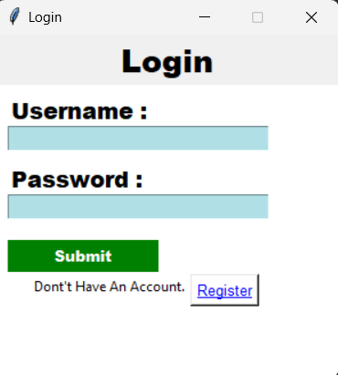
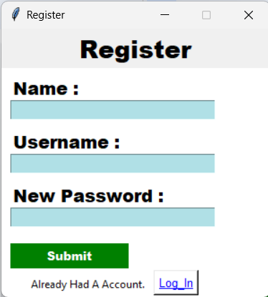
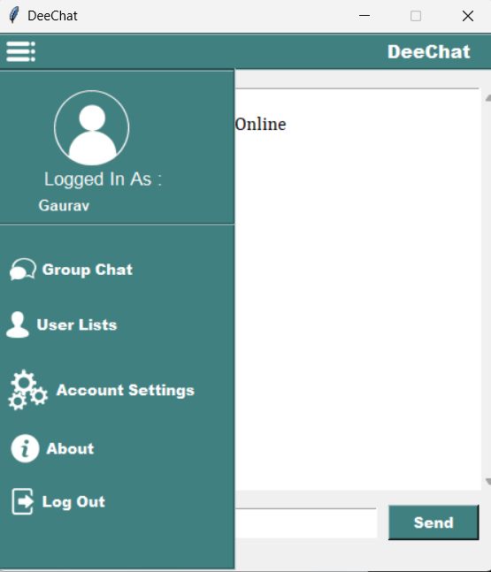
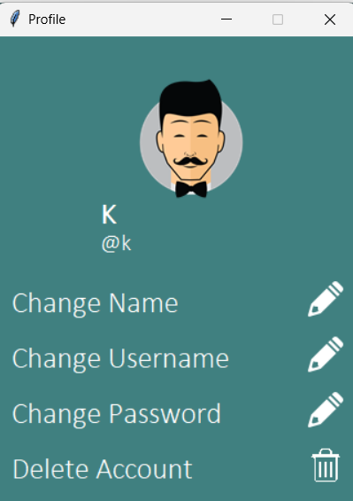
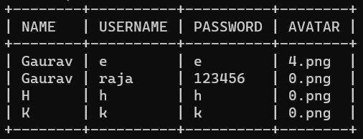
Multi-Client Chat Application(Socket Programming in python)

Slide 15
Future Scope:
File Sharing.
Database Optimization.
Scalability
Error Handling
Multi-Factor Authentication
UI Improvements
Cross-Platform Compatibility.

