Slide 1
Self-Driving Cars: The Future of Transportation
Redefining Mobility with Artificial Intelligence
VEDANT CHANDAK - RA2311003011671
Institution | Department

Slide 2
Problem Statement
Traffic Fatalities
• 1.3M deaths/year globally
• Leading cause: distracted driving
Human Error
• 90% of accidents due to human mistakes
Urban Congestion
• Wastes 100+ hours/driver/year
Pollution
• Transport: 29% of GHG emissions
Accessibility Problems
• Disabled, elderly face transport barriers

Slide 3
Solution Overview
AI Decision-Making
• Fast real-time decisions
Traffic Optimization
• Vehicle-to-vehicle communication
Green Mobility
• Reduced emissions by smart routing
Inclusive Transportation
• Access for elderly, disabled

Slide 4
Overall Architecture Diagram
Input Sensors
• Lidar, Radar, Ultrasonic, Cameras
Localization
• GPS + HD Mapping
AI Perception
• Identify objects, lanes, signs
Planning
• Safest, fastest route planning
Vehicle Control
• Control steering, brake, acceleration

Slide 5
Components in Detail
Lidar
• Laser pulses create 3D maps
Radar
• Works in fog, rain conditions
Cameras
• Traffic lights, lane lines detection
AI Algorithms
• Neural nets for environment prediction
Actuators
• Move vehicle based on AI decisions

Slide 6
Implementation Details
Perception
• Detect roads, obstacles
Prediction
• Forecast other cars/pedestrians' moves
Planning
• Find best paths
Control
• Execute real-time actions

Slide 7
AI in Action
Object Detection
• Bounding boxes around objects
Lane Tracking
• Lane marking detection in curves
Traffic Sign Recognition
• STOP, speed limit recognition
Dynamic Routing
• Change routes with traffic data

Slide 8
Input-Output Screens
Input: Sensors & Cameras
• Video streams, Lidar clouds
Processing: Object Recognition
• Pedestrian/car detection algorithms
Output: Steering Commands
• Navigate around obstacles safely

Slide 9
Challenges
Weather Dependency
• Rain, snow interfere with sensors
Ethical Dilemmas
• Whom to save during crashes?
Cybersecurity Risks
• Hackers compromising safety
Infrastructure Needs
• Need smart roads, 5G, V2X tech

Slide 10
Current Industry Leaders
Waymo
• Fully autonomous taxis
Tesla
• FSD Beta: City driving
Cruise
• GM's self-driving division
Uber ATG
• Uber's research center
Apple Titan Project
• Secret autonomous car project

Slide 11
Future Vision
Autonomous Smart Cities
• AI managing urban traffic
Zero-Fatality Roads
• No deaths from car crashes
Shared Autonomous Fleets
• On-demand, shared mobility
Greener Urban Transport
• Significantly lower emissions

Slide 12
Demo Link
Waymo Self-Driving Demo
• https://www.youtube.com/watch?v=tiwVMrTLUWg
Tesla FSD Beta Footage
• https://www.youtube.com/watch?v=tlThdr3O5Qo

Slide 13
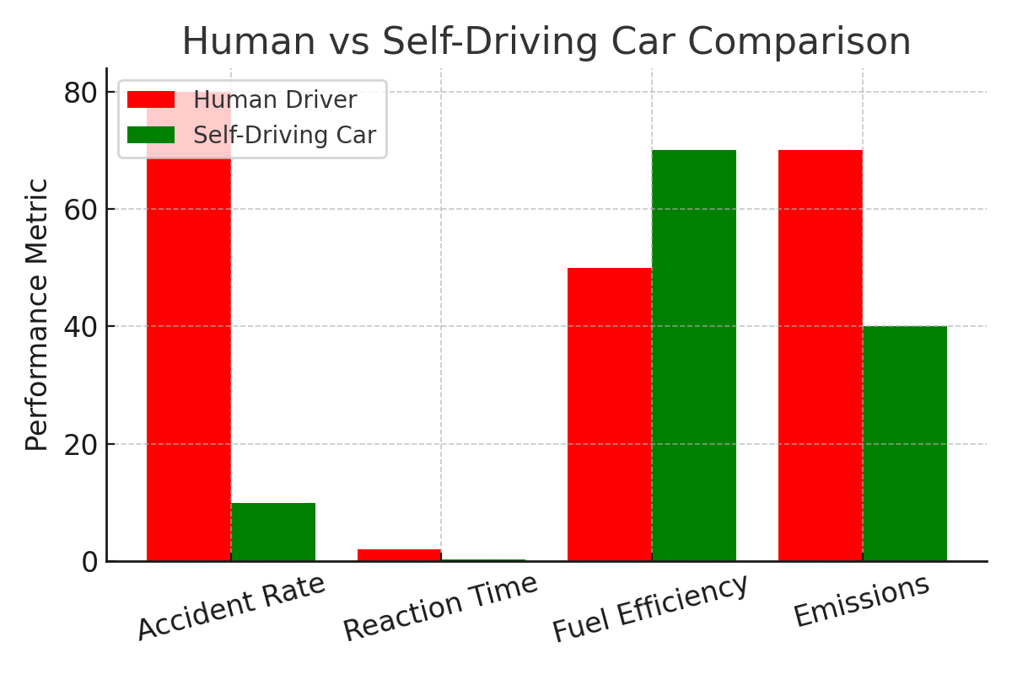
Results & Comparison Graph

