Slide 1

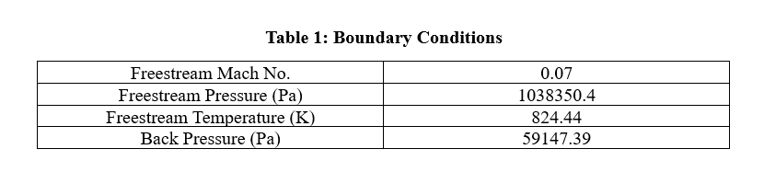
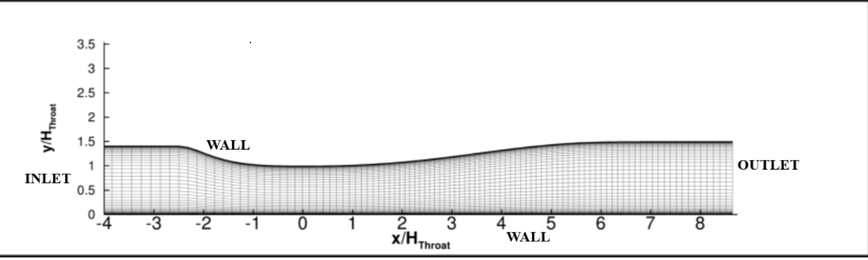
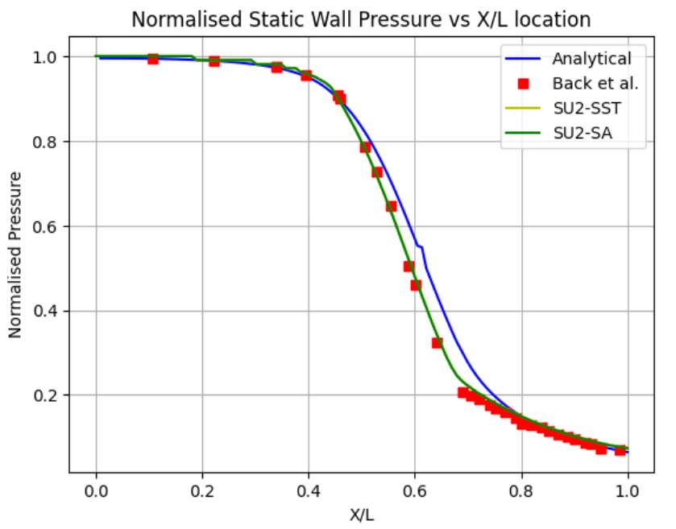
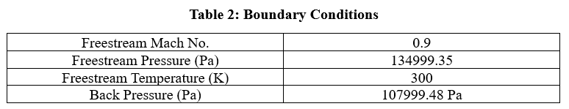
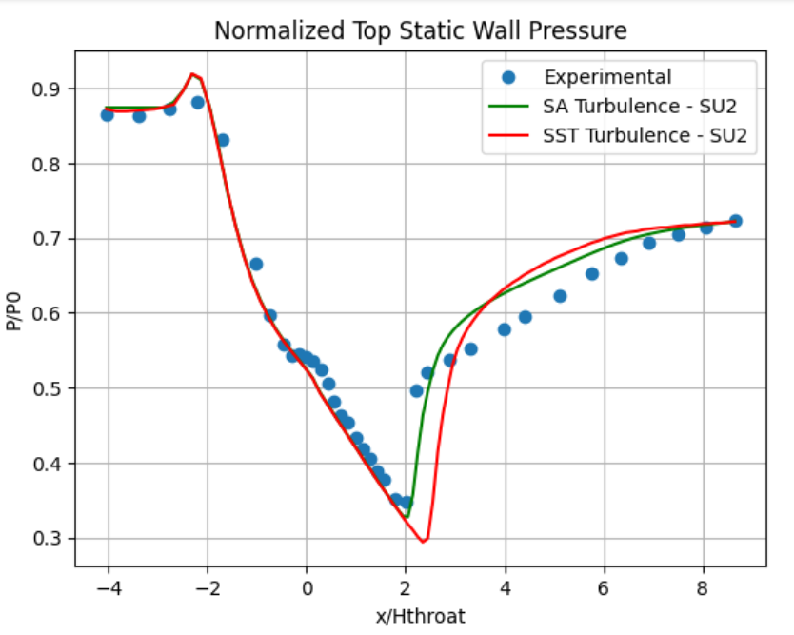
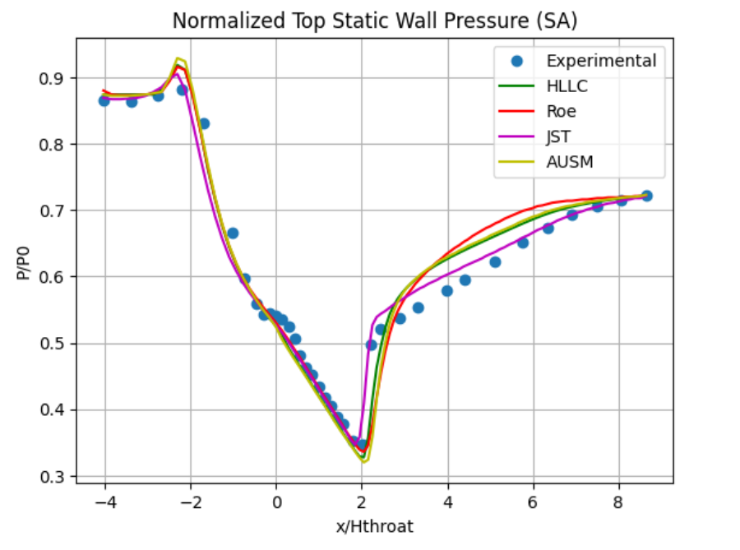
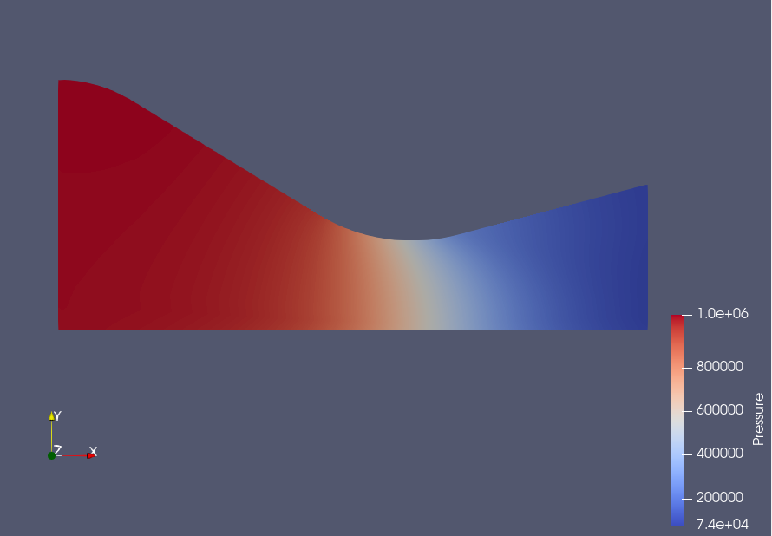
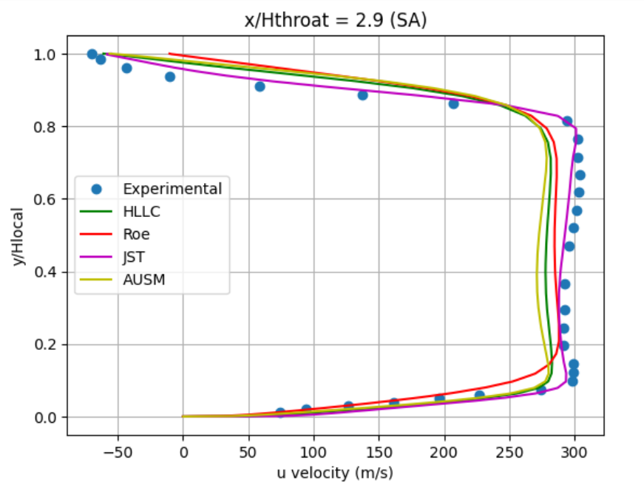
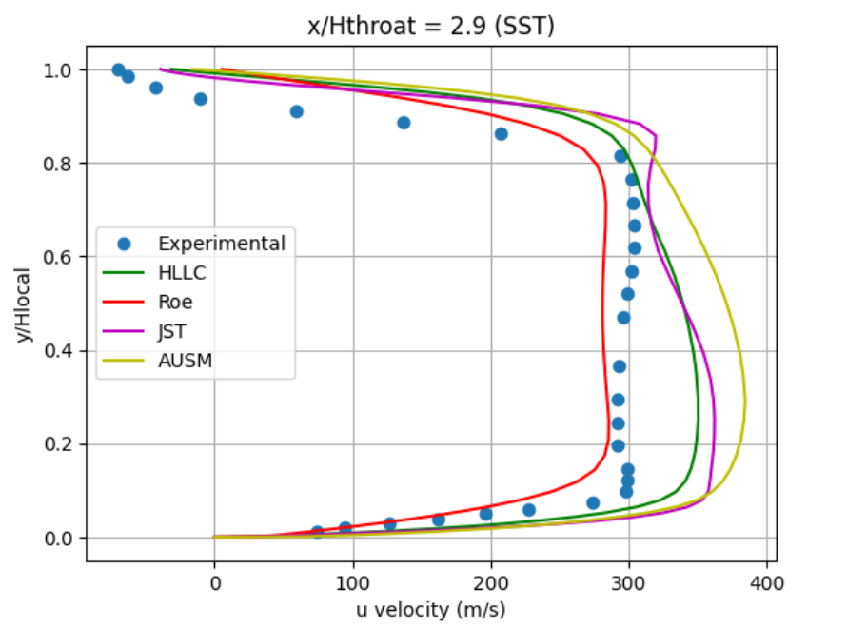
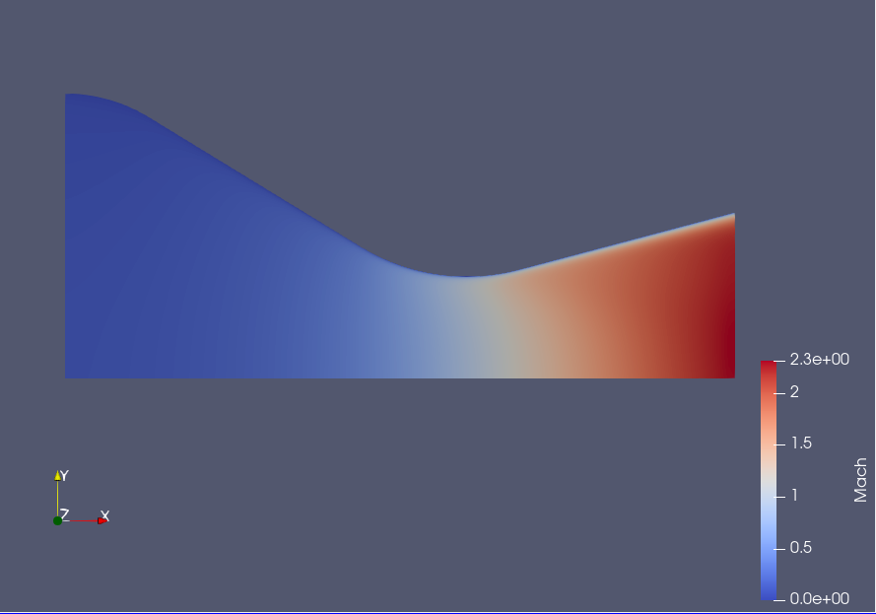
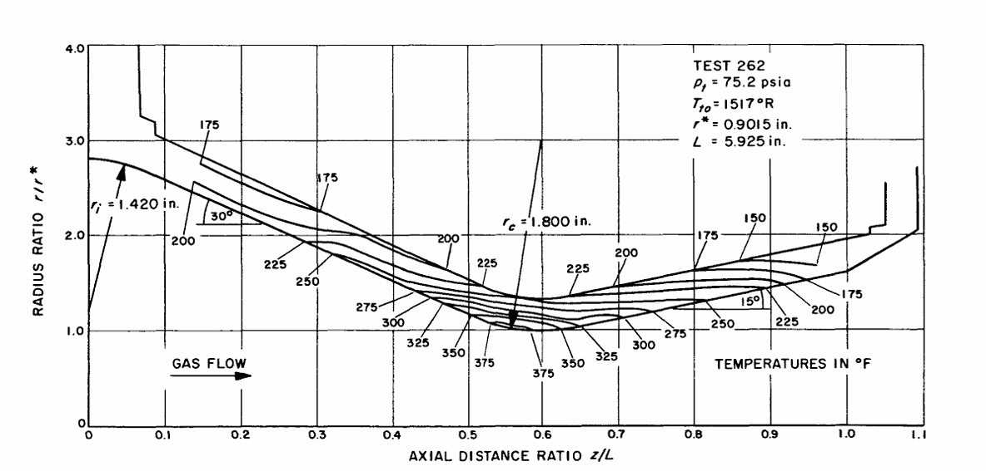
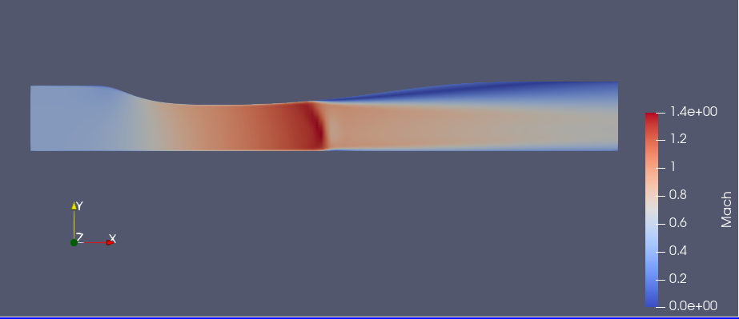
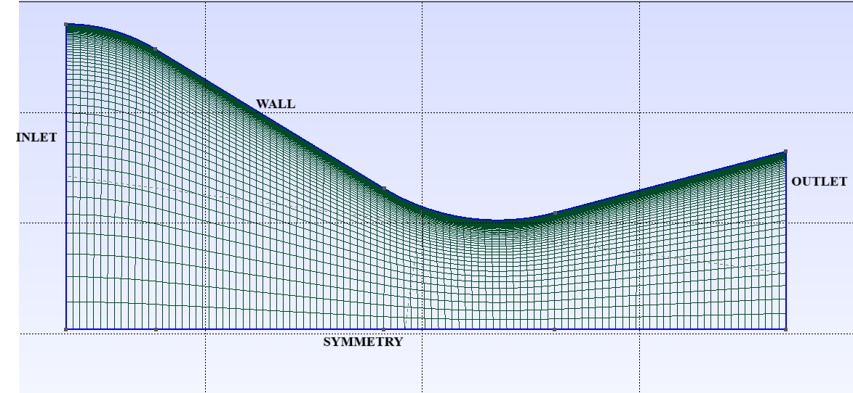
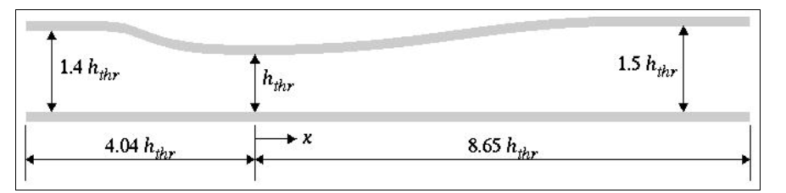
Evaluating the Effectiveness of SU2 in Computation of Internal Transonic Flow
Aditya Potdar, Prof. VR Kowsik Bodi and Prof. T Chandra Sekar
Department of Aerospace Engineering, IIT Bombay
Introduction
SU2 (Stanford University Unstructured) is an open-source suite of tools developed in C++ and Python for solving partial differential equations (PDEs) and tackling optimization problems constrained by PDEs. The founders and lead developers of the software are Dr. Francisco Palacios, Dr. Thomas D. Economon, and Prof. Juan J. Alonso.
Figure 7: Mesh and Boundary Conditions
Distinguishing features of SU2 are:
It has an object-oriented C++ structure.
SU2 is optimized for simulating compressible flows.
It can handle complex multiphysics problems.
There is full access to the source code.
Theory
Mach number: The ratio of the speed of the flow to the speed of sound.
Transonic flow is defined for the Mach number range of 0.8 till 1.3.
In transonic flow, the fluid flows near the speed of sound causing local subsonic and supersonic regions near the body present in the flow field.
A CD Nozzle (Convergent-Divergent Nozzle) also known as the de Laval nozzle consists of a fixed convergent section followed by a fixed divergent section. It is used to accelerate a compressible fluid to supersonic speeds.
Figure 3: Normalized wall pressure against location plot
(a)
(b)
Figure 8: Depicts the variation of top wall pressure along the length of the nozzle.
Objectives
Compare SU2's numerical results with Back & Massier's experimental data to assess accuracy.
Validate SU2's numerical predictions using the Sajben Transonic Diffuser case study.
With an R² of 0.9495, the SA model exceeds SST by 13.67% and lowers RMSE by 44.63%, achieving a value of 0.0088.
The JST numerical scheme shows the best performance with an R² of 0.9759 and RMSE of 0.021.
Figure 4: Pressure contour
1) Back & Massier
(a)
(b)
Figure 9: Velocity profile of various schemes.
Figure 5: Mach number contour
Figure 1: Geometry
The Spalart-Allmaras (SA) model surpassed the Shear Stress Transport (SST) model by 4.34% in matching experimental results.
The SA model yields a Root Mean Square Error (RMSE) of 0.0088 compared to the experimental results.
2) Sajben Transonic Diffuser
Figure 10: Mach number contour
Conclusion
The SU2 solver performs well with sufficient accuracy in resolving transonic flow problems. Thus, it can be further used to analyse transonic wind tunnel components.
Figure 2: Mesh and Boundary Conditions
Figure 6: Geometry
References
[1] LH Back, HL Gier, and PF Massier. Comparisons of experimental with predicted wall static-pressure distributions in conical supersonic nozzles. Tech. rep. JPL-TR-32-654. 1964. NASA, 1964.
[2] https://www.grc.nasa.gov/www/wind/valid/transdif/transdif.html
Where h_{thr} is 1.7322 inches.
IRCC, IIT Bombay, Mumbai

