Slide 1
From Photos to BIM-Ready Geometry
What typically takes hours to model manually can now be done in few minutes using only a phone camera
By: Vedant Chavan

Slide 2
From Photos to Building Models
INPUT
Smartphone photos of a room
OUTPUT
3D structural model
Walls, floors, ceilings extracted
Ready for BIM
THE CHALLENGE
Traditional methods: Slow, expensive, require expertise
My approach: Fast, automated, camera-based

Slide 3
Automated Pipeline
Images
Remove Objects
(SAM + YOLO)
Point Cloud (Modified VGGT)
Planes (RANSAC)
SAM : Segmentation model to extract precise masks for removal.
VGGT : A transformer-based multi-view stereo model generating dense point clouds.
RANSAC : Robust algorithm to fit planes even with noisy real-world point clouds.
Step | Technology | Purpose
1 | Capture Data | Generation of point cloud
2 | YOLOv8 + SAM | Remove furniture, people
3 | VGGT (Meta) | 3D reconstruction
4 | RANSAC + Convex Hull | Extract wall/floor planes
5 | Open3D | Visualization & validation

Slide 4
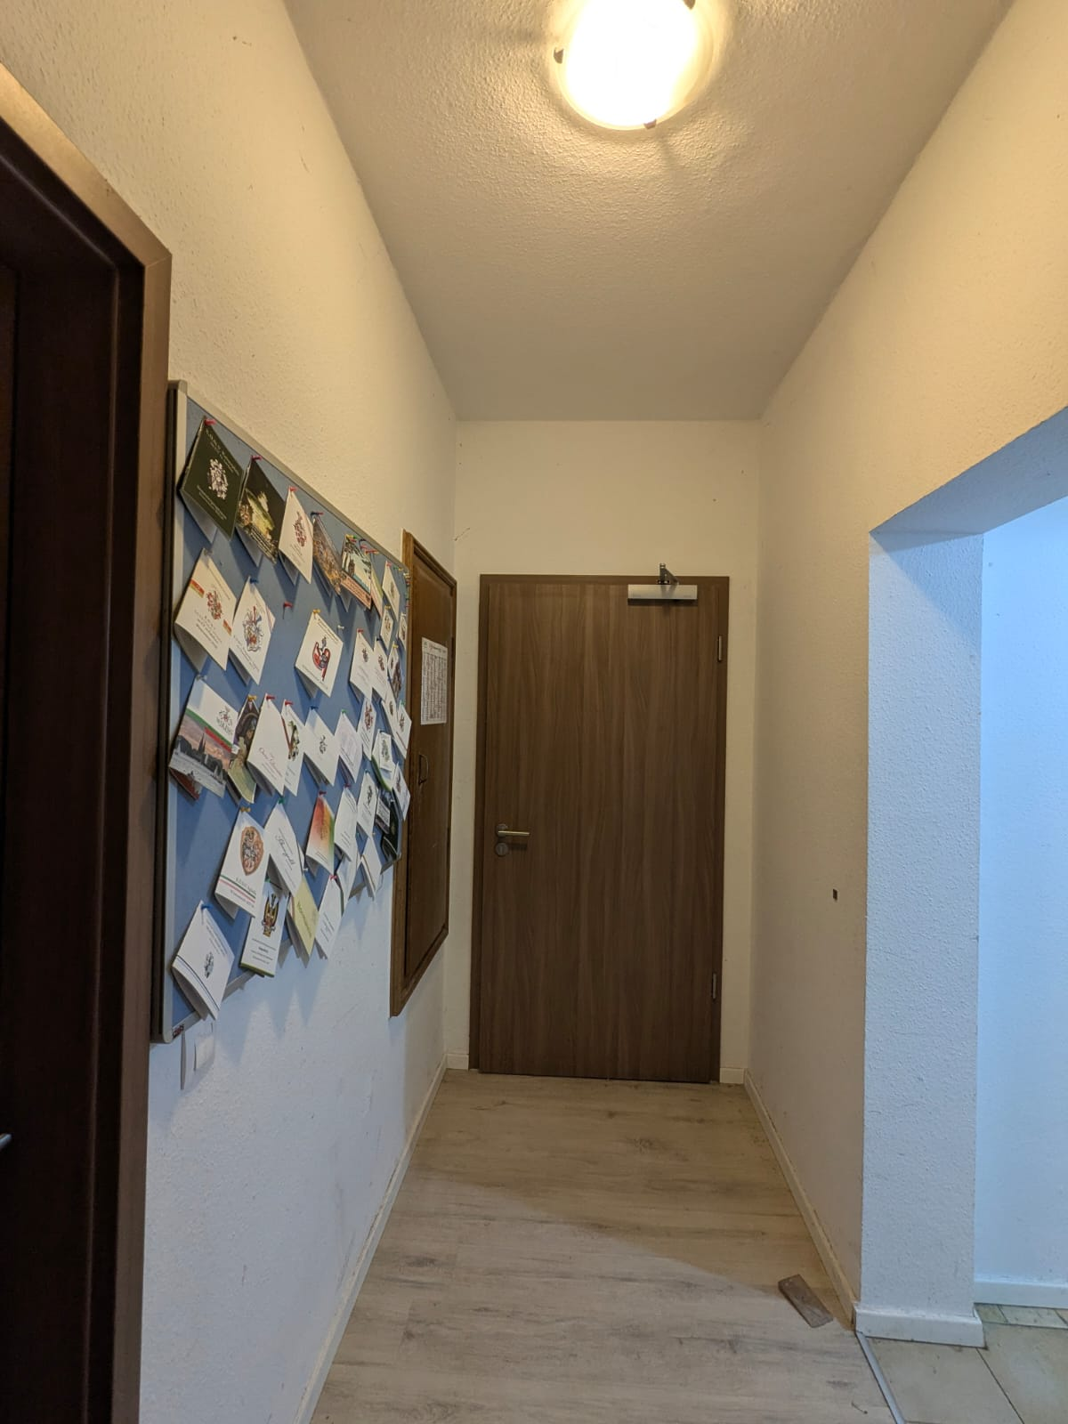
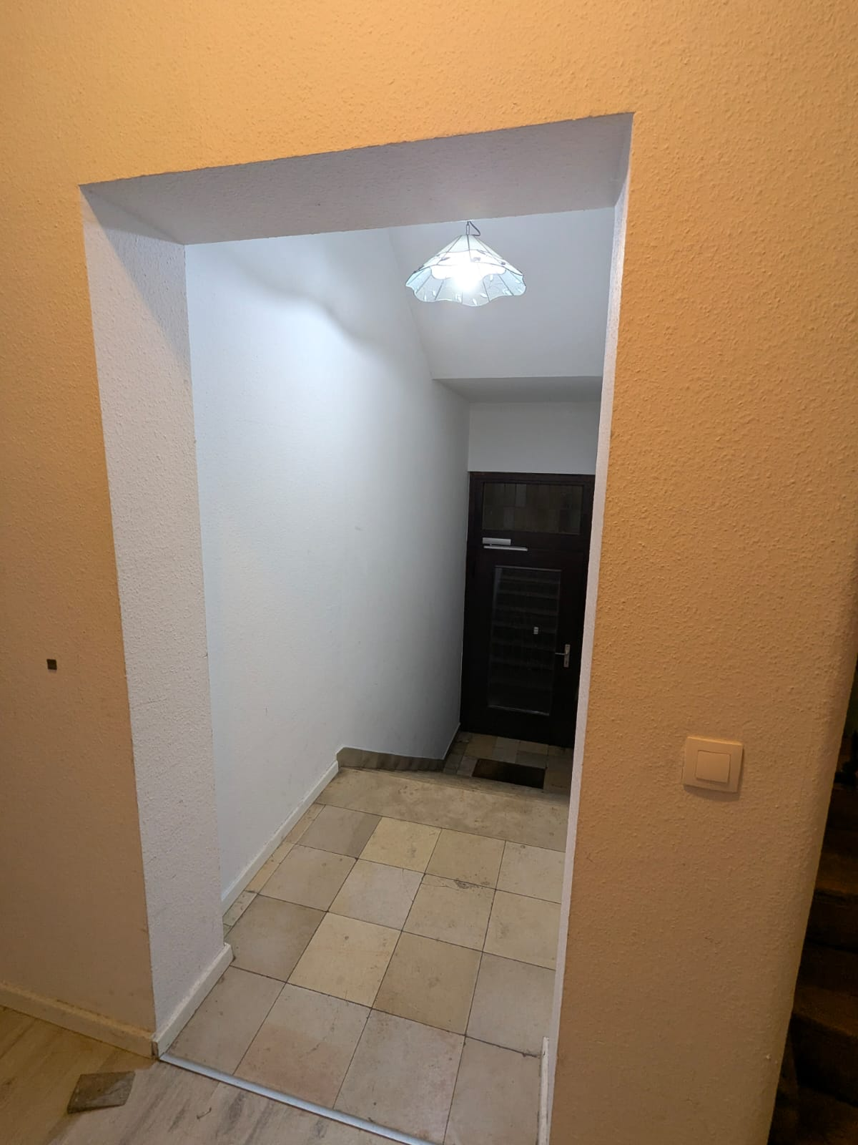
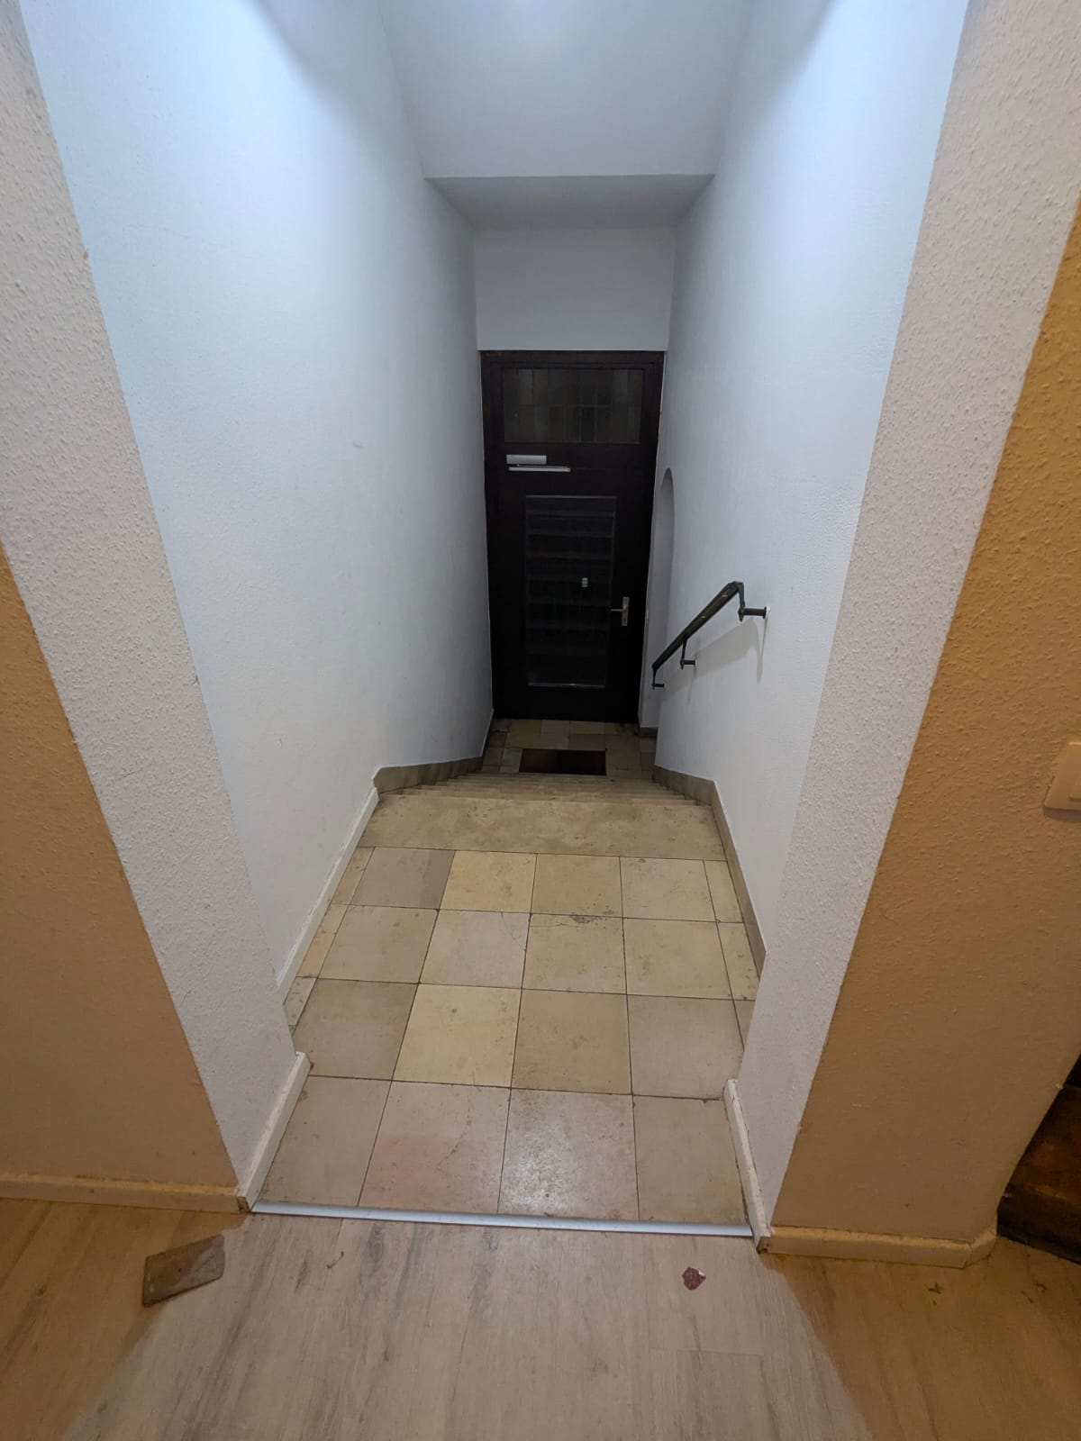
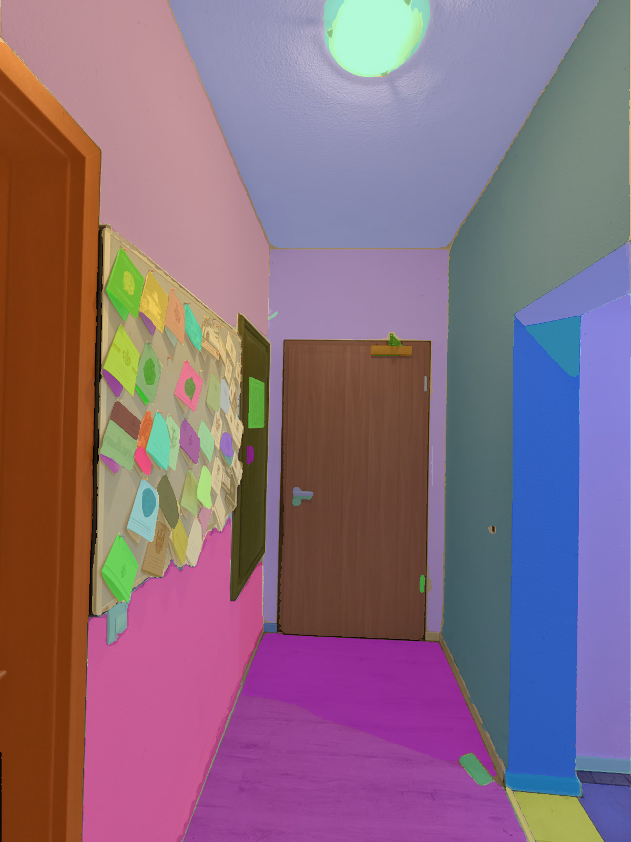

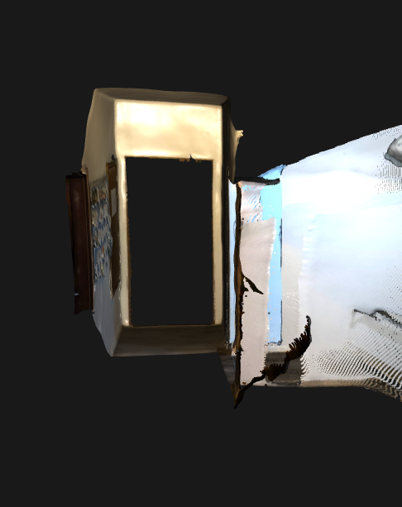
Data
Process Flow
Structural region isolation (e.g., door removed)
SAM
YOLO
Point Cloud (Only for required Objects)

Slide 5
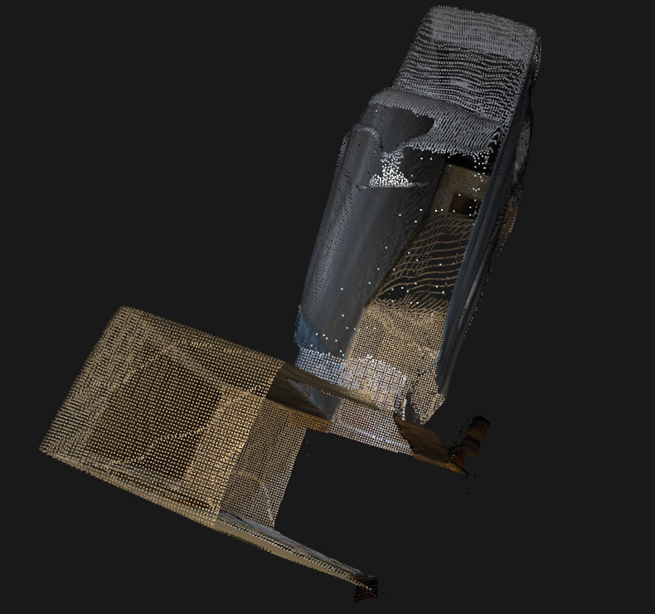
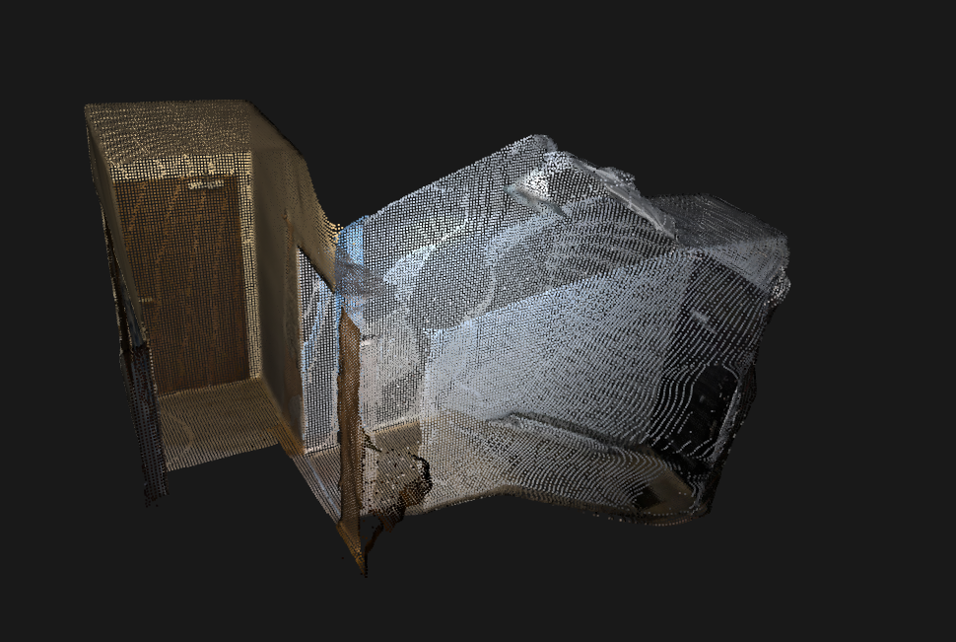
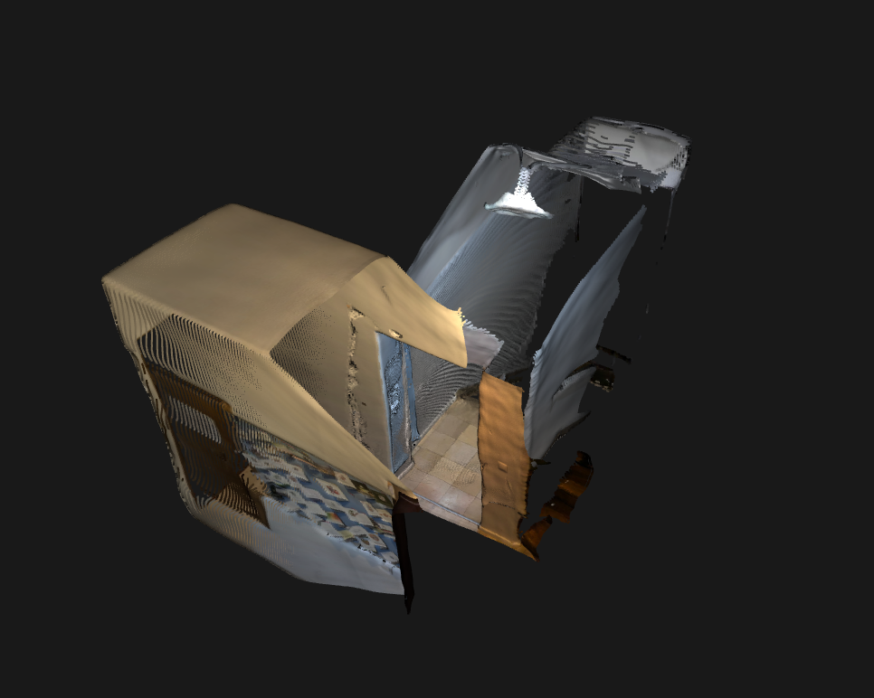
Generated Point cloud
Using the image set, VGGT generates a dense and metrically accurate point cloud
Generated Point Cloud with 3 photos only (from previous page),
without automatic cropping of objects (door)

Slide 6
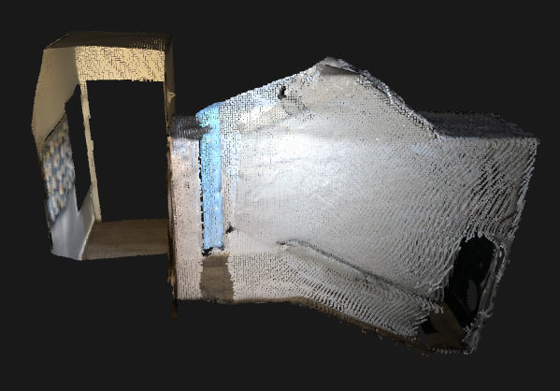
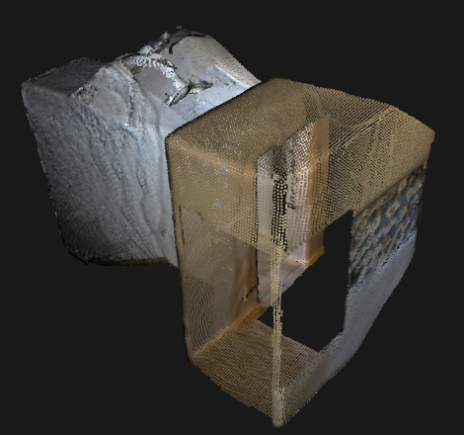
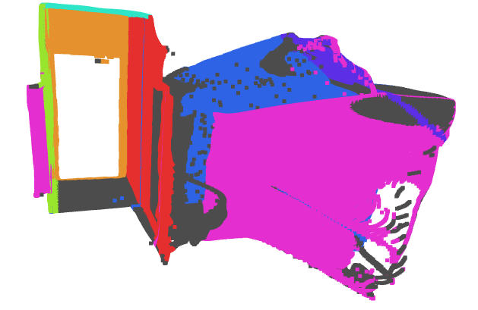
SAM + YOLO + Modified VGGT (Modified to ignore masked-out objects during reconstruction)
Generated point clouds with wall, floor, ceiling
Segmented Point Cloud

Slide 7
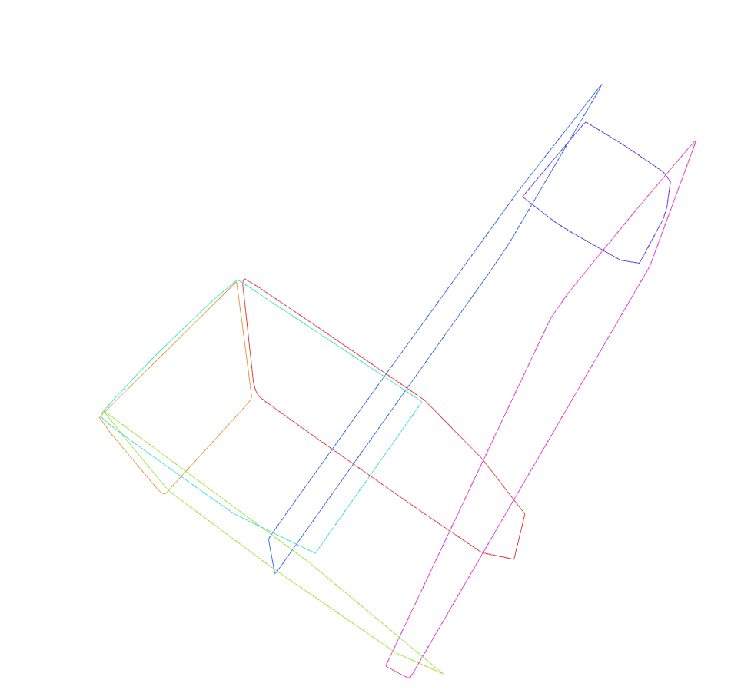
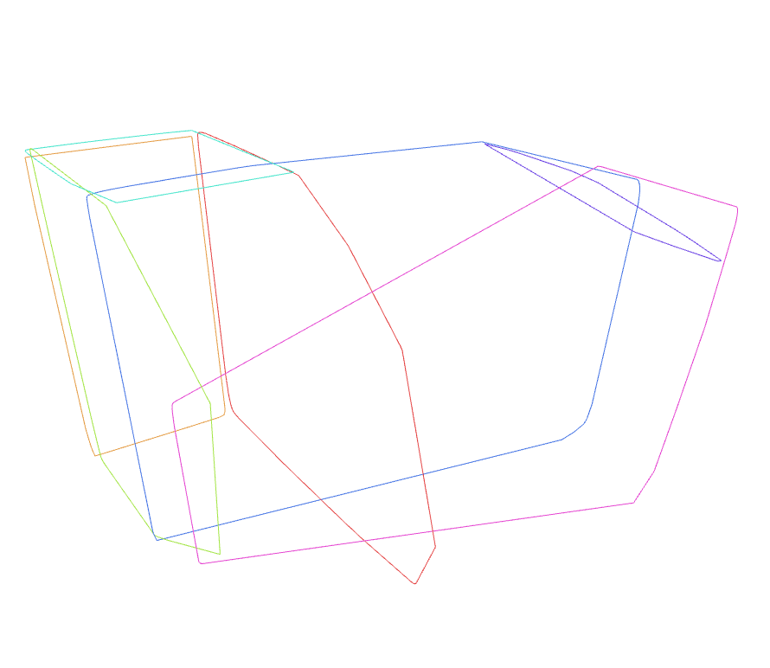
Generated Planes
These planes represent the structural surfaces: walls, floors, ceilings - that form the basis of a BIM model
Normal vectors
Centre coordinates
Boundary vertices (for CAD/BIM import)

Slide 8
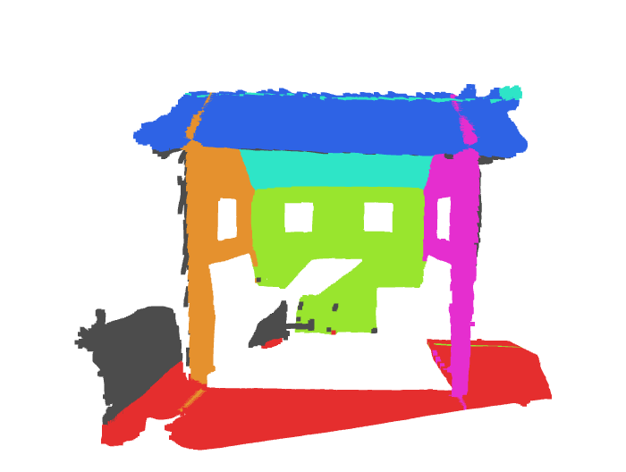
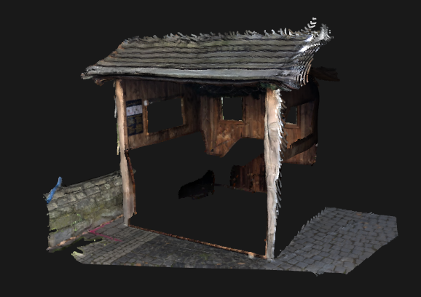
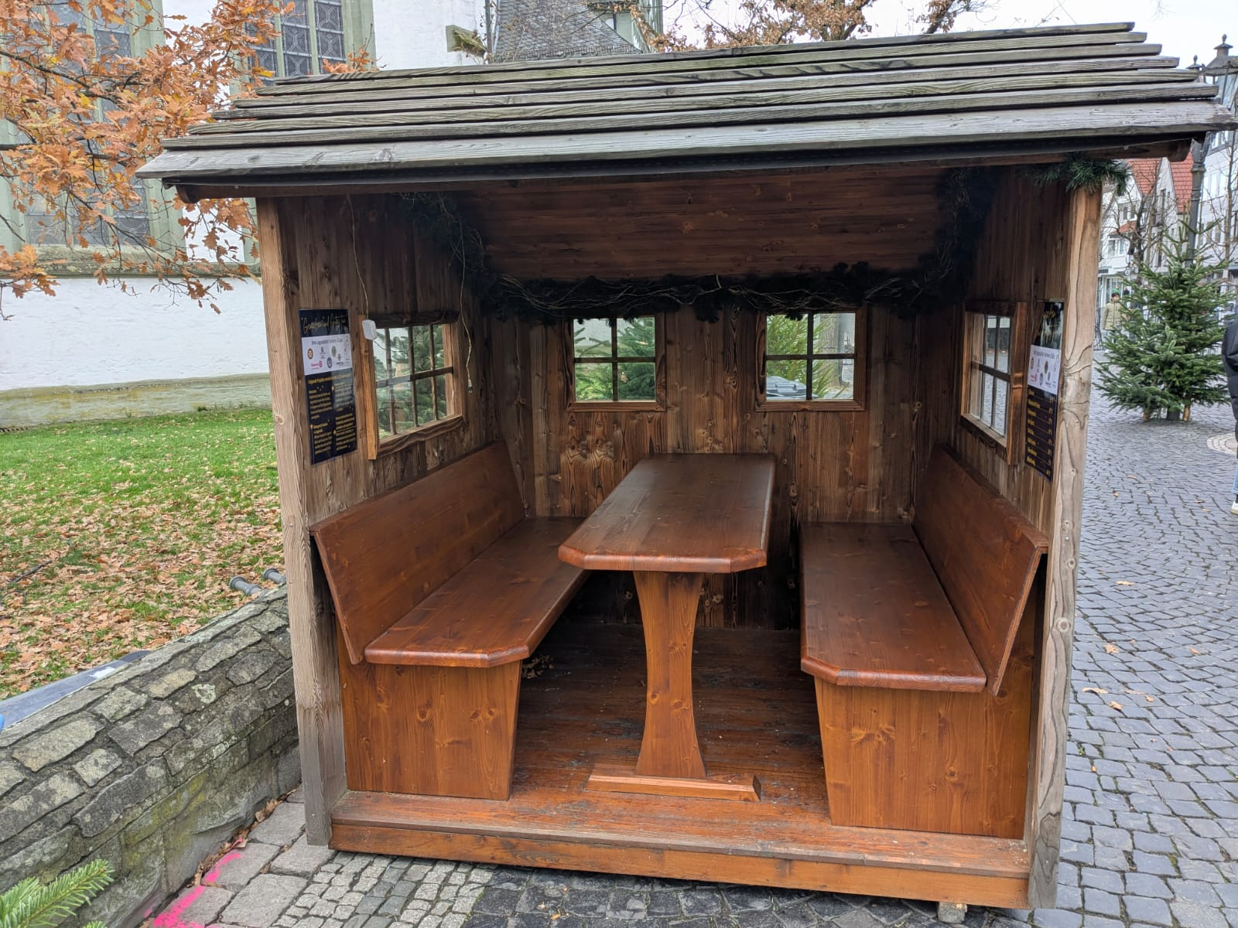
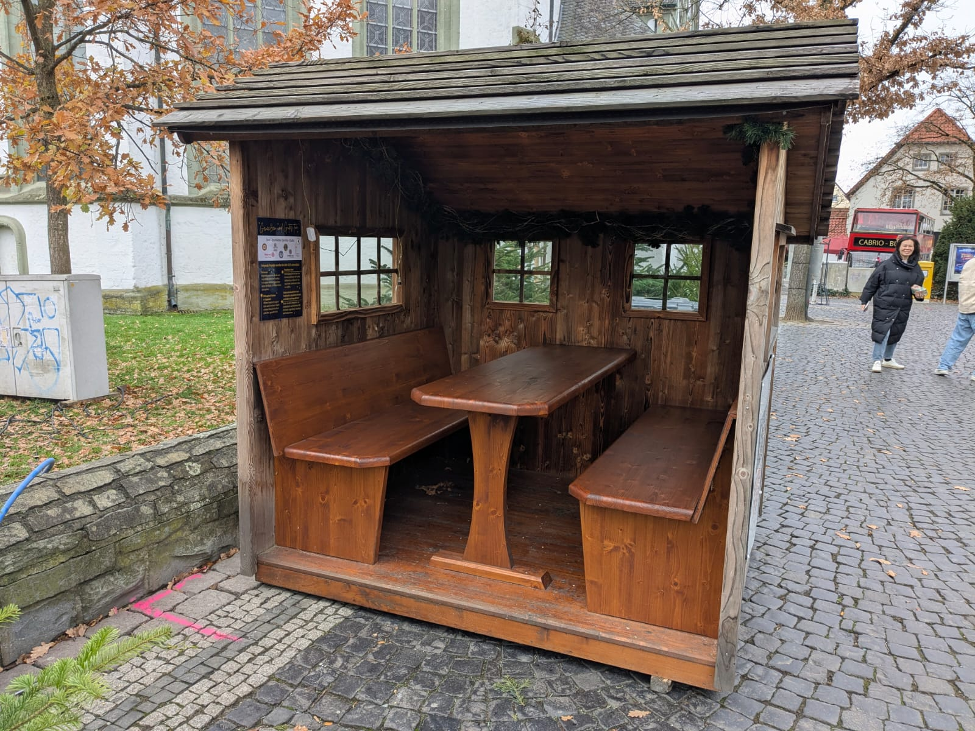
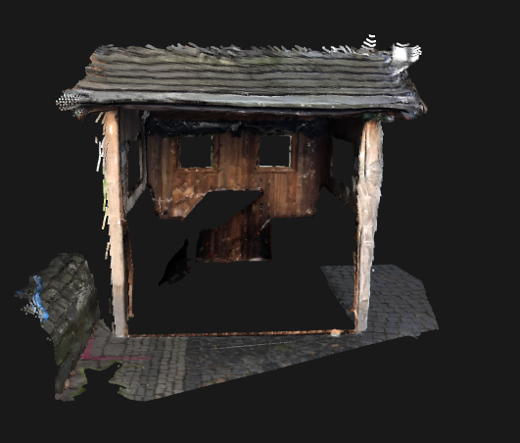
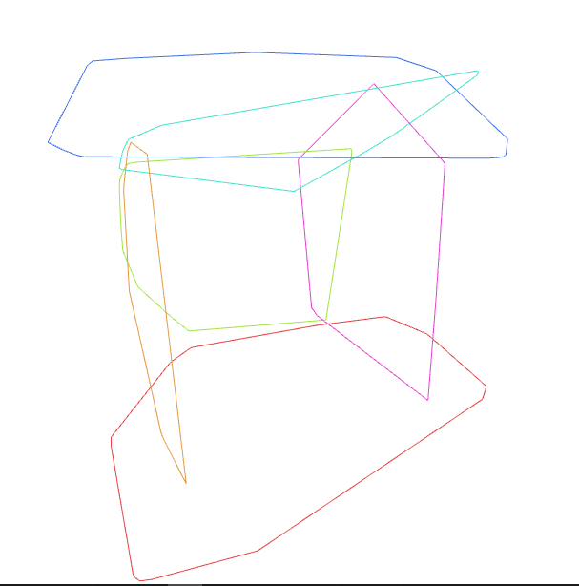
Point Cloud Segmentation
Photos of Shed in Christmas market (Lippstadt)
Plane Extraction
3D Reconstruction

Slide 9
Achievements & Roadmap
COMPLETED:
Automated object removal (YOLO + SAM)
3D point cloud reconstruction (VGGT)
Structural plane extraction (RANSAC)
Interactive validation workflow
IN PROGRESS:
Improved segmentation for complex geometry
Automatic point cloud denoising
Generative AI for cleaning cluttered scenes
Direct BIM export capabilities

