Slide 1

Glownest
Explorative data analysis of 2024 financials

Slide 2
Table of contents
Dataset Overview
Data Analysis
Final Insights & Strategy Recommendations
Conclusion

Slide 3
DATASET OVERVIEW
Taking a look at key elements of our data

Slide 4
Key details of our dataset
5 Product Categories – Face Serum, Shampoo, Body Wash, Lip Balm, Face Mask
5 Regions- North, South, East, West, North-East
Time Frame – Jan ’24 to Dec ’24
Customer Age Groups – 18-22yrs and 23-27yrs
We have a total of 300 rows in out data (12 months * 5 products * 5 Regions)
We have attributes like – Sales volume, Revenue, Marketing Spend, Discount %, Return Rate %, Customer Satisfaction Score, Inventory Turnover Days, Online Sales %, Profit and Competitor Profit
We have no missing values in out data! And no noticeable outliners either!

Slide 5
DATASET ANALYSIS
A DEEPDIVE INTO THE DATASET

Slide 6
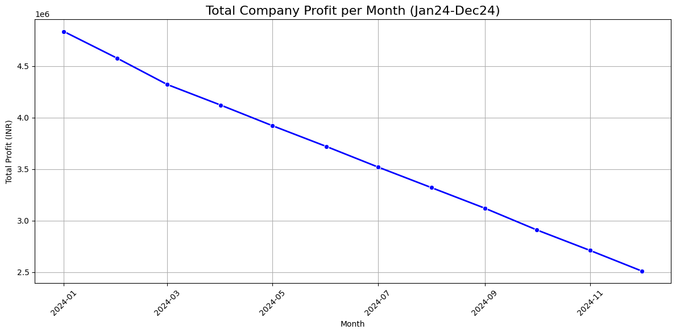
GLOWNEXT’S PROFITS OVER TIME
GlowNest’s monthly profit declined steadily from ₹4.83M in January to ₹2.51M in December 2024.
This consistent downward trend signals deeper operational or market challenges.
Immediate investigation into the root causes is warranted to prevent further erosion of profitability.

Slide 7
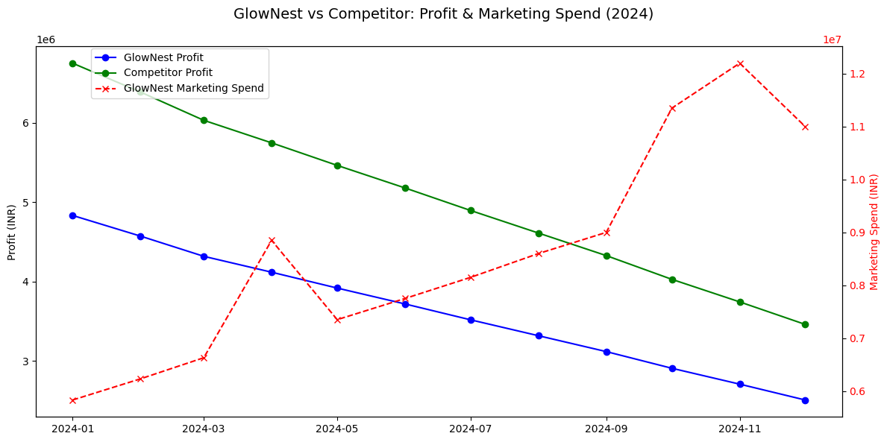
Comparing GlowNest's profit with its competitor
Throughout 2024, GlowNest’s main competitor consistently earned higher profits each month.
GlowNest consistently spends heavily on marketing, but still underperforms in profit compared to its competitor
Highlights the need for GlowNest to reassess its strategies to close the performance gap.

Slide 8
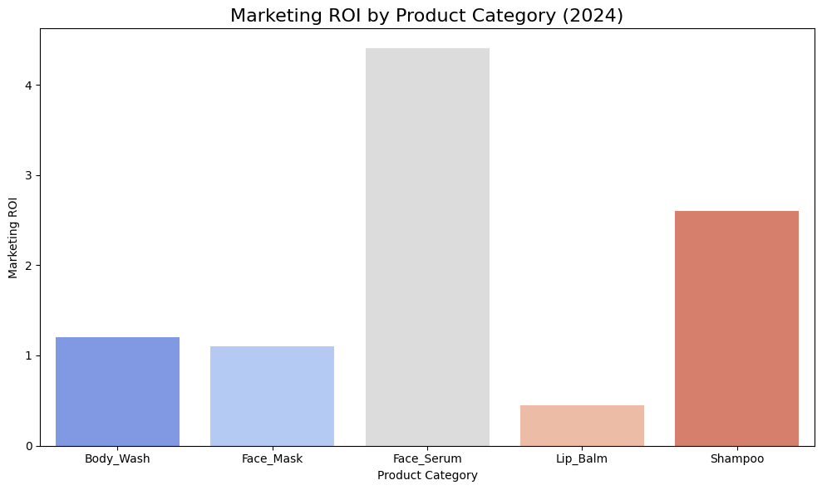
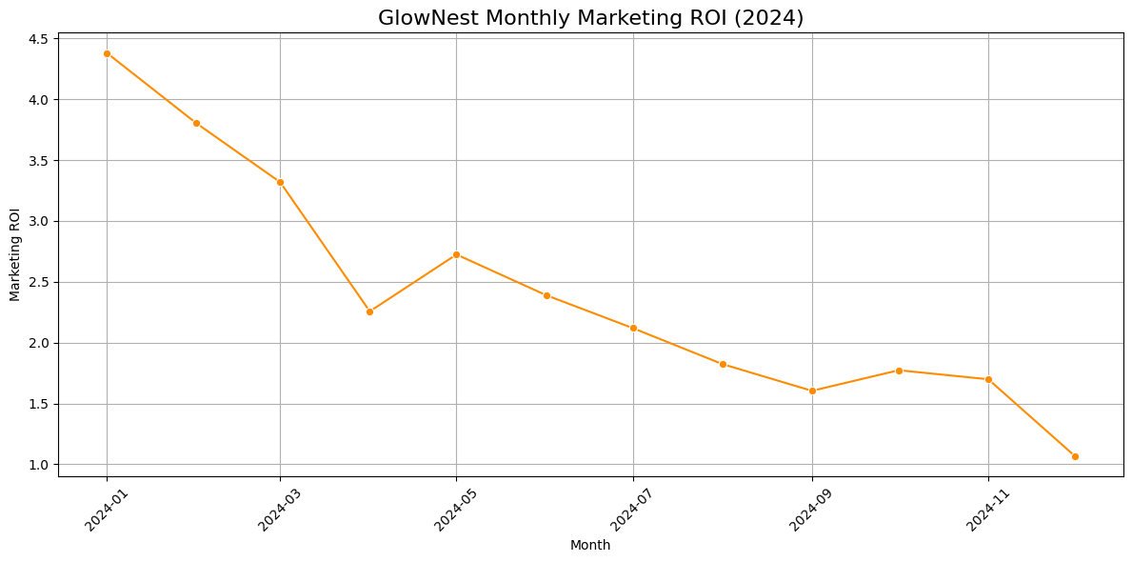
Marketing ROI Analysis
Marketing ROI dropped sharply from 4.38 in January to 1.07 in December, despite increased marketing spend.
By product, Face Serum achieved the highest ROI (4.40), while Lip Balm lagged significantly (0.44).
Indicates diminishing returns on marketing investments, especially in certain categories.

Slide 9
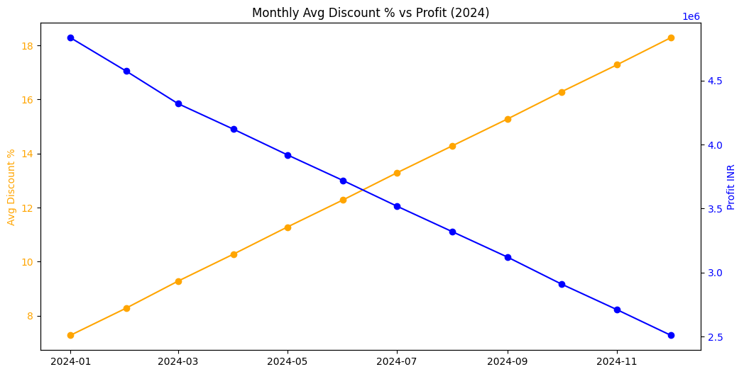
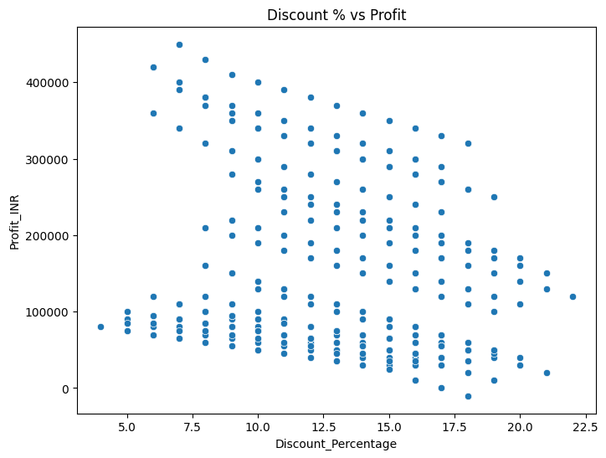
Discount Spiral Analysis
Discount rates increased from 7.28% in January to 18.28% in December.
Higher discounts did not prevent profit decline, suggesting discounting was ineffective or even counterproductive.
Correlation between Discount % and Profit: -0.160

Slide 10
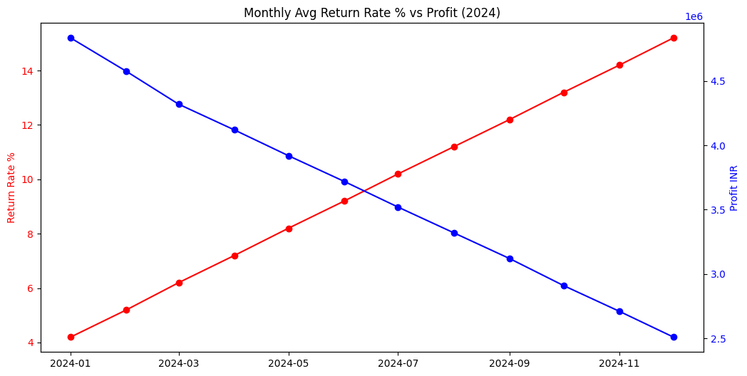
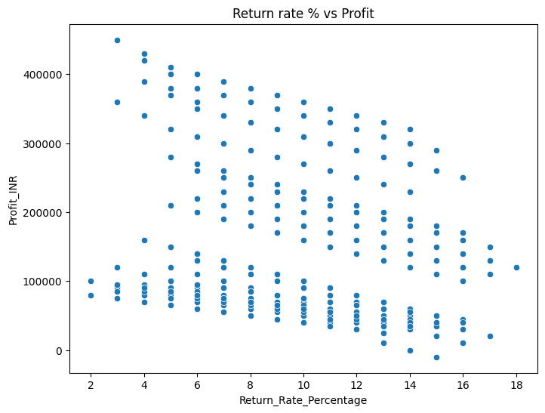
Quality Crisis Analysis
Correlation between Return Rate % and Profit: -0.207
Product return rates rose from 4.2% to 15.2% over the year.
This relationship suggests that product quality issues, fulfillment errors, or customer dissatisfaction are leading to more returns, which in turn are putting significant pressure on the company’s financial performance.

Slide 11
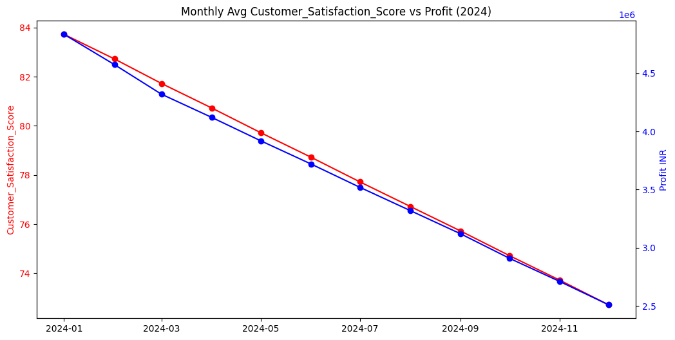
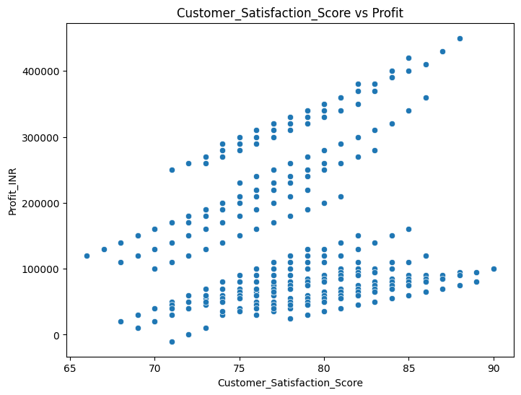
Quality Crisis Analysis
Correlation between Customer_Satisfaction_Score and Profit: 0.171
Customer satisfaction scores fell from 83.7 to 72.7.
These trends point to a growing quality or service issue impacting customer loyalty and profitability.
To stem profit decline, GlowNest should prioritize initiatives that improve customer satisfaction.

Slide 12
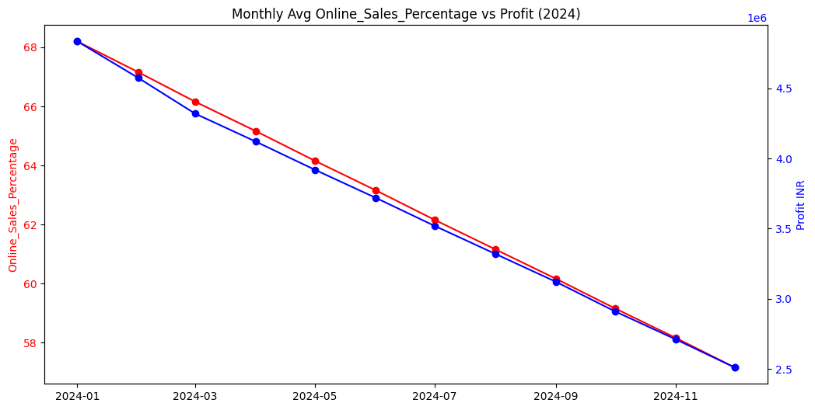
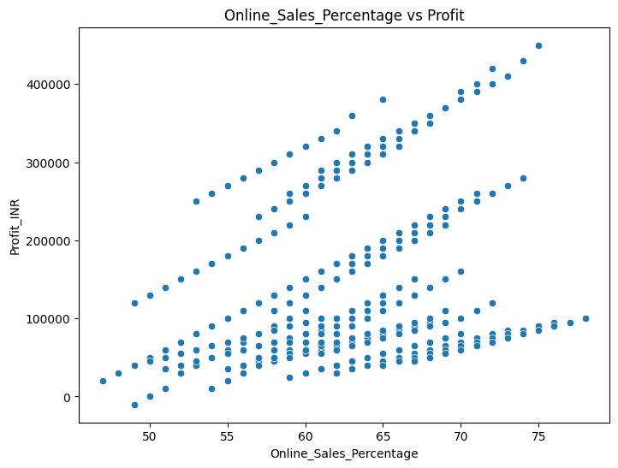
Digital Channel Wellness
Correlation between Online_Sales_Percentage and Profit: 0.332
Online sales as a percentage of total sales fell from 68.2% in January to 57.2% in December.
This decline suggests weakening digital channel performance and missed opportunities in e-commerce.

Slide 13
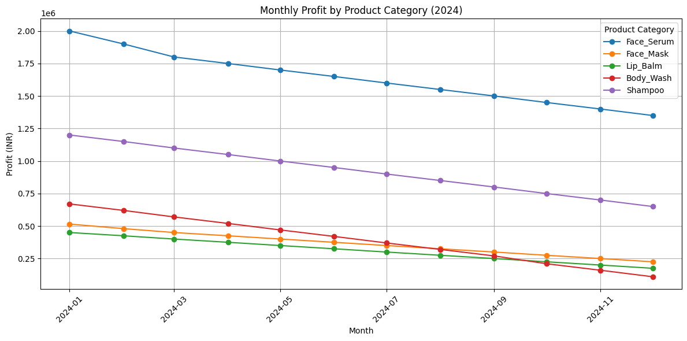
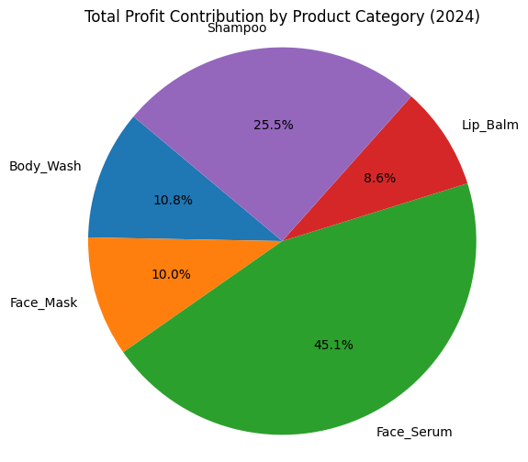
niversal Product Decline Analysis
Face Serum was the top performer by revenue and ROI; Lip Balm and Face Mask underperformed.
These visualizations underscore the importance of not only maintaining the strong performance of top categories but also strategically strengthening or diversifying the lower-contributing product lines.

Slide 14
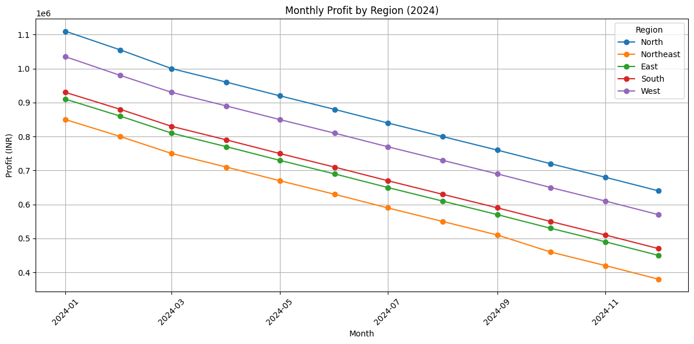
Regional Problems Analysis
Consistent Regional Decline: All regions—North, West, South, East, and Northeast—show a steady, parallel drop in monthly profit throughout 2024.
Company-Wide Impact: The uniform decline suggests broad issues like rising costs, falling demand, or inefficiencies affecting the entire company.
Northeast Underperformance: The Northeast region lags the most, likely due to weaker market presence, poor distribution, or low customer demand.

Slide 15
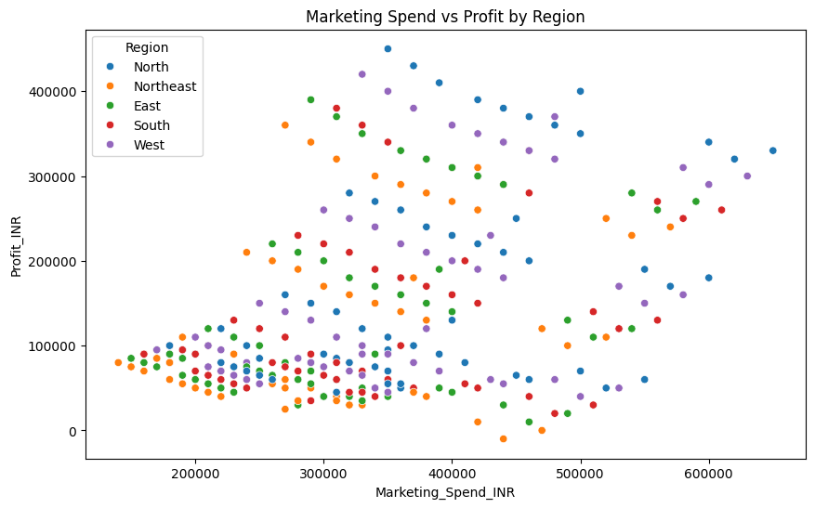
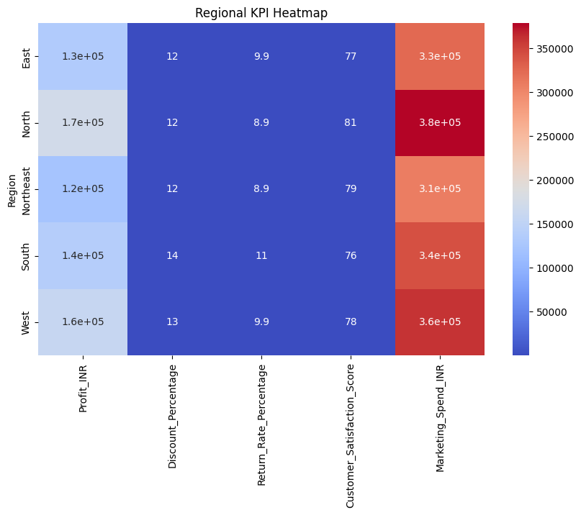
Regional Problems Analysis
Regional analysis reveals that all markets are experiencing declining profits, but the extent and underlying causes vary.
Targeted Regional Strategies Needed: Focus on enhancing customer experience and efficiency in weak regions, while replicating successful practices from stronger ones to reverse the decline.

Slide 16
Final Insights & Strategy Recommendations
WHAT CAN BE DONE?

Slide 17
KEY INSIGHTS
Area | Insight
Profit Trend | Overall declining trend across all months in 2024
Competitor Comparison | Competitor achieving higher profits with lower marketing spend
Marketing ROI | ROI falling sharply despite rising spend
Discount Strategy | Heavy discounting not translating to sustainable volume gains
Product Quality | High return rates and lower customer satisfaction linked to profit drop
Digital Weakness | Online sales declining, missed opportunity in growing digital space
Product Lines | All categories show downturn; some worse than others
Regional Issues | Certain regions like West & North show more profit erosion
“The problem is widespread, but there are clear hotspots that can be prioritized.”

Slide 18
Strategy Recommendations
Fix the Funnel
Cut ineffective marketing spend (focus on high-ROI channels/categories).
Stop blanket discounting — use targeted, data-driven offers.
Improve Customer Experience
Launch a quality assurance program to reduce return rates.
Run customer feedback loops to improve satisfaction.

Slide 19
Strategy Recommendations
Reclaim Digital Ground
Revamp online channel UX and product targeting.
Consider influencer or social-led campaigns to boost engagement.
Portfolio Optimization
Focus on reviving high-potential products.
Reevaluate or discontinue low-profit segment.

Slide 20
Strategy Recommendations
Regional Micro-Strategies
Prioritize investment in recovering North/West region.
Test localized campaigns and pricing models.
Benchmark & Monitor Performance Continuously
Establish clear KPIs for profit, ROI, customer satisfaction, and digital engagement.
Set up a monthly performance dashboard to track improvements and identify early signs of decline.
Benchmark against competitors regularly to adjust strategies proactively.

Slide 21
conclusion

Slide 22
conclusion
“GlowNest’s 2024 profit decline is multi-factorial — but not irreversible.”
Through focused, data-backed strategies and operational discipline, the company can stabilize, recover, and grow stronger in the coming quarters.

Slide 23

Thank You
Vedant vivek nichal
2024A7PS0174H

